Slide 1
Federal Bureau of Prisons
Transit Benefit Training

Slide 2
Topics
Program Overview
Background and Objectives
TRANServe's Role
BOP Employee's Role
Website Content
Legal Implications
Understanding the Certification Statement
Knowledge Checks
2

Slide 3
Background
Program History
1991 - Federal Transit
Administration pilot program
1993 - Clean Air Initiatives Act
2000 - Federal Workforce Transportation Fringe Benefit
2005 - SAFETEA-LU
Eligibility
All BOP employees working in
full or part time paid status
All BOP interns and volunteers working in a non paid status

Slide 4
Mass Public Transportation
Rail
Subway
Commuter
Light
Bus
Transit authority
Commuter
Ferries
Qualified vanpools
Commercial/private vehicle
At least six adults excluding the driver

Slide 5
TRANServe
Distributes transit benefit to qualified employees
Administers the Transit Benefit Program
Establishes best practices
Provides answers and
support

Slide 6
Employee Roles and Responsibilities
Understand the scope and limitations of the Transit Benefit Program
Not to sell or transfer the benefit or make false claims
Understand the penalties involved in misuse or false claims
It is a violation of law to provide false or fraudulent information to obtain the transit benefit, to transfer, or to sell the transit benefit.

Slide 7
Employee Roles and Responsibilities
Not to be named on a BOP provided worksite parking permit, nor participating in a carpool
Use the transit benefit only for home to work and work to home
transportation
Ensure the amount of transit benefit received does not exceed
actual monthly commuting cost of public transportation
Update commuting costs upon changes to commuting method, work schedule (telework), or change of address
Complete annual certification

Slide 8
Employee Roles and Responsibilities
When the TRANServe debit card is issued, employees are responsible for its safekeeping.
For Central Office Staff - Lost, stolen or damaged SmarTrip® cards may be replaced. Contact Metro via a sales office or online at www.wmata.com.
For lost, stolen or damaged TRANServe Cards, contact the card issuing company.

Slide 9
Legal Implications
Employees who misuse the transit benefit will be subject to appropriate administrative action including discipline and/or disqualification from future BOP transit benefit program. Disciplinary penalties could range from a letter of admonishment to removal from Federal service depending on the severity of the abuse.
10

Slide 10
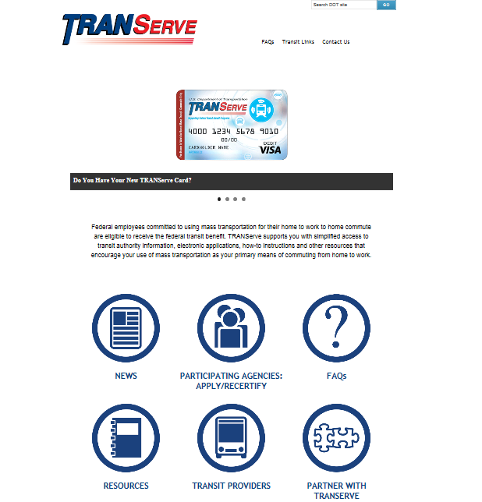
TRANServe Website
TRANServe.dot.gov
Website Pages:
Home
Participating Agencies
Frequently Asked
Questions (FAQs)
TRANServe Card
Resources
Transit Providers
Partner With TRANServe

Slide 11
Enrollment Process
Log into the TRANServe Electronic Transit Benefit Application
System (https://transitapp.ost.dot.gov/index.cfm)
First time enrollments click the “Register” button and create your profile information (temp password comes by email)
Login using your government email address and password
Click on “Transit Benefit Application”
Choose what to do:
Request information
Withdraw from the program
Certify/Enroll

Slide 12
Knowledge Check 1
The Transit Benefit Program objective is to:
A. Increase compensation of federal employees per month.
B. Provide incentive to federal employees to use public
transportation to reduce air pollution and traffic congestion.
C. Reward the employees for their hard work.

Slide 13
Knowledge Check 1 - Answer
The Transit Benefit Program objective is to:
A. Increase compensation of federal employees per month.
B. Provide incentive to federal employees to use public
transportation to reduce air pollution and traffic congestion.
C. Reward the employees for their hard work.
The Federal Workforce Transportation Fringe Benefit Program under Executive Order 13150 was put in place to reduce air pollution and traffic congestion.

Slide 14
Knowledge Check 2
If I misuse my transit benefit, such as selling my benefit or over estimating my need for the benefit, I could be removed from service to the federal government.
True
False

Slide 15
Knowledge Check 2 - Answer
If I misuse my transit benefit, such as selling my benefit or over estimating my need for the benefit, I could be removed from service to the federal government.
True
False
Disciplinary penalties could range from a letter of admonishment to removal from Federal service depending on the severity of the abuse.

Slide 16
Knowledge Check 3
The role of TRANServe is:
A. Distribute the transit benefit to BOP employees.
B. Administer the Transit Benefit Program.
C. Establish Best Practices.
D. All of the above.

Slide 17
Knowledge Check 3 - Answer
The role of TRANServe is:
A. Distribute the transit benefit to SEC employees.
B. Administer the Transit Benefit Program.
C. Establish Best Practices.
D. All of the above.
TRANServe administers the Transit Benefit and establishes best practices.

Slide 18
Knowledge Check 4
A staff member plans on teleworking. The correct course of action based on this is:
A. Inform his/her supervisor.
B. Continue claiming transit benefit without change.
C. Submit an updated application.

Slide 19
Knowledge Check 4 - Answer
A staff member plans on teleworking. The correct course of action based on this is:
A. Inform his/her supervisor.
B. Continue claiming transit benefit without change.
C. Submit an updated application.
You are responsible to update your application whenever your commuting method, work schedule, address changes.
20

Slide 20
Transit Benefit Certification
Back

Slide 21
Certification Required
Anyone who enrolls for the Transit Benefit Program must certify that certain conditions are true.
Certify:
“To formally and legally attest a
specific statement to be true”

Slide 22
Certification Statement

Slide 23
Certification
What did I just agree to?
I am employed by the BOP
I am eligible for a public transportation fare benefit
I will only use the transit benefit for my daily commute to and from work
I will not give, sell, or transfer my transit benefit
I will not use the Government-provided transit benefit in excess of the statutory limit
I will not claim the transit benefit in excess of my actual monthly commuting expense
I will not include parking fees in the computation of the daily,
weekly, monthly or annual commuting costs.

Slide 24
Knowledge Check 5
Rick joined a carpool after commuting by train for 5 years. He received the maximum benefit per month for his commute. He sells his benefit since he believes the benefit belongs to him. Is this the correct course of action?
Yes
No

Slide 25
Knowledge Check 5 - Answer
Rick joined a carpool after commuting by train for 5 years. He received the maximum benefit per month for his commute. He sells his benefit since he believes the benefit belongs to him. Is this the correct course of action?
Yes
No
It is against the law to sell or give away your transit benefit.

Slide 26
Knowledge Check 6
Carrie commutes to work from Maryland. Her costs are
$375 per month. She is eligible to receive the entire amount in transit benefit since her commute is so costly.
True
False

Slide 27
Knowledge Check 6 -
Answer
Carrie commutes to work from Maryland. Her costs are
$375 per month. She is eligible to receive the entire
amount in transit benefit since her commute is so costly.
☑ False
The federal government permits up to $255 in non-taxable transit benefit for mass transportation commuting costs. The employee must cover the amount over $255, “out of pocket”

Slide 28
Knowledge Check 7
Sarah rides in a carpool. She is eligible to receive the transit benefit.
True
False

Slide 29
Knowledge Check 7 - Answer
Sarah rides in a carpool. The transit benefit.
True
False
She is eligible to receive
The Federal Transit Benefit is for federal employees who choose to commute using mass transit in a commuter highway vehicle. This includes bus, rail, light rail or an authorized vanpool.

Slide 30
Knowledge Check 8
Alicia rides mass transit and parks in the lot near the station. She includes her parking fees in the computation of her monthly commuting cost. She is right to do this.
True
False

Slide 31
Knowledge Check 8 - Answer
Alicia rides mass transit and parks in the lot near the station. She includes her parking fees in the computation of her monthly commuting cost. She is right to do this.
True
False
The Federal Transit Benefit is provided solely for your home-to-work-to-home commute while using mass transportation. Any other use of the benefit is actionable as fraud, waste, or abuse of federal funds.

Slide 32
Knowledge Check 9
Melinda has come to an agreement with HR and her supervisor to work in the office 3 days and telework 2 days per week indefinitely. She currently receives
$25/week in transit benefits. The correct course of
action based on this change to her schedule is to:
A. Thank her supervisor for his/her understanding.
B. Continue claiming her transit benefit without change.
C. Update her transit benefit application to reflect her new commuting expense.

Slide 33
Knowledge Check 9 - Answer
Melinda has come to an agreement with HR and her supervisor to work in the office 3 days and telework 2 days per week indefinitely. She currently receives
$25/week in transit benefits. The correct course of
action based on this change is to:
A. Thank her supervisor for his/her understanding.
B. Continue claiming her transit benefit without change.
C. Update her transit benefit application to reflect her
new commuting expense.
You must change your benefit amount if your
commuting expense changes.

Slide 34
Knowledge Check 10
Christian is going to an off-site meeting. He is using mass transportation to and from the meeting, and decides to use his transit benefit. This is the correct course of action.
True
False

Slide 35
Knowledge Check 10 - Answer
Christian is going to an off-site meeting. He is using
mass transportation to and from the meeting, and
decides to use his transit benefit. course of action.
True
False
This is the correct
Travel to an off-site meeting or training class is an office expense. The Transit Benefit is provided solely for your home-to-work-to-home commute via mass transportation.

Slide 36
Congratulations!
You have successfully completed
TRANSIT BENEFIT TRAINING
Ba3ck9

