Slide 1

Gulf Coast Ecosystem Restoration Council Transit Benefit Program
Integrity Awareness
Training
Last updated January 29, 2017

Slide 2

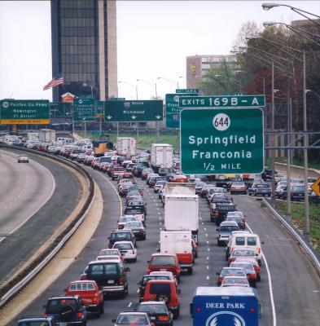
Topics
Program Overview
  Background
  TRANServe Role
  Employee Role
  Website Answers
  Legal Implications
Understanding the Certification Statement
Knowledge Checks

Slide 3
Program Overview
Transit Benefit Program:
  Protects Nation’s Infrastructure
  Reduces air pollution & traffic congestion
  Increases use of mass transit
Studies show traffic congestion:
  Wastes 1.9 billion gallons of gas
  Costs over $100 billion in wasted fuel & lost time
  Reduced commutes save individuals $200 monthly
Tax-free subsidy for actual costs of transportation
  Up to the maximum set by the IRS statutory limit

Slide 4

Background
Program History
  1991 - Federal Transit Administration Program Pilot
  1993 - Clean Air Act
  2000 – E.O. 13150 Federal Workforce Transportation
  2005 - SAFETEA-LU
Eligibility
  All federal employees working in full or part time paid status
  All federal interns and volunteers working in a non paid status

Slide 5
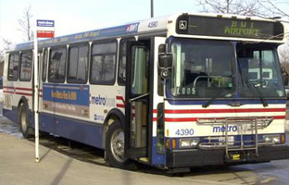
Mass Transportation
Qualified vanpools
  Commercial/private vehicle
  At least six adults excluding the driver
Rail
  Subway
  Commuter
  Light
Bus
  Transit authority
  Commuter
Ferry
  Pedestrian or bicycle
Trolley

Slide 6
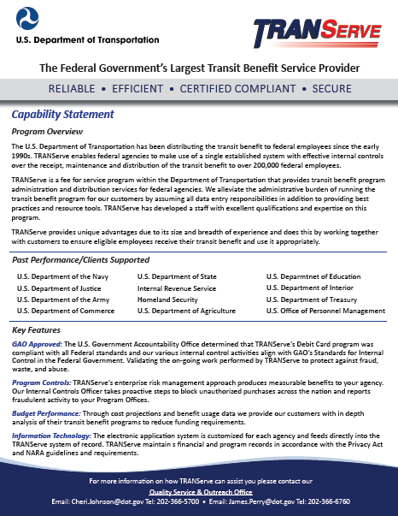

TRANServe’s Role
Administers the Transit Benefit Program
Distributes the transit benefit to agency qualified employees
Establishes best practices
Provides education, answers and support to Program Offices and Participants

Slide 7
Your Roles and Responsibilities
Understand the Transit Benefit Program’s scope and limitations
Understand it is a violation of federal law to transfer or sell the transit benefit or to provide false or fraudulent information in order to obtain the benefit
Understand the potential penalties for misuse or
false claims

Slide 8
Your Roles and Responsibilities
To not be named on a worksite parking permit at any Federal agency, nor participate in a carpool
To use the transit benefit for home to work and work to home transportation only.
To Ensure the amount of transit benefit received does not exceed actual monthly commuting cost of public transportation
To recertify your application to update commuting expenses whenever your commuting method, work schedule or address changes

Slide 9
Legal Implications
Employees who misuse the transit benefit are subject to appropriate administrative action including discipline and/or disqualification from future participation in the Transit Benefit Program.
Disciplinary penalties can range from a letter of admonishment to removal from Federal Service, depending on the severity of the abuse.

Slide 10
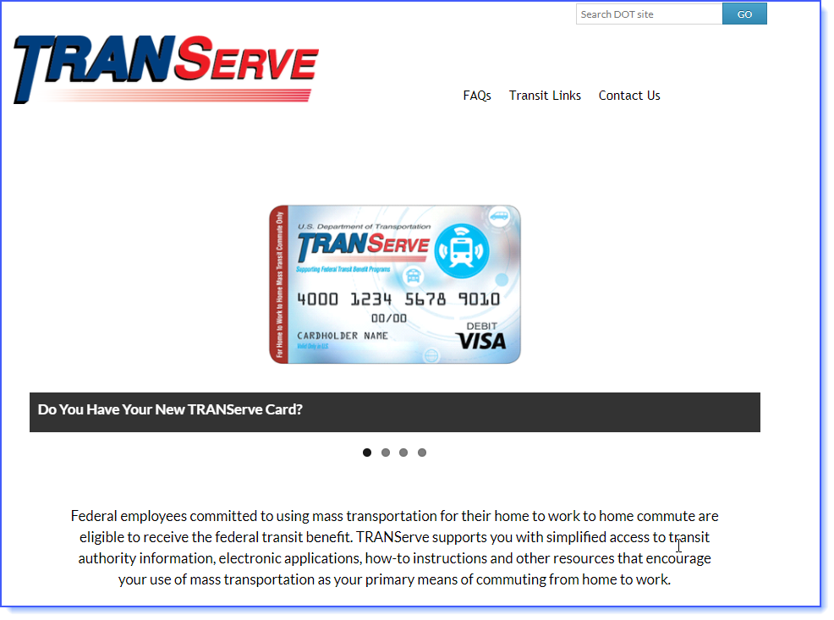
Use the Website: www.transportation.gov/transerve/
Apply
Recertify
TRANServe Card info
News
FAQs
Research mass transit commute
Subscribe

Slide 11


Knowledge Check 1
.
The Transit Benefit Program objective is to:
  A. Increase compensation of federal employees
  per month.
  B. Incentivize federal employees to use public transportation to reduce their contributions to traffic congestion and air pollution.
  C. Reward the employees for their hard work.

Slide 12
Knowledge Check 1
.
The Transit Benefit Program objective is to:
  A. Increase compensation of federal employees
  per month.
  B. Incentivize federal employees to use public transportation to reduce their contributions to traffic congestion and air pollution.
  C. Reward the employees for their hard work.
The Federal Workforce Transportation Fringe Benefit Program under Executive Order 13150 is designed to reduce traffic congestion and air pollution.

Slide 13

Knowledge Check 2
True or False?
If I misuse my transit benefit by selling it or over estimating my need for the benefit, I can be removed from federal service.
.

Slide 14
Knowledge Check 2
True or False?
If I misuse my transit benefit by selling it or over estimating my need for the benefit, I can be removed from federal service.
.
TRUE: Disciplinary action can range from a letter of admonishment to removal from Federal Service, depending on the severity of the abuse.

Slide 15
Knowledge Check 3
TRANServe’s Role is:
  A. To distribute the transit benefit to federal employees.
  B. To administer the Transit Benefit Program.
  C. To establish Best Practices.
  D. All of the above.

Slide 16
Knowledge Check 3
TRANServe’s Role is:
  A. To distribute the transit benefit to federal employees.
  B. To administer the Transit Benefit Program.
  C. To establish Best Practices.
  D. All of the above.
TRANServe delivers Transit Benefit Programs and establishes Best Practices.

Slide 17
Knowledge Check 4
Jermaine plans to start teleworking.
The next step is to:
  A. Inform his supervisor.
  B. Continue claiming his transit benefit without change.
  C. Submit an updated application.

Slide 18
Knowledge Check 4
Jermaine plans to start teleworking.
The next step is to:
  A. Inform his supervisor.
  B. Continue claiming his transit benefit without change.
  C. Submit an updated application.
You are responsible to update your transit benefit application and commuting cost worksheet whenever you change your commuting method, work schedule, or address.

Slide 19
.
The
Transit Benefit
Certification Statement

Slide 20

Certification Is Required
Certify:
“To formally and legally attest a specific statement to be true”
Before you can enroll in the Transit Benefit Program you must first certify that certain conditions are true about you.

Slide 21
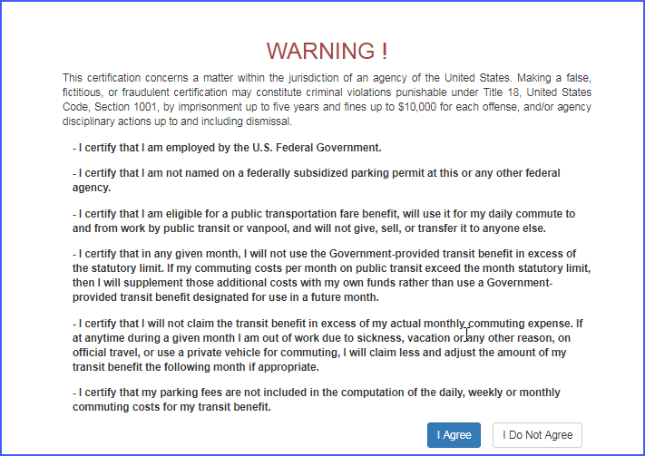
Read the Certification Statement Carefully

Slide 22

To What Must I Agree?
You Must agree:
I am employed by the U.S. Federal Government.
I am not named on a federally subsidized parking permit, anywhere.
I am eligible for a public transportation fare benefit
I will use the benefit for my daily mass transit commute to and from work
I will not give, sell or transfer it to anyone else
I will not use the Government provided benefit in excess of the IRS limit
I will not claim an amount in excess of my actual monthly commuting expense
I will not include parking fees as part of my commuting cost worksheet

Slide 23


Knowledge Check 5
Keeva joined a carpool after commuting on the train for 5 years. She received the maximum benefit per month for her commute. She sold her benefit since she believes the benefit belongs to her. Was this the correct course of action?
  Yes
  No
The answer is….

Slide 24
Knowledge Check 5
Keeva joined a carpool after commuting on the train for 5 years. She received the maximum benefit per month for her commute. She sold her benefit since she believes the benefit belongs to her. Was this the correct course of action?
  Yes
  No
It is against the law to give away or sell the Transit Benefit

Slide 25
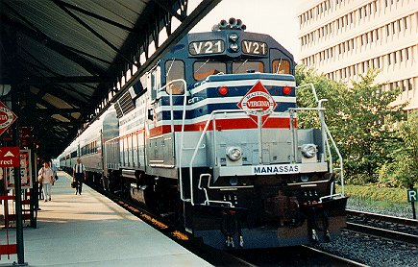
Knowledge Check 6
Hayly commutes from Virginia to get to work. Her commuting costs are $284 per month. She is eligible to receive additional transit benefit since her commute is so costly.
  True
  False

Slide 26
Knowledge Check 6
Hayly commutes from Virginia to get to work. Her commuting costs are $284 per month. She is eligible to receive additional transit benefit since her commute is so costly.
  True
  False
The federal government
may provide up to the IRS maximum for mass transportation commuting costs. Hayley must cover the additional amount, “out of pocket”.

Slide 27

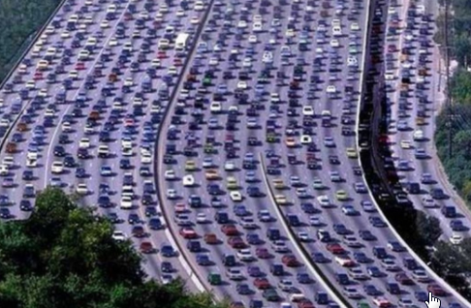
Knowledge Check 7
Becky chooses to ride in a carpool. She is eligible to receive the transit benefit.
  True

Slide 28
Knowledge Check 7
Becky chooses to ride in a carpool. She is eligible to receive the transit benefit.
  True
False. The Federal Transit Benefit is for federal employees who choose to commute
on mass transit in a commuter highway vehicle. This includes bus, rail, light rail and an authorized vanpools.

Slide 29
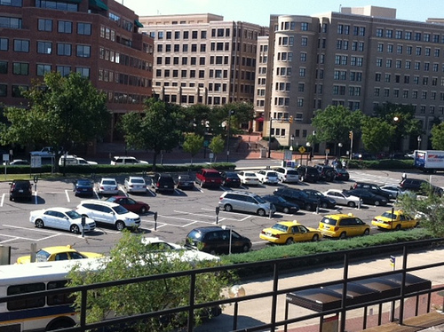
Knowledge Check 8
Ivan rides mass transit and parks in the lot near the station. He includes his parking fees in the computation of his monthly commuting cost. He is right to do this.
  True
  False

Slide 30
Knowledge Check 8
Ivan rides mass transit and parks in the lot near the station. He includes his parking fees in the computation of his monthly commuting cost. He is right to do this.
  True
  False
  FALSE - The Federal Transit Benefit is exclusively for your home-to-work-to-home commute on mass transportation. Any other use is actionable as fraud, waste, or abuse of federal funds

Slide 31
Knowledge Check 9
Ciera and her supervisor agree she may telework two days each week, indefinitely. Her transit benefit is $25 per week. Now that she does not commute every day, her correct course of action is to:
  A. Thank her supervisors’ for his/her understanding.
  B. Continue claiming her transit benefit without change.
  C. Change her transit benefit to $15 per week or $60 per month.

Slide 32
Knowledge Check 9
Ciera and her supervisor agree she may telework two days each week, indefinitely. Her transit benefit is $25 per week. Now that she does not commute every day, her correct course of action is to:
  A. Thank her supervisors’ for his/her understanding.
  B. Continue claiming her transit benefit without change.
  C. Change her transit benefit to $15 per week or $60 per month.
You must update your application and change your benefit amount whenever your commuting expenses change.

Slide 33
Knowledge Check 10
James is going to an off-site meeting. He is using mass transportation to travel to and from the meeting. Since he has extra funds on his TRANServe Card he decides to use his transit benefit. This is the correct course of action.
  True
  False

Slide 34
Knowledge Check 10
James is going to an off-site meeting. He is using mass transportation to travel to and from the meeting. Since he has extra funds on his TRANServe Card he decides to use his transit benefit. This is the correct course of action.
  True
  False
Travel to an off-site meeting or training class is an office expense. The Transit Benefit is provided solely for your home-to-work-to-home commute via mass transportation. “Extra” funds are swept back to your Agency at the end of the monthly cycle. A permanent change requires that you update your
application so you do not tie up much
needed funds.

Slide 35
Congratulations!
You have successfully completed
TRANSIT BENEFIT
INTEGRITY AWARENESS
TRAINING
To receive credit for this course in an electronic learning management system , you must click “Yes, I completed the course” at the bottom of this screen.

Slide 36
Thank you for choosing to commute using mass transit.
Additional information is available on our Website:
https://www.transportation.gov/transerve/faq
For Agency specific questions, please contact Gulf Coast Ecosystem Restoration Council Transit Benefit Program Office.

