Slide 1
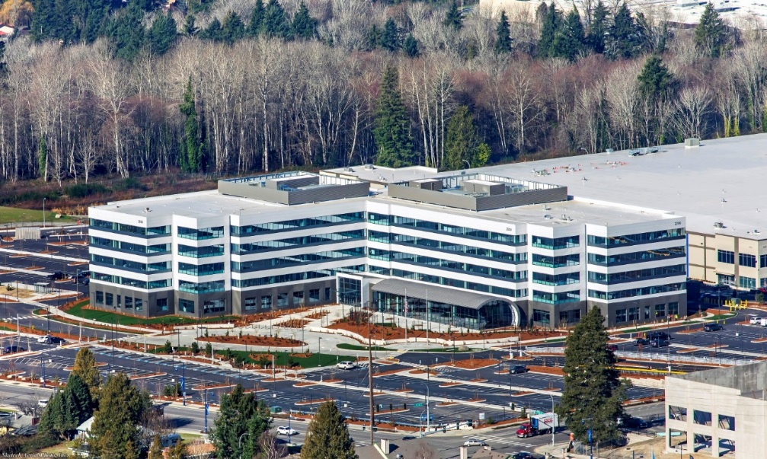
Visitor Information
Northwest Mountain Region
2200 S. 216th Street,
Des Moines, WA 98198
Photo courtesy of Abbott Construction

Slide 2
ANM Regional Office
Directions from SeaTac International Airport
17801 International Blvd, Seattle
Depart South
Take ramp right toward International Blvd (Denny’s on the corner)
Turn right onto S 170th ST
Turn right onto WA-99 S/International Blvd (Shell on the corner)
Turn right onto S 216th ST (7-Eleven on the corner)
Arrive at S 216th ST (the last intersection is 24th Ave S. If you reach 20th Ave S you’ve gone too far)
Directions Courtesy of Bing Maps

Slide 3
ANM Regional Office
From I-5 going South
Take I-5 South toward Portland
Take exit 151, take ramp right and follow signs for Military
Rd/S 200th ST
Turn left onto Military Rd S
Turn right onto 216th ST(7-Eleven on the corner)
Arrive at S 216th ST (the last intersection is 24th Ave S. If you reach 20th Ave S. you’ve gone too far)
Directions Courtesy of Bing Maps

Slide 4
ANM Regional Office
From I-5 going North
Take I-5 North toward Seattle
Take exit 149B, take ramp right for WA-516 West toward Des Moines
Bear right onto WA-516/S. Kent De Moines Rd
Turn right onto WA-99 N/Pacific Hwy S
Turn left onto S 216th ST (7-Eleven on the corner)
Arrive at S 216th ST(the last intersection is 24th Ave S. If you reach 20th Ave S you’ve gone too far)
Directions Courtesy of Bing Maps

