Slide 1
Tribal Transportation Self-Governance Negotiated Rulemaking
Jennifer Outhouse
Senior Attorney/Regulations Officer
FHWA

Slide 2
The Regulatory Process

Slide 3
What is Negotiated Rulemaking?
Negotiated Rulemaking Act of 1990 (5 U.S.C. 561 -570)
Supplement to the Administrative Procedure Act (5 U.S.C. 551-559)
Notes:
What is it?
Emerged in the 1980’s as an alternative to traditional rulemaking.
The essence of the idea is that in certain situations it is possible to bring together representatives of the agency and the various interest groups to negotiate the text of a proposed rule. The negotiators try to reach a consensus through a process of evaluating their own priorities and making tradeoffs to achieve an acceptable outcome on the issues of greatest interest to them. If they do achieve a consensus, the resulting rule is likely to be easier to implement and the likelihood of subsequent litigation is diminished.
The Negotiated Rulemaking Act establishes basic statutory requirements but allows great flexibility.
Supplement to the Administrative Procedures Act.

Slide 4
Why Use Negotiated Rulemaking?
Less Adversarial
FAST Act Section 1121
Previous Successes
Pros
Earlier implementation
Higher compliance rates
More cooperative relationships between the agency and other parties
Better information
Cons Resource intensive
Notes:
Less Adversarial – Normal regulatory processes are viewed as adversarial.
Parties may take extreme positions in their oral or written statements
Parties my choose to withhold information they view as damaging
Parties may put equal weight on every argument (leaving the government with little idea what is truly important to the commenter)
Reg Neg focused on producing better, more acceptable rules.
Congress told us to!
We hope to build on the recent successes in the tribal health and education sectors.
Pros Earlier implementation – since the program can be negotiated prior to the agency’s publication of the rule, parties know at an earlier time how the rule will affect them (so they can plan expenditures or changes they couldn’t if the outcome were uncertain)
Higher compliance rates – stakeholders feel they played a role in resolving the issues most important to them
Cooperative Relationships
Better information – Agencies can ask questions and get practical consequences of alternatives, additional data, and stakeholders can craft creative solutions that may not otherwise be presented. The Agency will write its own rule absent a consensus so there is incentive to reach consensus on the most important matters, while compromising on matters of less importance.
Cons
Resource intensive in the short term – no additional funding for this effort in the FAST Act. Staff time for both the Agency and stakeholders.

Slide 5
How Does This Work?
Agency Notification of Intent to Form a Committee
April 25, 2016 (81 FR 24158)
Agency Notification of Committee Members
July 27, 2016 (81 FR 49193)
Committee Meetings
Committee Report to Agency
NPRM
Public Comment
Final Rule
Notes:
Bob Sparrow will talk about this next a bit when we review the Committee expectations and protocols. But I wanted to give a high level overview for those who may not be familiar with the process.
Go through list.
Meetings are the most important step in this process.
Goal of the committee meetings to reach “consensus” on a draft rule. What does that mean?

Slide 6
Consensus?
The term “consensus” is usually understood in this context to mean that each interest represented concurs in the result, unless all members of the committee agree at the outset to a different meaning.
If a consensus is reached, the Agency will ordinarily publish the draft rule based on that consensus in an NPRM.
Negotiations that do not result in consensus on a draft rule can still be very useful to the agency by narrowing the issues in dispute, identifying information necessary to resolve issues, ranking priorities, and finding potentially acceptable solutions.

Slide 7
Committee Report
Consensus! – If the committee reaches a consensus on a draft final rule, the agency should be given both the text and a concise statement of its basis and purpose. (5 U.S.C. 566(f)).
No consensus? – The Act gives the committee the freedom to determine what information, recommendations, or materials, if any, are appropriate to give to the agency.
A formal report may not be necessary if committee records contain sufficient documentation of what took place during the negotiations, issues addressed, areas of agreement, and areas of concern.

Slide 8
NPRM Stage

Slide 9
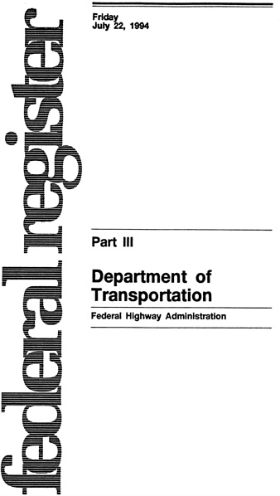
Comment period (typically 60 days)

Slide 10
Final Rule Stage

Slide 11
Questions??
Jennifer Outhouse
Senior Attorney Advisor/Regulations Officer
FHWA Chief Counsel’s Office
Jennifer.Outhouse@dot.gov
(202) 366-1381

