Slide 1
Native American/Alaska Native
Highway
Safety Program
Kristen Allen
Special Assistant
NHTSA’s Office of Regional Operations and Program Delivery
September 13, 2016

Slide 2
Indian State
Title 23, United States Code, Section 402 (h), provides for the application of the § 402 Highway Safety Program in Indian country.
For purposes of application in Indian country, “political subdivision of a State” includes an Indian Tribe.
Congress designated the Secretary of Interior as Governor of the Indian State – Governor designates Governor’s Highway Safety Representative
Charles Addington, Deputy Associate Director of BIA OJS serves as Governor’s Representative of the “Indian State”
BIA Indian Highway Safety Program (IHSP)- Lawrence Robertson, Director

Slide 3
Indian State
567 Indian Tribes are political subdivisions of the “Indian State”
Includes both American Indian and Alaskan Native
BIA Indian Highway Safety Program (IHSP), located in Albuquerque, NM, is responsible for the highway safety program for federally recognized tribes
NHTSA Region 6 Office – Fort Worth, Texas- oversight and coordinating role

Slide 4
IHSP Funding
Receives formula funding as do the other States and U.S. Territories
Receives 2% of total §402 apportionment – FAST Act – Approximately $4.6 million dollars annually
P&A funds limited to 5% of obligation.
  Approximately $247,000

Slide 5
BIA Staffing
IHSP has six full time employees
Three from §402 P&A funds
Three by the BIA Office of Justice Services.

Slide 6
IHSP Priority Program Areas
Alcohol Countermeasures
Police Traffic Services
DUI Courts
Occupant Protection/Child Passenger Safety
Traffic Records

Slide 7
IHSP Funding Cycle
January – RFP is mailed to Tribal Leaders of all federally recognized Tribes in the United States
Federal Register Notice is published and RFP is advertised via internet
Grant Writing Training class provided after letter and FR notice has been sent out
Proposals are due by COB on May 1st
Selection Committee meets in May of every year –
Selection Committee Members: IHSP, NHTSA, BIA-OJS, BIA-Roads, Indian Health Services (IHS), State HSO personnel

Slide 8
FY 2016 Highway Safety Program
38 Tribal Grants – 15 States: Arizona, California, Colorado, Idaho, Kansas, Michigan, Minnesota, Montana, Nevada, New Mexico, North Dakota, South Dakota, Texas, Wisconsin, Wyoming
Enforcement Grants:
  Alcohol Countermeasures/Speeding/Belt Use
  Full Time Officers
  Overtime grants
  Require participation in mobilizations

Slide 9
Program Contact Information
Lawrence Robertson– Program Director–
BIA Indian Highway Safety Program
1001 Indian School Road, NW, Suite 251
Albuquerque, New Mexico 87104
lawrence.robertson@bia.gov
Phone:(505) 563-3814

Slide 10
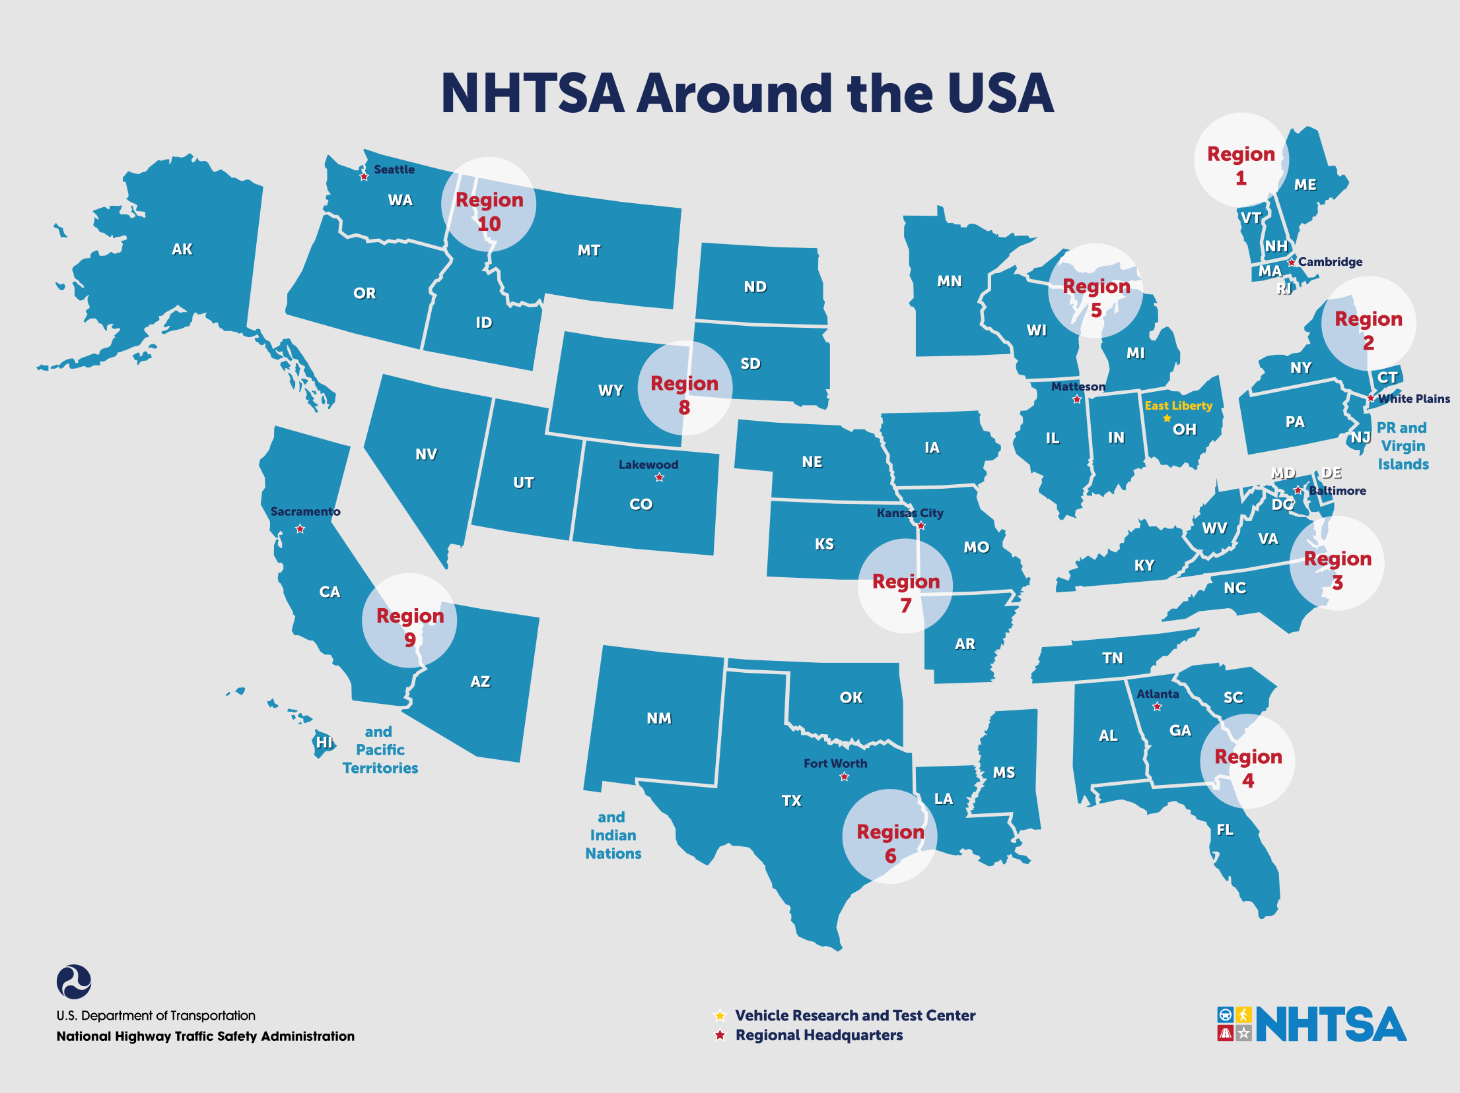

Slide 11
NHTSA Roles and Responsibilities
Region 6
Oversight
Program development & technical assistance
BIA & Tribal Training
Promote NHTSA Priorities- BIA planning
Facilitate meetings and outreach with BIA and other federal agencies (CDC, IHS, FHWA)

Slide 12
NHTSA Roles and Responsibilities
Region 6
Facilitate and coordinate NA activities with NHTSA Regions
Conference calls with NHTSA Regional POC for NA issues
Media/outreach support
Share IHSP Grant and activity information with NHTSA Regions
Collect and Share Best Practice activities

Slide 13
NHTSA Roles and Responsibilities
Regions
Identify and share NA project information and activities with Region 6
Support improvement of Tribal data collection
Participate in quarterly Native American Coordination Team calls
Advise States of Tribal projects funded by the BIA to ensure proper coordination of funds with State funded projects
Encourage States with Tribal populations to support and assist Tribes
Provide input to R6 on State and Tribal resource and technical assistance needs

Slide 14
Role of State Governments
Tribes, as political sub-divisions, may be provided funding by a State in accordance with 23 C.F.R. §402
Tribes receiving funds from a State can be utilized to meet the §402 requirement of 40% of funds being used by local political sub-divisions.

Slide 15
Kristen.allen@dot.gov www.NHTSA.gov

