Slide 1

FMCSA 101
Robert W. Miller
Director, Office of Policy, Strategic Planning & Regulations

Slide 2
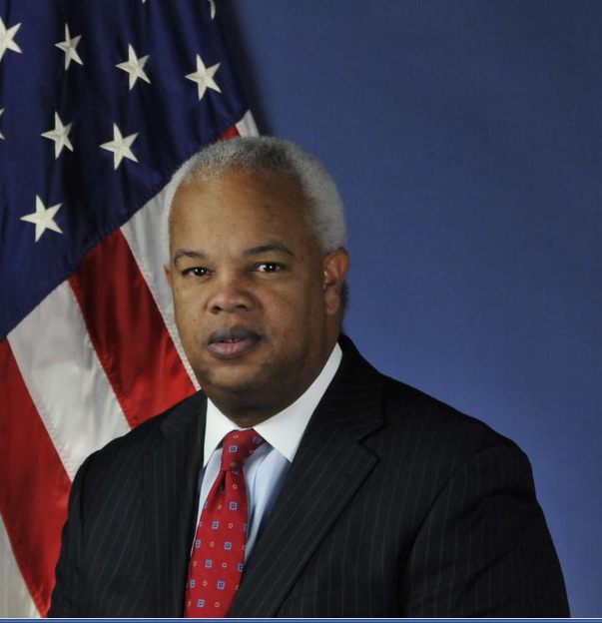
Who We Are: The Federal Motor Carrier Safety Administration
One of 11 operating administrations at the U.S. Department of Transportation
Established January 1, 2000 (formerly a part of FHWA)
Approximately 1,100 employees
Regulates interstate transportation by large trucks and buses, household goods operations, and inter/intrastate HAZMAT transportation
Over 55% of appropriated budget funds grants to State and industry safety partners (over $310 million)
Approximately 10,000 State/local enforcement officers
Administrator
T.F. Scott Darling, III

Slide 3
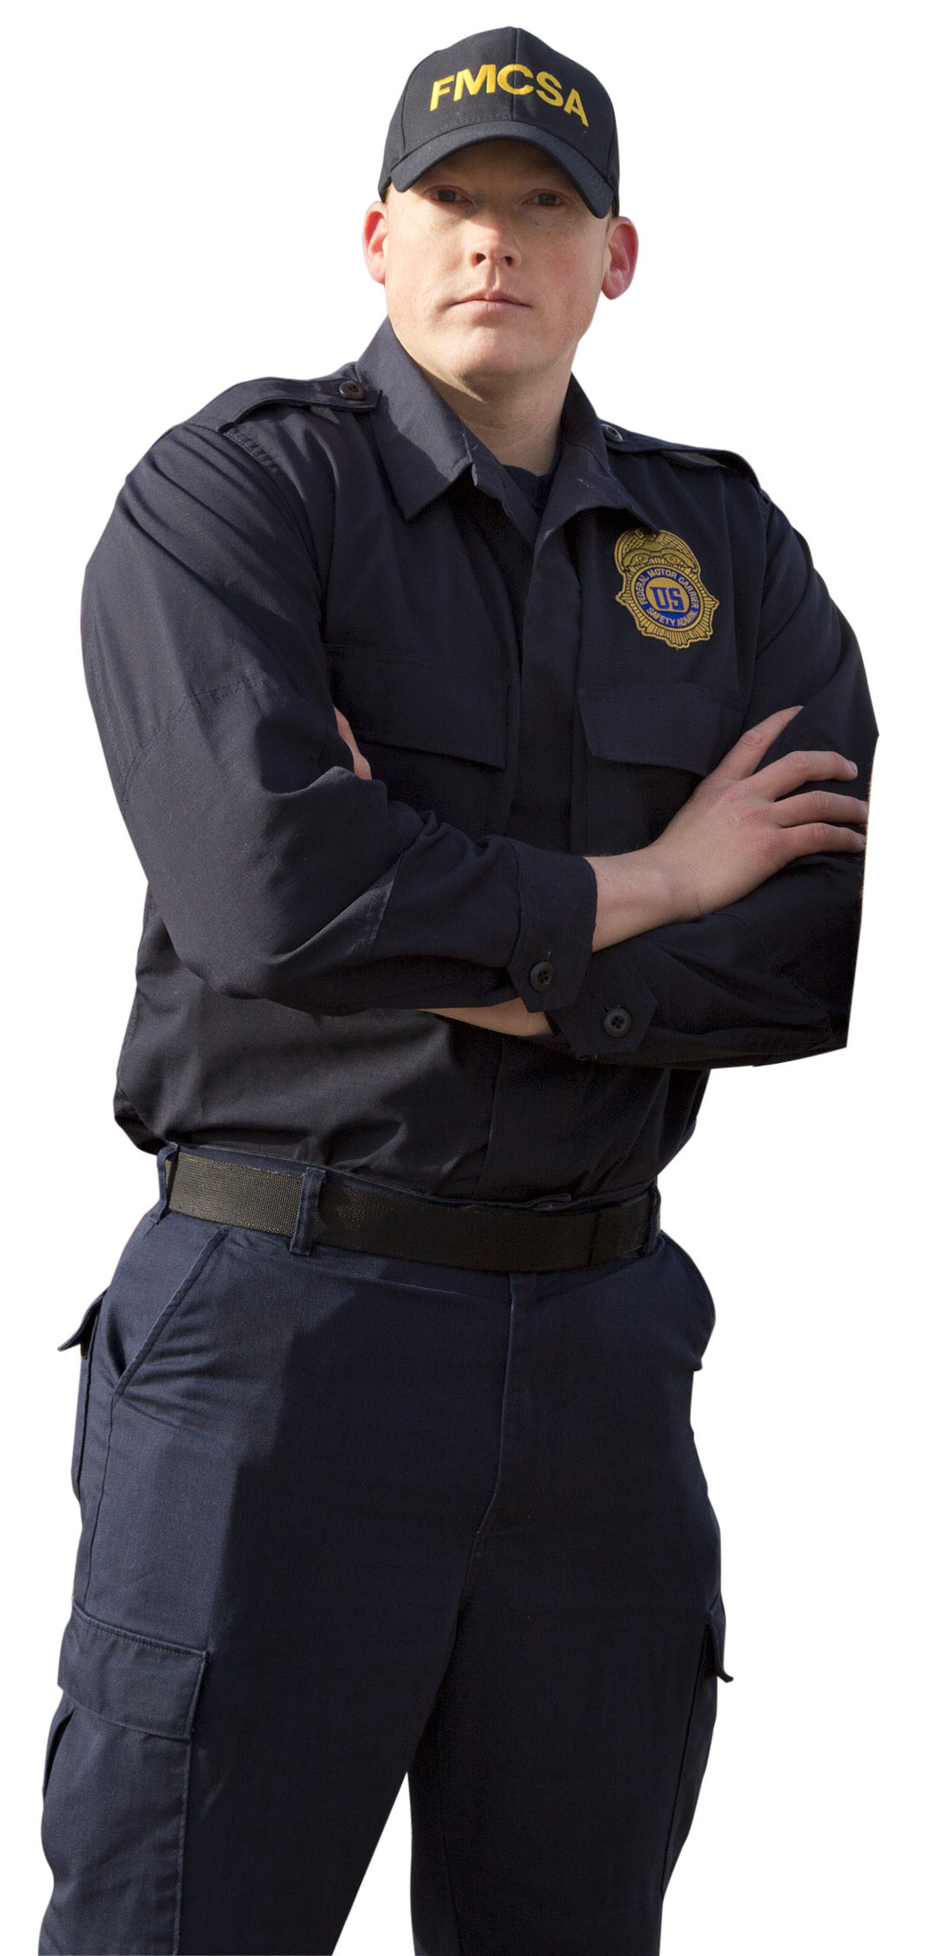
Our Three Core Principles
Raising the safety bar to enter the motor carrier industry
Requiring motor carriers and drivers to comply with rigorous safety standards
Removing high-risk motor carriers, and unsafe companies, drivers and vehicles from the road

Slide 4
Industry Profile
Over 535,000 Interstate Motor Carriers (truck and bus companies)
  64,000 Hazardous Materials Carriers
  12,000 Passenger Carriers
  4,900 Household Goods Carriers
Approximately 6 million Commercial Drivers
Over 300 billion Commercial Motor Vehicle Miles Travelled
The American Trucking Associations (ATA) reports that in 2012, trucks moved 9.4 billion tons of freight, or about 68.5% of all freight tonnage transported domestically
Most of the food we eat, clothing we wear, and goods we purchase travel on a commercial motor vehicle

Slide 5
Who We Are: Our Stakeholders and Safety Partners
Legislators
The White House
Safety Advocates
Motor Carrier Organizations
Commercial Motor Vehicle Drivers
State and Tribal Governments
Law Enforcement Personnel
Motor Carrier Safety Advisory Committee
Medical Review Board
Federal Register Notices
Listening Sessions
Participation in Industry Events
Public Outreach Activities
Notes:
Discuss ways we effectively partner with our stakeholders.

Slide 6

What We Do: Safety Oversight
Driver Hours of Service
Physical Qualification of Drivers and Qualification of Medical Examiners/Examinations
Commercial Driver’s License (including oversight of State Operations)
Drug and Alcohol Testing for Drivers
Driver Training
Vehicle Maintenance
Transportation of Hazardous Materials
Minimum Levels of Financial Responsibility
Household Goods Regulation
Registration Process

Slide 7
New Entrant Program
The purpose of the New Entrant program is to monitor motor carriers within the first 18 months of operations to assist with their compliance with the Federal Motor Carrier Safety Regulations.
A pass/fail New Entrant Safety Audit is performed within the first few months of operations. The purpose of the evaluation is to identify operational deficiencies and help the motor carrier improve its operations or remove unsafe companies from operation.
Safety ratings are not assigned.

Slide 8

Compliance, Safety, Accountability (CSA)
FMCSA’s data-driven safety compliance and enforcement program
Designed to improve safety and prevent commercial motor vehicle crashes, injuries, and fatalities by aggregating data and identify high-risk motor carriers
Helps motor carriers, including owner-operators, and drivers see patterns in safety performance to improve safety compliance

Slide 9
CSA’s Three Components
The Safety Measurement System (SMS)
  FMCSA’s workload prioritization tool that identifies carriers for interventions (e.g., warning letters, investigations)
Safety Interventions Process
  Wide array of interventions and tools to help FMCSA work with motor carriers to bring them into compliance with safety regulations. The Safety Management Cycle is an important tool in evaluating company safety practices.
Proposed Safety Fitness Determination (SFD) Rule
  Assess safety performance of larger segment of industry, keeping more unsafe carriers off the road (NPRM published 1/12/2016)

Slide 10
The Safety Measurement System (SMS)
Organizes data into 7 categories called Behavior Analysis and Safety Improvement Categories (BASICs)
  Unsafe Driving
  Hours of Service Compliance
  Vehicle Maintenance
  Driver Fitness
  Controlled Substances & Alcohol
  Hazardous Materials Compliance
  Crash Indicator
Prioritizes and identifies carriers for interventions (e.g., warning letters, inspections, investigations, enforcement)
Monthly updates based on the prior 24 months of data (weighted based on severity and when events occurred)

Slide 11
FMCSA At A Glance FY 2015
3,383,836 Truck and Bus Inspections
  20.9% Truck OOS Rate
  7.2% Bus OOS Rate
  4.9% Driver OOS Rate
20,463 Warning Letters Issued
14,668 Total Investigations Performed
5,066 Notices of Claim Issued
34.54% Investigations with Notices of Claim Issued
632 Unsatisfactory/Unfit OOS Orders
4.31% Investigations Resulting in UNSAT/UNFIT OOS Orders
7 Imminent Hazard OOS Orders
31,734 New Entrant Safety Audits
81.8% New Entrant Pass Rate
17,466 New Entrant OOS Orders

Slide 12
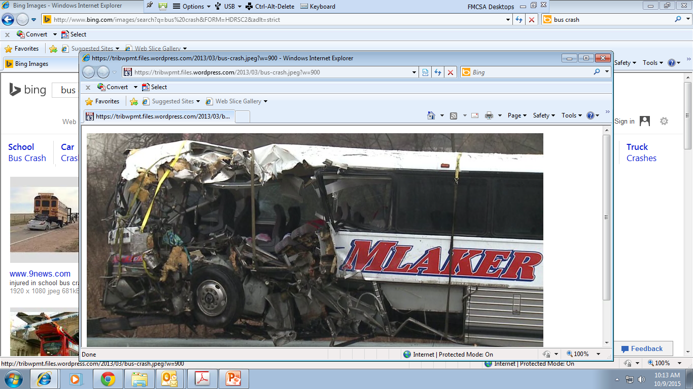
In 2014, there were 4,487 fatalities and 88,254 injuries in crashes involving large trucks or buses. There were 155,409 total crashes involving large trucks or buses.
- Source: Motor Carrier Safety Progress Report (as of March 31, 2016)

Slide 13
Current FMCSA Initiatives
Fixing America’s Surface Transportation Act (FAST Act) Implementation
Notice to Proceed with a Young Military Driver Pilot Program
Notice to Proceed With a Crash Preventability Demonstration Program
National Registry of Certified Medical Examiners
Safety Fitness Determination Rulemaking
Drug and Alcohol Clearinghouse Rulemaking
Entry-Level Driver Training Rulemaking
Obstructive Sleep Apnea Rulemaking

Slide 14
Tribal Government Grant Eligibility
High Priority Grants: authorized to enter into grants or cooperative agreements with State, local governments, federally recognized Indian tribes, other political jurisdictions, and other persons. 49 U.S.C. Section 31104(a)(2). These grant funds could be used for public education, enforcement activities, and safety demonstration projects related to commercial vehicle operations.
Commercial Motor Vehicle Driver Safety Program (CMV) Grants: authorized to enter into grants, contracts, and cooperative agreements with State, local governments, associations, institutions, corporations, and other persons. 49 U.S.C. Section 31106(c) and (d). These grants are offered to training institutions offering commercial driver training programs, which tribal governments may be offering and thereby would be eligible to apply.
Performance and Registration Information Program (PRISM) Grants: authorized to enter into grants, contracts, and cooperative agreements with State, local governments, associations, institutions, corporations, and other persons. 49 U.S.C. Section 31106(b) and (d). While some tribal governments may be issuing vehicle registrations, it would be difficult for a tribal government to meet all the programmatic requirements.

Slide 15
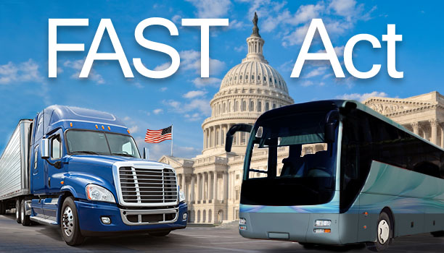
FAST Act Implementation
Implementation overview and status is available on the FMCSA website at www.fmcsa.dot.gov
Highlights:
  SMS Correlation Study
  Beyond Compliance Initiative
  Veterans Initiatives
  Grant Restructuring
Studies (5)
Rulemakings (20)
Working Groups (6)
Reports to Congress (15)

Slide 16
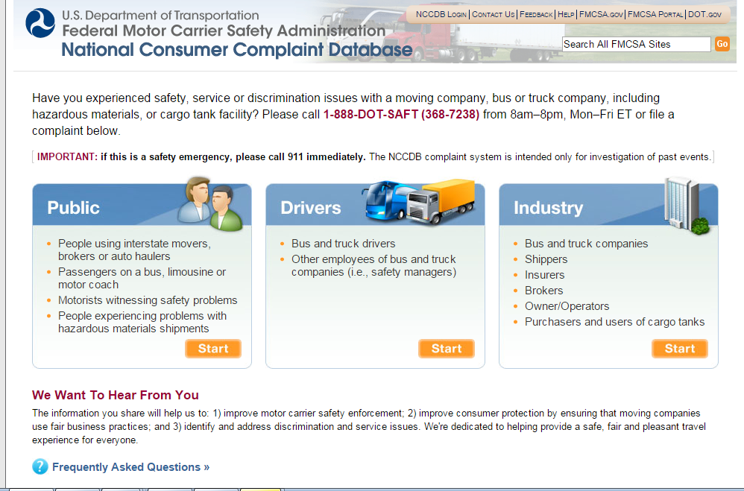
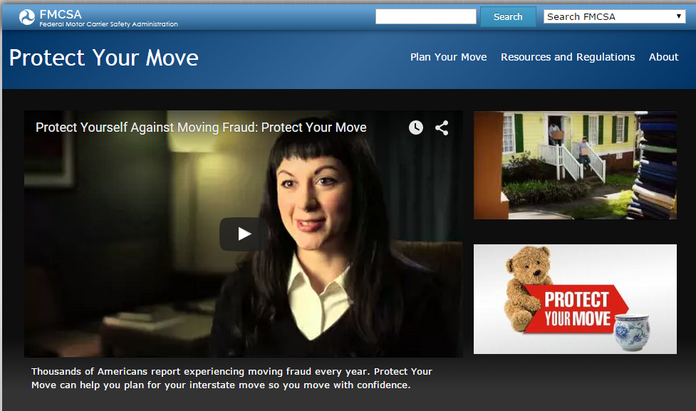
Constituent Resources
National Consumer Complaint Database
Protect Your Move
SAFER Bus App

Slide 17





Outreach and Education
Get Road Smart
Our Roads, Our Responsibility
Look Before You Book
Protect Your Move
Safety Belt Partnerships
LadderStep
Notes:
Get Road Smart – Promotes safety compliance to help keep our Nation’s roadways safer for everyone.
Look Before You Book — Helps travel planners and bus passengers learn about bus safety and research bus company performance history online or through a convenient mobile app.
Protect Your Move — Educates consumers on moving fraud and how to research interstate moving companies using FMCSA resources.
LadderStep: Ladders of Opportunity – or Ladder Step. Secretary Foxx is leading this USDOT effort to work on transportation projects to lift up citizens by improving local infrastructure to provide underserved communities with reliable and affordable connections to employment and education. Seven U.S. cities are participating, including Richmond, Atlanta, Baltimore, Indianapolis, Baton Rouge, Charlotte, and Phoenix.

Slide 18
Office of Governmental Affairs
Congressional Liaison
Technical Assistance Requests
Ed Gilman, Director: ed.gilman@dot.gov
Brielle Hopkins, Legislative Advisor: gabrielle.hopkins@dot.gov
FMCSA CONTACT INFORMATION
Web Page: www.FMCSA.dot.gov
Social Media: www.facebook.com/FMCSA
Federal Motor Carrier Safety Administration
1200 New Jersey Ave., S.E.
Washington, DC 20590
Telephone: 855-368-4200

