Slide 1
MARITIME ADMINISTRATION
Program Overview
September 2016

Slide 2
MARAD Overview
The Maritime Administration is the agency within the U.S. Department of Transportation dealing with waterborne transportation.
Its programs promote the use of waterborne transportation and its seamless integration with other segments of the transportation system, and the viability of the U.S. merchant marine.
Works in many areas involving ships and shipping, shipbuilding, port operations, vessel operations, national security, environment, and safety.

Slide 3
Overview Cont..
The Maritime Administration is also charged with maintaining the health of the merchant marine
  The agency provides support and information for current mariners, extensive support for educating future mariners,
Maintains a fleet of cargo ships in reserve to provide surge sea-lift during war and national emergencies
Recently realigned many of its functions, to revitalize its role as an industry facilitator, and to bring greater focus to the areas of environment and safety.
Notes:
MARAD is not a regulatory agency
through these three offices,
Office of Environment
Office of Safety
Office of Security
MARAD represents maritime transportation interests with other federal agency partners and internationally with organizations like the International Maritime Organization and the International Organization for Standardization.

Slide 4
NATIONAL DEFENSE
Notes:
This map was included in MARAD’s Panama Canal Expansion Study Phase I Report which was released in 2013.
The map was compiled by Jean Paul Rodgrigue at Hofstra University and it shows the density of shipping traffic on global trade routes. As you can see, the Panama Canal is critical for global shipping routes in general , and Asia-US East and Gulf Coast trade in particular.

Slide 5
National Defense Reserve Fleet/Ready Reserve Force
MARAD manages and maintains a fleet of Government-owned vessels in the National Defense Reserve Fleet (NDRF), including 46 vessels in the Ready Reserve Force (RRF).
Vessels in the RRF are kept at sites around the country in a reduced operating status (ROS).
The RRF provides a ready source of "surge" shipping, available when needed by the Department of Defense’s U.S. Transportation Command (USTRANSCOM), to support rapid deployment of U.S. military forces.

Slide 6
Maritime Security Program
MSP fleet consists of 60 active, commercially viable, militarily useful, privately-owned vessels.
  Provides assured access to U.S. commercial sealift capability to support DOD.
  Provides access not only to modern vessels and vessel capacity, but also a global intermodal transportation network.
  Provides employment for 2,400 U.S. citizen merchant mariners needed to crew government-owned vessels.

Slide 7
Jones Act
The Jones Act (46 U.S.C. § 55102) requires that merchandise being transported by water between U.S. points must travel in U.S.-built and U.S.-citizen owned vessels that are registered in the United States.
U.S. Customs and Border Protection (CBP) has direct responsibility for enforcing the Jones Act and the Department of Homeland Security (DHS) may grant waivers of the U.S.-flag requirements only in the interest of national defense.
MARAD’s role in the waiver process is to canvass the U.S.-flag domestic shipping market to locate suitable coastwise qualified vessels, and then report the results to CBP.

Slide 8
Cargo Preference
The Cargo Preference program office oversees the administration of and compliance with U.S. cargo preference laws and regulations
  Require shippers to use U.S.-flag vessels to transport any government-impelled ocean borne cargoes.
Government-impelled cargo is cargo that is moving either as a direct result of Federal Government involvement or indirectly through financial sponsorship of a Federal program or in connection with a guarantee provided by the Federal Government.
The purpose of the cargo preference program is to provide a revenue base that will retain and encourage a privately owned and operated U.S.-flag Merchant Marine.

Slide 9
Mariner education

Slide 10
U.S. Merchant Marine Academy
The Maritime Administration vigorously supports maritime training and education programs. Our intent is to improve the quality of the U.S. maritime industry through improved services to the people who serve at sea and those who work ashore in diverse professions such as shipbuilding, steamship company operations and port operations.
USMMA is located at King’s Point, New York
  Four-year maritime-focused program
    Bachelor of Science degree
    USCG merchant mariner credential, unlimited tonnage or horsepower officer endorsement
    Active duty or reserve commission
  Sea Year
    Midshipmen required to have 360 days of sea service to obtain USCG credential

Slide 11
State Maritime Academies
MARAD also provides financial support and training vessels to six State-operated maritime academies
  California Maritime Academy, Maine Maritime Academy, Massachusetts Maritime Academy, Great Lakes Maritime Academy, Texas A&M Maritime Academy, and the State University of New York Maritime College.
  National Security Multi-Mission Vessel (NSMV)
    SMA training vessels are used to train merchant mariners needed to crew commercial and military support vessels
    Training vessels are also used for humanitarian assistance and disaster relief missions

Slide 12
TRANSPORTATION OPERATIONS & PROGRAMS

Slide 13
Office of International Activities
The Office of International Activities is responsible for coordinating the Maritime Administration’s participation in international activities concerned with maritime transportation matters
Keeping abreast of and engaged in foreign economic and political developments which may affect United States maritime transport interests
International Trade Specialist (me)
  Focus on Arctic Trade
  Engagement with Alaska Tribes

Slide 14
Gateways Program
The Maritime Administration provides critical marine transportation outreach activities at our major U.S. gateway ports
Offices are located in 10 of the largest ports regions on the West, East, and Gulf Coasts, the Great Lakes and the inland river system
These offices work with headquarters staff, state and local authorities, congressional representatives at the local and district level, and a broad range of port, shipper and carrier stakeholders
Cooperate on projects, identify Federal and state funding, and work on environmental and community challenges in the ports and their inter-modal connections.

Slide 15
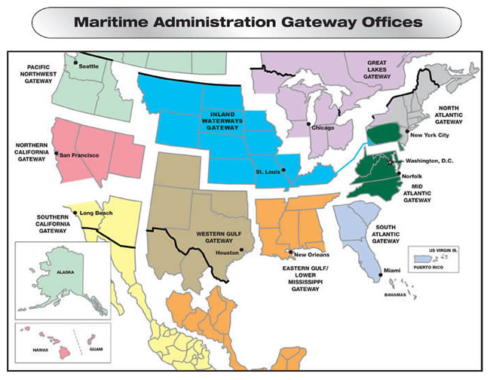
Gateway Locations
Mid-Atlantic Gateway
South Atlantic Gateway
Great Lakes Gateway
Inland Waterways
New Orleans Gateway
Houston Gateway
Northern California/Mid-Pacific Gateway (San Francisco)
Southern California Gateway (Long Beach)
Pacific Northwest,
Alaska Gateway (Seattle)

Slide 16
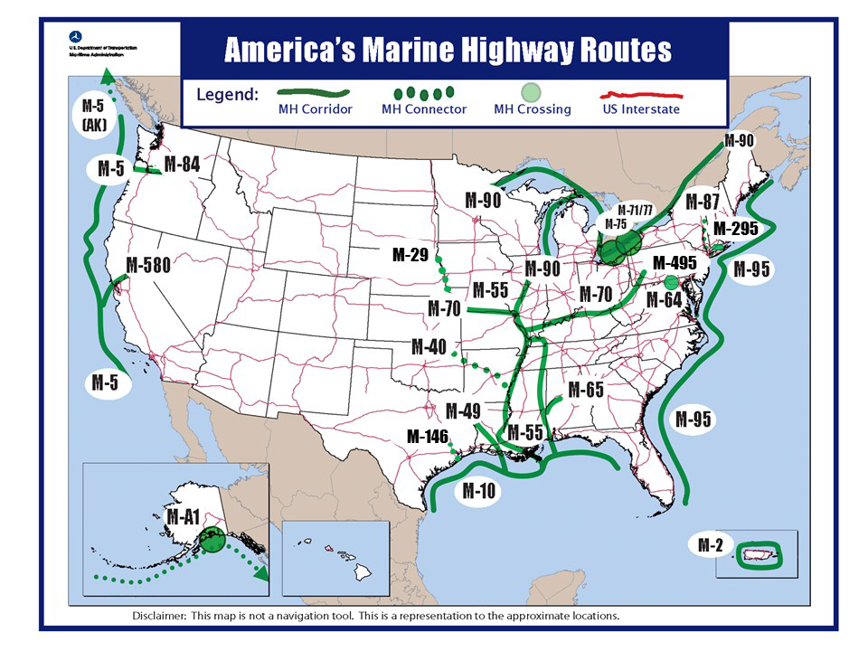
America’s Marine Highways
America’s Marine Highway System consists of over 29,000 nautical miles of navigable waterways including rivers, bays, channels, the Great Lakes, the Saint Lawrence Seaway System, coastal, and open-ocean routes.
The FY 2016 Consolidation Appropriation Act provided $5 million in funding for Marine Highway Project Grants. Awards are expected to be made this Fall.

Slide 17
Port Infrastructure Development/Strong Ports
Objectives:
Integrate ports into surface transportation system planning
Improve state of repair, capacity, efficiency and environmental sustainability of all U.S. ports
Improve port eligibility and competitiveness for public and private funds through enhanced planning and engagement while supporting the execution of port projects with Federal assistance
Build coalitions of ports/MPOs/DOTs
Notes:
In recent years, ports have emphasized their need for a go-to guide to plan, fund and execute critical repair and project upgrades
the Department of Transportation and the American Association of Port Authorities brought together experts from around the port industry to develop an easy-to-read, easy-to-understand, and easy-to-execute Port Planning and Investment Toolkit.
The toolkit modules can be used to help ports:
Evaluate port conditions
Define problems
Plan thoroughly
Navigate the preplanning process
Engage private partners
Present actionable needs to administrators
Access available funding
Complete project

Slide 18
Small Shipyard Grants
The purpose of the program is to foster efficiency, competitive operations, and quality ship construction, repair, and reconfiguration in small shipyards across the United States.
Congress has provided approximately $177 million between FY 2008 and FY 2016 for the Assistance to Small Shipyards program supporting 169 grants.
For FY 2016, MARAD received 118 grant applications requesting $80 million in assistance, far exceeding the $4.9 million made available for the grants.

Slide 19
Title XI Ship Financing
The Title XI Ship Financing program promotes the U.S. Merchant Marine fleet and U.S. shipyard growth and modernization.
Provides a U.S. government guarantee of private sector debt financing
  For vessels constructed or reconstructed in the United States
  For U.S. shipyard advance/modern technology
MARAD manages a $1.45 billion loan portfolio and 30 individual loan guarantee contracts.
Currently, there are two pending applications requesting a total of approximately $776 in loans. MARAD has $47 million in subsidy available for loan guarantees, which will cover approximately $518 million in loan requests depending on the risk rating the projects are given.

Slide 20
Maritime Environmental and Technical Assistance
The META program seeks to foster collaborative efforts among Federal agencies, academia, industry and the public to address critical marine transportation environmental issues.
    Supports research, development and demonstration of innovative technologies for practical applications
Current focus are aquatic invasive species, ballast water and underwater hull growth, port and vessel air emissions, and alternative fuels and energy technologies.
The President’s FY 2017 Budget requests $3 million for the META program.

Slide 21
Intermodal Funding

Slide 22
Intermodal Funding for Maritime
DOT has awarded $578 million in TIGER funding for 48 port projects since 2009
Maritime projects received $115 million in FASTLANE Grants for five projects
MARAD managed a $50 million Port Improvement Project in Guam, funded by DOD.

Slide 23
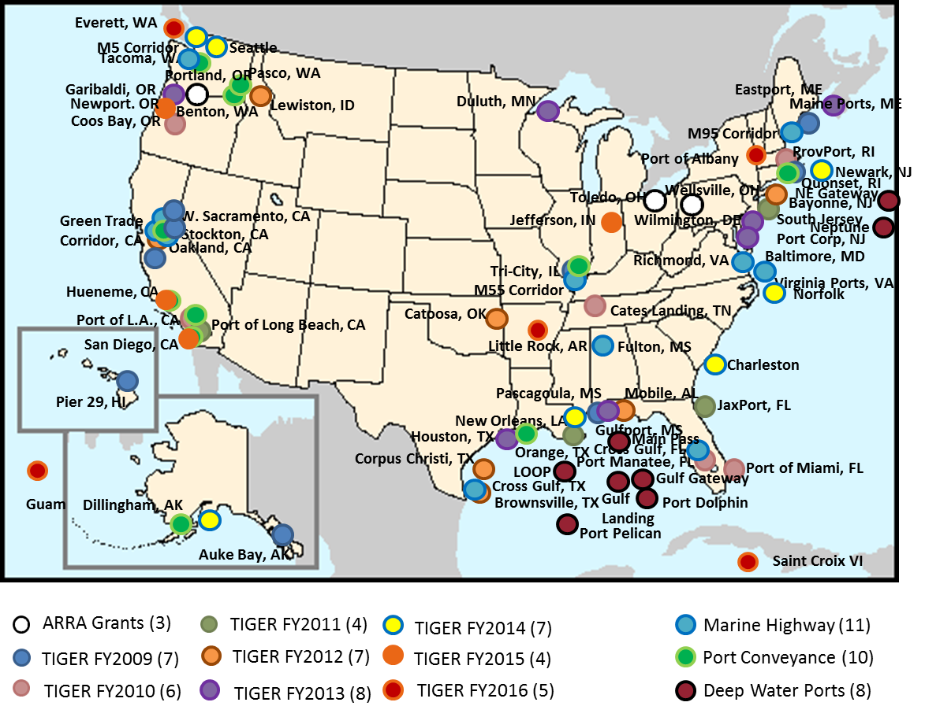
MARAD Port Infrastructure Development
Notes:
Two years ago, the American Society of Civil Engineers released the latest in a series of reports titled; “A Failure to Act.” It describes the quantifies the impact of continuing to invest in our ports at the current levels. Not if we don’t invest, but if we keep spending on them at the current rate...
A loss of $4 trillion dollars over the next 27 years, along with 178,000 jobs lost every year between now and then.
“Three years ago the World Economic Forum ranked US port infrastructure 22nd in the world.”
(Source: Port Technology International, 12 January, 2012)

Slide 24
Questions?
Alyson Azzara
Alyson.azzara@dot.gov
202-366-1838

