Slide 1
Office of the Secretary of Transportation

Slide 2
U.S. Department of Transportation 1966-2016

Slide 3
U.S. Department of Transportation
The top priorities at USDOT are to keep the traveling public safe and secure, increase their mobility, and have transportation systems contribute to economic growth.
DOT employs almost 55,000 people across the country, in the Office of the Secretary of Transportation and its operating administrations and bureaus, each with its own management and organizational structure.

Slide 4
Office of the Secretary (OST)
Secretary, Deputy Secretary
Office of the Under Secretary for Transportation Policy
Budget and Programs
General Counsel
Public Affairs
Governmental Affairs
Administration
Assistant Secretary for Research and Technology
Drug and Alcohol Policy and Compliance
Executive Secretariat
Civil Rights
Small and Disadvantaged Business Utilization
Intelligence, Security, and Emergency Response
Chief Information Officer

Slide 5
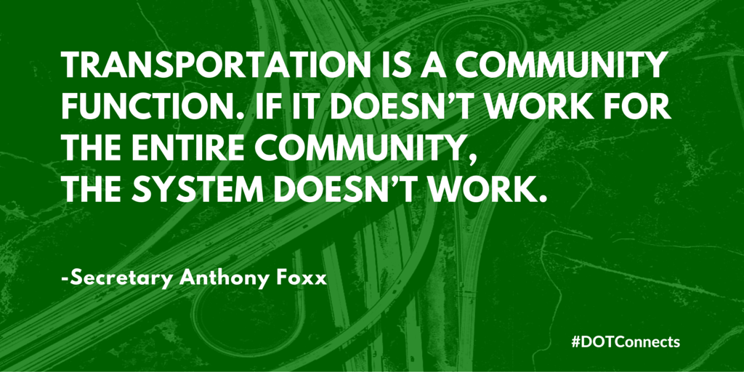
Ladders of Opportunity
Secretary Foxx’s Principles:
1. Transportation connects people to opportunity and can invigorate opportunity within communities. To the greatest extent possible, we should support transportation projects that do both.
2. While we cannot change the past, we can ensure that current and future transportation projects connect and strengthen communities, including areas that have, in the past, been on the wrong side of transportation decisions.
3. Transportation facilities should be built by, for and with the communities impacted by them. Development of transportation facilities should meaningfully reflect and incorporate the input of all the people and communities they touch.

Slide 6
$500 million (FY 2016) multimodal, merit-based discretionary grant program
TIGER Website: www.transportation.gov/tiger/
Awards announced Friday, July 29, 2016 supporting 40 projects in communities throughout the United States
Future funding availability is uncertain
Questions? Email TIGERGrants@dot.gov

Slide 7
Eligible Projects
Eligible Applicants
State, local, and tribal governments, including U.S. territories
Transit agencies
Port authorities
Metropolitan planning organizations
Other political subdivisions of State or local governments
A collaboration among such entities
Highway and bridge projects
Pedestrian and bicycle projects
Public transportation projects
Passenger and freight rail transportation projects
Port infrastructure investments

Slide 8
FASTLANE Grants
$4.5 billion authorized through FY 2020
$800 million for FY 2016
Application period for FY 2016 closed April 14, 2016; awards pending announcement
Visit: www.transportation.gov/FASTLANEgrants
Applicants can submit three applications per program (TIGER and FASTLANE)

Slide 9
Eligible Applicants
FASTLANE Grants
Eligible Projects
State(s)
Metropolitan Planning Organizations with 200,000 population
Local Government(s)
Political subdivision(s) or State or local government
Public authorities (including port authorities) with a transportation function
Federal land management agencies applying jointly with a State(s)
Tribal government/consortiums
Multi-State or multijurisdictional group of public entities
Highway freight projects carried out on the National Highway Freight Network
Highway or bridge projects carried out on the National Highway System, including:
Projects that add Interstate System capacity to increase mobility
Projects located in a national scenic area
Grade crossing or grade separation projects
Other freight projects that are:
Intermodal/rail freight project
Within the boundaries of a public or private freight rail, maritime (including ports) or intermodal facility

