Slide 1
Shakira N. Mack
Senior Program Analyst
Office of Hazardous Materials Safety

Slide 2
Notes:
Our vision is to become the most innovative transportation safety organization in the world.

Slide 3
PHMSA 2021: Organizational Structure

Slide 4
What Does PHMSA Do?
REGULATIONS AND STANDARDS
Regulates the movement of energy products and hazardous materials by all transportation modes, including pipelines
DATA AND RISK ANALYSIS
Analyzes safety performance, and is continuously improving its data quality and analytic capabilities to identify, assess and manage safety risks
RESEARCH AND DEVELOPMENT
Conducts research and development to improve standards for pipeline safety and hazardous materials transportation

Slide 5
What Does PHMSA Do?
TRAINING
Develops publications and curriculum, and provides in-person training opportunities for hazardous materials professionals and emergency responders.
PHMSA’s training and qualification center provides pipeline safety and inspection training for federal and state pipeline inspectors.
GRANTS
Pipeline safety grants support pipeline safety inspection, enforcement and outreach programs
Hazardous materials safety grants provides more than $26 million annually to states, territories, tribes and nonprofit organizations for hazardous materials safety planning and training activities.

Slide 6
What Does PHMSA Do?
ADVISORY BULLETINS AND GUIDANCE
PHMSA issues safety advisory notices and bulletins to address emerging risks and share lessons learned from inspections and investigations
INSPECTION AND ENFORCEMENT
PHMSA inspects pipeline facilities, and entities that offer hazardous materials for transportation, including manufacturers and shippers.
ACCIDENT INVESTIGATION
Investigates pipelines failures and other incidents involving hazardous materials

Slide 7
Our National Presence

Slide 8
Key Issues
PIPES Act Implementation
Hazardous Liquid pipelines
Gas Gathering and Transmission pipelines
Valves and Rupture Detection
Operator Qualification, Incident Notification
Natural Gas Storage
FAST Act Implementation
Oil Spill Response and Information Sharing
Crude Oil Study
Safety of Lithium Batteries

Slide 9
PHMSA Grants
Grant Name |  | Overview | Eligibility | Award Information
Hazardous Materials Emergency Preparedness (HMEP) Grants | Funding to communities for hazmat emergency planning and training activities |  | Tribes, States and Territories | Approximately $20M distributed by formula to States and Territories; Approximately $700K available for Tribes
Hazardous Materials Instructor Training (HMIT) Grants | Funding for training instructors to train hazmat employees |  | Nonprofit organizations | Up to $4M
Community Safety Grants | Funding for national outreach and training programs to assist communities in preparing for and responding to accidents and incidents involving the transportation of hazmat |  | Nonprofit organizations | Up to $1M

Slide 10
PHMSA Grants
Grant Name |  | Overview | Eligibility | Award Information
Assistance to Locals for Emergency Response Training (ALERT) Grants | Funding to train emergency responders to effectively respond to incidents that involve shipments of crude oil, ethanol, and other flammable liquids by rail. |  | Nonprofit organizations | Funded by prior year recoveries
Technical Assistance Grants (TAG) | Provides funding to communities for technical assistance (engineering or other scientific) and analyses of local pipeline safety issues |  | Local communities, Tribal entities, and Nonprofit organizations | Grant may not exceed $100,000 for a single recipient and the funds authorized for these grants

Slide 11
Examples of Eligible Tribal Activities Funded by PHMSA Grants
DOT HAZWASTE regulations training
Incident Command training
Develop and Update Emergency Plans
Table top exercises
Hazmat Awareness and Operational Training
Commodity Flow Studies
Improvement of local pipeline emergency response capabilities
Improvement of safe digging or damage prevention programs
Development of pipeline safety information resources
Implementation of local land use practices that enhance pipeline safety
Community and pipeline awareness campaigns

Slide 12
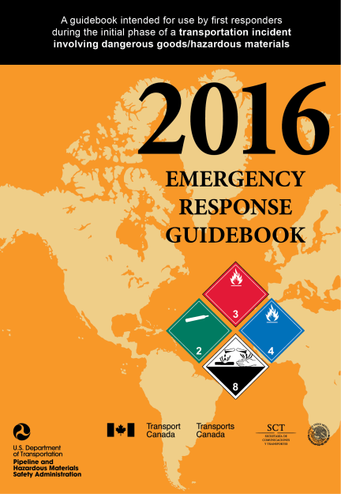
Safety Resources
Emergency Response Guidebook: Provides first responders with a
go-to reference to help deal with hazardous materials accidents
during the critical first 30 minutes. DOT’s goal is to place an ERG in every emergency service vehicle nationwide.
Training: PHMSA supports several types training and technical assistance seminars and workshops enhance regulations compliance, inspection techniques, enforcement uniformity, and emergency preparedness of the thousands of safety professionals shipping, carrying or enforcing compliance for the movement of hazardous materials across the country.
Pipelines and Informed Planning Alliance: Offers local governments, community developers, and pipeline operators a variety of recommendations to improve safety when making land-use decisions near or adjacent to existing transmission pipelines.
Outreach Teams: Hazardous Materials Safety Assistance Team and Community Assistance and Technical Services Managers serve as PHMSA’s designated representatives before a wide variety of stakeholders to provide consultation on new and amended regulatory requirements and conduct training or other public awareness activities.

Slide 13
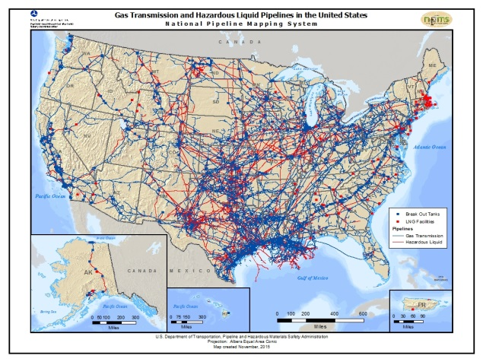
Safety Resources
National Pipeline Mapping System: A geographic information system that contains the locations and attributes of hazardous liquid and natural gas transmission pipelines, liquefied natural gas facilities, and breakout tanks. The NPMS is a valuable tool for planning community growth, emergency response, and pipeline awareness.
811-Call Before You Dig:
Working with the Common
Ground Alliance, PHMSA
promotes the leading way to
prevent damage to pipelines by
calling 811 prior to conducting any underground excavation activity. Nearly one-third of all major pipeline accidents are caused by excavation damage and not calling state One-Call centers in advance.
Hazardous Materials Information Center: Provides help on the use of Hazardous Materials Regulations. Center representatives answer questions regarding regulatory interpretations, accepts reports of hazardous materials violations, or provide other information specific to complying with regulatory requirements.
Safe Travel Website: Increases hazardous materials and battery safety public awareness. Printed guides explain safe travel with consumer-use hazardous materials, and provide a handy list of safety tips to minimize the risk of fires.

Slide 14
Contact Us
Hazardous Materials Safety Contacts: Contact the Hazardous Materials Information Center at 1-800-HMR-4922 (1-800-467-4922) or 202-366-4488 for Washington DC residents Monday through Friday from 9:00 am to 5:00 pm (EST). More Hazmat Contacts.
Pipeline Safety Contacts: Contact the Pipeline Safety Information Center at 202-366-4595 and Fax: 202-493-2311. More Pipeline Contacts.
Enforcement Feedback: Ask questions or submit complaints to Hazardous Materials Enforcement.
Training: Training is available through each PHMSA Region and the Training Center. You can also read more about Training Resources.

