Slide 1
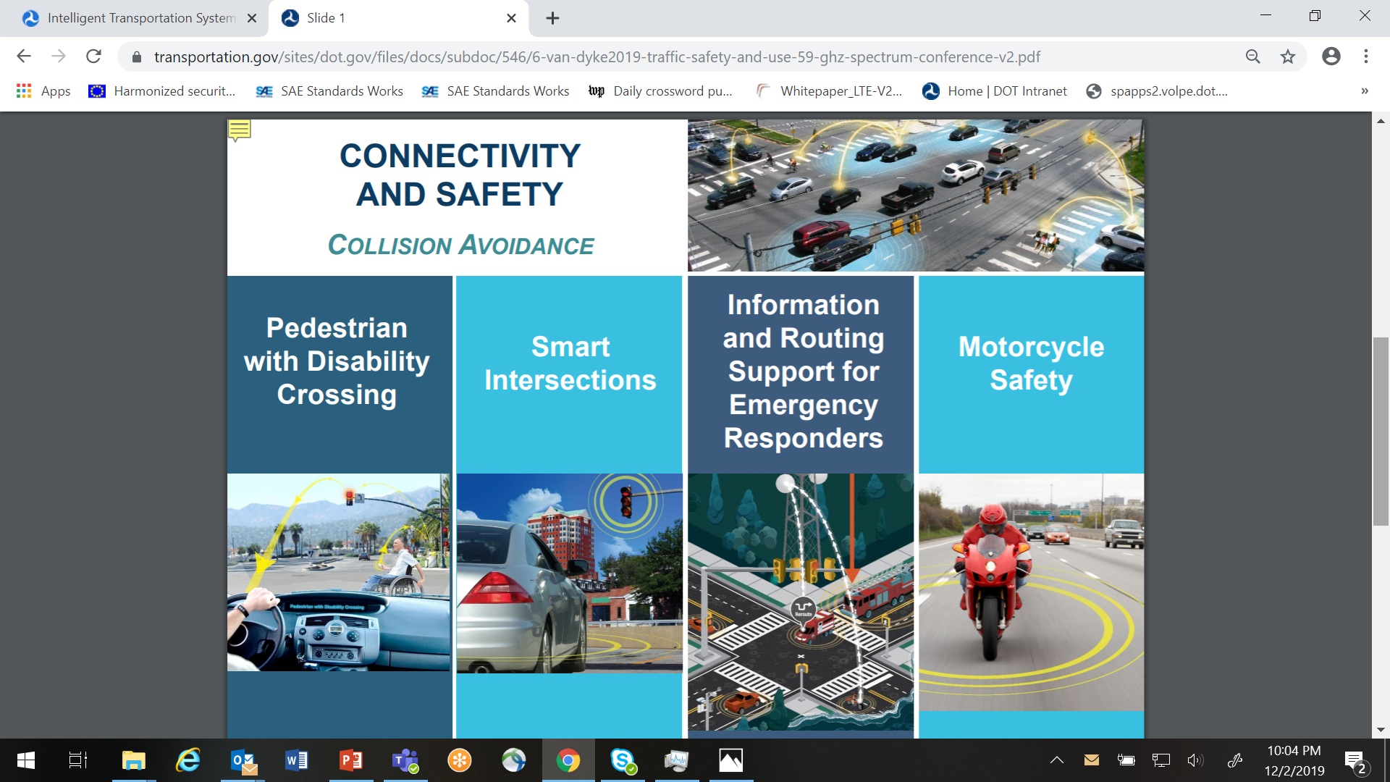
V2X Communications for Transportation:
An Overview

Slide 2
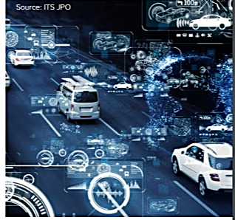
Agenda
  The transformative nature of cooperative-ITS communications—known as V2X Communications for Transportation
  Purpose: achieving safety and other public benefits
  Understanding the technology and its component elements
  Cooperative communications are an “eco-system”
    Every next generation of communications technology has to address all aspects of the eco-system to work properly
    Adds complexity to today’s communications as we know them
  Technology Evolution and New Challenges:
    Addition of a new radio technology—LTE Cellular V2X
    Proposed changes by FCC through NPRM
  USDOT Role
  USDOT Activities
Notes:
High level summary of where we are with V2X, including work US DOT is doing to perform testing, the measurements necessary to support the current trend toward adoption, and identify some of the remaining challenges for V2X communications and how the USDOT’s Spectrum research program is addressing these issues.
We will start will a quick overview of the unique requirements of V2X communications and how they fulfill the needs of a highly mobile transportation environment.
Then, challenges related to spectrum, including rapid changes occurring in telecom industry, the emergence of spectrum sharing industry concepts, and recent issues with the FCC proposing different NPRMs for the use of the transportation safety spectrum.

Slide 3
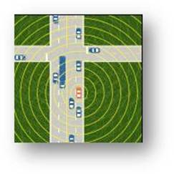
1. Overview of 5.9 GHz Communications
“Connected Vehicle Technologies”…
….are equipment, applications, systems, or technologies that enable vehicle-to-vehicle (V2V), vehicle-to-infrastructure (V2I), and vehicle-to-portable device (V2X) communications in support of communications-based safety, mobility, and environmental approaches to transportation. A key difference from today’s traffic applications that connect travelers through smart phones or in-vehicle navigation systems, is the additional data that can be drawn from electronic control units and sensors connected to a vehicle’s Controller Area Network bus (CAN bus). This data is broadcast to nearby vehicles, providing the receiving vehicle with 360 degrees of coverage and detection. Today’s vehicle-based sensors are limited in terms of direction, field-of-view, and distance at which they are able to detect potential conflicts. Short-range data exchange with infrastructure can produce specific road-segment information for drivers and travelers within a specific geographic area.
Image: USDOT

Slide 4
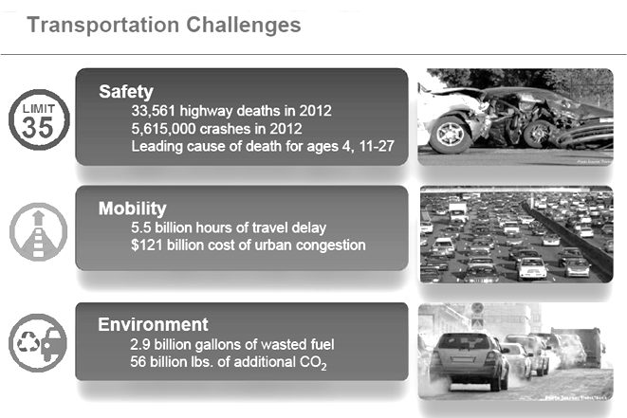
2. Purpose: Public Benefit
Safety Applications:
Applications that cannot be replicated by any current, known vehicle-resident sensor- or camera-based systems:
V2V:
  Intersection Movement Assist (IMA)
  Left Turn Assist (LTA)
  Emergency Electronic Brake Light
V2I:
  Red Light Violation Warning
  Curve Speed Warning
  Reduced Speed/Work Zone Warning
Automation:
  High-speed Platooning
Overall, these crashes directly cost $195 billion to society in terms of lost productivity, medical costs, legal and court costs, emergency service costs (EMS), insurance administration costs, congestion costs, property damage, and workplace losses. When you add the cost for less-tangible consequences like physical pain or lost quality-of-life, we estimate the total costs for those crashes to be $721 billion.
Notes:
Costs are in 2014 dollars and, for clarity, include the economic costs. See Blincoe, L.J., Miller, T.R., Zaloshnja, E., & Lawrence, B.A. (2014, May), The economic and societal impact of motor vehicle crashes, 2010, (Report No. DOT HS 812 013), Washington, DC: National Highway Traffic Safety Administration (Revised, May, 2015), available at: http://www-nrd.nhtsa.dot.gov/pubs/ 812013.pdf (last accessed Dec 7, 2016) (National Highway Traffic Safety Administration (NHTSA), Department of Transportation (DOT). Notice of Proposed Rulemaking (NPRM) 49 CFR Part 571 [Docket No. NHTSA–2016–0126] RIN 2127–AL55)
Safety Benefits Estimation:
81 percent of light-vehicle crashes involving unimpaired drivers could be addressed
Overall, a fully mature V2V system could potentially address the following unimpaired crashes:
About 4,409,000 police-reported or 79 percent of all vehicle target crashes.
4,336,000 police-reported or 81 percent of all light-vehicle target crashes.
267,000 police-reported or 71 percent of all heavy-truck target crashes annually.
V2I systems could potentially address the following unimpaired crashes:
About 1,465,000 police-reported or 26 percent of all-vehicle target crashes.
1,431,000 police-reported or 27 percent of all light-vehicle target crashes.
55,000 police-reported or 15 percent of all heavy-truck target crashes annually.
Combined V2V and V2I systems could potentially address the following unimpaired crashes:
About 4,503,000 police-reported or 81 percent of all-vehicle target crashes.
4,417,000 police-reported or 83 percent of all light-vehicle target crashes.
272,000 police-reported or 72 percent of all heavy-truck target crashes annually.

Slide 5
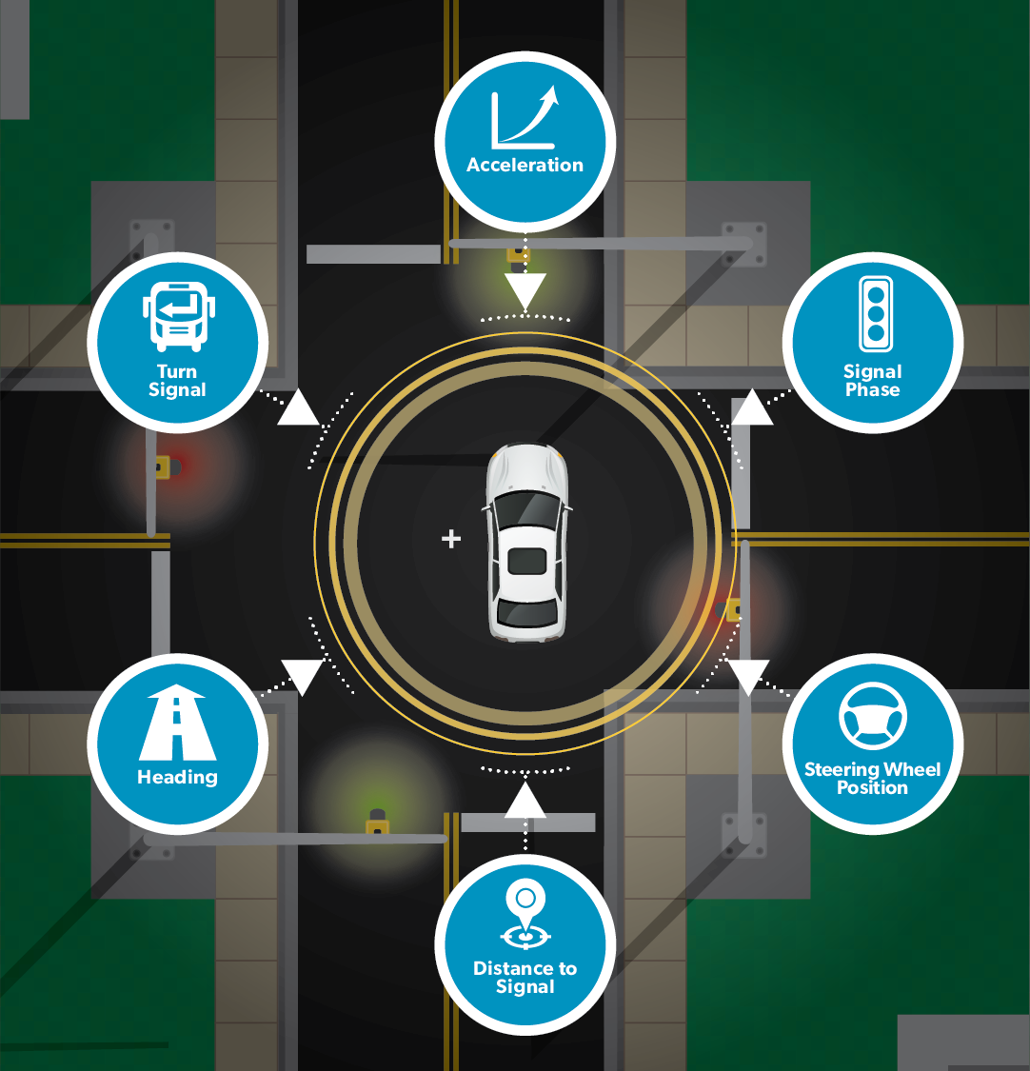
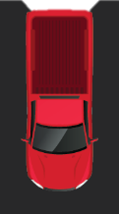
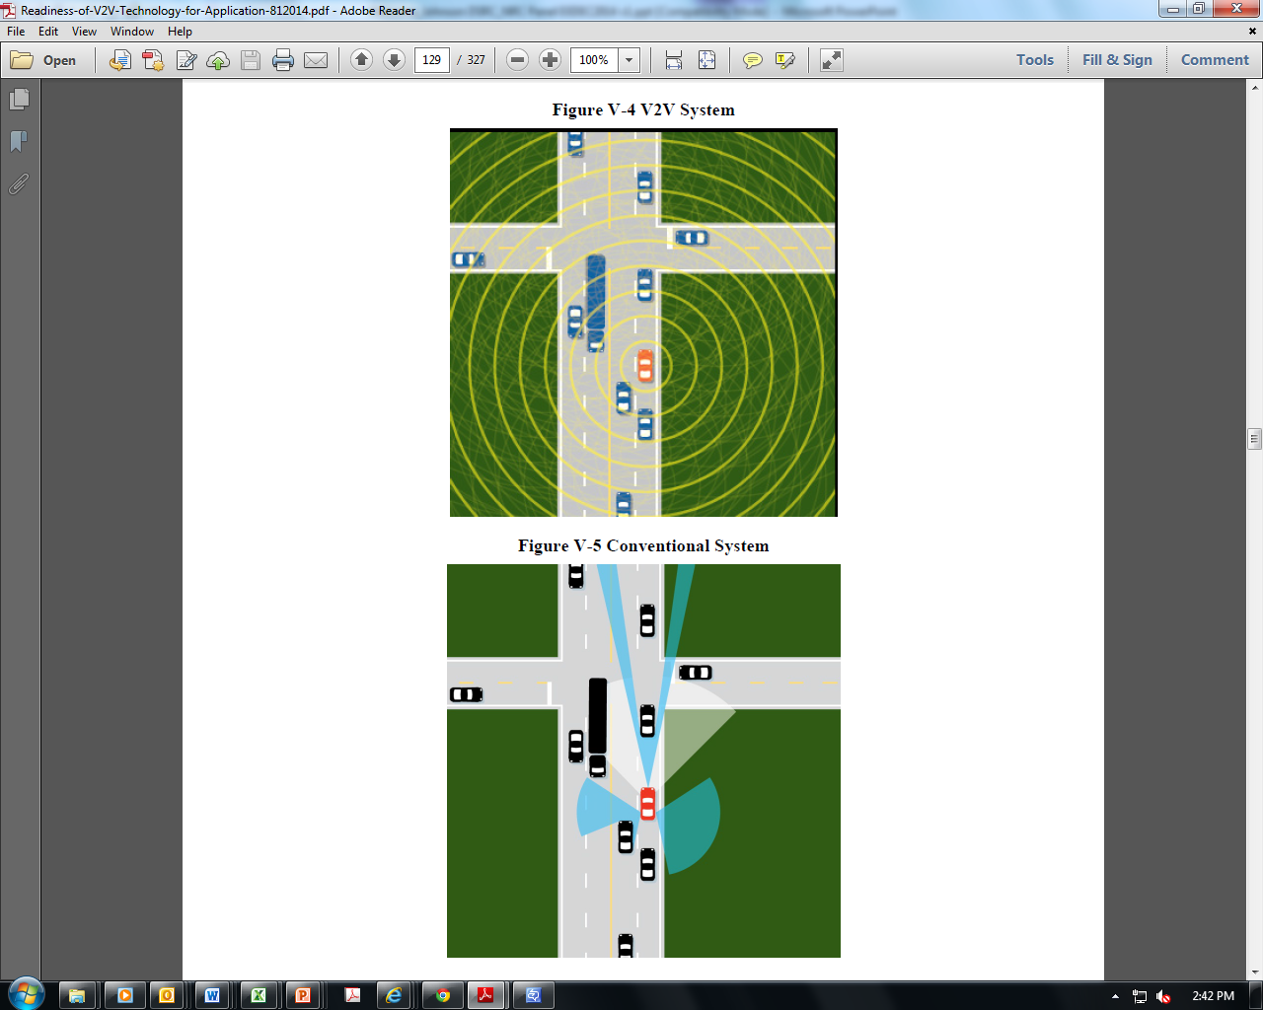
3. The Innovation
360 Degree coverage:
All nearby events and hazard forming in the roadway
Based on broadcast data of nearby vehicles + exchanges with roadside devices linked with traffic operations centers (or other data exchanges such as weather)
Vehicle Detected
Cooperative-ITS
Sensor Systems Alone
Notes:
Automation cameras are not robust enough for operations within snow, sleet, fog, and a range of other conditions.
Today’s sensor systems do not communicate outside of the vehicle.
Cooperative ITS fuses all of this data together to communicate to nearby vehicles but also devices with pedestrians, bicyclists, and other users of the transportation environment

Slide 6
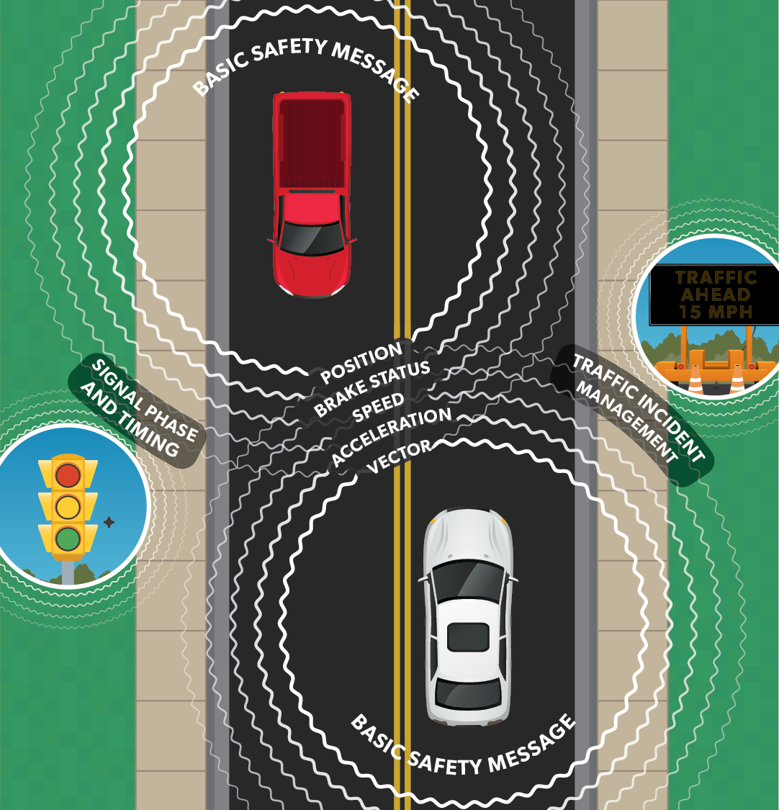
3. The Technology
Cooperative 5.9 Communications
  Low latency, local-open-ad-hoc, mesh concept adapted for vehicle environment (swarm intelligence)
  Data distributed in a broadcast mode—robust, local broadcasts inform nearby vehicles of the (potential) actions that might form crash situations
  Peer-to-peer data exchanges
  All makes and models of vehicles and devices can “hear” each other (interoperable)
  Engineered to work in a moving transportation environment with high reliability in inclement weather conditions
  Includes security and privacy protection

Slide 7
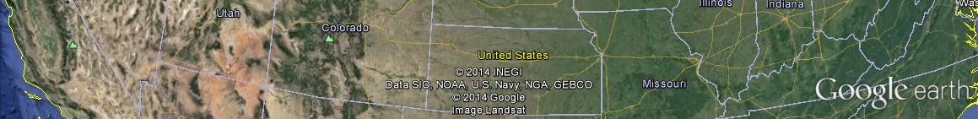
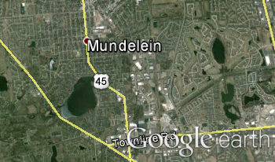
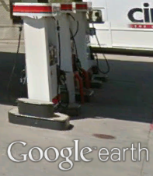
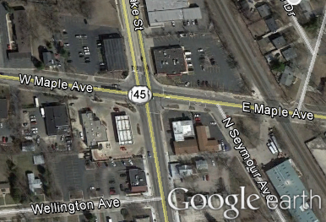
3. V2X Communications Role for Safety
For the foreseeable future, transportation will require use a hybrid mix of communications resources: wired and wireless, the Internet, satellite
3,000 miles, 3,000 meters, 300 meters, 3 meters—transportation safety and mobility communications are best suited to “local” or “hyper-local” communications whereby all nearby vehicles, infrastructure devices, and pedestrian/traveler devices can “hear” each other.
5.9 GHz band extremely well-suited to these local, interoperable transportation communications.
Continent-Wide
Wide Area Network
5.9GHz
Local Area
Network
Notes:
We think that there are three things that if done well will project connected intelligent transportation systems into the “after” state:
To accomplish transportation application goals, we have a number of communication resources that have to be properly, efficiently melded together, and
There are two classes of data used in transportation systems.
Those two things can then be unified through well-organized tools.
*******************************
OK, I don’t quite get this one.

Slide 8
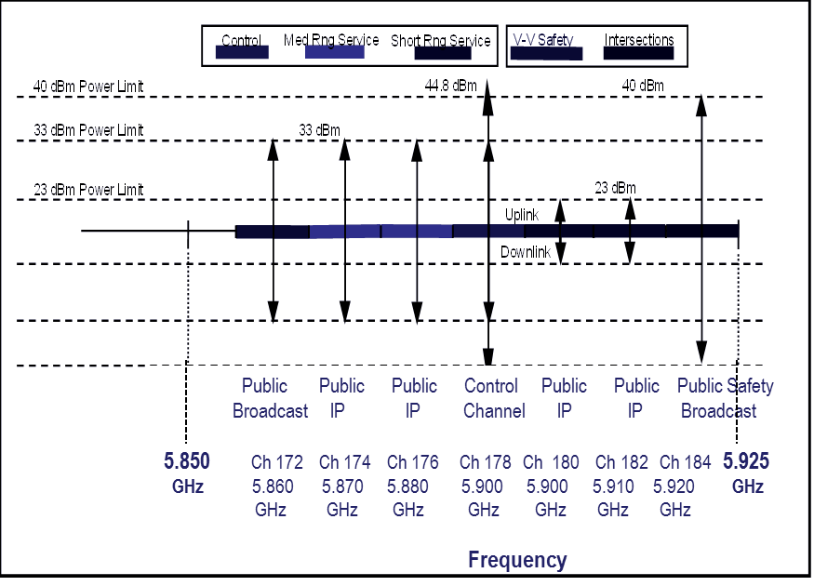
3. The Allocation
  Original FCC spectrum allocation granted in 1999
    Request came from USDOT, industry partners
    Different bands were studied that were mostly unoccupied but had primary users and were configured to support V2X communications
  FCC provided NPRM with questions in 2002
  FCC provided first service and licensing rules in 2004 and updated them in 2006 as research produced additional details

Slide 9
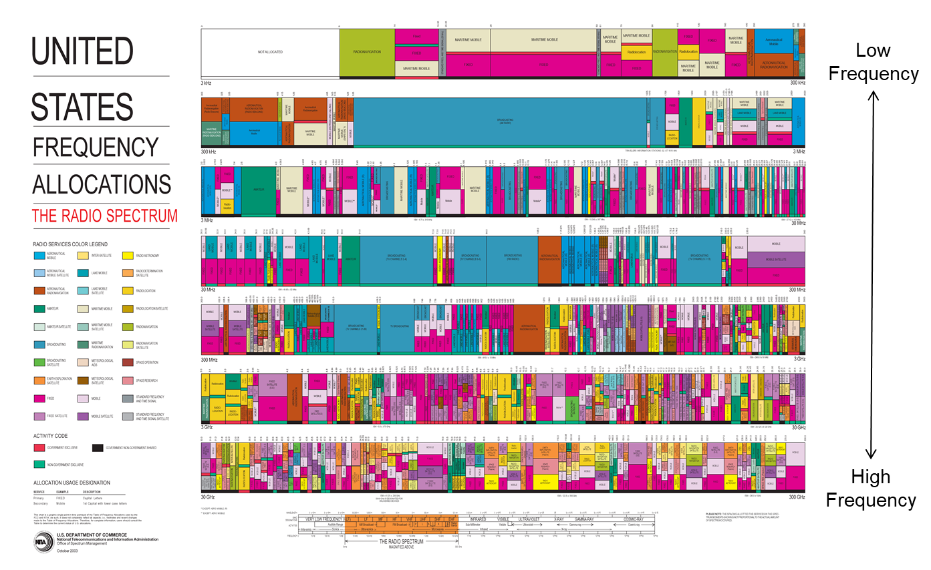
3. Criticality of Spectrum Availability
With No Interference
The “Safety Band” allocation is critical for transportation safety  supports the vision of advancing toward a fully connected and automated transportation system.
Over 37,000 deaths on our Na­tion’s roads every year  it is critical that efforts to free up additional spectrum do not come at the expense of saving lives.
ITS Allocation

Slide 10
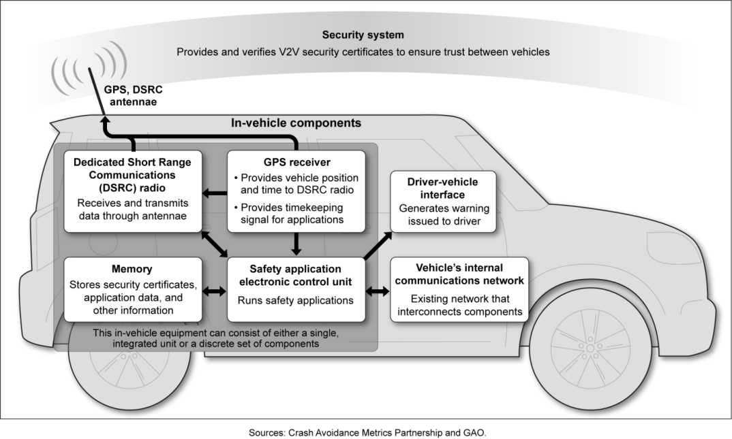
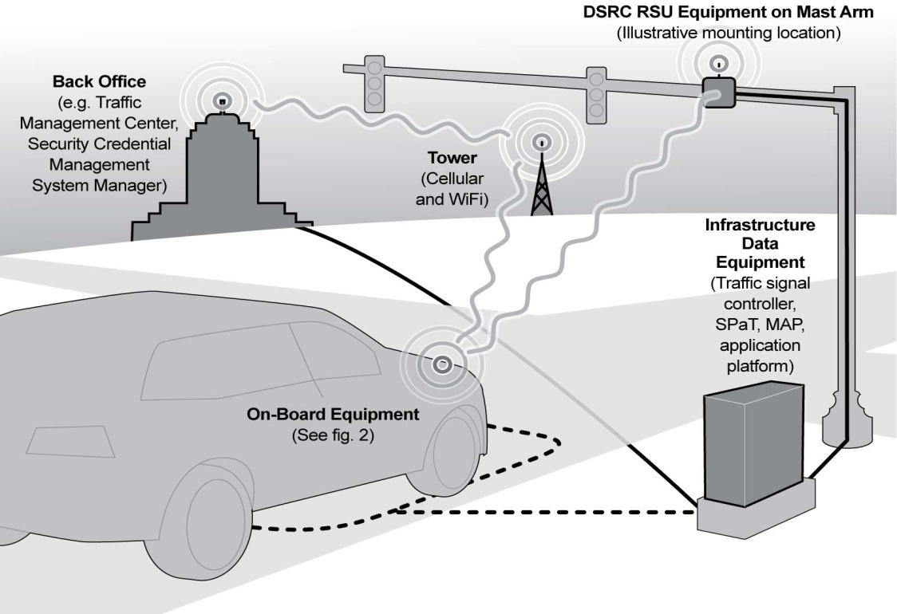
3. Component Elements: Simple
For V2V, combination of:
Hardware
Software
Driver-Vehicle Interface
Data
V2V Safety Applications
Radio
Receives and transmits data through antennae
GPS Receiver
Provides vehicle position and time to radio
Provides timekeeping signal for applications
RSU Equipment on Mast Arm
(illustrative mounting location)
For V2I, combination of:
Infrastructure Equipment
Data Sensors and Other Equipment
Driver-Vehicle Interface
Enabling Applications:
  Signal Phase & Timing
  MAP
  Position Corrections
V2I Applications (Safety, Mobility, Environmental)
Back Office Operations

Slide 11
4. V2X Eco-System Implementation: Complex
Radio Technology & Standards
I
Market Availability
Certification
XI
Interoperability
II
Many technological, institutional, social, and market components have to come together to enable V2X data exchanges for safety applications
Nationwide Scalability
X
Vehicle & Environment Dynamics
III
Technology Change
Technology Adaption
Technology Testing
Scalability
Market Availability Certification
Customer Acceptance
Sharing
IX
Band Plan / Spectral Efficiency
IV
Consumer Acceptance: Affordable, No Fees/ Subscriptions
VIII
Mitigation of Interference & Congestion
V
Consumer Acceptance: Security/Trust, Privacy
VIII
Coexistence w/ Other Primary Users
VI
Institutional Changes
VII
  Satellite Industry
  Military Radars
  Industrial, Scientific, and Medical Users (ISM)

Slide 12
4.I. Technology Change:
Radios Adapted for Transportation
V2V and V2I Safety Needs | Characteristics that a radio must support—
Speed of Transmission Fast network access times Low latency Rapid message delivery | Relatively few messaging protocols or requirements Delays of well under 100 microseconds Allows for data exchange of over 6 megabytes/second Allows for connectivity at speeds of over 60 mph or over 120 mph with vehicles driving toward/closing in on each other.
Coverage/Scale | Performs both broadcast and point-to-point communications in very short distances Limited range between exchange allows for spectrum reuse and limits interference System expected to be extensible to all types of vehicle systems, mobile devices, and applications--interoperable System implementation expected to be national in scale and extensible across North America
High Reliability and Stability | Performance immune to extreme weather conditions Designed to be tolerant to multi-path transmissions typical within roadway environments Has a tailored system of over-the-air security and message authentication + privacy protection that work at high speeds Is capable of granting different permissions to (for instance) police or emergency vehicles Works in high vehicle-speed mobility conditions Offers a stable platform; does not evolve rapidly

Slide 13
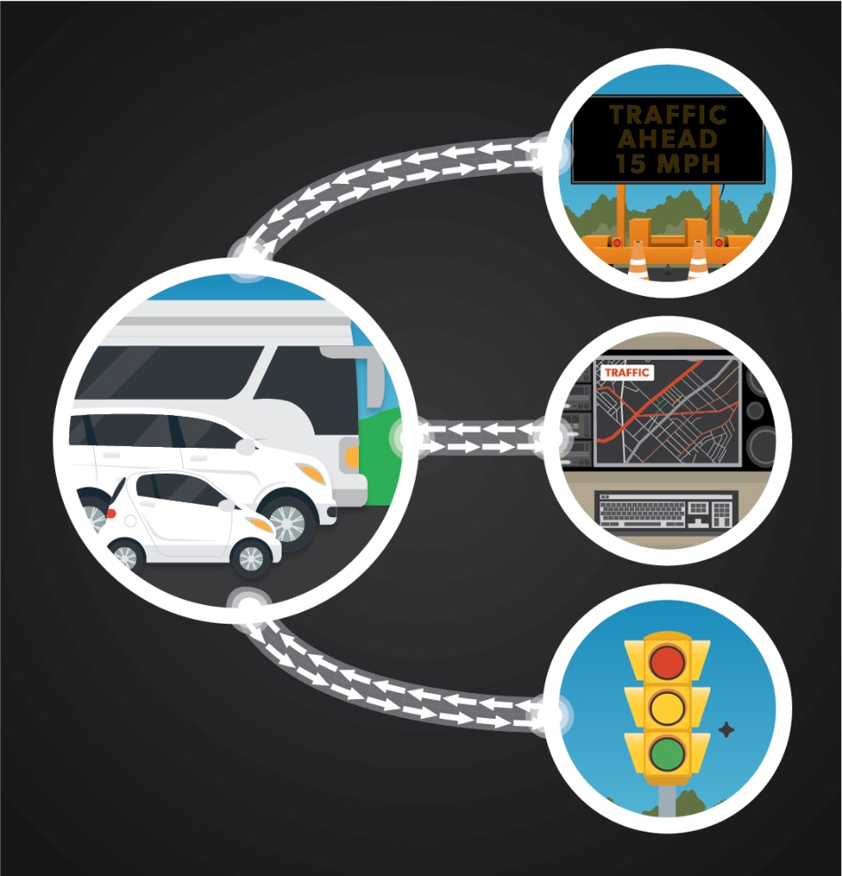
4.II. Technology Change: Cooperative Applications based on Interoperability
To gain the full benefits, it is imperative that all vehicles and devices can “hear” each other.
To ensure that the radios work in the presence of hundreds of other vehicles (potentially over 1000 in any one 300 meter area), there are trade-offs with settings (among others):
    Message size
    Spacing between message transmissions
    Message repetition rate
    Message priority
    Device power levels and ranges
    Channel size
    Reliability versus data throughput

Slide 14
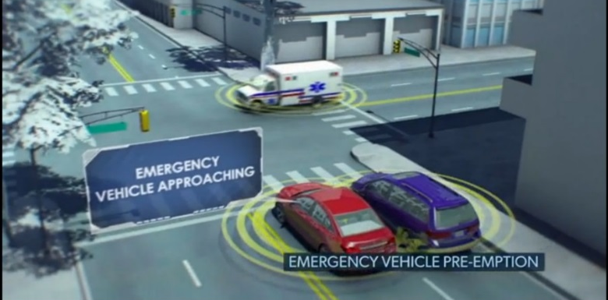
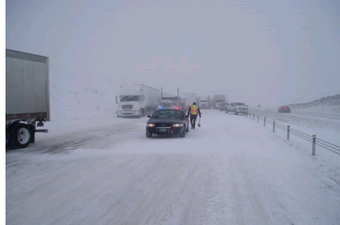
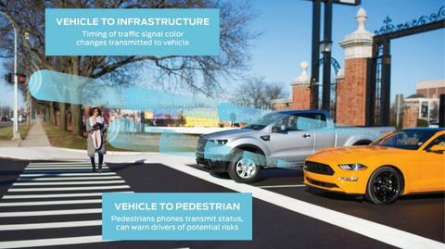
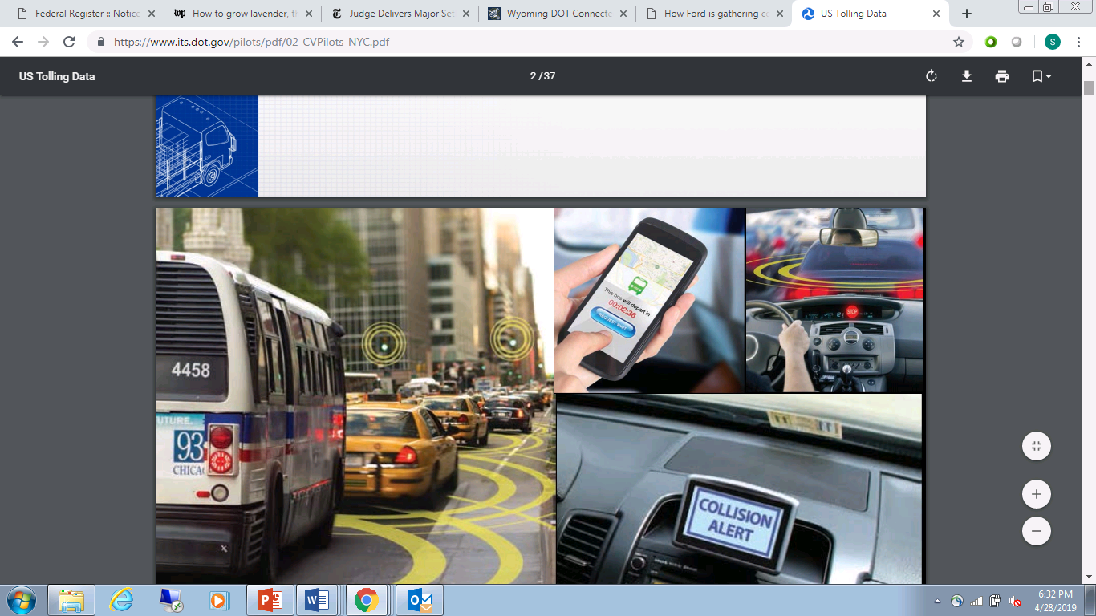
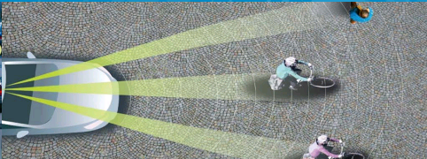
4.III. Technology Adaptations: Vehicle & Environment Dynamics
At any given moment, the transportation environment elements are moving and stopping randomly.
Key safety use case—when vehicles are moving rapidly at each other, effectively achieving 150mph (for instance, suburban highway) closing speeds while:
  Other devices (say, pedestrians or motorcyclists) are moving slower and/or stopping unexpectedly (lost motorists)
  Buildings or other blocking agents (for instance, weather or corn fields) suddenly reduce line-of-sight communications
CAUTION:
Blowing snow
Visibility

Slide 15
4.IV. Technology Adaptated for Complexity + Spectral Efficiency = Trade-offs in Band Plan and Technology Features
  Priority
    Safety messages identifying hazard conditions need to receive priority use of spectrum:
        Dynamic shifting of priority among V2X messages
        Special permissions given to emergency vehicles / responders
V2X communications are tailored to account for:
  Density
  Device density and ranges-always changing. Lead to trade-offs with:
      Channel congestion/ channel busy rate, information age
      Modulation, data rates
      Message success (packet error rate/packet completion rate)
  Dynamics
    Vehicle/device users moving rapidly (Multipath, Doppler)
    System dynamics always changing:
        Vehicle and device speed (potentially up to 150 mph closing speeds), direction
        Message sizes differ based on applications in use
        Non-normal operating conditions (weather, work zones that introduce people, other machines operating near traffic, etc.)
Addressed by Standards
Application Algorithms
+
FCC Rules
  Interference
    Normal interference from the environment has to be accounted for
    5.9 GHz channels are used at different power settings
  Installation and Antennae Set-up
    Roadside
    On the vehicle
    On devices with pedestrians, bicyclists, canes, wheelchairs, strollers, others
Addressed by FCC Rules – Band Plan
Addressed by Standards

Slide 16
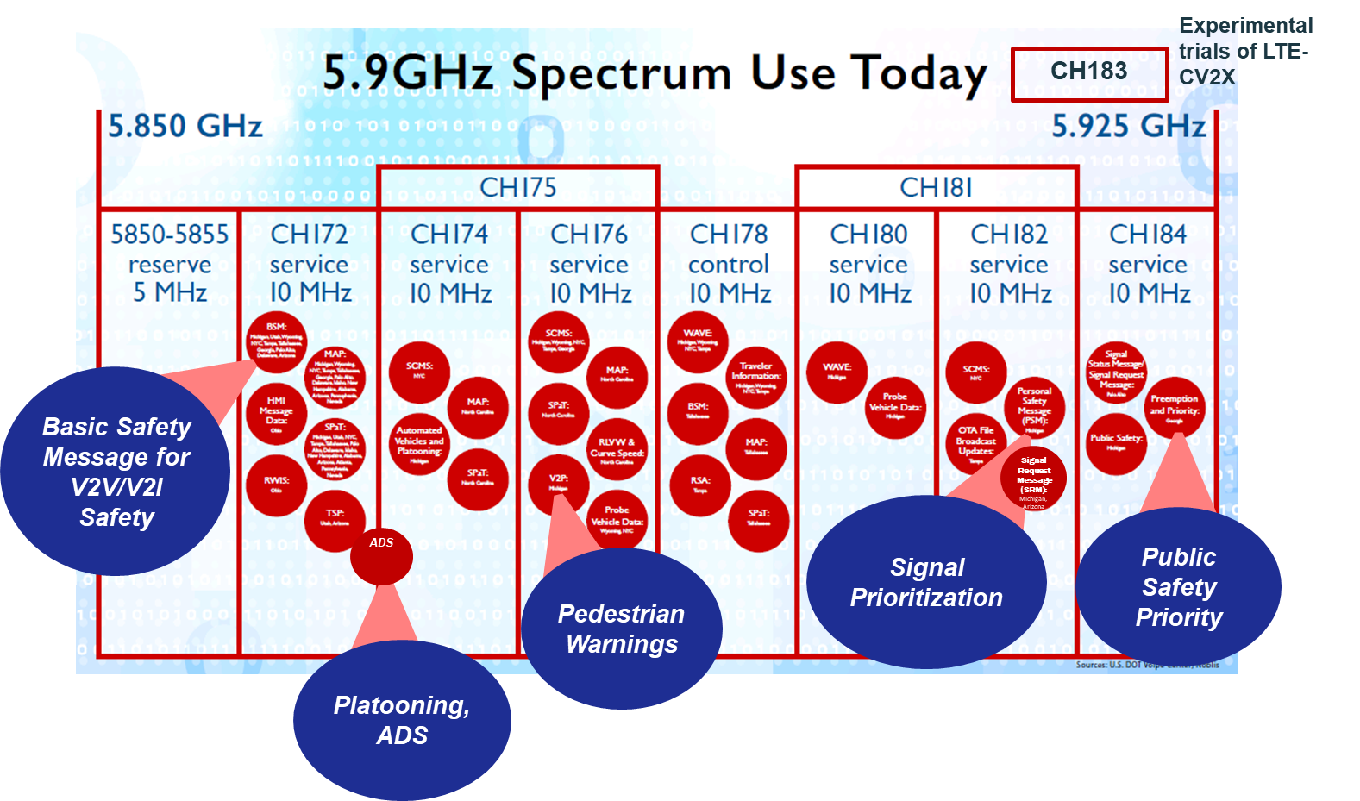
4.IV. Technology Testing = Band Plan, Spectral Efficiency, & Channel Usage
The band plan accounts for the complexities and trade-offs in a spectrally efficient manner.
Any new band plan requires analysis of how the radio requirements, complexities and trade-offs are addressed.
Notes:
What we stand to achieve with the many V2x applications is not insignificant. These applications will save lives, prevent crashes, reduce injuries and reduce property damage incidents, while optimizing our transportation system operations and reducing delays—all of which reduce taxpayer burden.
These applications can include a wide range of important interoperable, trusted and authenticable messaging:
vehicle to vehicle,
vehicle to infrastructure,
infrastructure to vehicle, and
vehicle to mobile/portable devices, particularly for vulnerable road users.
Three of the seven 10 MHz DSRC channels have been designated by the FCC for specific uses:
Channel 172 for time-critical safety-of-life and property applications
Channel 178 as a control channel
Channel 184 for public safety or government applications only
The control channel approach allows for the flexible, dynamic assignment of safety and other messages to un-designated service channels according to their priorities and local channel usage, thus all seven 10 MHz channels are used for safety
Priorities for V2X messages conform to three priorities:
“…communications involving the safety of life have access priority over all other DSRCS communications…” (FCC Part 90.377(d(1))
“…communications involving public safety have access priority over all other V2X communications…”(FCC Part 90.377(d(2)) that are not safety-of-life communications; and,
“Roadside Units (RSUs) operated by state or local governmental entities are presumptively engaged in public safety priority communications.”(FCC Part 90.377(d(2))
These priorities are assigned according to the pre-determined priority level of each application, and are enforced through permissions allocated to each application through a rigorous certification and credentialing process for transmitted messages.
[NOTE: Need specific language from FCC R&O for 172 and 184 designated usage]
Paragraphs 13-17 of FCC-06-110A1: https://docs.fcc.gov/public/attachments/FCC-06-110A1.pdf (won’t let me hyperlink).

Slide 17
4.V. Can Never Fully Eliminate Interference
An efficient band plan ≠ totally quiet environment.
Devices and standards evolve—such as out-of-band emission (OOBE) filters
Technology of other primary users evolves (radar, satellite, ISM)
FCC rules evolve
USDOT and automotive manufacturers have developed targeted definitions to identify external interference sources and determine how the radios can mitigate small amounts of interference.
V2X radio Interference can take three forms:
(1) Transmitting and receiving devices cannot hear because more radios in the environment raise the background noise
(2) Receiving devices don’t receive messages or receive corrupted messages due to other radio interference (packets colliding in the receiver)
(3) Transmitting devices suppress their transmissions when they hear interference on the channel
In its 2004 Report and Order, the FCC concludes: “…it is paramount that such communications be protected from interference given the consequences to the traveling public should any one of the safety applications fail due to unacceptable error rates or delay..”

Slide 18
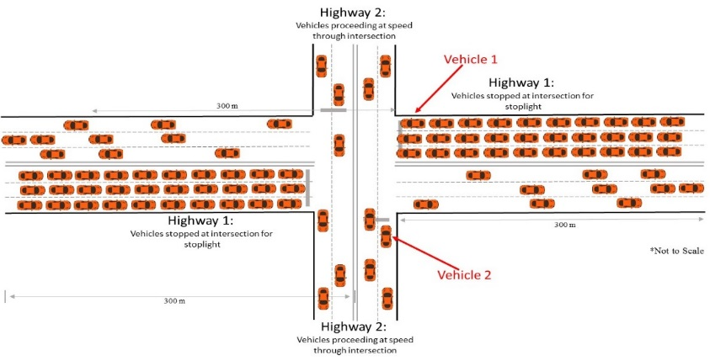
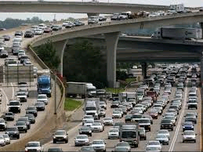
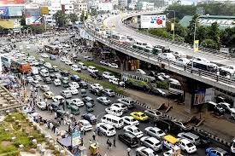
4.V. Because of System Dynamics, Expect Channel Congestion
Equally as important is the ability to manage channel congestion. USDOT and automotive manufacturers developed algorithms that change transmission rate based on speed and level of channel busy percentages

Slide 19
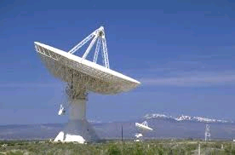
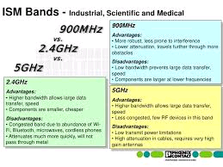
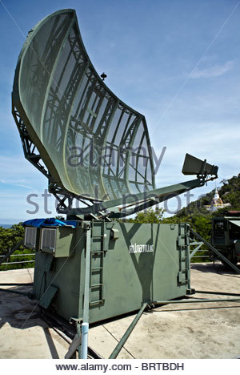
4.VI. Requirement to Co-Exist with Other Primary Users
Add co-existence with other primary users—Military Radar systems, Satellite uplinks, and Industry, Scientific, and Medical technologies which are primarily indoors, but (a) could be used near windows near streets; and (b) have stronger signal strength when performing industrial machine-to-machine

Slide 20
4.VII. With Deployment and Use comes Institutional Change
To enable V2V and V2I communications, agencies and private firms have changed:
State and Local DOTs/ Infrastructure Owners and Operators (IOOs):
  Installing roadside infrastructure
  Adapting existing and procuring new signal controllers to implement Signal Phase and Timing (SPaT) and intersection MAPs
  Changing/securing backhaul systems to work with the cooperative-ITS security credential system
  Acquiring security credential services
Manufacturers:
  OEMs are changing their production lines to equip vehicles with on-board units and antenna
  OEMs are securing their production lines to work with the cooperative-ITS security credential system, in some instances, building out their own capability
  Tier 1, 2, and 3 suppliers have secured their sites to produce/integrate component parts of the OBUs and RSUs
Security Providers:
  Have developed new security credentials for the transportation environment and are producing them (intensive operations)
  Received certification to provide services

Slide 21

4.VIII. Consumer Acceptance
For the technologies to work, consumers need to be assured of:
Security
Privacy
No subscription fees
Affordable
Security also plays another critical role in interoperability:
For other makes/models of devices to “hear” and trust the message, each message must be authenticatable
  USDOT, OEMs, and security services adapted Public Key Infrastructure (PKI) to serve transportation needs
  Credentials change out randomly to obscure location and to protect privacy
  Credential system comes with misbehavior detection to identify spoofers, , malicious actors, system failures
  Because credentials are not linked or networked, disruptions are localized--difficult to create “zombie apocalypse”

Slide 22
4.IX. The Addition of Sharing
Now add the complexity with sharing. Two types of sharing under analysis:
Rechannelization: In this proposal, unlicensed national information infrastructure (UNII-4) devices looking to share the lower 40Mhz for wider channels (40MHz, 80 MHz, 160MHz):
  Based on physics, we might expect adjacent channel energy “bleed over” into upper 30MHz where V2X safety will need to move—this is the basis of the USDOT-FCC-NTIA Phase II testing
  If moving to wider channels, V2X must adjust—10MHz channels are highly efficient for V2X
  UNII-4 has different message priority schemes; different message types, transmit rates; different power levels and ranges:
    Current band plan configured to prioritize data—short bursts
    Unlicensed devices planned for video—longer transmissions—as well as voice, and data—how to prioritize needs to be resolved
  V2X will interfere with itself (USDOT test results available-unpublished) which suggests rechannelization is not feasible
Detect & Vacate: In this proposal, UNII-4 devices look to share the lower 40Mhz by detecting DSRC and vacating (D&V):
  Also part of Phase 2 testing

Slide 23
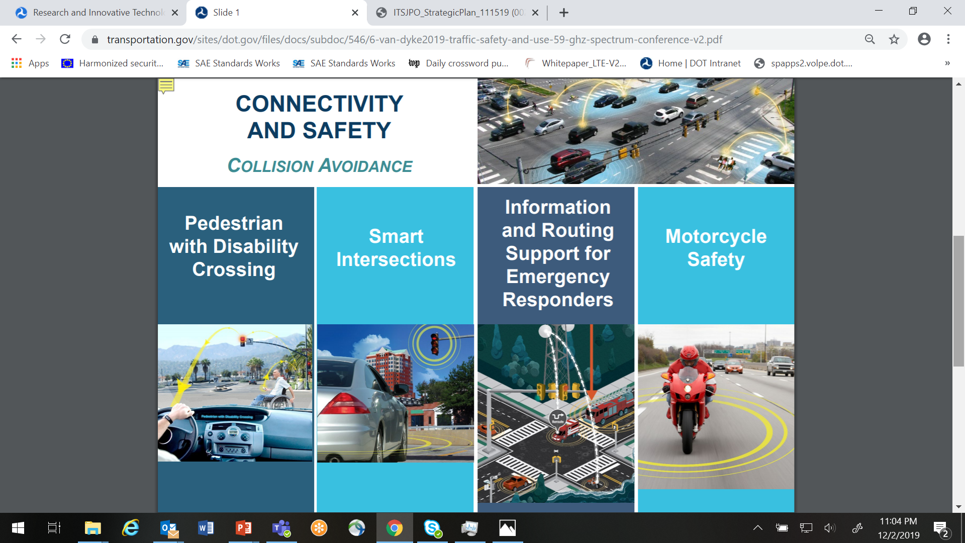
4.X. Nationwide Scalability
V2X Communications tested (2008-2010), demonstrated in real-world conditions (2012-2014), and proven through standards and certification (2012-2016)
Investments by State and local agencies have advanced: As of November 2019:
  57 operational sites; 40 in planning (12 additional sites since March 2019)
  8,098 infrastructure installations; 18, 877 vehicle installations (mostly public sector vehicles) + private fleet vehicles (numbers of GM Cadillacs, but installed since 2017)

Slide 24
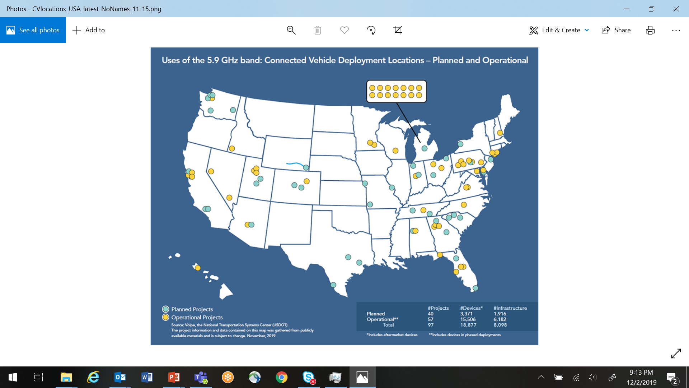
4.X. Nationwide Scalability

Slide 25
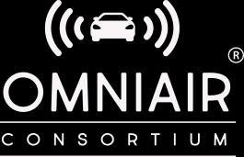
4.XI. Market Availability & Certification
To encourage use of the spectrum, technologies have to be market available and tested
For V2X
OEMs | General Motors, Toyota, Volkswagen, Honda for automobiles; for truck integrators, Peloton and Volvo offer modules
Device Suppliers | Delphi, Qualcomm, Savari, Visteon, Denso, Commsignia, Cohda, Siemens, Econolite, many others
Chip Manufacturers | Qualcomm, NXP, Autotalks, Huawei, others
Standards | Available through IEEE, SAE, ISO; standards are tested/mature, basis of certification tests
Certification Labs | Certification test suites exist from: Danlaw, 7Layers, OmniAir Consortium
For LTE-CV2X
OEMs | Ford
Device Suppliers | Qualcomm, Huawei
Chip Manufacturers | Qualcomm, NXP, Autotalks
Standards | Based on 3GPP Release 14 (2016); new standard for cooperative ITS under development at SAE
Certification Labs | OmniAir Consortium working on developing tests

Slide 26
5. Technology Evolution & Challenges
New radio technologies:
  4G LTE Cellular V2X
  5G New Radio
Band Plan Challenges
  Continued interest by broadband industry in taking spectrum away for video streaming and infotainment

Slide 27
5.I. The Addition of LTE-CV2X
4G LTE-Cellular V2X (LTE-CV2X):
  A recent technological innovation:
    Designed for public safety use when cell towers not available
    Build on LTE which was not designed for non-networked broadcasts
    Given its newness, questions exist about performance, interference, scalability, interoperability
  In terms of sharing the band:
    V2X and LTE-CV2X cannot “hear” each other and cannot be interoperable within the same channel; thus LTE-CV2X requires its own channels
    V2X is Wi-Fi-based and “asynchronous”; and LTE-CV2X is cellular-based and “synchronous”—require different band and channel configurations…appear to not be able to coexist within the 5.9 GHz band
    Unsure of whether LTE-CV2X can coexist with other primary users (ISM, military radars, satellite uplinks)
  US DOT conducting tests and validating industry statements

Slide 28
5.II. Recent Proposed NPRM
Current proposed NPRM (Nov 2019):
  This proposal removes 45 MHz from V2X communications and gives it to UNII-3 and UNII-4 operations
    Due to laws of physics, V2X cannot perform all of the anticipated and in-use V2V and V2I safety and mobility in the remaining 30 MHz
This proposal removes the priority for safety messaging

Slide 29
6. What is USDOT’s role?
Independent, objective testing on behalf of transportation community, to demonstrate safety
Provide results to FCC to support decision-making:
  FCC notes that DOT is the agency that defines safety
  DOT’s results help FCC understand the variations and opportunities with band use
In USDOT’s 2018 Request for Comments, respondents (State and local transportation agencies, V2X vendors, app developers, OEMs, etc.) asked USDOT to continue with testing and research role:
  They have a desire to receive results on the feasibility of spectrum sharing with unlicensed broadband devices.
  They have a desire to receive results about LTE-CV2X capabilities and offer a comparison against existing V2X communications as input to their investment decisions.
  They want a way to identify the performance and safety capabilities of future communications technologies (i.e., 5G) as they emerge to participate in the transportation environment.
  They want more data on backward compatibility between generations of V2X technologies.
  They want to protect the 75 MHz for transportation as they see opportunities for the spectrum with upcoming emerging technologies (such as automation).

Slide 30
6. US DOT Activities: Safety Band Research and Test Program

Slide 31


6. Phase 2 DSRC-UNII Sharing Testing Plan
Can DSRC continue to provide safety-critical messages in the presence of unlicensed national information infrastructure (UNII-4) devices?
Assess three types of interference:
  Interference at DSRC receiver that leads to corrupted or no messages received
  Interference at DSRC transmitter that suppresses message transmission
  Adjacent/n-adjacent channel interference
Can UNII-4 devices effectively share the Safety Band with DSRC by mitigating potential interference to DSRC operations using the proposed sharing techniques?
  Re-channelization
  Detect & Vacate

Slide 32
6. Test Metrics
Performance indicators
Packet Error Rate (PER)
  Data Throughput
  Network Latency or Delay
  Packet Delay Variation (aka, “Jitter”)
Specific to Re-Channelization of the Band for DSRC & Unlicensed Wi-Fi
Detection Threshold: Point at which the probability of detecting DSRC signal is equal to or greater than target percentage (90th percentile).
(Received) Packet Completion Rate (PCR): Ratio of the number of successfully received DSRC packets to number of transmitted DSRC packets.
(Transmitted) Packet Completion Rate (PCR): Ratio of the number of DSRC packets placed in the transmit queue to number of successfully transmitted DSRC packets.
Inter Arrival Time (of Received Packets) (IAT): Time between two successive received DSRC packets.
Inter Departure Time (of Transmitted Packets) (IDT): Time between two successive DSRC transmitted packets.

Slide 33
6. Test Metrics
Specific to Detect & Vacate with DSRC & Unlicensed Wi-Fi
Detection Threshold at which point probability of detecting DSRC preamble is equal to or greater than certain percentage (90th percentile).
Channel-Move Time or the time between detection of DSRC preamble and start of IEEE 802.11 transmission in a backup channel.
(Received) Packet Completion Rate (PCR): The ratio of the number of successfully received packets to number of transmitted packets.
(Transmitted) Packet Completion Rate (PCR): The ratio of the number of packets placed in transmit queue to the number of successfully transmitted packets.
Inter Arrival Time (of Received Packets) (IAT): The time between two successive received packets.
Inter Departure Time (of Transmitted Packets) (IDT): The time between two successive transmitted packets

Slide 34
6. USDOT’s LTE-CV2X Testing Framework
Operations and Safety Performance tests to assess LTE-CV2X capability to support crash-imminent V2V/V2I safety applications
  Interference tests to identify whether there is interference and the magnitude and impacts:
  LTE-CV2X with existing V2X communications
  LTE-CV2X and unlicensed Wi-Fi above the band
  Sensitivity of LTE-CV2X technology to other/existing forms of interference?
Scalability tests to measure the consistency of performance as increasing numbers of LTE-CV2X devices are added
Interoperability tests at the chipset, radio, applications levels for interoperability among different device vendors and chipset manufacturers. Can all makes and models “hear and understand” one another?
System Dynamics and Congestion testing to assess how LTE-CV2X technology performs in complex, highly dynamic and congested transportation scenarios with varying conditions as well as a range of environmental effects
Validation tests to ensure that the laboratory, field testing and industry simulation and test results are able to be validated.

Slide 35
6. US DOT’s Testing Progress & 5G Efforts
V2X Communications and UNII-4 Sharing Testing with Phase 2 has begun:
  First rechannelization devices in testing
  Working to gain access to additional rechannelization devices + detect-and-vacate devices
LTE-CV2X Testing has begun
  First devices received in Summer 2019; testing launched at end of August.
  Testing on operability and interference underway
  Working with development platforms; receiving commercial-prototypes and will add them to the testing
5G:
  Monitoring of transportation use cases and device specifications
  Seeking to acquire 5G prototypes (appear to be available in Asia for testing as of this past Fall)
  Assessing 5G’s security to meet transportation needs
  Coordinating with other Federal agencies

Slide 36
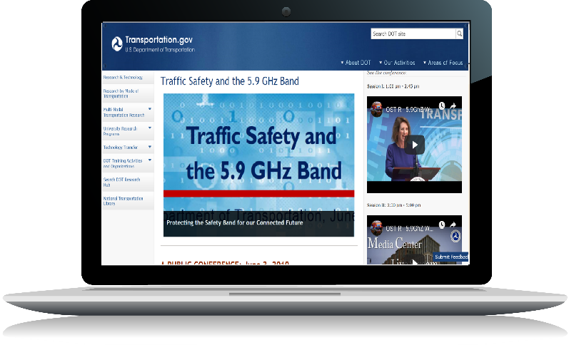



For More Information
        For Information:
        https://www.transportation.gov/content/safety-band
        https://www.its.dot.gov
        Contacts for Testing New Communications Technologies
        Jim Arnold, USDOT Spectrum Engineer; James.A.Arnold@dot.gov
        Jonathan Walker, Division Chief, Knowledge Transfer and Policy, ITS Joint Program Office; Jonathan.B.Walker@dot.gov
        Contacts for Testing New Communications Technologies
        Tim Klein, Director, Technology Policy and Outreach; Timothy.Klein@dot.gov
        Suzanne Sloan, Transportation Technology Policy Specialist; Suzanne.sloan@dot.gov

