Slide 1
Beyond Traffic: The Smart City Challenge Information Session #7: Application Homestretch – An Open Q&A Session
January 19, 2016
U.S. Department of Transportation (USDOT)

Slide 2
Webinar Overview
Overview of Beyond Traffic: The Smart City Challenge
Paul Allen’s Vulcan, Inc. – Overview of Partner Support
Mobileye – Overview of Partner Support
Application Content Requirements
Questions & Answers
For More Information
Notes:
Paul Allen’s Vulcan Inc. and Mobileye will also participate in this webinar to give an overview of their plans to support winning city’s vision for a Smart City

Slide 3
Beyond Traffic: The Smart City Challenge
Encourage cities to put forward their best and most creative ideas for innovatively addressing the challenges they are facing.
The Smart City Challenge will address how emerging transportation data, technologies, and applications can be integrated with existing systems in a city to address transportation challenges.
Demonstrate how advanced data and intelligent transportation systems (ITS) technologies and applications can be used to reduce congestion, keep travelers safe, protect the environment, respond to climate change, connect underserved communities, and support economic vitality.

Slide 4
Beyond Traffic: The Smart City Challenge
Phase 1 (Deadline February 4, 2016):
Support concept development and planning activities
Estimated five Smart City Challenge Finalists
$100K each
Phase 2 (Solicitation and Deadline TBD):
Smart City Challenge Finalists
Support implementation of their proposed demonstration
$50 Million+
U.S. Department of Transportation: $40 Million
Vulcan: $10 Million
Mobileye: Installation of Mobileye’s Shield +TM on every bus
Notes:
Phase 1: Proposals for Phase 1’s Notice of Funding Opportunity are due February 4, 2016 at 3:00 pm ET. Applicants are asked to include a high level vision of proposed demonstration, framework, and initial concepts tailored to their city. Fixed amount cooperative agreements of $100,000 will be awarded to an estimated five Smart City Challenge Finalists to support concept development and planning activities.
Phase 2: Finalists will further develop their concepts for demonstration. One city will be selected to implement their proposed concept. USDOT will provide funding up to $40 million to the winning city. In addition, Vulcan is offering an additional $10 million to the winning city to support infrastructure for electric vehicles and the winning city's public bus system will get installation of Mobileye's Shield +TM on every bus.

Slide 5
Beyond Traffic: The Smart City Challenge
Estimated Date | Action
February 2016 | Applications Due
March 2016 | Selected Smart City Challenge Finalists Announced
March 2016 | Awards Issued to Smart City Challenge Finalists
March 2016 | The USDOT Solicits Applications from Finalists for Smart City Challenge Implementation
May 2016 | Applications Due from Finalists
June 2016 | Selected Smart City Challenge Implementation Awardee Announced

Slide 6
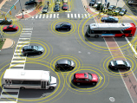
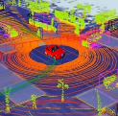
Advanced Technologies and Smart Cities
Technology convergence will revolutionize transportation, dramatically improving safety and mobility while
reducing costs and environmental impacts
Connected Vehicles
Benefits
Order of magnitude safety improvements
Reduced congestion
Reduced emissions and use of fossil fuels
Improved access to jobs and services
Reduced transportation costs for gov’t and users
Improved accessibility and mobility
Vehicle Automation
Connected-Automated Vehicles
Internet of Things
Machine Learning
Big Data
Mobility on Demand
Smart Cities

Slide 7
The USDOT’s Vision for a Smart City
The USDOT recognizes that each city has unique attributes, and each city’s proposed demonstration will be tailored to their vision and goals.
The USDOT’s vision for a Smart City Challenge is “to identify an urbanized area where advanced technologies are integrated into the aspects of a city and play a critical role in helping cities and their citizens address challenges in safety, mobility, sustainability, economic vitality, and address climate change.”
To assist cities, the USDOT identified twelve (12) vision elements that are intended to provide a framework for Applicants to consider in the development of a city’s proposed demonstration without making each item a requirement for award.

Slide 8
Beyond Traffic: The Smart City Challenge
Technology Elements (Highest Priority)
Vision Element #1
Urban Automation
Vision Element #2
Connected Vehicles
Vision Element #3
Intelligent, Sensor-
Based Infrastructure
Innovative Approaches to Urban Transportation Elements (High Priority)
Vision Element #4
User-Focused Mobility
Services and Choices
Vision Element #5
Urban Analytics
Vision Element #6
Urban Delivery and
Logistics
Vision Element #7 Strategic Business Models & Partnering
Vision Element #8
Smart Grid, Roadway
Electrification, & EVs
Vision Element #9 Connected, Involved Citizens
re-charging
Smart City Elements (Priority)
Vision Element #10 Architecture and
Standards
Vision Element #11
Low-Cost, Efficient,
Secure, & Resilient ICT
Vision Element #12
Smart Land Use

Slide 9
Phase 1 Planned Awards
Beyond Traffic: The Smart City Challenge
Overview of Partners’ Plans to Support the Challenge
Spencer Reeder
Vulcan, Inc.
Elad Serfaty and Elan Nyer
Mobileye
Notes:
Paul Allen’s Vulcan Inc. and Mobileye will also participate in this webinar to give an overview of their plans to support winning city’s vision for a Smart City

Slide 10
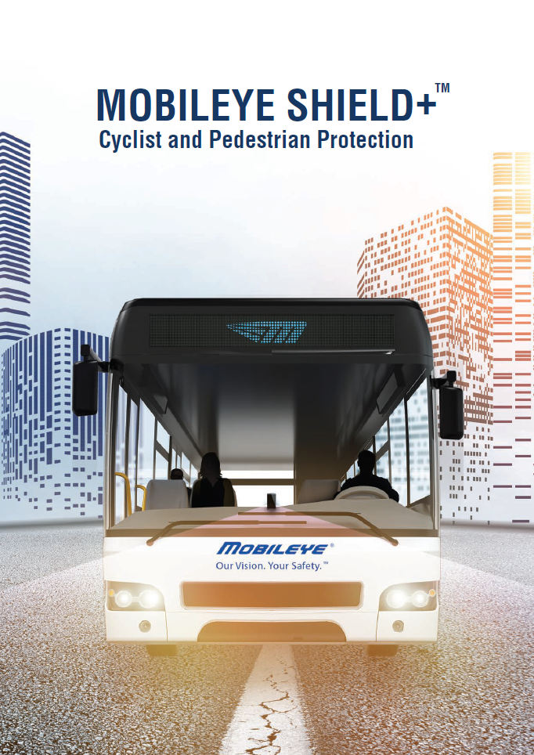
The Leader in Collision
Avoidance Systems

Slide 11
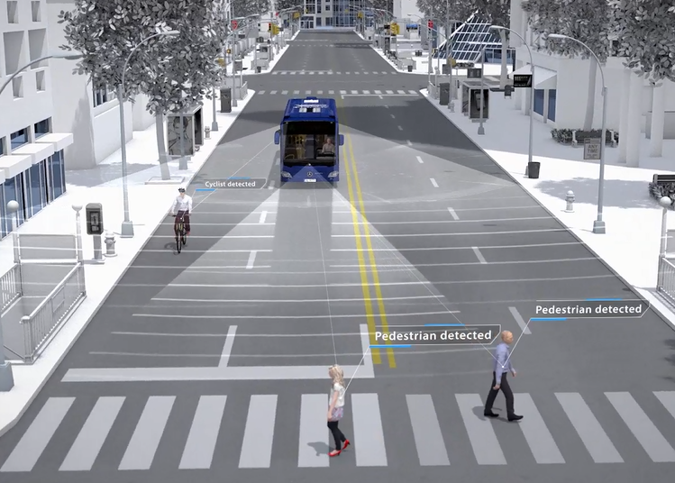
Shield+ Smart Angle Detection
Notes:
Replace with new Shield+ Video

Slide 12
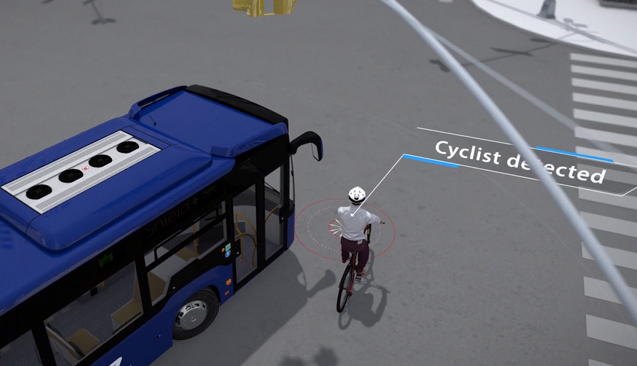
Shield+ Smart Artificial Vision Technology

Slide 13
Delivery of Warnings
Notes:
Orange light is pedestrian in danger zone, red is imminent collision.

Slide 14
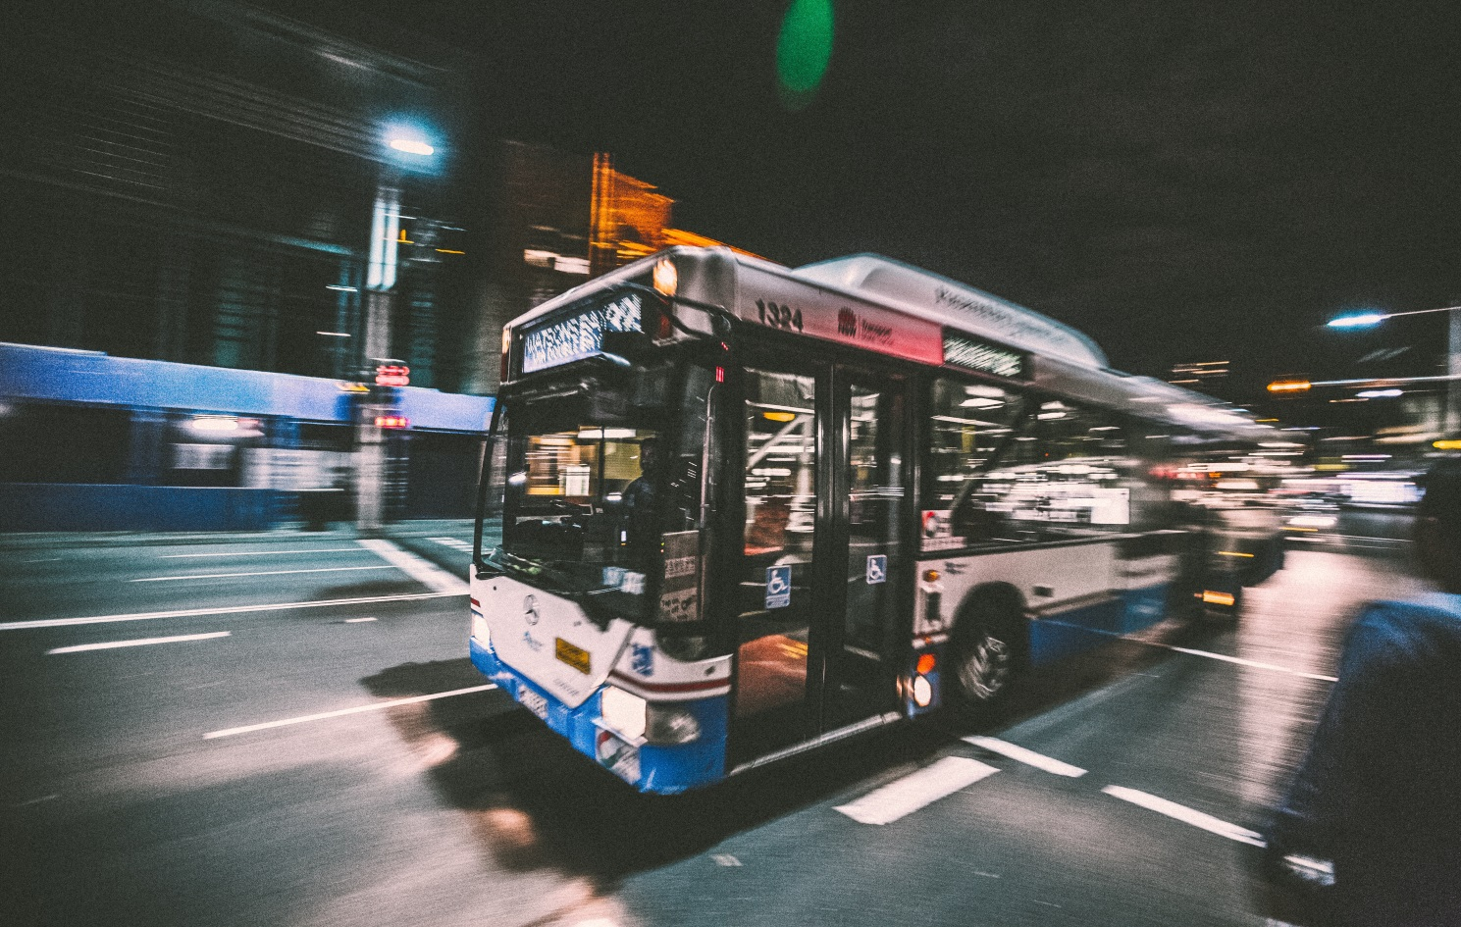
External Alerts

Slide 15
Smart (Safe) Cities
Our Vision. Your Safety ™

Slide 16
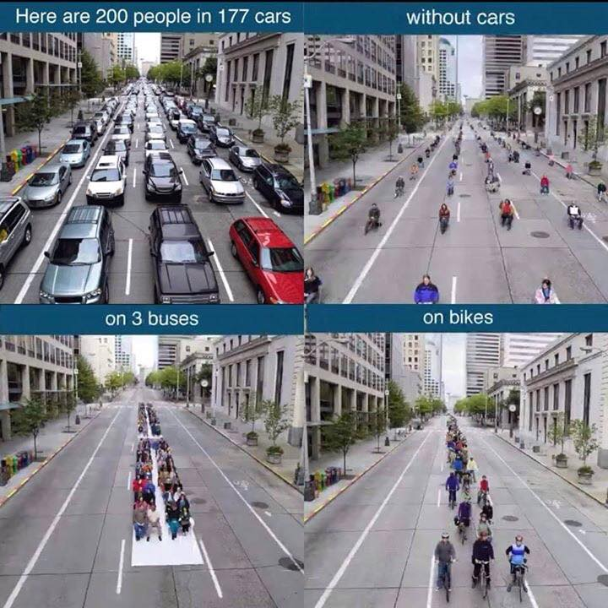
Smart Mobility = Safe Mixed-Modal Transportation
Public Transportation
Safe Cycling
Safe Pedestrian
Infrastructure

Slide 17
Shield+ Mapping Solution

Slide 18
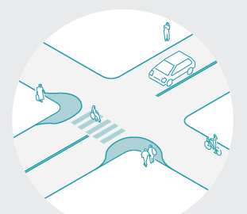
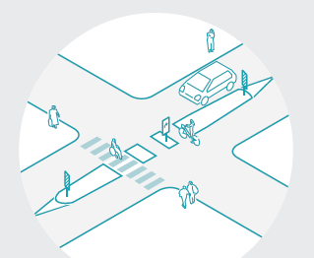
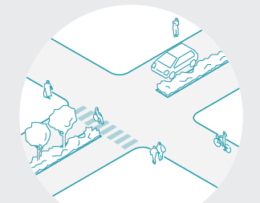
We know how to make streets, bike lanes and intersections safer.
Curb Extensions
Medians & Cyclist
Cut-Throughs
Landscape Islands

Slide 19
Shield+ provides
Constant update of near crashes with pedestrians and cyclists
Exact geolocation of incidents
Real-time big data on dangerous intersections

Slide 20
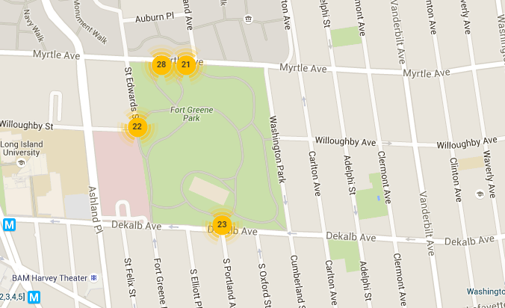
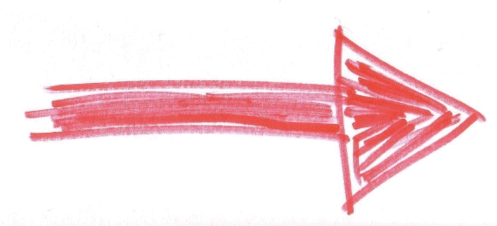
4 Hot Spots Detected around Fort Greene Park (Brooklyn, NY)
Notes:
Discuss Fort Greene (pronounced Green as in yarok) Park, Brooklyn: Bike Lanes.

Slide 21
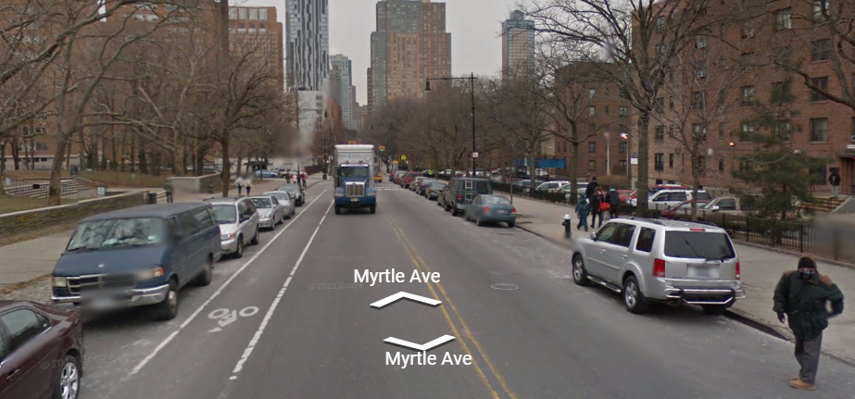
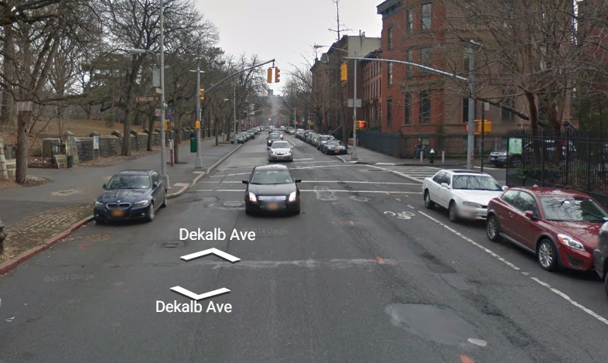
Street View
Unprotected bike lane
Dangerous potholes force cyclists into traffic
Unprotected bike lane
Driver’s open door into bike lane
No protection from traffic
Notes:
No protected bike lanes
Pot-holes and passenger doors cause cyclists to swerve into street

Slide 22
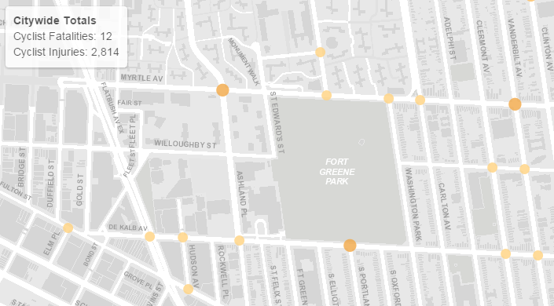
Actual NYC Police Reports, show numerous cyclist injuries along North and South side of Fort Greene Park
Notes:
Point out that the above injuries are ONLY FROM CYCLISTS

Slide 23
Mobileye Shield+:
Assists large vehicle operators prevent collisions with vulnerable road users.
Assists decision makers by providing invaluable real-time big data on dangerous intersections.

Slide 24
Our Vision. Your Safety ™
Thank You
http://www.mobileye.com/smart-cities-challenge/

Slide 25
Phase 1 Application Content
Include
Do Not Include
High level vision of proposed demonstration; framework and initial concepts; tailored to your city
Part 1 Vision Narrative (1 file)
Up to 30 pages of technical content
Cover page, table of contents, and letters of commitment are allowed and are excluded from page limit
Part 2 Forms & Organizational Info (1 file) – No page limit
Very detailed technical approach
Very detailed management approach
Budget information
More than 30 pages of technical content
Videos
Excess marketing materials
Notes:
Application Content: The intent of the Phase 1 application is to provide a high-level summary narrative of your City’s vision of a smart city demonstration. Applications for this Phase 1 shall reflect a high-level vision for the city’s proposed demonstration. A high-level vision need only include the framework and initial concepts of the Applicant’s proposed demonstration. A detailed approach and a detailed budget are not required under this first solicitation. The second follow-on solicitation, Phase 2, will require the Finalists to submit a detailed technical and management approach to implementing the proposed demonstration, as well as a detailed budget.
Applications must include a Part 1 Vision Narrative; and a Part 2 to include Standard Forms and organizational information.
There is a page limitation to the Part 1 Vision Narrative. The limit is 30 pages of technical content, excluding a cover page, table of contents and any letters of commitment you choose to submit. Please do not submit excess materials such as videos or marketing materials.

Slide 26
Smart City Challenge – Phase 1 Application
Part 1: Vision Narrative
Vision Narrative
Vision and city challenges
Alignment with population characteristics
Alignment with the other desired characteristics
Site Map
Alignment with USDOT’s twelve vision elements
Institutional risks and mitigation plans
Team partners, key stakeholders, and public and/or private partnerships
Transportation infrastructure and system features
Data plans
Standards and architecture plan, certification processes
Measurable goals and objectives, and approach to monitor impact
Capacity, executive commitment, infrastructure readiness, and capabilities
Opportunities to leverage Federal resources through cost share, in-kind donations, and partnering
Notes:
Pages 27 through 30 of the Notice of Funding Opportunity spell out in detail the 13 items that you should address in your VISION NARRATIVE. I’ve summarized them here on this slide, but recommend you read those pages in detail to understand what content is required. And keep in mind, the intent of this Phase 1 application is to be a high-level description of your proposed demonstration. Thus the 30 page limit.
Bullet 5 asks you to address how your ideas, how your proposed Smart City demonstration, aligns with our list of “12 VISION ELEMENTS”, contained in the NOFO. The USDOT recognizes that each city has unique attributes, and each city’s proposed demonstration will be tailored to the city’s vision and goals. The NOFO presented our vision elements, without making each item a requirement for award. Rather, the 12 Vision Elements contained in the NOFO provide a framework for you to consider in the development of your city’s proposed demonstration.

Slide 27
Smart City Challenge – Phase 1 Application
Part 2: Forms and Information
Forms
Organizational Information
Standard Form 424
Standard Form 424A
Standard Form 424B
Standard Form LLL
http://www.grants.gov/web/grants/forms/sf-424-family.html#sortby=1
Any exceptions to the anticipated award terms and conditions
Dun and Bradstreet (D&B) Data Universal Numbering System (DUNS) number
Any known conflicts of interest
Audits completed
Contracts terminated
Violations of Federal criminal law
Register in SAM.gov before submitting its application
Notes:
Part 2 of the application includes a set of required Standard Forms, and a set of questions regarding your organization. The forms are available in fillable pdf format on the grants.gov website. NOFO page 31 gives guidance on how to fill out various data fields, but certainly email or call me with any questions on the forms. Note: SF 424A, you may leave BLANK BLOCK 6 through 23, which ask for cost detail. These entries are not applicable on this fixed amount award under Phase 1. They will be required in Phase 2 applications.
Organizational Information: pages 32 and 33 in the NOFO: Identify any exceptions to the award terms and conditions in the NOFO. Note the NOFO contains terms and conditions in Section F, as well as a link to our online list of general grant terms and conditions. Review the terms and advise of any exceptions in your application.
DUNS number and registration in Sam.gov are required to receive an award. The prime applicant must register in sam.gov, which requires a DUNS number. It’s ok if you don’t have it upon application submittal, but note you will not be able to receive an award without an active sam.gov registration. The Sam.gov website has many resources to walk you through the registration process, training videos, user guides, help desk, etc.

Slide 28
Beyond Traffic: The Smart City Challenge
For More Information

Slide 29
Beyond Traffic: The Smart City Challenge
Past Information Sessions
Data, Architecture, and Standards (Virtual) 12/16/2015 (1:00 to 2:30 pm EST)
Connected Vehicles and Automation (Virtual) 12/17/2015 (1:00 to 2:30 pm EST)
Sharing Economy, User-Focused Mobility, and Accessible Transportation (Virtual) 12/18/2015 (1:00 to 2:30 pm EST)
The Smart City Challenge Application and Selection Process (Virtual) 12/21/2015 (1:00 to 2:00 pm EST)
Urban Freight Delivery and Logistics (Virtual) 1/6/2016 (11:30 am to 1:00 pm EST)
To access presentations and recordings, visit: https://www.transportation.gov/smartcity/infosessions

Slide 30
Beyond Traffic: The Smart City Challenge
Information Sessions
Link Between Beyond Traffic and The Smart City Challenge (Virtual) 1/14/2016 (1:30 to 2:30 pm EST)
Smart City Challenge Application Homestretch – An Open Q&A Session (Virtual) 1/19/2016 (12:00 to 1:00 pm EST)
Understanding Dedicated Short Range Communications (DSRC) (Virtual) 1/21/2016 (12:00 to 1:00 pm EST)
For More Information and RSVP Information on upcoming webinars, visit: https://www.transportation.gov/smartcity/infosessions

Slide 31
Beyond Traffic: The Smart City Challenge
For More Information and Questions
Department of Transportation
https://www.transportation.gov/
Smart City Challenge
www.transportation.gov/smartcity
Questions?
SmartCityChallenge@dot.gov
Notes:
Brian Cronin

