Slide 1
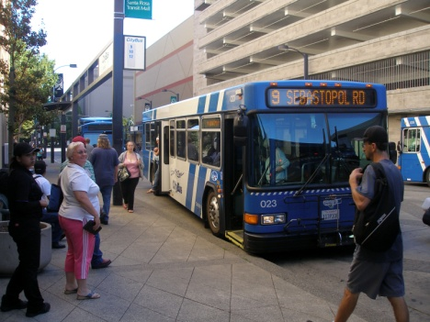
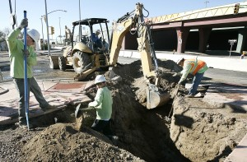
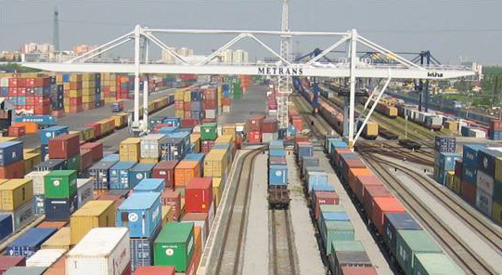
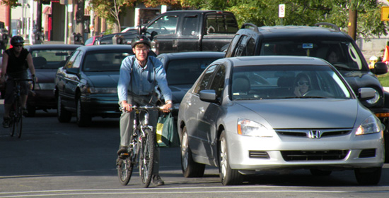
Traffic Congestion
and
NHS Performance
A Listening Session on MAP-21 Performance Measures
October 25, 2012 • Virtual Town Hall Meeting
U.S. Department of Transportation

Slide 2
Meeting Schedule and Logistics
Please take a moment to respond to the chat poll by clicking the “pie chart” icon above the video screen.

Slide 3
Meeting Schedule and Logistics
Introduction and Background – 20 minutes
Listening Session on 5 Topics – 100 minutes
Participant Input
Webcast Chat – 800 registered attendees
Once prompted, submit input by clicking on the “chat bubble” icon above the video display.
Phone Lines – 50 connections
Muted until Listening Session discussion begins
Meeting Room – ~50 attendees

Slide 4
Meeting Objective
Discuss, listen, and learn how ideas can be implemented.
WHY?
HOW?
Notes:
We have been engaged with stakeholders through a variety of means to listen to why particular measures or aspects of measures should be considered as the approach to assess NHS Performance and Traffic Congestion. These discussions have been very helpful as it has provided us a better understanding of stakeholder and partner agency needs.
Our objective today is to “move from why to how” so that we can better understand how these ideas can be implemented and to discuss some of the challenges that may present risks to successful implementation.

Slide 5
MAP-21 – Managing Performance
Establishment of Goals
Establishing Measures
Setting Targets
Assessing Performance
Developing Plans
Producing Reports
Learn More
www.fhwa.dot.gov/map21 09/11/2012 Webinar Recording
Notes:
MAP-21 establishes a comprehensive approach to manage performance at a national level through the federal-aid highway, public transportation, and highway safety programs. Today I am going to provide you a quick overview of the performance elements contained within the federal-aid highway requirements of MAP-21 as we will be focusing on congestion and system performance during this event.
MAP-21 established 7 national goals in which to focus to federal-aid program: safety, infrastructure cond, congestion reduction, system reliability, freight movement & economic vitality, environmental sustainability, and reduced project delivery delays
The law requires USDOT to establish, with input, performance measures through a rule within 18 months. In this rule measures need to be established for States and MPOs to use to carry out performance elements of several programs (NHPP, HSIP, CMAQ, Freight Policy). The rule will establish data standards necessary to ensure for consistency in the collection and reporting of the measure across the country.
After the measures are established, States will have 1 year to set performance targets and MPOs, where applicable, will have 180 days to set targets after the State sets their targets.
Both the Statewide and metro trans improvement programs will need to document the anticipated effect of the program investments toward achieving the performance targets. Planning process will need to integrate the strategies in the AMP, SHSP and CMAQ performance plans.
States will report to USDOT on their progress towards the achievement of targets 4 yrs after the DOE and every 2 yrs thereafter.
Both the NHPP and HSIP programs require States to make significant progress towards the achievement of targets. States that do not make sufficient progress will be required to document the actions they will take to improve and, in some cases, be required to set aside program funding to carry out these actions.
In addition, the NHPP requires a minimum condition level for both Interstate pavements and NHS bridges and the HSIP program includes special rules for fatalities on high risk rural roads and fatalities and serious injuries for older drivers.

Slide 6
Measures for Today’s Discussion
Performance
… to carry out the National Highway Performance Program the Secretary shall establish measures to assess…
the Performance of the NHS (excluding the Interstate)
Congestion
… to carry out the Congestion Mitigation and Air Quality Improvement Program the Secretary shall establish measures to assess…
Traffic Congestion
Notes:
These are the two areas in which measures need to be established that we will be discussing today. I have provided some excerpts of the actual MAP-21 language to provide you a better understanding of the need for these measures.

Slide 7
Evaluation of Candidate Measures
Is it Appropriate?
Will the measure support national programs?
Are We Ready?
Can data be in place to support the desired measure?
6 Factors
6 Factors
Notes:
Following a consistent approach to evaluate candidate measures that consider both if the measure can meet the needs outlined in MAP-21 and if everything is in place to develop a reliable a credible measure.
Some areas in which we need to develop measures were more defined by Congress in MAP-21 (e.g. safety measures), however, in the case of the NHS Performance and Traffic Congestion areas this wasn’t as much the case.
Approach used to assess candidate measures in a consistent and structured manner.

Slide 8
Is The Measure Appropriate?
Focused
Is the measure focused on an area of national interest?
Collaborated
Has the measure been developed in partnership with stakeholders?
Maintainable
Is the measure maintainable to accommodate changes?
Impactful
Track-able
Feasible
Can the measure be used to support investment decisions, policy making and target setting?
Can the measure be used to analyze performance trends?
Has the feasibility & practicality to collect, store, & report data for the measure been considered?

Slide 9
Are We Ready to Use the Measure?
Who Provides the Data?
Federal Agency
State/Local Agency
Data Quality
Timeliness
Consistency
Third Party
Completeness
Accuracy
Accessibility
Data Integration
Collection
Storage
Access
Notes:
Scenario 1 – An entity other than FHWA or a State DOT will collect and process data. States and FHWA will have access to this information (i.e. freight travel data) but will not “own” the data.
Scenario 2 – States/FLMAs will collect data conforming to a national standard and will report data to FHWA. FHWA will manage this data in a national repository that will be accessible to FHWA and States/FLMAs. States/FLMAs will maintain their own data source of this information that could include more detail (i.e. the National Bridge Inventory data).
Scenario 3 – FHWA will collect data at a national level and will provide data to States/FLMAs for their use. FHWA will manage this data in a national repository and States/FLMA will have access to this information (i.e. the Road and Bridge inventory/condition data for the Park Roads and Parkways Program of the National Park Service).
Timeliness – The data should be updated as required to produce valid results. Each office who manages data (data owner) should establish respective data collection frequency and submittal deadline(s).
Consistency – The same data elements should be collected over time, and subsequent data should have adequate continuity with the preceding (or historical data). If it becomes necessary to change or modify a data element or to change the values of data elements, this should be clearly documented, coordinated and communicated.
Completeness – The data should be adequately complete for performance assessment and reporting. Each data owner should clearly define completeness of data sufficient to assess and report the performance measure. Any necessary metadata (data about data) should also be considered.
Accuracy – Collection of data should be in accordance with established data standards and should employ acceptable data quality controls and quality assurance processes. Each program office should develop data standard(s) and acceptance criteria.
Accessibility (Section 5.1) – Once the updated data is accepted, the data should be readily and easily accessible internally to FHWA and externally to States/FLMAs.
Data Integration – In order to better support policies and programs at the national level, the location information (spatial component) of the data must be linked (or reasonably be able to translate) to other data through common identifiers such as a location reference point. Integration should also be supported between State and local systems.

Slide 10
Online Dialogue Summary
Visited 8,165 times
228 ideas, 293 comments, 3,695 votes
8 Campaigns
54%
54%

Slide 11
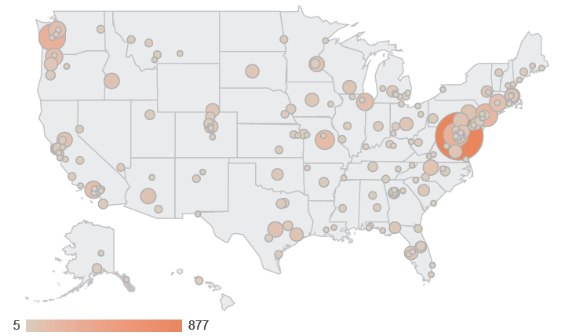
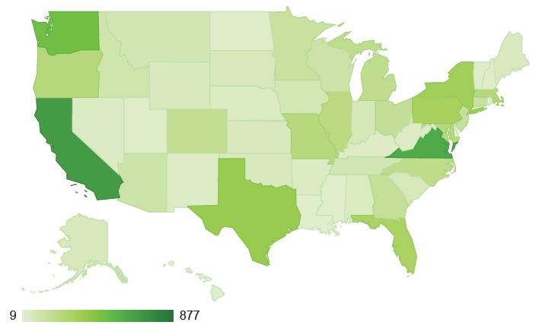
Online Participation
Federal
State
Local/Regional
Organization
University
Individual
Unknown

Slide 12
Who Contributed Ideas?
228
Ideas
The National Online Dialogue is not a statistical study. All numbers are unofficial and presented for discussion purposes only

Slide 13
Who Commented on Ideas?
293
Comments
The National Online Dialogue is not a statistical study. All numbers are unofficial and presented for discussion purposes only

Slide 14
Who Rated the Ideas?
3,695
Ratings
The National Online Dialogue is not a statistical study. All numbers are unofficial and presented for discussion purposes only

Slide 15
Logistics for Phone Participants
Use a hard phone line for best quality.
Mute the Webcast audio to prevent feedback once we open the phone lines.
If using a speaker phone, the person speaking should be close to the phone’s microphone and speak directly into the microphone.
Use *6 to mute your phone when not speaking and *6 to unmute your phone (or use your mute button on your phone).

Slide 16
Logistics for Chat Room Participants
When Prompted by the facilitator, submit your comments to the chat room by selecting the “chat bubble” icon above the video display
Be concise and clear and try to keep text to a minimum.
All comments will be logged and viewable to everyone on the webcast.

Slide 17
Logistics for Mtg Room Participants
Only one person can speak at a time.
Raise your hand and a we will bring the microphone to you.
Be mindful of other’s desires to participate and keep your comments brief, but informative.

Slide 18
Online Discussion Themes
Measuring vehicle and passenger movement
Accounting for the distance and time of trips
Reflecting multi-modal use and operations
Linking trans, land use and economic growth
Cost, availability and timeliness of data
Providing for a scalable measure
Setting appropriate thresholds
Challenges in target setting

Slide 19
Today’s Discussion Topic Areas
Measuring the Movement of People
Incorporating Distance in a Measure
Measuring Movement by Transportation Modes
Providing for a Scalable Measure
One Size Does Not Fit All

Slide 20
Measuring the Movement of People
Base Congestion and System Performance measures on the movement of people vs. only the movement of vehicles
What is the current state-of-practice to measure the movement of people? Is this adequate enough to provide for readily available, current, and affordable data?
How granular (segment, corridor, system) does the data need to be for performance monitoring and performance reporting? How often does the data need to be collected and reported?
What opportunities may exist to improve measurements in this area? Can we seize these opportunities within the next 5 yrs?

Slide 21
Incorporating Distance in a Measure
Account for the distance traveled to move from point A to B in the Congestion and System Performance measures.
If two trips to the same destination take the same amount of time but cover different distances travelled should this difference be reflected in a measure? If so, how can this be done?
How can distance be accounted for in a measure?
What are the data sources? Are they readily available and accessible?

Slide 22
Measuring Movement by Transportation Modes
Account for all modes of travel available to arrive at a destination in the Congestion measure.
How can the multiple modes of travel be considered in a measurement of travel for a trip with a defined origin and destination?
Should multi modal aspects be considered only in metropolitan areas?
What is the current state-of-practice to measure movements on different modes of transportation? Is this adequate enough to provide for readily available, current, and affordable data?
How detailed does the data need to be to support performance reporting? How often does the data need to be collected and reported?
What opportunities may exist to improve measurements in this area? Can we seize these opportunities within the next 5 yrs?

Slide 23
Providing for a Scalable Measure
Measures of Congestion and System Performance should be scalable to provide a view of roadway segment/corridor performance and a view of overall system performance.
What approaches can be considered that would allow detailed level data to be rolled up effectively to represent a system?
Do all roadway segments need to be measured? If not, which roadways should be measured?
How are corridors/segments defined? How are trips defined? As a corridor, a pair of origin/destinations, other?

Slide 24
One Size Does Not Fit All
Performance measures will need to reflect the differences in travel expectations and travel patterns across the country and will need to be developed so they can be used for different roadway systems and population areas.
A delay measure could be defined using different “delay thresholds” based on target speeds. These thresholds could be set by States and MPOs based on a variety of factors. How can this be accomplished in a region by region in a viable manner and consistent manner?
How can “desired” travel time be defined in a manner that allows for local flexibility so that it can be applied to different geographic areas?
How can the number of measures be minimized while still providing flexibility in its application to different systems and areas?

Slide 25
Thank You!
More Information on MAP-21
DOT website - http://www.dot.gov/map21
FHWA website – http://www.fhwa.dot.gov/map21
FTA website – http://www.fta.dot.gov/map21
Email Comments/Input
PerformanceMeasuresRulemaking@dot.gov

