Slide 1
Webinar for Notice of Funding Opportunity State and Local Government Data Analysis Tools to Support Policy and Decision Making for Roadway Safety
Office of the Under Secretary of Transportation for Policy
Office of the Secretary of Transportation
U.S. Department of Transportation

Slide 2
Webinar Agenda
Overview of the Safety Data Initiative
Broad Overview of the Solicitation
Descriptions of SDI Beta Safety Tools or Category A tools
Questions & Answers

Slide 3
Webinar
Jason Broehm Transportation Policy Analyst Office of the Secretary of Transportation
Paul Teicher Senior Policy Analyst Office of the Secretary of Transportation
Allison Caloggero, Moderator
Staff Assistant, the Volpe National Transportation Systems Center

Slide 4
Overview of the Safety Data Initiative

Slide 5
Systemic Safety Approach
Identify risks that contribute to fatalities and serious injuries
Use interventions and countermeasures to mitigate or eliminate identified safety risks

Slide 6
The Problem
We need better data analysis tools to understand what is happening on our roadways

Slide 7
Safety Data Initiative
Launched in 2018
Surface transportation focused
Intended to build upon and enhance current safety efforts related to data, analysis, and policymaking
Cross cutting, collaborative effort:
Office of the Secretary of Transportation (OST)
Policy Office
Office of the Chief Information Officer
Bureau of Transportation Statistics
Federal Highway Administration (FHWA)
National Highway Traffic Safety Administration (NHTSA)
Federal Motor Carrier Safety Administration (FMCSA)
Other Operating Administrations (OAs)

Slide 8
Focus Areas
Integrate existing DOT data and new “big data” sources
Use advanced data analytics to provide predictive insights into safety risks
Create data visualizations to help policymakers arrive at solutions

Slide 9
Solicitation Overview

Slide 10
General Background
OST one-time funding opportunity on Grants.Gov
https://www.grants.gov/web/grants/view-opportunity.html?oppId=322472
OST to partner with state and local governments, along with their supporting partners, through cooperative agreements
Partnerships will develop, refine, and implement safety tools as use cases that address a specific roadway safety problem through funding for technical assistance and peer exchanges

Slide 11
USDOT Goals
Improve the capacity of state and local governments to use tools and information for safety policy and decision making
Convert data into safety tools useful to practitioners
Accelerate the safety community’s ability to derive more value out of data and apply information in a meaningful way

Slide 12
Basic Questions to Answer
What is the safety problem?
What are the knowledge gaps?
How will the tool address the knowledge gap(s) and safety problem(s)?
*Hot tip for project narratives required in Section D – Application and Submission Information*

Slide 13
Funding
Up to $3 million, subject to USDOT discretion
Anticipate 6-12 awards between $250,000 and $500,000
Cost sharing or matching is not required, but favorably considered
In-kind contributions are encouraged

Slide 14
Eligibility
Eligible Primary Applicant
States governments
Local governments
Regional governments / MPOs
Tribal governments
Political subdivisions of a State or local government
Eligible Partners, but NOT Eligible to be Primary Applicants
Private sector
Both public and private research/academic institutions
Transportation stakeholders
National organizations
Governments eligible to be primary applicants can also be partners

Slide 15
Deliverables
Primary Deliverables
Project Management Plan
Analytic Design Plan
Safety Tool
Report
Documentation and End Products
Peer Exchanges
Pay for Performance Model
Funding will be provided after completing the primary deliverables
50% after completing the management and analytic design plans
25% after completing the safety tool
25% for the report, documentation, and end products
Travel will be reimbursed

Slide 16
Evaluation Criteria
Technical Merit
*hot tip: the period of performance is relatively short at one year*
Potential for Use
*hot tip: describe who is going to use the safety tool, and the implementation strategy*
Potential for Replication
*hot tip: be clear about what the recipient delivers to USDOT at the end*
Diversity of Recipients
*hot tip: adequately describe who you are in the application*
Partnerships

Slide 17
Timeline
Webinar recording will be online approximately one week after the date of the webinar on the SDI website
Questions Due: December 10th 2019 at 3pm ET. Send question(s) to usdotsafetydatainitiative@dot.gov with Subject Line “Question for SDI NOFO”
Applications Due: January 17th 2020 at 3pm ET
Hot tip: *MUST SUBMIT APPLICATION to grants.gov under solicitation DOT-OSTP-SDI-2019-002*
https://www.grants.gov/web/grants/view-opportunity.html?oppId=322472
Anticipated Awards: March to April of 2020

Slide 18
Optional Data Science and Analytic Services
Need identified to provide some applicants access to services to support data science and analytic activities
Optional opportunity to leverage Federal data science and analytic resources: the Volpe National Transportation Systems Center
No benefit or penalty in the application review processes to use the Volpe Center versus other in-house or contracted data science and analytic services elsewhere

Slide 19
Volpe Center: Data Science Services
Applicants have the option to use technical support from Volpe for efficient access to data science services, including:
Data cleaning and processing: prepare datasets for integration, analysis, and visualization, generate aggregated variables for statistical analysis
Data integration: link spatial datasets, crash data, or other Federal datasets, merge with road networks, integrate into new or existing safety tools
Develop analytical methods and big data pipelines using cloud services
Statistical modeling using traditional or machine learning approaches: crash models, risk models
Data visualization and Tableau dashboards: tools to identify patterns in integrated data, visualize differences over time, display statistical model results
Refer to the SDI NOFO for more information about how to work with Volpe

Slide 20
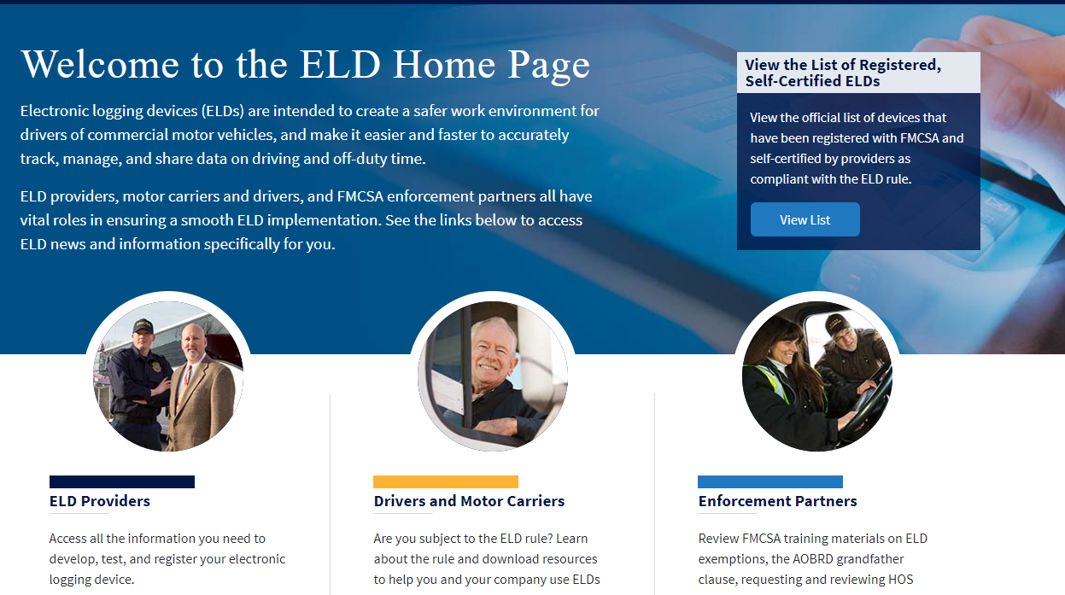
Volpe Data Science Services: Examples
Waze pilot projects (part of the SDI Beta tools)
Addressing Driver Behavior to Improve Safety
Video processing tool for naturalistic driving data: can detect and map work zone features with over 90 percent accuracy across the video data set
Use machine learning and commercial-grade CPUs to process a one-hour video in 30 seconds, compared to three to four hours for manual coding
Improving Motor Carrier Safety through State-of-the-Art Technology
Developed technology for transmitting ELD data and software application
Designed communication and outreach materials, including program website
Notes:
Novel data analysis techniques are transforming mobility in the U.S. and around the world. This is how the U.S. DOT Volpe Center is applying its unique capabilities across the data spectrum—modeling and visualization, machine learning, modernization, and analysis and collection—to inform decision making and improve the safety and efficiency of multimodal transportation systems (https://www.volpe.dot.gov/sites/volpe.dot.gov/files/docs/our-work/63301/advancingdatadrivendecisionmakingintransportation.pdf).
electronic logging devices (ELD)

Slide 21
Anticipated Work Areas
OST intends to fund projects in two categories:
Further develop and refine SDI Beta Safety Tools; or
Refine and develop other, specific safety tools identified in an application submission
A
B

Slide 22
Category B: Refine or Develop Other Tools
Refine and develop other, specific safety tools identified by the applicant
Initial basic research on the safety problem has already been explored by the applicant using data and other information

Slide 23
Category A: Further Develop Tools
On-the-ground validation of SDI Beta Safety Tools
Applicants can choose from a list of six (6) SDI Beta Safety Tools to further develop and refine
Continue the projects as a derivative work product that is modified and expanded upon to fit the information needs identified in the application as an applied use case
Approaches may include new data sources, modified analytic approach, revised visualization, derivative analysis, etc.

Slide 24
SDI Beta Safety Tools Developed
University of Central Florida’s Real Time Crash Risk Visualization
Ford’s Safety Insights
Safety Applications of Waze Data
2-Step Model
Pedestrian Fatality Risk Map
FARS Visualizations

Slide 25
Pedestrian Fatality Risk Map
Risk model that quantifies pedestrian fatality risk at the U.S. Census tract level
Uses integrated data: NHTSA, FHWA, EPA, and Census data such as fatality crashes, traffic volumes, built environment and socio-demographic characteristics
Beta decision support tool to assist with risk diagnostics to identify locations that merit further review (and potentially interventions)
Published in Accident Analysis & Prevention but not “tested in the wild”
Derivative product could use new crash data sources and State/local data

Slide 26
FARS Visualizations
Converted data files into curated data visualization products in Tableau
Able to identify trends and patterns, and compare and contract various attributes
Two visualizations of the Fatality Analysis Reporting System (FARS) data focus on speeding and pedestrian safety
Derivative product could use a similar concept/framework, and use new data sources, in order to help with decision making

Slide 27
Questions & Answers

Slide 28
Further Information and Questions
www.transportation.gov/SafetyDataInitiative
USDOTSafetyDataInitiative@dot.gov

Slide 29
Appendix
Additional background and supplementary materials

Slide 30
SDI Lessons Learned to Date
State and local government capabilities, needs, and challenges are different. Different approaches are necessary to further the use of safety data for policy and decision making.
Some state and local governments could benefit from more basic, fundamental analytic tools that are easy to use instead of sophisticated but complex products. There is also value in activities such as quality integrated datasets and compelling visualizations.
State and local governments may have the data, but not the analytic capacity. Some may have data but they are unintegrated, or the data quality is not robust.
Higher capacity state and local governments can drive innovation and execute promising practices that could be replicated elsewhere.

Slide 31
How We Are Thinking About Success
Provide benefits to the jurisdiction where it is being applied
Provide blueprints to scale and replicate the tools elsewhere
Documenting best practices and lessons learned in implementation
Enhance shared learning through peer exchanges

