Slide 1
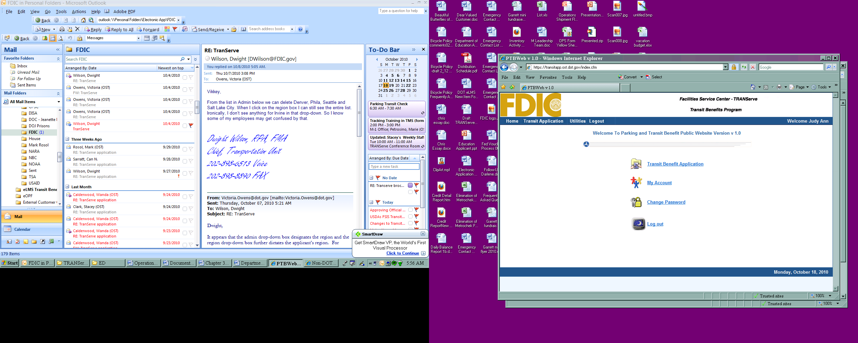
TRANSIT BENEFIT
KNOWLEDGE CHECK
Presented By:
2010

Slide 2
Training Objectives
Clarify transit benefit requirements
Emphasize internal controls in place to minimize fraud and abuse
Address ramifications of non-compliance
Provide real-life scenarios to enhance employee understanding
Educate participants to their roles and responsibilities

Slide 3
Topics
Program Overview
  Background and Objectives
  Legal Implications
Understanding the Certification Statement
Scenarios

Slide 4

Background
Established in 1991, as a Federal Transit Administration pilot program
Clean Air Initiatives Act in 1993
Federal Workforce Transportation Fringe Benefit – EO 13150 April 21, 2000

Slide 5
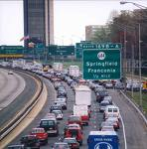
Program Objectives
Air Pollution Reduction
Reduce Traffic Congestion

Slide 6
Legal Implications
Tax Evasion & Fraud
Employees who misuse transit subsidies will be subject to appropriate administrative action including discipline and disqualification for future Transit Benefits. Disciplinary penalties could range from a letter of admonishment to removal from Federal service depending on the severity of the abuse.

Slide 7
Knowledge Check
The Transit Benefit Program objective is to:
Increase compensation of federal employees up to the maximum statutory limit.
Provide incentive to federal employees to use public transportation to reduce air pollution and traffic congestion.
Reward the employees for their hard work.

Slide 8
The Answer
The correct answer is B.
The Federal Workforce Transportation Fringe Benefit Program under Executive Order 13150 was put in place to reduce air pollution and traffic congestion.

Slide 9
Knowledge Check
If I misuse my transit benefit, such as selling my benefit or over estimating my need for the benefit, I could be removed from service to the federal government.
 TRUE
 FALSE

Slide 10
The Answer
The correct answer is TRUE.
Disciplinary penalties could range from a letter of admonishment to removal from Federal service depending on the severity of the abuse.

Slide 11
Certification Required
  Anyone who signs up for transit benefits through the Federal Deposit Insurance Corporation must certify that certain conditions are true. The following slides describe these conditions.

Slide 12
What does certification mean?
“To formally and legally attest a specific statement to be true”

Slide 13
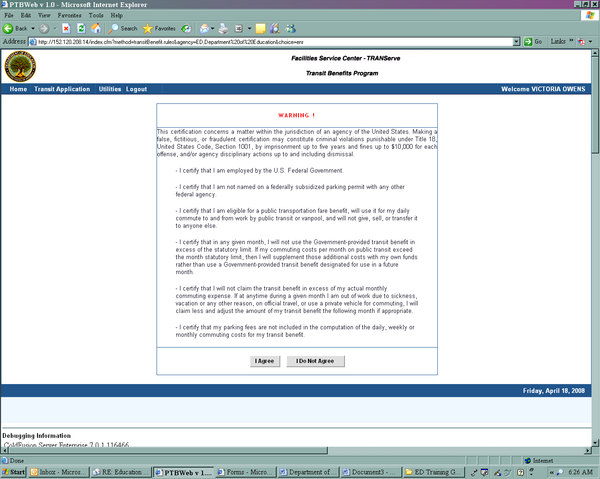
Certification Statement

Slide 14
Certification
What did I just agree to?
I am employed by the Federal government
I am eligible for a public transportation fare benefit
I will only use the transit benefit for my daily commute to and from work
I will not give, sell or transfer my transit benefit to anyone else
I will not use the Government-provided transit benefit in excess of the statutory limit

Slide 15
Certification Part I
“I certify that I am employed by the U. S. Federal Deposit Insurance Corporation and not named on a federally subsidized parking permit with the Federal Deposit Insurance Corporation or any other federal agency.”
This means:
You do not have federally subsidized parking
You are not listed on any federal parking pass
You do not park your personal/leased vehicle at a government parking lot or garage

Slide 16
Certification Part II
“I certify that I am eligible for a public transportation fare benefit, will use it for my daily commute to and from work, and will not transfer it to anyone else.”
This means:
You are qualified to receive the transit benefits
You use mass transportation to/and from work
You will not give or sell your subsidy benefit to anyone

Slide 17
Certification Part III
“I certify that in any given month, I will not use the Government provided transit benefit in excess of the statutory limit.”
This means:
You will not use more than your monthly estimated commuting cost
After you use your transit benefit, you agree to pay additional cost, out of pocket

Slide 18
Knowledge Check
Joe needed to drive to work to attend a late meeting and signed up to use temporary parking. His transit benefit is $40 per month. He does not adjust his benefits the following month. Joe was correct to do this.
 TRUE
 FALSE

Slide 19
The Answer
The correct answer is FALSE.
Joe should have subtracted the amount that he did not use the following month. In this case, he did not use $2 since he drove to work one day.

Slide 20
Knowledge Check
Sharon has joined a carpool after commuting via train for 5 years. She has been receiving a transit benefit of $115 per month for her commute. She has decided to sell her benefit at a 10% discount to her best friend since she believes the benefit belongs to her. Is this the correct course of action for Sharon?
 YES
 NO

Slide 21
The Answer
The correct answer is NO.
It is against the law to sell or give away your transit benefit. If there are unused benefits, they need to be returned.

Slide 22
Knowledge Check
Carmen travels from Virginia to get to work. His commuting costs are $264 per month. He is qualified to receive additional transit benefit since his commute is so costly.
 TRUE
 FALSE

Slide 23
The Answer
The correct answer is FALSE.
The federal government will provide employees up to the maximum subsidy amount for mass transportation commuting cost. The employee must cover the additional amount, “out of pocket”.

Slide 24
Scenarios
The following scenarios were developed from real life situations that you may encounter as a Transit Benefit participant.

Slide 25
Scenario 1
My commuting costs have changed.
What do I do?

Slide 26
Scenario 1
My commuting costs have changed.
All changes to your commuting cost must be updated on your application. To make these changes, follow these steps:
Go to http://transerve.dot.gov
Click on “Other Federal Employees”
Click on “Forms”
Click on “U.S. Federal Deposit Insurance Corporation”
Click on “Transit Benefit Application and Worksheet”
Log-in and click on “Transit Benefit Application”
Click “Change an Existing Account”
Follow the step-by-step directions to update your application

Slide 27
Scenario 2
I drive to work on occasion.
Do I need to adjust my benefit?

Slide 28
Scenario 2
I drive to work on occasion.
When the amount of your transit benefit exceeds the amount you need you must adjust your benefit.
Example #1: You have certified that your estimated commuting cost is $4.00 per day, or $80.00 per month. On two days during the month you request and receive temporary parking, reducing your cost by $8.00. At the next transit benefit distribution you must request $72.00, reducing the amount of media left over.

Slide 29
Scenario 2
I drive to work on occasion.
Example #2: You have certified that your estimated commuting cost is $8.00 per day, or $160.00 per month. You receive a transit benefit of $115.00 per month. On two days during the month you request and receive temporary parking, reducing your transit cost by $16.00. At the next transit benefit distribution you do not need to reduce your transit benefit as your actual commuting cost still exceeds the amount of transit benefit you receive.

Slide 30
Knowledge Check
Vikkey is going on vacation for two weeks in August. Her transit benefit is $100 per month. The correct amount of benefit to claim the month when she returns from vacation is:
$100
$50
$0

Slide 31
The Answer
The correct answer is B.
Since Vikkey is not eligible to receive transit benefits while on leave, she must receive ½ of her $100 benefit or $50.

Slide 32
Scenario 3
I am leaving the agency and have leftover transit benefits.
What can I do?

Slide 33
Scenario 3
I am leaving the agency and have leftover transit benefits.
In both the Headquarters and Regions, return your unused benefits to your Transit Benefit Coordinator.
Excess Smart Benefits must be taken to your Transit Benefit Coordinator in the form of either a money order or personal check.

Slide 34
Scenario 4
I plan to go on extended leave.
Can I still receive my transit benefit?

Slide 35
Scenario 4
I plan to go on extended leave.
If you are out on extended leave (90 days or more), you must withdraw from the program and re-enroll when you return. To do this, follow the steps below:
Go to http://transerve.dot.gov
Click on “Other Federal Employees”
Click on “Forms”
Click on “U.S. Federal Deposit Insurance Corporation”
Click on “Transit Benefit Application and Worksheet”
Log-in and click on “Transit Benefit Application”
Click “Withdraw from the Program”

Slide 36
Knowledge Check
Shunda is leaving FDIC to work for DOJ and she has determined that the correct way to handle her leftover transit benefit is to:
Give her leftover Metrocheks to her sister.
Sell her leftover Metrocheks to her co-worker.
Return her Metrocheks to her Transit Benefit Coordinator.

Slide 37
The Answer
The correct answer is C.
Benefits are not transferable and are not to be sold.
If you are in the Smart Benefit Program or have added Metrocheks onto a SmarTrip® card, those benefits must be returned by submitting a money order to your Point of Contact (POC).

Slide 38
Scenario 5
I have fare media left over from the previous quarter.
What do I do?

Slide 39
Scenario 5
I have fare media left over from the previous quarter.
Take a lesser amount of transit benefit during the next distribution.
Example: You have certified that your estimated commuting cost is $5.00 per day, or $100.00 per month. You are on leave for 10 days. During the next transit benefit distribution, you must request $50.00.

Slide 40
Scenario 6
I plan to telecommute.
Do I need to change my benefit amount?

Slide 41
Scenario 6
I plan to telecommute.
Yes, if your commuting costs changed when your work schedule changed. All changes must be updated on your application. To make these changes, go to:
http://transerve.dot.gov
Click on “Other Federal Employees”
Click on “Forms”
Click on “U.S. Federal Deposit Insurance Corporation”
Click on “Transit Benefit Application and Worksheet”
Log-in and click on “Transit Benefit Application”
Click “Change an Existing Account”
Follow the step-by-step directions to update your application

Slide 42
Knowledge Check
Martha has come to an agreement with HR and her supervisor to adjust her work week in the office to 3 days per week and will telecommute 2 days per week indefinitely. She currently receives $25 per week in transit benefits. The correct course of action to take based on this change is to
Thank her supervisors’ for his/her understanding.
Continue claiming her transit benefit without change.
Change her transit benefit to $15 per week or $60 per month.

Slide 43
The Answer
The correct answer is C.
You must change your benefits if your transit requirements change.

Slide 44
Scenario 7
What if my fare media is lost, stolen or damaged?
Who do I contact?

Slide 45
Scenario 7
What if my fare media is lost, stolen or damaged?
Once the fare media is distributed to you, you are responsible for its safekeeping. Lost, stolen or damaged fare media will not be replaced by the Department. In the NCR, damaged fare media may be replaced by taking it to a Metro Sales Office. (www.wmata.com)
In the Regions, contact your Point of Contact (POC).

Slide 46
Scenario 8
I didn’t use all my benefit.
Can I give it to a co-worker?

Slide 47
Scenario 8
I didn’t use all my benefit.
No. Your transit benefit belongs to you; and no one else. Did you know it’s against the rules (and the law) to sell or give your vouchers to someone else? The program was designed to assist employees with public transportation costs in an effort to cut-down air pollution and relieve traffic congestion. The IRS code states that this is a tax-free benefit. http://www.irs.gov/pub/irs-tege/fringe_benefit_fslg.pdf

Slide 48
Knowledge Check
Jose` has a damaged fare card. The Transit Benefit Office will replace this card.
 TRUE
 FALSE

Slide 49
The Answer
The correct answer is FALSE
Once the fare media is distributed and becomes damaged, it is your responsibility to have it replaced by the transit authority.

Slide 50
Scenario 9
There were 2 “Code Red” days during the last month and bus transportation was free.
Do I need to adjust my benefit?

Slide 51
Scenario 9
There were 2 “Code Red” days during the last month and bus transportation was free.
Any time the amount of your transit benefit exceeds the amount you need, you must adjust your benefit.

Slide 52
Scenario 10
I have commuting costs that exceed the maximum subsidy amount.
What do I do?

Slide 53
Scenario 10
I have commuting costs that exceed the maximum subsidy amount.
If your costs exceed the maximum benefit, you are required to supplement additional costs.
The IRS set the amount of commuting costs to be subsidized to federal employees and the Department cannot provide an amount greater than the maximum to their employees.

Slide 54
Knowledge Check
Phil takes the Metro bus to work and receives $30 per month in transit benefits. It is August and one day has been declared a Code Red day. In September Phil should:
Change the transit benefit to reflect the day he rode free .
Be happy that the weather has cooled down.
Walk to work.

Slide 55
The Answer
The correct answer is A.
If your trip to work does not cost you anything, you should not claim it as a benefit.

Slide 56
Knowledge Check
Marie is going out on maternity leave on November 1 and will be home from work until February 1. The correct way to change her transit benefit is to notify her supervisor.
 TRUE
 FALSE

Slide 57
The Answer
The correct answer is FALSE. If you are out on extended leave (90 days or more), you must withdraw from the program and re-enroll when you return. To do this, follow the steps below:
Go to http://transerve.dot.gov
Click on “Other Federal Employees”
Click on “Forms”
Click on “U.S. Federal Deposit Insurance Corporation”
Click on “Transit Benefit Application and Worksheet”
Log-in and click on “Transit Benefit Application”
Click “Withdraw from the Program”

