Slide 1
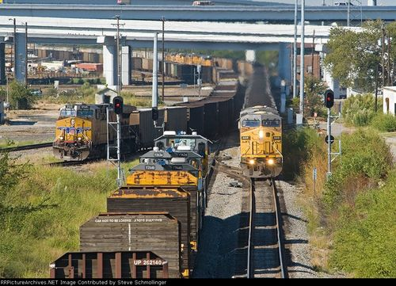
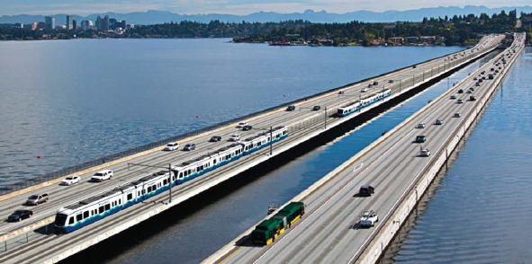
Transportation Investment Generating Economic Recovery
TIGER Overview
John Augustine, Director, Office of Infrastructure Finance and Innovation
Presented by the Office of the Under Secretary of Transportation for Policy
United States Department of Transportation

Slide 2
Multimodal, merit-based discretionary grant program
$500 million available for TIGER 2015
6,100 applications received since 2009
$124 billion requested
342 Awards totaling $4.1 billion

Slide 3
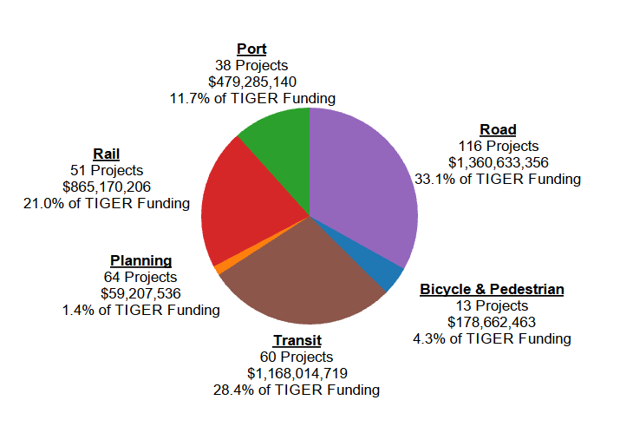
TIGER I-VI Statistics

Slide 4
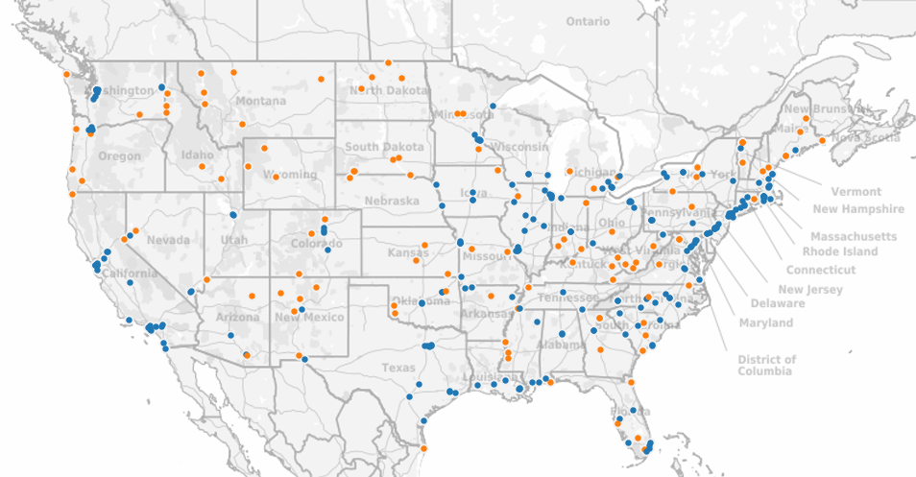
TIGER I-VI Project Locations

Slide 5
How is TIGER different?
Transformative Projects
Providing new services, access, safety enhancements, efficiency gains, revitalization
Leverages Resources
Matching funds from city, state, and private funding sources maximizes scarce resources
Encourages Partnership
Partnering enables innovative projects

Slide 6
How is TIGER different? cont.
Innovative, Multi-modal Projects
Funds projects that would otherwise have no other source of funding
Non-traditional grantees
Provides grants to cities, counties, maritime ports, rail projects, MPOs, Tribal lands
Merit-based awards
Competition enhances quality of applications

Slide 7
2015 Notice of Funding Availability
No Planning Grants
Pre-construction activities eligible as part of a viable capital project by June 30, 2017
$10M minimum request for urban projects
20% local match required
$1M minimum request for rural projects
No match required
20% set aside ($100M) for rural projects

Slide 8
2015 Notice of Funding Availability (cont.)
Primary Selection Criteria:
State of Good Repair
Economic Competitiveness
Quality of Life
Environmental Sustainability
Safety
Secondary Selection Criteria:
Partnership and Innovation

Slide 9
2015 Notice of Funding Availability (cont.)
Clearer articulation of Ladders of Opportunity
Improve connections between people and centers of employment, education, and services
Contribute to community revitalization
Pre-Application
REQUIRED for all 2015 TIGER Applications!!!
Helps identify curable deficiencies prior to formal submission deadline
Expedites DOT evaluation of final applications

Slide 10
2015 TIGER Applications
Pre-Application – Instructions and information are available at www.dot.gov/TIGER
Must be submitted before 11:59 PM E.D.T on May 4, 2015.
Final Application – www.Grants.gov
Must be submitted before 11:59 PM E.D.T. on June 5, 2015.

Slide 11
Technical Assistance
USDOT offers technical assistance to help applicants through the TIGER process
Previous TIGER application debriefs
Benefit cost analysis resource guide
Special Topics Webinars
Questions sent to: TIGERGrants@dot.gov
Additional information: http://www.dot.gov/tiger

Slide 12
Lessons Learned Joanna Turner, Executive Director, National Association of Regional Councils
Transportation Investment Generating Economic Recovery
Presented by the Office of the Under Secretary of Transportation for Policy
United States Department of Transportation

Slide 13
Panelists – Successful TIGER Applicants
Secretary Bill Johnson, Secretary of Commerce, State of Florida and CEO of Enterprise Florida — Port of Miami Rail Access
Deputy Mayor Rina Cutler, Transportation and Utilities, City of Philadelphia — Philadelphia Area Pedestrian and Bicycle Network & Wayne Junction Substation Replacement
Dr. Fred Ohene, P.E., Assistant General Manager - Engineering and Planning, Regional Transportation Commission of Southern Nevada — Sahara Avenue BRT project
Wes Dean, P.E., Assistant Chief Engineer, Field Operations, Mississippi Department of Transportation
Keith Metcalf, P.E., Deputy Chief Engineer, Washington Department of Transportation — US 395 North Spokane Corridor
Jeff Folsom, P.E., Assistant Bridge Engineer, Maine Department of Transportation — Memorial Bridge and Sarah Mildred Long Bridge

Slide 14
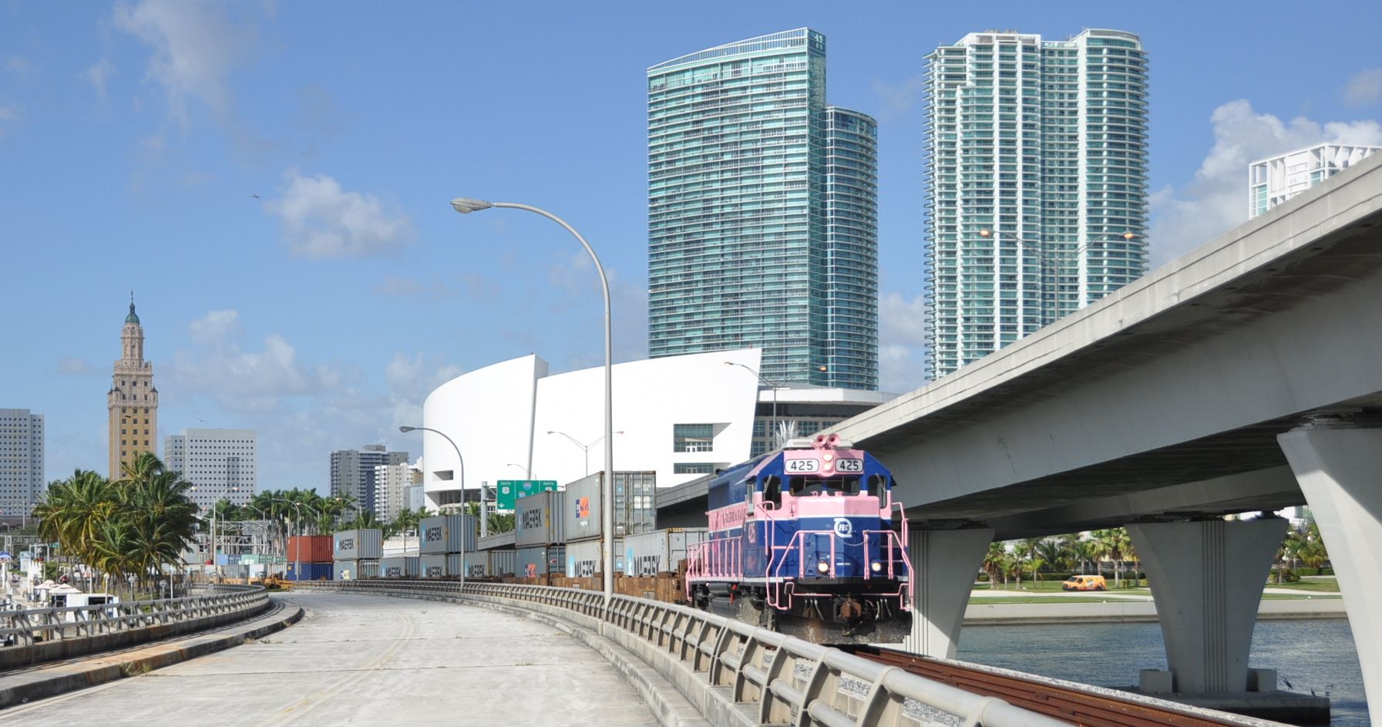
Secretary Bill Johnson Secretary of Commerce, State of Florida and CEO of Enterprise Florida
Project: Port of Miami Rail Access
TIGER Round: 2
TIGER Grant: $22,767,000
“Established intermodal container rail service to the Port of Miami by building an intermodal yard and making necessary rail and bridge improvements."

Slide 15
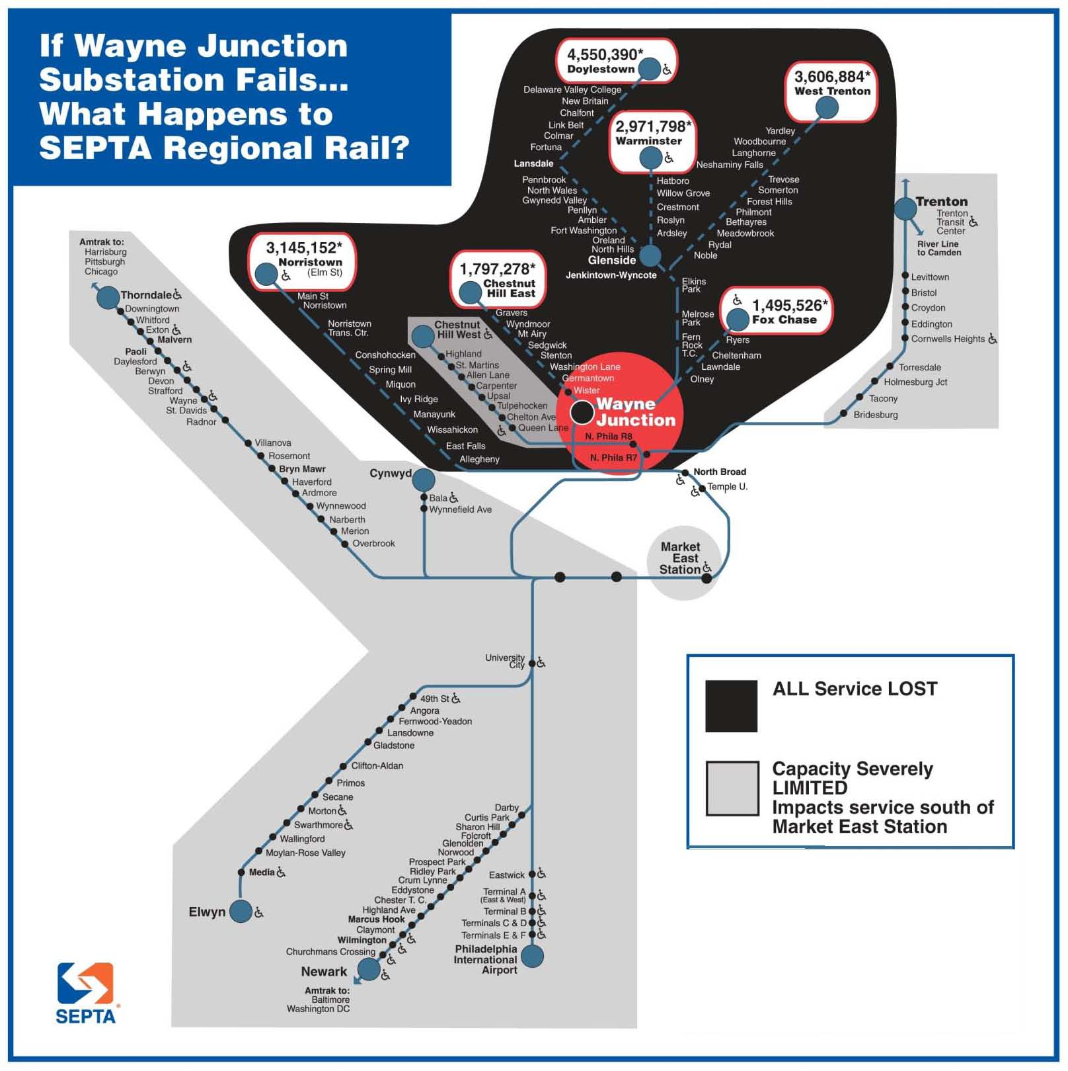
Deputy Mayor Rina Cutler Transportation and Utilities, City of Philadelphia
Project: Philadelphia Area Pedestrian and Bicycle Network & Wayne Junction Substation Replacement
TIGER Round: 1 // 4
TIGER Grant: $23,000,000 // $12,862,699
“Repaired, reconstructed and improved 16.3 miles of pedestrian and bicycle facilities and completed a 128-mile regional network in six counties around Philadelphia and Southern New Jersey.”
“Rebuilt the Wayne Junction Power Substation, which powers much of Southeastern Pennsylvania Transit Authority’s (SEPTA) transit systems.”

Slide 16
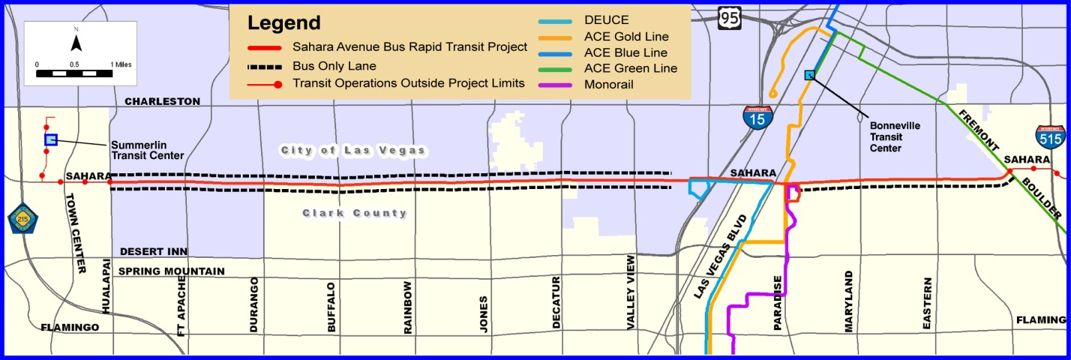
Dr. Fred Ohene P.E., Assistant General Manager - Engineering and Planning, Regional Transportation Commission of Southern Nevada
Project: Sahara Avenue Bus Rapid Transit
TIGER Round: 1
TIGER Grant: $34,400,000
“Improved the efficiency and quality of transit service on the 17-mile road running through the heart of Las Vegas.”

Slide 17
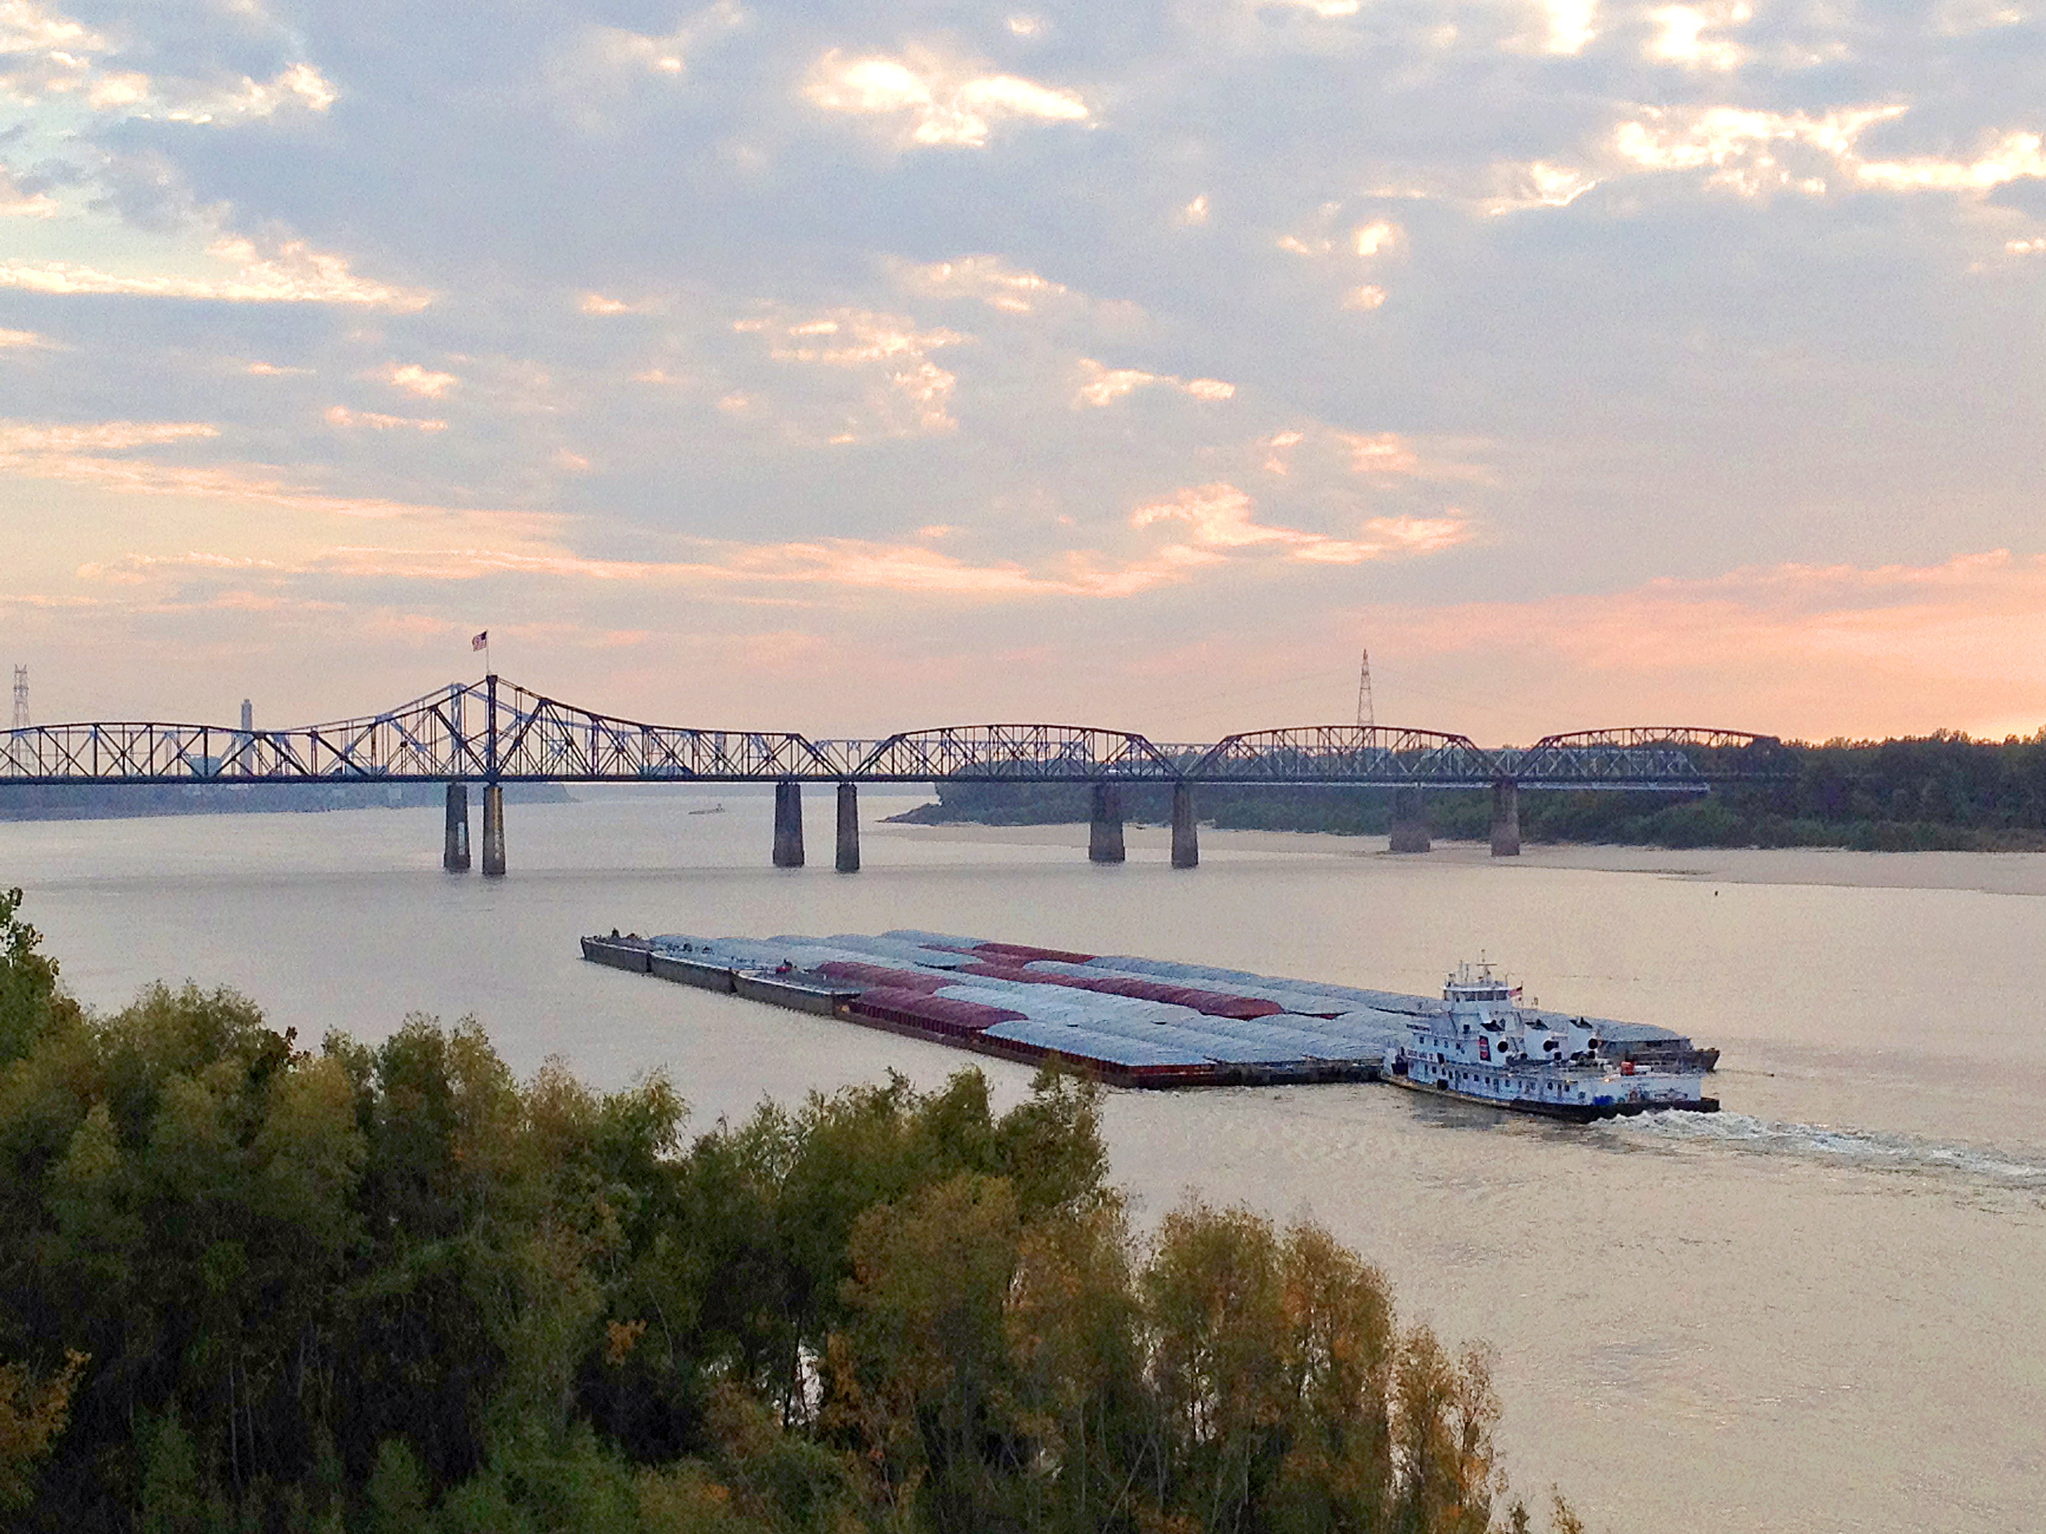
Wes Dean P.E., Assistant Chief Engineer, Field Operations, Mississippi Department of Transportation
Project: I-20 Mississippi River Bridge Rehabilitation
TIGER Round: 5
TIGER Grant: $4,250,000
“Supported the rehabilitation of the I-20/Vicksburg Mississippi River Bridge, which experienced unanticipated stresses due to movement of the pier foundations. The funds were used to improve the bridge to withstand minor side-to-side movements.”

Slide 18
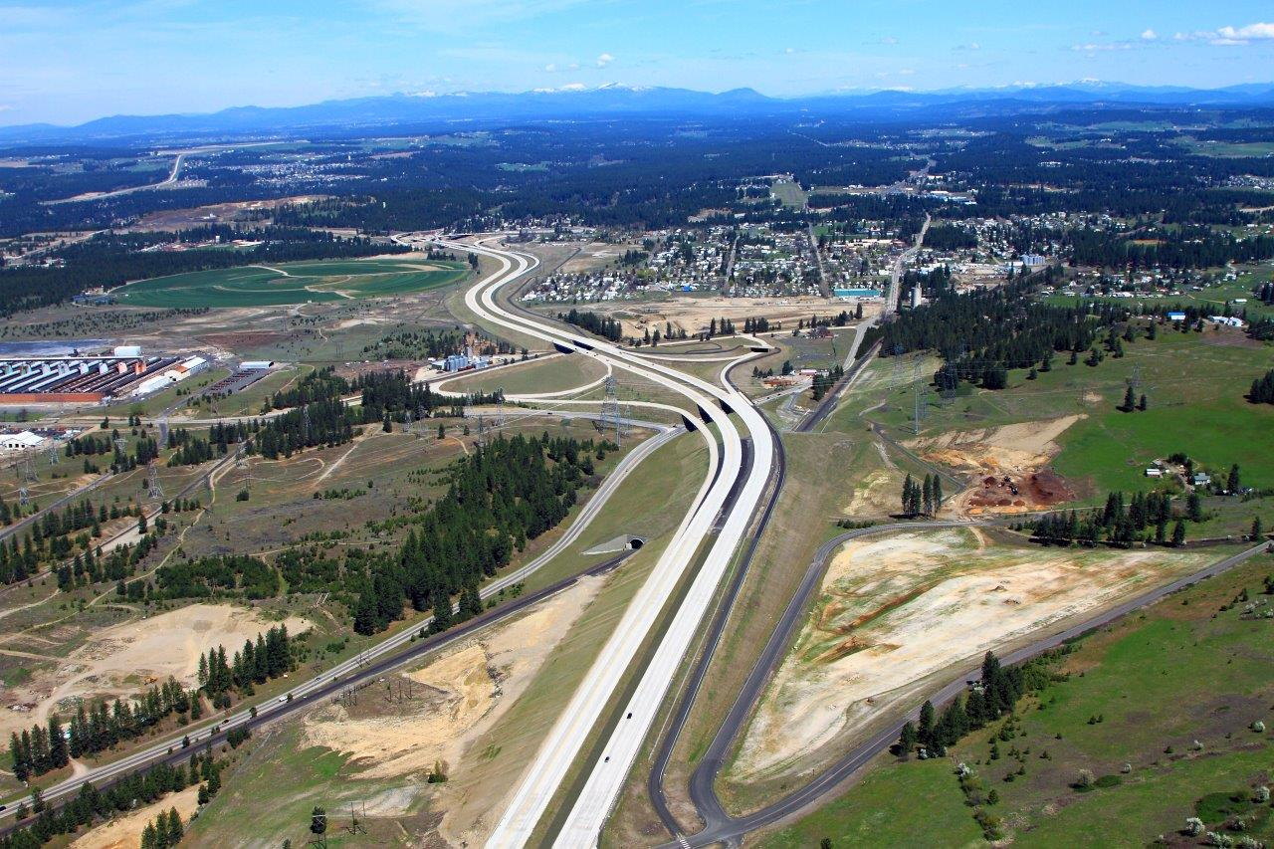
Keith Metcalf P.E., Deputy Chief Engineer, Washington Department of Transportation
Project: US-395 North Spokane Corridor - Francis Ave. to Farwell Rd. Southbound
TIGER Round: 1
TIGER Grant: $35,000,000
“Built 3.7 miles of roads that helped take freight and regional traffic off local roads by providing a divided, free-flow freeway facility.”

Slide 19
Jeff Folsom P.E., Assistant Bridge Engineer, Maine Department of Transportation
Project: Memorial Bridge Replacement & Sarah Mildred Long Bridge Project
TIGER Round: 2 // 6
TIGER Grant: $20,000,000 // $25,000,000
“Replaced a deteriorating bridge that restored truck traffic to the most efficient route from the Portsmouth Naval shipyard.”
“Funded the rail components of the Sarah Mildred Long Bridge replacement over the Piscataqua River.”

Slide 20
Open Discussion & Questions

Slide 21
Preparing a Competitive TIGER Application & How to Apply Robert Mariner, Deputy Director, Office of Infrastructure Finance and Innovation
Transportation Investment Generating Economic Recovery
Presented by the Office of the Under Secretary of Transportation for Policy
United States Department of Transportation

Slide 22
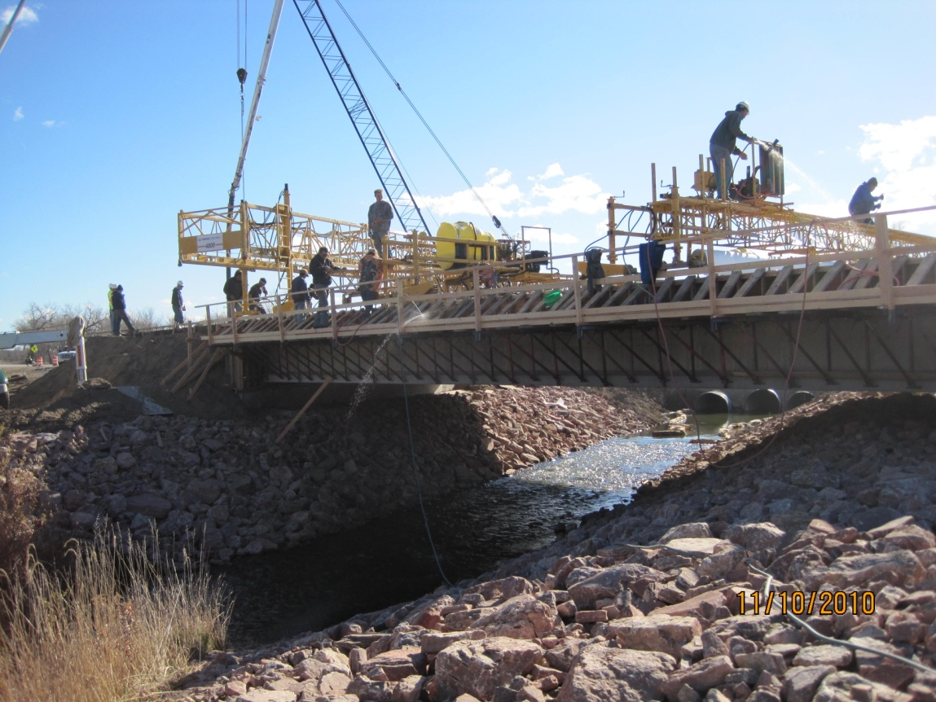
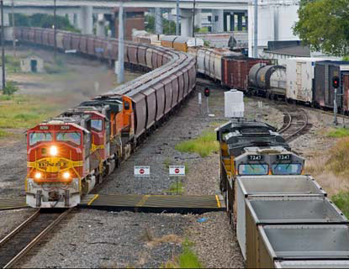
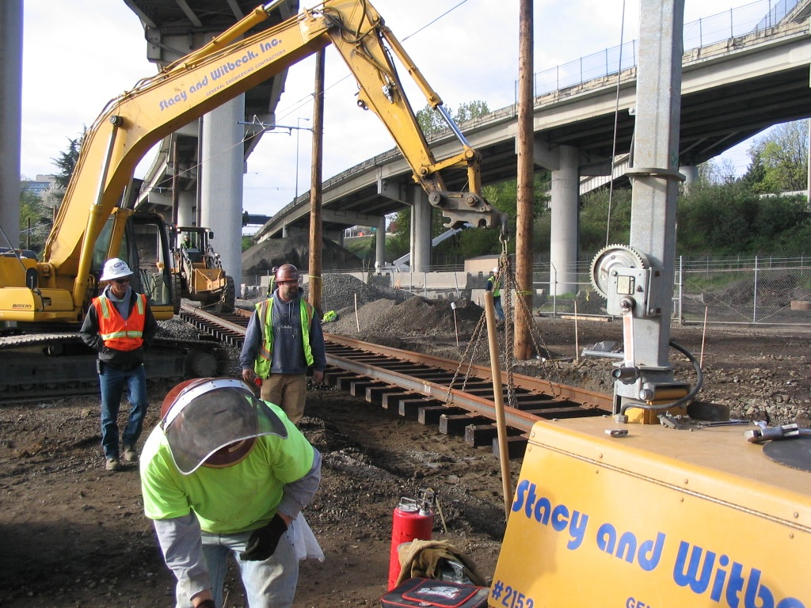
Pine Ridge, SD
North Kingston, RI
Fort Worth, TX
Portland, OR

Slide 23
$500 million multimodal, merit-based discretionary grant program for 2015
$100 million for rural areas
Geographic and Modal diversity requirement
Highly Competitive Program
2014: 798 applications, $9.5B in requests

Slide 24
2015 Application Process
April 3rd Pre-Application Registration Opened
Pre-Application Portal (www.dot.gov/tiger)
May 4th Pre-Applications Due (11:59 p.m. E.D.T)
May 5th Final Applications Open – Grants.Gov
June 5th Final Applications Due (11:59 p.m. E.D.T)

Slide 25
TIGER 2015 Pre-Application Process

Slide 26
TIGER 2015 Final Application Process
Final Applications MUST be submitted via www.Grants.Gov with the Pre-Application TIGER ID.
(Field 5b - Federal Award Identifier)
To register on Grants.gov, applicants must:
Obtain a Data Universal Numbering System (DUNS) number;
Register with the System for Award Management (SAM) at www.SAM.gov;
Create a Grants.gov username and password; and
The E-Business Point of Contact (POC) at your organization must respond to the registration email from Grants.gov and login at Grants.gov to authorize you as an Authorized Organization Representative (AOR).

Slide 27
Keys to Competitive Applications
Eligibility
Address Criteria & Outcomes
Clarity
Leveraging Investment
Project Components
Project Readiness/NEPA
Highly Competitive Projects
Applicant Pitfalls

Slide 28
Eligibility
Surface transportation capital projects only
State, local and tribal governments including U.S. territories, transit agencies, port authorities, MPOs, and other political subdivisions of State or local governments. (Private entities, including non-profits, must partner with an eligible lead applicant).
$10M minimum request for urban projects
20% local match required
$12.5M minimum total project cost
$1M minimum request for rural projects
No match required
20% set aside ($100M) for rural projects
No Planning Grants
Pre-construction activities eligible as part of a viable capital project

Slide 29
Address Criteria and Outcomes
Application outline in NoFA
Describe how project address challenge
Detail how federal funds will be used
Address the selection criteria
Secondary Criteria
Innovation
Partnership
Primary Criteria
Safety
State of Good Repair
Economic Competitiveness
Quality of Life
Environmental Sustainability

Slide 30
Clarity
Ensure project descriptions are clear and concise
Pictures and maps are helpful
DOT Evaluators may review 100 applications within a short period of time
Focus on why project is compelling/transformative

Slide 31
Leveraging Investment
Matching state and local funds with private funds helps demonstrate commitment
Public-private projects must demonstrate significant public benefits
Across six rounds, $3.50 dollars of co-investment for every TIGER dollar spent

Slide 32
Project Segmentation
Clearly identify multiple project elements if the project is segmentable
Segments must have “Independent Utility”
Provides transportation benefits
Will be ready for use when complete
Phases must complete operable segment

Slide 33
Highly Competitive Projects
Multimodal projects, coordinated investment from other sources and programs
Demonstrate transformative projects across selection criteria
Demonstrate ladders of opportunity for disadvantaged groups*
New Partnerships, multi-jurisdictional cooperation
Public-Private Partnerships
Support DOT’s national priorities
Non-traditional or hard-to-fund projects

Slide 34
Applicant Pitfalls
Ineligibility: applicant and projects
Priorities/outcomes not aligned with selection criteria
Project readiness
Insufficient matching funds, lack of demonstration
Non-Construction requests: O/M assistance
Grouping unrelated projects

Slide 35
Question and Answer Session

Slide 36
Breakout Sessions
Project Readiness: Scope, Schedule and Budget
Atrium (webcast)
Project Delivery: What Successful Applicants Should Expect
Media Center
Strategies for Financing Future Projects
Conference Center Rooms 8-9-10

Slide 37
Project Readiness: Scope, Schedule, Budget
Transportation Investment Generating Economic Recovery
Presented by the Office of the Under Secretary of Transportation for Policy
United States Department of Transportation

Slide 38
Selection Criteria
Primary Selection Criteria
Secondary Selection Criteria
Benefit Cost Analysis
Cost Share
Demonstrated Project Readiness

Slide 39
Demonstrated Project Readiness: Technical Feasibility
Applications should demonstrate:
engineering and design studies
development of design criteria
basis for cost estimates and contingency levels

Slide 40
Demonstrated Project Readiness: Financial Feasibility
Applications should demonstrate:
capital and operating fund commitments
availability/eligibility of matching funds
availability of contingency reserves
financial condition of the project sponsor
ability to manage grants
detailed project budget

Slide 41
Demonstrated Project Readiness: Project Schedule
Applications should demonstrate:
all necessary pre-construction activities will be complete to allow grant funds to be obligated no later than June 30, 2017
the project can begin construction quickly and that the grant funds will be spent steadily and expeditiously once construction starts, expended by September 30, 2022
evidence that the needed property and/or right-of-way acquisition can and will be completed expeditiously

Slide 42
Demonstrated Project Readiness: Required Approvals
Applications should demonstrate receipt, or anticipation of receipt by June 30, 2017, of all environmental reviews, approvals, and permits:
Project status and schedule under NEPA (National Environmental Policy Act)
Information on other reviews, including:
Clean Water Act
Endangered Species Act
Historic Preservation reviews
Navigable Waters and Bridge permitting
Other Federal, State, and local requirements

Slide 43
Demonstrated Project Readiness: Required Approvals
Legislative Approvals
Receipt of necessary state and local approvals
Other demonstrations of broad project support
State and Local Planning
If applicable for project type, demonstrate project inclusion on necessary State, regional, and local planning documents
If not on planning documents, submit evidence that actions are underway

Slide 44
Demonstrated Project Readiness: Assessment of Project Risks and Mitigation Strategies
Applications should identify greatest potential project risks, such as procurement delays, environmental uncertainties, and unexpected increases in project costs
Applications should describe achievable mitigation strategies for the identified risks

Slide 45
Question and Answer Session

Slide 46
Transportation Investment Generating Economic Recovery
What Happens Now? Carlos Monje Jr., Assistant Secretary for Policy
Presented by the Office of the Under Secretary of Transportation for Policy
United States Department of Transportation

Slide 47
TIGER: Benefits
Innovation
Partnerships
Hard to fund projects
Intermodal
Cross-Jurisdiction
Rural

Slide 48
TIGER: Overwhelming Need
Awards:
Six Years
$4.1 billion
342 projects
All 50 states, the District of Columbia and Puerto Rico.
Applications:
6,000 projects (5.7% awarded)
$124 billion in requests (3.3% funded)

Slide 49
Congress
GROW AMERICA addresses many needs:
More than doubles available TIGER funding to $1.25B annually
Authorizes TIGER program for six years
Increases the number of outstanding projects that could be funded each year
Provides long term certainty for better project planning, financing, and risk reduction

Slide 50
Next Steps?
Complete your Pre-Application!!!
Register for Grants.Gov
Submit Final Application

Slide 51
What Next? (cont.)
Complete your Pre-Application:
Go to: www.dot.gov/TIGER
Click: How to Apply
Application must be submitted before
11:59 PM E.D.T on May 4, 2015.

Slide 52
What Next? (cont.)
Register your organization with Grants.Gov:
Registration normally takes 3-5 business days.
However, it can take several weeks if problems are encountered.
Please register as soon as possible!
Go to: http://www.grants.gov/web/grants/applicants/apply-for-grants.html

Slide 53
What Next? (cont.)
Submit final applications before 11:59 PM E.D.T. on June 5, 2015
Go to: www.Grants.gov
Strongly recommend that you submit your application early!!!

Slide 54
Additional Application Help
Webinars: http://www.dot.gov/tiger/resources
How to Compete for TIGER Discretionary Grants: April 14 and April 28
Preparing a Benefit-Cost Analysis for a TIGER Grant: April 23
Frequently Asked Questions: http://www.dot.gov/tiger/faq
For Assistance email: TIGERGrants@dot.gov

Slide 55
Questions

