Slide 1
Beyond Traffic: The Smart City Challenge Information Session #5: Urban Freight and Logistics
January 6, 2016
U.S. Department of Transportation (USDOT)

Slide 2
Beyond Traffic: The Smart City Challenge
Encourage cities to put forward their best and most creative ideas for innovatively addressing the challenges they are facing.
The Smart City Challenge will address how emerging transportation data, technologies, and applications can be integrated with existing systems in a city to address transportation challenges.
Demonstrate how advanced data and intelligent transportation systems (ITS) technologies and applications can be used to reduce congestion, keep travelers safe, protect the environment, respond to climate change, connect underserved communities, and support economic vitality.

Slide 3
Beyond Traffic: The Smart City Challenge
Phase 1 (Deadline February 4, 2016):
Support concept development and planning activities
Estimated five Smart City Challenge Finalists
$100K each
Phase 2 (Solicitation and Deadline TBD):
Smart City Challenge Finalists
Support implementation of their proposed demonstration
$50 Million
U.S. Department of Transportation: $40 Million
Vulcan Foundation: $10 Million

Slide 4
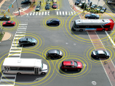
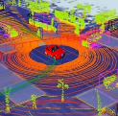
Advanced Technologies and Smart Cities
Technology convergence will revolutionize transportation, dramatically improving safety and mobility while
reducing costs and environmental impacts
Connected Vehicles
Benefits
Order of magnitude safety improvements
Reduced congestion
Reduced emissions and use of fossil fuels
Improved access to jobs and services
Reduced transportation costs for gov’t and users
Improved accessibility and mobility
Vehicle Automation
Connected-Automated Vehicles
Internet of Things
Machine Learning
Big Data
Mobility on Demand
Smart Cities

Slide 5
The USDOT’s Vision for a Smart City
The USDOT recognizes that each city has unique attributes, and each city’s proposed demonstration will be tailored to their vision and goals.
The USDOT’s vision for a Smart City Challenge is “to identify an urbanized area where advanced technologies are integrated into the aspects of a city and play a critical role in helping cities and their citizens address challenges in safety, mobility, sustainability, economic vitality, and address climate change.”
To assist cities, the USDOT identified twelve (12) vision elements that are intended to provide a framework for Applicants to consider in the development of a city’s proposed demonstration without making each item a requirement for award.

Slide 6
Beyond Traffic: The Smart City Challenge
Technology Elements (Highest Priority)
Vision Element #1
Urban Automation
Vision Element #2
Connected Vehicles
Vision Element #3
Intelligent, Sensor-
Based Infrastructure
Innovative Approaches to Urban Transportation Elements (High Priority)
Vision Element #4
User-Focused Mobility
Services and Choices
Vision Element #5
Urban Analytics
Vision Element #6
Urban Delivery and
Logistics
Vision Element #7 Strategic Business Models & Partnering
Vision Element #8
Smart Grid, Roadway
Electrification, & EVs
Vision Element #9 Connected, Involved Citizens
re-charging
Smart City Elements (Priority)
Vision Element #10 Architecture and
Standards
Vision Element #11
Low-Cost, Efficient,
Secure, & Resilient ICT
Vision Element #12
Smart Land Use

Slide 7
Beyond Traffic: The Smart City Challenge
Technology Elements (Highest Priority)
Vision Element #1
Urban Automation
Vision Element #2
Connected Vehicles
Vision Element #3
Intelligent, Sensor-
Based Infrastructure
Innovative Approaches to Urban Transportation Elements (High Priority)
Vision Element #4
User-Focused Mobility
Services and Choices
Vision Element #5
Urban Analytics
Vision Element #6
Urban Delivery and
Logistics
Vision Element #7 Strategic Business Models & Partnering
Vision Element #8
Smart Grid, Roadway
Electrification, & EVs
Vision Element #9 Connected, Involved Citizens
re-charging
Smart City Elements (Priority)
Vision Element #10 Architecture and
Standards
Vision Element #11
Low-Cost, Efficient,
Secure, & Resilient ICT
Vision Element #12
Smart Land Use

Slide 8
Today’s Speakers
Caitlin Rayman – Federal Highway Administration (FHWA)
Tamiko Burnell – Federal Highway Administration (FHWA)
Stephen Shafer – Maritime Administration (MARAD)
Brian Routhier – Federal Motor Carrier Safety Administration (FMCSA)
Travis Black – Maritime Administration (MARAD)

Slide 9
Vision Element #4 Urban Delivery and Logistics
This vision element includes the use of data or deployment of technologies to reduce congestion, improve safety, and protect the environment for a more efficient supply chain

Slide 10
Freight Trends
As populations increase and urbanization continues, cities will need to identify innovative ways to effectively and efficiently move goods – including food, energy, and manufactured goods – into cities
The country’s 100 largest metro areas drive national goods trade
More than 80% of all U.S. goods movements either start or end in these cities
Just 10% of U.S. trade corridors move 79% of all goods
In 2010, $16.2 trillion of the $20.3 trillion in goods movement occurred in these metro areas
Notes:
As you are all aware, cities generate much of our nation’s economic activity, which requires moving goods and waste throughout the city and surrounding region. Here are some statistics illustrating that point.

Slide 11
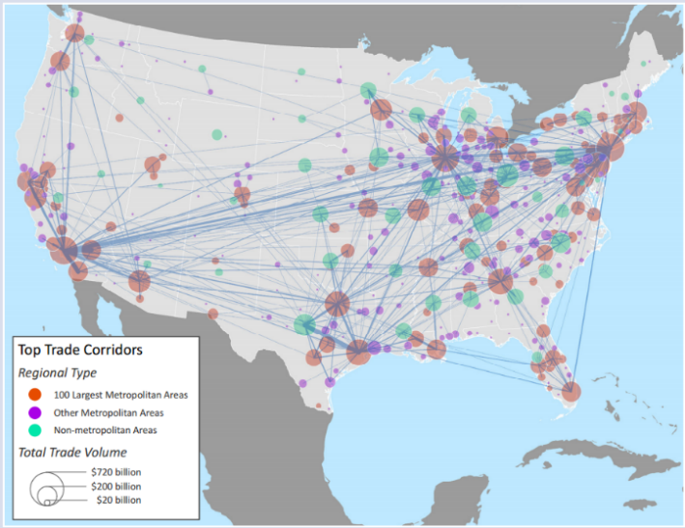
Goods Movement in the U.S.
Top 1 Percent of Trade Corridors Based on Value, Domestic Corridors Only, 2010
Notes:
This map further illustrates the importance of cities to goods movement, and it shows the top 100 urban-to-urban trade pairs in the United States.
Taken from BROOKINGS, August 2014. http://www.brookings.edu/~/media/research/files/reports/2014/11/freight-networks/srvy_gcifreightnetworks_oct24.pdf. Note: Entire top 1 percent of corridors include 888 corridors and over $4.4 trillion in total traded goods value. Source: Brookings analysis of EDR and Census data

Slide 12
Freight Movement is Multimodal
Our freight system is a multimodal engine that we depend on to drive our economy
Source: Beyond Traffic 2045
Notes:
Our freight system is a multimodal engine that we depend on to drive our economy.
Our nation’s ability to compete in global markets, and to meet the needs and expectations of consumers and industry, depends on a robust multimodal freight transportation system.

Slide 13
Intermodal Freight
Intermodal freight transport involves the transportation of freight in an intermodal container using multiple modes of transportation (rail, ship, and truck), without any handling of the freight itself when changing modes.
This method reduces cargo handling, improves security, reduces damage and loss, and allows freight to be transported faster
Source: Beyond Traffic 2045

Slide 14
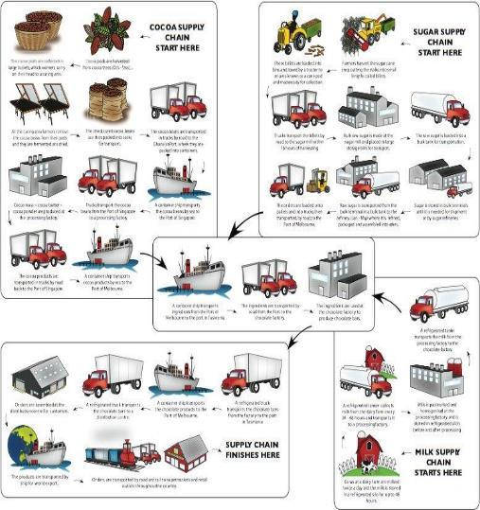
Supply Chains
Supply Chain Examples
Gasoline & Petroleum
Food Services
Supermarket Grocery
Big Box Retail
Retail Drug Store
Apparel Retail
Pharmaceutical and Biotechnology
Construction Materials
Waste & Recyclables
Others
Notes:
Supply Chain: The sequence of processes involved in the production and distribution of a commodity.

Slide 15
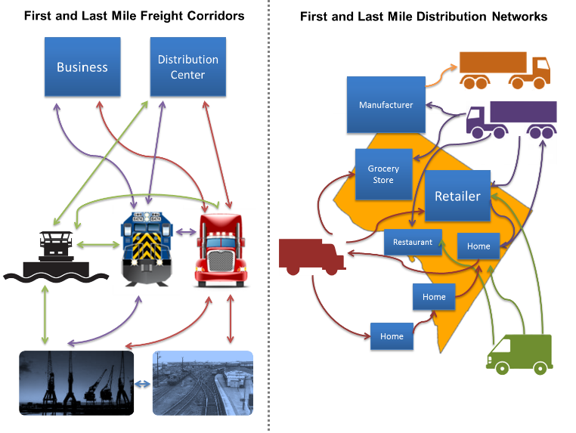
First and Last Mile Delivery
Notes:
Our increasingly urbanized population poses challenges for “first mile” and “last mile” freight movements.
Freight demand is expected to be concentrated in the large metropolitan areas where America’s population is growing the fastest. Congestion in several metropolitan population centers is already severe and could become more extreme. Increasing freight demand in these densely populated areas will complicate “first mile” movement of goods out of ports and the “last mile” movement of goods from freight hubs to their final destinations, which is often the least efficient portion of the supply chain for many consumer goods.

Slide 16
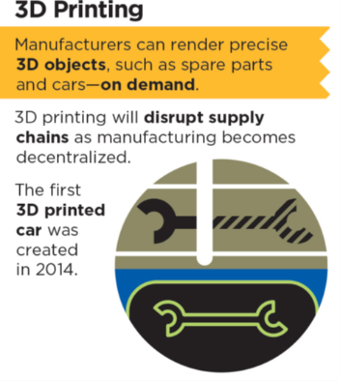
Emerging Goods Movement Trends
Online Shopping: Online shopping makes it possible for companies to bypass traditional storefronts. While online shopping reduces travel associated with shopping trips, these services are likely to increase truck traffic in urban areas as goods are delivered to residencies.
3D Printing: This technology has the potential to disrupt traditional supply chains and counteract the growth of imports by reducing the need for large-scale manufacturing, transportation, and storage.
Notes:
Online shopping makes it possible for companies to bypass traditional storefronts. While online shopping and next day delivery services captures a large market share reducing travel associated with shopping trips, these services are likely to increase truck traffic in urban areas as good are delivered to residencies.
3D printing has the potential to disrupt traditional supply chains and counteract the growth of imports by reducing the need for large-scale manufacturing, transportation, and storage. 3D printing is a groundbreaking technology that allows manufacturers to render three-dimensional objects from a digital file with great precision using a laser or an extruder to build an object layer by layer. Engineers have been using 3D printers for more than a decade, but 3D printers are now becoming more precise and more amenable to using a broader range of materials. Desktop 3D printers have now been made commercially available and their costs are dropping, leading to more widespread consumer use. 3D printers could make it possible to manufacture customized products and parts more quickly and inexpensively.
Just as online shopping now makes it possible for companies to bypass traditional storefronts, 3D printing will allow for more localized production and decentralized manufacturing. It may also lead to an increase in the delivery of raw materials for 3D manufacturing. In the service parts industry, 3D printing may result in decreasing shipments of finished parts. In health care, 3D printing is being used to manufacture customized hearing aids, braces, and even artificial limbs. The potential effects of 3D printing on certain industries—electronics, automobiles, medicine—are great, but the future of such a novel technology is difficult to predict. Continued advances in 3D printing could impact freight transportation by shortening supply chains for high-value, urgent products, reducing demand for air freight in particular.

Slide 17
Challenges and Opportunities
Safety
Truck Safety
Geometric Design
Weather-related Challenges
Congestion
Scheduling and Logistics
Parking
Urban Parking
Long Haul Parking
Environment
How can innovative solutions and advanced technologies be used to address these challenges?

Slide 18
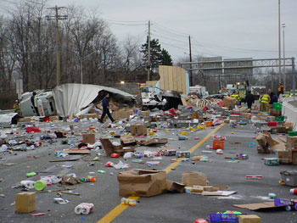
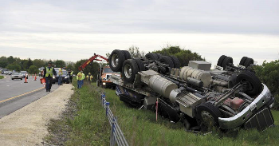
Challenge: Safety
Freight transportation is involved in approximately 13 percent of all transportation fatalities
3,964 people were killed in crashes involving large trucks in 2013
Large trucks are less likely to be involved in crashes than passenger vehicles, but crashes involving trucks are more likely to be fatal
The need to transport increasing amounts of freight to large urban areas in the future could increase conflicts between freight and passenger traffic

Slide 19
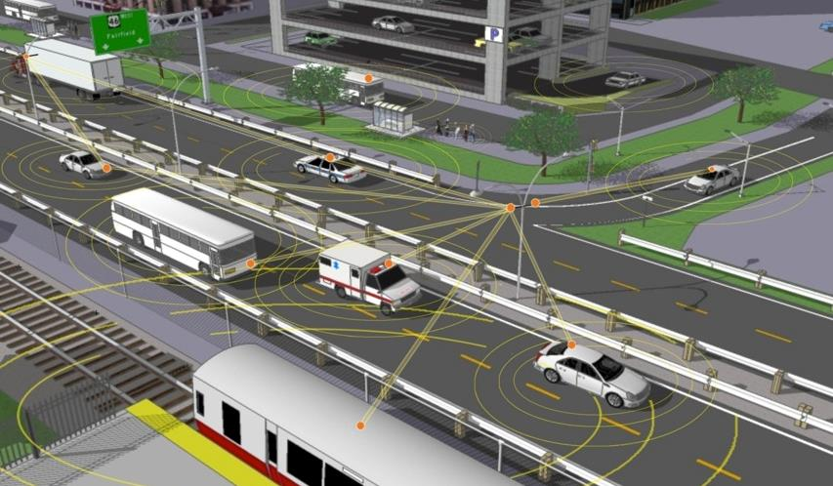
Opportunities to Improve Safety Connected Vehicles
Notes:
Purpose of Slide: Provide a brief overview of how connected vehicles work.
Transition: Connected vehicles are a part of a “connected everything” system.
Key Messages: Real-time data is transmitted through multiple sources and alerts drivers to avoid crashes or back-ups. Infrastructure data includes signal phase and timing (SPaT), speed warnings (drive 35 mph), and the number of available parking spaces.
Vehicles equipped with DSRC will broadcast information such as their location, speeds, and direction of travel in the basic safety message (BSM). In the future, it may be possible to share additional data such as crash notifications and location, pavement condition, or slippery road surfaces.
Data can also be transmitted to the traveler via cellular technology. If you look closely, the picture shows connectivity between the people at the bus stop and the bus. The connected vehicle concept encompasses connectivity between vehicles, the infrastructure, and the traveler.

Slide 20
Opportunity: Connected Vehicles
Vehicle-to-Vehicle (V2V) Communications for Trucks
Connected vehicle applications developed for truck platforms are being designed to be interoperable with all other vehicle platforms.
Examples of V2V safety applications for heavy vehicles include:
Forward Collision Warning
Blind Spot Warning/Lane Change Warning
Intersection Movement Assist
Electronic Emergency Brake Light
In 2014, NHTSA announced an Advanced Notice of Proposed Rulemaking (ANPRM) for V2V on Light Vehicles and has stated their intent to make an agency decision on V2V safety technology for heavy vehicles.
Notes:
Connected vehicle applications developed for truck platforms are being designed to be interoperable with all other vehicle platforms, so that drivers in light and heavy vehicles can be more aware of each other as they share our highways.
Some of the trucking applications to be developed as part of the V2V safety program include:
Forward Collision Warning–Warns drivers of an impending rear-end collision with a vehicle ahead in the same lane and direction of travel;
Blind Spot Warning/Lane Change Warning–Helps drivers avoid or mitigate collisions with vehicles in or approaching a blind spot;
Intersection Movement Assist–Warns drivers when it is unsafe to enter an intersection due to high- collision probability with other vehicles;
Electronic Emergency Brake Light–Helps drivers avoid or mitigate rear-end collisions with braking vehicles in the forward path of travel.
Because of the substantial impact that V2V technology could have on safety, NHTSA believes that this technology warrants consideration for possible regulatory action. In 2014, NHTSA announced an Advanced Notice of Proposed Rulemaking for V2V on Light Vehicles and has stated their intent to make an agency decision on V2V safety technology for heavy vehicles

Slide 21
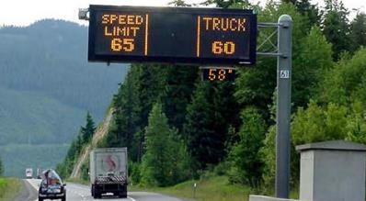
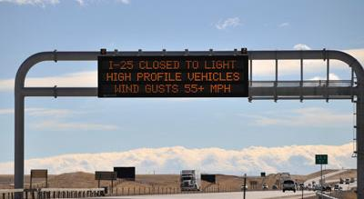
Opportunity: Safety Applications
Dynamic Speed Limits
Dynamic downhill truck speed warning system on I-70 (Denver, CO)
Variable truck speed limit on I-84 (Pendleton, OR)
Dynamic Truck Restrictions
Wind warning for high profile vehicles on I-25 (Wyoming)
Source: ENTERPRISE Pooled Fund Study ↑ Source: Wyoming DOT ↓
Notes:
Variable truck speed limit sign advises truck drivers what speed they should travel to make it safely down Emigrant Hill, on I-84 between Pendleton and La Grande (Oregon)
The Downhill Truck Speed Warning System (DTSWS) calculates and displays a safe downhill descent speed for each passing truck of greater than 40,000 lbs. gross vehicle weight (GVW) based on each truck’s axle configuration and gross vehicle weight, and the downgrade of the highway incline. The variable message sign (VMS) displaying the advised speed is located 250 feet beyond the loop detectors and weigh-in-motion (WIM) strips

Slide 22
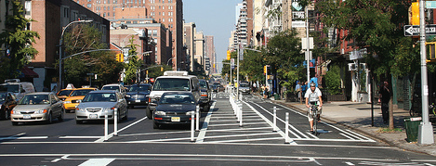
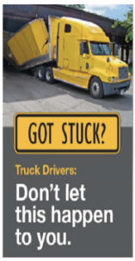
Challenge: Geometric Design
Design Issues
Turning radius
Height/width clearances that often affect the ability of large vehicles to maneuver safely among other motorists
At‐grade crossing clearance and distance of rail lines from parallel highway corridors
Road Diet (Context Sensitive Design): Impacts to freight delivery at local businesses

Slide 23
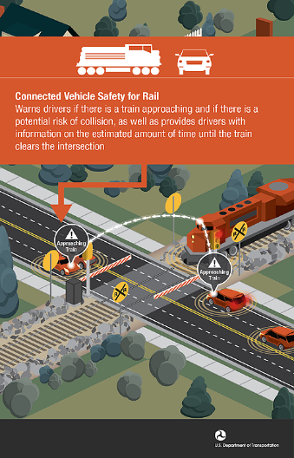
Opportunities: Safety Applications
At Grade Rail Crossing: Warns drivers of an approaching train if there is potential risk of collision
Curve Speed Warning: Allows connected vehicles to receive information that it is approaching a curve along with the recommended speed for the curve
Overheight Detection: Detects overheight vehicles moving toward obstacles such as bridges, tunnels and other overhead structures and individually warns drivers

Slide 24
Challenge: Weather-related Safety
Approximately 22% of all vehicle crashes are weather-related
Weather-related crashes include crashes that occur in adverse weather (i.e., rain, sleet, snow, fog, severe crosswinds, or blowing snow/sand/debris) or on slick pavement (i.e., wet pavement, snowy/slushy pavement, or icy pavement)
Each year trucking companies lose an estimated 32.6 billion vehicle hours due to weather-related congestion in 281 of the nation's metropolitan areas
Nearly 12 percent of total estimated truck delay is due to weather in the 20 cities with the greatest volume of truck traffic
The estimated cost of weather-related delay to trucking companies ranges from 2.2 billion dollars to 3.5 billion dollars annually
Source: " Analysis of Weather Incident Effects on Commercial Vehicle Mobility in Large U.S. Cities," Mitretek Systems

Slide 25
Opportunity: Road Weather Operations
Connected Vehicle Pilot (Wyoming)
Wyoming’s Connected Vehicle (CV) Pilot Demonstration Project seeks to improve safety and monitor performance on I-80.
Weather events common to the corridor are ice and snow covered road surfaces, poor visibility, and high wind events. Between 2002 and 2012, over 3,472 high-wind crashes occurred.
The demonstration will develop applications that use V2I connectivity to support a flexible range of services that improves safety and mobility for heavy vehicles.
For More Information: http://www.its.dot.gov/pilots/wave1.htm
Notes:
ICF/Wyoming: The primary objective of the ICF/Wyoming CV Pilot is to reduce the number of truck blow-over incidents and adverse weather related incidents (including secondary incidents) on the Interstate 80 (I-80) corridor in order to improve safety and reduce incident-related delays. Secondary objectives include:
Reduce the latency and increase the coverage of road condition reports along the I-80 corridor by gathering data from equipped snow plows and trucks
Support in-vehicle dissemination of advisories to support speed management, detours, parking and presence of maintenance and emergency vehicles
Support fleet management center operations by providing current and forecasted road conditions along I-80
Support vehicle to vehicle communication of road condition and posted speeds along the I-80 corridor especially in the variable speed limit zones
Information from these applications is expected to be made available directly to the equipped fleets or through data connections to fleet management centers, who will then communicate the information to their trucks using their own systems. Applications currently under consideration by the site include: Road Weather Advisories and Warnings for Motorists and Freight Carriers, Road Weather Information and Routing Support for Emergency Responders, Road Weather Information for Maintenance and Fleet Management Systems, Weather-Responsive Variable Speed Limit System, Freight-Specific Dynamic Travel Planning, Spot Weather Impact Warning, Situational Awareness, and Warnings about Upcoming Work Zone.

Slide 26
Questions

Slide 27
Challenge: Congestion
Freight demand is expected to be concentrated in metropolitan areas. Congestion in several metropolitan population centers is already severe and could become more extreme by 2045.
Increasing freight demand in these densely populated areas will complicate “first mile” movement of goods out of ports and the “last mile” movement of goods from freight hubs to their final destinations.
Notes:
Growth in overall freight demand will put increased pressure on freight bottlenecks throughout the country. In 2012, approximately 10 million trucks moved more than 13 billion tons of freight across America’s highways. These trucks are major contributors to congestion on 4,500 of the busiest highway miles in the nation.
Bottlenecks severely limit the performance and capacity of the highway system by delaying large numbers of truck freight shipments. Areas with the worst truck delays include major international trade gateways and hubs, such as Los Angeles, New York, and Chicago, and major distribution centers such as Atlanta, Charlotte, Dallas-Fort Worth, Denver, Columbus (Ohio), and Portland (Oregon). Border crossings are also bottlenecks. At two major Mexico border crossings, it takes trucks, on average, nearly an hour to enter the United States.

Slide 28
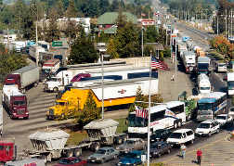
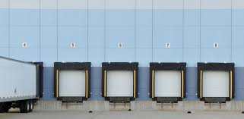
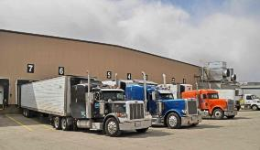
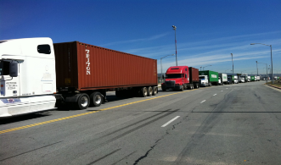
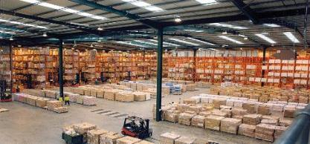
Challenge: Scheduling and Logistics
Wait Times
Receiver Scheduling
On-time Pickup and Delivery

Slide 29
Opportunity: Freight Advanced Freight Traveler Information System (FRATIS)
Freight-Specific Dynamic Planning and Performance
Data on wait times at intermodal facilities, traffic conditions, incidents, road closures and work zones, route restrictions, and truck parking availability.
Provides adaptive communication between drayage companies, drivers, and intermodal facilities, along with real-time information and dynamic routing for drivers.
Drayage Optimization
Seeks to optimize truck/load movements between freight facilities.
Uses travel information and port terminal conditions to assign individual trucks with “best time” windows for pick-up or drop-off so that they can optimize operations.
Fore More Information: http://www.its.dot.gov/pilots/wave1.htm
Notes:
Freight-Specific Dynamic Travel Planning and Performance
This application bundle seeks to include all of the traveler information, dynamic routing, and performance monitoring elements that users need.
Enhances traveler information systems to address specific freight needs
Provides route guidance to freight facilities, incident alerts, road closures, work zones, routing restrictions (hazmat, oversize/overweight), and performance monitoring
Builds on the Cross-Town Improvement Project (C-TIP) Real Time Traffic Monitoring (RTTM) and Dynamic Route Guidance (DRG) applications for best route between freight facilities.
Provides intermodal connection information, container disposition and schedule
Leverages existing data in the public domain, as well as emerging private sector applications to provide benefits to both sectors.
Drayage Optimization
This application bundle seeks to combine container load matching and freight information exchange systems to fully optimize drayage operations, thereby minimizing bobtails/dry runs and wasted miles, as well as spreading out truck arrivals at intermodal terminals throughout the day.
Reduces freight delays at key facilities that overbook their capacity to ensure uninterrupted operations within the terminal/warehouse
Optimize drayage operations so that load movements are coordinated between freight facilities
Individual trucks are assigned time windows within which they will be expected to arrive at a pickup or drop-off location
Early or late arrivals to the facility are dynamically balanced
Web-based forum for load matching provided to reduce empty moves

Slide 30
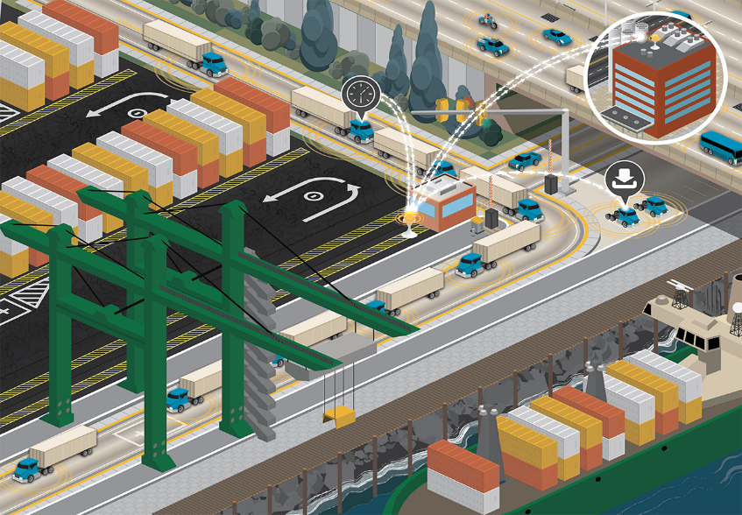
Opportunity: FRATIS
1. Drayage companies receive their orders for a given day
Notes:
I’m going to walk you through the six core FRATIS functions in order to give you a better overview of the whole process.
The first step starts just the same as if FRATIS was not in place with the drayage companies entering their daily pick up and drop off orders into their back office systems (if it exists), if they don’t have a backend system, they can use their own FRATIS user interface to enter their daily orders.

Slide 31
Opportunity: FRATIS
2. Orders are collected and run through an optimization algorithm to create optimized plan
Notes:
Those orders are collected, sent to the FRATIS optimization algorithm. Various methods were used to move this data between the drayage companies and the Optimization algorithm including entering the data directly into FRATIS and FTPing the information in files. Once the information was gathered the optimization algorithm was run for a single day and a single drayage company. The algorithm optimized to reduce the number of bob-trail trips and the distance trucks would have to travel during the day while also taking in to account constraints by the drayage company like driver availability and hours of service, time windows, etc.

Slide 32
Opportunity: FRATIS
3. The optimized plan is reviewed and approved by the dispatcher
Notes:
Once the optimization is complete the drayage company can review the optimized plan. This is a important step as it allows the drayage company time to validate the plan and make any changes to it before they send it out.

Slide 33
Opportunity: FRATIS
4. The optimized driver plans are distributed to each truck drivers through in-vehicle units
Notes:
The approved plan is then broken up and each driver’s part is either 1) sent to the truck through in vehicle units which were TomTom 7150 units (Los Angeles) or smartphones (Dallas-Fort Worth) or 2) manually assigned with legacy system (South Florida) for the FRATIS prototype. This information included each of the drivers pickup and drop off points for the day in order with their routes for each job. Routing information would update dynamically as needed should traffic conditions change to make sure drivers where taking the fastest route.

Slide 34
Opportunity: FRATIS
5. Changes to orders are sent directly to the drivers
Notes:
Any updates to the orders would be sent directly to the drivers units so they can see the changes. The in vehicle units also allowed for direct communication between the drivers and dispatchers which was used to confirm changes and ask any questions about orders.

Slide 35
Opportunity: FRATIS
6. Order status information is sent directly back to the drayage companies
Notes:
As orders are completed the drivers update their information on the in-vehicle unit giving status updates to the drayage companies about their progress. When customer contact the drayage company about their order status the company can quickly review the truck progress and give a detail ETA for the order based on the trucks location and status. This feature can be enhanced potentially in future versions of FRATIS where ETA information can be directly sent to the customer based on the trucks status. Another feature for future enhancements includes optimizing on each driver within a fleet.
Once all of the orders are filled the same process starts over again the next day.

Slide 36
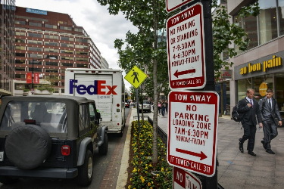
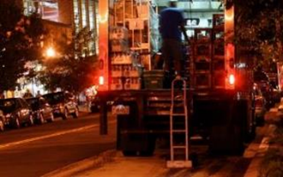
Opportunity: Off-Peak / Overnight Deliveries
Trucks deliver goods to stores during off-peak hours or overnight
When there is no personnel available for the reception of the goods, delivery systems can be used, like drop boxes or safes
Incentives may be provided to trucking companies and businesses to shift delivery to overnight/off-peak hours
Notes:
Source: https://www.washingtonpost.com/news/dr-gridlock/wp/2015/10/01/could-overnight-deliveries-be-the-solution-to-traffic-congestion/
In many cities, limited parking exists for delivery large trucks. This results in trucks double parking, blocking travel lanes or taking up precious parking spaces — while making their deliveries.
With off-peak / overnight deliveries, trucks deliver goods to stores during off-peak hours or overnight.
When there is no personnel available for the reception of the goods, delivery systems can be used, like drop boxes or saves.
Incentives may be provided to trucking companies and businesses to shift delivery to overnight/off-peak hours.

Slide 37
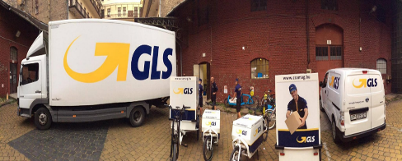
Opportunity: Consolidation Centers
Features mega size warehouses on the outskirts of the city with smaller decentralized warehouses inside the city:
Heavy commercial vehicles carry goods to big warehouses on the outskirts of the city.
From there, medium and light commercial vehicles would deliver goods to a warehouse within a city. These vehicles may include electric vehicles and in the future, smaller automated vehicles, or shared-use vehicles.
May consider load consolidation strategies
Notes:
Load consolidation. It can be hard for competing suppliers to cooperate, but when they group their goods together on one truck, it can make for fewer trips — though it can also make for bigger trucks.
Cargo bikes. The European Union has a project to study ways to move freight to modes with fewer negative externalities than trucking. The project, called Cycle Logistics, has estimated that 42 percent of urban freight could go on bikes instead of trucks.

Slide 38
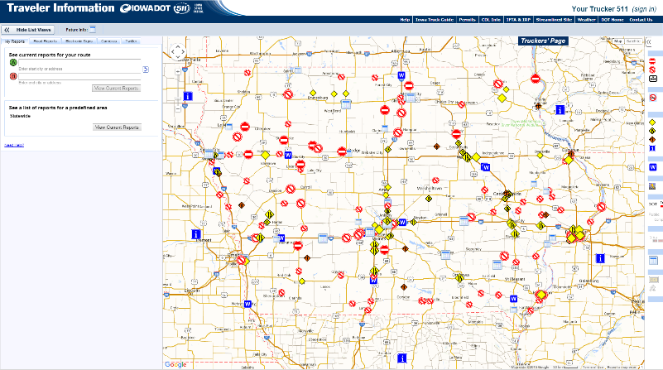
Opportunity: Advanced Freight Traveler Information Truck-specific 511 Page
Source: Iowa DOT
Notes:
Additional notes:
This is a statewide example: Iowa provides a truck specific section on their 511 page that allows users to input a route and view current conditions.
Citywide example – Washington DC has a trucker web page that allows drivers to view truck routes, restrictions, and loading zones; useful for local deliveries

Slide 39
Opportunity: Dynamic Routing
Thru traffic and local deliveries have different information needs
Thru traffic: Road closure, construction, or accidents that could lead to congestion
Local deliveries: Weight, HAZMAT, and loading zone restrictions that could impact route or timing of delivery
Dynamic Routing Opportunities
Communicate information for commercial vehicles via dynamic message signs, Highway Advisory Radio, and Truck-specific 511
Provide dynamic guidance and re-routing opportunities based on current conditions
Utilize dynamic pricing to level demand and reduce congestion during peak times
Notes:
Additional notes:
Barriers to local deliveries can result in increased congestion, fuel use. Examples of barriers include:
Inadequate street design
Parking availability
Policy and signage are inconsistent from city to city
Idling may be restricted
Dynamic routing opportunities are shown on a spectrum:
Traveler information becoming increasingly prevalent, as demonstrated in previous examples of this presentation
Dynamic route guidance and pricing are an evolution of these concepts.

Slide 40
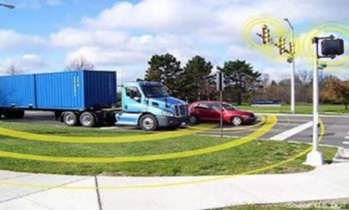
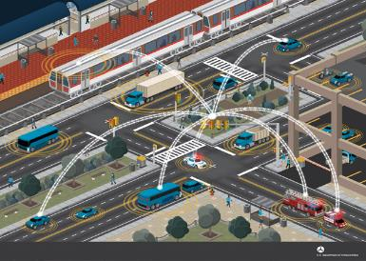
Opportunity: Traffic Signal Operations
Freight Signal Priority (FSP)
Provides traffic signal priority for freight and commercial vehicles traveling in a signalized network
Saves time
Reduces fuel consumption and emissions
Traffic Signal Timing
Advanced traffic signal timing applications in heavy‐use truck corridors can reduce delay for trucks in urban environments

Slide 41
Questions

Slide 42
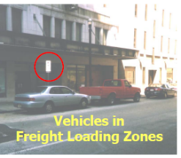
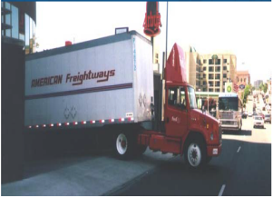
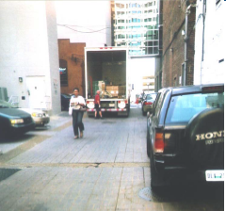
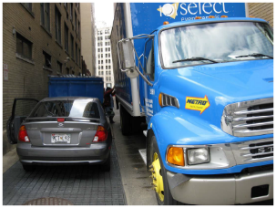
Challenge: Parking
Urban Parking
Limited parking for delivery vehicles
Vehicles parked in loading zones
Design issues
Lack of enforcement
Long Haul Parking
Truck parking shortages
Limited parking information

Slide 43
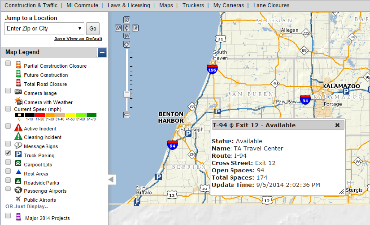
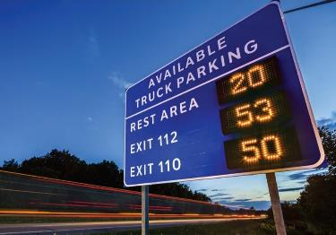
Opportunity: Dynamic Truck Parking
Smart Truck Parking
Enhance highway safety by providing timely and reliable truck parking information
Dynamic message signs prior to parking location provide truckers with information about current parking availability
Information may also available via websites, mobile apps, and through connected vehicle technologies
Source: Michigan DOT
Notes:
Source: MDOT Smart Truck Parking presentation
Additional notes on truck parking:
Locating parking for long-haul trips is difficult and time consuming
Truckers need good parking options:
15% of fatal crashes are fatigue related
DOT hours of service rules require breaks
Impacts:
Wasted time (15 minutes equates to $4.4B annually)
Wasted fuel and increased emissions (15 minutes equates to 3.3millon TONS CO2 annually)

Slide 44
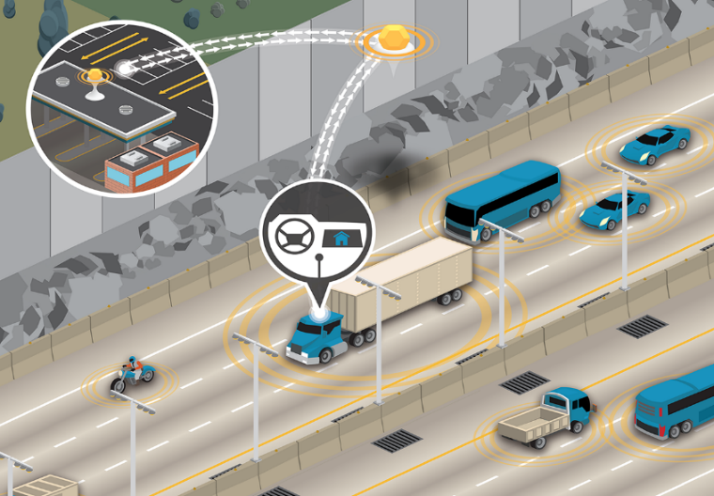
Opportunity: Smart Truck Parking Leveraging Connected Vehicle Technologies

Slide 45
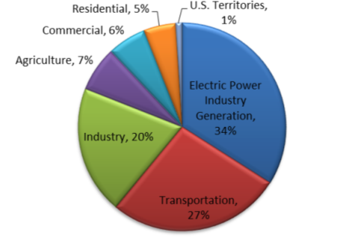
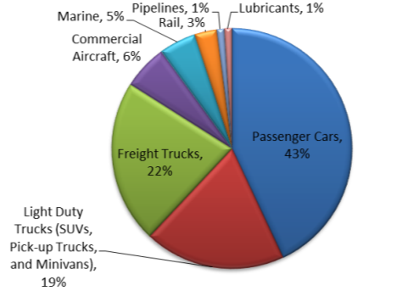
Challenge: Transportation and the Environment
The transport sector in the U.S. accounts for 27% of greenhouse gas (GHG) emissions and 70% of U.S. petroleum consumption
Light duty vehicles and heavy trucks are the greatest fuel users in the transport sector
Source: EPA. Inventory of U.S. Greenhouse Gas Emissions and Sinks, 1990 to 2010. 2012.
Notes:
Transportation has a significant impact on the environment. If you look at the pie chart on the left, transportation accounts for about 27% of all GHG emissions. Surface transportation, shown in the pie chart on the right, is a very significant proportion of those emissions accounting for 84% of all transport emissions. Passenger vehicles (43%), freight trucks (22%), and light duty trucks (19%) sum to about 78% of all transport emissions.
Given these numbers, there would seem to be a significant window of opportunity here for ITS in general (and connected vehicle technologies specifically) to address environmental issues. The ITS JPO’s AERIS program intends to investigate if connected vehicle technologies and strategies could have a significant impact on reducing the negative effect of transportation on the environment.
Environmental Impacts
Increasing freight activity in urban areas could also intensify the debate over land use and pollution. Without effective policies and regulations, growing freight movements will increase greenhouse gas emissions, and will affect human health in neighborhoods along freight corridors. Trucking, intermodal rail, waterborne transportation, and air cargo constitute large and growing sources of greenhouse gas emissions. Trucking accounts for about 9 percent of all highway miles traveled, but it is the source of 20 percent of all transportation-sector greenhouse gas emissions. Freight on other modes accounts for an additional 7 percent of greenhouse gas emissions.

Slide 46
Challenge: Trucks and GHG Emissions
Heavy trucks are responsible for most of the growth in greenhouse gas emissions in the freight sector
Notes:
Since 1990, greenhouse gas emissions from trucking have increased five times faster than emissions from passenger travel.
Trucking is the single largest contributor to freight-related air pollution nationally. Compared to cars, heavy trucks emit large amounts of toxic air pollutants—including hydrocarbons and nitrous oxides. While trucks have made great strides in reducing emissions, the average diesel-fueled heavy truck emits more than twice as many hydrocarbons per mile and more than 15 times as many nitrous oxides as the average passenger car. These emissions can impact human health, particularly in neighborhoods adjacent to heavily trafficked freight corridors.
Heavy trucks are responsible for most of the growth in greenhouse gas emissions in the freight sector.

Slide 47
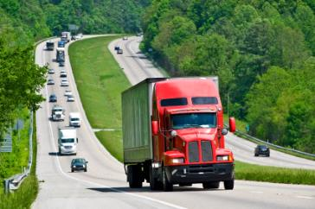
Opportunity: Eco-Driving
Sensors can be used to track the drivers' habits and provide real-time feedback to drivers
Fuel waste stems from hard accelerations, hard braking, hard turning, the inability to maintain a constant speed, and excessive idling
A 2011 report suggested that eco-driving strategies could improve fuel efficiency by up to 22 percent saving commercial truck operators more than $12,500 a year per truck
Source: SmartDrive Systems, whose products track individual driving habits for fleet operators
Notes:
Drivers of heavy-duty trucks may boost fuel efficiency by as much as 22 percent by changing their driving and idling habits, according to a survey of almost 700 U.S. truck drivers.
The survey results indicate that truck-driver training may have as much of an impact at cutting greenhouse-gas emissions as powertrain improvements and vehicle weight reductions. Such fuel economy improvements may save commercial truck operators more than $12,500 a year per truck, according to a report by San Diego-based SmartDrive Systems, whose products track individual driving habits for fleet operators.
After two months of eco-driving training, the average driver surveyed by SmartDrive improved his fuel efficiency to 6.73 miles per gallon from 5.92 miles per gallon, the company said in the report.

Slide 48
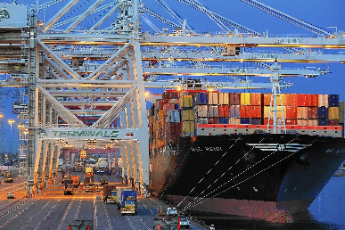
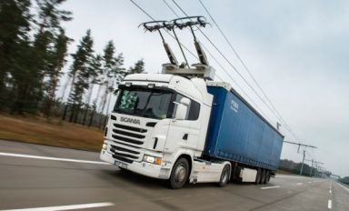
Opportunity: Catenary Systems
The Ports of Los Angeles and Long Beach’s e-highway concept consists of an overhead catenary system running along the outside lanes of both sides of the road leading to the port
Specially outfitted hybrid or all-electric trucks can attach to the system using automated current-transfer devices called pantographs (similar to trolleys)
Once connected, the trucks can pull all their power from the overhead lines, effectively becoming emission-free vehicles
Notes:
E-Highway Catenary System. A road design project dubbed the e-highway is aiming to reduce and maybe even eliminate the pollution problems caused by all this truck traffic near the ports of Los Angeles and Long Beach. The experimental system is being built along a mile of the corridor to test how highly polluting diesel truck traffic could instead run on emission-free electric power. The demonstration could offer a solution to pollution-related problems along the Alameda Corridor and other high-traffic roadways all over the world. The e-highway consists of an overhead catenary system that will run along the outside lanes of both sides of the road, sort of like the overhead wires that provide power to electric buses, trolleys, and trains in cities. Specially outfitted hybrid or all-electric trucks can attach to the system using automated current-transfer devices called pantographs. Once connected, the trucks will pull all their power from the overhead lines, effectively becoming emission-free vehicles.

Slide 49
Emerging Area: Automation
Fully and partially automated trucks, ships, and planes, and automatic freight-transfer facilities, may eventually transform the freight industry
Automated features to improve the safety and efficiency of freight movement are already being introduced
On trucks, initial automation systems combine adaptive speed control, automatic braking, lane-departure warning systems, and vehicle-to-vehicle (V2V) communications
In the long-term, driverless cars could be used for last mile delivery to deliver packages to centrally located, self-service stations
At warehouses and ports, self-driving vehicles can load and unload goods
Notes:
Fully and partially automated trucks, ships, and planes, and automatic freight-transfer facilities, may eventually transform the freight industry.

Slide 50
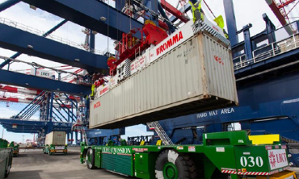
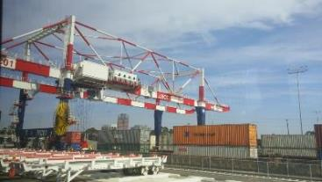
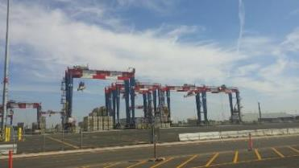
Opportunity: Automation at Ports
Automation is being used at major container ports around the world. The process of transferring containers from ships to docks, trucks, and trains is becoming highly automated, reducing reliance on human operators.
Notes:
Work with your port
Green Port Policy
Protect the community from harmful environmental impacts of Port operations.
Distinguish the Port as a leader in environmental stewardship and compliance.
Promote sustainability.
Employ best available technology to avoid or reduce environmental impacts.
Engage and educate the community.

Slide 51
Questions

Slide 52
Beyond Traffic: The Smart City Challenge
For More Information

Slide 53
Beyond Traffic: The Smart City Challenge
Information Sessions
Data, Architecture, and Standards (Virtual) 12/16/2015 (1:00 to 2:30 pm EST)
Connected Vehicles and Automation (Virtual) 12/17/2015 (1:00 to 2:30 pm EST)
Sharing Economy, User-Focused Mobility, and Accessible Transportation (Virtual) 12/18/2015 (1:00 to 2:30 pm EST)
The Smart City Challenge Application and Selection Process (Virtual) 12/21/2015 (1:00 to 2:00 pm EST)
Urban Freight and Logistics (Virtual) 1/6/2016 (11:30 am to 1:00 pm EST)
To access presentations and listen to recordings, visit: https://www.transportation.gov/smartcity/infosessions

Slide 54
Beyond Traffic: The Smart City Challenge
For More Information and Questions
Department of Transportation
https://www.transportation.gov/
Smart City Challenge
www.transportation.gov/smartcity
Questions?
SmartCityChallenge@dot.gov

