Slide 1
Beyond Traffic: The Smart City Challenge Information Session #8: Understanding Dedicated Short Range Communications (DSRC)
January 21, 2016
U.S. Department of Transportation (USDOT)

Slide 2
Beyond Traffic: The Smart City Challenge
Encourage cities to put forward their best and most creative ideas for innovatively addressing the challenges they are facing.
The Smart City Challenge will address how emerging transportation data, technologies, and applications can be integrated with existing systems in a city to address transportation challenges.
Demonstrate how advanced data and intelligent transportation systems (ITS) technologies and applications can be used to reduce congestion, keep travelers safe, protect the environment, respond to climate change, connect underserved communities, and support economic vitality.

Slide 3
Beyond Traffic: The Smart City Challenge
Phase 1 (Deadline February 4, 2016):
Support concept development and planning activities
Estimated five Smart City Challenge Finalists
$100K each
Phase 2 (Solicitation and Deadline TBD):
Smart City Challenge Finalists
Support implementation of their proposed demonstration
$50 Million+
U.S. Department of Transportation: $40 Million
Vulcan: $10 Million
Mobileye: Installation of Mobileye’s Shield +TM on every bus
Notes:
Phase 1: Proposals for Phase 1’s Notice of Funding Opportunity are due February 4, 2016 at 3:00 pm ET. Applicants are asked to include a high level vision of proposed demonstration, framework, and initial concepts tailored to their city. Fixed amount cooperative agreements of $100,000 will be awarded to an estimated five Smart City Challenge Finalists to support concept development and planning activities.
Phase 2: Finalists will further develop their concepts for demonstration. One city will be selected to implement their proposed concept. USDOT will provide funding up to $40 million to the winning city. In addition, Vulcan is offering an additional $10 million to the winning city to support infrastructure for electric vehicles and the winning city's public bus system will get installation of Mobileye's Shield +TM on every bus.

Slide 4
Beyond Traffic: The Smart City Challenge
Estimated Date | Action
February 2016 | Applications Due
March 2016 | Selected Smart City Challenge Finalists Announced
March 2016 | Awards Issued to Smart City Challenge Finalists
March 2016 | The USDOT Solicits Applications from Finalists for Smart City Challenge Implementation
May 2016 | Applications Due from Finalists
June 2016 | Selected Smart City Challenge Implementation Awardee Announced

Slide 5
Beyond Traffic: The Smart City Challenge
Technology Elements (Highest Priority)
Vision Element #1
Urban Automation
Vision Element #2
Connected Vehicles
Vision Element #3
Intelligent, Sensor-
Based Infrastructure
Innovative Approaches to Urban Transportation Elements (High Priority)
Vision Element #4
User-Focused Mobility
Services and Choices
Vision Element #5
Urban Analytics
Vision Element #6
Urban Delivery and
Logistics
Vision Element #7 Strategic Business Models & Partnering
Vision Element #8
Smart Grid, Roadway
Electrification, & EVs
Vision Element #9 Connected, Involved Citizens
re-charging
Smart City Elements (Priority)
Vision Element #10 Architecture and
Standards
Vision Element #11
Low-Cost, Efficient,
Secure, & Resilient ICT
Vision Element #12
Smart Land Use

Slide 6
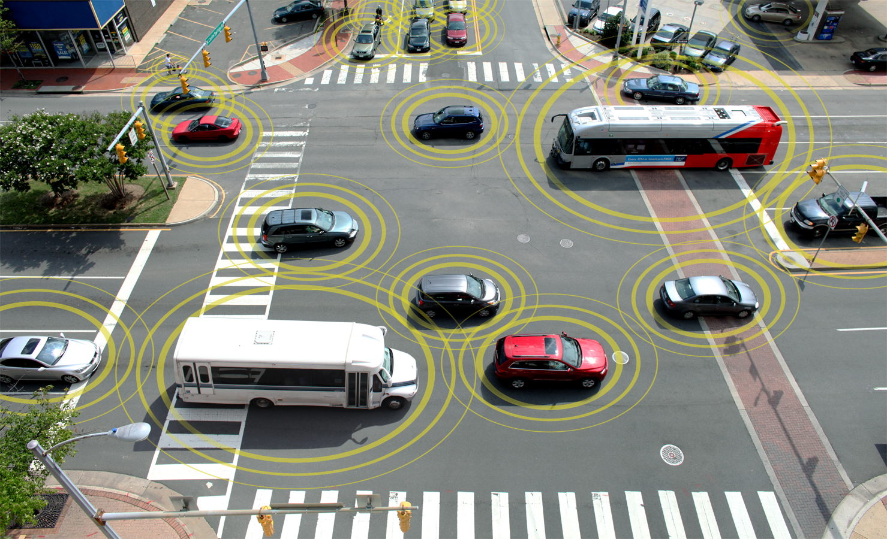
Connected Vehicles

Slide 7
System-Level User Needs
DSRC was developed to satisfy certain, key system-level user needs
First, the system
All of the resources available
Where DSRC fits in

Slide 8
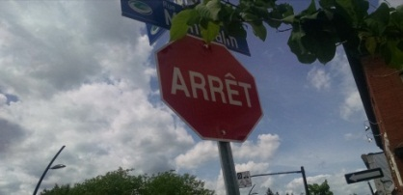
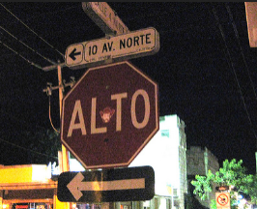
Uniform Implementations
Source: USDOT
The Internet of Something Big
Reference architecture
Consensus definitions
Opportunity for a common experience, ability to do more
Source: Flicker
Notes:
Transportation has passed the “Internet of Things” and has moved on to the Internet of Something Big
We are borrowing heavily on our experience of building important infrastructure on a continent-wide scale
- transcontinental railroad networks, Interstate Highway system, etc.
Uniform deployment based on concepts developed in Southeast Michigan 2014 project.
Fundamental elements of the system will be interoperable.
Reference architecture for consistent implementations
Consensus definitions, interpretation of standards for fundamental data elements
Common communication security practice
Provide for the opportunity for a common experience, the ability to do more.
Goal is continent-wide deployment. Everything in the testing is being developed to be deployed on a much larger scale.
Comments and critiques are welcome

Slide 9
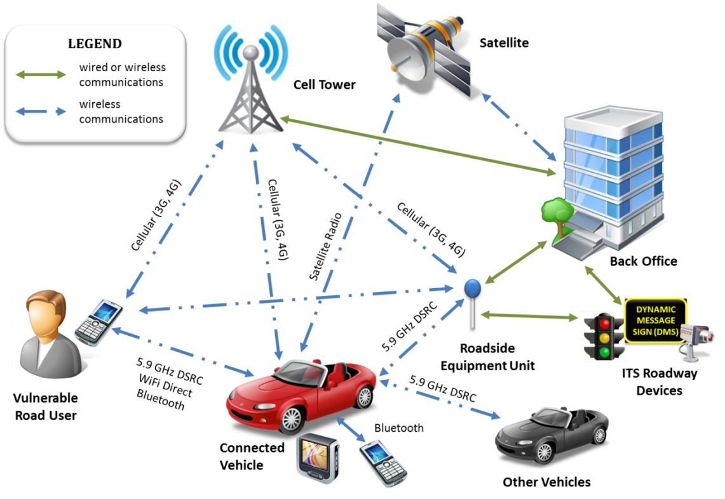
Connected Vehicle Physical View
5.9 GHz DSRC

Slide 10
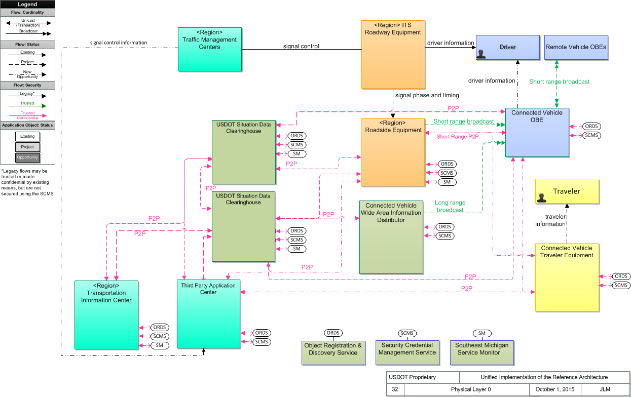
Unified Implementation of the CVRIA
Connected Vehicle Reference
Implementation Architecture.
Makes use of all available communication media.
Uniform data unit definitions.
Architecture site
http://standards.its.dot.gov/DevelopmentActivities/CVReference
SET-IT tool site
Version 2.1
Sample project
http://www.iteris.com/cvria/html/resources/tools.html
Notes:
Need to start with an understanding of the complete connected intelligent transportation system so you will know all of the parts that will be needed.
The Unified implementation of the Reference Architecture embodies the fundamentals we need to work on:
- All elements of a connected vehicle system – mobile, field, center.
- Multiple communication media, wired and wireless, end-to-end, with a common process for assuring trust and protecting confidentiality.
Data abstraction points to facilitate data flow and aggregation. A place is provided for multiple application interest groups to connect up and use (and contribute to) the flow.
************
The things in the boxes are physical objects. Lines are information flows
- The blue boxes (upper right) are inside the vehicle
- Yellow boxes are travelers and their equipment
- In the middle (orange and teal) exist at the boundary between moving and fixed elements. Bridge between wired and wireless
- On the left side (green) : fixed infrastructure – they exist somewhere at an IP address. Data are gathered and aggregated and synthesized
- Black oval: facilitate the flow of the fundamental data that all travelers need.
- Bottom (dark green): support services for overall concept – to make it all work
This is the kind of system that we think could be scaled up to national level

Slide 11
USDOT System-Level User Needs
Communication security
Common process for all information flows
Preserving “Privacy by Design”
Data flow and evolution
Common movement processes
Two types of data
Multiple communication media
DSRC on all 7 channels
Established wireless media
Other IP transport media
Tools
Consistent implementations
“The opportunity for a common experience.”
“The ability to do more.”
Notes:
Supports the overall strategic objective of INTEROPERABILITY
Goal: nationwide or even continent-wide deployment
Communication/security: communication security practices apply to ALL information flows throughout entire system. Can be applied to any communication medium regardless of where it sits in the architecture
Privacy by design: want to perpetuate the concepts tested in Ann Arbor and apply them to entire system
Data flow/evolution: needs to be able to scale up to a national level. Architecture designed to support 2 types of data:
* Data that everybody should have access to in a CV environment, and everybody should be able to contribute to
* Metaphor: Red octagon stop sign, three color traffic light
* Private data used to support P2P transactions – maintenance, management, enforcement, and commercial
Multiple communication media: working on getting them all to function together seamlessly.
Tools: convenient way to share knowledge / institutionalize knowledge, to share with people who will actually implement the CV projects. To support interoperability with previous work, and other projects being developed concurrently

Slide 12
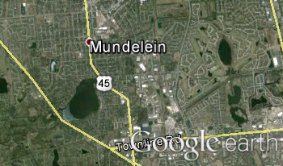
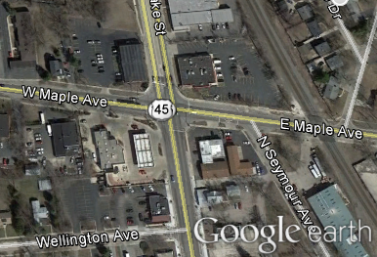
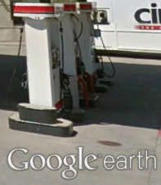
A Variety of Communication Media, Data Needs
Resources: wired and wireless, the Internet
3,000 miles, 3,000 meters, 300 meters, 3 meters.
Continent-Wide
Wide Area Network
5.9GHz DSRC
Local Area
Network
Requirements: Two types of data distribution
To all, to one
Notes:
We think that there are three things that if done well will project connected intelligent transportation systems into the “after” state:
To accomplish transportation application goals, we have a number of communication resources that have to be properly, efficiently melded together, and
There are two classes of data used in transportation systems.
Those two things can then be unified through well-organized tools.
*******************************

Slide 13
Dedicated Short Range Communications
What it is
Low latency, Wi-Fi-like medium adapted for vehicle environment
Original FCC spectrum allocation in 1999
FCC revised allocation in 2004 and 2006
How the technology works
Data can be distributed in a broadcast mode (300m range – line of sight)
Peer-to-peer data exchanges as well
Engineered to work well in a moving vehicle environment
Privacy is protected
Notes:
Purpose of Slide: Explain how the DSRC communications technology works.
Transition: Here’s how it works.
Key Messages: Data is transmitted 10 times a second, up to 300 meters in the line of sight. Privacy is protected, and the vehicle will never be recorded or tracked.
Interactivity: Ask participants: What kind of messages are transmitted? The answer is basic safety messages, such as vehicle position, speed, heading, acceleration, size, and brake system status.

Slide 14
DSRC Basics
Source: FCC Report and Order FCC 03-324
Packet-based medium based on IEEE 802 family specifications for lower-layer definition
Additional network layer definitions and a cryptographic process for establishing trust and protecting confidentiality given in IEEE 1609 family
Payload definitions and performance requirements for common data units established in SAE standards
General IP transport available with certain priority requirements and packet size limitations

Slide 15
Why DSRC?
DSRC was developed with a primary goal of enabling vehicular safety applications.
It is the only short-range wireless alternative today that provides:
Fast Network Acquisition
Low Latency
High Reliability when Required
Priority for Safety Applications
Interoperability
Security and Privacy
Notes:
DSRC was developed with a primary goal of enabling vehicular safety applications. DSRC is the only short-range wireless alternative today that provides:
Fast Network Acquisition: Active safety applications require immediate establishment of communication.
Low Latency: Active safety applications must execute in the smallest amount of time possible.
High Reliability when Required: Active safety applications require high level of link reliability.
It works in high vehicle speed mobility conditions.
Its performance is immune to extreme weather conditions (e.g. rain, fog, snow, etc.).
Priority for Safety Applications: Safety applications on DSRC are given priority over non-safety applications.
Interoperability: DSRC ensures interoperability, which is the key to successful deployment of active safety applications. It also supports both vehicle-to-vehicle and vehicle-to-infrastructure communications.
Security and Privacy: DSRC provides safety message authentication and privacy.

Slide 16
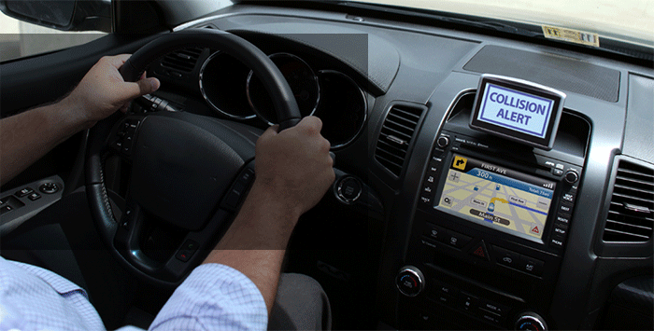
Aftermarket Vehicle Devices
A device installed in a vehicle capable of sending and receiving DSRC messages. These devices have a working human-machine interface (HMI); run V2V and V2I applications and issue audible or visual warnings and/or alerts to the driver of the vehicle.
Notes:
An aftermarket automotive grade electronic device installed in a vehicle, without connection to vehicle systems, that is capable of sending and receiving the safety messages, as defined in Society of Automotive Engineers (SAE) standard J2735, Dedicated Short Range Communications (DSRC) Message Set Dictionary, version 2009-11, over a Dedicated Short Range Communication (DSRC) 5.9 GHz wireless communications link. The device has a working human-machine interface (HMI); runs V2V and V2I applications and issues audible or visual warnings and/or alerts to the driver of the vehicle in which it is installed; and has internal permanent storage capability.

Slide 17
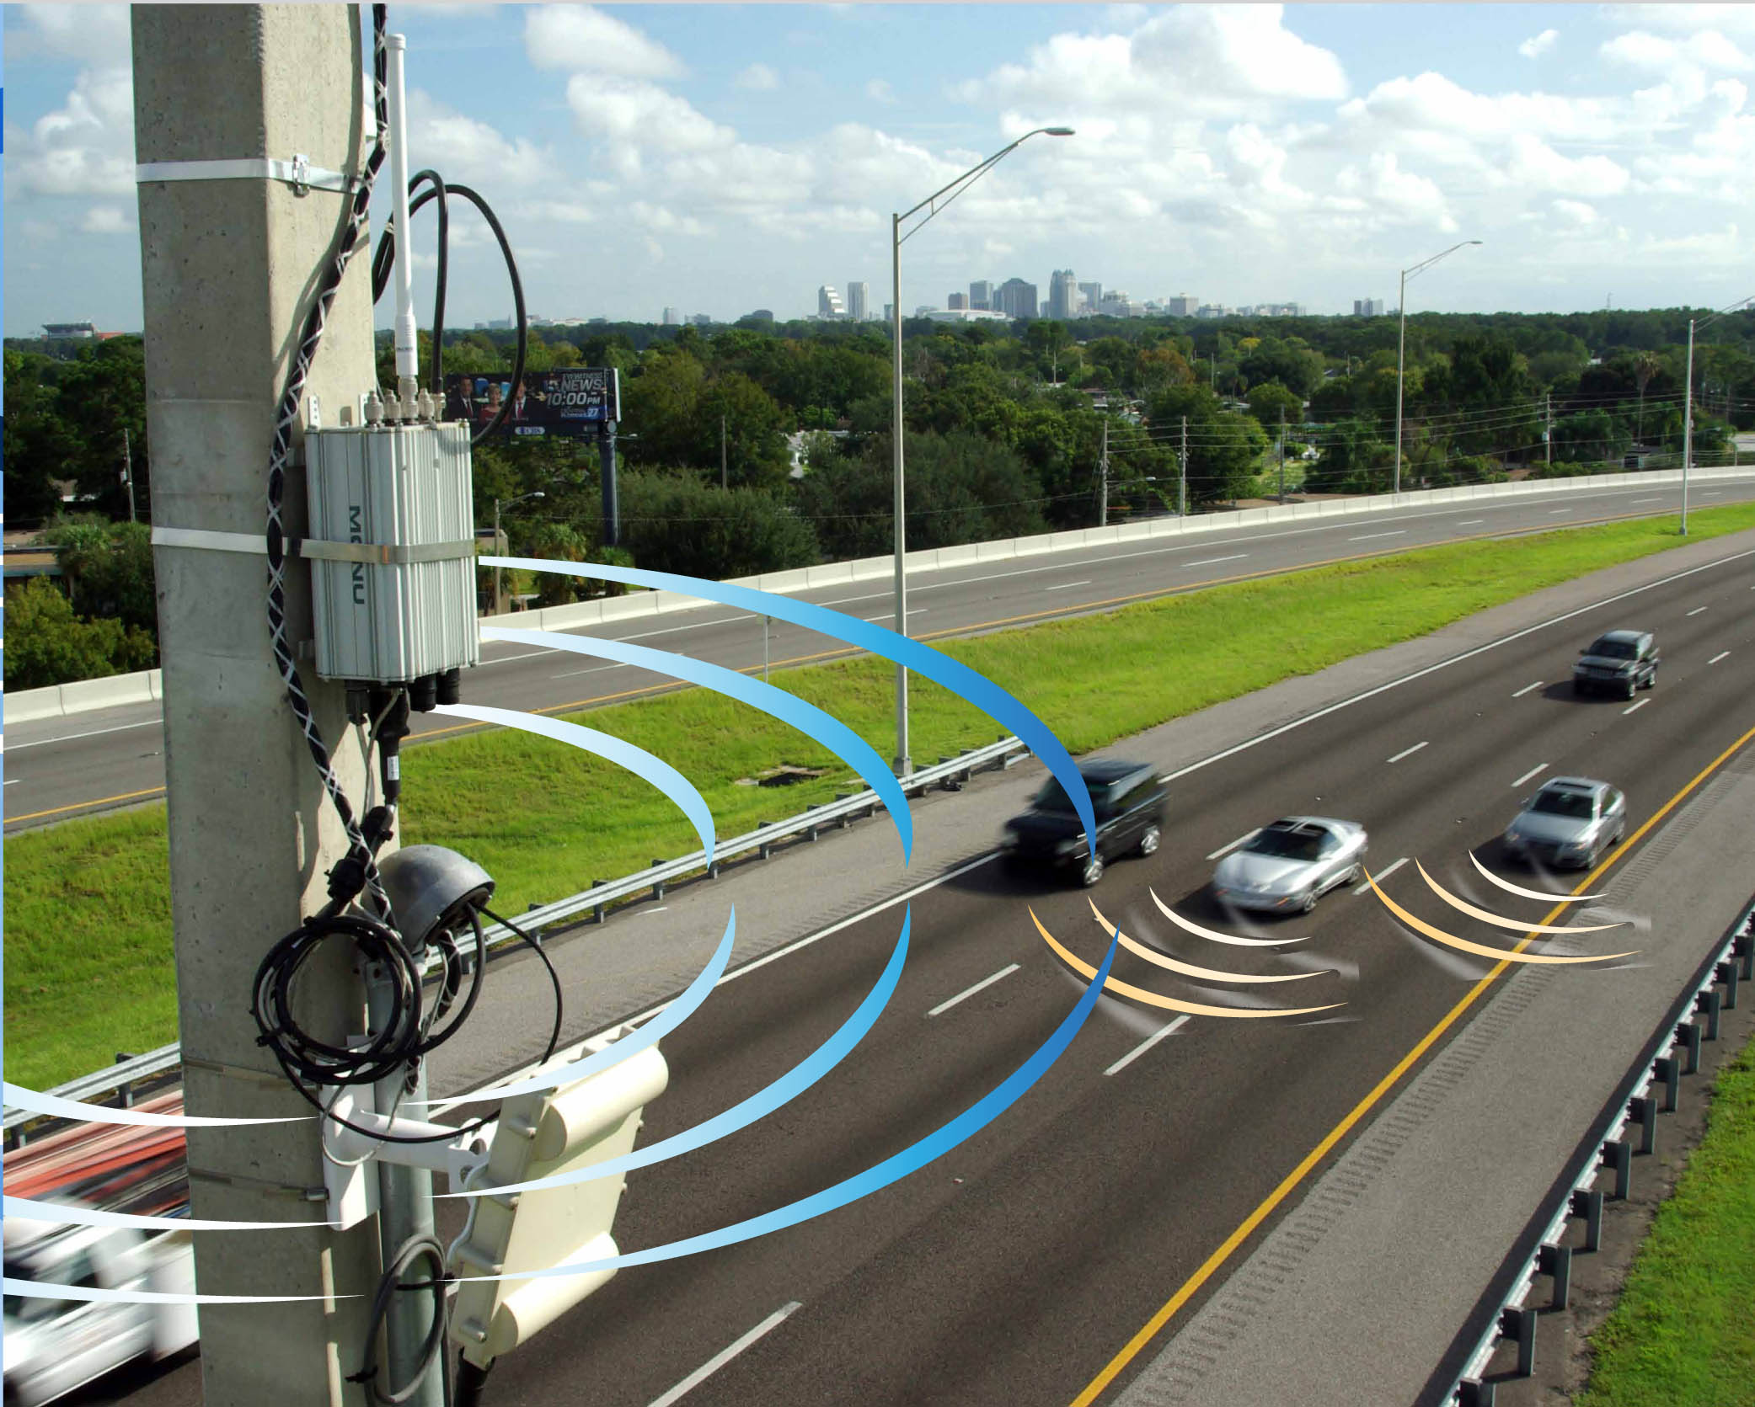
Roadside Equipment Unit
Devices installed along the roadway capable of sending and receiving DSRC messages…and can interface with traffic control systems (e.g., traffic signal controllers)

Slide 18
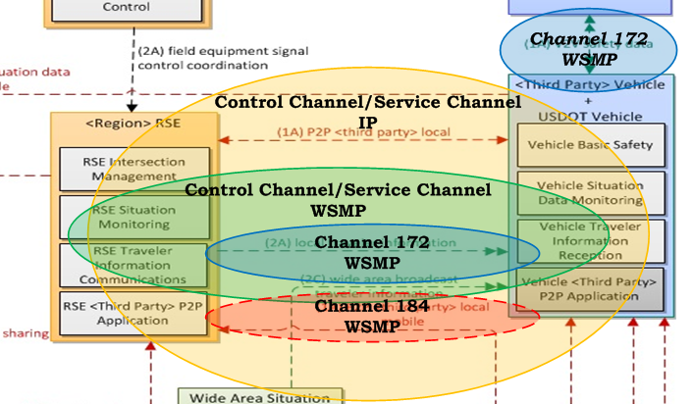
DSRC in the Reference Architecture
DSRC has 4 parts
Channel 172 WSMP for time critical, very efficient data sharing for crash avoidance and efficiency improvement
Channel 184 WSMP for Public Service use
Control Channel/Service Channel (Channels 174 – 182) for other WSMP
Control Channel/Service Channel (Channels 174 – 182) for IP transport
Notes:
Need to understand all of the parts of DSRC.
DSRC can be deployed as separate parts by independent but cooperating parties.

Slide 19
WSMP Transported SAE J2735 Data Units
SAE J2735 specifies a message set, and its data frames and data elements originally for use by applications intended to utilize the 5.9 GHz Dedicated Short Range Communications for Wireless Access in Vehicular Environments (DSRC/WAVE, referenced in this document simply as “DSRC”), communications systems.
Data units that follow the SAE J2735 definition are now transported by other media.
SAE J2735 Messages
A la Carte (ACM)
Basic Safety Message (BSM)
Common Safety Request (CSR)
Emergency Vehicle Alert (EVA)
Intersection Collision Avoidance (ICA)
Map Data (MAP)
NMEA Corrections (NMEA)
Probe Data Management (PDM)
Probe Vehicle Data (PVD)
Roadside Alert (RSA)
RTCM Corrections (RTCM)
Signal Phase and Timing (SPaT)
Signal Request Message (SRM)
Signal Status Message (SSM)
Traveler Information Message (TIM)
Notes:
SAE J2735 specifies a message set, and its data frames and data elements specifically for use by applications intended to utilize the 5.9 GHz Dedicated Short Range Communications for Wireless Access in Vehicular Environments (DSRC/WAVE, referenced in this document simply as “DSRC”), communications systems.
Although the scope of the standard is focused on DSRC, the message set, and its data frames and data elements have been designed, to the extent possible, to also be of potential use for applications that may be deployed in conjunction with other wireless communications technologies.

Slide 20
Maturity Levels
4 levels of maturity in the use of DSRC:
DSRC on Channel 172 for crash avoidance
Safety Pilot/Model Deployment
DSRC on Channel 172 for intersection safety and efficiency improvement
DSRC on All Channels for a variety of message-based uses
Connected Vehicle Pilots
DSRC on all channels for message-based and IP transport-based uses.
No one entity has to build all of the parts
Different parties can contribute parts of the whole
Notes:
Internet Protocol transport is the one part of DSRC that has not been explored greatly.
IP transport will likely be a very useful companion to WAVE Short Protocol transport.
Range finding opportunities are a useful byproduct of a complete deployment of DSRC IP gateways in stage 4.

Slide 21
DSRC – a Key Part of Communications
Large-scale pilots are underway that will exercise the complete system architecture with the full capability of DSRC
We have arrived at a consensus of interpretation of standards for the next generation of installations
Production programs are underway
DSRC is ready to be part of the next Generation of Wireless Media
Notes:
A new medium to cover use cases that involve moving vehicles does not need to be invented.
DSRC as we know it today already exists!

Slide 22
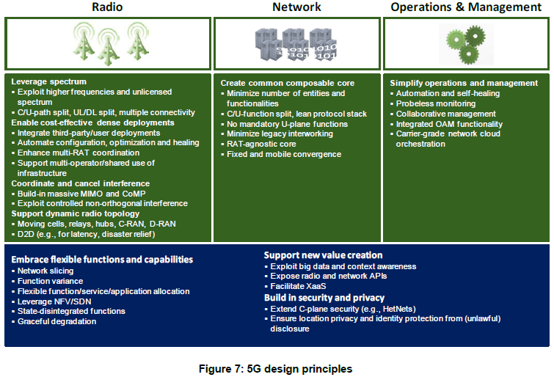
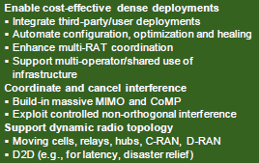
Looking Forward to the Next Generation
Better coordination of Radio Access Technologies
Opportunity of preserve the capabilities of DSRC in a portfolio of wireless services
DSRC could cover significant vehicle-oriented use case needs
NGMN 5G White Paper, Next Generation Mobile Networks Alliance, 17 February, 2015
Notes:
The NGMN Alliance white paper is available at https://www.ngmn.org/uploads/media/NGMN_5G_White_Paper_V1_0.pdf
Look at the use cases given.
DSRC (as one of the “embraced” other RAT’s) could support those cases as it is designed today.

Slide 23
Main Points
Scalable to a continent-wide deployment
Not just a smart city but a smart continent with uniform implementations and ubiquitous access for fundamental elements
Demonstrates full utility of assets
All of the capabilities of spectrum allocations are demonstrated and effective ways of sharing capacity are shown.

Slide 24
Beyond Traffic: The Smart City Challenge
For More Information

Slide 25
Beyond Traffic: The Smart City Challenge
Past Information Sessions
Data, Architecture, and Standards (Virtual) 12/16/2015 (1:00 to 2:30 pm EST)
Connected Vehicles and Automation (Virtual) 12/17/2015 (1:00 to 2:30 pm EST)
Sharing Economy, User-Focused Mobility, and Accessible Transportation (Virtual) 12/18/2015 (1:00 to 2:30 pm EST)
The Smart City Challenge Application and Selection Process (Virtual) 12/21/2015 (1:00 to 2:00 pm EST)
Urban Freight Delivery and Logistics (Virtual) 1/6/2016 (11:30 am to 1:00 pm EST)
To access presentations and recordings, visit: https://www.transportation.gov/smartcity/infosessions

Slide 26
Beyond Traffic: The Smart City Challenge
Information Sessions
Link Between Beyond Traffic and The Smart City Challenge (Virtual) 1/14/2016 (1:30 to 2:30 pm EST)
Smart City Challenge Application Homestretch – An Open Q&A Session (Virtual) 1/19/2016 (12:00 to 1:00 pm EST)
Understanding Dedicated Short Range Communications (DSRC) (Virtual) 1/21/2016 (12:00 to 1:00 pm EST)
For More Information and RSVP Information on upcoming webinars, visit: https://www.transportation.gov/smartcity/infosessions

Slide 27
Beyond Traffic: The Smart City Challenge
For More Information and Questions
Department of Transportation
https://www.transportation.gov/
Smart City Challenge
www.transportation.gov/smartcity
Questions?
SmartCityChallenge@dot.gov
Notes:
Brian Cronin

