Slide 1
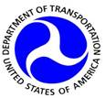
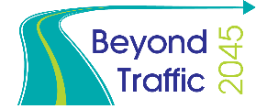
Beyond Traffic: The Smart City Challenge
Information Session #3:
The Sharing Economy, User-Focused Mobility, and Accessible Transportation
December 18, 2015
U.S. Department of Transportation (USDOT)
Notes:
Gwo-Wei:
Greetings, everyone. Thank you for joining us today for the third webinar in a series of informational presentations on the Smart City Challenge.
I am Gwo-Wei Torng, Director of Mobility Innovation at the Federal Transit Administration, or FTA. I will be one of three presenters today and we look forward to discussing with you how the sharing economy, new user-focused mobility models and accessible transportation support a Smart City.
NEXT

Slide 2

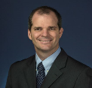

Mohammed Yousuf
ATTRI Program Manager
Federal Highway Administration
Mohammed.Yousuf@dot.gov
Bob Sheehan
Multimodal and V2I Program Manager
ITS Joint Program Office
Robert.Sheehan@dot.gov
Gwo-Wei Torng
Director, Mobility Innovation
Federal Transit Administration
Gwo-Wei.Torng @dot.gov
Notes:
Gwo-Wei:
As I stated, I will be one of three presenters today.
First, I would like to introduce Bob Sheehan from the Intelligent Transportation Systems (ITS) Joint Program Office, or as we call it, ITS JPO. Bob is a program manager at JPO for various program and initiatives which work across U.S.DOT including the Vehicle to Infrastructure initiative within the Connected Vehicle program and all things multimodal. We will discuss a few of his programs later.
Second, I would like to welcome Mohammed Yousuf. Mohammed leads up a very innovative program that works across the department, bringing attention to and developing solutions for accessible transportation. We will also cover the Accessible Transportation Technology Research Initiative or ATTRI today.
Before we get started, though, I want to pass the microphone over to Brian Cronin, ITS Team Leader of the Intelligent Transportation Systems Joint Program Office, who will review some overarching general information on the Smart City Challenge.
BRIAN, …
NEXT

Slide 3

Beyond Traffic: The Smart City Challenge
Encourage cities to put forward their best and most creative ideas for innovatively addressing the challenges they are facing.
The Smart City Challenge will address how emerging transportation data, technologies, and applications can be integrated with existing systems in a city to address transportation challenges.
Demonstrate how advanced data and intelligent transportation systems (ITS) technologies and applications can be used to reduce congestion, keep travelers safe, protect the environment, respond to climate change, connect underserved communities, and support economic vitality.
Notes:
Brian Cronin

Slide 4
Beyond Traffic: The Smart City Challenge
Phase 1 (Deadline February 4, 2016):
Support concept development and planning activities
Estimated five Smart City Challenge Finalists
$100K each
Phase 2 (Solicitation and Deadline TBD):
Smart City Challenge Finalists
Support implementation of their proposed demonstration
$50 Million
  U.S. Department of Transportation: $40 Million
  Vulcan Foundation: $10 Million
Notes:
Brian Cronin

Slide 5
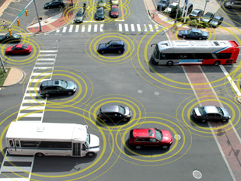
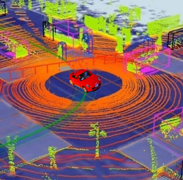

Advanced Technologies and Smart Cities
Technology convergence will revolutionize transportation, dramatically improving safety and mobility while reducing costs and environmental impacts
Connected Vehicles
Benefits
Order of magnitude safety improvements
Reduced congestion
Reduced emissions and use of fossil fuels
Improved access to jobs and services
Reduced transportation costs for gov’t and users
Improved accessibility and mobility
Vehicle Automation
Connected-Automated Vehicles
Internet of Things
Machine Learning
Big Data
Mobility on Demand
Smart Cities
Notes:
Brian Cronin

Slide 6
The USDOT’s Vision for a Smart City
The USDOT recognizes that each city has unique attributes, and each city’s proposed demonstration will be tailored to their vision and goals.
The USDOT’s vision for a Smart City Challenge is “to identify an urbanized area where advanced technologies are integrated into the aspects of a city and play a critical role in helping cities and their citizens address challenges in safety, mobility, sustainability, economic vitality, and address climate change.”
To assist cities, the USDOT identified twelve (12) vision elements that are intended to provide a framework for Applicants to consider in the development of a city’s proposed demonstration without making each item a requirement for award.
Notes:
Brian Cronin

Slide 7

Beyond Traffic: The Smart City Challenge
Technology Elements (Highest Priority)
Vision Element #1
Urban Automation
Vision Element #2
Connected Vehicles
Vision Element #3
Intelligent, Sensor-
Based Infrastructure
Innovative Approaches to Urban Transportation Elements (High Priority)
Vision Element #4
User-Focused Mobility
Services and Choices
Vision Element #5
Urban Analytics
Vision Element #6
Urban Delivery and
Logistics
Vision Element #7 Strategic Business Models & Partnering
Vision Element #8
Smart Grid, Roadway
Electrification, & EVs
Vision Element #9 Connected, Involved Citizens
re-charging
Smart City Elements (Priority)
Vision Element #10 Architecture and
Standards
Vision Element #11
Low-Cost, Efficient,
Secure, & Resilient ICT
Vision Element #12
Smart Land Use
Notes:
Brian Cronin
The USDOT is encouraging Applicants to consider the twelve elements in developing ideas for developing their city’s vision for a Smart City.
Applicants should consider how emerging transportation data, technologies, and applications can be integrated with existing systems across a city, helping both cities, citizens, and businesses achieve goals for safety, mobility, sustainability, and economic vitality in an increasingly complex, interdependent and multimodal world.

Slide 8


Beyond Traffic: The Smart City Challenge
Technology Elements (Highest Priority)
Vision Element #1
Urban Automation
Vision Element #2
Connected Vehicles
Vision Element #3
Intelligent, Sensor-
Based Infrastructure
Innovative Approaches to Urban Transportation Elements (High Priority)
Vision Element #4
User-Focused Mobility
Services and Choices
Vision Element #5
Urban Analytics
Vision Element #6
Urban Delivery and
Logistics
Vision Element #7 Strategic Business Models & Partnering
Vision Element #8
Smart Grid, Roadway
Electrification, & EVs
Vision Element #9 Connected, Involved Citizens
re-charging
Smart City Elements (Priority)
Vision Element #10 Architecture and
Standards
Vision Element #11
Low-Cost, Efficient,
Secure, & Resilient ICT
Vision Element #12
Smart Land Use
Notes:
Brian Cronin
In this session, we will hope to touch upon a few of the growing trends which are mobilizing opportunities for the creation of a smart city such as the sharing economy, review a recently conceived program of USDOT that will engage these trends in personal mobility, known at Mobility on Demand (MOD) and encourage a discussion about other aspects of a Smart City.
Thanks for your attention. At this time I will turn the presentation back over to Gwo-Wei.
Gwo-Wei, ….

Slide 9
Webinar Overview
Overview of the Beyond Traffic: The Smart City Challenge
An Evolving Transportation Ecosystem
Enabling Factors and Trends
Current Initiatives and Programs
Changing Perceptions
For More Information
Notes:
Gwo-Wei:
Thanks for the information Brian. At the end of our presentation we will provide you with some additional information and websites where you can continue to receive information on the Smart City Challenge.
Okay, let’s get started. Let’s quickly review our agenda.
Today will briefly discuss Beyond Traffic, an effort Secretary Foxx has led which is the genesis of the Smart City Challenge, we will discuss trends leading to an evolution in our transportation ecosystem, some additional factors enabling this evolution, we will highlight some examples of current and ongoing research initiatives which support Smart Cities, and end with a conversation around changing perceptions of transportation.
At the end, we will review how you can stay connected with the Smart City Challenge
NEXT

Slide 10
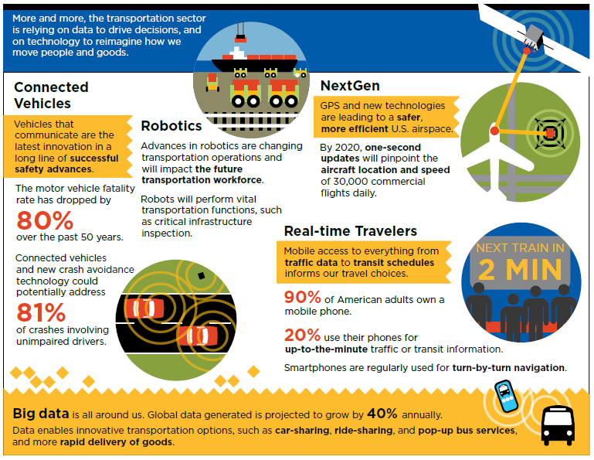
Beyond Traffic 2015 - How Will We Move?
Source: USDOT Beyond Traffic 2045
Notes:
Gwo-Wei:
At a high level, the U.S.DOT is changing its way of thinking and setting policies to ensure that we have a world-class transportation system in the future. One example, is the Beyond Traffic 2045 report and the subsequent Smart City Challenge. Beyond Traffic is intended to drive discussion for stakeholders to have a conversation about the shape, size, and condition of the future transportation system and how it will meet the needs and goals of our nation for decades to come.
Today, we want to take that conversation one step further and engage you on what a Smart City looks like. In particular, how shared-use, user-focused mobility and accessibility are essential to a Smart City.
If 30 years in the future looks far away, look back just 15-years ago. Now look forward just 15-years. A lot has changed and will change and we need to be prepared to accommodate population growths, changes in demographics, and financial and infrastructure challenges.
We need to begin leveraging technological advances and finding new ways to meet the challenges of tomorrow as well as addressing new trends and demographics.
This is an infographic from Beyond Traffic that nicely depicts some of the trends documented in the report. If you have not read it, I highly suggest you do.
NEXT

Slide 11
Evolving Transportation Ecosystem
Population growth
Changes in demographics
Highest transit ridership since 1950s
Technological advances
Financial and infrastructure challenges
Need new approach to meet challenges of tomorrow
TRADITIONAL
ITS ENABLED
TRENDING
CONNECTED
SMART
Privately owned vehicles
Lack of mobility options
Services in Siloes
Integrated services and payment
Transit prioritization
Trip planning applications
Mobility options presented through mobile technology
Personalized mobility choices
Growing shared use business models
Real-time multimodal information
Dynamic management of infrastructure
Universal payment systems
Automated vehicles
Seamless mobility connections
Predictive data and real-time info exchange
Notes:
Gwo-Wei:
Our transportation Ecosystem is evolving. There are new ways of doing business, new demands on our infrastructure, and new technological tools to take advantage of as we design our Smart Cities of the future. Whole this new environment may pose new challenges, opportunities abound.
Here at U.S.DOT we see a natural progression from traditional transportation operations to those that are smart, utilizing ITS technology, leveraging new business models, and focusing on unique customer needs will create an environment where individual mobility demands are met seamlessly.
From a transit perspective, among the challenges and opportunities we see include :
Today we have the highest transit ridership since the 1950s.
That will continue grow as the U.S. population both increases and becomes proportionally older.
Many of the fastest growing jobs and industry sectors are the very ones whose employees rely most heavily on transit.
That includes technology that’s already here today and technology that’s on the horizon.
With the collective know-how of transit agencies across the country – and the world – we can apply that technology to continue providing a safe and reliable transportation option.
In the end, we must be reactive and proactive to meet future mobility needs.
NEXT

Slide 12

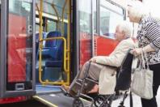
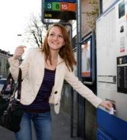


Growing Mobility Demands
Growing Mobility Demands
Aging Americans Require Mobility Choice: The number of older Americans is rapidly increasing. In 2020 there will be 30 million additional people age 60 or older than there were in 2005. Unique mobility options are needed for “Aging in place”.
All Travelers Need Mobility Choice: All travelers including travelers with disabilities, low income individuals and minors need better mobility choices for their independent travel. Reliable and accessible point to point transportation is essential for all travelers.
Millennial Americans Want Mobility Choice: Public transportation utilization is on the rise. Younger generations want both convenience and cost savings and over 65% of Millennials consider transportation as an important factor in housing decisions.
Notes:
Gwo-Wei:
There are three main reasons why new mobility concepts within a Smart City are critical to the future of the U.S. and its transport system:
The number of older Americans is rapidly increasing as the Baby Boomers begin to retire. There will be 30 million additional people age 60 or older in 2020 than there were in 2005. While many older Americans are still driving today, those individuals will at some point be unable to provide their own transportation due to either physical or mental disabilities or possibly because they may no longer be able to afford to own and maintain their own vehicles. MOD affords older Americans the opportunity to age in place and live independently for longer periods of time than they can currently.
http://www.ncsl.org/documents/transportation/aging-in-place-2011.pdf
Americans who rely on paratransit services, including the elderly, those with disabilities, and low income individuals, need improved personal mobility options. They currently are generally required to request trips at least 24 hours in advance, through systems that can be confusing to individuals. They also may experience lengthy rides that can be over an hour long to go a few miles from home. When the vision of MOD is realized, these individuals will be afforded levels of personal mobility that are comparable with those of individuals driving their own vehicles.
Lastly, Millennial Americans want MOD. Studies and surveys of Millennials show that they are choosing to take public transit (for both convenience and cost savings) and that for 66%, it factored into deciding where to live. The success of companies such as Uber and RideScout show that there is a market demand for door-to-door services at varying price points.
http://www.apta.com/resources/reportsandpublications/Documents/APTA-Millennials-and-Mobility.pdf
http://www.usatoday.com/story/money/personalfinance/2014/04/24/millennials-prefer-public-transportation/8097555/
Thank you for listening. Now that we have covered some of the trends and demands of our Evolving Transportation Ecosystem, Bob will take over and review some enabling technologies and solutions appearing within the marketplace which enable a Smart City.
BOB, …

Slide 13
Enabling Technological and Operational Solutions
New technological and operational solutions have emerged including new business models and partnerships that can be leveraged to solve transportation problems in new ways. These solutions can assist breaking down institutional, technological and operational barriers and provide new opportunities for individual mobility. Some examples include:
  Shared Use Economy
  Advances in ITS
  Smart Payment and Parking
  Integration of Data and Systems
  Connected Travelers
  Bus Rapid Transit (BRT)
  Wayfinding and Navigation
Open Data Standards
Connected Automation
Wearable and Mobile Technologies
Robotics and Machine Vision
Innovative Partnerships and Business Models
Transportation Network Companies
Notes:
Bob:
Thanks, Gwo-Wei. I really appreciate the opportunity to be with you all here today. These are all topics I am highly passionate about and I can’t say how excited I am to be involved in this new effort, the Smart City Challenge
For my part, I would like to review with you some new technological and operational solutions that have emerged including new business models and partnerships that can be leveraged to solve transportation problems in new ways. These solutions can assist breaking down institutional, technological and operational barriers and provide new opportunities for individual mobility.
Let’s review some examples.
NEXT

Slide 14
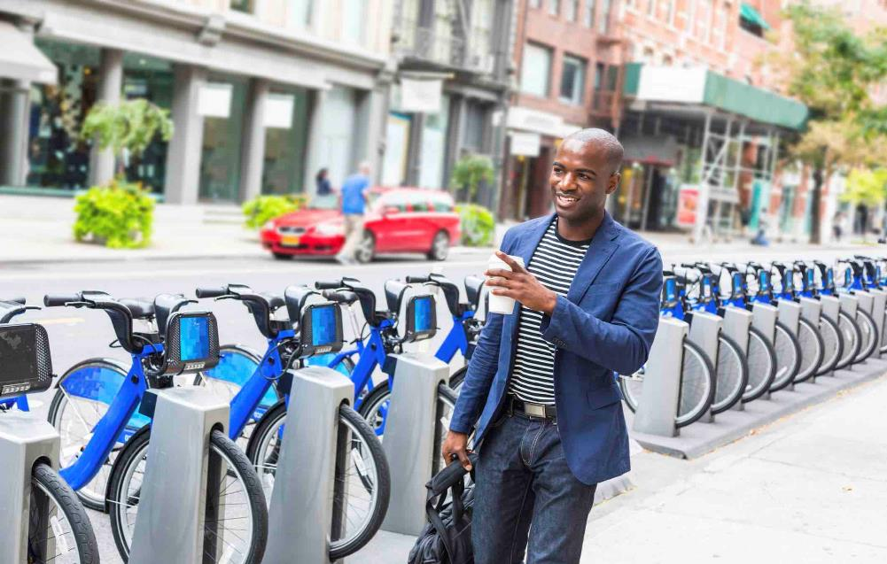
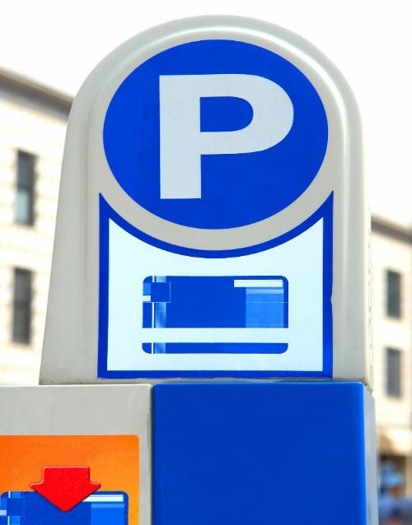
Shared Use Economy
The sharing economy uses the Internet and mobile apps to allow individuals to monetize underutilized space, assets, and skills.
New business models are proliferating faster than the legal and regulatory arenas can adapt to them.
Over the next 30 years, our legal and regulatory system may be increasingly challenged by emerging forms of business and travel that transcend traditional legal and planning concepts.
Notes:
Bob

Slide 15

Connected, Involved Citizens
Cities are deploying mobile apps that make it easy for citizens to report a problem.
Using the problem’s location and category, it sends a report by email to the responsible department for action.
Reports are visible to everyone on a public site – anyone can see what’s already been reported, leave updates, or subscribe to alerts.
Notes:
Bob

Slide 16
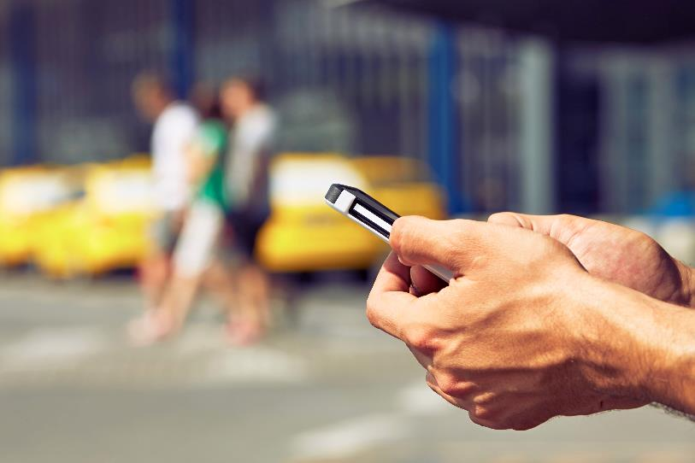
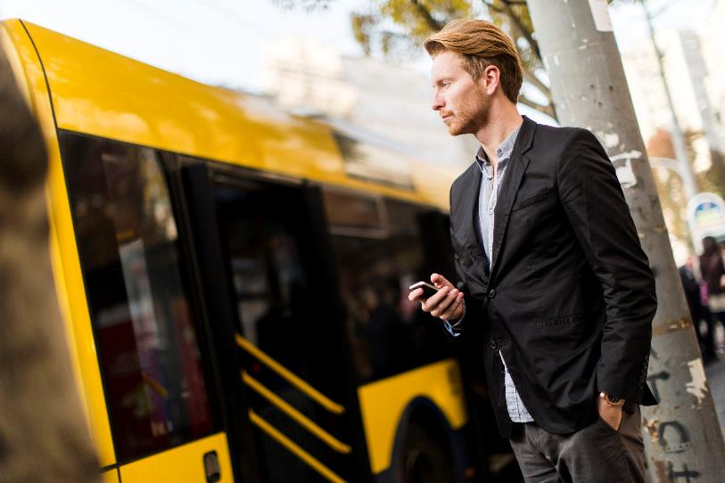
On-Demand Services & Ride Sourcing
On-demand systems such as bikesharing and carsharing combined with new ride sourcing application and transportation network companies are changing the people move about.
Microtransit companies engaging the public sector through new partnerships are changing the way we think about integrating transit and solving first and last mile access issues.
These new opportunities are changing the way we travel throughout our cities and provide real point-to-point mobility in real-time.
Notes:
Bob

Slide 17
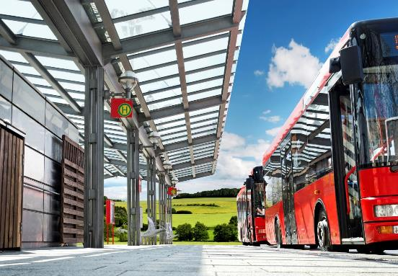
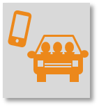
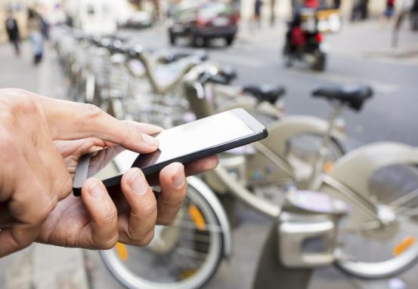
Vision Element #6: User-Focused Mobility
Services and Choices
Mobility as a Service (MaaS)
Across Europe, cities are deploying a systems that integrate various forms of shared and public transport in a single payment network.
These systems allow people to purchase mobility in real-time, straight from their smartphones.
The hope is to furnish riders with an array of flexible and well-coordinated options so that alternative modes become more competitive with private car ownership.
Notes:
Bob

Slide 18
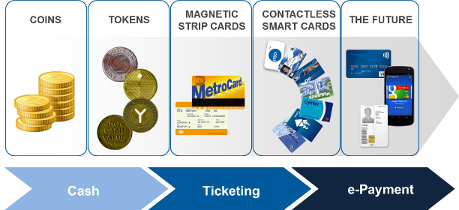
Payment – Connected, Integrated,
& Customer Centric
Collecting cash is slow, requires lots of handling, leads to inflexible payment schedules, is expensive to collect, and insecure.
Payment systems create a relationship with a service provider and connect the individual to the system.
Payment systems are becoming more integrated, flexible and connected.
Notes:
Bob:
One great example of how FTA and public transportation is relevant in this new transportation environment is in the context of payment systems. Historically, public transportation has evolved in this arena from cash and tokens to now using mobile technology. Throughout history, it has been transit’s role to establish relationships with its customer and technologies are allowing this relationship to develop more so.
As payment systems become more flexible, integrated and connected, so must our transportation systems. This integration will create more flexibility, additional transportation options and greater individual mobility.

Slide 19
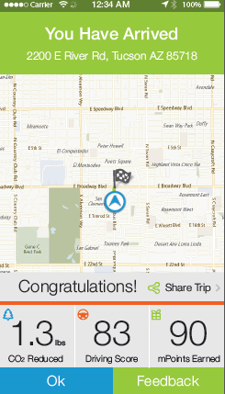
Traveler Behavior, Gamification, Smartphones and Public Agency Partnerships
Transportation agencies and third parties are obtaining a variety of crowdsourced data via “passive” users whose mobile phones and vehicles act as probes for data collection.
Artificial intelligence and enhanced data analytics linked with personal profiles and user needs can assist with individual mobility choices.
Technologies and applications are being developed to aggregate and infer further data, such as volumes, incident detection, and additional weather and infrastructure condition information.
Gamification and incentives are also techniques are also be further engage, persuade and empower participants to solve large-scale, real-world challenges.
Source: Metropia
Notes:
Bob

Slide 20
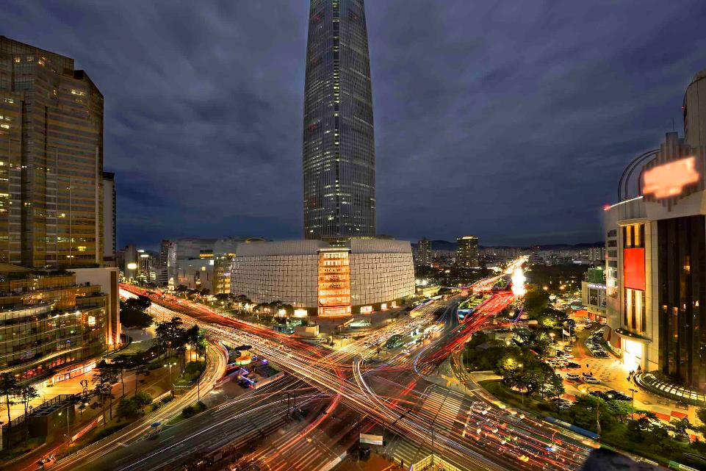
Incentives
Seoul’s eco-mileage program is aimed at reducing greenhouse gas (GHG) emissions and global warming by improving energy efficiency and saving energy.
Citizens may earn card points by using public transportation and other eco-friendly forms of transportation; this is possible through the city administration’s memorandum of understanding (MOU) with BC Card, Korea’s biggest credit card company.
The incentives are a motivating factor for energy conservation for many citizens, and enhancing their commitment to environmental protection.
Notes:
Bob

Slide 21
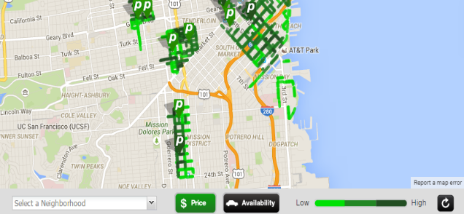
Demand-responsive Parking Management
Demand-responsive parking aligned with dynamic pricing and management systems provide real-time parking availability information for on- and off-street parking.
In a Smart City environment parking can be managed by incrementally raising or lowering parking prices based on demand to maintain a minimum level of parking availability.
Managing parking also aligns well with demand management strategies.
Notes:
Bob

Slide 22
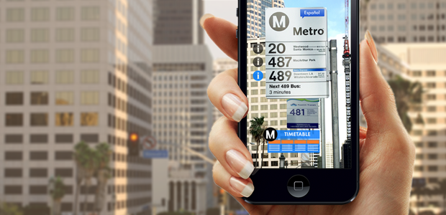
Augmented Reality
Using a smartphone's location data along with the phone’s camera to detect points of interest, augmented reality can deliver, in real-time, data a city chooses to make available – from wayfinding and navigation information, to transit schedules and traffic reports.
Information about local events, accessible amenities, emergency service facilities or the number of available parking spots in a parking garage can also be transmitted.
Source: CivicAR https://gcn.com/blogs/emerging-tech/2015/08/augmented-reality.aspx
Notes:
Bob

Slide 23
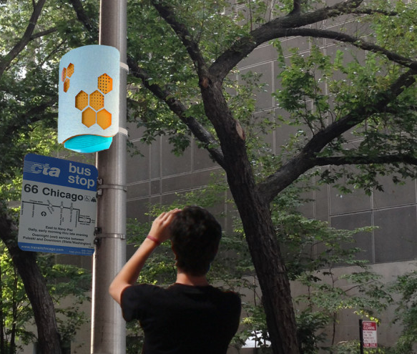
Intelligent, Sensor-Based Infrastructure
Several cities are deploying sensors attached to traffic poles that stream a variety of environmental data.
Minute-by-minute measurements of temperature, humidity, light, sound, barometric pressure and air quality, can be shared with researchers and the general public in real-time.
Sensors also estimate pedestrian traffic on the sidewalks by counting the number of smartphones in the area.
Potential for smart infrastructure to provide information on accessibility. Information could be presented in a variety of accessible formats to meet the needs of all travelers.
Notes:
Bob:
AFTER DISCUSSING SLIDE:
Well, at this point, we have reviewed several of the enabling factors which are encouraging the development of Smart Cities across the U.S. and the world. I have appreciated reviewing a few of these technological and operational tools with you.
I would now like to turn the presentation, once again, to Gwo-Wei.
Gwo-Wei,…

Slide 24
U.S. DOT Initiatives & Programs enabling Smart Cities
Mobility on Demand (MOD)
  Providing Traveler centric Personal Mobility Options
  Embracing Shared Use Mobility
Accessible Transportation Technology Research Initiative (ATTRI)
  Documenting User Needs
  Establishing Foundation Consideration
Mobility Services for All Americans (MSAA)
  Institutional & Service Integration
  Data Interoperability
Integrated Corridor Management (ICM)
  Infrastructure Management and Optimization
  Transit and Shared Use Prioritization
Connected Vehicle Program
  Connecting vehicles and infrastructure for enhanced safety and mobility
  Real-time and predictive traveler information
Universal Automated Community Transport (UACT)
  Providing First Mile/Last Mile Solutions
  Community-based automation
Notes:
Gwo-Wei:
Thank you, Bob. As Bob mention, those were just a few examples. I would like to remind you that additional trends and information can be found in Beyond Traffic.
Now, we wanted to take the opportunity to review with you a few examples of research initiative here at U.S.DOT which are currently working on a few of the challenges documented in Beyond Traffic. May of these research activities and the preliminary findings and results could add to a Smart City. They should be looked at as tools and components of a smart city.
They are:
Mobility on Demand (MOD), a concept working on Providing Traveler centric Personal Mobility Options, Embracing Shared Use Mobility
Accessible Transportation Technology Research Initiative (ATTRI), which has been Documenting User Needs of travelers by focusing on accessibility, and has Established Foundation Consideration which are useful components to any Smart City
We then have:
Mobility Services for All Americans (MSAA), a program that is working on Institutional & Service Integration through Data Interoperability within human service transportation
Integrated Corridor Management (ICM), an Infrastructure Management and Optimization program that looks toward providing Transit and Shared Use Prioritization on existing infrastructure
and, the
Connected Vehicle Program, Connecting vehicles and infrastructure for enhanced safety and mobility with Real-time and predictive traveler information
Last but not least, we will briefly touch upon,
UACT, or Universal Automated Community Transport, providing first/last mile solutions with community-based automation
NEXT

Slide 25
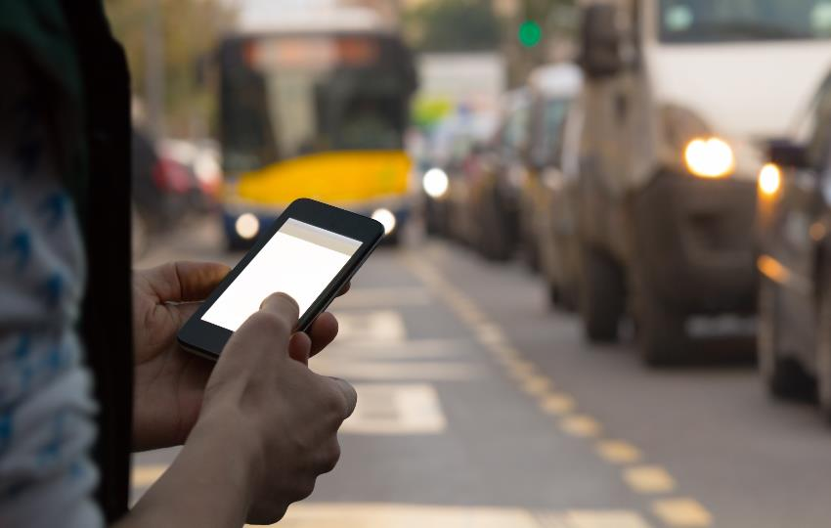

Mobility on Demand (MOD)
  Promotes choice in personal mobility & optimizes the transportation system through Intelligent Transportation Systems (ITS)
  Advances connected vehicles & automation applications
  Utilizes emerging technologies & data exchange to enable personal mobility
  Encourages multimodal connectivity & system interoperability
Travelers
Shared Economy
On-
Demand Services
MOD
Notes:
Gwo-Wei:
Let me begin our brief review of ongoing initiatives by describing Mobility on Demand, or MOD. MOD brings together new on-demand services like those we are familiar with in ride-sourcing or new micro transit operations with bike-sharing, carsharing, and the like. The third component, but certainly the most important is the traveler. MOD is a traveler-centric approach to mobility.
MOD promotes choice in personal mobility and optimizes the transportation system through ITS and other technology and innovative business practices.
It also advances connected vehicles & automation applications by providing and consuming data and providing that data for management of the transportation system.
MOD Utilizes emerging technologies and this data exchange to enable personal mobility by Encourages multimodal connectivity & system interoperability to provide a seamless experience for the user by providing real-time information to individuals so that they might be able to make informed decisions throughout their point-to-point trip.
NEXT

Slide 26
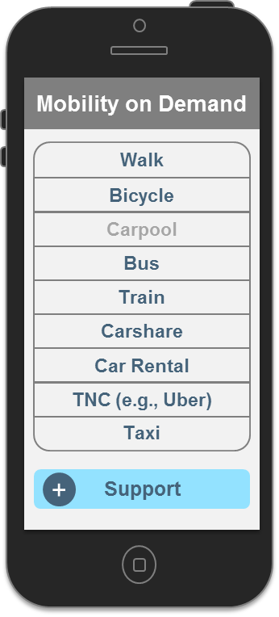
Optimizing Shared Use through MOD
The travel options and choices made by the traveler are provided by an overarching “management” type function, that supports a system optimal objective, rather than individual optimal decisions.
Travel choices are simplified through open data and communications technology that provides personalized information – including traveler information, travel options, and integrated mobile payment – directly to the user.
Carsharing
Provides members with access to an car for short-term use
Public Transport
Public Bus, Light Rail, Heavy Rail
and other Public Transport Services
Connected Traveler
$
Bikesharing
Provides members with access to an car for short-term use
Smart Payment
Allows users to pay for
services using a smartphone app
Mobility on Demand
Ridesharing
Carpooling, vanpooling,
and real-time ridesharing services
c
Incentives
Rewards and incentivizes
users for good travel choices
TNCs and Taxis
Transportation Network Companies (TNCs) and Taxi Services
P
Smart Parking
Allows users to pay for parking using a mobile app
Car Rental
Conventional Rental Car Services
Real-Time Traffic
Includes public agency and
private sector traffic data
Trip Planning & Navigation Services
Notes:
Gwo-Wei:
The real key to MOD is managing the system of systems, providing real time information to support individual traveler demands.
The travel options and choices made by the traveler are provided by an overarching “management” type function that supports a system optimal objective, rather than individual optimal decisions. Travel choices are simplified through open data and communications technology that provides personalized information – including traveler information, travel options, and integrated mobile payment – directly to the user.
MOD is expected to enable smarter, more efficient, and safer mobility within a multimodal ecosystem that benefits individual travelers, transportation operators, and system managers alike.
NEXT

Slide 27
Integrating Services & Institutions through MSAA
Travel Management Coordination Centers (TMCC) provide and interoperable system that adds value to the customer, service provider and human service transportation program
Provides one-stop, unified, customer-based travel information and trip planning services and supports coordinated human service transportation
Customer
Simplified Access
Provider
Operational Efficiency
Human Service Program
Streamlined program management
Trip Planning & Real-Time Information
Enhanced Service & Optimized Resources
Integrated Billing & Accounting
Service
Coordination
Technology Integration
TMCC
Notes:
Gwo-Wei:
Next, really a backbone to MOD and the new mobility ecosystem is the development of interoperable data across multiple service providers and modes. Through the Mobility Services for All Americans, U.S.DOT is working in this arena.
MSAA focuses on the Human Transportation Services, Paratransit, and Demand Response Transportation fields by attempting to optimize service and operations through Travel Management Coordination Centers, or TMCCs.
TMCCs Provide one-stop, unified, customer-based travel information and trip planning services and supports coordinated human service transportation. Three new locations recently received deployment planning funds under MSAA. They are San Luis Obispo, Atlanta and Denver. More information on these activities can by located on FTA’s website.
In the end, MSAA is pursuing interoperable systems that add value to the customer, service provider, human service transportation industry by simplifying access to services, assisting with operational efficiency, and streamlining management issues.
At this point, I will say my good bye. It has been a pleasure. However, I would like to introduce you to Mohammed Yousuf. Mohammed will talk in more detail about accessibility.
MOHAMMED,…
GW --- partransit and demand response focus . Ties to MOD

Slide 28



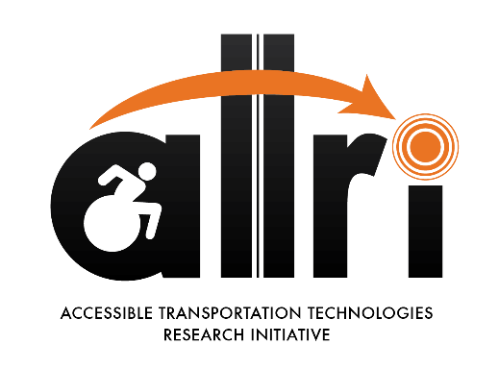
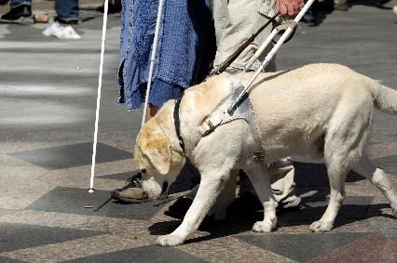
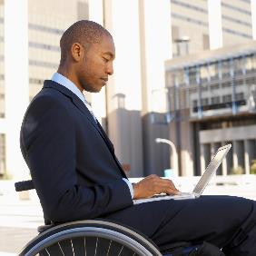

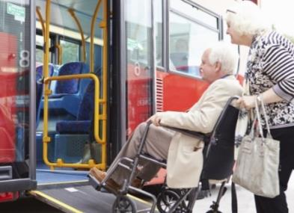
Addressing User Needs through ATTRI
Persons with Disabilities
Veterans with Disabilities
Older Adults
  Persons with disabilities comprise nearly 20% of the US population. Nearly 25% live below the poverty line.
  Over 21 million Americas are Veterans. 45% of eligible Veterans file claims for disability.
  Nearly 1 in 7 people (43 million) in the US are over 65 years old. This number is expected to reach 72.1 million by 2030.
Notes:
Mohammed

Slide 29
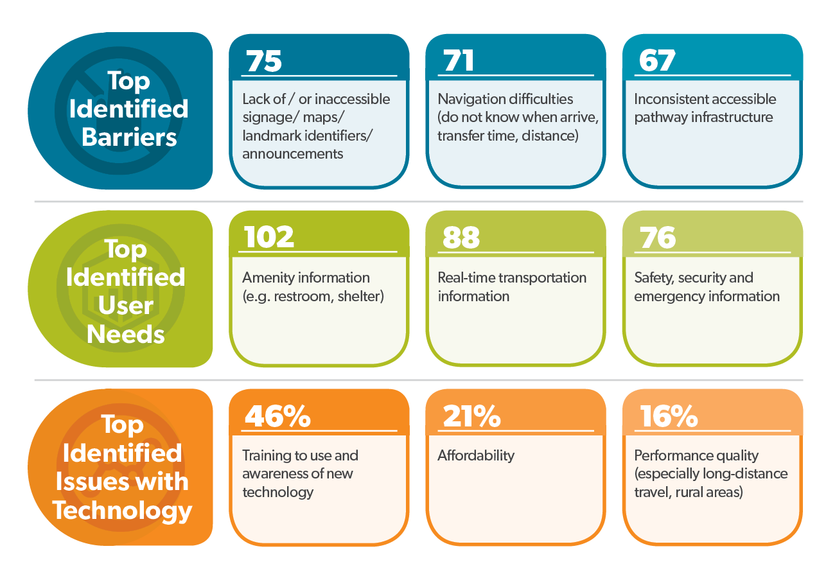

ATTRI Stakeholder Feedback & Response Themes
User Needs
Final Report
Due: Spring 2016
Notes:
Mohammed:

Slide 30





ATTRI Technology Scan Recommendations
Wayfinding &
Navigation Solutions
ITS & Assistive Technologies
Automation & Robotics
Data Integration
Enhanced Human Services Transportation
Focus on integration of map data and standardized infrastructure descriptions from various sources
New data unique and specific to ATTRI users should be developed
Focus on remote assistance for stakeholders and opportunities to inform and aid barrier traversal
Modernizing assistive technology maintenance and asset management (area for advanced research)
Shared neighborhood autonomous vehicles which are cost effective and aid at traversing distances between transit stops, homes, and places of employment.
Assist service models, electric vehicles, and autonomous vehicles create opportunities for novel accessible designs
Reduce complexity and identify coordination in service matchmaking through open data and services
Develop environment for community generated data
Support initiatives by ridersharing services to involve ATTRI stakeholders and develop accessible versions of these services.
Support mode shift through private on-demand ride services
Tech Scan Final Reports
Due: Spring 2016
Notes:
ATTRI is looking at 5 technology areas in order to research and develop accessible transportation applications:
wayfinding and navigation,
automation and robotics,
ITS and assistive technologies,
data integration, and
enhhanced human service transportation

Slide 31







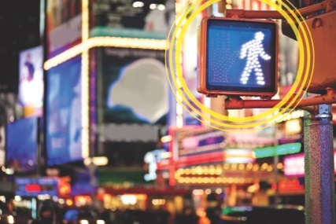
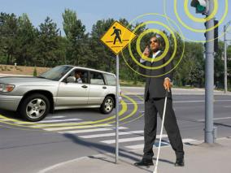

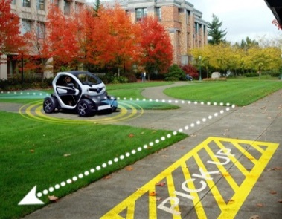
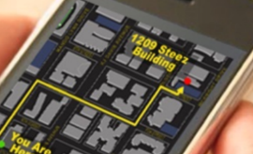
Identifying Accessible Transportation Opportunities
  76% people with disabilities say adequate transportation is important to their job search
  29% consider it a significant problem in accessing jobs
Targeted
Populations
Persons with
Disabilities
Veterans with
Disabilities
Older
Adults
Types of
Disabilities
Vision
Mobility
Hearing
Cognitive
Enabling
Technologies
ITS,
Wireless & Sensors
Connected Vehicles
Automated Vehicles/ Personal Mobility
Robotics, Artificial Intelligence
Accessible Data
Notes:
Mohammed

Slide 32
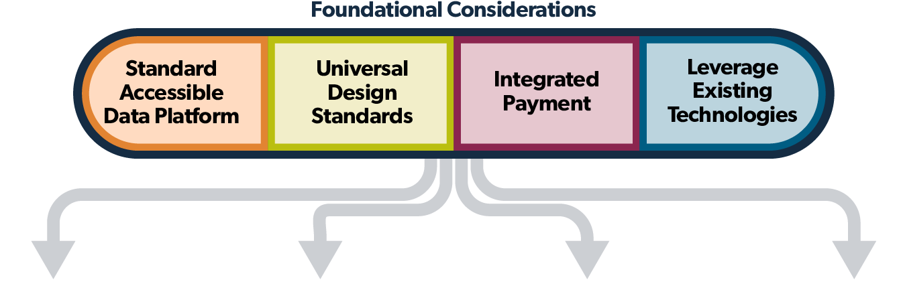
Developing Accessible Transportation Solutions
Smart Wayfinding
& Navigation Systems
Pre-Trip Concierge & Virtualization
Shared Use, Automation & Robotics
Safe Intersection Crossing
Automated Robotic Characterization of Pedestrian Zones
Machine and robotic cross-walk assistant
Slow-speed automatic vehicles
Automated intersection crossing assistance
Pedestrians interface with traffic signal and vehicles receive alerts
Multiple communication formats (visual, audible, haptic)
Smartphone-based navigation systems for indoor & outdoor use
Wearable technologies
Community navigators
Pre-trip and in-route traveler information
Crowd-sourcing
Virtual caregiver help for pre-trip planning an on route support
Notes:
Mohammed
These foundation considerations should be a considered and include in any future transportation system to ensure that people, regardless of ability, have access and means to personal mobility.

Slide 33

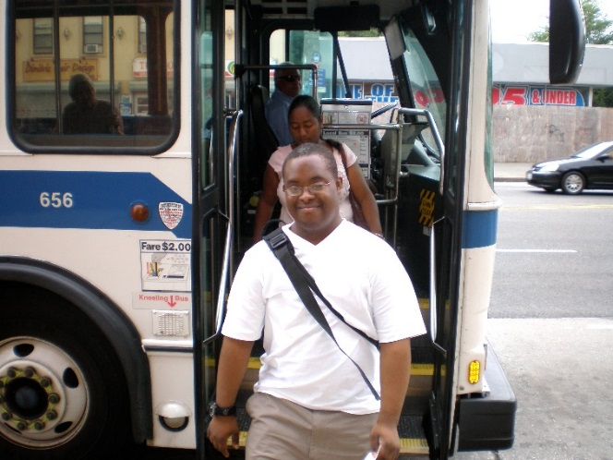
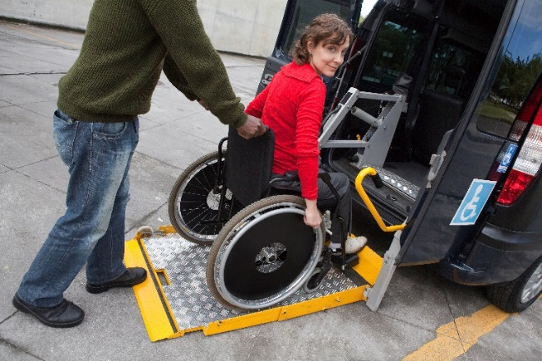
Universal Design
  Design of products or the environment, to be aesthetically appealing and functionally usable to the greatest extent possible by all users, regardless of their age, ability, or status in life.
  Smart City implementation and new transportation options must be inclusive of all citizens. All new solutions should be designed using universal design principles.
  Innovative transportation applications should include standardized accessibility data and provide information using multiple accessible data formats which are universally understood and able to be communicated regardless of ability.
Notes:
Mohammed

Slide 34
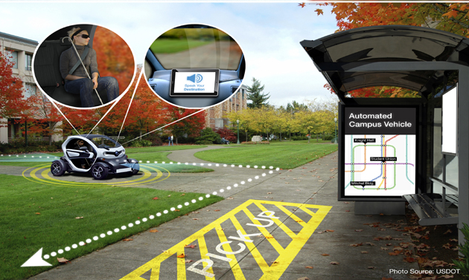
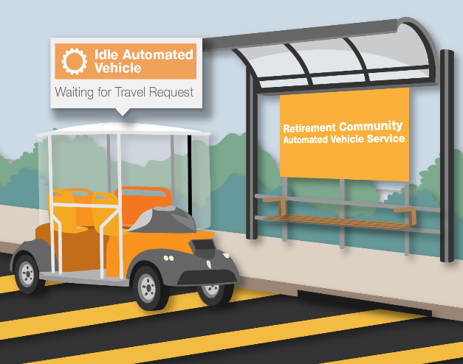
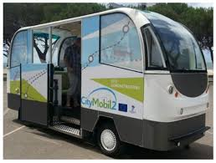
Universal Automated Community Transport
Development of an universal automated community transport applications with a focus on universal design and requirements inclusive of all users and non-users.
Implementation and operation of community-based, shared-use automated vehicles deployed for efficient first/last mile access to a public transportation hub or other activity centers.
Notes:
Mohammed:
AFTER DISCUSSING SLIDE:
Thank you all for sharing time with me today. At this point I would like to turn back the presentation to Bob for a few final slides:

Slide 35
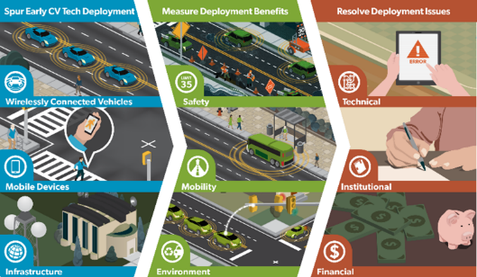
Enhancing Mobility through Connected Vehicles
  Using vehicle-to-infrastructure (V2I) capabilities and anonymous information from passengers’ wireless devices relayed through dedicated short-range communications (DSRC) and other wireless transmission media, has the potential to provide transportation agencies with dramatically improved real-time traffic, transit, and parking data, making it easier to manage transportation systems for maximum efficiency and minimum congestion.
  Connected vehicles could enable travelers to change their route, time, and mode of travel, based on up-to-the-minute conditions, to avoid traffic jams.
Notes:
Bob

Slide 36
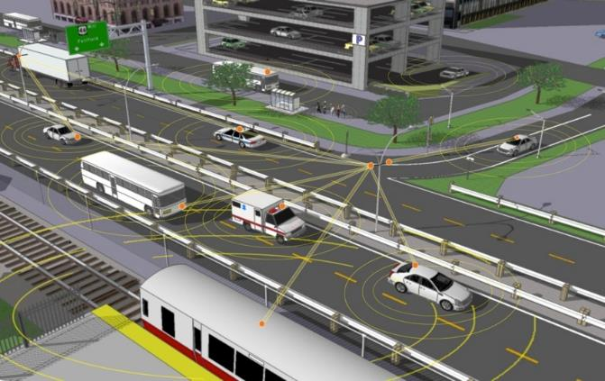
Managing Infrastructure through ICM
Active management of all individual facilities within the corridor are considered to provide real-time travel information, predictive trip data and encourages optimizing all legs of a trip form origin to destination
Traveler Information:
Individual trip profiles, social media data, trip choice and shared data
Infrastructure Data:
Signal Phase and Timing, Drive 35 mph, 50 Parking Spaces Available
Vehicle Data:
Managing Infrastructure and prioritizing HOV and fuel efficient vehicles
Transit Data:
Passenger and Vehicle information for real-time prioritization
Notes:
Bob

Slide 37
Integrating Levels of Management through ICM
Institutional
Integration
Coordination to collaboration between various agencies and jurisdictions that transcends institutional boundaries.
Operational
Integration
Multi-agency and cross-network operational strategies to manage the total capacity and demand of the corridor.
Sharing and distribution of information, and system operations and control functions to support the immediate analysis and response.
Technical
Integration
Notes:
Bob

Slide 38
New Technologies Leading to Changing Perceptions
Focus on sustainability + smart cities is growing
Shared mobility combined with transportation demand management (TDM) strategies are changing perceptions of mobility
Intelligent Transportation Systems
Integrated, Dynamic Transportation in a Connected Society
Connected & Automated Vehicles
Transportation Systems Management and Operations
Traditional Transportation Options
The sharing economy and shared mobility options and potential is spawning innovative business models and influencing individual transportation choices and behavior
Ongoing evolution and changes are expected
Source: Shaheen, 2015
© UC Berkeley, 2015
Notes:
Bob:
USDOT visualizes a progression from traditional transportation options to those that are integrated. Dynamic and driven by real time information and new innovative services. This eco systems will be driven by the shared-use economy, strategies on managing demand and incorporating the needs of all users independent of their abilities for a transportation system that is accessible, connected and smart.

Slide 39
Envision a “Connected Everything” in a Smart City Environment
By 2020 there will be 50 to 100 billion ‘things’ connected to the Internet
There are are 13.5 billion devices connected to the Internet today
Notes:
Bob:
Many “things” are about to be automated and/or wirelessly connected and will communicate with other “things”
Connected things will enable us to understand transportation systems differently, better
Connectivity provides powerful new information for personal mobility
The demand for personal mobility is giving rise to the mobility consumer
Individuals want Mobility on Demand
Wow, That has been great. If you can’t tell, we are all excited to be here and engaged with you in the Smart City Challenge. We hope you have enjoyed your time with us today and we highly encourage you to send us your vision of a smart city.
While we are finished here this afternoon, I am going to pass the microphone back over to Brian for a few closing words and reminders.
BRIAN

Slide 40
Beyond Traffic: The Smart City Challenge
For More Information
Notes:
Brian Cronin

Slide 41
Beyond Traffic: The Smart City Challenge
Information Sessions
The Smart City Forum (In Person / Virtual) 12/15/2015 ( 9:00 am to 4:00 pm EST) U.S. Department of Transportation (Washington, DC)
Data, Architecture, and Standards (Virtual) 12/16/2015 (1:00 to 2:30 pm EST)
Connected Vehicles and Automation (Virtual) 12/17/2015 (1:00 to 2:30 pm EST)
Sharing Economy, User-Focused Mobility, and Accessible Transportation (Virtual) 12/18/2015 (1:00 to 2:30 pm EST)
The Smart City Challenge Application and Selection Process (Virtual) 12/21/2015 (1:00 to 2:00 pm EST)
For More Information and RSVP Information: www.transportation.gov/smartcity
Notes:
Brian Cronin

Slide 42
Beyond Traffic: The Smart City Challenge
For More Information and Questions
Department of Transportation
https://www.transportation.gov/
Smart City Challenge
www.transportation.gov/smartcity
Questions?
SmartCityChallenge@dot.gov
Notes:
Brian Cronin

