Slide 1
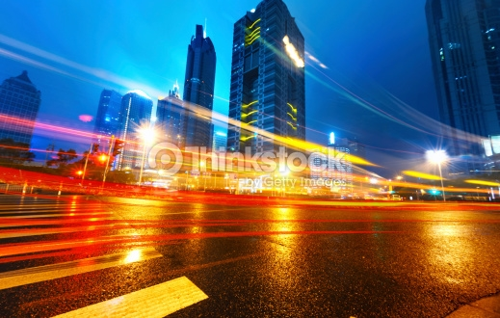
THE SMART CITY CHALLENGE
Notes:
http://www.thinkstockphotos.com/image/stock-photo-light-trails-on-the-modern-building/470721459/popup?sq=traffic information/f=CPIHV/s=DynamicRank

Slide 2
Beyond Traffic: The Smart City Challenge
$50 million could be a game-changer for your city.
You have to be in it, to win it.
Changing the narrative on transportation: No 20th century solutions for 21st century challenges.
What does it mean to be a “smart” city?
Notes:
The USDOT is encouraging Applicants to consider the twelve elements in developing ideas for developing their city’s vision for a Smart City.
Applicants should consider how emerging transportation data, technologies, and applications can be integrated with existing systems across a city, helping both cities, citizens, and businesses achieve goals for safety, mobility, sustainability, and economic vitality in an increasingly complex, interdependent and multimodal world.

Slide 3
Beyond Traffic: The Smart City Challenge
Phase 1 (now through February 4):
High-level concept development and planning activities
Focus on being one of the five Smart City Challenge Finalists
Webinars in December and Limited Road Show in January
Phase 2 (March – June)
Granting $100,000 to the five Smart City Challenge Finalists to support implementation of their proposed demonstration.
No match required.
Refine proposals, develop budget, find partners, present
Finalist selected in June
$50 million ($40 million from USDOT/$10 million from Vulcan)
Notes:
The USDOT is encouraging Applicants to consider the twelve elements in developing ideas for developing their city’s vision for a Smart City.
Applicants should consider how emerging transportation data, technologies, and applications can be integrated with existing systems across a city, helping both cities, citizens, and businesses achieve goals for safety, mobility, sustainability, and economic vitality in an increasingly complex, interdependent and multimodal world.

Slide 4
Beyond Traffic: The Smart City Challenge
An Ideal Smart City
Notes:
The USDOT is encouraging Applicants to consider the twelve elements in developing ideas for developing their city’s vision for a Smart City.
Applicants should consider how emerging transportation data, technologies, and applications can be integrated with existing systems across a city, helping both cities, citizens, and businesses achieve goals for safety, mobility, sustainability, and economic vitality in an increasingly complex, interdependent and multimodal world.

Slide 5
Beyond Traffic: The Smart City Challenge
An Ideal Smart City
A population between approximately 200,000 and 850,000 people within the city (Census-designated place) limits;
A dense urban population;
An environment conducive to demonstrating advanced technologies;
An existing public transportation system;
A commitment to integrating transportation services with the sharing economy;
A commitment to making data open, discoverable, and usable by the public to fuel entrepreneurship and innovation; and
Continuity of committed leadership and capacity to carry out the demonstration throughout the period of performance.
Notes:
The USDOT is encouraging Applicants to consider the twelve elements in developing ideas for developing their city’s vision for a Smart City.
Applicants should consider how emerging transportation data, technologies, and applications can be integrated with existing systems across a city, helping both cities, citizens, and businesses achieve goals for safety, mobility, sustainability, and economic vitality in an increasingly complex, interdependent and multimodal world.

Slide 6
Beyond Traffic: The Smart City Challenge
Technology Elements (Highest Priority)
Vision Element #1
Urban Automation
Vision Element #2
Connected Vehicles
Vision Element #3
Intelligent, Sensor-
Based Infrastructure
Innovative Approaches to Urban Transportation Elements (High Priority)
Vision Element #4
User-Focused Mobility
Services and Choices
Vision Element #5
Urban Analytics
Vision Element #6
Urban Delivery and
Logistics
Vision Element #7 Strategic Business Models & Partnering
Vision Element #8
Smart Grid, Roadway
Electrification, & EVs
Vision Element #9 Connected, Involved Citizens
re-charging
Smart City Elements (Priority)
Vision Element #10 Architecture and
Standards
Vision Element #11
Low-Cost, Efficient,
Secure, & Resilient ICT
Vision Element #12
Smart Land Use
Notes:
The USDOT is encouraging Applicants to consider the twelve elements in developing ideas for developing their city’s vision for a Smart City.
Applicants should consider how emerging transportation data, technologies, and applications can be integrated with existing systems across a city, helping both cities, citizens, and businesses achieve goals for safety, mobility, sustainability, and economic vitality in an increasingly complex, interdependent and multimodal world.

Slide 7
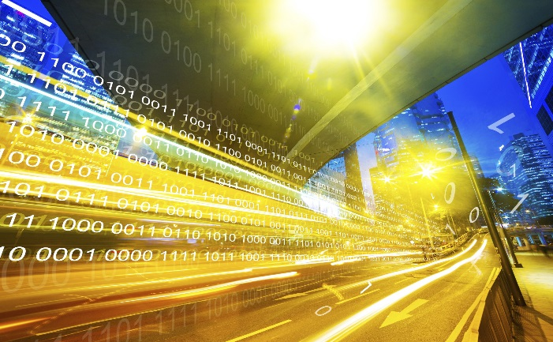
Advanced Technologies and Smart Cities
Technology convergence will revolutionize transportation, dramatically improving safety and mobility while
reducing costs and environmental impacts
Automation
Benefits
Order of magnitude safety improvements
Reduced congestion
Reduced emissions and use of fossil fuels
Improved access to jobs and services
Reduced transportation costs for gov’t and users
Improved accessibility and mobility through Mobility on Demand (MOD)
Open Data
Internet of Things
Machine Learning
Connected Vehicles
Smart Cities
Mobility on Demand

Slide 8
Beyond Traffic: The Smart City Challenge
Phase 1
Critical Deadlines
February 4, 2016 | Applications Due at 3:00 pm EST
March 2016 | Selected Smart City Challenge Finalists Announced
March 2016 | Awards Issued to Smart City Challenge Finalists
March 2016 | The USDOT Solicits Applications from Finalists for Smart City Challenge Implementation
May 2016 | Applications Due from Finalists
June 2016 | Selected Smart City Challenge Implementation Awardee Announced
Notes:
The USDOT is encouraging Applicants to consider the twelve elements in developing ideas for developing their city’s vision for a Smart City.
Applicants should consider how emerging transportation data, technologies, and applications can be integrated with existing systems across a city, helping both cities, citizens, and businesses achieve goals for safety, mobility, sustainability, and economic vitality in an increasingly complex, interdependent and multimodal world.

Slide 9
Beyond Traffic: The Smart City Challenge
Information Sessions
Data, Architecture, and Standards (Virtual) 12/16/2015 (1:00 to 2:30 pm EST)
Connected Vehicles and Automation (Virtual) 12/17/2015 (1:00 to 2:30 pm EST)
Sharing Economy, User-Focused Mobility, and Accessible Transportation (Virtual) 12/18/2015 (1:00 to 2:30 pm EST)
The Smart City Challenge Application and Selection Process (Virtual) 12/21/2015 (1:00 to 2:00 pm EST)
For More Information and RSVP Information: www.transportation.gov/smartcity
Notes:
The USDOT is encouraging Applicants to consider the twelve elements in developing ideas for developing their city’s vision for a Smart City.
Applicants should consider how emerging transportation data, technologies, and applications can be integrated with existing systems across a city, helping both cities, citizens, and businesses achieve goals for safety, mobility, sustainability, and economic vitality in an increasingly complex, interdependent and multimodal world.

Slide 10
Beyond Traffic: The Smart City Challenge
Information Sessions
For More Information and Questions
Smart City Challenge
www.transportation.gov/smartcity
Questions?
SmartCityChallenge@dot.gov
Notes:
The USDOT is encouraging Applicants to consider the twelve elements in developing ideas for developing their city’s vision for a Smart City.
Applicants should consider how emerging transportation data, technologies, and applications can be integrated with existing systems across a city, helping both cities, citizens, and businesses achieve goals for safety, mobility, sustainability, and economic vitality in an increasingly complex, interdependent and multimodal world.

