Slide 1



Beyond Traffic: The Smart City Challenge
Information Session #1: Data, Architecture and Standards
December 16, 2015
U.S. Department of Transportation (USDOT)

Slide 2

Webinar Overview
Overview of the Beyond Traffic: The Smart City Challenge
Vision Element #3: Intelligent, Sensor-Based Infrastructure Vision Element #5: Urban Analytics
Vision Element #10: Architecture and Standards
For More Information

Slide 3



Beyond Traffic: The Smart City Challenge
Encourage cities to put forward their best and most creative ideas for innovatively addressing the challenges they are facing.
The Smart City Challenge will address how emerging transportation data, technologies, and applications can be integrated with existing systems in a city to address transportation challenges.
Demonstrate how advanced data and intelligent transportation systems (ITS) technologies and applications can be used to reduce congestion, keep travelers safe, protect the environment, respond to climate change, connect underserved communities, and support economic vitality.

Slide 4
Beyond Traffic: The Smart City Challenge
Phase 1 (Deadline February 4, 2016):
Support concept development and planning activities
Estimated five Smart City Challenge Finalists
$100K each
Phase 2 (Solicitation and Deadline TBD):
Smart City Challenge Finalists
Support implementation of their proposed demonstration
$50 Million
  U.S. Department of Transportation: $40 Million
  Vulcan Foundation: $10 Million

Slide 5



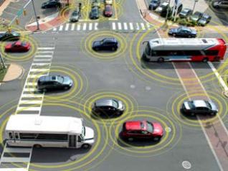
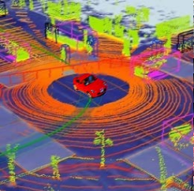

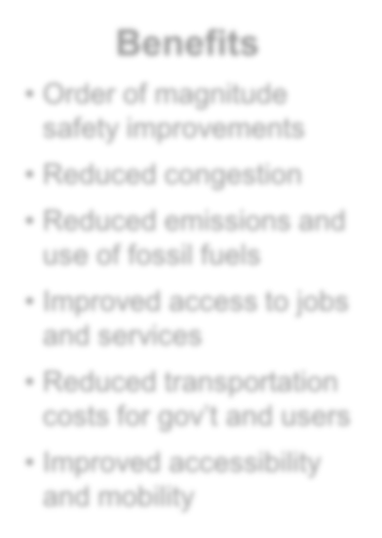






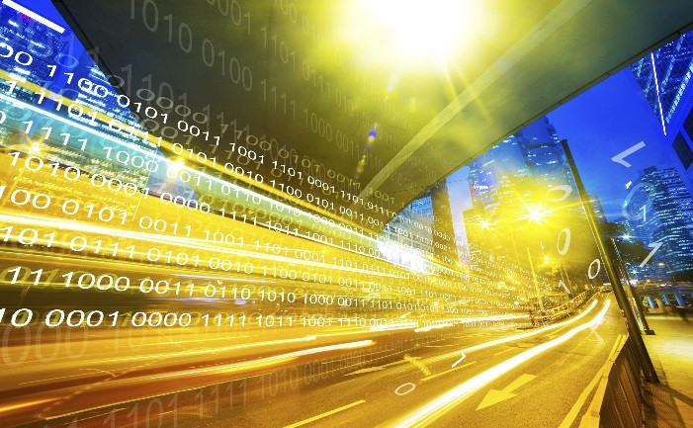






Advanced Technologies and Smart Cities
Technology convergence will revolutionize transportation, dramatically improving safety and mobility while
reducing costs and environmental impacts
Connected Vehicles
Benefits
Order of magnitude safety improvements
Reduced congestion
Reduced emissions and use of fossil fuels
Improved access to jobs and services
Reduced transportation costs for gov’t and users
Improved accessibility and mobility
Vehicle Automation
Connected-Automated Vehicles
Internet of Things
Machine Learning
Big Data
Mobility on Demand
Smart Cities

Slide 6
The USDOT’s Vision for a Smart City
The USDOT recognizes that each city has unique attributes, and each city’s proposed demonstration will be tailored to their vision and goals.
The USDOT’s vision for a Smart City Challenge is “to identify an urbanized area where advanced technologies are integrated into the aspects of a city and play a critical role in helping cities and their citizens address challenges in safety, mobility, sustainability, economic vitality, and address climate change.”
To assist cities, the USDOT identified twelve (12) vision elements that are intended to provide a framework for Applicants to consider in the development of a city’s proposed demonstration without making each item a requirement for award.

Slide 7





Beyond Traffic: The Smart City Challenge
Technology Elements (Highest Priority)
Vision Element #1
Urban Automation
Vision Element #2
Connected Vehicles
Vision Element #3 Intelligent, Sensor- Based Infrastructure
Innovative Approaches to Urban Transportation Elements (High Priority)
Vision Element #4 User-Focused Mobility Services and Choices
Vision Element #5 Vision Element #6
Urban Analytics Urban Delivery and
Logistics
re-charging
Vision Element #7 Strategic Business Models & Partnering
Vision Element #8 Smart Grid, Roadway Electrification, & EVs
Vision Element #9
Connected, Involved
Citizens
Smart City Elements (Priority)
Vision Element #10
Architecture and
Vision Element #11
Vision Element #12
Low-Cost, Efficient,
Smart Land Use
U.S. Department of Transportation 7
Standards
Secure, & Resilient ICT

Slide 8
Beyond Traffic: The Smart City Challenge
Technology Elements (Highest Priority)
Vision Element #3 Intelligent, Sensor- Based Infrastructure
Innovative Approaches to Urban Transportation Elements (High Priority)
Vision Element #5
Urban Analytics
Vision Element #1 Vision Element #2
Urban Automation Connected Vehicles
Vision Element #4 User-Focused Mobility Services and Choices
Vision Element #6
Urban Delivery and
Logistics
Vision Element #7 Vision Element #8 Vision Element #9 Strategic Business _{re-charging} Smart Grid, Roadway Connected, Involved Models & Partnering Electrification, & EVs Citizens
Smart City Elements (Priority)
Vision Element #10
Architecture and
Vision Element #11 Low-Cost, Efficient, Secure, & Resilient ICT
Vision Element #12
Smart Land Use
U.S. Department of Transportation 8
Standards

Slide 9
Vision Element #3
Intelligent, Sensor-Based Infrastructure

Slide 10

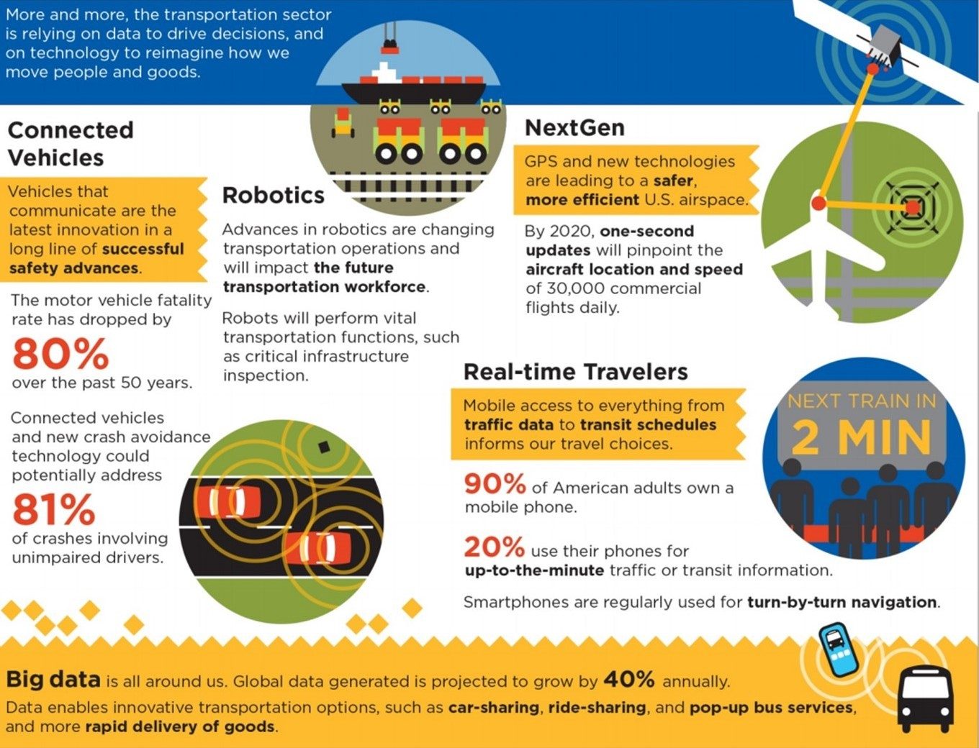
Vision Element #3: Intelligent, Sensor-Based
Infrastructure

Slide 11
Vision Element #3: Intelligent, Sensor-Based
Infrastructure
Smart cities contain and use a collective intelligent infrastructure that allow sensors to collect and report real-time data to inform every day transportation-related operations and performance and trends of a city.
These data allow city operators to know how the city is operating and how the operation of facilities, systems, services, and information generated for the public can be enhanced.
Intelligent infrastructure includes sensors that collect traffic, pedestrian, bicyclist, environmental data, and other information available throughout the city.
A successful Smart City Demonstration would integrate these data with existing transportation data and operations, allowing the city to improve operations of the transportation network.

Slide 12
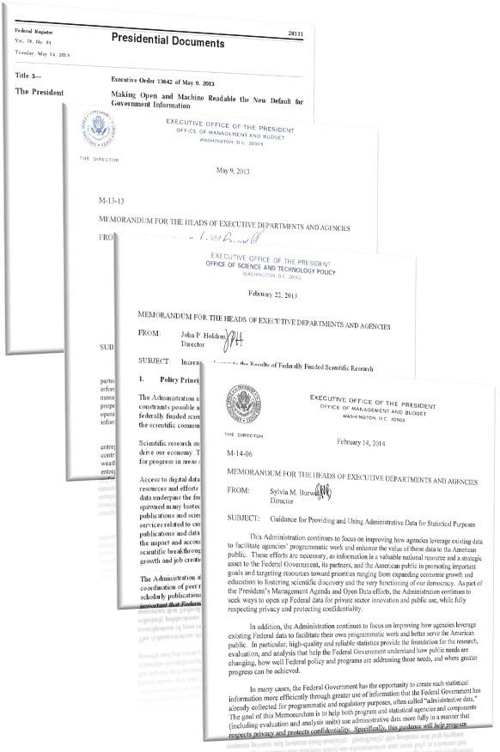
Vision Element #3: Intelligent, Sensor-Based
Infrastructure
Data Policy is a key to the success of this vision element
  Federal, State and local governments recognizing data is a strategic asset
  Policies support open sharing machine- readable data with public, service providers and other agencies
  Policies support developing and maintaining systems and connections to share this data
An open transportation data ecosystem, built on the presumption of sharing can:
  Improve public safety
  Enhance public services
  Enable personal mobility
  Expand economic growth

Slide 13
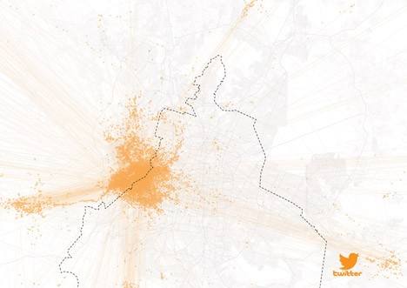
Vision Element #3: Intelligent, Sensor-Based
Infrastructure
Trend: technology advancements allowing agencies and citizens to increase the area of coverage of their systems and the amount of data they collect and use.
Urban Future Award
  Mexico City proposed a system where drivers anonymously donate data about location and movement
  Data are shared via Web site and app in real-time
  Data are archived for urban and transportation planners
“In Mexico we see that people make sensitive mobility data available to the whole community if their individual benefit (less congestion, more leisure time) is greater than their concerns about protecting data”

Slide 14
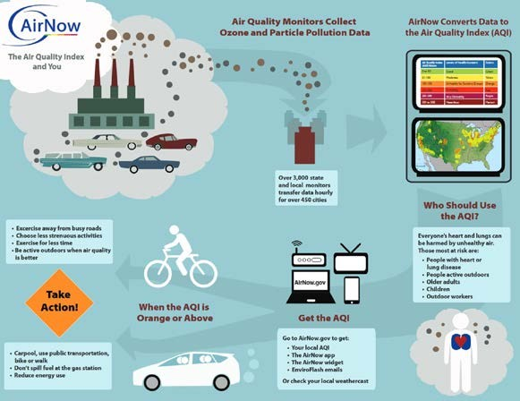
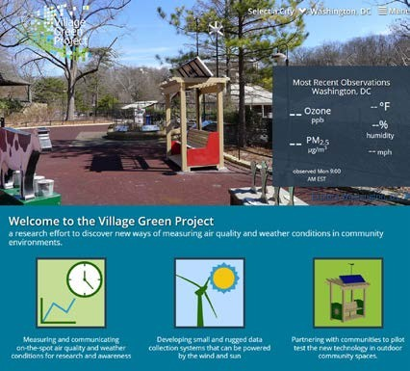
Vision Element #3: Intelligent, Sensor-Based
Infrastructure
Trend: open networks of sensors to facilitate data gathering and information for government and the public
Environmental Protection Agency’s AirNow program
  Over 3,000 sensors around the country
  An open platform that allows for more sensors to be plugged in at any time
  Application Programming Interfaces facilitate data sharing
Village Green Project
  Measuring and communicating on-the-spot air quality and weather conditions for research and awareness
  Developing small and rugged data collection systems that can be powered by the wind and sun
  Partnering with communities to pilot test the new technology in outdoor community spaces.

Slide 15
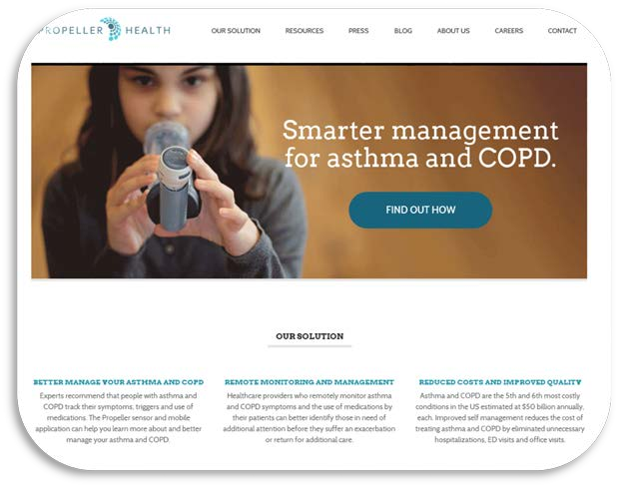
Vision Element #3: Intelligent, Sensor-Based
Infrastructure
Trend: sensor-based collection and user-centered choices about data sharing
Provides patients with ways to collect & analyze data about their asthma and inhaler use
Patients chooses what to share:
  Clinical data
  Personal data
  Sensor data
  Aggregated, anonymized location data
Patients choose who gets to see their data
  Family and friends
  Healthcare provider
  Health care researchers, clinical trials
What are the potential roles for connected vehicles, toll tags, smart phones, light poles, transit fare media and other transportation-related components?

Slide 16
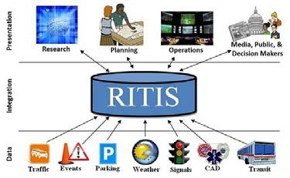
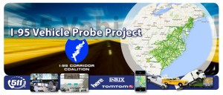
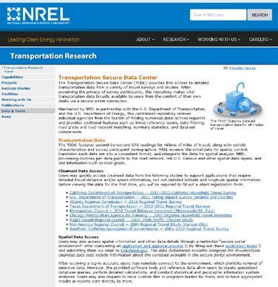
Vision Element #3: Intelligent, Sensor-Based
Infrastructure
Trend: governments collect, preserve, and share data for a variety of applications, establishing appropriate policies for access
Example: repository for travel survey and study data
  GPS tracks
  Survey participant demographics
Example: real-time traffic data sharing
  Regional data fusion and dissemination
  Applications for users, operators, policy-makers, researchers
Varying access levels
  Public-use cleansed files
  Detailed and spatial-enabled files

Slide 17
Vision Element #3: Intelligent, Sensor-Based
Infrastructure
Open Data Policies:
https://project-open-data.cio.gov/ https://www.transportation.gov/open/official-dot-public-access-plan http://sunlightfoundation.com/policy/local/
ITS Research Data:
https://www.its-rde.net/
ITS Open Source:
http://www.itsforge.net/
White Paper:
The Smart/Connected City and Its Implications for Connected Transportation
http://1.usa.gov/1XVPV2h
USDOT PoC:
Daniel Morgan
Chief Data Officer daniel.morgan@dot.gov, 202-366-4308

Slide 18
Vision Element #5
Urban Analytics

Slide 19

Vision Element #5: Urban Analytics
In a data-rich environment, cities and citizens are increasingly able to share, use, and leverage (previously unavailable) datasets to address complex urban problems or to improve current operations or capabilities.
Urban analytics create value from the data that is collected from connected vehicles, connected citizens, and sensors throughout a city or available from the Internet using information generated by private companies.
Analytics can be used to predict future conditions and the potential benefits of implementing different operational strategies, control plans and response plans coordinated among agencies and service providers.

Slide 20
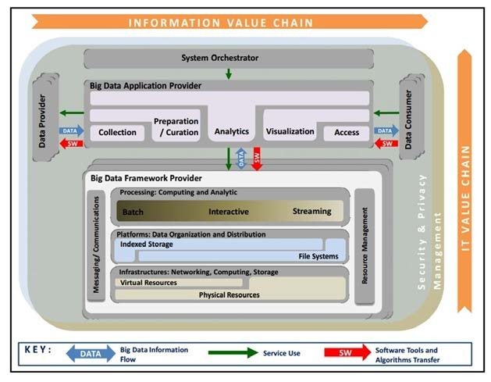
Vision Element #5: Urban Analytics
National Institute of Standards and Technology Big Data Reference Architecture
  Provides definitions, taxonomies, use cases, and requirements
  Addresses security and privacy considerations
A series of Special Publications (NIST SP 1500 series) developed
Learn more: http://bigdatawg.nist.gov/V1_output_ docs.php

Slide 21
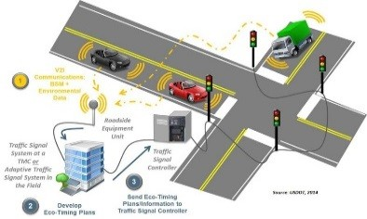
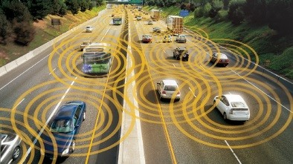





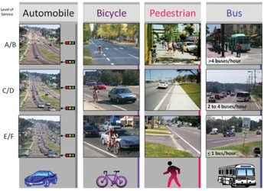
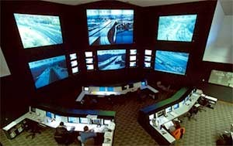
Vision Element #5: Urban Analytics
Analytics can be applied over a number of planning horizons, not just real-time, to:
Real-time traffic data…
…from existing and emerging sensors
Study travel patterns
Validate and calibrate transportation and travel models
Analyze corridor operations
Urban Analytics
Measure mobility and reliability performance
Understand traveler behavior
Develop travel demand management policies
One example: FHWA’s Travel Model Improvement Program http://www.fhwa.dot.gov/planning/tmip/
For system operations and planning
Across all modes of transportation
The examples provided on this slide are not intended to express preference for the purpose of evaluating proposals. Applicants are encouraged to propose innovative automation strategies that demonstrate safety, mobility, and/or environmental benefits in an urbanized area.

Slide 22
Vision Element #5: Urban Analytics
Big Data Architecture:
http://bigdatawg.nist.gov/V1_output_docs.php
Travel Model Improvement Program:
http://www.fhwa.dot.gov/planning/tmip/
ITS Open Source:
http://www.itsforge.net/
Integrated Corridor Management:
http://www.its.dot.gov/factsheets/pdf/icm.pdf
USDOT PoC:
Daniel Morgan
Chief Data Officer daniel.morgan@dot.gov, 202-366-4308

Slide 23
Vision Element #10
Architecture and Standards

Slide 24

Vision Element #10: Architecture and Standards
Because vehicles and travelers move broadly across regions, uniform operation that is accessible to everyone is essential for safe and efficient transportation operations.
To the extent viable, the USDOT envisions that Smart City Demonstration sites will define and demonstrate integration of ITS systems with other systems which comprise a smart city.
As part of this effort, the nature of required interfaces to other systems should be defined to utilize existing networking or other standards when available. Where new standards are needed, these needs should be fully documented.

Slide 25
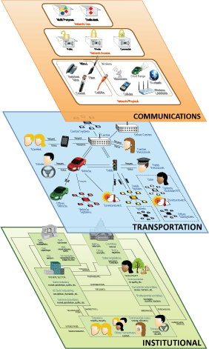
Vision Element #10: Architecture and Standards
The National ITS Architecture provides a common framework to plan, define, and integrate ITS solutions.
The Connected Vehicle Reference Implementation (CVRIA) includes information to support development of fully interoperable regional connected vehicle architectures. (CVRIA will be fully integrated in to the National Architecture later in 2016)
USDOT envisions that Smart City Demonstration sites will use the CVRIA/National ITS Architecture, and published and under-development ITS standards.

Slide 26
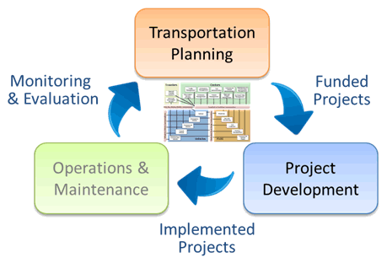
Vision Element #10: Architecture and Standards
Supporting Transportation Planning and Project Development
National ITS Architecture has been used to develop regional architectures in all 50 states and 300 metropolitan areas
Leverages FHWA’s Planning for Operations program
Connect Planning goals, & objectives, & performance measures with ITS services

Slide 27




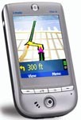








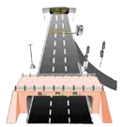

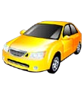
Vision Element #10: Architecture and Standards
Why a National ITS Architecture: good engineering practice for complex system of systems … and legally required
  Legislative direction to maintain a US National ITS Architecture
  Facilitates interoperable, standards-based deployments.
Nationwide, and preferably North American, interoperability now essential
  Vehicles operate throughout the region
    Must have access to standardized service/applications
    Must at least assure non- interference.
Travelers
Remote Traveler Support
Personal Information Access
Centers
Payment
Traffic Management
Emergency
Commercial Maintenance &
Management
Administration
Vehicle Construction
Information Service Provider
Administration Management
Emissions Management
Transit Management
Fleet and Freight Management
Archived Data Management
Wide Area Wireless (Mobile) Communications
Fixed Point – Fixed Point Communications
Vehicle – Vehicle Communications
Vehicle
Field – Vehicle Communications
Roadway
Emergency Vehicle
Security Monitoring
Commercial
Roadway Payment
Vehicle
Transit
Parking Management
Vehicle
Maintenance &
Construction
Field
Commercial Vehicle Check
Vehicle
Vehicles

Slide 28












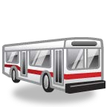














Vision Element #10: Architecture and Standards
National Architecture is a common framework for planning, defining, and integrating ITS.
Logical Architecture
Physical Architecture
Service Packages
Subsystems & Terminators
Processes
Data Flows
Architecture Flows
Equipment Packages
Standards Mapping
Theory of Operations
Website includes:
  Hypertext
  PDF documents
  Databases
1
2
http://www.its.dot.gov/arch/index.htm

Slide 29
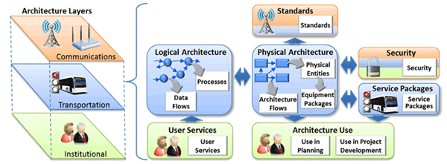
Vision Element #10: Architecture and Standards
ITS Standards
ITS architecture provides a common framework for planning, defining, and integrating ITS
Architecture flows are mapped to ITS standards
ITS interface standards establish communication rules for how ITS devices can perform, how they can connect, and how they can exchange data in order to interoperate

Slide 30
Vision Element #10: Architecture and Standards
Standards Supporting ITS
Standards satisfy interfaces in architectures
Use “off-the-shelf” networking standards where applicable
USDOT supports development of key ITS-Specific Standards
  Infrastructure Standards
    Center-to-center (C2C): Traffic Management Data Dictionary
    Center-to-field (C2F): National Transportation Communications for ITS Protocol (NTCIP)
    Advanced Transportation Controller (ATC)
  Connected Vehicle
  Automation Standards: Roadmap development currently underway
International Harmonization – cooperate internationally to:
  Meet common needs with common standards/architectures
  Share labor and expertise
  Reduce overall deployment cost and time, broaden markets

Slide 31

Vision Element #10: Architecture and Standards
Connected Vehicle Standards
Cover vehicle to infrastructure (V2I), vehicle to device (V2D), and vehicle to vehicle (V2V) communications
  Dedicated Short Range Communications (DSRC) at 5.9 GHz spectrum for crash imminent safety applications
  DSRC and other technologies (3g, 4g, LTE, etc.) for applications of all types
SAE J2735 – message and dialog definitions for V2V, V2I and V2D
SAE J2945/x – performance requirements for applications
IEEE 1609.x – protocol level standards for basic communications and security management
IEEE 802.11 – wireless media definitions that for DSRC enabling IEEE1609 and SAE J2735
1609.2
Application Services
Current (J2735) and Future Higher Layer Standards
Security | Management | UDP / TCP |  | WS MP
 |  | IPv6
 |  | LLC
 |  | WAVE MAC (including channel coordination)
 |  | PHY
1609.3
1609.4
802.11

Slide 32
Vision Element #10: Architecture and Standards
Unifying framework and common language for connected vehicle development and deployment
  CVRIA/SET-IT v2.0 current, National Architecture integration by Summer, 2016
  Multi-view: Enterprise/Functional/Physical/Communications

Slide 33
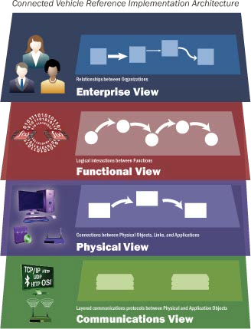
Vision Element #10: Architecture and Standards
CVRIA Includes Multiple Views
Enterprise - Describes the relationships between organizations and the roles they play.
Functional - Describes abstract functional elements (processes) and logical interactions (data flows) that satisfy the system requirements.
Physical - Describes physical objects (systems and devices) and their application objects as well as the high-level interfaces between them.
Communications - Describes the layered sets of communications protocols that are required to support communications among the participating physical objects in the CV environment.

Slide 34

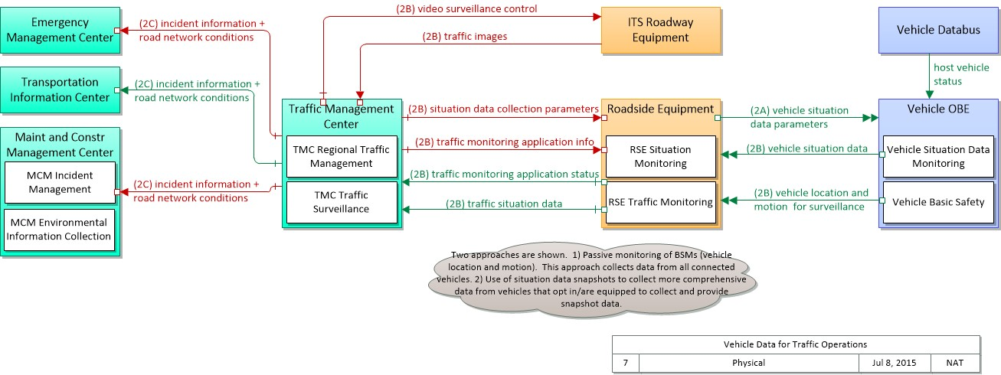
Vision Element #10: Architecture and Standards
Assures envisioned capabilities fit well within the greater ITS system
  Architecture can guide but should not constrain research
SET-IT tool can document system architecture, ConOps, and other requirements
Allows adopting/adapting work completed to date – “go shopping” …
Example: Vehicle Data for Traffic Operations
NOTE: This is a way this application may be realized, but not the only way. There are other ways to build a given application and accomplish a stated objective.

Slide 35
Vision Element #10: Architecture and Standards
To the extent viable, the USDOT envisions that Smart City Demonstration sites will define and demonstrate integration of ITS systems with other systems which comprise a smart city.
As part of this effort, the nature of required interfaces to other systems should be defined to utilize existing networking or other standards when available. Where new or revised standards are needed, these needs should be fully documented.
USDOT provides ITS Architecture and Standards to enable interoperable systems
  Include the National ITS Architecture and CVRIA in the overall system architecture
  Enable connections to other smart city system architectures
  If beneficial, use CVRIA/SET-IT as basis for developing architectures to support other smart city services

Slide 36
Vision Element #10: Architecture and Standards
ITS Standards: https://standards.its.dot.gov/
ITS Architecture: http://www.its.dot.gov/arch/index.htm
Explore CVRIA:
  CVRIA web training:
www.iteris.com/cvria http://www.iteris.com/cvria/html/resources/cvriatraining.html
Download SET-IT:
www.iteris.com/cvria/html/resources/tools.html
NOTE: Requires 32-bit version of Microsoft Visio 2010/2013
SET-IT web training:
http://www.iteris.com/cvria/html/forms/setittrainingform.php
Input to improve CVRIA or SET-IT? Questions? Comments?
CVRIA Team:
SET-IT Team:
cvriacomments@iteris.com setit@iteris.com
USDOT PoCs:
Walt Fehr
Program Manager, Systems Engineering walton.fehr@dot.gov, 202-366-0268
Steve Sill
Program Manager, ITS Architecture and Standards
steve.sill@dot.gov, 202-366-1603
U.S. Department of Transportation
36

Slide 37
Beyond Traffic: The Smart City Challenge
For More Information

Slide 38

Beyond Traffic: The Smart City Challenge
Information Sessions
The Smart City Forum (In Person / Virtual)
12/15/2015 ( 9:00 am to 4:00 pm EST)
U.S. Department of Transportation (Washington, DC)
Data, Architecture, and Standards (Virtual)
12/16/2015 (1:00 to 2:30 pm EST)
Connected Vehicles and Automation (Virtual)
12/17/2015 (1:00 to 2:30 pm EST)
Sharing Economy, User-Focused Mobility, and Accessible Transportation (Virtual)
12/18/2015 (1:00 to 2:30 pm EST)
The Smart City Challenge Application and Selection Process (Virtual)
12/21/2015 (1:00 to 2:00 pm EST)
For More Information and RSVP Information: www.transportation.gov/smartcity

Slide 39
Beyond Traffic: The Smart City Challenge
For More Information and Questions
Department of Transportation https://www.transportation.gov/
Smart City Challenge www.transportation.gov/smartcity
Questions?
SmartCityChallenge@dot.gov

