Slide 1
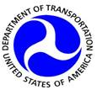

Beyond Traffic: The Smart City Challenge
Information Session #2: Connected Vehicles and Automation
December 17, 2015
U.S. Department of Transportation (USDOT)

Slide 2
Webinar Overview
Overview of the Beyond Traffic: The Smart City Challenge
Connected Vehicles
Urban Automation
Low-Cost, Efficient, Secure, & Resilient ICT
For More Information

Slide 3

Beyond Traffic: The Smart City Challenge
Encourage cities to put forward their best and most creative ideas for innovatively addressing the challenges they are facing.
The Smart City Challenge will address how emerging transportation data, technologies, and applications can be integrated with existing systems in a city to address transportation challenges.
Demonstrate how advanced data and intelligent transportation systems (ITS) technologies and applications can be used to reduce congestion, keep travelers safe, protect the environment, respond to climate change, connect underserved communities, and support economic vitality.
Notes:
The USDOT is encouraging Applicants to consider the twelve elements in developing ideas for developing their city’s vision for a Smart City.
Applicants should consider how emerging transportation data, technologies, and applications can be integrated with existing systems across a city, helping both cities, citizens, and businesses achieve goals for safety, mobility, sustainability, and economic vitality in an increasingly complex, interdependent and multimodal world.

Slide 4
Beyond Traffic: The Smart City Challenge
Phase 1 (Deadline February 4, 2016):
Support concept development and planning activities
Estimated five Smart City Challenge Finalists
$100K each
Phase 2 (Solicitation and Deadline TBD):
Smart City Challenge Finalists
Support implementation of their proposed demonstration
$50 Million
  U.S. Department of Transportation: $40 Million
  Vulcan Foundation: $10 Million
Notes:
The USDOT is encouraging Applicants to consider the twelve elements in developing ideas for developing their city’s vision for a Smart City.
Applicants should consider how emerging transportation data, technologies, and applications can be integrated with existing systems across a city, helping both cities, citizens, and businesses achieve goals for safety, mobility, sustainability, and economic vitality in an increasingly complex, interdependent and multimodal world.

Slide 5
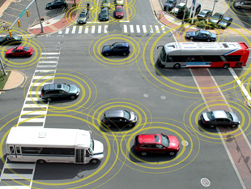
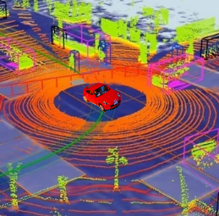
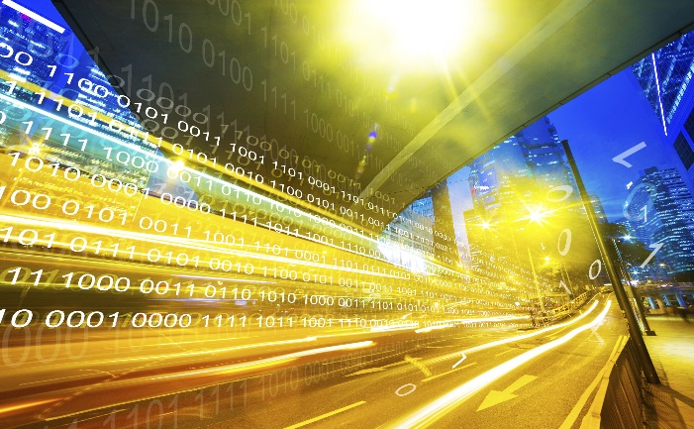
Advanced Technologies and Smart Cities
Technology convergence will revolutionize transportation, dramatically improving safety and mobility while
reducing costs and environmental impacts
Connected Vehicles
Benefits
Order of magnitude safety improvements
Reduced congestion
Reduced emissions and use of fossil fuels
Improved access to jobs and services
Reduced transportation costs for gov’t and users
Improved accessibility and mobility
Vehicle Automation
Connected-Automated Vehicles
Internet of Things
Machine Learning
Big Data
Mobility on Demand
Smart Cities

Slide 6
The USDOT’s Vision for a Smart City
The USDOT recognizes that each city has unique attributes, and each city’s proposed demonstration will be tailored to their vision and goals.
The USDOT’s vision for a Smart City Challenge is “to identify an urbanized area where advanced technologies are integrated into the aspects of a city and play a critical role in helping cities and their citizens address challenges in safety, mobility, sustainability, economic vitality, and address climate change.”
To assist cities, the USDOT identified twelve (12) vision elements that are intended to provide a framework for Applicants to consider in the development of a city’s proposed demonstration without making each item a requirement for award.

Slide 7

Beyond Traffic: The Smart City Challenge
Technology Elements (Highest Priority)
Vision Element #1
Urban Automation
Vision Element #2
Connected Vehicles
Vision Element #3
Intelligent, Sensor-
Based Infrastructure
Innovative Approaches to Urban Transportation Elements (High Priority)
Vision Element #4
User-Focused Mobility
Services and Choices
Vision Element #5
Urban Analytics
Vision Element #6
Urban Delivery and
Logistics
Vision Element #7 Strategic Business Models & Partnering
Vision Element #8
Smart Grid, Roadway
Electrification, & EVs
Vision Element #9 Connected, Involved Citizens
re-charging
Smart City Elements (Priority)
Vision Element #10 Architecture and
Standards
Vision Element #11
Low-Cost, Efficient,
Secure, & Resilient ICT
Vision Element #12
Smart Land Use
Notes:
The USDOT is encouraging Applicants to consider the twelve elements in developing ideas for developing their city’s vision for a Smart City.
Applicants should consider how emerging transportation data, technologies, and applications can be integrated with existing systems across a city, helping both cities, citizens, and businesses achieve goals for safety, mobility, sustainability, and economic vitality in an increasingly complex, interdependent and multimodal world.

Slide 8
Beyond Traffic: The Smart City Challenge
Technology Elements (Highest Priority)
Vision Element #1
Urban Automation
Vision Element #2
Connected Vehicles
Vision Element #3
Intelligent, Sensor-
Based Infrastructure
Innovative Approaches to Urban Transportation Elements (High Priority)
Vision Element #4
User-Focused Mobility
Services and Choices
Vision Element #5
Urban Analytics
Vision Element #6
Urban Delivery and
Logistics
Vision Element #7 Strategic Business Models & Partnering
Vision Element #8
Smart Grid, Roadway
Electrification, & EVs
Vision Element #9 Connected, Involved Citizens
re-charging
Smart City Elements (Priority)
Vision Element #10 Architecture and
Standards
Vision Element #11
Low-Cost, Efficient,
Secure, & Resilient ICT
Vision Element #12
Smart Land Use
Notes:
The USDOT is encouraging Applicants to consider the twelve elements in developing ideas for developing their city’s vision for a Smart City.
Applicants should consider how emerging transportation data, technologies, and applications can be integrated with existing systems across a city, helping both cities, citizens, and businesses achieve goals for safety, mobility, sustainability, and economic vitality in an increasingly complex, interdependent and multimodal world.

Slide 9
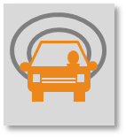
Vision Element #2
Connected Vehicles

Slide 10
Vision Element #2: Connected Vehicles
U.S. Crash Safety Picture
Motor Vehicle Crashes are Costly and Increasing
  Human toll: 32, 675 people died in 2014
  $836 billion dollars a year to society
  A leading cause of death for 4 to 34 year olds
  U.S. falling behind other European countries and Japan
Avoiding the crash has to be a priority
  Driver error cited as critical reason in 94% of crashes
  Decades spent on crash protection
  Need to accelerate deployment of crash avoidance technologies

Slide 11
Vision Element #2: Connected Vehicles
Vehicle-to-Vehicle (V2V) Communications
  Allows nearby vehicles to exchange data on their position and use these data to warn drivers of potential collisions
  V2V technologies are capable of warning drivers of potential collisions that are not visible to sensors, such as a stopped vehicle blocked from view, or a moving vehicle at a blind intersection
  Unprecedented and transformative technology: Extendable to other vehicle types, road users, and infrastructure

Slide 12
Vision Element #2: Connected Vehicles
Sec. Foxx Accelerating Technology
On-board Sensors
  Warning systems already in star rating program
  September 11 announcement by automakers to make automatic braking standard equipment.
  Nov and Dec announcements to include automatic braking in star program
Vehicle-to-Vehicle (V2V)
  On February 3, 2014, intend to require an onboard DSRC-based V2V communications technology
  Advanced proposal published in August 2014
  Notice of Proposed Rulemaking in 2016
Self-Driving
  Evaluate regulatory structure/remove barriers
  Support safe introduction

Slide 13
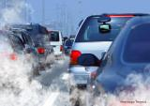
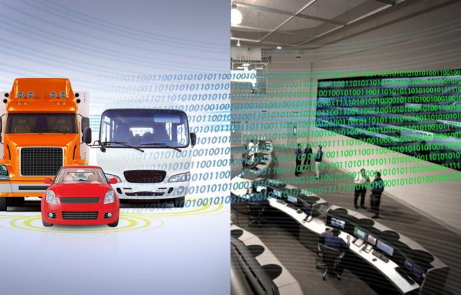
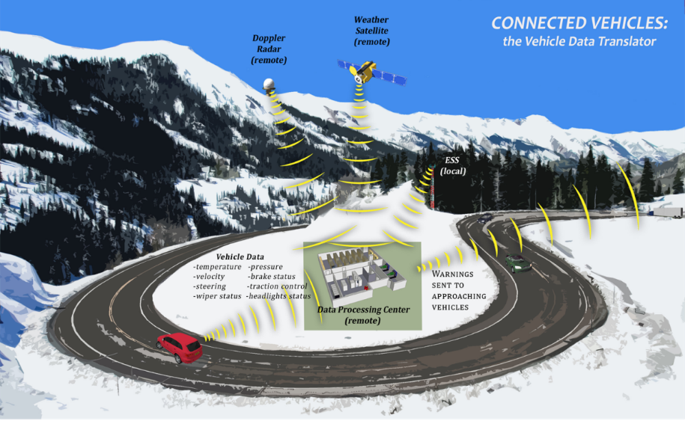
In addition to Safety, Connected Vehicles will Improve Mobility, Road Weather Info, and the Environment
Vision Element #2: Connected Vehicles
Mobility
5.5 billion hours of travel delay
$121 billion cost of urban congestion
Environment
2.9 billion gallons of wasted fuel
56 billion lbs of additional CO₂
Notes:
Data from connected vehicles will make travel easier, help to make cars and trucks less polluting and make it easier for drivers to anticipate dangerous weather conditions.

Slide 14
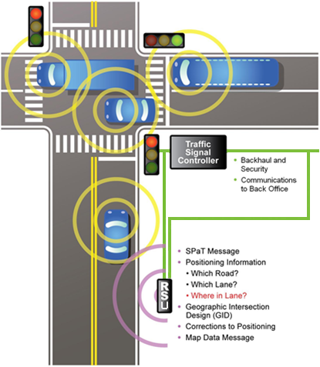
Vision Element #2: Connected Vehicles
Vehicle-to-Infrastructure (V2I) Communications
  Allows infrastructure to communicate with vehicles
  Could be used to inform drivers about weather, traffic, work zones, and even potholes
  Allows for coordinated signal timing and enhanced parking information systems that may improve urban traffic flow
  Interim version of V2I Deployment Guidance to be released in early 2016

Slide 15
Vision Element #2: Connected Vehicles
V2I Deployment Guidance – Outline & Topics
  Chapter 1. Introduction
    Intent of the document
    Significance of V2I
    Available Connected Vehicle Standards
  Chapter 2. Federal-aid eligibility for V2I deployments
    General eligibility for V2I activities
    Brief summary of Federal-aid Programs for V2I
  Chapter 3. Guidance
    Hardware and Software device certification
    Use of Right-of-Way
    Use of public sector fleets (including incident responder vehicles)
    Using Public-Private Partnerships (P3s)
    Communication technologies
    Security and privacy in a Cooperative ITS Environment

Slide 16
Vision Element #2: Connected Vehicles
V2I Deployment Products
  The Vehicle-to-Infrastructure (V2I) Deployment Guidance and Products document will be available at http://www.its.dot.gov/v2i/
  Products and Tools (Available by the end of 2015)
    Systems Engineering Guide
    Connected Vehicles and the Planning Process
    Guide to FCC Licensing for DSRC transmitters
    V2I Message Lexicon
    Pre-Deployment Guidance for V2I Safety Applications
    Estimating Benefits and Economic Impacts
    Near Term Transition and Phasing
    Connected Vehicle Training Resources

Slide 17
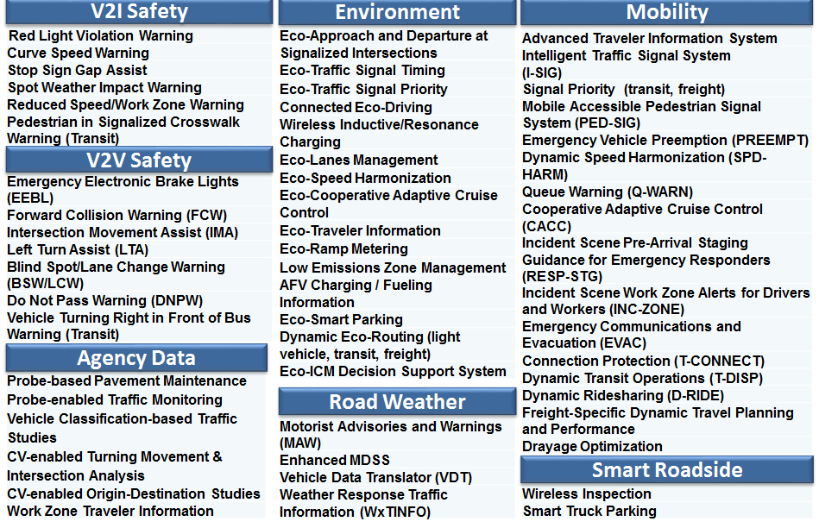
Vision Element #2: Connected Vehicles
Connected Vehicle Applications

Slide 18
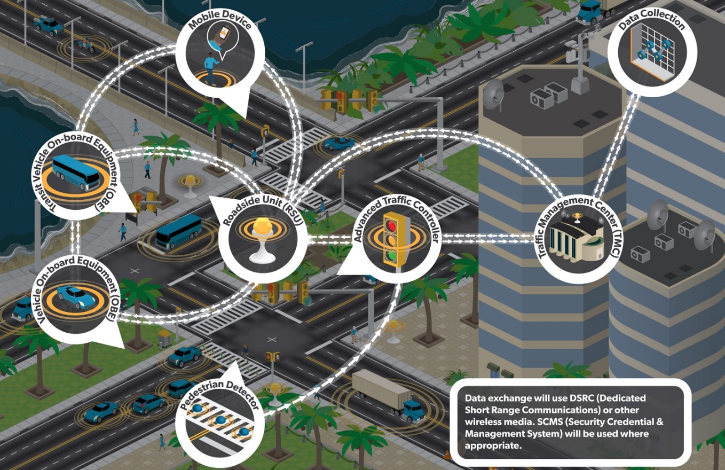
Vision Element #2: Connected Vehicles
Notes:
Connected Vehicle Applications utilize a shared communications and control infrastructure
Smart Cities may seek to integrate a variety of commercially available communication technologies including cellular, satellite, Wi-Fi and others.
Dedicated Short Range Communication (DSRC) technology operating in the 5.9 GHz range may be used to expand demonstrations of V2V and V2I applications.

Slide 19
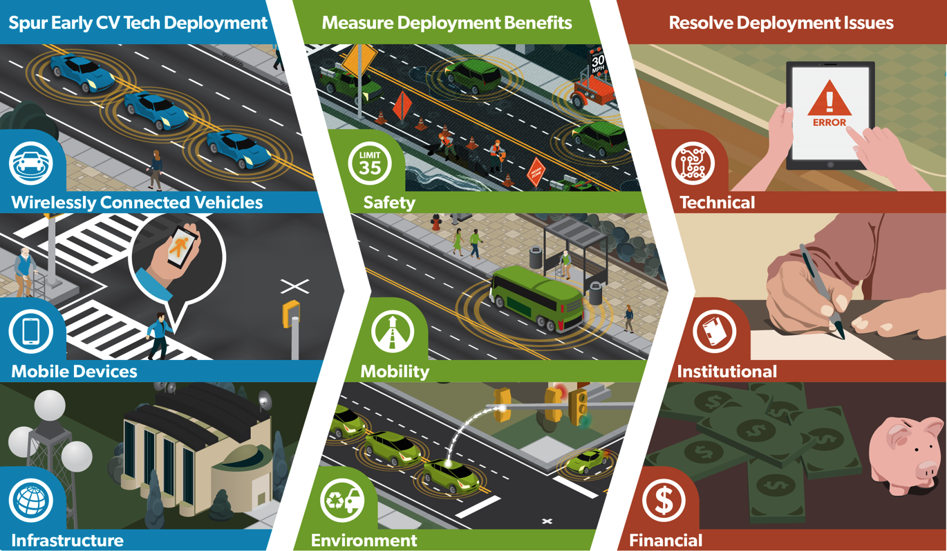
Vision Element #2: Connected Vehicles
Connected Vehicle Pilot Deployment Program

Slide 20
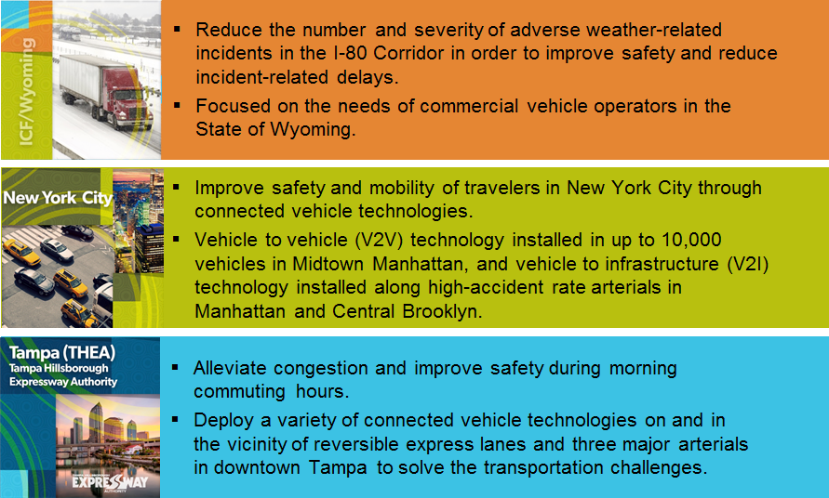
Vision Element #2: Connected Vehicles
Connected Vehicle Pilot Deployment Program Sites

Slide 21
Vision Element #2: Connected Vehicles
Connected Vehicles and Smart Cities
In a smart city, all critical city systems—transportation, energy, public services, public safety, health care, telecommunications are capable of communicating with each other to allow coordination and improve efficiency. They are capable of generating, transmitting and processing data about a wide variety of related activities within the city.
If a “smart city” is a system of systems that use ICT to communicate with and leverage each other to improve vital city operations,
Then smart cities is designed to examine the opportunities created where these systems interface with transport and mobility.
  In other words, where connected city, the connected citizen, and the connected vehicle meet and interact.
Smart Cities seek to maximize and leverage the benefits of connected transportation by integrating those transport services, vehicles and related technologies and data with other data enabled innovations in a city
Notes:
The validity to be smart and connected has to be based more than a city’s use of information and communication technologies (ICTs). ICTs simply help bring everything together – serving as the common denominator underlying the core of the city. To truly be smart, a city needs to do three things. It needs to be:

Slide 22
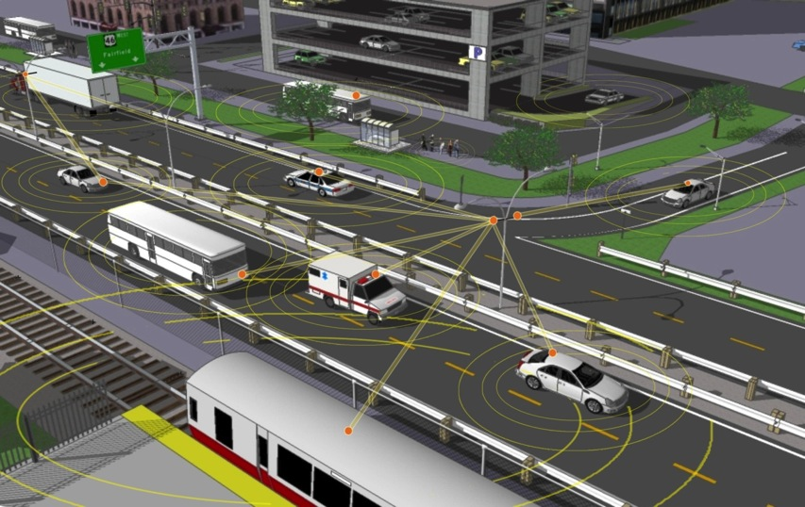
Smart Cities and Connected Vehicles
Smart Cities incorporate and expand connected transportation to ensure that connected transportation data, technologies and applications – as well as connected travelers – are fully integrated with other systems across a city, and fulfill their potential to improve safety, mobility and environmental outcomes in a complexly interdependent and multimodal world that supports a more sustainable relationship between transport and the city.

Slide 23
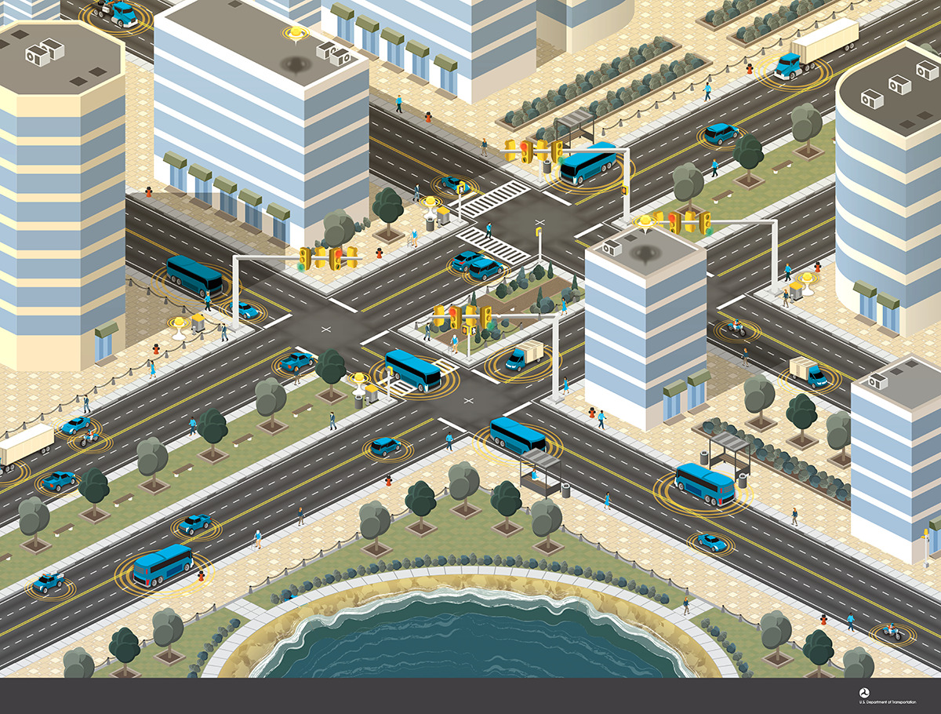
Vision Element #2: Connected Vehicles
Example Deployment in a Smart City
Data collected from connected vehicles provide insights into the performance of the city
Transit vehicles leverage connected vehicle technologies for transit signal priority
Connected vehicle data supports advanced traffic signal operations
Notes:
Purpose of Slide: Introduce connected vehicles and the connected vehicles environment.
Transition: This is a video with a short clip of President Obama discussing the importance of connected vehicle technology and introduction to DSRC technology.
Key Messages: Connected vehicle technology using dedicated short range communications (DSRC) offer important innovations to reduce crashes, congestion, and provide energy savings.
Suggested Interaction: Show the video clip.
Additional Resources: Link to full video: http://www.its.dot.gov/library/media/16dsrc.htm

Slide 24
Vision Element #2: Connected Vehicles
Questions to Focus Thinking
Overarching Questions
  What are some critical issues and challenges facing today’s cities? How can connected vehicle technologies, data and/or applications help address these issues?
  How will the integrated and connected nature of today’s cities be of critical importance to the likelihood of success of the eventual deployment of connected vehicles?
  How do transportation services and connected vehicle technologies, data and applications intersect with other sectors of the city and how can these be leveraged to the overall benefit of a jurisdiction?
  Who are the core stakeholders at the nexus of the connected traveler and the smart city, both inside and outside of transportation? How can necessary partnerships and other relationships among them be developed?

Slide 25
Vision Element #1
Urban Automation

Slide 26

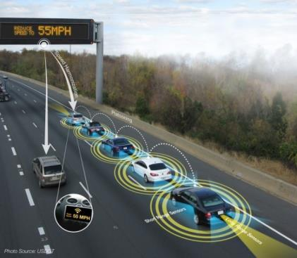
Vision Element #1: Urban Automation
Automation Can Be a Tool for Solving Problems
Improving safety
  Reduce and mitigate crashes
Increasing mobility and accessibility
  Expand capacity of roadway infrastructure
  Enhance traffic flow dynamics
  More personal mobility options for disabled and aging population
Reducing energy use and emissions
  Aerodynamic “drafting”
  Improve traffic flow dynamics
…but connectivity is critical to achieving the greatest benefits

Slide 27
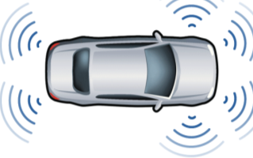
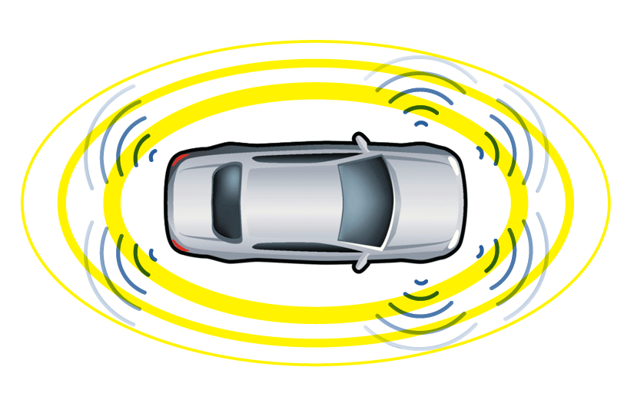
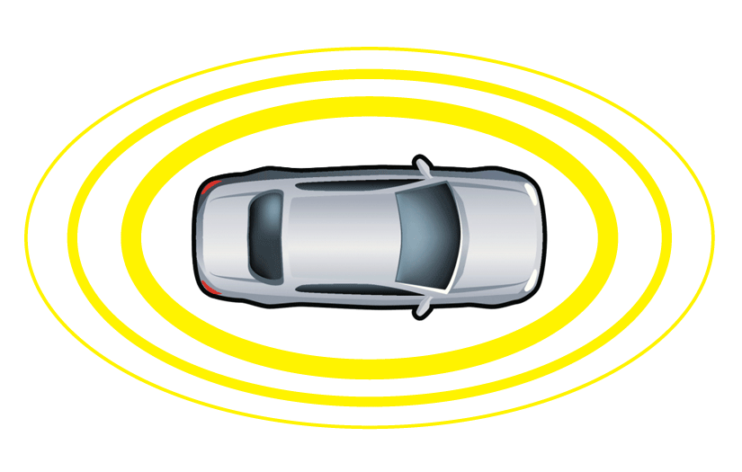
Vision Element #1: Urban Automation
Connected Automation for Greatest Benefits
Autonomous Vehicle
Operates in isolation from other vehicles using internal sensors
Connected Automated Vehicle
Leverages autonomous and connected vehicle capabilities
Connected Vehicle
Communicates with nearby vehicles and infrastructure

Slide 28
Vision Element #1: Urban Automation
Example Systems at Each Automation Level
SAELevel | Example Systems | Driver Roles
1 | Adaptive Cruise Control OR Lane Keeping Assistance | Must drive other functions and monitor driving environment
2 | Adaptive Cruise Control AND Lane Keeping Assistance Traffic Jam Assist | Must monitor driving environment (system nags driver to try to ensure it)
3 | Traffic Jam Pilot Automated parking Highway Autopilot | May read a book, text, or web surf, but be prepared to intervene when needed
4 | Closed campus driverless shuttle Valet parking in garage ‘Fully automated’ in certain conditions | May sleep, and system can revert to minimum risk condition if needed
5 | Automated taxi Car-share repositioning system | No driver needed
Source: California PATH

Slide 29
Vision Element #1: Urban Automation
State of the Art
Highway Operation (Levels 1, 2, or 3)
  Prototypes driving in-lane, changing lanes, merging
Street Operation (Levels 1, 2, or 3)
  Prototypes driving wide range of city streets
  Handling elements such as signalized intersections, roundabouts
Automated Chauffeuring (Level 4)
  Seen as a natural evolution by some OEMs
  Pursued by Google, Uber, others
  Street level automated driving
  Low speed
  Limited geographic area

Slide 30
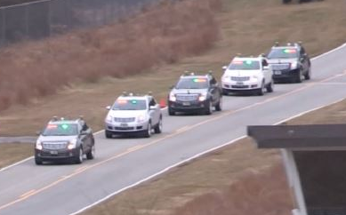
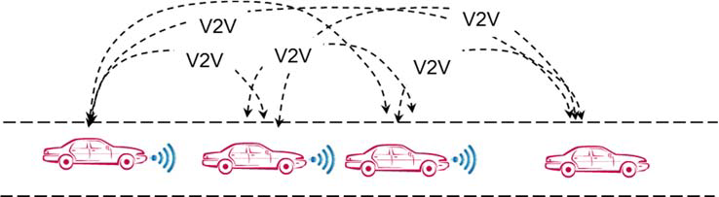
Vision Element #1: Urban Automation
USDOT Research Efforts: CACC Development Projects
Enabling Cooperative Adaptive Cruise Control (CACC) High Performance Vehicle Streams
CACC Field Tests
  OEM Assessment of CACC Concepts and Prototype
  Driver Acceptance of Level 1 Applications

Slide 31
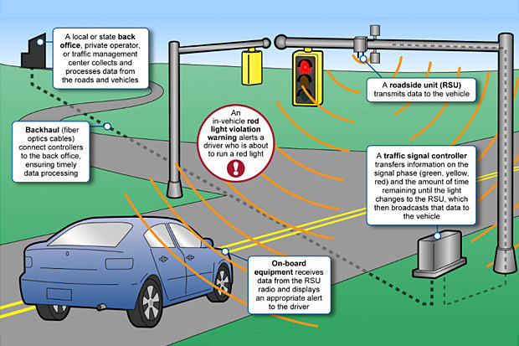
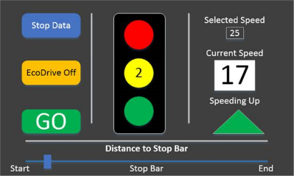
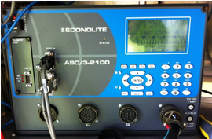

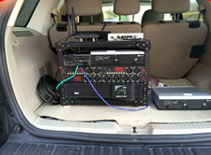

Vision Element #1: Urban Automation
USDOT Research Efforts: Eco-GlidePath
7
Back Office:
A local TMC processes data from roads and vehicles
3
Roadside Unit
Driver-Vehicle Interface
The roadside unit transmits SPaT and MAP messages using DSRC
6
1
Backhaul: Communications back to TMC
Traffic Signal Controller
4
5
Onboard Computer with Automated Longitudinal Control Capabilities
Onboard Unit
SPaT Black Box
2

Slide 32
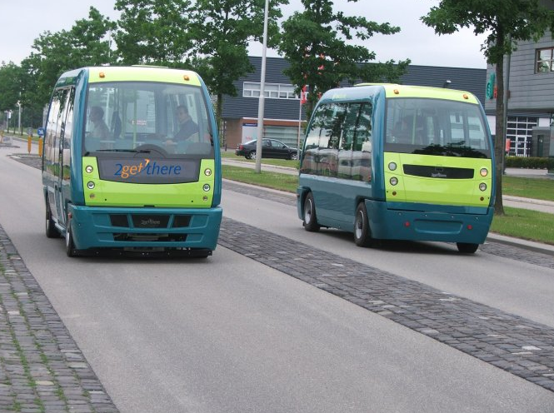
Vision Element #1: Urban Automation
Low Speed Self-Driving Shuttles
  CityMobil2 is a pilot platform for automated road transport systems, which has been implemented in several urban environments across Europe.
  Supplements existing public transit systems, offering collective, semi-collective and personal on-demand shuttle services.
  Cybercars offer a ride-to-the-ride where demand is low or pick-up points far apart, getting consumers to the nearest mass transit or bus station where they will transfer for the next leg of the journey.
Notes:
http://www.thinkstockphotos.com/image/stock-photo-autonomous-self-driving-driverless-vehicle/486778794/popup?sq=autonomous%20vehicles/f=CPIHVX/p=3/s=DynamicRank

Slide 33
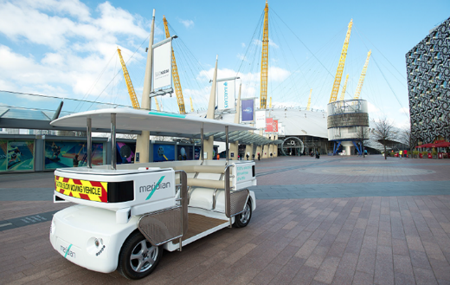
Vision Element #1: Urban Automation
GATEway (Greenwich Automated Transport Environment)
  Seeks to demonstrate the safe and efficient integration of sophisticated automated transport systems into complex real world smart city environments, including automated shuttle transport on the Greenwich peninsula and autonomous valet parking of cars.
  Creates a multifaceted, validated, long term test bed in the heart of the UK’s megacity for the evaluation of the next generation of automated transport systems including the detailed testing protocols and benchmark data to provide robust independent verification of automated system.

Slide 34
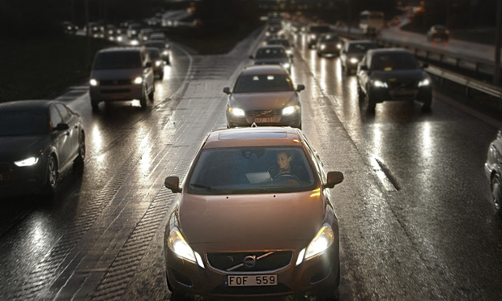
Vision Element #1: Urban Automation
Volvo will test 100 of its autonomous cars on public roads driven in normal traffic by members of the public by 2017.
The car manufacturer announced a collaboration with Swedish legislators and transport authorities to test the cars on 30 miles of roads around Gothenburg by 2017, marking Volvo’s first public pilot of fully autonomous vehicles.

Slide 35
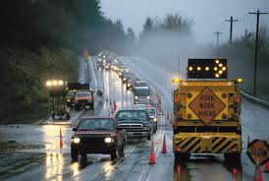
Vision Element #1: Urban Automation
Technical Challenges
Human factors
  Ensuring safe transfer of control between human driver and AV systems
  Conditional automation (L3) most challenging
Testing and certification complexity
  Identifying and physically testing all possible crash scenarios not feasible
  Certification status with subsequent control/decisionmaking software updates
Operations
  Ability to operate in changing environments (work zones, inclement weather, mixed traffic)
Cybersecurity
  New potential vulnerabilities due to electronic controls and software

Slide 36

Vision Element #1: Urban Automation
Policy and Institutional Challenges
Federal and State Regulations
  Inconsistencies in state regulations could introduce confusion and compliance issues
  Some current federal vehicle safety regulations assume human drivers
  Driver licensing standards (states) and vehicle design standards (fed) merge at high automation levels
User Expectations and Acceptance
  Misalignment of system capabilities and driver expectations could lead to unsafe outcomes
Data Privacy Concerns
  Understanding data collection, access and any implications for public agencies
Liability and Insurance
  Compatibility of existing legal and insurance frameworks

Slide 37

Vision Element #11
Low-Cost, Efficient, Secure, & Resilient ICT

Slide 38
Vision Element #11: Low-Cost, Efficient,
Secure, & Resilient ICT
The success of Smart City Demonstration depends upon affordable information and communications technology (ICT), from both a public and personal perspective.
ICT in a Smart City needs to be resilient, secure, and respectful of privacy. Resilient design includes supporting standards common technology architectures and integrative policies.
Privacy and security play a critical role in enabling smart cities because they build trust with people. Privacy and security constitute practices that safeguard data, privacy, and physical assets.

Slide 39
Vision Element #11: Low-Cost, Efficient,
Secure, & Resilient ICT
Privacy
  Private information relates to any data emitted, collected, or stored about individuals.
  A key concept in privacy analysis is Personal Identifiable Information (PII). PII is any information that can be used to distinguish or trace an individual’s identity.
  Smart Cities needs to determine the extent to which their system or systems will collect or store PII and PII-related information, and ensure that there is a legitimate need for this information to meet the goals of the system and that the data is only accessible for and used for these legitimate purposes.

Slide 40
Vision Element #11: Low-Cost, Efficient,
Secure, & Resilient ICT
Security
  Rigorous, proven processes are needed to ensure that security mechanisms are embedded in systems and infrastructure to protect against attacks.
  Demonstration sites are expected to use industry best practices as they relate to objects and interfaces used in their installations.
  The USDOT is developing a prototype security credential management system (SCMS) which will be available for use in DSRC-based communications.
  Physical security of the deployed devices and security for non-DSRC communications are not covered by the SCMS and should be addressed through other means in the Demonstration.

Slide 41
Vision Element #11: Secure & Resilient ICT
The Need for Communications Security
Vehicle and infrastructures messages must be trusted for the system to work. That is, vehicles receiving the messages must have confidence that messages are:
  Real (genuine); from a vehicle or infrastructure device in proximity
  Convey accurate data about the vehicle or infrastructure
Overall confidence in the system could erode if “fake”, altered, and/or misleading messages are broadcast – leading to false (+ / – ) warnings
Therefore…CV Systems need:
  Method to validate the original sender of the message is trusted (authenticity)
  Method to prevent the messages from being spoofed or altered (integrity)
…AND, this security must be delivered without compromising privacy of end users.

Slide 42
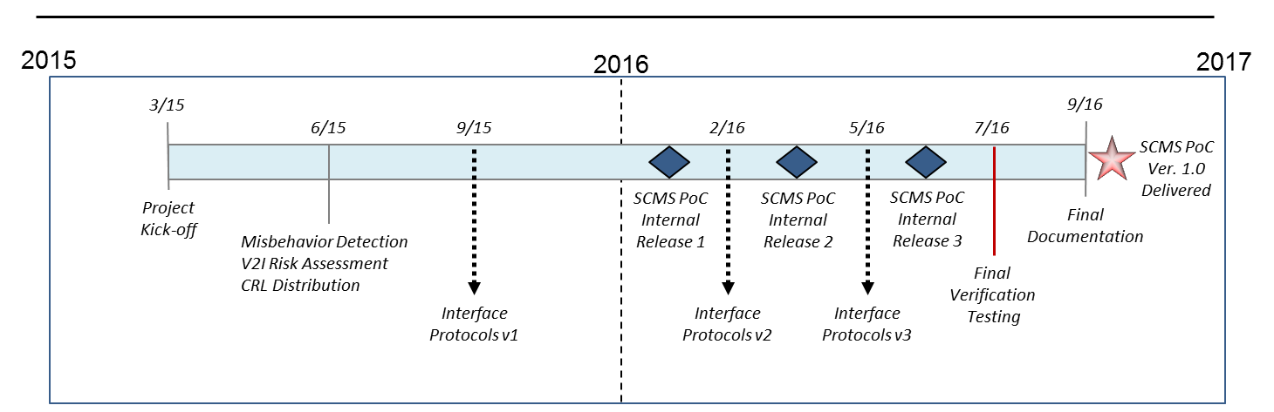
Vision Element #11: Secure & Resilient ICT
SCMS POC – Development Schedule
3 Internal SCMS Releases for Testing/Auditing Purposes
  Feb 2016, March, 2016, and June 2016
SCMS PoC Version 1.0 Delivered by September 2016
  Does not include Misbehavior Authority
Final Documentation Delivered at Project End
  Includes requirements, design, test, and code

Slide 43
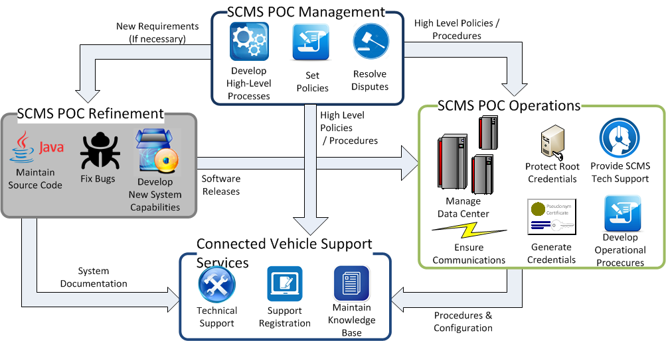
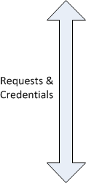
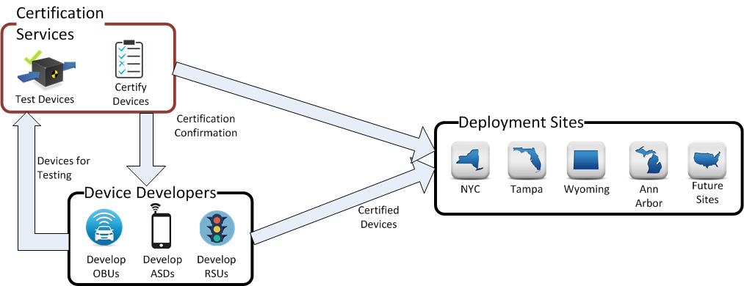

Vision Element #11: Secure & Resilient ICT
SCMS Management and Operations

Slide 44

Vision Element #11: Secure & Resilient ICT
Access Security
How are the security materials stored internally?
Which users are allowed to access to the device?
What are the user name and password policies for authorized users?
Is remote access to the device allowed?

Slide 45

Vision Element #11: Secure & Resilient ICT
Physical Security
What protections are being utilized to prevent tampering with device?
Tamper evident protections?
  Seals?
  Tape?
Tamper resistant protections?
  Specialized screws/keys
  Software protections

Slide 46
Beyond Traffic: The Smart City Challenge
For More Information

Slide 47
Beyond Traffic: The Smart City Challenge
Information Sessions
The Smart City Forum (In Person / Virtual) 12/15/2015 ( 9:00 am to 4:00 pm EST) U.S. Department of Transportation (Washington, DC)
Data, Architecture, and Standards (Virtual) 12/16/2015 (1:00 to 2:30 pm EST)
Connected Vehicles and Automation (Virtual) 12/17/2015 (1:00 to 2:30 pm EST)
Sharing Economy, User-Focused Mobility, and Accessible Transportation (Virtual) 12/18/2015 (1:00 to 2:30 pm EST)
The Smart City Challenge Application and Selection Process (Virtual) 12/21/2015 (1:00 to 2:00 pm EST)
For More Information and RSVP Information: www.transportation.gov/smartcity
Notes:
The USDOT is encouraging Applicants to consider the twelve elements in developing ideas for developing their city’s vision for a Smart City.
Applicants should consider how emerging transportation data, technologies, and applications can be integrated with existing systems across a city, helping both cities, citizens, and businesses achieve goals for safety, mobility, sustainability, and economic vitality in an increasingly complex, interdependent and multimodal world.

Slide 48
Beyond Traffic: The Smart City Challenge
For More Information and Questions
Department of Transportation
https://www.transportation.gov/
Smart City Challenge
www.transportation.gov/smartcity
Questions?
SmartCityChallenge@dot.gov
Notes:
The USDOT is encouraging Applicants to consider the twelve elements in developing ideas for developing their city’s vision for a Smart City.
Applicants should consider how emerging transportation data, technologies, and applications can be integrated with existing systems across a city, helping both cities, citizens, and businesses achieve goals for safety, mobility, sustainability, and economic vitality in an increasingly complex, interdependent and multimodal world.

