Slide 1
Beyond Traffic: The Smart City Challenge Information Session #4: Application and Selection Process
December 21, 2015
U.S. Department of Transportation (USDOT)

Slide 2
Webinar Overview
Overview of the Beyond Traffic: The Smart City Challenge
Overview of Phase 1 Notice of Funding Opportunity
Application Content
Evaluation, Selection and Award
Overview of Phase 2 Notice of Funding Opportunity
For More Information

Slide 3
Beyond Traffic: The Smart City Challenge
Encourage cities to put forward their best and most creative ideas for innovatively addressing the challenges they are facing.
The Smart City Challenge will address how emerging transportation data, technologies, and applications can be integrated with existing systems in a city to address transportation challenges.
Demonstrate how advanced data and intelligent transportation systems (ITS) technologies and applications can be used to reduce congestion, keep travelers safe, protect the environment, respond to climate change, connect underserved communities, and support economic vitality.

Slide 4
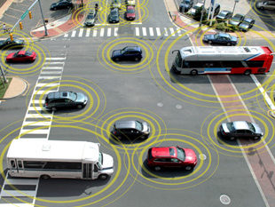
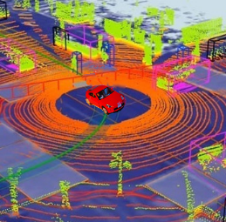
Advanced Technologies and Smart Cities
Technology convergence will revolutionize transportation, dramatically improving safety and mobility while
reducing costs and environmental impacts
Connected Vehicles
Benefits
Order of magnitude safety improvements
Reduced congestion
Reduced emissions and use of fossil fuels
Improved access to jobs and services
Reduced transportation costs for gov’t and users
Improved accessibility and mobility
Vehicle Automation
Connected-Automated Vehicles
Internet of Things
Machine Learning
Big Data
Mobility on Demand
Smart Cities

Slide 5
The USDOT’s Vision for a Smart City
The USDOT recognizes that each city has unique attributes, and each city’s proposed demonstration will be tailored to their vision and goals.
The USDOT’s vision for a Smart City Challenge is “to identify an urbanized area where advanced technologies are integrated into the aspects of a city and play a critical role in helping cities and their citizens address challenges in safety, mobility, sustainability, economic vitality, and address climate change.”
To assist cities, the USDOT identified twelve (12) vision elements that are intended to provide a framework for Applicants to consider in the development of a city’s proposed demonstration without making each item a requirement for award.

Slide 6
Beyond Traffic: The Smart City Challenge
Technology Elements (Highest Priority)
Vision Element #1
Urban Automation
Vision Element #2
Connected Vehicles
Vision Element #3
Intelligent, Sensor-
Based Infrastructure
Innovative Approaches to Urban Transportation Elements (High Priority)
Vision Element #4
User-Focused Mobility
Services and Choices
Vision Element #5
Urban Analytics
Vision Element #6
Urban Delivery and
Logistics
Vision Element #7 Strategic Business Models & Partnering
Vision Element #8
Smart Grid, Roadway
Electrification, & EVs
Vision Element #9 Connected, Involved Citizens
re-charging
Smart City Elements (Priority)
Vision Element #10 Architecture and
Standards
Vision Element #11
Low-Cost, Efficient,
Secure, & Resilient ICT
Vision Element #12
Smart Land Use
Notes:
The USDOT is encouraging Applicants to consider the twelve elements in developing ideas for their city’s vision for a Smart City.

Slide 7
Beyond Traffic: The Smart City Challenge
Phases
Phase 1 (Deadline February 4, 2016):
Support concept development and planning activities
Estimated five Smart City Challenge Finalists
$100K each
Phase 2 (Solicitation and Deadline TBD):
Smart City Challenge Finalists
Support implementation of their proposed demonstration
$50 Million
U.S. Department of Transportation: $40 Million
Vulcan Foundation: $10 Million
Notes:
We have framed the Smart City Challenge to include two phases.
In the current phase, Phase 1, the US DOT issued a Notice of Funding Opportunity on December 7th, soliciting applications for the Smart City Challenge. These applications are due February 4th. Under phase 1, the USDOT intends to select five Smart City Challenge Finalists, who will each receive fixed amount cooperative agreement awards in the amount of $100K each, to provide support for each Finalist’s concept development and planning activities. We anticipate the selection of Finalists to occur in March.
In Phase 2, the USDOT will issue a second Notice of Funding Opportunity with competition limited to the five Finalists. The Notice, estimated to be released in March, will be posted publicly at grants.gov and on the Smart City Challenge website. Finalists will have roughly two months to prepare and submit detailed technical and budget applications for their proposed demonstration. In June 2016, the US DOT intends to announce the one selected winner to receive an award of up to $40 Million to carry out their Smart City Challenge demonstration. In addition, Vulcan Foundation intends to provide $10 Million to the selected City.

Slide 8
Beyond Traffic: The Smart City Challenge
Phase 1 Funding Opportunity
Issued December 7, 2015 at www.grants.gov under Funding Opportunity Number DTFH6116RA00002
Applications due to SmartCityChallenge@dot.gov by February 4, 2016 by 3:00 pm Eastern Time
One Eligibility Requirement – Prime Applicants must be State or local governments, tribal governments, transit agencies or authorities, public toll authorities, metropolitan planning organizations, other subdivisions of a State or local government, or a multijurisdictional group applying through a single lead Applicant.
Team members anticipated – Subcontractors, Subawardees, and Partners
Notes:
There is one eligibility requirement to be an applicant under the Smart City Challenge. As stated in the Notice of Funding Opportunity, prime applicants must be State or local governments, tribal governments, transit agencies, or authorities, public toll authorities, metropolitan planning organizations, other subdivisions of a State or local government, or a multijurisdictional group applying through a single lead Applicant.
We anticipate that a prime applicant will use various team members to carry out the work. Team members may be subcontractors, or subawardees, or partners. For this Phase 1 application, you are asked to provide an outline of team partners, including existing or future teaming anticipated. Such arrangements do not need to be firm or finalized for this Phase 1 application. The Phase 1 application is intended to be a high-level summary. The Phase 2 application, however, will require a detailed description of the proposed team members.

Slide 9
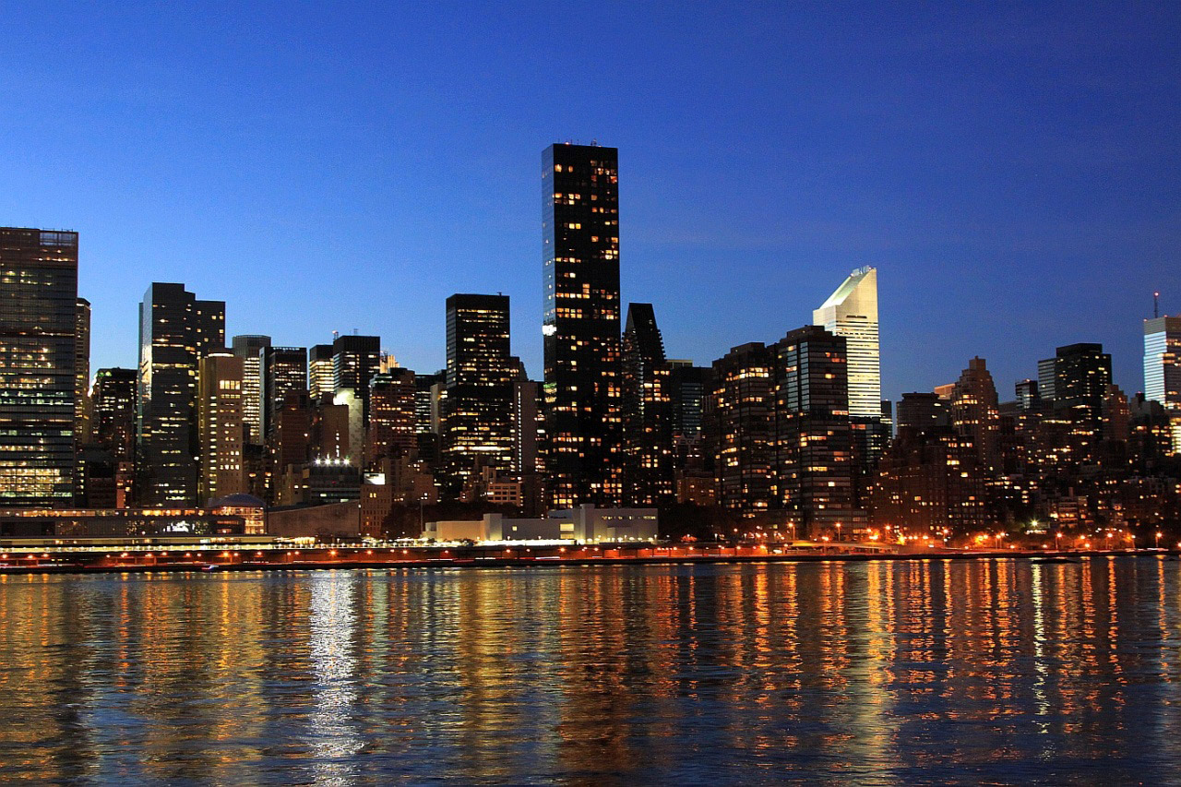
Phase 1 Planned Awards
Beyond Traffic: The Smart City Challenge
Phase 1 Funding Opportunity
Estimated five awards
“Smart City Challenge Finalists”
Fixed amount cooperative agreements
$100,000 each; no cost share
Covers concept development and planning activities
Six-month performance period
Deliverables: monthly progress reports, a video, final report.
Notes:
What is a fixed amount award? Per 2 CFR §200.45, fixed amount awards means a type of grant agreement under which the Federal awarding agency provides a fixed amount of funding without regard to actual costs incurred under the Federal award. This type of Federal award reduces some of the administrative burden and record-keeping requirements for both parties. Accountability is based primarily on performance and results. Payments are based on meeting specific requirements of the Federal award. There is no governmental review of the actual costs incurred by the awardee in performance of the award. No cost share is required. Period of performance will be six months. Estimated award in March.
Scope of the Phase 1 awards will include Concept Development and Planning activities such as development of technical demonstration plans and budget plan documents, and performance of pre-implementation planning. The USDOT intends for the concept development awards to support, prepare, and enable Finalists to submit detailed applications for the performance of their proposed Smart City demonstration. The USDOT intends for the Phase 1 awards to allow each Finalist to further their own Smart City plans even if they do not receive the $40 Million Smart City Challenge award. During the Phase 1 award periods, Finalists will participate in a number of planning, outreach and educational opportunities to further develop their plans.
Deliverables under the Phase 1 awards are listed on page 22 of the NOFO and include monthly progress reports, participation in webinars and meetings with the USDOT, a video, a Presentation to USDOT personnel, and a final report.

Slide 10
Phase 1 Application Content
Include
Do Not Include
High level vision of proposed demonstration; framework and initial concepts; tailored to your city
Part 1 Vision Narrative (1 file)
Up to 30 pages of technical content
Cover page, table of contents, and letters of commitment are allowed and are excluded from page limit
Part 2 Forms & Organizational Info (1 file) – No page limit
Very detailed technical approach
Very detailed management approach
Budget information
More than 30 pages of technical content
Videos
Excess marketing materials
Notes:
Application Content: The intent of the Phase 1 application is to provide a high-level summary narrative of your City’s vision of a smart city demonstration. Applications for this Phase 1 shall reflect a high-level vision for the city’s proposed demonstration. A high-level vision need only include the framework and initial concepts of the Applicant’s proposed demonstration. A detailed approach and a detailed budget are not required under this first solicitation. The second follow-on solicitation, Phase 2, will require the Finalists to submit a detailed technical and management approach to implementing the proposed demonstration, as well as a detailed budget.
Applications must include a Part 1 Vision Narrative; and a Part 2 to include Standard Forms and organizational information.
There is a page limitation to the Part 1 Vision Narrative. The limit is 30 pages of technical content, excluding a cover page, table of contents and any letters of commitment you choose to submit. Please do not submit excess materials such as videos or marketing materials.

Slide 11
Smart City Challenge – Phase 1 Application
Part 1: Vision Narrative
Vision Narrative
Vision and city challenges
Alignment with population characteristics
Alignment with the other desired characteristics
Site Map
Alignment with USDOT’s twelve vision elements
Institutional risks and mitigation plans
Team partners, key stakeholders, and public and/or private partnerships
Transportation infrastructure and system features
Data plans
Standards and architecture plan, certification processes
Measurable goals and objectives, and approach to monitor impact
Capacity, executive commitment, infrastructure readiness, and capabilities
Opportunities to leverage Federal resources through cost share, in-kind donations, and partnering
Notes:
Pages 27 through 30 of the Notice of Funding Opportunity spell out in detail the 13 items that you should address in your VISION NARRATIVE. I’ve summarized them here on this slide, but recommend you read those pages in detail to understand what content is required. And keep in mind, the intent of this Phase 1 application is to be a high-level description of your proposed demonstration. Thus the 30 page limit.
Now, 3 of the bulleted items on this slide (#2, 3, and 5) relate directly to other parts of the NOFO. Bullet 5 asks you to address how your ideas, how your proposed Smart City demonstration, aligns with our list of “12 VISION ELEMENTS”, contained in the NOFO. The USDOT recognizes that each city has unique attributes, and each city’s proposed demonstration will be tailored to the city’s vision and goals. The NOFO presented our vision elements, without making each item a requirement for award. Rather, the 12 Vision Elements contained in the NOFO provide a framework for you to consider in the development of your city’s proposed demonstration.
Bullets 2 and 3 ask you to address how your City aligns with our list of “Desired Characteristics” included in the NOFO. Again, just as with the 12 Vision Elements, these characteristics are not required, but rather are desired. They represent what the USDOT has determined to be the ideal. Two important Desired Characteristics have led to many questions: Population and Density.

Slide 12
Population and Density Characteristics
Desired Characteristics
What if my city is outside the range?
Population between approximately 200,000 and 850,000 people within the city (Census-designated place) limits using 2010 Census data
Population density that includes a significant share (greater than 15%) of the overall population of its urbanized area using 2010 Census data
Desired Characteristics vs. Eligibility Requirements
Applicants that fall outside the population and density guidelines are welcome to apply, but should be aware that USDOT anticipates significant competition. When making the business decision to apply or not, applicants should consider the technical merit evaluation criteria as a whole. Shortcomings in one area will likely require significantly increased merit in another area to remain competitive.
Notes:
I’ve listed on this slide the population and density desired characteristics that we included in our Notice. These Desired Characteristics are not firm eligibility requirements. Rather, they serve to communicate the USDOT’s ideal attributes for the demonstration. The USDOT will evaluate the technical merit of each application as a whole, including the degree that a city aligns with the USDOT’s desired characteristics.
What if your City is outside the guidelines? Applicants that fall outside the population and density guidelines are welcome to apply. We invite and encourage all eligible applicants to submit bold and innovative applications. BUT, if your City does not align with the population guidelines, you should be aware that we do anticipate significant competition. When making your business decision to apply or not, you should consider the technical merit evaluation criteria as a whole. Shortcomings in one area will likely require significantly increased merit in another area to remain competitive.

Slide 13
Population and Density (continued)
To assist potential applicants, USDOT intends to post a list of cities that meet the population and density guidelines according to our research
Please monitor the Smart City Challenge website for this list: www.transportation.gov/smartcity
Cities can look up their population in the 2010 census here: http://factfinder.census.gov/faces/nav/jsf/pages/index.xhtml
Information about Census urbanized areas can be found at: https://www.census.gov/geo/reference/ua/urban-rural-2010.html
Notes:
To help applicants know whether or not they fall within the stated population guidelines, we’ve provided a list online of the cities that, from our research, meet the population and density characteristics. There are about 65 listed. See the Smart City Challenge website at:
https://www.transportation.gov/smartcity/citypopulations.

Slide 14
Smart City Challenge – Phase 1 Application
Part 2: Forms and Information
Forms
Organizational Information
Standard Form 424
Standard Form 424A
Standard Form 424B
Standard Form LLL
http://www.grants.gov/web/grants/forms/sf-424-family.html#sortby=1
Any exceptions to the anticipated award terms and conditions
Dun and Bradstreet (D&B) Data Universal Numbering System (DUNS) number
Any known conflicts of interest
Audits completed
Contracts terminated
Violations of Federal criminal law
Register in SAM.gov before submitting its application
Notes:
Part 2 of the application includes a set of required Standard Forms, and a set of questions regarding your organization. The forms are available in fillable pdf format on the grants.gov website. NOFO page 31 gives guidance on how to fill out various data fields, but certainly email or call me with any questions on the forms. Note: SF 424A, you may leave BLANK BLOCK 6 through 23, which ask for cost detail. These entries are not applicable on this fixed amount award under Phase 1. They will be required in Phase 2 applications.
Organizational Information: pages 32 and 33 in the NOFO: Identify any exceptions to the award terms and conditions in the NOFO. Note the NOFO contains terms and conditions in Section F, as well as a link to our online list of general grant terms and conditions. Review the terms and advise of any exceptions in your application.
DUNS number and registration in Sam.gov are required to receive an award. The prime applicant must register in sam.gov, which requires a DUNS number. It’s ok if you don’t have it upon application submittal, but note you will not be able to receive an award without an active sam.gov registration. The Sam.gov website has many resources to walk you through the registration process, training videos, user guides, help desk, etc.

Slide 15
Phase 1 Evaluation, Selection, & Award
Evaluation Criteria
Evaluation Process
Selecting Official
Award
Notes:
The next few slides will provide your information on the evaluation criteria, and our planned evaluation and selection process. We’ll cover the evaluation criteria which are contained in the Notice of Funding Opportunity, the evaluation and selection process, and the content of the award document.

Slide 16
Evaluation Criteria – Technical Merit
Degree that the proposed city and demonstration site align with the USDOT’s Desired Characteristics as listed in the Notice
Demonstration of a sound, innovative, integrated, and holistic vision of the Applicant’s Smart City program consistent with the USDOT’s goals and twelve vision elements as defined in the Notice
Extent that the Applicant’s vision and goals address issues identified in Beyond Traffic 2045
Likelihood of success in implementing the demonstration, including commitment from public and private sectors, and technical capability to perform
Notes:
Section E, page 35 -37 of the NOFO, describes the Technical Merit evaluation criteria that will be used in the award selection process.
I’ve listed on this slide the four Technical Merit criteria, which are of equal importance.
(read the four items)

Slide 17
Evaluation and Selection Process
Merit Review Process
Leadership Review and Selection
Cross-modal panel of USDOT experts will review applications against the technical merit criteria in the NOFO
Panel identifies strengths, weaknesses and risks of each application
Panel collectively assigns a merit rating of Recommended or Not Recommended
Results shared with USDOT Leadership through reports and briefings
USDOT will select the applications that are considered the most advantageous to the Government using the technical merit criteria
The Secretary of Transportation will make the final selections
Estimate five selected “Smart City Challenge Finalists”
Notes:
Section E of the Notice of Funding Opportunity provides information on the selection process. A team of experts from across the USDOT will review the applications received against the technical merit criteria defined in the NOFO. The team will document the strengths, weaknesses and risks of each proposal and provide a rating of recommended and not recommended. The expert team will present the information to leadership from the modal administrations involved in the program. Leadership will advise the Secretary of the evaluation results. The Secretary will then select the estimated five “Smart City Challenge Finalists”. He will select the applications that are considered the most advantageous to the Government using the technical merit criteria in the NOFO.
Applications selected for award will undergo a risk assessment prior to award, to evaluate items such as financial stability, history of performance, and past audit findings.

Slide 18
Beyond Traffic: The Smart City Challenge
Phase 1 Awards
Selected Smart City Challenge Finalists to be announced by the Secretary in March 2016
The agreement award documents must then be signed by the USDOT Agreement Officer and the selected applicants
The award documents will contain:
Terms and conditions contained in Section F of the Notice of Funding Opportunity
Relevant regulations
Deliverables and reporting requirements
Period of performance
Scope of work
Notes:
We anticipate the Secretary will announce selections in March 2016. After the announcement, both parties will sign the award documents to make the award effective, also in March.
The award document will consist of the relevant portions of the NOFO that need to appear in the award. Specifically, the award will include the terms and conditions contained in Section F of the Notice, the applicable grant regulations as cited in the Notice, a list of deliverables and reporting requirements (which are currently contained on page 5 of the NOFO). The award will include the accounting information necessary to obligate $100,000 in Federal funding. The award will include a scope of work to include Concept Development and Planning activities, development of technical demonstration plans and budget plan documents, and submittal of required deliverables.
The award will also include a payment plan for the fixed amount payments as mutually agreed upon by the parties. Payment under a fixed amount award must be linked to performance, deliverables or milestones. Therefore, USDOT anticipates authorizing fixed amount monthly payments to align with monthly progress reports. A schedule will be worked out by the parties at award.

Slide 19
Beyond Traffic: The Smart City Challenge
Looking Ahead to Phase 2
Eligibility: Open only to Smart City Challenge Finalists
Applications: Detailed approach and will include detailed budget
Application Process: May include oral presentations
Technical Merit Evaluation Criteria: Similar to Phase 1
Technical Evaluation Review and Selection Process: Similar to Phase 1
Notes:
Looking ahead to Phase 2 of the Smart City Challenge…
USDOT will issue a Notice of Funding Opportunity for Phase 2 with eligibility open to only the Phase 1 Finalists. The NOFO will be issued publicly at grants.gov and on the Smart City Challenge website.
Applicants will be invited to submit an application to include their detailed technical and management approach, and a detailed budget. Applicants will be invited to provide Oral Presentations to the Secretary.
The evaluation and selection process will be similar to the Phase 1 process. A panel of experts from across the USDOT will evaluate the applications. The panel will document strengths, weaknesses and risks. The Secretary will make the final selection. Following selection, an award document will be signed by both parties.

Slide 20
Beyond Traffic: The Smart City Challenge
Information Sessions
Data, Architecture, and Standards (Virtual) 12/16/2015 (1:00 to 2:30 pm EST)
Connected Vehicles and Automation (Virtual) 12/17/2015 (1:00 to 2:30 pm EST)
Sharing Economy, User-Focused Mobility, and Accessible Transportation (Virtual) 12/18/2015 (1:00 to 2:30 pm EST)
The Smart City Challenge Application and Selection Process (Virtual) 12/21/2015 (1:00 to 2:00 pm EST)
NEW! JUST ADDED! Urban Freight and Logistics (Virtual) 1/6/2016 (11:30 am to 1:00 pm EST)
For More Information and RSVP Information: www.transportation.gov/smartcity
Notes:
As a reminder, this is the fourth in a series of five webinars. We have just added the fifth webinar for January 6th on the topic of Urban Freight and Logistics. To participate, you must RSVP for the webinar. See the Smart City Challenge website for the link to RSVP.
Slides and recordings of all five webinars will be made available at the Smart City Challenge website.
(My list of Q&A?)

Slide 21
Beyond Traffic: The Smart City Challenge
For More Information and Questions
Department of Transportation
https://www.transportation.gov/
Smart City Challenge
www.transportation.gov/smartcity
Questions?
SmartCityChallenge@dot.gov

