Slide 1
MDA Transit Benefit Integrity Awareness Training Updated February 9, 2016
Next

Slide 2
Topics
Program Overview
Background and Objectives
TRANServe’s Role
Employee’s Role
Website Content
Legal Implications
Understanding the Certification Statement
Knowledge Checks
Back
Next
MDA

Slide 3
Program Overview
Transit Benefit Program:
Reduces air pollution
Reduces traffic congestion
Increases use of mass transit
Studies show that congestion wastes:
3.7 billion hours of travel delays
$63 billion per year, nationally
$850 and $1,600 in lost time and fuel each year per commuter
Tax-free subsidy for actual mass transit commuting costs
Up to the maximum statutory limit
Back
Next
MDA

Slide 4
Background
Program History
1991 - Federal Transit Administration pilot program
1993 - Clean Air Initiatives Act
2000 - Federal Workforce Transportation Fringe Benefit
2005 - SAFETEA-LU
Back
Next
MDA

Slide 5
Background
Eligibility
Participants must be salaried employees (i.e., full-time, part-time, temporaries, stay-in-school, etc.) who use qualified transit facilities or commuter highway vehicles on a monthly basis to commute to and from work, and who do not receive Federal parking and are not named on a worksite parking permit at any Federal agency
Back
Next
MDA
Notes:
Insert USCIS Language here.

Slide 6
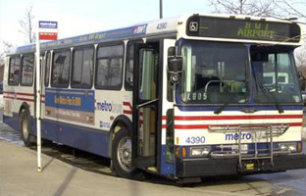
Mass Public Transportation
Rail
Subway
Commuter
Light
Bus
Transit authority
Commuter
Ferries
Pedestrian or bicycle
Qualified vanpools
Commercial/private vehicle
At least 6 adults, excluding the driver
Back
Next
MDA

Slide 7
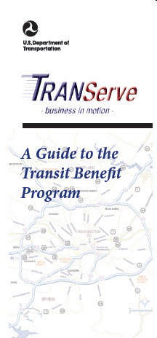
TRANServe’s Role
Service Provider to Federal Agencies
Distributes the transit benefit to qualified employees
Administers the Transit Benefit Program
Establishes best practices
Supports program participants
Back
Next
MDA

Slide 8
Employee Roles and Responsibilities
Understand the scope and limitations of the Transit Benefit Program
Do not sell, transfer the benefit, or make false claims
Understand the penalties involved in misuse or false claims
It is a violation of law to provide false or fraudulent information to obtain the transit benefit, to transfer, or to sell the transit benefit.
Back
Next
MDA

Slide 9
Employee Roles and Responsibilities
Not named on a worksite parking permit at any Federal agency, nor otherwise participate in a carpool
Use transit benefit for home to work and work to home transportation, only
Ensure the amount of transit benefit received does not exceed actual monthly commuting cost using public transportation
Responsible to update commuting costs upon changes to commuting method, work schedule, or address
Back
Next
MDA

Slide 10
Employee Roles and Responsibilities
Once paper fare media is distributed, you are responsible for its safekeeping. Lost, stolen or damaged paper fare media will not be replaced.
Contact Metro via a sales office or online at www.wmata.com.
To replace lost, stolen or damaged SmarTrip® cards. [Applies only in the National Capital Region (NCR) ]
For lost, stolen or damaged TRANServe Cards, contact JP Morgan Chase at UCARD Center (https://ucard.chase.com)
Back
Next
MDA

Slide 11
Legal Implications
Employees who misuse the transit benefit are subject to appropriate administrative action including discipline and/or disqualification from future participation in the USCIS Transit Benefit Program. Disciplinary penalties could range from a letter of admonishment to removal from Federal Service, depending on the severity of the abuse.
Back
Next
MDA

Slide 12
TRANServe Website
TRANServe.dot.gov
Website Pages:
Home
Participants
F.A.Q. (Frequently Asked Questions)
Debit Card
Resources
Return of Excess Benefit
Contact Us
Back
Next
MDA

Slide 13
Enrollment Process
Log in to the TRANServe Electronic Transit Benefit Application System (https://transitapp.ost.dot.gov)
First time Users click the “Register” button to create a profile and get your temporary password.
Login using government email address and password
Click on “Home”, then “Transit Benefit Application System”
Choose what to do:
Request information
Withdraw from the program
Certify/Enroll
Back
Next
MDA

Slide 14
Knowledge Check 1
The Transit Benefit Program objective is to:
A. Increase compensation of federal employees per month.
B. Provide incentive to federal employees to use public transportation to reduce air pollution and traffic congestion.
C. Reward the employees for their hard work.
Back
Next
MDA

Slide 15
Knowledge Check 1 - Answer
The Transit Benefit Program objective is to:
A. Increase compensation of federal employees per month.
B. Provide incentive to federal employees to use public transportation to reduce air pollution and traffic congestion.
C. Reward the employees for their hard work.
The Federal Workforce Transportation Fringe Benefit Program under Executive Order 13150 was put in place to reduce air pollution and traffic congestion.
Back
Next
MDA

Slide 16
Knowledge Check 2
If I misuse my transit benefit, for example, selling my benefit or over estimating my need for the benefit, I could be removed from service to the federal government.
True
False
Back
Next
MDA

Slide 17
Knowledge Check 2 - Answer
If I misuse my transit benefit, for example, selling my benefit or over estimating my need for the benefit, I could be removed from service to the federal government.
True
False
Disciplinary penalties could range from a letter of admonishment to removal from Federal service depending on the severity of the abuse.
Back
Next
MDA

Slide 18
Knowledge Check 3
TRANServe’s Role is to:
A. Distribute the transit benefit to USCIS employees.
B. Administer the Transit Benefit Program.
C. Establish Best Practices.
D. All of the above.
Back
Next
MDA

Slide 19
Knowledge Check 3 - Answer
TRANServe’s Role is to:
A. Distribute transit benefits to USCIS employees.
B. Administer the Transit Benefit Program.
C. Establish Best Practices.
D. All of the above.
TRANServe administers the Transit Benefit and establishes Best Practices for those Agencies serviced by DOT/TRANServe.
Back
Next
MDA

Slide 20
Knowledge Check 4
Carol plans on teleworking. The correct course of action based on this is:
A. Inform her supervisor.
B. Continue claiming the transit benefit without change.
C. Update her application on https://transerve.dot.gov .
Back
Next
MDA

Slide 21
Knowledge Check 4 - Answer
Ben plans on teleworking. The correct course of action based on this is:
A. Inform her supervisor.
B. Continue claiming her transit benefit without change.
C. Update her application on https://transerve.dot.gov .
You are responsible to update whenever commuting costs, commuting method, work schedule, or your home or work address changes.
Back
Next
MDA

Slide 22
Transit Benefit Certification
MDA
Back
Next

Slide 23
Certification Required
Anyone who enrolls in the Transit Benefit Program must certify that certain conditions are true.
Certify:
“To formally and legally attest a specific statement to be true”
Back
Next
MDA
Notes:
Should read “enrolls in” instead of sign up for

Slide 24
Certification Statement
Back
Next
MDA

Slide 25
Certification
What did I just agree to?
I am employed by the U.S. Federal Government
I am eligible for a public transportation fare benefit
I will only use the transit benefit for my daily commute between home and work
I will not give, sell, or transfer my transit benefit to anyone else
I will not use the Government-provided transit benefit in excess of the statutory limit
I will not claim the transit benefit in excess of my actual monthly commuting expense
I will not include parking fees in the calculation of my daily, weekly or monthly commuting cost.
Back
Next
MDA

Slide 26
Knowledge Check 5
Lynne joined a carpool after commuting by train for 5 years. She always received the maximum benefit per month for her commute. Now she sells her benefit since she believes the benefit belongs to her. Is this the correct course of action?
Yes
No
Back
Next
MDA

Slide 27
Knowledge Check 5 - Answer
Lynne joined a carpool after commuting by train for 5 years. She always received the maximum benefit per month for her commute. Now she sells her benefit since she believes the benefit belongs to her. Is this the correct course of action?
Yes
No
It is against the law to sell or give away your transit benefit.
Back
Next
MDA

Slide 28
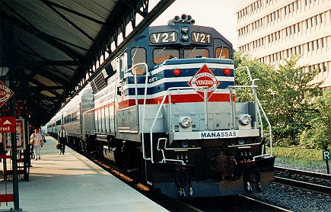
Knowledge Check 6
Ellery commutes from Virginia to get to work. His commuting costs are $284 per month. He is eligible to receive additional transit benefit since his commute is so costly.
True
False
Back
Next
MDA

Slide 29
Knowledge Check 6 - Answer
Ellery commutes from Virginia to get to work. His commuting costs are $284 per month. He is eligible to receive additional transit benefit since his commute is so costly.
True
False
The federal government will provide employees up to the statutory limit for the cost of commuting by mass transportation. The employee must cover the additional amount, “out of pocket”.
Back
Next
MDA

Slide 30
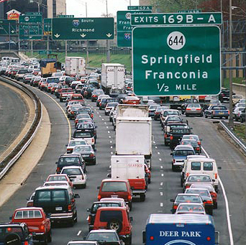
Knowledge Check 7
Tina rides in a carpool. She is eligible to receive the transit benefit.
True
False
Back
Next
MDA

Slide 31
Knowledge Check 7 - Answer
Tina rides in a carpool. She is eligible to receive the transit benefit.
True
False
The Federal Transit Benefit is for federal employees who choose to commute using mass transit in a commuter highway vehicle. This includes bus, rail, light rail or an authorized vanpool.
Back
Next
MDA

Slide 32
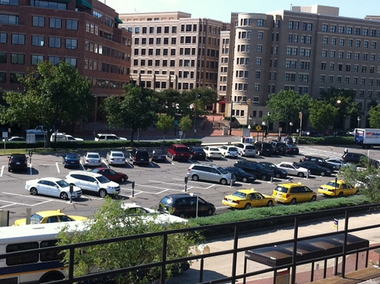
Knowledge Check 8
Michael rides mass transit and parks in the lot near the station. He includes his parking fees when he calculates his monthly commuting expense. He is right to do this.
True
False
Back
Next
MDA

Slide 33
Knowledge Check 8 - Answer
Michael rides mass transit and parks in the lot near the station. He includes his parking fees when he calculates his monthly commuting expense. He is right to do this.
True
False
The Federal Transit Benefit is provided solely for your home-to-work-to-home commute via mass transportation. Any other use of these funds is actionable as fraud, waste, or abuse of federal funds.
Back
Next
MDA

Slide 34
Knowledge Check 9
Melanie has come to an agreement with HR and her supervisor to work in the office 3 days and telework 2 days each week, indefinitely. She currently receives $25 per week in transit benefit. The correct course of action based on her schedule change is to:
A. Thank her supervisors’ for his/her understanding.
B. Continue claiming her transit benefit without change.
C. Update her transit benefit to $15 per week or $60 per month.
Back
Next
MDA

Slide 35
Knowledge Check 9 - Answer
Melanie has come to an agreement with HR and her supervisor to work in the office 3 days and telework 2 days each week, indefinitely. She currently receives $25 per week in transit benefit. The correct course of action based on her schedule change is to:
A. Thank her supervisors’ for his/her understanding.
B. Continue claiming her transit benefit without change.
C. Update her transit benefit to $15 per week or $60 per month.
You must change your benefit amount whenever your routine commuting expense changes.
Back
Next
MDA

Slide 36
Knowledge Check 10
Wendy is going to an off-site meeting. She uses mass transportation to and from the meeting, and decides to use her transit benefit, since she has “extra” this month. This is the correct action.
True
False
Back
Next
MDA

Slide 37
Knowledge Check 10 - Answer
Wendy is going to an off-site meeting. She uses mass transportation to and from the meeting, and decides to use her transit benefit, since she has “extra” this month. This is the correct action.
True
False
Travel to an off-site meeting or training class is an office expense. The Transit Benefit is provided solely for your home-to-work-to-home commute via mass transportation.
Back
Next
MDA

Slide 38
Congratulations!
You have successfully completed
TRANSIT BENEFIT PROGRAM
INTEGRITY AWARENESS
TRAINING
In order to receive credit for this course in AGLearn, you must receive 70% or higher on Knowledge Checks.
Back
MDA

