Slide 1
Beyond Traffic: The Smart City Challenge Informational Webinar: Evaluation and the Smart City Challenge
April 26, 2016
U.S. Department of Transportation (USDOT)

Slide 2
The Purpose of Today’s Webinar
Provide an overview of Performance Measurement and Evaluation as it relates to the Smart City Challenge Phase 2 Notice of Funding Opportunity (NOFO)
Discuss USDOT expectations for your Phase 2 Proposal related to Performance Measurement and Evaluation
Describe the USDOT’s ITS Program approach to evaluation and provide time for discussion
Answer any questions you may have about Performance Measurement and Evaluation
Provide information on technical resources – across the 12 vision elements – available to the Smart City Finalists

Slide 3
Expected Outcomes of the Smart City Challenge (Page 8 of the NOFO)
Improve Safety – By using advanced technologies, including connected vehicle technologies, to reduce the number of collisions, fatalities, and injuries for both vehicle occupants and non-vehicle occupants.
Enhance Mobility – By providing real-time traveler information and emerging mobility services to improve personal mobility for all citizens including people with lower incomes, people with disabilities, and older adults.
Enhance Ladders of Opportunity – By providing access to advanced technology and its benefits for underserved areas and residents, increasing connectivity to employment, education and other services, and contributing to revitalization by incentivize reinvestment in underserved communities.
Address Climate Change – By implementing advanced technologies and policies that support a more sustainable and cost-effective relationship between transportation and the environment through more efficient fuel use and emissions reductions.

Slide 4
Goals of the Smart City Challenge (Pages 10 and 11 in the NOFO)
Identify the transportation challenges your city is facing;
Determine which technologies, strategies, and applications demonstrate the most potential to address, if not solve, those challenges;
Take the evolutionary steps to integrate advanced technologies;
Demonstrate, quantify, and evaluate the impact of advanced technologies, strategies, and applications;
Examine the technical, policy, and institutional mechanisms needed for realizing the potential of these strategies and applications;
Assess reproducibility of interoperable solutions and qualify successful smart city systems and services for technology and knowledge transfer to other cities facing similar challenges;
Work with Federal partners and programs focused on optimizing the usage of advanced and affordable clean transportation options; and
Collaborate to accelerate the deployment of clean transportation and connected and automated vehicle technologies.

Slide 5
NOFO Sections Related to Performance Measurement and Evaluation
SECTION A, PROGRAM DESCRIPTION: 5. Conducting a Federally Funded Smart City Demonstration
Subsection C, Performance Measurement (Page 30)
Performance Measurement Plan
Response to USDOT Deployment Tracking Surveys
Subsection E, Data Management and Support for Independent Evaluation (Page 38)
Data Management Plan
Independent Evaluation Support Plan
Data to support USDOT’s Independent Evaluation
Data provided to the USDOT’s Research Data Exchange (RDE)
SECTION D, APPLICATION AND SUBMISSION INFORMATION
Subsection 3 (Volume 1) – (Technical Approach) (Pages 59 and 60)

Slide 6
Subsection C: Performance Measurement (Page 30 in the NOFO)
Performance Measurement Plan
Identify performance measures and associated quantitative performance targets;
Discuss the types of data needed to support ongoing performance of the Smart City Demonstration and evaluation;
Define hypotheses and methodologies for collecting: (i) pre-demonstration data that can be used as a performance baseline, (ii) continuous data during life of the demonstration to support performance monitoring and evaluation, (iii) cost data, and (iv) information on the timeframe that applications are deployed; and
Address how performance measures data will be released as open data.

Slide 7
Performance Measures should Discuss How the City Plans to… (Page 31 in the NOFO)
Reduce traffic-related fatalities and injuries
Reduce traffic congestion
Improve travel time reliability
Increase the use and integration of electric vehicles
Increase the transition to clean energy
Reduce transportation-related emissions
Improve personal mobility and increase accessibility for all citizens, including low-income individuals and persons with disabilities
Optimize multimodal system performance
Increase the number of mobility options and services
Improve public access to real-time integrated multimodal transportation information
Provide cost savings to transportation agencies, businesses, and the traveling public
Increase the connectivity between city services and connected travelers
Increase connectivity to employment, education, services and other opportunities
Provide other benefits to transportation users and the general public

Slide 8
Subsection E: Data Management and Support for Independent Evaluation (Page 40)
As part of the Smart City Demonstration, an Independent Evaluation will be conducted by the USDOT. The Independent Evaluator will:
Conduct an evaluation applying quantitative and qualitative evaluation methodologies to:
Conduct before and after performance assessments;
Cost-benefit assessments of the demonstration;
Assess user acceptance/citizen satisfaction of the demonstration;
Document lessons learned, challenges and approaches for mitigating, addressing, and /or overcoming them;
Estimate total impacts, costs, and return-on-investment (ROI) of the demonstration; and
Assess if the Smart City Demonstration achieved its vision.

Slide 9
Subsection E: Data Management and Support for Independent Evaluation (Page 38)
The Recipient shall develop an Evaluation Support Plan documenting how they will work with the Independent Evaluator. Responsibilities are likely to include:
Provision of collected data and corresponding meta data;
Provision of frequently monitored performance measures estimates and desired targets;
Limited availability of the site for the independent evaluators to conduct additional field tests and experiments to supplement data not available from the site; and
Participation in surveys and interviews conducted by the independent evaluators.
The Recipient is responsible for supporting the independent evaluator’s access to the site and to site staff to conduct evaluation-related experiments, interviews, and surveys.

Slide 10
Subsection E: Data Management and Support for Independent Evaluation (Page 40)
Systems must be capable of generating the data needed to calculate measures over time – that is, to show how well the systems are performing with respect to performance measures and targets identified in the Performance Measurement Plan.
The Recipient shall:
Apply data quality measures and processes including security protocols to convert the raw data into processed, quality data and ensure that those data are stored in a secure database
Securely transmit data to support evaluation, on a schedule and using a medium agreed upon with the Independent Evaluator
Note: Data collected for use by the Independent Evaluator shall be considered “owned” by the USDOT. The Recipient shall transmit only those data required to support evaluation by the Independent Evaluator

Slide 11
Research Data Exchange (RDE) (Page 41 in the NOFO)
Connected vehicle, mobile device, and infrastructure sensor data captured during the Smart City Demonstration are expected to be broadly shared with the community to inform prospective deployers of Smart City applications
The RDE is a Web-based resource that collects, manages, and provides access to multi-source and multi-modal transportation data
Quality-checked, well-documented, and freely available to the public
Currently has ITS and connected vehicle data from 17 locations
The USDOT envisions that this data sharing capability will better support the needs of ITS researchers and developers while reducing costs and encouraging innovation
https://www.its-rde.net/

Slide 12
Section D: Application and Submission Information (Page 59 in the NOFO)
In your Smart City Challenge Phase 2 Proposal,
Provide measurable goals and objectives for your proposed demonstration;
Describe your approach for monitoring the impact of the demonstration on mobility, safety, ladders of opportunity, efficiency, clean energy, sustainability, and climate change; and
Identify a set of targeted performance measures that relate to the primary impact of your proposed demonstration.

Slide 13
Questions?

Slide 14
Responding to New Challenges and Opportunities
The Smart City Challenge is a once-in-a-lifetime opportunity to be a “living laboratory”
The Smart City Challenge provides an opportunity to measure the impact of smart city technologies and provide practical guidance and lessons learned to other cities considering deployment
This is an unprecedented opportunity for performance measure design, data collection, and analysis, as well as evaluation methodology design and evaluation guidance development
Your efforts will serve as a roadmap for cities that want to start deploying Smart City technologies
Effective Smart City deployment information will be used to articulate quantifiable (and defendable) benefits to the nation

Slide 15
Performance Measurement and Evaluation Approach
Ask Strategic Questions
In the end, what will your city want to get for its investment?
What do you want to learn from the deployment?
What specific questions do you want answered?
What hypotheses do you want to test?
What data do you need to measure to compute what you want to measure?
What are the best methods to use to evaluate the deployment?
How do you want the results reported and disseminated?
Getting the Results of the Evaluation
What performance measures make the most sense?
Were the Strategic Questions Answered?

Slide 16
Performance Measurement and Evaluation Approach
Set performance measures and associated quantitative performance targets with stakeholders at the beginning of the demonstration in the Performance Measurement Plan
Partner with the independent evaluator.
Establish testable hypotheses:
Example: If transit signal priority is deployed on all city buses, then 80% of all buses will arrive at their destination on-time
Identify what data you need to monitor performance of the system and to support evaluation
Establish baseline conditions:
Collect data on your system’s performance before new technologies are introduced to support before and after analysis

Slide 17
Understanding the Performance of the City
The Smart City Challenge provides an opportunity for you to show off the potential of innovative and advanced technologies!
Advanced technologies offer opportunities for you to monitor how the city is operating and how to enhance the operation of facilities, systems, services, and information generated for the public. Leverage these technologies to support data collection.
Position yourself to answer questions from city officials, decision makers, and your citizens about the performance of the Smart City Demonstration?
What did you do with the $40M?
What difference are you making? What are the benefits?
If something didn’t work, why didn’t it work?

Slide 18
Why Is Evaluation Important?
Evaluation can be a tool to help identify what is going right, what is not going well, and why.
Many (hopefully most!) things will go right, but some will go wrong
If nothing goes wrong, we weren’t innovative enough
It can inform conversations about how to mitigate these problems
The SCC will provide an opportunity for you and others to learn from novel Smart City Challenge activities
What worked well, what didn’t, and why?
Challenges and strategies to address them

Slide 19
Why Is Evaluation Important?
Successful Evaluation will enable other cities to be able to replicate and/or exceed your demonstration.
Knowing what you tried, what worked, and what didn’t work will reduce time, cost, and frustration for your colleagues and for those of you representing cities that aren’t selected but who wish to pursue some of these things anyway.
Imagine you were the 2nd city trying this, what would you want to learn from the first? Treat that city the way you’d want to be treated.
Why are we doing this?
What do we expect to happen?
If it does happen – what might that mean?
If it doesn’t happen—what might that mean?
How can we make things better the next time: “if we could do it all over…”

Slide 20
System Impact Evaluation Best Practices
Choose performance measures of value to your stakeholders
Choosing the wrong measures can result in distorted view of the system
Stakeholders need to reach an agreement or consensus on the measures and targets
Establish clear traceability from goals to measures, and from system inputs to outcomes
Develop data management process to integrate multi-source data into a common format and database
Plan for both automated and manual data checks when verifying data quality and perform regular diagnostic checks to ensure equipment accuracy and health

Slide 21
Smart City Challenge Performance Measurement and Evaluation Summary
SMART CITY CHALLENGE DEMONSTRATION SITE
Performance Measurement Plan
Monitor the Performance of the System
Response to USDOT Deployment Tracking Surveys
Data Management Plan
Independent Evaluation Support Plan
Data to support USDOT’s Independent Evaluation
Data provided to the USDOT’s Research Data Exchange
INDEPENDENT EVALUATOR
Before and after assessment;
Cost-benefit assessment;
User acceptance/citizen satisfaction;
Lessons learned;
Total impacts, costs, and return-on-investment (ROI);
Assess if the demonstration achieved its vision
USDOT’s Research Data Exchange (RDE)
Other Researchers / Prospective Deployers
Project Partner #1
Project Partner #2
Project Partner…N

Slide 22
ITS JPO Evaluation Program Overview
Description
The ITS evaluation program supports activities aimed at developing appropriate performance measures for meeting deployment objectives and making strategic effectiveness assessments, determining the effectiveness and benefits of deployed ITS, and monitoring/predicting trends in the adoption, use, and replacement of ITS technologies.
ITS Evaluation Program Goals
Accelerate deployment by generating and disseminating key information on ITS performance, effectiveness impacts, costs, and extent of deployment
Measure, analyze, and report data on ITS market maturity and development, the extent of ITS deployment, trends in technology adoption/usage, and the effect of various JPO/DOT intervention policies on adoption
Provide strategic and tactical data and information to assist JPO and DOT leadership with assessing the effectiveness of ITS deployment and assisting with future strategic planning and accelerating adoption

Slide 23
Questions?

Slide 24
Technical Resources Available to the Smart City Finalists

Slide 25
Smart City Challenge Information Sessions
Information Session #1 Data, Architecture, and Standards
Information Session #2 Connected Vehicles and Automation
Information Session #3 The Sharing Economy, User-Focused Mobility, and Accessible Transportation
Information Session #4 The Smart City Challenge Application and Selection Process
Information Session #5 Urban Freight Delivery and Logistics
Information Session #6 The Connection Between "Beyond Traffic" and the Smart City Challenge
Information Session #7 The Application Homestretch: an Open Question-and-Answer Session
Information Session #8 Understanding Dedicated Short Range Communications (DSRC)
https://www.transportation.gov/smartcity/infosessions

Slide 26
FHWA Systems Engineering Guidance
CITE Training
Applied Systems Engineering for Advanced Transportation Projects
Publications
Systems Engineering for Intelligent Transportation Systems (ITS): A handbook that provides an introduction to systems engineering
Building Quality Intelligent Transportation Systems Through Systems Engineering: introduces systems engineering for advanced transportation systems projects
Developing Functional Requirements for ITS Projects: Presents guidelines for developing good functional requirements
A Guide to Configuration Management for ITS: Introduces configuration management - a formal and consistent process of making changes to an ITS system under development.
http://ops.fhwa.dot.gov/int_its_deployment/sys_eng.htm

Slide 27
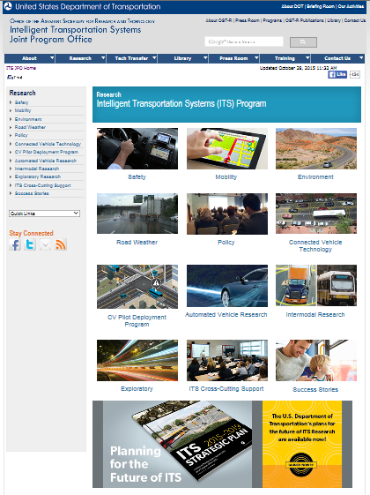
ITS JPO Research
http://www.its.dot.gov/index.htm
ITS JPO Research Initiatives:
Strategic Plan 2015-2019
Safety
Mobility
Environment
Road Weather
Policy
Connected Vehicle Technology
CV Pilot Deployment Program
Intermodal Research
Exploratory Research
ITS Cross-Cutting Support

Slide 28
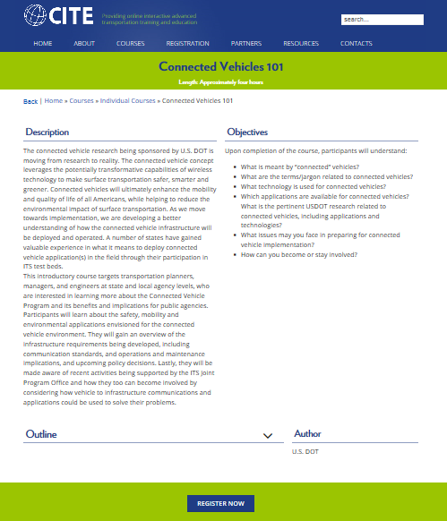
Connected Vehicle Courses
Connected Vehicles 101
A free online introductory course targeting transportation planners, managers, and engineers at state and local agency levels, who are interested in learning more about the Connected Vehicle Program and its benefits and implications for public agencies. http://www.citeconsortium.org/course/connected-vehicles-101/
Coming Soon…
Connected Vehicles 102
Connected Vehicles 201

Slide 29
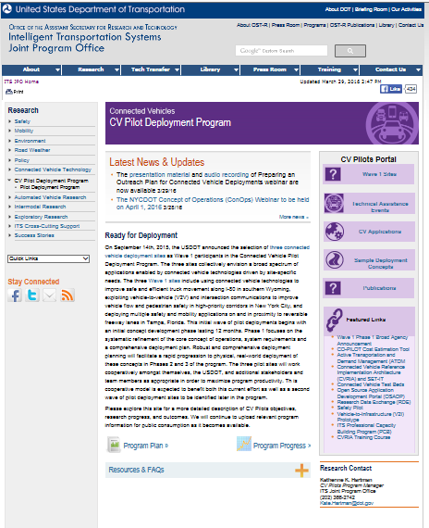
Connected Vehicle Pilots: Technical Assistance
http://www.its.dot.gov/pilots/index.htm
Technical Assistance
Wave 1 ConOps
CVRIA and SET-IT Bootcamp
Preparing a Safety Management Plan
Preparing a Security Operational Concept
Rapid Consensus Meeting on CV Pilot Era Standards
Preparing a Human Use Approval Summary
Preparing a Training and Education Plan
Preparing a Privacy Operational Concept
Preparing a Performance Measurement Plans
SCMS Proof-of-Concept Interface Requirements
Preparing Data for the RDE
Preparing an Outreach Plan

Slide 30
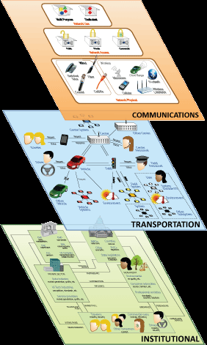
ITS Architecture and CVRIA
The National ITS Architecture provides a common framework to plan, define, and integrate ITS solutions: http://www.iteris.com/itsarch/
The Connected Vehicle Reference Implementation (CVRIA) includes information to support development of fully interoperable regional connected vehicle architectures. (CVRIA will be fully integrated in to the National Architecture later in 2016): http://www.iteris.com/cvria/

Slide 31
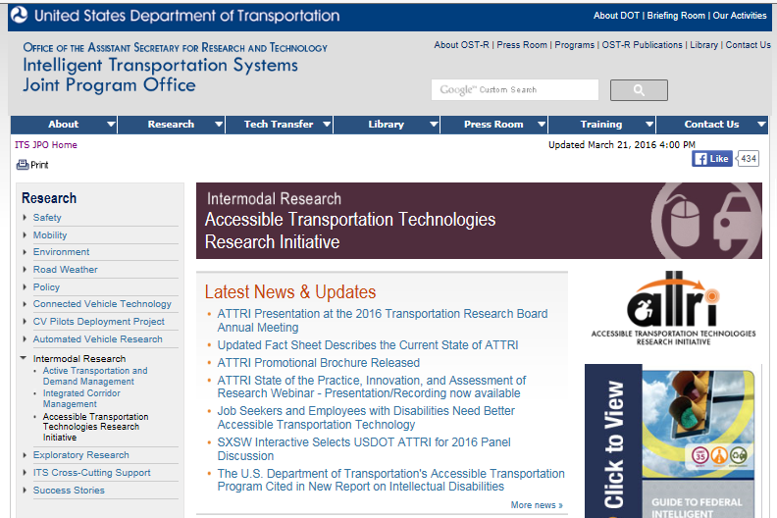
Accessible Transportation Research
http://www.its.dot.gov/attri/

Slide 32
Next Steps

Slide 33
Beyond Traffic: The Smart City Challenge
For More Information and Questions
Smart City Challenge
www.transportation.gov/smartcity
Questions?
SmartCityChallenge@dot.gov

