Slide 1
Response to Transportation Events Involving Public Health
Presented by
Captain Lynn Slepski

Slide 2
Transportation Public Health Incidents
Surveillance
Educated public
Engineered controls
Coordinated response
  International Standards
  Public/private partnerships
Medical countermeasures

Slide 3

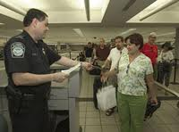
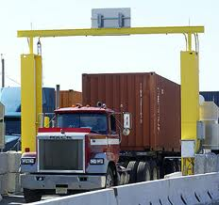
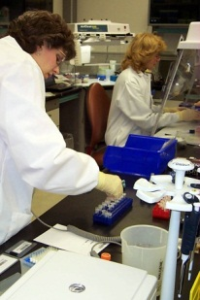
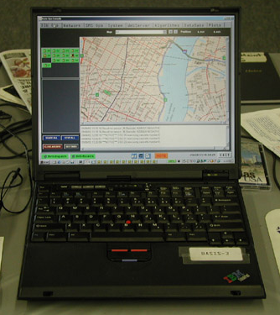
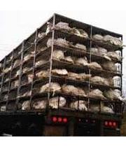
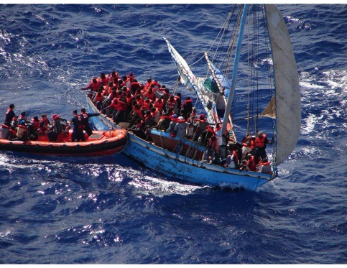
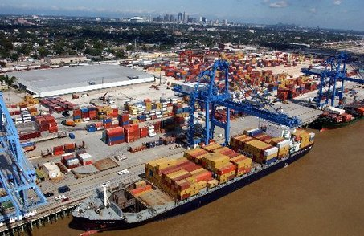
Surveillance

Slide 4
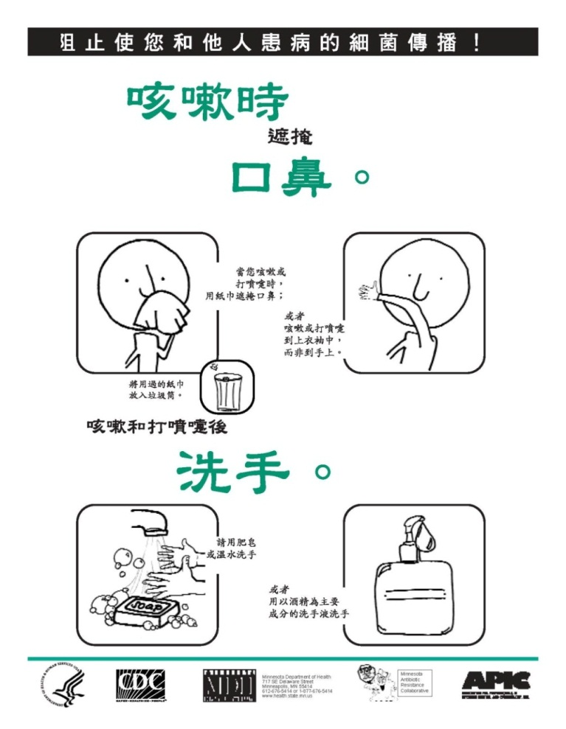
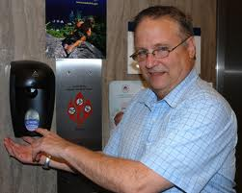
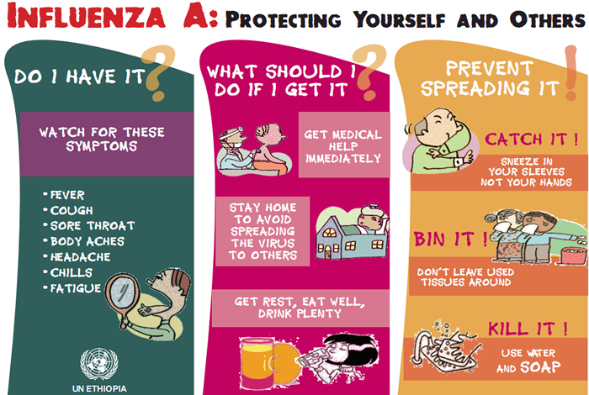
Educated Public

Slide 5

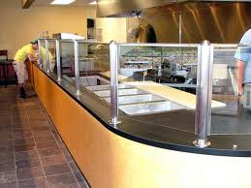
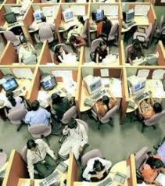

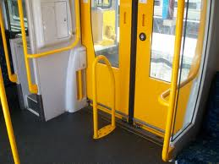
Engineering Controls

Slide 6
Coordinated Response
Goal of a Coordinated Response
Incident
1
Delay outbreak peak
US
Pandemic Outbreak:
No Intervention
2
Decompress peak burden on hospitals/infrastructure
3
Diminish overall cases and health impacts
Private
Partners
Daily Cases
Pandemic Outbreak:
With Intervention
Local
Community
Days Since First Case

Slide 7




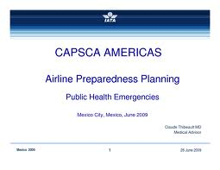
























Partners

Slide 8
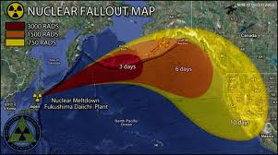
Real World Event—
Japan Fukushima Nuclear Plant

Slide 9
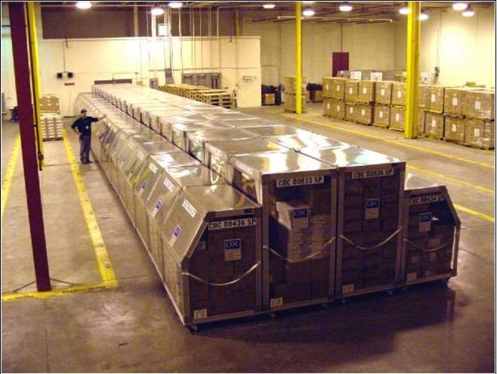
Strategic National Stockpile

