Slide 1
Traffic response
to public health emergencies
Department of Safety Supervision MOT China

Slide 2
Ⅰ.Public health emergencies
Infectious diseases,caused by a variety of pathogens, can be transmitted among people, animals or from human to animals.
Animal epidemic occurs suddenly and will cause or threaten to cause serious losses of livestock production and serious harm to public health.

Slide 3
Infectious diseases species
A Class infectious diseases shall include plague and cholera.
B Class infectious diseases shall include SARS, AIDS, viral hepatitis, poliomyelitis,H5N1, A/H1N1 flu , measles, EHF(epidemic hemorrhagic fever),rabies, epidemic encephalitis B, dengue fever, anthrax, bacillary and amoebic dysentery, pulmonary tuberculosis, typhoid and paratyphoid, epidemic cerebrospinal meningitis,pertussis ,diphtheria, tetanus neonatorum ,scarlet fever, brucellosis, gonorrhea, syphilis, leptospirosis, schistosomiasis, malaria.

Slide 4
Infectious diseases species
C Class infectious diseases shall include influenza, epidemic parotitis, rubella, acute hemorrhagic conjunctivitis, leprosy, epidemic and endemic typhus, kala-azar,echinococcosis,filariasis,hand-foot-mouth disease(HFMD) and infectious diarrhea other than cholera,dysentery,typhoid and paratyphoid.

Slide 5
Animal diseases species
Animal diseases of class Ⅰ (17 types):
Foot and mouth disease, swine vesicular disease, swine fever, African swine fever, highly pathogenic blue ear pig disease, African horse sickness, rinderpest,Contagious pleuropneumonia, bovine spongiform encephalopathy, scrapie, bluetongue, peste des petits ruminants, sheep pox and goat pox,Highly pathogenic avian influenza, Newcastle disease, carp spring viremia of white spot syndrome.
Animal diseases of class Ⅱ:
Rabies, brucellosis, anthrax, Aujeszky, Clostridium perfringens disease, paratuberculosis, toxoplasmosis,Hydatid disease, leptospirosis.
Animal diseases of class Ⅲ:
Blackleg disease, listeriosis, melioidosis, actinomycosis, Fasciola hepatica disease, filariasis.

Slide 6
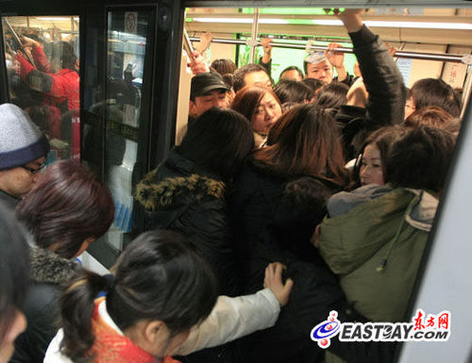
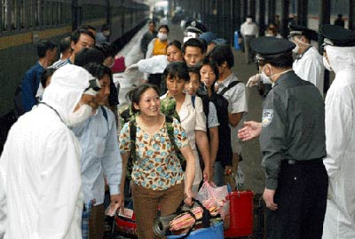
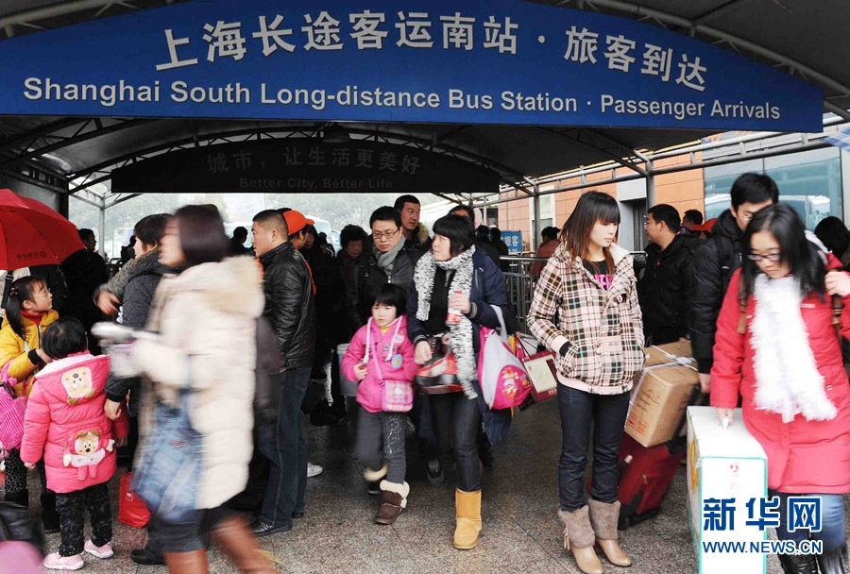
The conditions for spread of infectious diseases
Source of infection
Route of transmission
Susceptible populations
Notes:
传染源(source of infection)是指体内有病原体生长、繁殖并且能排出病原体的人和动物。包括病人、病原携带者和受感染的动物。对与病人接触者和病原体携带者，应视具体情况进行医学观察、检疫或隔离，亦可进行预防接种与药物预防。
传播途径_百度百科
病原体从传染源排出体外，经过一定的传播方式，到达与侵入新的易感者的过程，谓之传播途径。
交通运输特点：1、人员集中在狭窄空间，人员密度大；2、运输过程中的人员流动性大；3、人员之间相互不了解，并集散性强；4、运送的人员结构复杂，多夹杂着老年人和儿童等易感人群。

Slide 7
Ⅱ.laws and regulations on public health emergencies
1.Law of the PRC on the Prevention and Treatment of Infectious Diseases
2.Frontier Health and Quarantine Law of the People's Republic of China
3.Animal Epidemic Prevention Law of the People's Republic of China
4.Law of people's Republic of China on the Entry and Exit Animal and Plant Quarantine

Slide 8
Ⅱ.laws and regulations on public health emergencies
5.Regulations on Preparedness for and Response to Emergent Public Health Hazards
6.Regulations on Domestic Communications Health Quarantine
7.Emergency Measures for Handling Major Animal Epidemics

Slide 9
Ⅱ.laws and regulations on public health emergencies
8.Contingency plans for National public health emergencies
9.Contingency plans for National public emergencies of medical rescue
10.Contingency plans for National sudden major animal epidemic
11.Implementation Regulations for Domestic Communications Health Quarantine

Slide 10
Ⅲ . Emergency Disposal
Ⅰ.The principles of emergency response are:
To maximize the control of the spread and proliferation of quarantine infectious disease.
And
To minimize the interference with the development of transportation and social economy.

Slide 11
Ⅲ . Emergency Disposal
Ⅱ.The organizational structure and relationship of emergency disposals：
Central / Local Government
Provisional lazaretto
Temporary communications health quarantine command organization
Provisional quarantine station
Health sector
Agricultural sector
Transport sector
Quality supervision department
Foreign affairs department
Notes:
当检疫传染病暴发、流行并借交通工具传播或者有借交通工具传播严重危险时，由省、自治区、直辖市人民政府确定检疫传染病疫区，并决定对出入检疫传染病疫区的交通工具及其乘运的人员、物资实施变通卫生检疫。
在检疫传染病疫区内，最后一例鼠疫病人被隔离9日后，最后一例霍乱病人被隔离5日后，以及国务院确定并公布的其他检疫传染病最后一例病人被隔离至最长潜伏期后，未发现新的检疫传染病病人，病人所污染的物资和场所均经卫生
处理合格，疫情得到有效控制，借交通工具传播的严重危险已经消除，决定机关可以宣布解除检疫传染病疫区，停止实施交通卫生检疫。
确定和解除检疫传染病疫区和实施交通卫生检疫的决定，应向国务院卫生行政部门和国务院铁路、交通、民用航空行政主管部门通报。
临时交通卫生检疫指挥组织，可根据需要设置临时交通卫生检疫站、留验站。

Slide 12
Ⅲ . Emergency Disposal
Ⅲ.Responsibilities of the relevant departments during the quarantine period.(The health sector)
To set up provisional traffic lazaretto according to the needs of communications health quarantine.
To hand over the passenger list of patient(s) of quarantine infectious disease(s), pathogen carrier(s), suspected patient(s) of quarantine infectious disease(s) and corpse of them from the competent departments of railways, communications and civil aviation administration respectively to the designated department of public health administrations.
To assist the competent public health institutions of the competent departments of railways, communications and civil aviation administration to take the corresponding measures for communications health quarantine.
To coordinate and mobilize the drugs, biological products, equipment, transportation vehicle ,personal protective equipment and other supplies required by the quarantine infectious disease prevention and control .
Departments of public health administration of local people's governments above the county level have the power to take the corresponding measures for communications health quarantine within their respective administrative areas.
To organize and coordinate the implementation of communications health quarantine work in the administrative area.

Slide 13
Ⅲ . Emergency Disposal
Ⅲ.Responsibilities of the relevant departments during the quarantine period.Transport sector
According to the needs of the communications health quarantine, set epidemic situations on quarantine infectious diseases on stations, ports, airports, transport docking places and entrances of quarantine infectious disease(s) epidemic area.
As needed,coordinate and dispatch personnel of communications health quarantine to conduct medical inspection together with trains, ships, aircraft and other transport vehicles.
Be responsible for the communications health quarantine work of the employees working for the communication system.

Slide 14
Ⅲ . Emergency Disposal
Ⅲ.Responsibilities of the relevant departments during the quarantine period. (Provisional quarantine station)
To check and inspect the personnel, means of communication and the materials carried by them that enter or exit the quarantine infectious disease(s) epidemic area(s).
To impose control over and carry out sanitary treatment of articles contaminated by pathogen(s) of quarantine infectious disease(s) or of those articles that may have been contaminated.
In the event of discovery of patient(s) of quarantine infectious disease(s),pathogen carrier(s), suspected patient(s) of quarantined infectious disease(s)and those who have had close contact with them，to report to the competent department of the operational unit of the means of communication and to carry out temporary isolation, medical inspection and other emergency medical measures for them.
To hand over the passenger list of patient(s) of quarantine infectious disease(s), pathogen carrier(s), suspected patient(s) of quarantine infectious disease(s) and corpse of them to the designated department of public health administration , and to transfer those who have had close contact with them to temporary traffic health lazaretto.

Slide 15
Ⅲ . Emergency Disposal
Ⅲ.Responsibilities of the relevant departments during the quarantine period. (Provisional quarantine station)
To carry out emergency sanitary treatment of the means of communication passing through the said epidemic area and their parking(berthing) site(s).
In the event of discovery of transport that enter or exit the quarantine infectious disease(s) epidemic area or materials outside the third provision of article IX , where quarantine has been passed, a certificate of passing quarantine shall be issued.
To distribute travelers with medical convenience cards according to the needs of the quarantine infectious diseases treatment.
To propaganda the communications health quarantine regulations and knowledge on the prevention and control of the quarantine infectious disease.

Slide 16
Ⅲ . Emergency Disposal
Ⅲ.Responsibilities of the relevant departments during the quarantine period
To receive those who have had close contact with patient(s) of quarantine infectious disease(s) from the temporary communications health quarantine stations.
To carry out medical inspection, checkups, preventive treatment and other emergency medical measures for those who have had close contact with patient(s) of quarantine infectious disease(s).
To carry out sanitary treatment of articles contaminated by pathogen(s) of quarantine infectious disease(s) or of those articles that may have been contaminated and the environment under possible contamination.

Slide 17
Ⅲ . Emergency Disposal
Ⅳ. The start and termination of health quarantine
State Council
Health sector
Transport sector
Local government
Local health sector
Local transport sector
Notes:
国家卫生行政部门公布检疫传染病疫情。
在城镇、人口密集区发生鼠疫人与人之间的传播或者其它重大检疫传染病疫情，并有借交通工具传规严重危险，需要实施导致中断干线交通的交通卫生检疫措施时，由国务院卫生行政部门会同国务院铁路、交通、民用航空行政主管部门提出实施方案，报请国务院决定。
当检疫传染病暴发、流行并借交通工具传播或者有借交通工具传播严重危险时，由省、自治区、直辖市人民政府确定检疫传染病疫区，并决定对出入检疫传染病疫区的交通工具及其乘运的人员、物资实施变通卫生检疫。
确定和解除检疫传染病疫区和实施交通卫生检疫的决定，应向国务院卫生行政部门和国务院铁路、交通、民用航空行政主管部门通报。
发现鼠疫、霍乱病人、病原携带者和疑似鼠疫、霍乱病，国务院卫生行政部门和国务院铁路、交通、民用航空行政主管部门，应当分别向有关的省级人民政府及其所属卫生行政部门和铁路、交通、民用航空行政主管部门的卫生主管机构通报。
发现有感染鼠疫的啮齿类动物或者啮齿类动物反常死亡，并且死因不明，县级以上地方人民政府卫生行政部门或者铁路、交通、民用航空行政主管部门的卫生主管机构对该交通工具实施交通卫生检疫时，应按规定逐级报告。
在检疫传染病疫区内，最后一例鼠疫病人被隔离9日后，最后一例霍乱病人被隔离5日后，以及国务院确定并公布的其他检疫传染病最后一例病人被隔离至最长潜伏期后，未发现新的检疫传染病病人，病人所污染的物资和场所均经卫生
处理合格，疫情得到有效控制，借交通工具传播的严重危险已经消除，决定机关可以宣布解除检疫传染病疫区，停止实施交通卫生检疫。

Slide 18
Ⅲ .Emergency Response
Ⅴ.Transmission of information
Health Department
Transport sector
Transport enterprises
Temporary communications health quarantine command organization
General Administration of customs
Health sector
On-the-spot quarantine authorities
Notes:
实施交通卫生检疫期间，当检疫传染病有借交通工具及其乘运的人员、物资向国境口岸传播危险时，临时交通卫生检疫指挥组织应及时向国务院卫生行政部门报告，并向海关总署通报。
检疫传染病疫区所在地的省、自治区、直辖市人民政府卫生行政部门和铁路、交通、民用航空行政主管部门的卫生主管机构应当互相通报疫情，并按规定途径和时限上报疫情。铁路、交通、民用航空行政主管部门的卫生主管机构接到疫情报告后，应当及时通知有关交通工具的营运单位。
医疗保健、卫生防疫人员在进行检疫传染病疫情的调查处理过程中，如发现检疫传染病病人、病原携带者、疑似检疫传染病病人和与其密切接触者，已乘交通工具出行时，应当立即报告。
“零报告”制度。

Slide 19
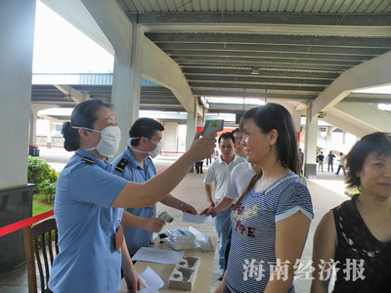
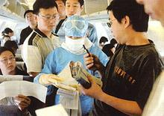
Ⅲ .Emergency Response
Ⅵ.Quarantine measures
A certificate of passing quarantine and inspection
Notes:
(一)实行检疫合格证明和查验制度。
1、场站工作人员及进入场站的旅客测体温；
2、对乘客进行登记；
3、离开疫区的旅客凭有效身份证明和检疫合格证明购票、乘坐交通工具；
4、离开疫区的交通工具上的其他人员应具有有效身份证明和检疫合格证明；
5、交通工具凭检疫合格证明离开疫区；
6、物资凭检疫合格证明放行：
7、船舶、航空器航行中，卫生检疫人员应进行医学巡视，观察乘客健康状况。

Slide 20
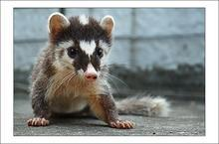
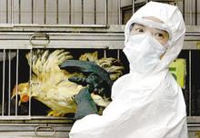
Ⅲ .Emergency Response
Ⅵ.Quarantine measures
Stoppage on acceptance of goods that is prohibited to transport

Slide 21
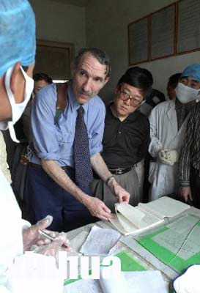
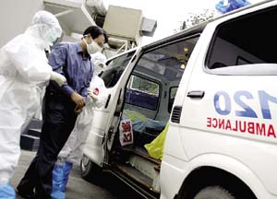
Ⅲ .Emergency Response
Ⅵ.Quarantine measures
Take medical measures
Notes:
1、对检疫传染病病人、病原携带者、疑似检疫传染病病人和与其密切接触者进行详细登记，投服预防药物。
2、将相关人员送到临时交通卫生检疫站。
3、对于已离开车船站场的人员，立即组织追查，并将其带回交临时交通卫生检疫站处理。

Slide 22
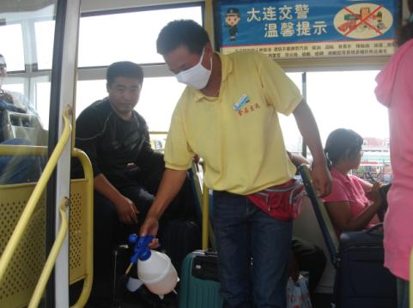
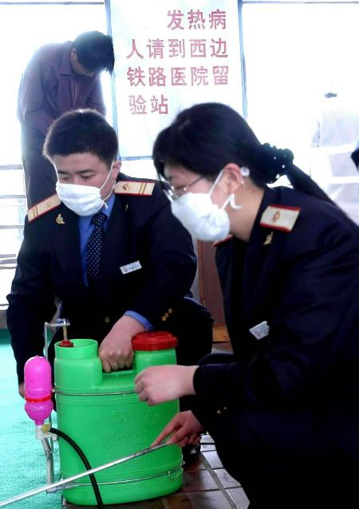
Ⅲ .Emergency Response
Ⅵ.Quarantine measures
Administrative control and sanitary treatment
Notes:
对被检疫传染病病原体污染或者可能被污染的交通工具及其停靠场所和物资实施行政控制和采取卫生措施。
1、抵达目的地后，卫生检疫人员对车厢、客舱、餐厅、厕所、盥洗室等场所进行消毒、杀虫、灭鼠等卫生处理，固体废弃物集中进行卫生处理。在疫区加注的压舱水经过消毒后，方可排放；
2、对于疑似检疫传染病病人的排泄物、呕吐物进行处理；
3、交通工具经消毒、杀虫、灭鼠等卫生处理，并经指定的卫生防疫机构检查合格，检疫合格证明。

Slide 23
Thanks！

