Slide 1
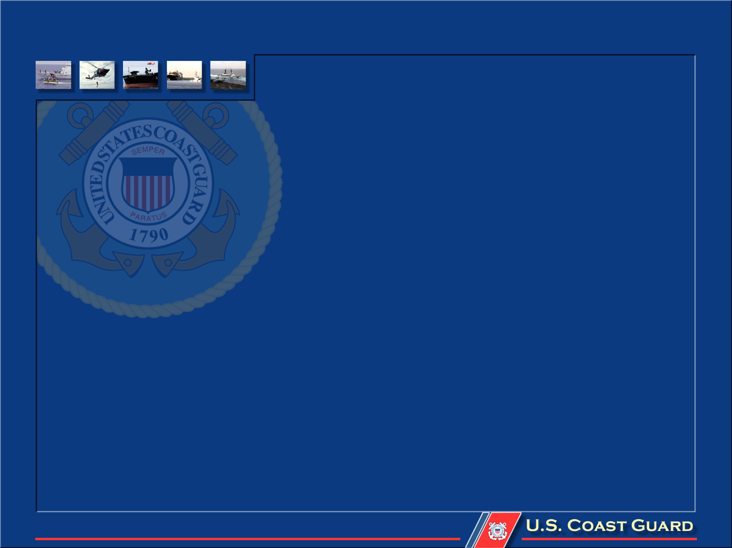
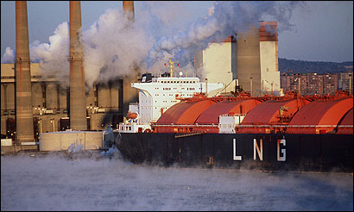
Petrochemicals in harbor areas; safety supervision and emergency response
Presented by
Captain David Murk
U.S. Coast Guard
Senior Maritime Advisor to the Secretary of Transportation

Slide 2
Coast Guard Operational Commander Roles
Captain of the Port
Officer In Charge, Marine Inspection
Federal On-Scene Coordinator
Federal Maritime Security Coordinator

Slide 3
Captain of the Port: Specific Authorities
Deny entry, establish any needed operational restrictions, or direct the movement of any vessel…..
Impose a wide range of restrictions on waterfront facilities & vessel operations……

Slide 4
Officer in Charge, Marine Inspections: Specific Authorities
Enforcement of marine safety laws, rules & regulations
Licensing of merchant mariner personnel
Inspect & exercise port state control
Impose any one or more control measures

Slide 5
Federal On-scene Coordinator: Specific Authorities
Incidents occurring in the Coastal Zone of the US
Responsible for directing all federal, state, tribal, local and private sector response
Any oil spill or threat of a spill that might impact US waters to the outermost extent of the EEZ.

Slide 6
National Response System Components
Comprised of…
National Response Team
National Response Center
13 Regional Response Teams
Federal On-Scene Coordinators
Area Committees
State/Local Governments
Regulated Industry
Special Teams
Joint Response Teams w/neighboring countries

Slide 7
Relationship of Plans
National Response Framework
National Oil and Hazardous Substances Pollution Contingency Plan
International Joint Plans
Regional Contingency Plans
Federal Agency Internal Plans
Area Contingency Plans
Facility Response Plans
State/Local Plans
Vessel Response Plans

Slide 8
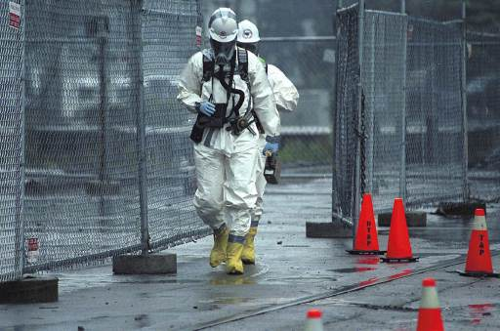
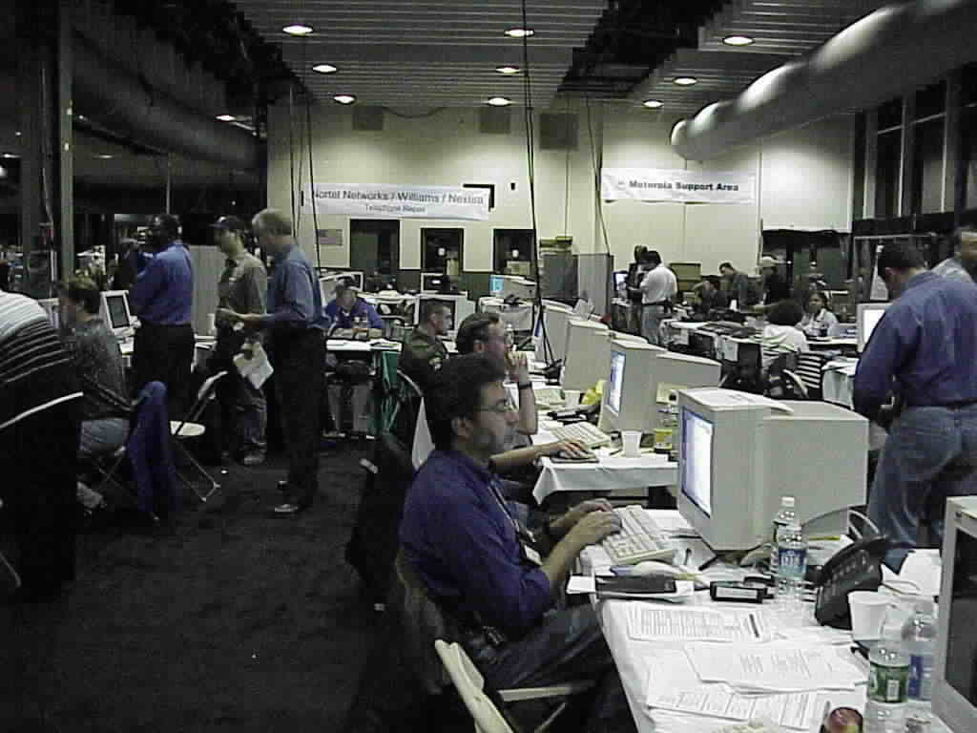
Federal On-scene Coordinator Relationships
Area Committee (Chair): Fed, State, local & private sector 1st responders
Regional Response Team: Fed, State, local sectors & NGOs
… and Local Emergency Planning Committees, International Response Planning Committees, etc.
CG
State Private
Unified
Command

Slide 9
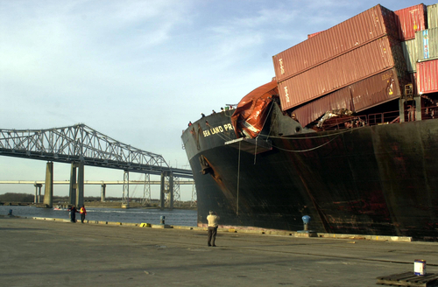
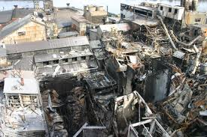
What can and will happen

Slide 10
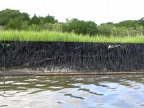
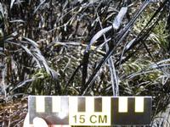
Savannah River Mystery Spill

Slide 11
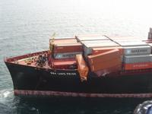
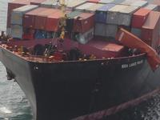
Port of Charleston Ship Container Chemical Leak

Slide 12
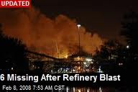
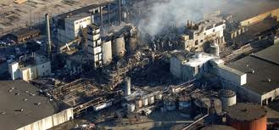
Savannah River Sugar Refinery Explosion

