Slide 1
Management of Emergency Response to Subway Accidents
Stephan A. Parker
Transportation Research Board
Of The National Academies

Slide 2
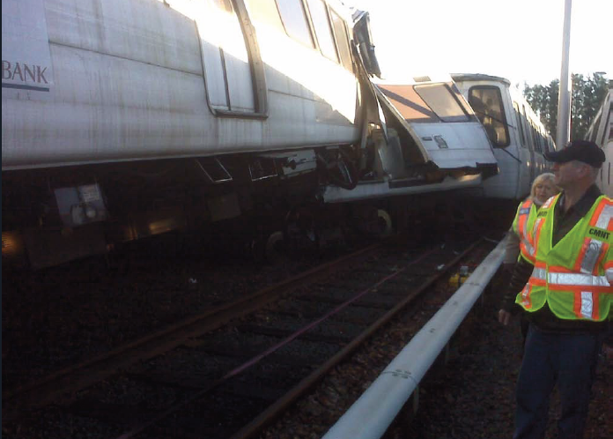
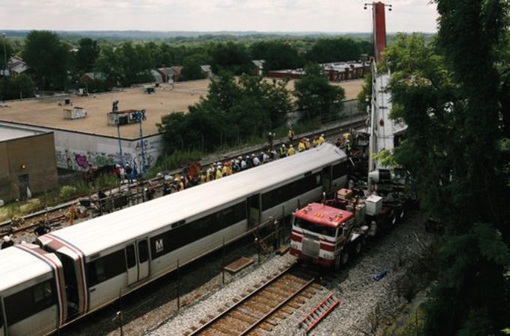
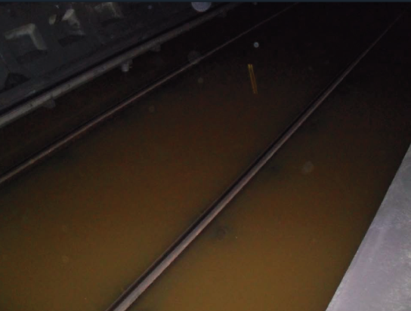
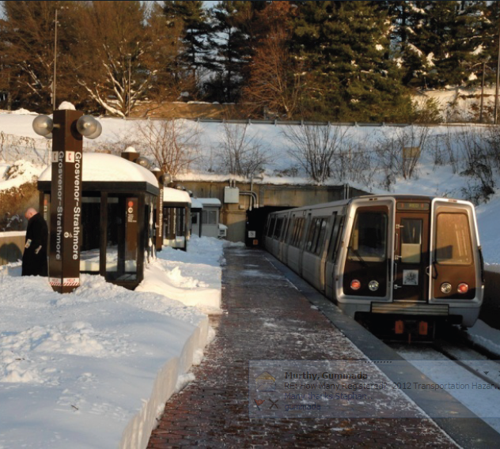
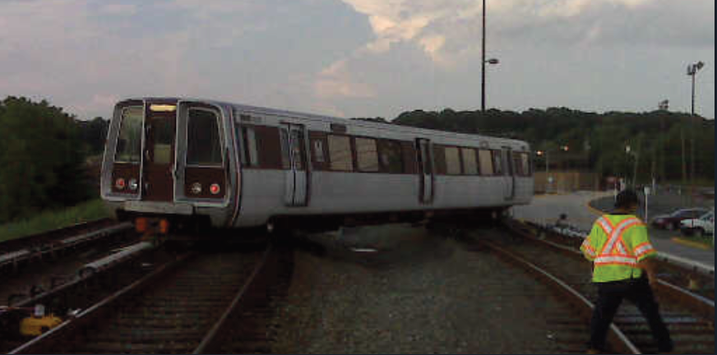
Derailment, collision, flooding, snow
Photo Source: WMATA

Slide 3
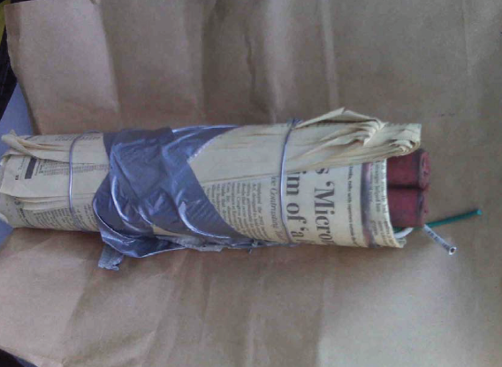
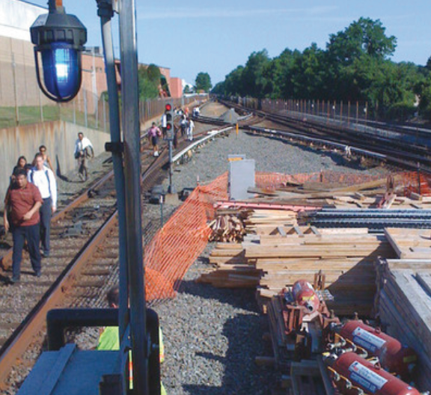
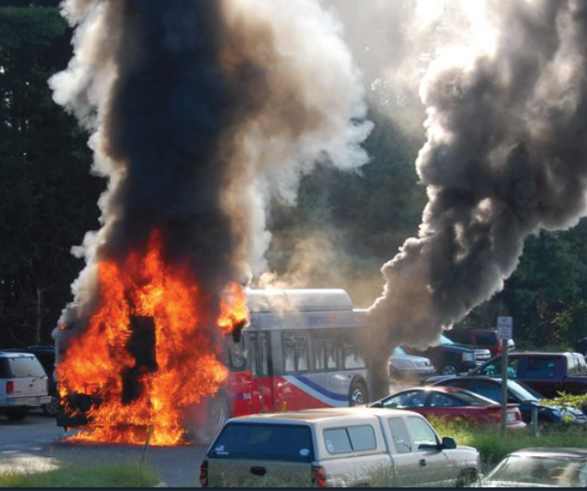
Open Systems
Most public transportation systems throughout the world are “open-systems”
Mass transit must remain vigilant
  Soft target
  Large crowds
  Proximity to government facilities
  Limited resources
Source: WMATA

Slide 4
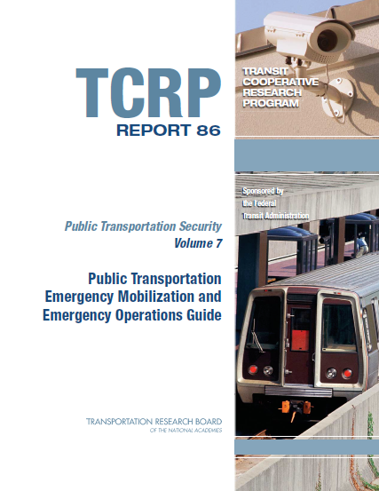
Emergency Mobilization and Operations Guide
Early recognition of emergency events
Expedite response
Coordinate application and integration of additional organized, qualified resources from other agencies
Ensure that public transportation resources are available to support the response

Slide 5
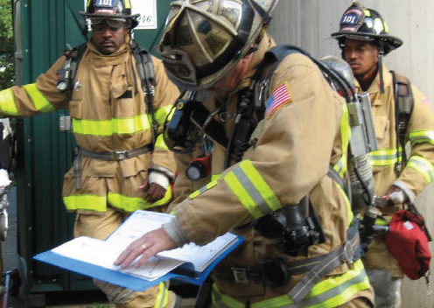

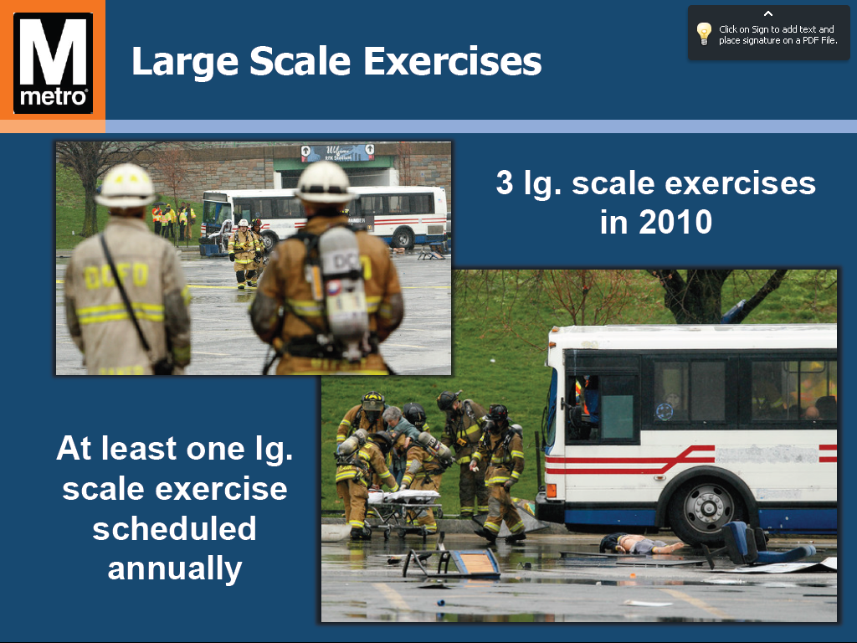
Developing an Emergency Operations Plan
Emergency Operations Plan Elements
Developing the Emergency Operations Plan
Emergency Planning Principles Applied to Public Transportation
Photo Source: WMATA

Slide 6
Terrorism Response: Capabilities Assessment, Prevention, and Awareness
Assessment of Existing Capabilities
Prevention
Awareness
Incident Response Protocols

Slide 7
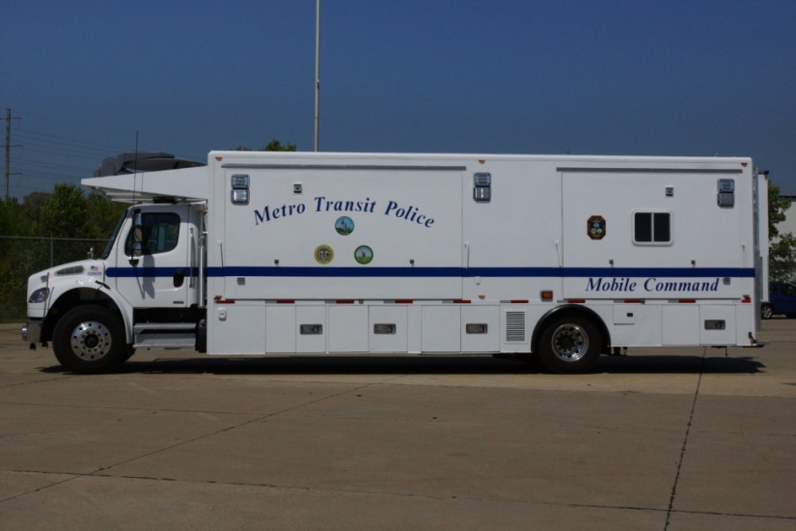
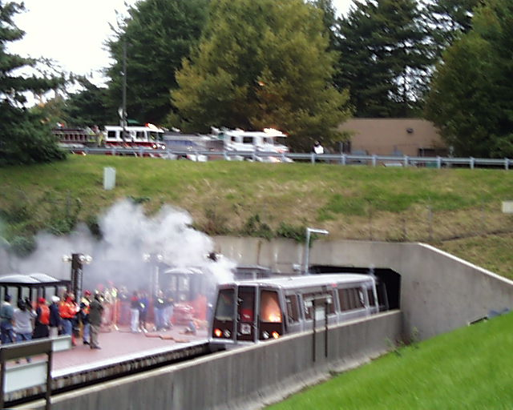
Washington Transit Authority
Office of Emergency Management
Emergency response, recovery, mitigation, and prevention expertise through:
Planning
Response and Recovery
Special Projects
Training and Outreach
Source: WMATA

Slide 8

Emergency Mobilization and Operations at WMATA
Effective organizational safety and
security culture
Annual training for all employees
Mass communication to all employees
Public awareness and outreach
Law Enforcement/Public Safety Collaboration
Emergency Preparedness
Passenger Information Display Systems
Local and regional drills with key stakeholders
Source: WMATA

Slide 9
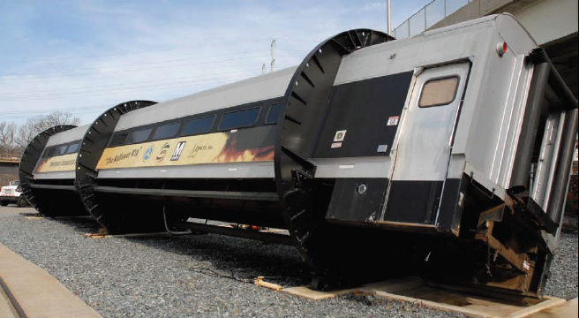
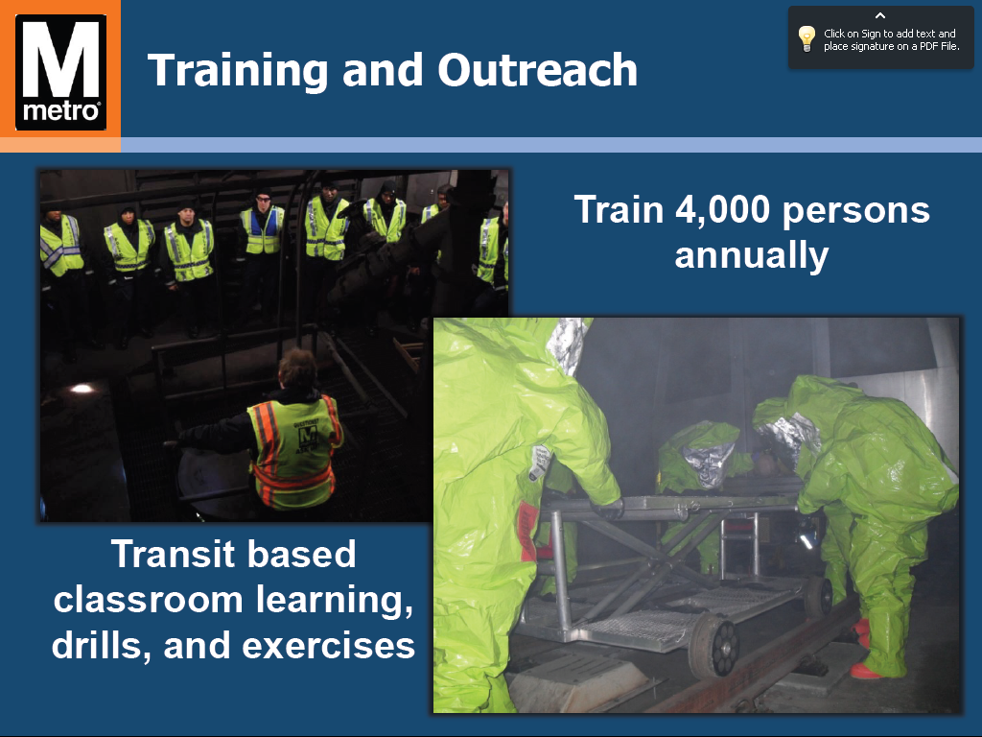
Training and Outreach at WMATA
Transit based classroom learning, drills, and exercises
Train 4,000 persons annually
Source: WMATA

Slide 10
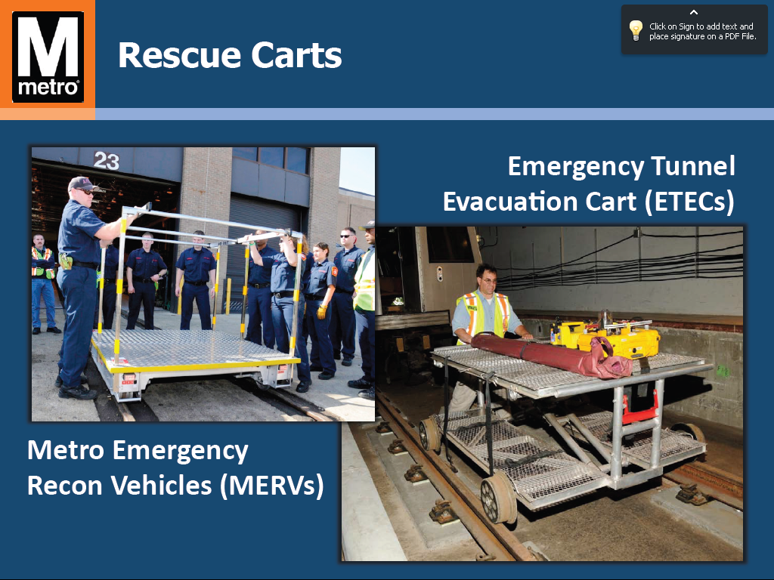
Special Project: WMATA Rescue Carts
Emergency Tunnel Evacuation Cart
Metro Emergency Recon Vehicle
Source: WMATA

