Slide 1
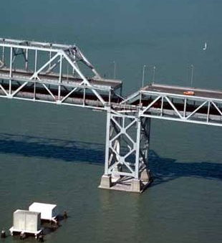
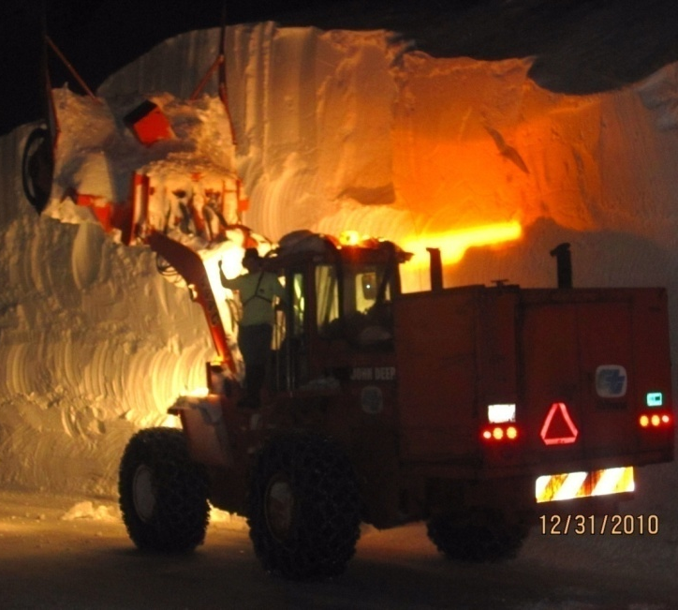
Principles in Pre-Positioning Transportation Equipment & Materials for Emergency Response
Herby Lissade, P.E.
Chief, Office of Emergency Management

Slide 2
What does Caltrans use to respond to Emergencies?
22,000 Department Employees
330 Maintenance stations
713 Changeable Message Signs
Most importantly – Almost 4,900 Dedicated and Experienced Highway Maintenance Employees.
1703 Closed Circuit TV Cameras
8,200 Pieces of equipment
323 Park and Ride Lots
and 87 Safety Roadside Rest Areas
143 Highway Advisory Radio stations

Slide 3
Caltrans Capabilities
Maintenance Field Operations
Telecommunications
Architectural and Engineering Services
Traffic Management
Geographical Information Systems
Procurement and Warehousing
Right of Way/Real Estate Assets
Maintenance Field Operations
Emergency traffic control and incident access control
Establishment of alternate corridors and detour routes
Debris removal and route clearance
Short term emergency repairs to highway elements and structures
Hazardous materials response

Slide 4
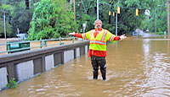
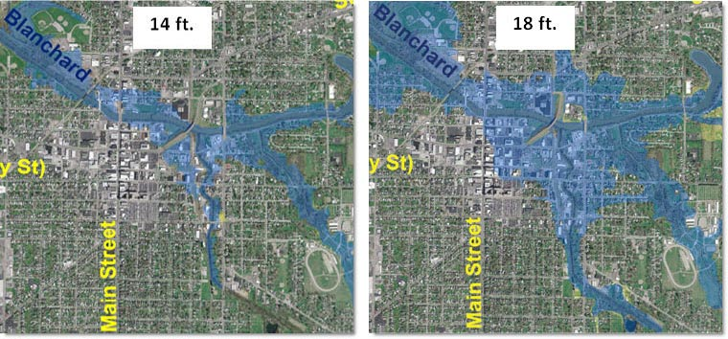
Lessons Learned
After Action Reports
Standard Operating Procedures Best Management Practices Exercises and Training
Threats & Vulnerability Assessment
Know what the hazards are, for example flooding (inundation mapping) and Fire Maps; Mitigation Plans

Slide 5
Emergency Response Facilities, Equipment & Material
Maintenance Stations
Bulk Fuel Sites
Emergency Generators
Critical supplies warehousing at emergency levels to provide timely delivery
Employee Housing (urban and remote areas)

Slide 6
Bulk Fuel
220 Sites with generated power.
Critical Facility Fuel Level: 30%
Bulk Fuel Location for Emergency Response – in strategic and densely populated areas.

Slide 7
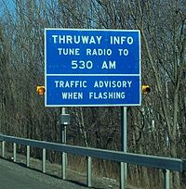
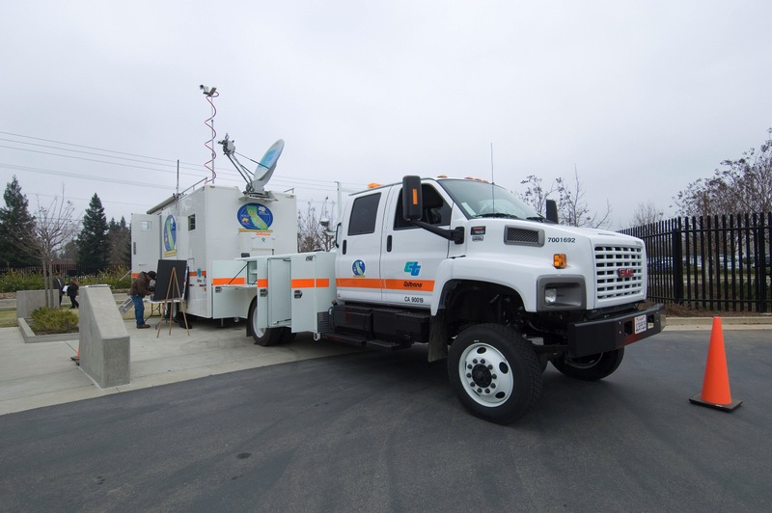
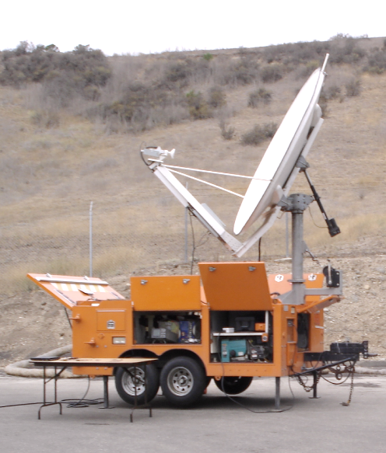
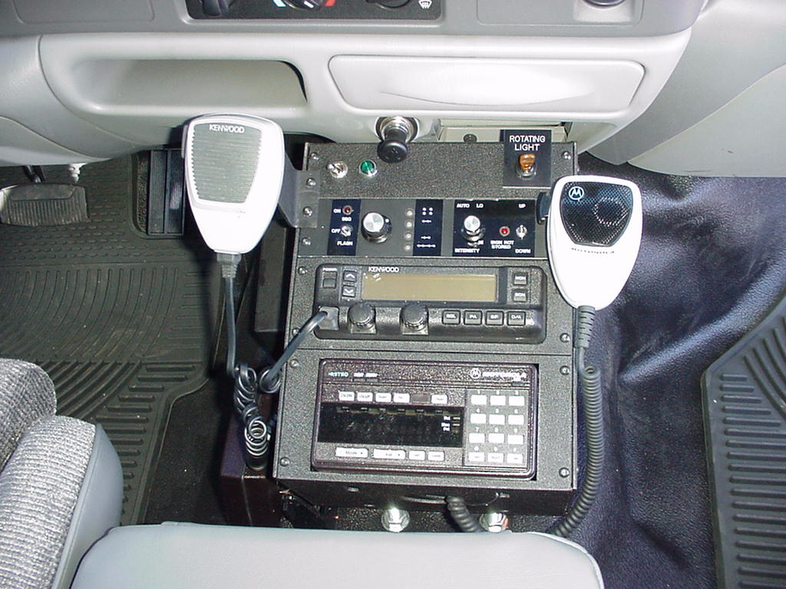
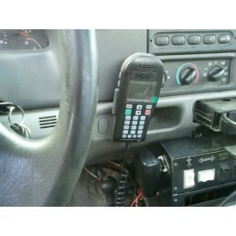
Telecommunication Systems

Slide 8
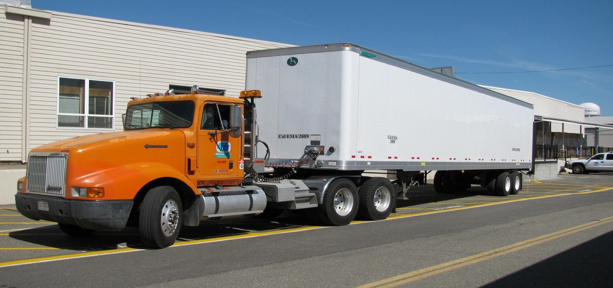
Emergency Supply Pods
Procurement, staging and delivery of mission critical supplies/materials

Slide 9
California Highway Maintenance Stations
30 Mile Buffer – Placement for response time
Along Emergency Lifeline Routes and NHS
Additional Maps
Strategic Highway Network
National Highway System
Emergency Supply Chain

Slide 10
