Slide 1
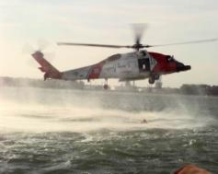
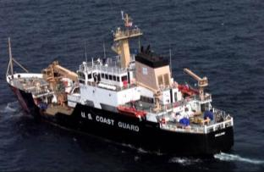
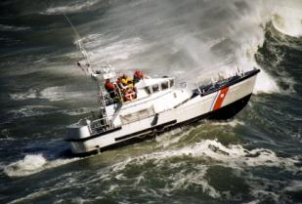
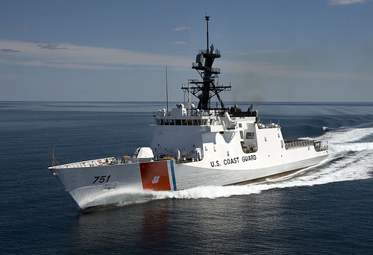
美国的海上 急救队
美国海岸警卫队

Slide 2
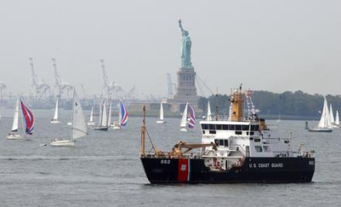
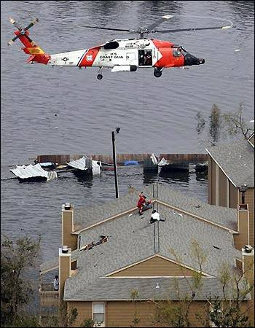
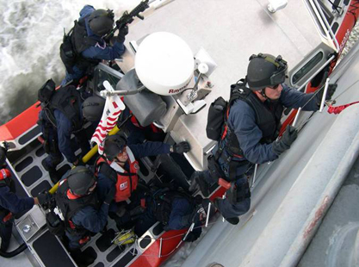
海上管理
海上安全
海上治安
Notes:
The United States Coast Guard is a military, multimission, maritime service within the Department of Homeland Security and one of the nation's five armed services.
We protect the public, the environment, and U.S. economic and security interests in any maritime region in which those interests may be at risk, including international waters and America's coasts, ports, and inland waterways.
The Coast Guard provides unique benefits to the nation because of its distinctive blend of military, humanitarian, and civilian law-enforcement capabilities.
To serve the public, the Coast Guard has three fundamental roles that are further delineated into eleven distinct but fundamentally integrated statutory missions:
Maritime Security: Protect the Nation from threats delivered by the Sea
Maritime Safety: Protect those on the Sea
Maritime Stewardship: Protect the Sea itself
Coast Guard Core Missions
Ports, Waterways & Coastal Security
Illegal Drug Interdiction
Undocumented Migrant Interdiction
Other Law Enforcement, e.g. Exclusive Economic Zone Enforcement
Defense Readiness
Search and Rescue
Marine Safety
Aids to Navigation & Waterways Management
Ice Operations
Marine Environmental Protection
Living Marine Resources, e.g. Fisheries Enforcement
Daily, the Coast Guard is busy protecting our citizens and maritime interests with operations that cover the full range of our core roles. Thanks in no small part to our multi-mission capabilities, and the flexibility of our personnel, we are able to accomplish a significant amount with the resources at-hand.

Slide 3
Notes:
The U.S. Coast Guard traces its roots back the to establishment of the Revenue Cutter Service in 1790, and was established as a branch of the U.S. Armed Forces in 1915. In 2003, the Coast Guard was organizationally placed under the Department of Homeland Security.

Slide 4
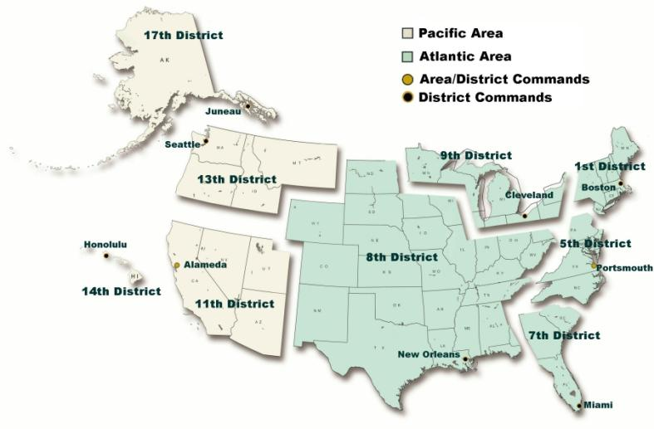
地区和管区司令部

Slide 5
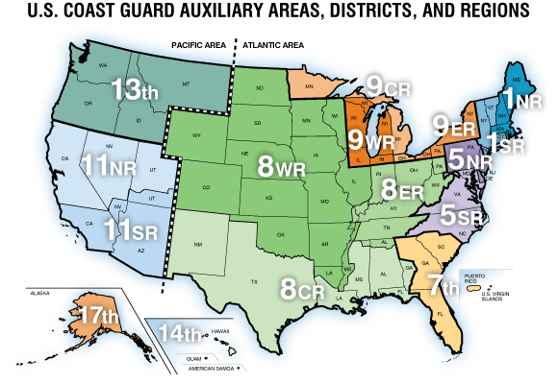

Slide 6
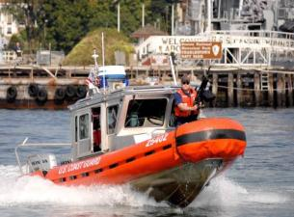
海岸警卫队分层战略
国际港口保卫 计划 国家访问 和 集装箱安全 倡议
总是有执法和海关人员
总是有军事部门 (14 USC 1, 10 USC 101)
外国
公海
联合作战
结合 独特 能力 和 职权
专属经济区
200 海里
毗连区
24 海里
12 海里
领海
联邦/ 州/当地 合作伙伴
海上运输安全法案 管制的 设备
内水 和 港口
港务主任
控制港口通道
6
Notes:
In pursuing the Coast Guard’s three fundamental roles of maritime security, maritime safety, and maritime stewardship, the CG is guided by several principles. First and foremost is the principle of layered security or defense-in-depth. This slide illustrates the Coast Guard’s approach to layered security/defense.
Amplifying Information on Coast Guard Authorities:
Congress has granted the Coast Guard wide-ranging statutory law enforcement authority consistent with the Coast Guard’s multi-faceted missions. These authorities reside in a variety of statutory and regulatory titles reflecting the scope of Coast Guard enforcement activities and the historical evolution of the Service since the beginning of the Republic.

Slide 7
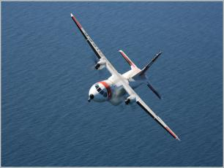
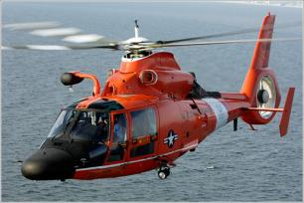
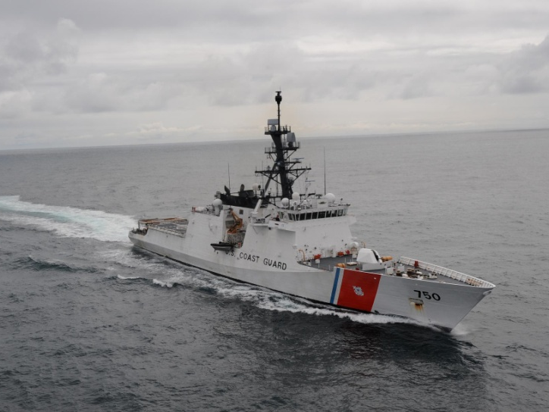
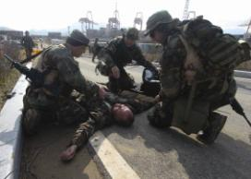
海岸警卫队资源和人员
1,850条小型船
54 架飞机
143 架直升机
42,400 现役
6,900 预备役
7,900 平民
30,000 辅助人员
26 个专业团队
247 艘快艇
Notes:
The Coast Guard conducts its varying missions by sea, air, and on land, and our members operate an extensive inventory of cutters, boats and aircraft.
Today there are over 42,000 active duty Coast Guard men and women, almost 7,000 reservists, over 7,000 civilians, and nearly 30,000 volunteer auxiliarists working to safeguard the nation against all threats, hazards, and challenges in the maritime domain.

Slide 8
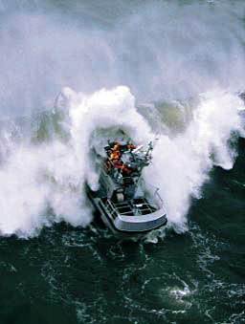
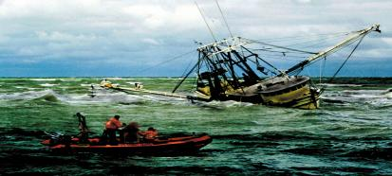
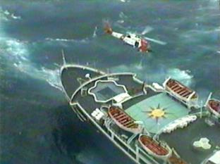
搜救和救援
海上安全
50,000 人次/年
Notes:
The sea can be unforgiving and even the most professional mariners can easily find themselves in peril. From our origins as the U.S. Life-Saving Service, we have a long and proud tradition of responding immediately to save lives in peril. We currently respond to more than 50,000 calls for help each year.

Slide 9
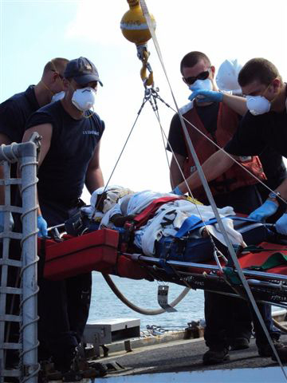
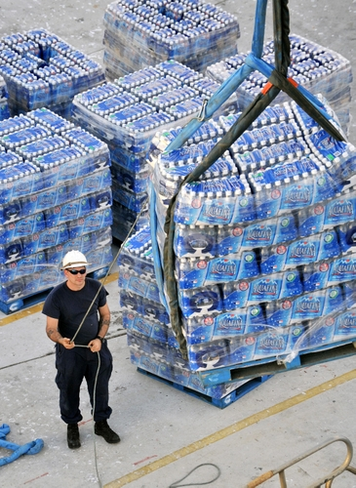
人道主义的援助 灾难应对
海上安全
Notes:
The sea can be unforgiving and even the most professional mariners can easily find themselves in peril. From our origins as the U.S. Life-Saving Service, we have a long and proud tradition of responding immediately to save lives in peril. We currently respond to more than 50,000 calls for help each year.

Slide 10
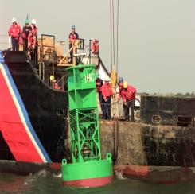
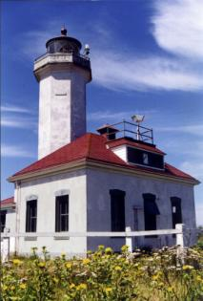
航行辅助
海事管理使命
世界上最大的航行辅助
50,000 个浮标, 固定指示器, 灯塔
Notes:
To aid ships transiting our congested and complex waterways, the Coast Guard maintains the world’s largest system of long- and short-range aids-to-navigation, with more than 50,000 buoys, fixed markers, and lighthouses. The Coast Guard also maintains the differential global positioning system, enabling mariners to electronically determine their position.

Slide 11
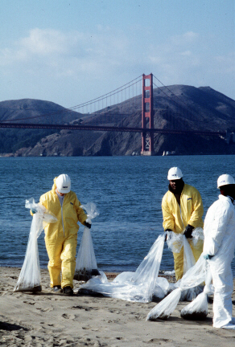
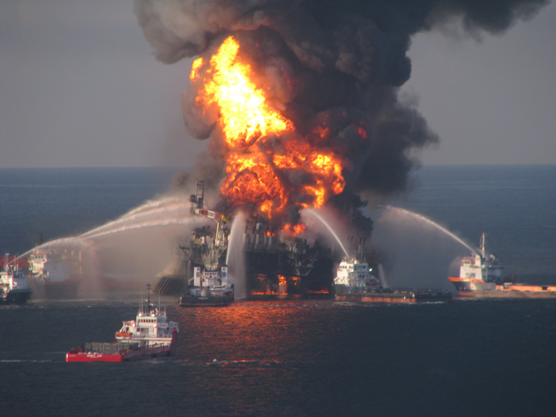
海洋环境保护
防止， 应对石油和危险品的泄漏
Notes:
To address these, we closely regulate the shipping industry to prevent or minimize the environmental damage caused by oil and chemical spills and the dumping of wastes at sea. Our mandate to do so was significantly strengthened by the Oil Pollution Act of 1990, which was passed in response to the devastating Exxon Valdez oil spill the year before. As a result of these efforts, oil spills have decreased by two-thirds during the past five years.
The Coast Guard led U.S. federal response efforts under the National Response Framework following the explosion on the Deepwater Horizon oil platform and subsequent oil spill of national significance. As the Federal On Scene Commander, the local Coast Guard Captain of the Port was responsible for command and control of the response and cleanup, which utilized the National Response Framework and Incident Command System to coordinate the efforts of local, state, and federal agencies with non-governmental organizations, the responsible party, and private sector oil spill response companies.

Slide 12
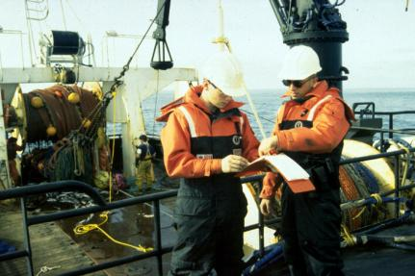
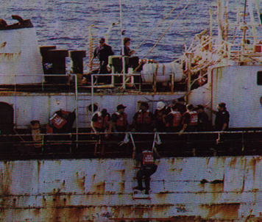
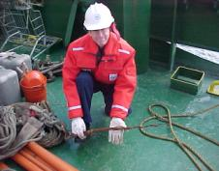
海事安全
海洋安全
规则
教育
检查

Slide 13
附注资格
船只检查员
休闲游艇安全顾问
公共教育讲师
游艇船员
船员
舵手
空勤人员
飞行员
乘务人员
空中观察员
导航设备验证者
招聘人员
警戒员
快艇资格
翻译者
食品服务 (AUXCHEF)
团队协调培训（TCT）调解人
公共事务/社会哈媒体
专业人员
海事安全
海事安全和海洋环境保护培训班 (Trident Program)
海港巡逻
急救队
渔船/拖船检验员
附注部门协调员(ASC)

Slide 14
游船安全
救生衣
注册和编号
导航灯
排风设备
灭火器
求救信号(信号弹, 喇叭, 等.)
电瓶盖和连接线

Slide 15
集结志愿者
带薪 vs. 无薪
需要管理
食物和水
住房
培训
监督
志愿者管理包括在规划内
进入还是动员
培训
监督, 管理, 任务, 复员
保险和责任
资金和权力

Slide 16
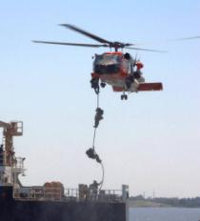
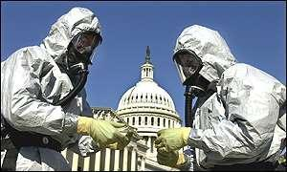
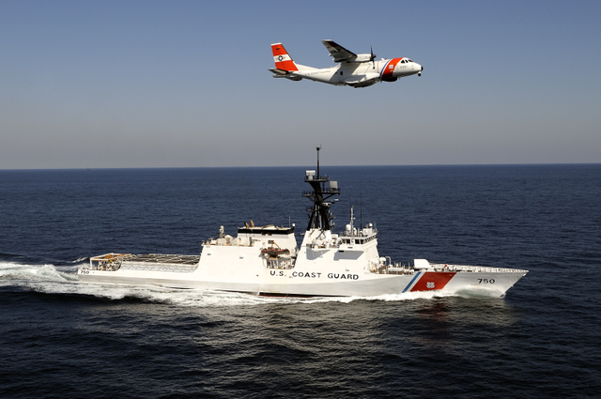
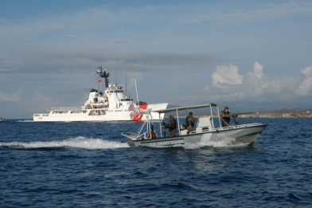
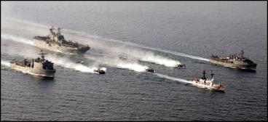
随时待命
Notes:
This concludes this briefing.

