Slide 1
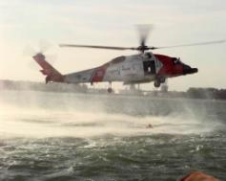
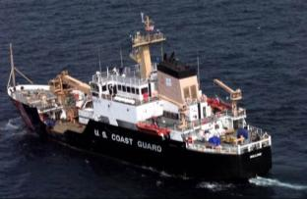
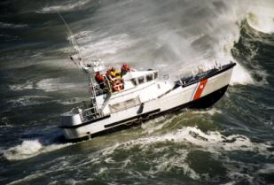
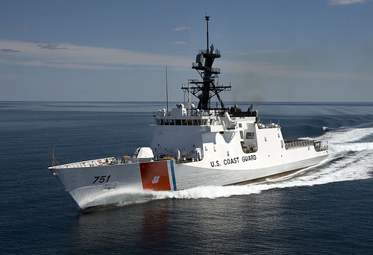
America’s Maritime First Responder
U.S. Coast Guard

Slide 2
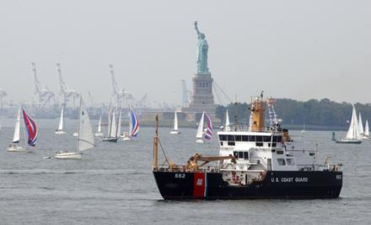
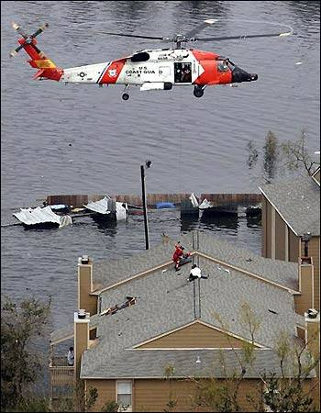
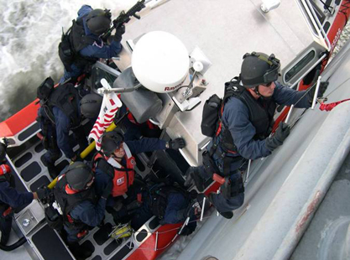
Maritime
Stewardship
Maritime Safety
Maritime
Security

Slide 4
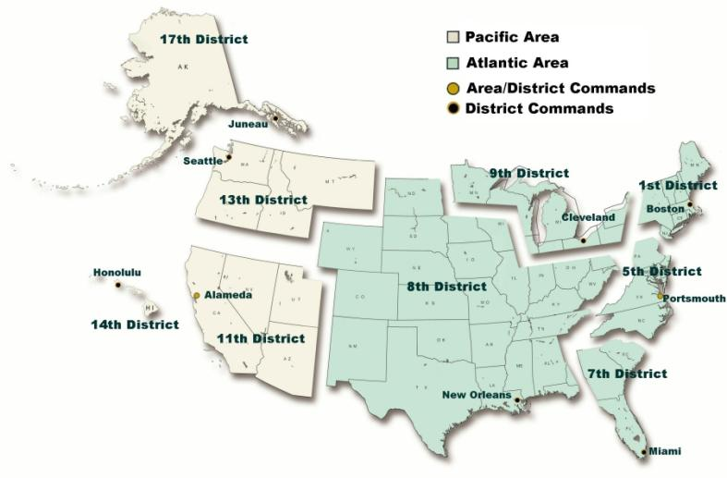
Area and District Headquarters

Slide 5
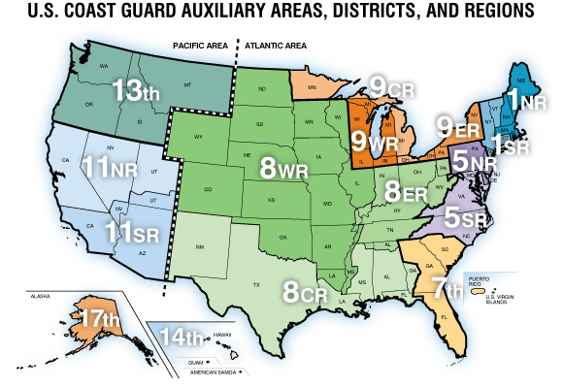

Slide 6
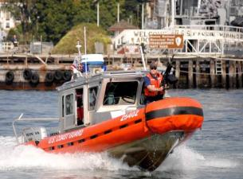
Coast Guard Layered Strategy
International Port Security Program Country Visits & Container Security Initiative
At All Times LE and Customs Officers
At All Times A Military Service (14 USC 1, 10 USC 101)
Foreign Countries
High Seas
Joint Ops – Combining Unique Capabilities & Authorities
EEZ
200 NM
Contiguous Zone
24 NM
12 NM
Territorial Sea
Fed/ State/Local Partnerships
MSTA Regulated Facilities
Internal Waters & Ports
Captain of the Port
Controls Port Access
6

Slide 7
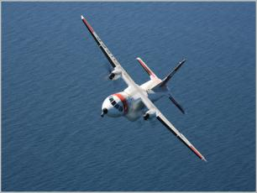
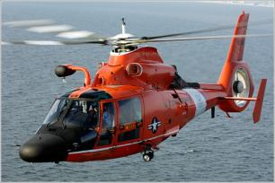
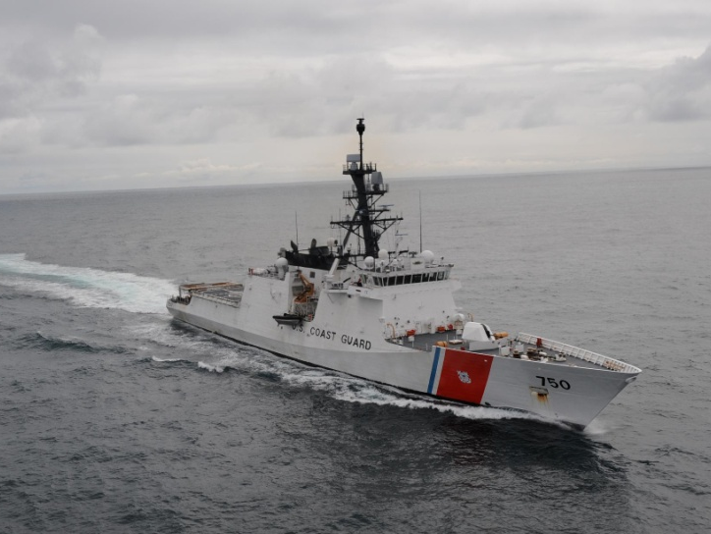
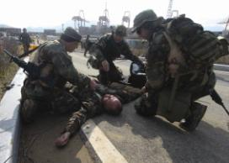
Coast Guard Resources and Personnel
1,850 Small Boats
54 Airplanes
143 Helicopters
42,400 Active Duty
6,900 Reservists
7,900 Civilians
30,000 Auxiliarists
26 Specialized Teams
247 Cutters

Slide 8
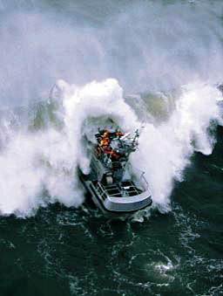
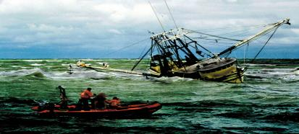
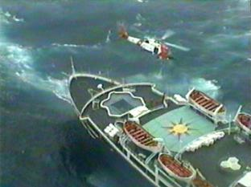
Search and Rescue
Maritime Safety
50,000 calls per year

Slide 9
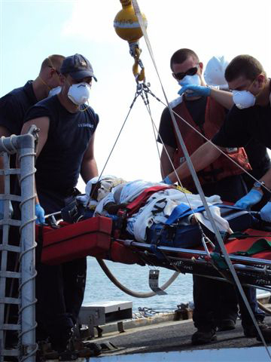
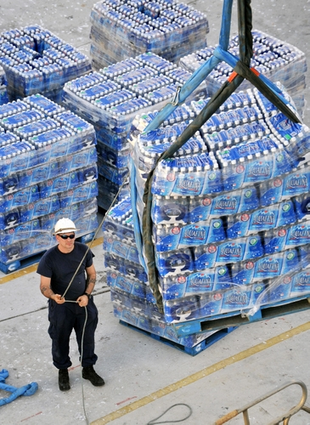
Humanitarian Assistance Disaster Response
Maritime Safety

Slide 10
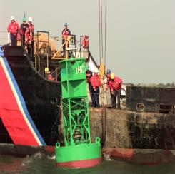
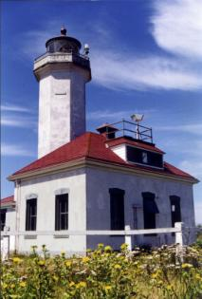
Aids to Navigation
Maritime Stewardship
World’s largest Aids to Navigation system
Over 50,000 buoys, fixed markers, and lighthouses

Slide 11
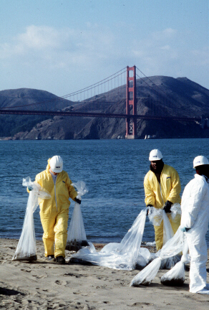
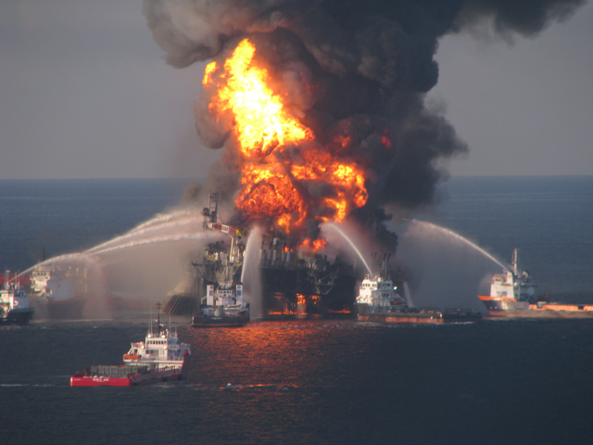
Marine Environmental Protection
Maritime Stewardship
Prevent and respond to oil and hazardous substance spills

Slide 12
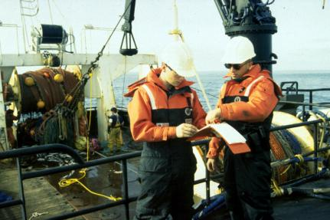
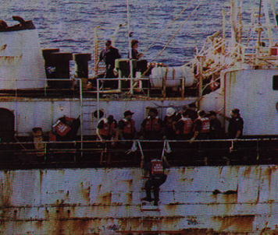
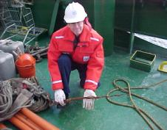
Marine Safety
Maritime Safety
Regulation
Education
Inspection

Slide 13
Auxiliary Qualifications
Vessel Examiner
Recreational Boating Safety Visitor
Public Education Instructor
Boat Crew
Crewman
Coxswain
Aviation
Pilot
Air Crew
Air Observer
Aids to Navigation Verifier
Recruiter
Watchstander
Cutter Qualifications
Interpreters
Food Service Support (AUXCHEF)
TCT Facilitators
Public Affairs/Soc Media SpecialistsMarine Safety
Trident Program
Harbor Patrol
First Responder
Fishing/Towing Vsl Examiner
Auxiliary Sector Coordinator (ASC)

Slide 14
Boating Safety
Life Jackets
Registration and numbering
Navigation lights
Ventilation
Fire extinguishers
Distress signals (flares, horn, etc.)
Battery cover and connections

Slide 15
Convergent Volunteers
Paid vs. Unpaid
Management required
Food and water
Housing
Training
Supervision
Volunteer management incorporated into planning process
Intake or mobilization
Training
Supervision, management, assignment, demobilization
Insurance and liability
Funding and authority

Slide 16
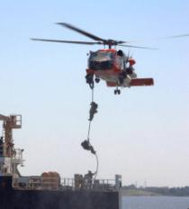
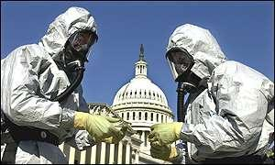
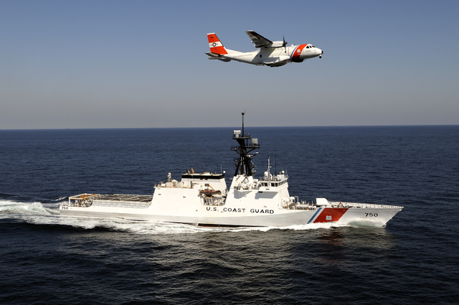
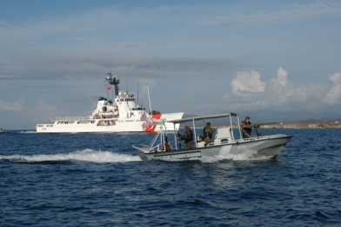
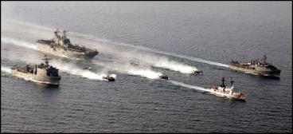
Semper Paratus
Notes:
This concludes this briefing.

