Slide 1
30-Year National Transportation Policy Framework to the Future September 12, 2014

Slide 2
Today’s Webinar
Validate key trends and assumptions that will influence the 30 year plan.
Develop futuristic visions for what our nation’s transportation system might look like in 30 years.
Identify decision points and pathways for these choices.

Slide 3
How This Webinar Will Work
We want your input!
This webinar is composed of a number of questions.
Throughout the session, participants will be asked to provide feedback regarding trends and future opportunities.
Participants have the opportunity to provide insights through both the chat box and the polling feature that will be presented during the webinar.

Slide 4
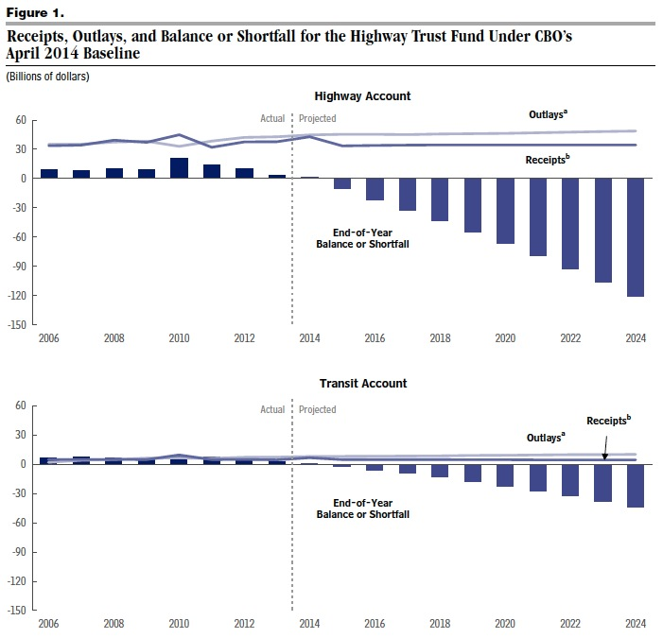
1. Financing shortfalls have led to continuing funding crisis, resulting in new diverse funding sources
Notes:
Funding and financing trends lead to continuing crisis and result in new diverse funding sources
Existing Federal Funding programs are largely and increasingly insufficient
The Lack of long term funding leads to deferred maintenance and planning unpredictability. Problem affects all modes to varying degrees.
Highways: Highway Trust Fund insolvency, which is largely due to inflation and construction costs, but also exacerbated by reduced fuel use
Aviation: Airport and Airway Trust Fund reduced by use of Airline fees for optional services which keep airfares low while not being subject excise tax.
Lack of predictable, dedicated source of federal funding for rail
Insufficient funding in marine highways and ports
In response, new financing mechanisms and sources of non-Federal funding are on the rise
“Value capture” uses new property tax revenue or rental profits from development around transportation projects to payback federal loans.
Proliferation of private investment through public-private partnerships (P3s); many P3 projects are supported by foreign capital
New State, local, and private sources of funding to match Federal program funds

Slide 5
Polling Question #1
Financing Trend
We will likely experience a shift away from Federal support, which will continue to challenge project development. Innovative funding sources will be needed to meet critical transportation needs.
On a scale of 1-5 (1=way off; 5=on the mark)
Please indicate why in the chat box after answering the poll.

Slide 6
Key Questions
Over the next 30 years, what new financing mechanisms will be used to fund freight and/or passenger transportation?

Slide 7
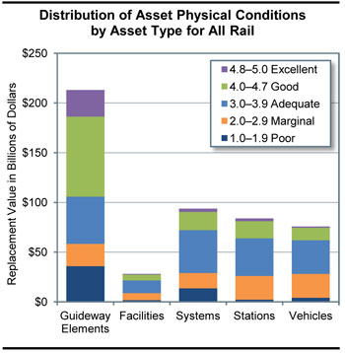
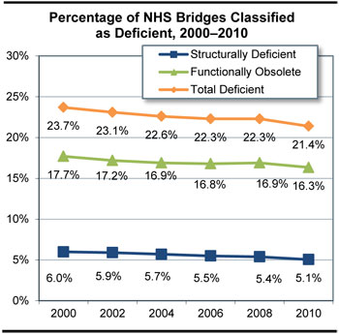
2. Aging infrastructure lacks sufficient investment in maintenance and repair
Notes:
2. Aging infrastructure lacks sufficient investment in maintenance and repair
Short-line railroads are capital constrained and many have track in poor condition, unable to accommodate today's heavier freight loads.
Maritime – the Maintenance and modernization of ports is needed to ease congestion and boost economy
Transit - Bringing existing transit assets up to a state of good repair would require an annualized investment level of $18.5 billion through the year 2030. Overall, the backlog for transit is now $85.9 billion. This doesn’t include investment needed to keep pace with expansion needs.
Highways - Implementing all cost-beneficial highway and bridge investments would cost as much as $145.9 billion per year.

Slide 8
Polling Question #2
Aging Infrastructure
Do you expect that our infrastructure condition will improve or worsen over time?
On a scale of 1-5, (1=worsen; 5=improve)
Please indicate why in the chat box after answering the poll.

Slide 9
Key Questions
Over the next 30 years, what will happen to the backlog of state-of-good repair needs?
What changes, if any, will occur to support operating and maintenance of freight and passenger transportation systems?

Slide 10
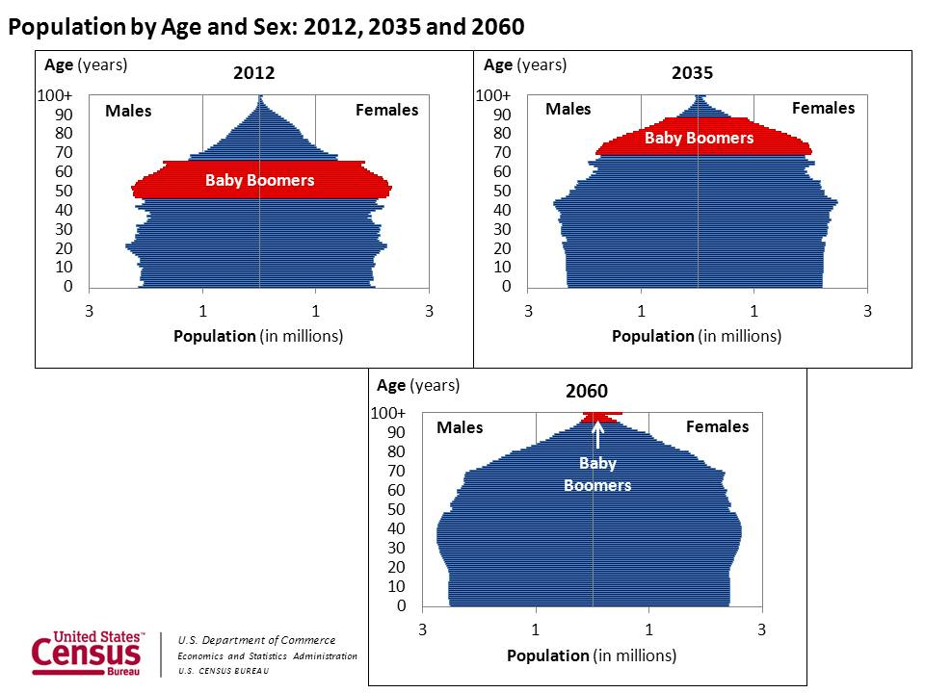
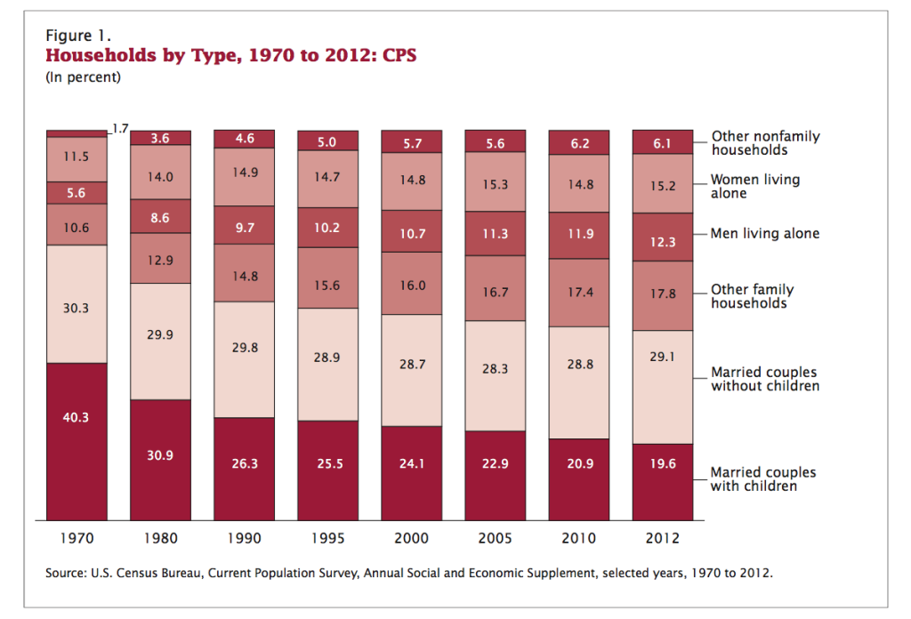
toward a larger, older population in smaller households
3. Demographic trends
Notes:
U.S. Population is growing, although more slowly
Since 1970s, there’s been a 56% increase in US population; by 2050, the US population is could grow an additional 40%.
Although as percentage the growth rate of .7% is the lowest since the 30s – an ever larger population will increase congestion in high growth areas and increase demand for travel and freight movement
Aging Population
Increases in life expectancy at birth is resulting in more people living into old age
By 2025 20% of all drivers will be 65 or older – older road users tend to be more vulnerable and also increase demands for paratransit and emergency medical services
We also see more elderly households in rural areas, which can add to the challenge of providing needed services.
Changes in household composition
More people living in single person households – by 2050 may account for 50% of all households
Recent growth of multi-generation households

Slide 11
Polling Question #3
Demographics
Do you believe that there will be sufficient changes to city, building, station, and vehicle design to accommodate an aging population and meet independent living needs?
On a scale of 1-5 (1=does not meet need; 5= completely meets needs)
Please indicate why in the chat box after answering the poll.

Slide 12
Key Questions
Over the next 30 years, what new and existing transportation services will be used to meet the transportation needs of our communities?

Slide 13
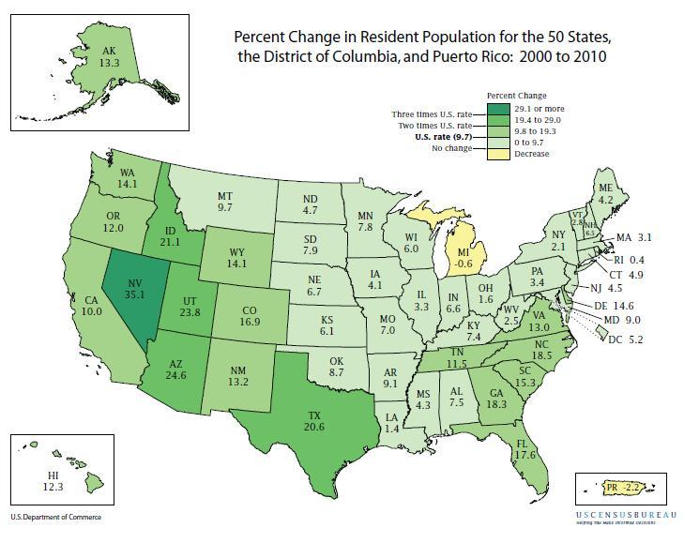
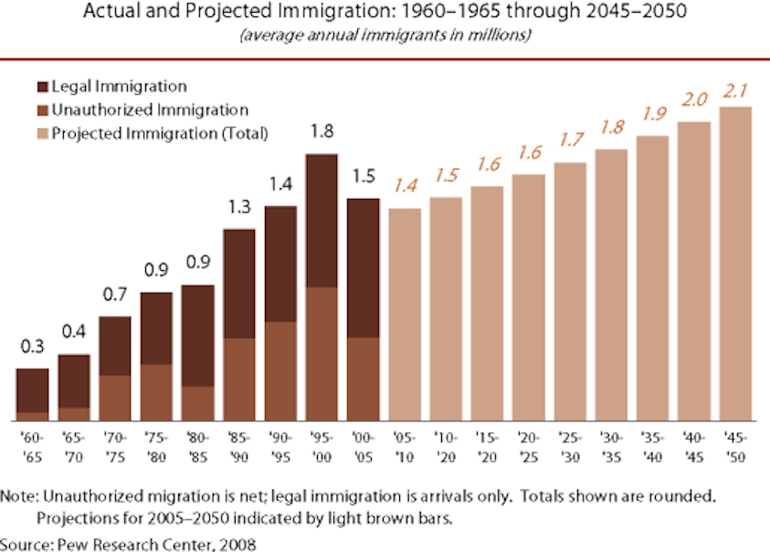
Migratory trends toward larger cities and more suburban poverty, with immigration as primary driver of population growth
Notes:
Immigration is projected to surpass natural increase as primary driver of population growth for first time in two centuries;
Increasing population diversity is already a primary factor in labor force, where Hispanic and Asian Americans are the fastest growing groups.
Recent immigrants are less likely to own personal vehicles, and greater language diversity also may have implications for translation needs and road safety
Shifting Migration Patterns
Recent increase of migration into cities, particularly for young people and retirees, with preference for denser, transit-oriented, walkable communities
Between 2000-2010, urban population growth (12.7%) outpaced overall national growth (9.7%). population projections centered in largest metro areas
Declining rates of cars per person and licensing rates for young adults, and leveling off of per capita VMT
Emergence of megaregions – by 2050 75% of US may live in megaregions – some of which cross not only State and local boundaries but also international borders, further exacerbating the challenge of planning to manage growth.
Rural population declining not only as a percentage of total US population but also in raw numbers.
Lower-income households are increasingly moving to suburbs (33% of poor in 2010, from 25% in 1970), where provision of public transportation service is more costly
Overall, recent population growth has been increasingly skewed to the Southern and Western States

Slide 14
Polling Question #4
Migration
Projections indicate that cities will be larger, requiring redesigns in infrastructure to accommodate growth.
On a scale of 1-5 (1=way off; 5=on the mark)
Please indicate why in the chat box after answering the poll.

Slide 15
Key Questions
Over the next 3 decades, how will we (as a country) provide reliable transportation for a growing population?
How will population growth and land-use changes affect travel patterns and the use of our nation’s transportation system?

Slide 16
Key Questions
What policies can close the gaps in the transportation network for the ‘first and last mile’:
FOR Passengers
FOR Freight

Slide 17
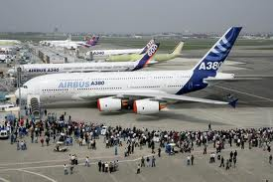
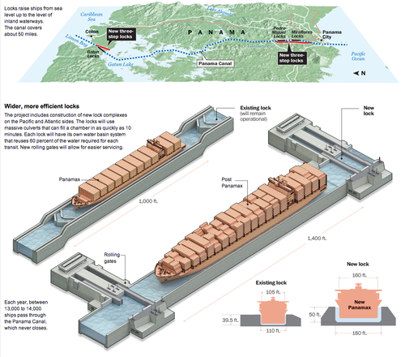
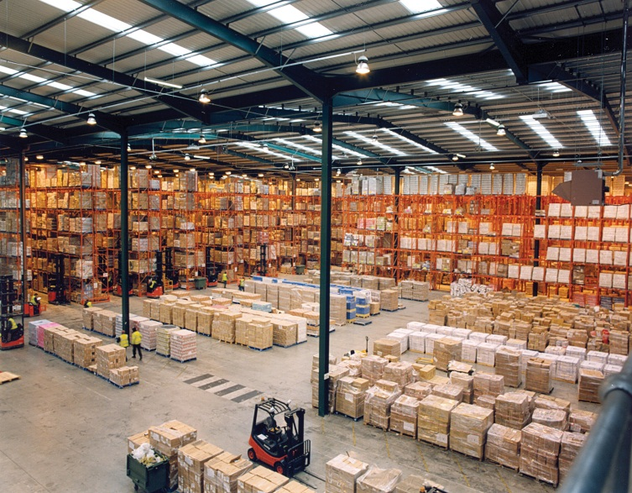
4. Domestic and global commercial and economic trends create new challenges for meeting freight and passenger transportation needs
Notes:
Household Income
Large and growing gap between high and low-income workers; recent declines in real median household incomes
Middle and low income households spend larger proportion of income on transportation
15% of Americans are in poverty (2010)- significantly higher for African Americans and Hispanics
Commercial changes
Online shopping leading to increasing demand for small package home delivery
Majority of trade occurring in 50 largest metro areas.
Airline mergers, and consolidation of hubs, possibly resulting in more congestion, higher fares, and/or fewer air travelers
Trend toward larger aircraft—efficiency gains at large airports, loss of service to small airports
Growth of low-cost carrier models
International Transportation and Trade
Changing US trade balance toward increased imports
At the moment, lower U.S. energy costs are boosting U.S. manufacturing, and accelerating international exports as well as the infrastructure to support them
Trade agreements if ratified will increase international freight flows
Increasing international per-capita GDP raising demand for international travel Panama Canal Widening: Expected to increase traffic at East Coast Ports, relieving Western freight chokepoints
New Arctic Shipping routes are being made available due to Melting polar ice caps

Slide 18
Polling Question #5
Domestic and global commercial and economic trends
Will the transportation infrastructure be sufficient to meet the demands for passenger movement in 2045?
On a scale of 1-5 (1=not sufficient; 5=sufficient)
Please indicate why in the chat box after answering the poll.

Slide 19
Key Questions
What will be the interaction between freight and passenger movement in our country?

Slide 20
Key Questions
How will changes in household income affect transportation demand?

Slide 21
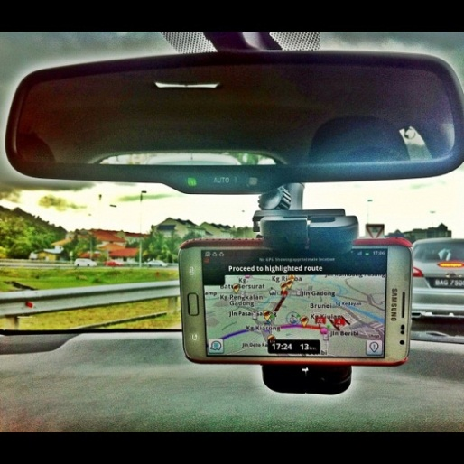
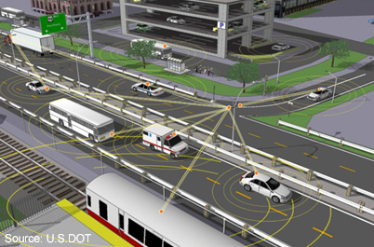
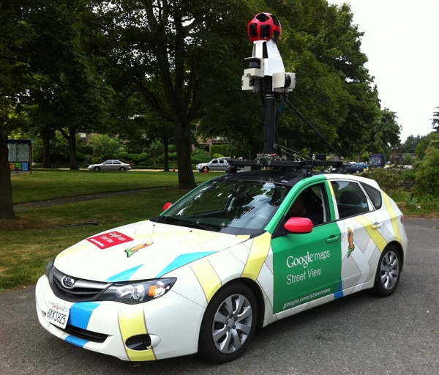
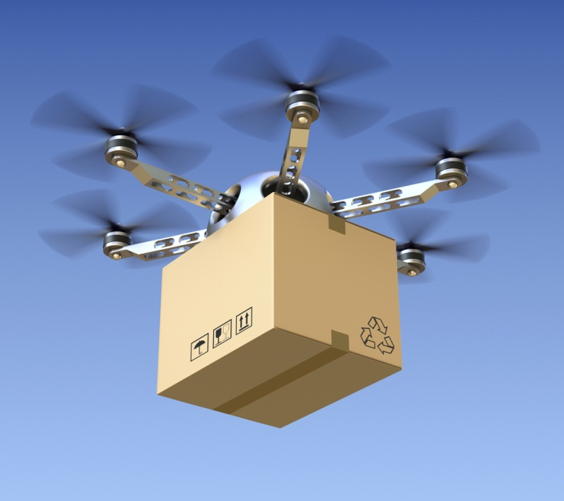
5. Technology enables new applications of data that will enhance roadways and airspace, with new considerations for safety
Notes:
Advances in Automation enhancing delivery of public transportation services and improving maritime and freight logistics
Vehicle technology
V2V and V2I communications to enable vehicles to prevent crashes
Positive Train Control mandate for all passenger railroads
Autonomous vehicles are in development and testing -- require changes to operational and regulatory frameworks
Aviation technology
NextGen improvements will optimize the airspace flows and flight procedures
FAA must find a way to integrate unmanned aircraft systems into the airspace
Growth of commercial space transportation market and emergence of suborbital space travel will impact freight and passenger patterns
Increase of teleworking and non-tradition work settings changing commute patterns
Web-based applications could increase capacity and mobility (without car ownership)
Proliferation of transportation data
Operators and industries collect an increasing volume of data on transportation patterns and operations, with the potential to improve efficiency and planning
Increased ability for real-time response by system operators and users
Lack of a comprehensive cooperative system for data collection and analysis
Significant Safety Security and policy considerations, including operator distraction risks, spectrum allocation competition, reliance on complex electronic control systems, (e.g. overreliance on GPS as a single source of PNT, which could become a national and economic security threat).
Also safety benefits, such as in-vehicle safety systems e.g. seat belt interlocks or automated impaired driving detection system, and crash avoidance benefits.

Slide 22
Polling Question #6
Technology
Do you agree that the technologies discussed today will be key drivers for change in our transportation system?
On a scale of 1-5; (1=way off; 5=on the mark)
Please use chat box to tell us what other technology changes should be considered.

Slide 23
Key Questions
How can new connected and automated vehicle technologies affect both safety and efficiency?

Slide 24
6. Shifting energy economics and fuel sources create significant disruption (e.g., CNG buses) as well as new opportunities for innovation
Notes:
Increasing supply of U.S. and Canadian crude oil and natural gas, in areas without sufficient pipeline capacity
Potential U.S. transition to natural gas net exporter by 2018
Unconventional fossil fuel extraction is expected to continue expanding dramatically
Lack of pipeline capacity from new production regions leading to oil by rail and water, with safety and security implications
Continuing increase in demand for natural gas for electric power and other sectors
Lower fuel costs; more efficient natural gas electric power generation facilities;
Growth will be strongly driven by recent greenhouse gas emissions regulations from the EPA.
In transportation CNG buses are increasing due to low fuel costs. Interest in natural gas for new rail and maritime ports
Overall US per capita energy use projected to decline due to increasing oil costs and energy efficiency improvements and greater deployment of electric and ethanol cars, and CNG trucks and buses

Slide 25
Polling Question #7
Shifting Energy Economics
Transportation will be using non-traditional energy sources at a rate equal to or greater than traditional sources.
On a scale of 1-5 (1=way off; and 5=on the mark)
Please indicate why in the chat box after answering the poll.

Slide 26
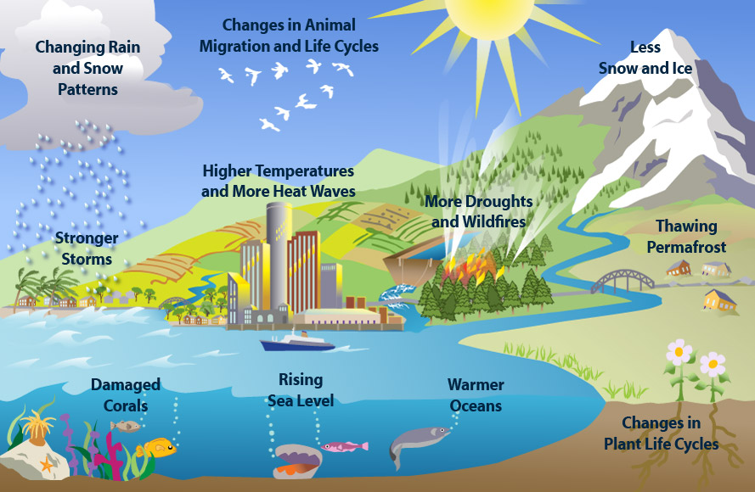
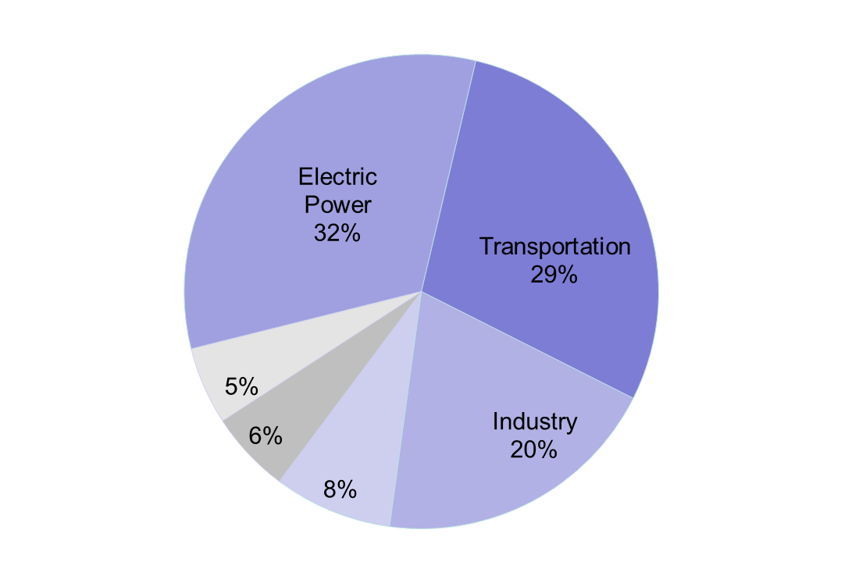
7. Climate change disrupts infrastructure while low-carbon solutions affect costs and demand
All U.S. GHG emissions
Transportation components of U.S. GHG emissions
Notes:
Increasing greenhouse gas emissions
Transportation greenhouse gas emissions increased 18.3% since 1990, whereas overall emissions increased by only 8.4%
Transportation policy will have to respond to climate change, which means potentially increased costs.
We’ve already seen regulations affect cost and demand, such as CAFE and the new EPA power plant regulations
Transportation infrastructure is also going to be affected by Climate change impacts
Global mean sea level rise of 5 to 8 inches by 2040
Average global temperature increase of 2°F to 11.5°F over pre-industrial levels by 2100,.
More frequent/intense storm events, flooding and heavy snowfalls
land use, water shortages, new migration patterns, agricultural and economic impacts
These changes have implications for infrastructure, operations, costs, and also could threaten U.S. and international supply chains

Slide 27
Polling Question #8
Climate Change
Over the next three decades, what is the likelihood that the U.S. transportation sector will dramatically reduce emissions?
On a scale of 1-5 (1=not likely; 5=very likely)
Please indicate why in the chat box after answering the poll.

Slide 28
Key Questions
To what extent will changing climates and impacts from climate change affect where Americans choose to live and create new domestic migration patterns?

Slide 29
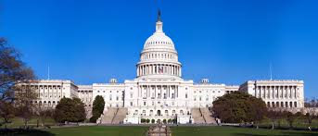
US policymakers may need to anticipate and respond to these trends.
Increased performance measurement
Potential for regulatory change
Environmental
Financial
Immigration
Safety
Notes:
Performance measures
Move to performance-based system complicated by lack of set standards, and multitude of government entities involved in setting targets and measuring performance
Potential for regulatory change
Increased environmental regulation – e.g. ballast water, emissions regulations—safety requirements, cargo restrictions, and other have the potential to shift relative costs and demand of different modes
Financial regulations could affect costs and availability of financing
Immigration regulations could change projections for population increase and have impacts to labor force
Transportation systems needs will require comprehensive Local, Regional, and National planning
Growth of megaregions affected by Lack of appropriate jurisdictional scale planning
Competition between local areas can result in a fragmented infrastructure
The lack of a national perspective in transportation planning could affect national competitiveness.
Policy will need to integrate private owners and operators into the planning process

Slide 30
Key Questions
What role will passenger rail, buses, taxi, bikes, walking or other modal shift play to meet transportation demand over the next 30 years?

Slide 31
Key Questions
How will we achieve a multi-modal freight system over the next 30 years?

Slide 32
Key Questions
As demographics shift, what will be the interaction between freight and passenger movement in our country?

Slide 33
Key Questions
How do we ensure that our transportation system is safe across all modes?

Slide 34
Key Questions
What other emerging issues need to be taken into consideration over the next three decades?

Slide 35
Key Questions
How do we ensure that the transportation workforce has the skills to match the rapidly evolving transportation and information technology advancements?

Slide 36
Closing Questions
In your opinion, what would a world class transportation system look like in 2045?
(Please Respond in Chat Box)

Slide 37
Closing Questions
What key policy initiatives will help achieve your vision over the next 30 years?
(Please Respond in Chat Box)

Slide 38
30-Year National Transportation Policy Framework to the Future
30Years@dot.gov

