Slide 1

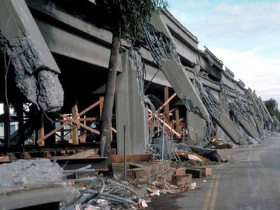
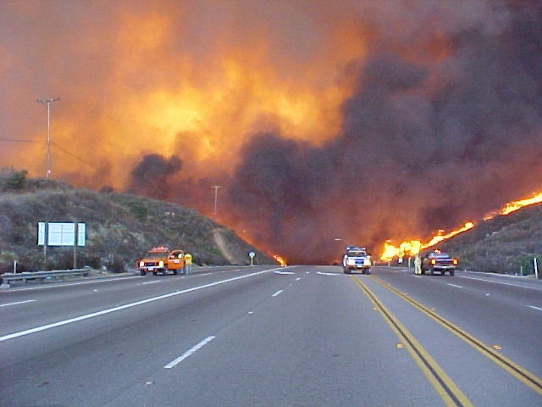
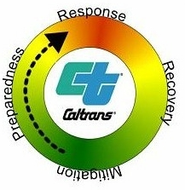
Assessment Methods and Criteria
For Highway Network Safety
Presented by Herby G. Lissade, P.E.
Chief, Office of Emergency Management
California Department of Transportation

Slide 2
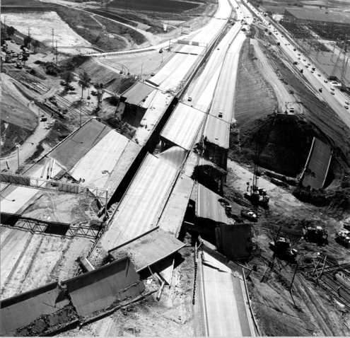
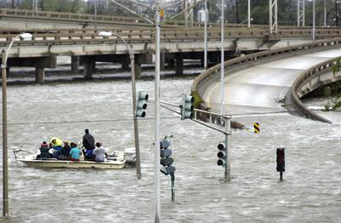
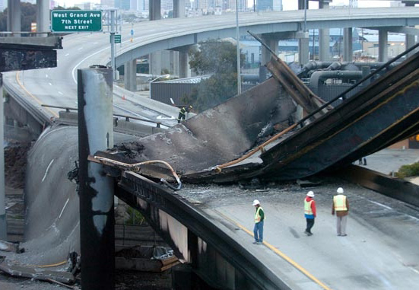
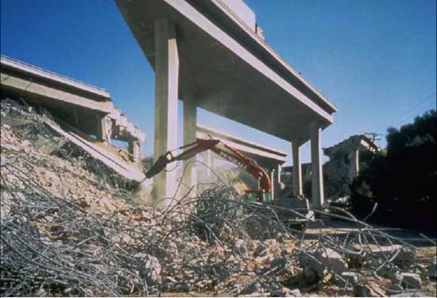
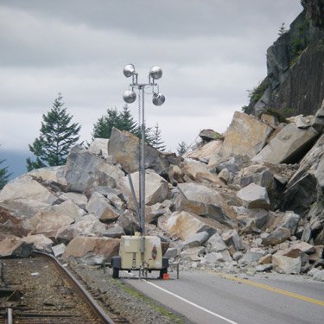
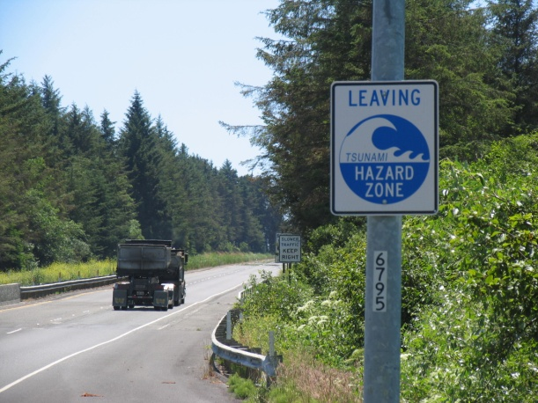
Damage Assessment
Varies for Earthquakes, Floods or Fires

Slide 3
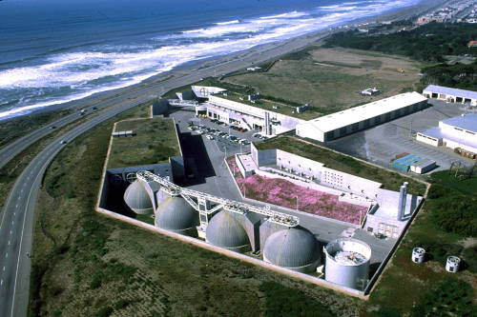
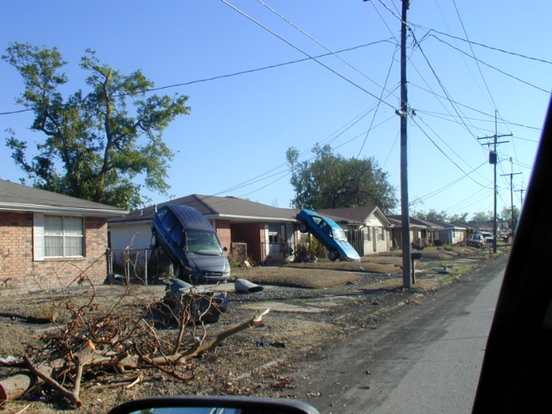
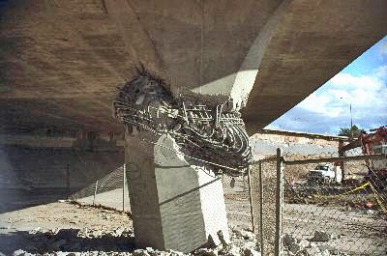
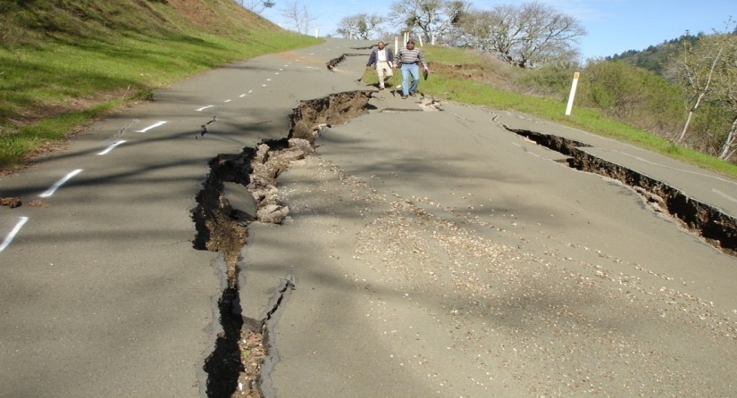
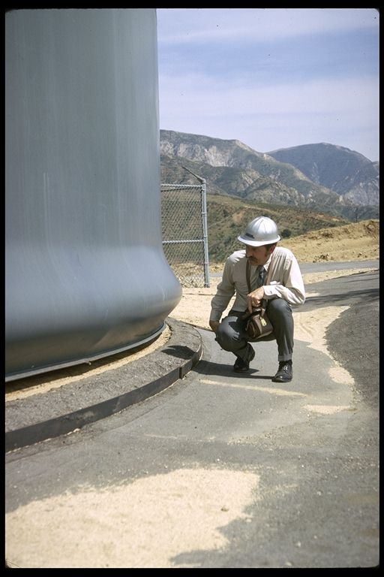
Safety Assessment Program
Rapid assessment of infrastructure by Prequalified professionals:
- Registered Civil, structural and Geotechnical Engineers.
- Licensed Architects
- Registered Geologist and Engineering Geologist
Project Development Tool Box
Method and procedures to help accelerate contract delivery, such as incentives/disincentives for construction time and Emergency Contract Registry.
http://www.dot.ca.gov/hq/oppd/projaccel/index.htm.
Notes:
.

Slide 4
ShakeCast
- Developed with the United States Geological Survey
- 1,900 sensors throughout California
- For events greater than a 4.0 earthquake
- Web based application
- Automatically retrieves earthquake shaking data
- Automatically analyzes individual bridge performance
- Generates inspection prioritization reports sent out by email, within minutes, to inspectors and managers anywhere in the world, pushed to their smart phones.
- helps to expedite post earthquake evaluations

Slide 5
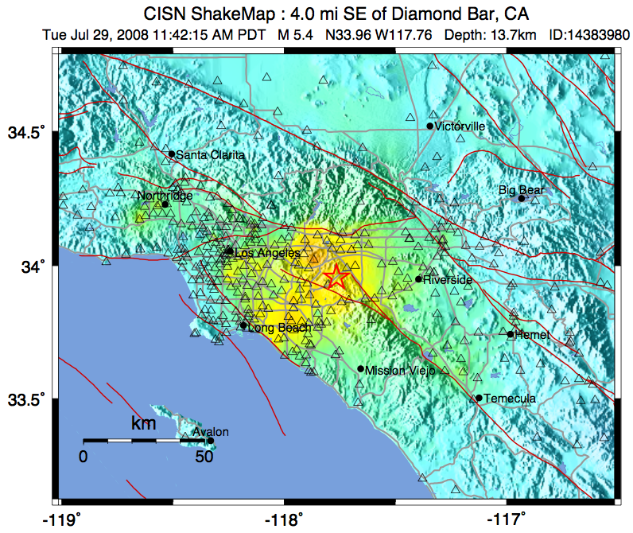
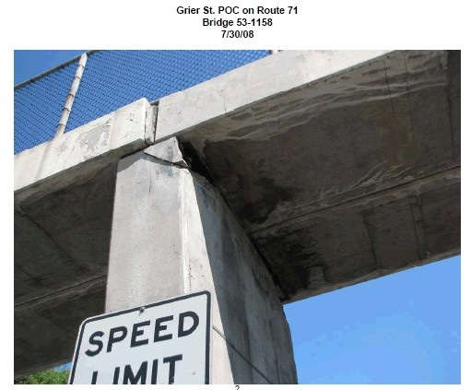
5.4 Chino Hills July 2008
ShakeCast
A Tool for Rapid Post earthquake Assessment and Response.
ShakeCast identified the only bridge damaged in this event as the 3rd highest priority for inspection.

Slide 6
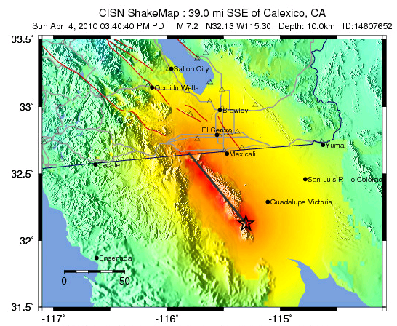
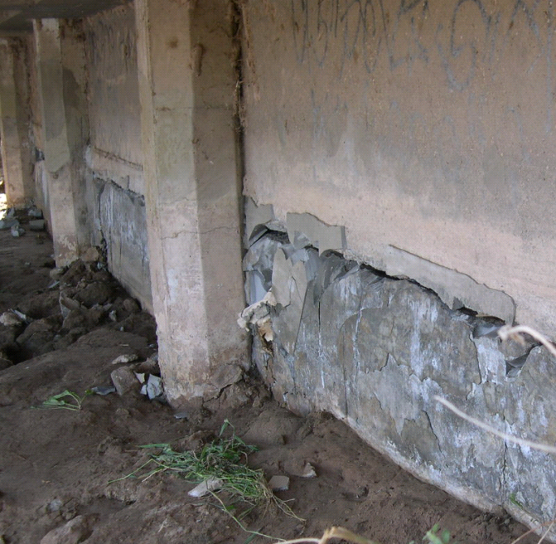
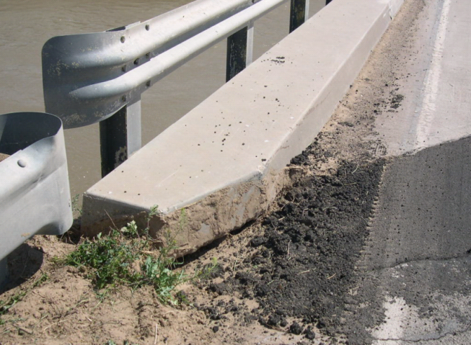
7.2 Calexico April 2010
ShakeCast
ShakeCast identified the only bridge damaged in this event as the top priority for inspection.

Slide 7
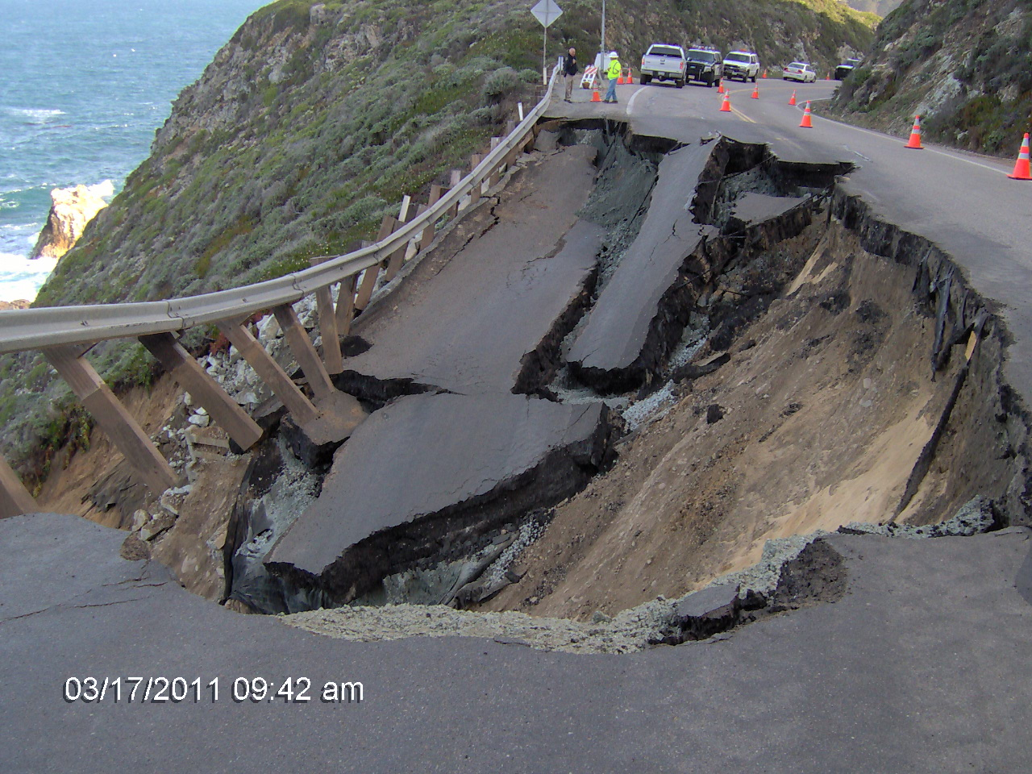
Disaster Response
Major Damage Restoration
Disaster Response has two phases:
  Emergency Opening [no Plans Specifications and Estimates]
  Restoration [Plans Specifications and Estimates]
Restoration is reconstruction of facility to pre-disaster condition
In the disaster aftermath emergency procedures are usually invoked which cut red tape and shorten the Plans Specifications and Estimate process

Slide 8
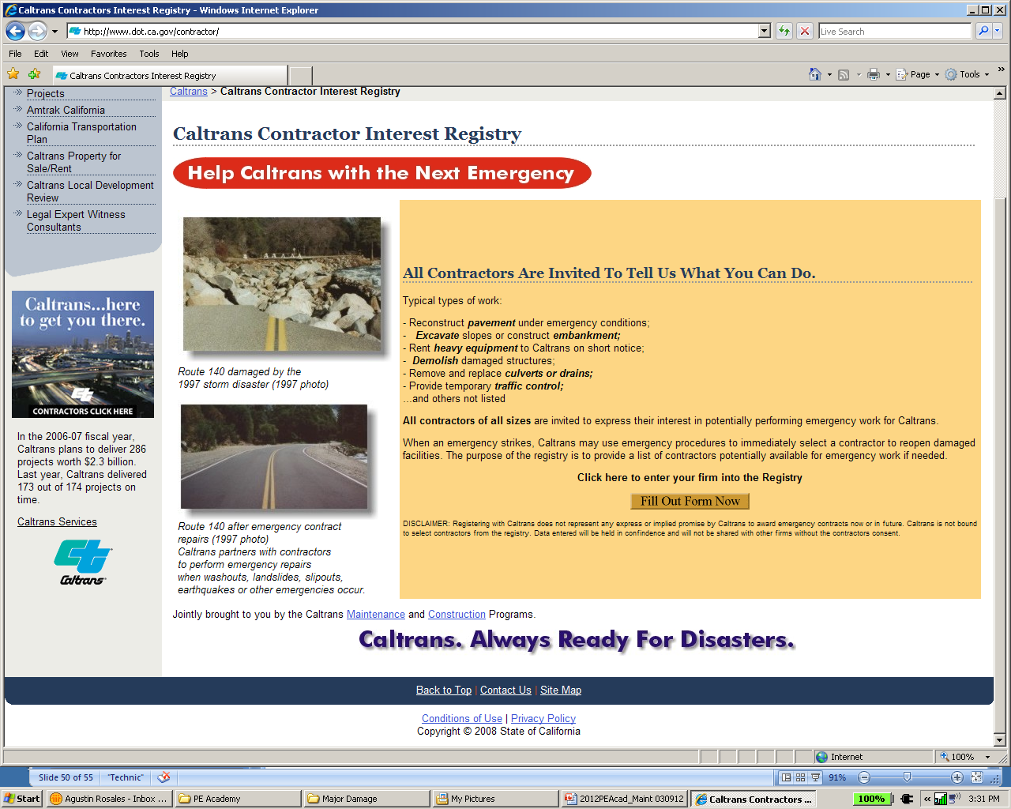
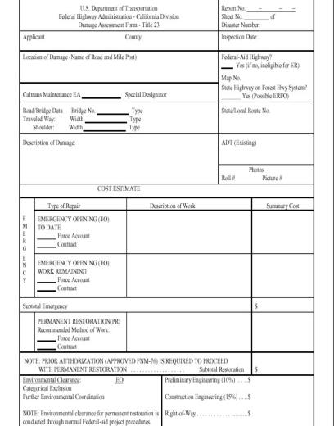
Disaster Response
Deputy Directive
Relief from some environmental and permit requirements
Set aside Contract Act with Director’s Orders
Caltrans Contractor Interest Registry
The Damage Assessment Form can be used for any Major Damage project (state or federal funds).
Director’s Orders

Slide 9
Thanks!
Notes:
Questions?

