Slide 1
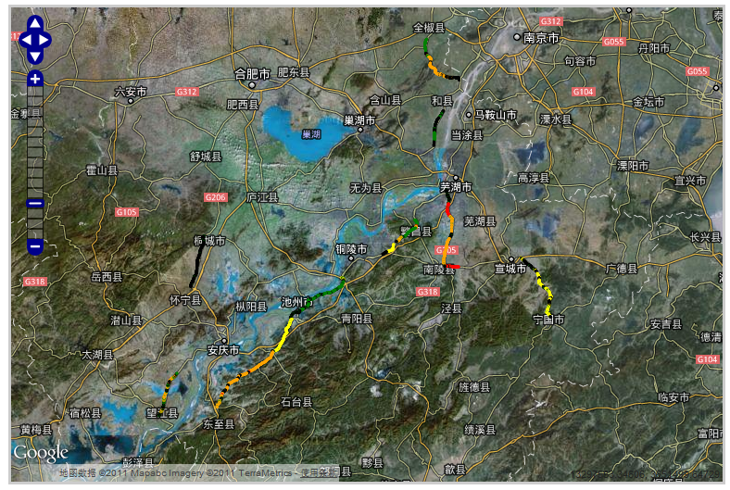
Road Network Risk Assessment and Index
Zhang Tiejun
tj.zhang@rioh.cn
13911024196

Slide 2

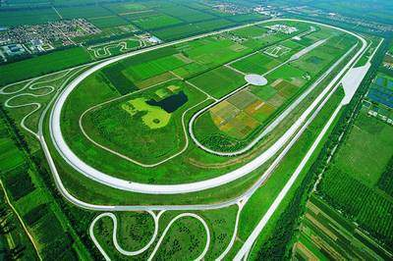
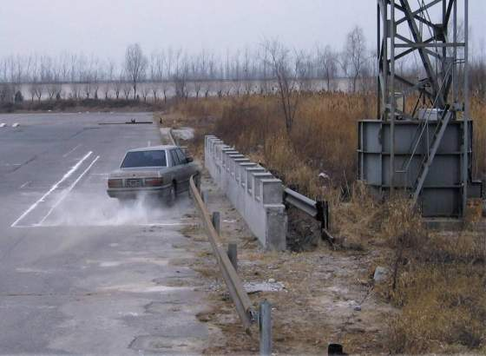
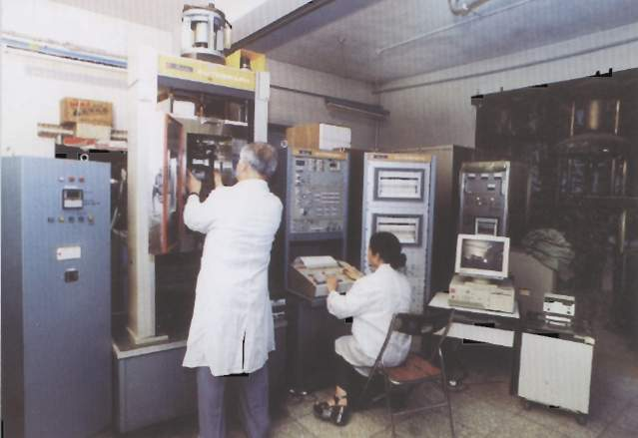
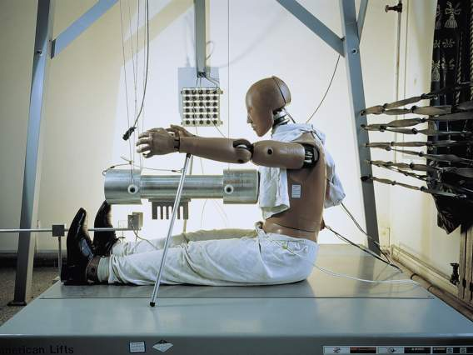
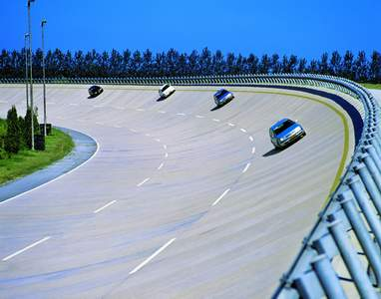
  Founded in 1956. The only research institute directly under the Ministry of Transport, engaging in science and technical research in highway traffic and transportation field. Provide technology support for rapid, scientific and healthy development of highway traffic and transportation in China
Research area
  Highway engineering
  Bridge engineering
  Traffic engineering
  ITS
  Highway transportation
  Moto vehicle application
  Highway environment protection
  Logistics

Slide 3
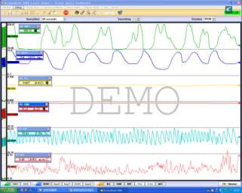
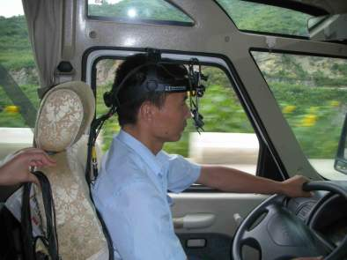
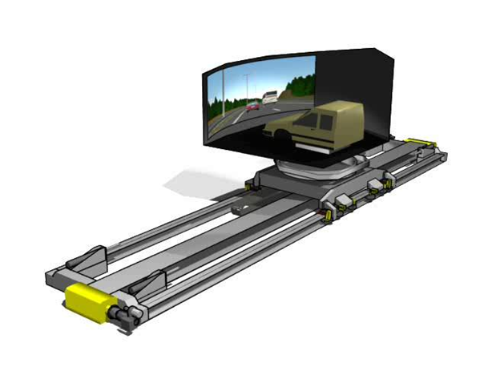
Road Safety Research Center
  One department of RIOH, was founded in 1973.
  Mission:Improve safety of road traffic system and save lives
  5 platforms
  -Road Safety Research Center（RSRC), MOT
  -National Center for Quality Supervision & Inspection of Traffic Safety Facilities（NSITS）
  -National Traffic Engineering Facilities (Highway) Standardization Technical Committee（NTSC）
  -Road Traffic Forensic Center, RIOH
  -Beijing Zhongjiao Hua’an Science & Technology Co., Ltd.
  127professional staff. 12 senior engineers, 12 Ph.Ds, 50 Masters
  Key Laboratory of Road Safety Technology, MOT
Notes:
Electricity biofeedback instrument Helmet eye tracker
Developing driving simulator of 8 DOF and
360 degree projection

Slide 4
Outlines
1
Introduction
2
RIOH Risk Assessment Research
3
Risk Assessment Model
4
Application Examples

Slide 5
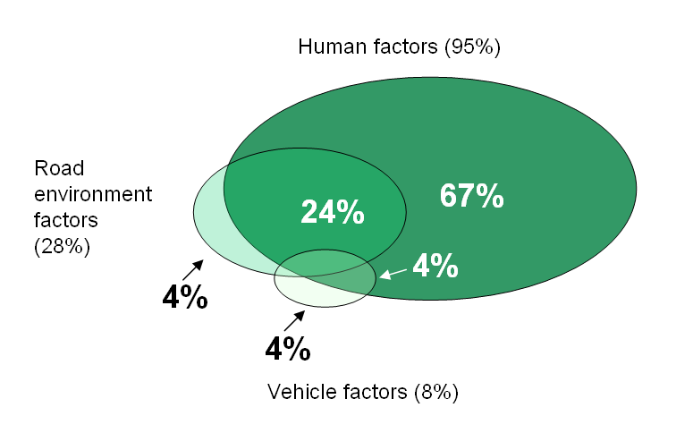
Crash cause characteristic*
1 Introduction
*RIOH，accident analysis report for mountainous highways，2011.

Slide 6
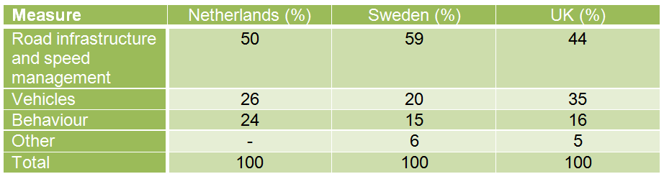
SUNflower Study
(Sweden, UK, Netherlands)
Koornstra et al., 2002. SUNflower: A comparative study of the development of road safety in Sweden, the United Kingdom and the Netherlands.

Slide 7
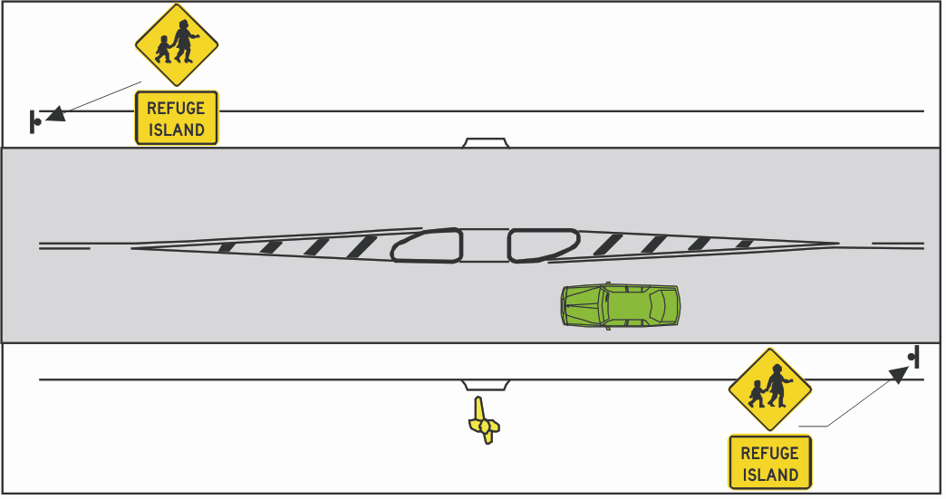
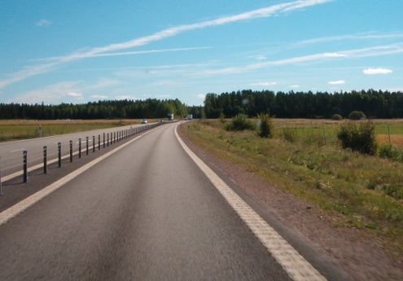
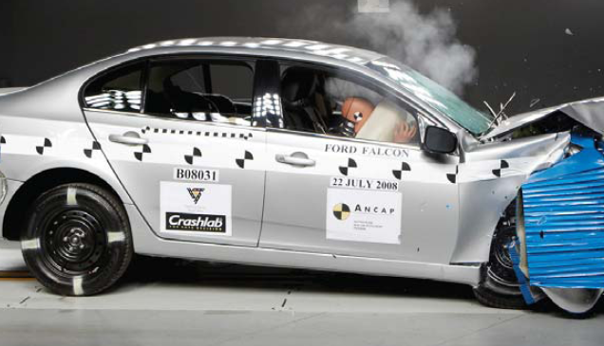
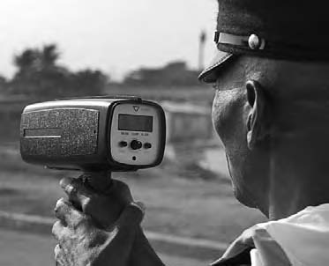
Road safe system
Safe road
Speed
a shared responsibility
Safe vehicle
Safe user
5 star user== 5 star vehicle== 5 star road

Slide 8
2 RIOH Risk Assessment Research
1 Before 2003: Traffic safety audits, and safety influence analysis of individual road or traffic factors.
Beginning of the performance of traffic safety audit.
Got some basic safety influence characteristics of individual road and traffic factors , such as the safety influence of gradient.
2 2003 to 2008:”Road safety assessment in west area” and “Research of Highway Safety Manual in China” supported by MOT, systematic research of traffic safety complex factors was launched.
Theory and methods of accident black spot identification.
Accident prediction models of two-lane highways and four-lane undivided highways
Safety management(Key segments selection, Safety analysis, countermeasure , Economic appraisal)

Slide 9
2 RIOH Risk Assessment Research
3 2009 to 2011：Through National Science and Technology Plan of Action, international cooperation, systematic research of risk assessment achievements was launched.
Establishment of the basic performance process of risk assessment of road network.
Build the rapid and dynamic traffic safety data collection system, the traffic safety basic database.
Development of the core models which include 17 road factors basing on the traffic safety data in more than 7 provinces.
Establishment of the database of traffic safety improvement countermeasures and effect results.

Slide 10
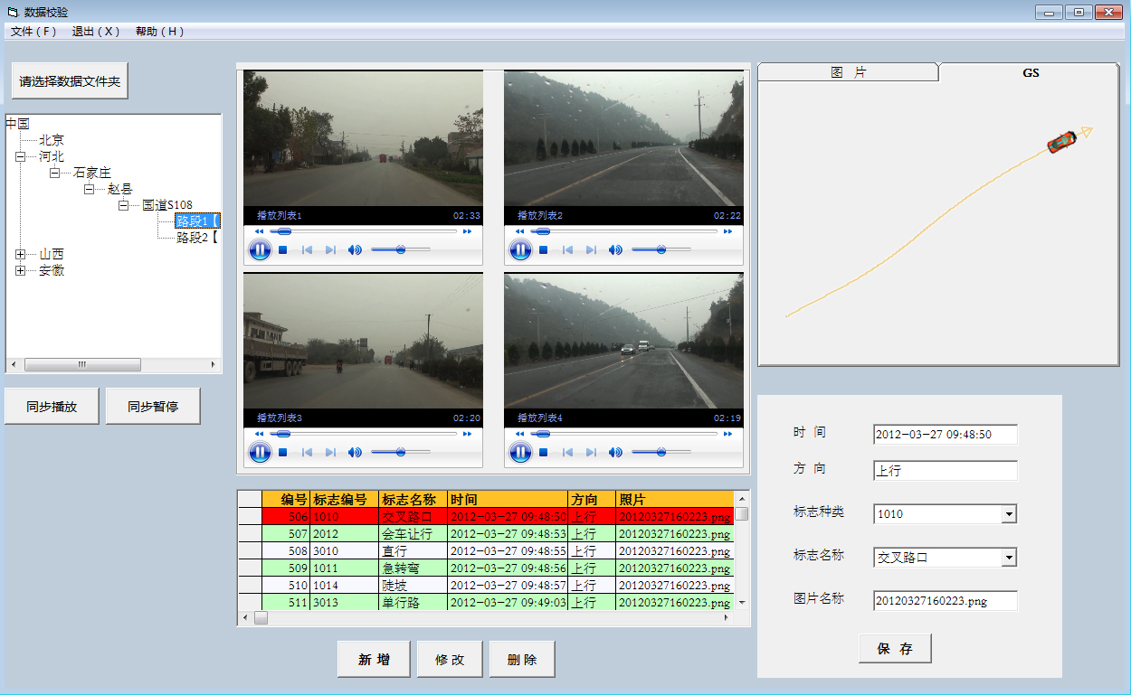
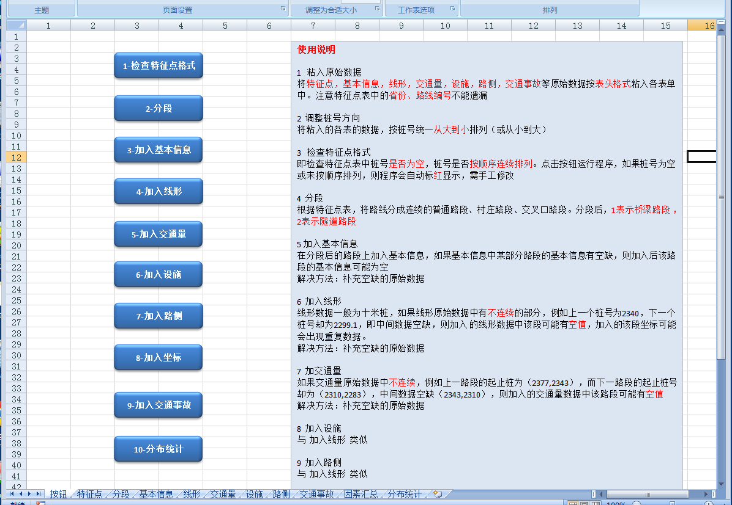
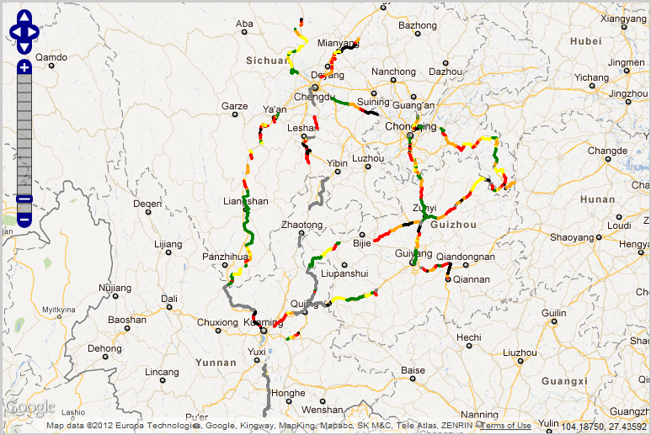
Survey Data management
Survey System
Risk Map system
Risk assessment model
Countermeasure and
Economic appraisal model
Page10

Slide 11
3 Risk Assessment Model
Four key Sub-models:
Traffic Data Collection and Management
Risk Scores Calculation and Risk Reason Analysis
Countermeasure Database
Economic appraisal
Convenient Application software System

Slide 12
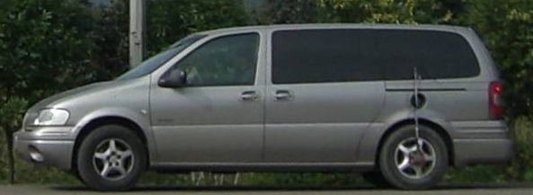
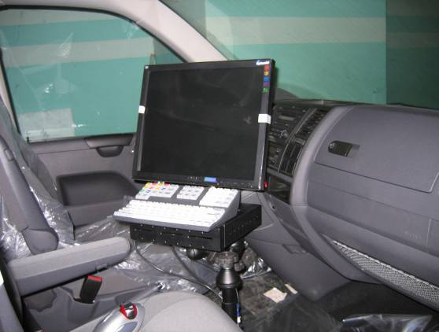
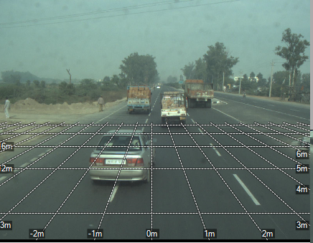
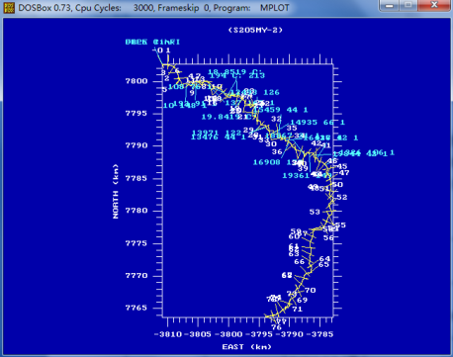
Risk Assessment Model
Data collection and management
Road
alignment
Traffic
safety facility
Operating
speed
Accident data
In recent
five years
Traffic
volume
Roadside
Climate

Slide 13
Risk Assessment Model-Risk calculation
Assessment Segment Definition
Road Network
Freeway
Two-lane
Four-lane
undivided
Four-lane
divided
others
Class
Volume
AADT₁
……
AADT_{n}
Intersection
Bridge
Tunnel
Bridge&Tunnel
Link
construction

Slide 14
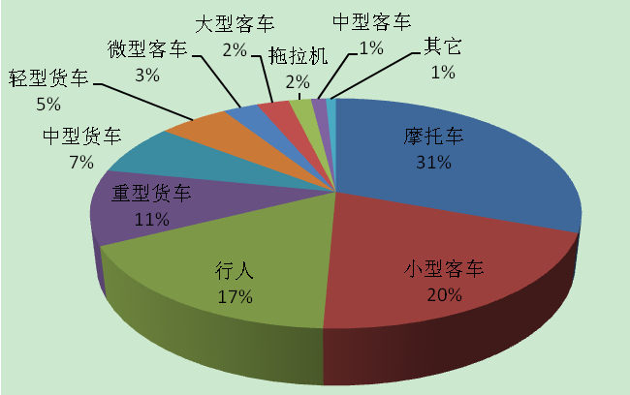
Risk Assessment Model-Risk calculation
Risk Scores Calculation based on road and traffic character
Focus on
main road users

Slide 15
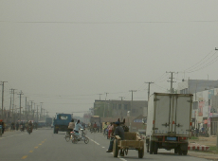
Risk Assessment Model-Risk calculation
Risk Scores Calculation based on road and traffic character
Highway
=
Common Segment
+
Village Segment
+
Intersection

Slide 16
Risk Scores Calculation based on road and traffic character
Head on Crash
Rear-ended Crash
Roadside Crash
Focus on main crash type

Slide 17
Risk Assessment Model-Risk calculation
Risk Scores Calculation based on road and traffic character
Accident Rate
Common Segment
Village Segment
Intersection
severity
S_{i}
P_{i}
Total Crash Damage
Traffic Volume
Three-dimensional model of Crash Damage

Slide 18
Risk Assessment Model-Risk calculation
Base condition Risk Score
Factual condition Score Index
Accident Type
Safety Factors
Accident rate index ( P_{i} )
  Curvature
  Speed
  Lane number
  ……
Severity Index( S_{i} )
  Speed
  Roadside
  ……
P_{i}>or<1
S_{i}>or<1

Slide 19
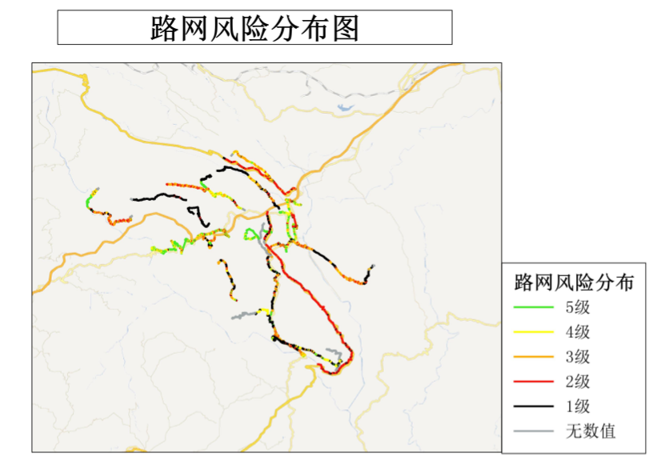
Risk Assessment Model-Risk calculation

Slide 20
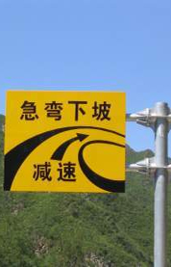
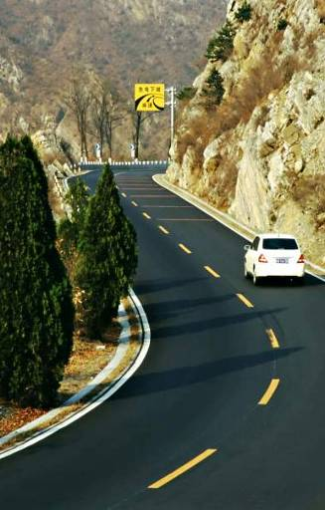
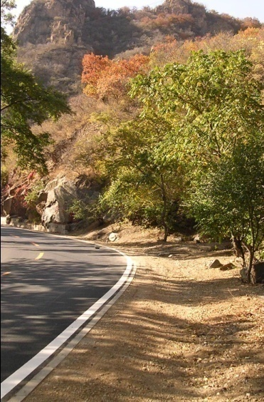
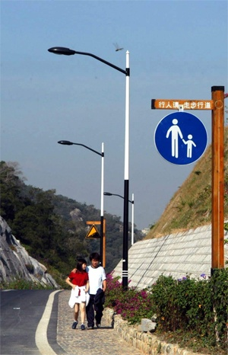
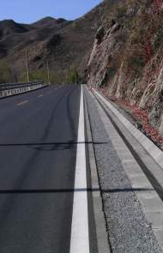
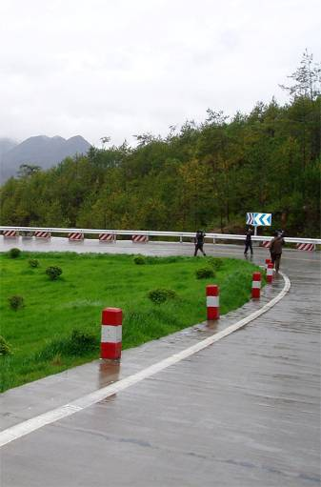


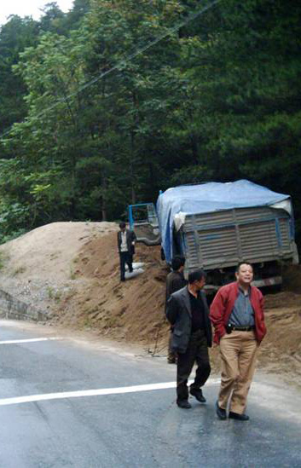
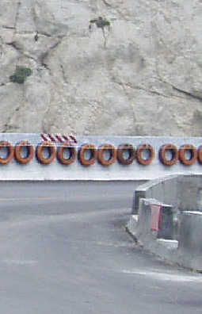
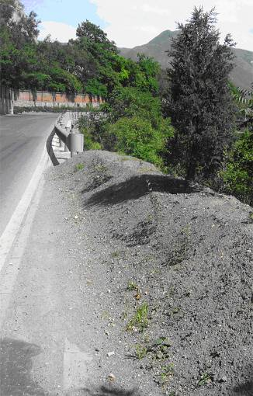
Risk Assessment Model
Countermeasure Database
Countermeasure
Safety Effect
Cost
Idea Innovation
saving
forgaving
flexible

Slide 21
Risk Assessment Model
Economic appraisal
Before Enforcement
Optimization methods in operation theory
Select the plan with maximum effect(Benefit/Cost)
After Enforcement
Assess the factual effect of safety enforcement
Renew countermeasure database

Slide 22
4 Application examples
Define the network
Collate data
Assign data to network
Produce maps
Quality review
Talk about results

Slide 23
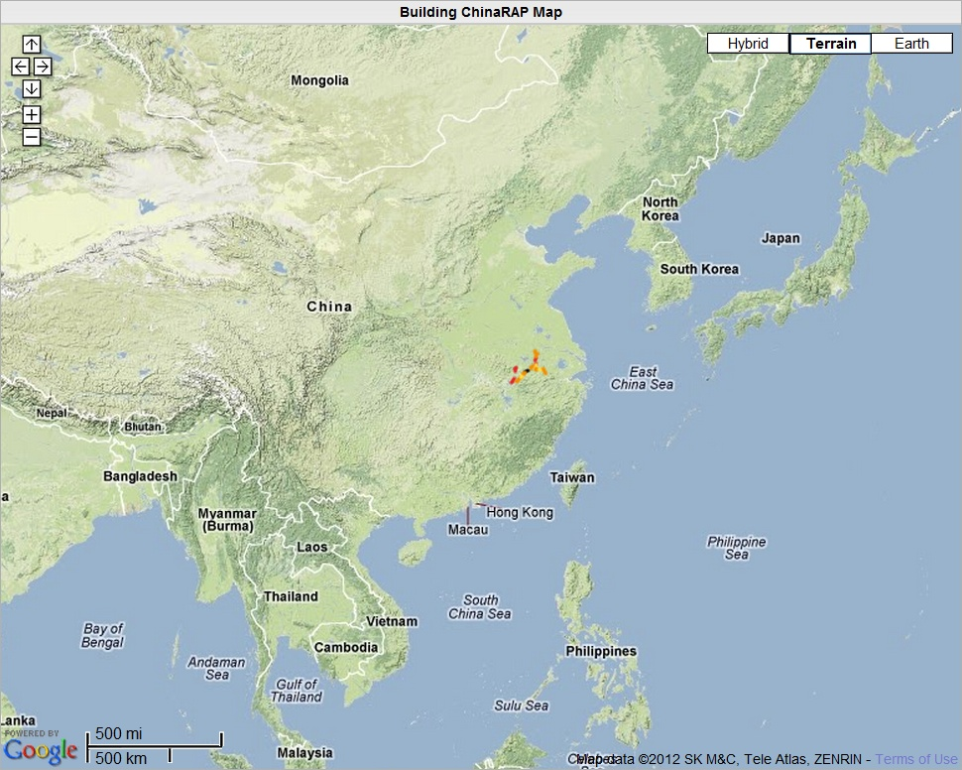
Assessments in Anhui Province

Slide 24
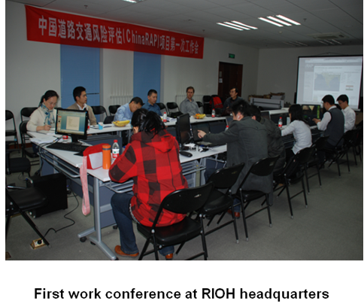
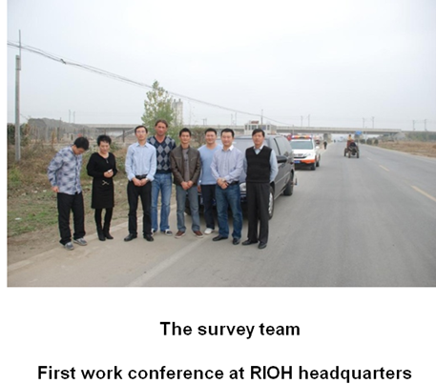
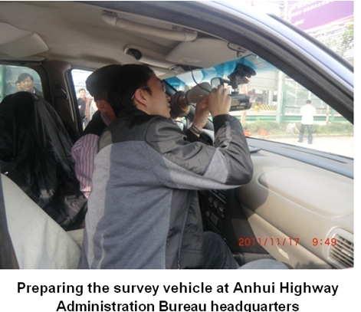
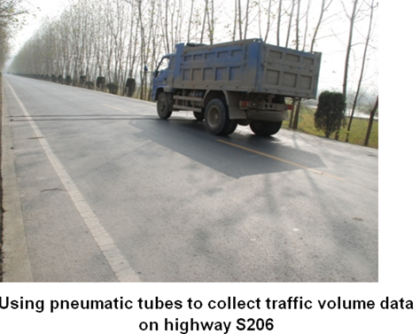

Slide 25
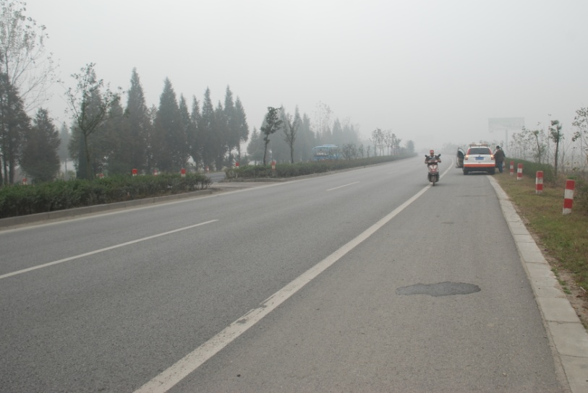
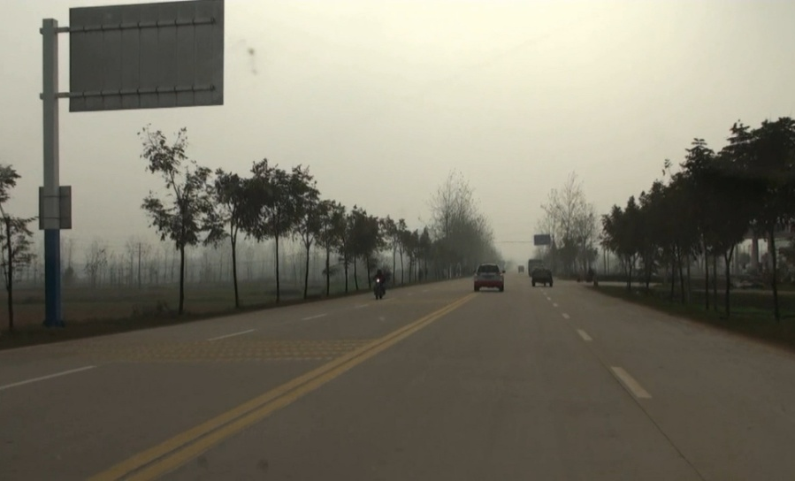
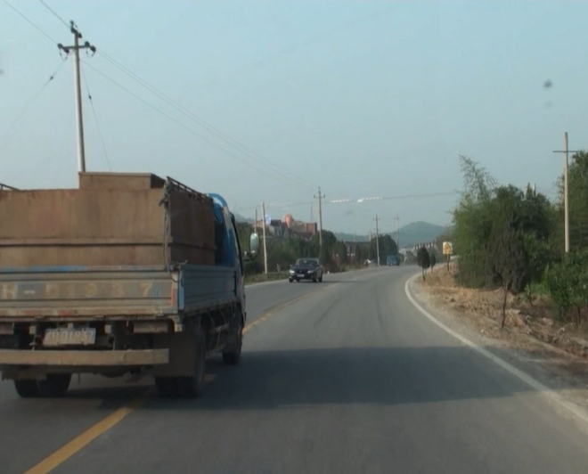
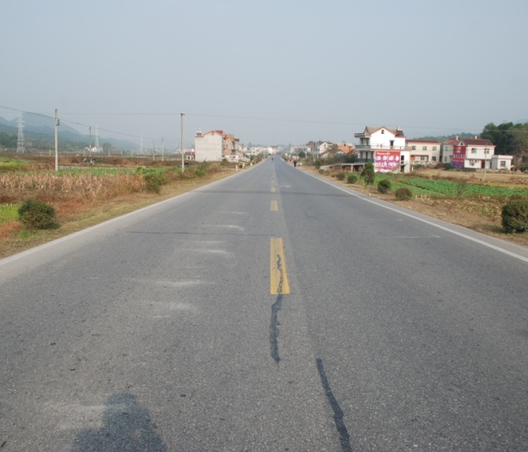
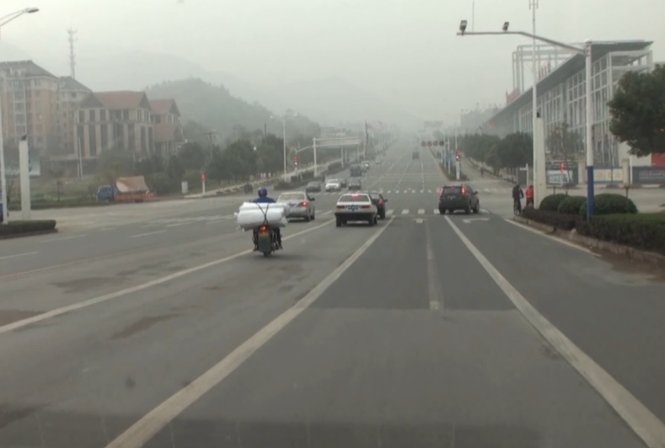
G205 – Class 1
S321 – ‘Class 2(a)’ (Upgraded Class 2)
G206 – Class 2
X014 – Class 3
S320– Urban

Slide 26
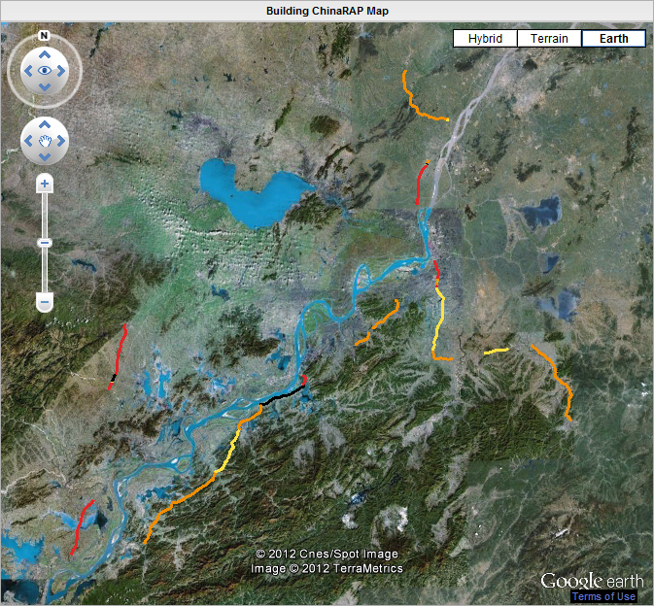
Page26

Slide 27
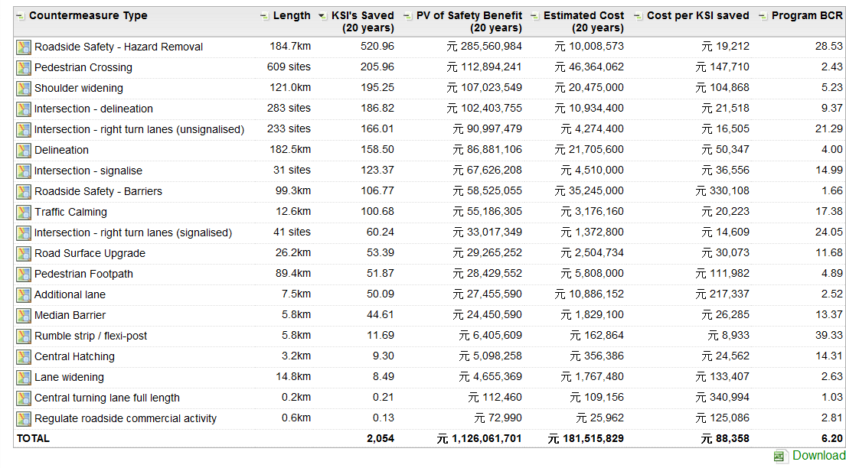
Economic Analysis
Page27

Slide 28
Investment Plan (20 years)
Investment: RMB 180 m
Deaths and serious
injuries prevented: 2,054 (-23%)
Benefit cost ratio: 6.2 : 1
Leading countermeasures
Roadside safety
Shoulder sealing
Pedestrian crossings
。
。

Slide 29
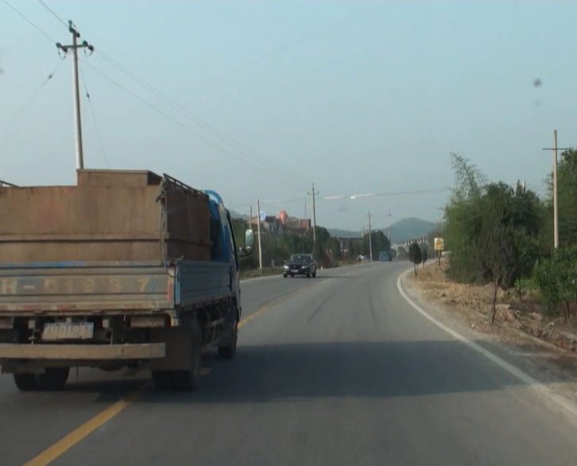
Actual risk-Overtaking risk

Slide 30
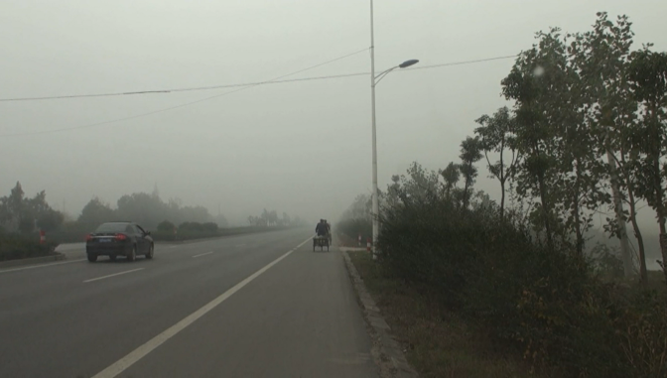
Roadside hazard risk

Slide 31
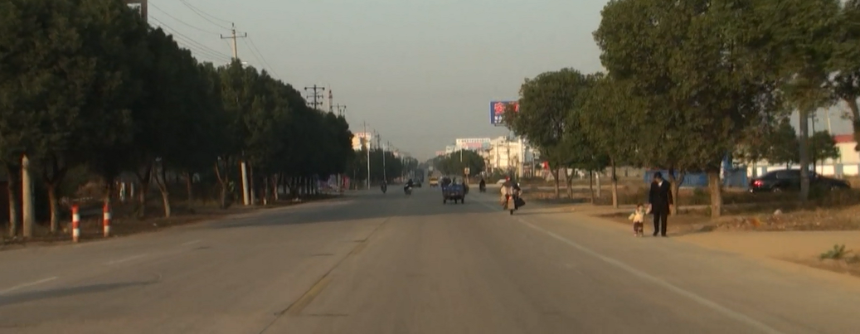
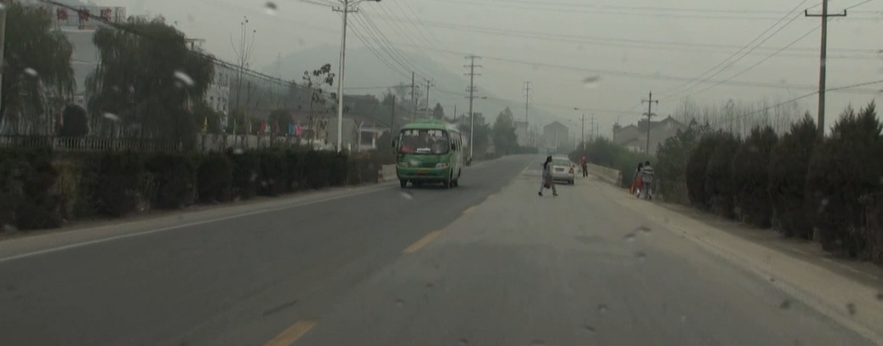
Pedestrian facilities can be improved

Slide 32




Use of pedestrian facilities can be improved

Slide 33
Road network risk assessment and index
Thanks！！

