Slide 1
Bureau of Transportation of Statistics Data Services & Data Curation
The United States Department of Transportation
Leighton L Christiansen 0000-0002-0534-4268
Data Curator, National Transportation Library
ntldatacurator@dot.gov
Presentation to:
DOT TRCC
2017-03-23
Notes:
As federal agencies move beyond publications, and begin making more of their data publicly accessible, they run into a number of data management and data curation challenges. I will discuss the best practices, workflows, and software NTL is deploying to provide long-term access to, and preservation of, the transportation datasets.

Slide 2
Notes:
Data Management Guidance & Training
Data Public Access Guidance & Advocacy
Best Practices Implementation & Recommendations Creation
We can help you better describe your data so that all users can access more effectively
Data Curation
Format migration over time
Long-term Preservation
& more to come

Slide 3
Some Key Terms
Data Management¹
deliberate planning, creation, storage, access and preservation of data produced from a given investigation¹
Data Curation²
enables data discovery and retrieval, maintains data quality, adds value, and provides for re-use over time²
Data Science³
drawing useful conclusions from large and diverse data sets through exploration, prediction, and inference³
Notes:
I would like to start with some key definitions.
“In the context of research and scholarship, "Data Management" refers to the storage, access and preservation of data produced from a given investigation. Data management practices cover the entire lifecycle of the data, from planning the investigation to conducting it, and from backing up data as it is created and used; to long term preservation of data deliverables after the research investigation has concluded.”
Source: University Library, Texas A&M University. “Data Management Defined - Research Data Management - Guides at Texas A&M University.” Research Data Management, October 1, 2013. http://guides.library.tamu.edu/DataManagement
Or to borrow a plain language definition from Kristin Briney, (page 7) “Data management is the compilation of many small practices that make your data easier to find, easier to understand, less likely to be lost, and more likely to be usable during a project or ten years later.”
Briney, Kristin. 2015. Data management for researchers: organize, maintain and share your data for research success. (6)
“Data curation is the active and ongoing management of data through its lifecycle of interest and usefulness to scholarship, science, and education. (And you could add to this list government, the public, business, etc.) Data curation enables data discovery and retrieval, maintains data quality, adds value, and provides for re-use over time through activities including authentication, archiving, management, preservation, and representation.”
Source: Graduate School of Library and Information Science at the University of Illinois at Urbana-Champaign. “Specialization in Data Curation,” 2013. http://www.lis.illinois.edu/academics/programs/specializations/data_curation.
“Data Science is about drawing useful conclusions from large and diverse data sets through exploration, prediction, and inference, using the skills and practices of statistics, information science, and computer programming.”
Based on: http://www.inferentialthinking.com/chapter1/what-is-data-science.html
You will likely recognize your own work at BTS touching on many of the actions described in these definitions. This illustrates (SLIDE)…the interconnectedness of skills that we hope to harness to improve data management and public access to BTS data.

Slide 4
Linked Processes
Data Management ∈ Data Curation
Data Curation ⇒ Data Science
Notes:
This illustrates (SLIDE)…the interconnectedness of skills that we hope to harness to improve data management and public access to BTS data.
Data management is a necessary element of data curation. And to enable good data curation, it often means that we have to encourage researchers to think beyond a specific investigation, and adapt good data management practices to meet future needs.
Good Data curation, in turn, enables broader, longitudinal Data Science. By preserving and adding value to data, data curation makes the task of data science more efficient and effective, as well as opening new output possibilities.
Why is all of this important to the US DOT and the BTS?
(SLIDE)

Slide 5
U.S. DOT Public Access Requirements
http://ntl.bts.gov/publicaccess/
Researchers and authors are subject to U.S. DOT Public Access requirements if:
U.S. DOT funded scientific research;
Newly funded or extended on or after January 1, 2016.
Researchers and authors will need to submit:
ORCiDs
2 – 3 page Data Management Plan (with proposal);
Final peer-reviewed manuscript;
Final Digital Datasets; and,
Any other written outputs (final reports, technical reports, tech summaries, etc.)

Slide 6
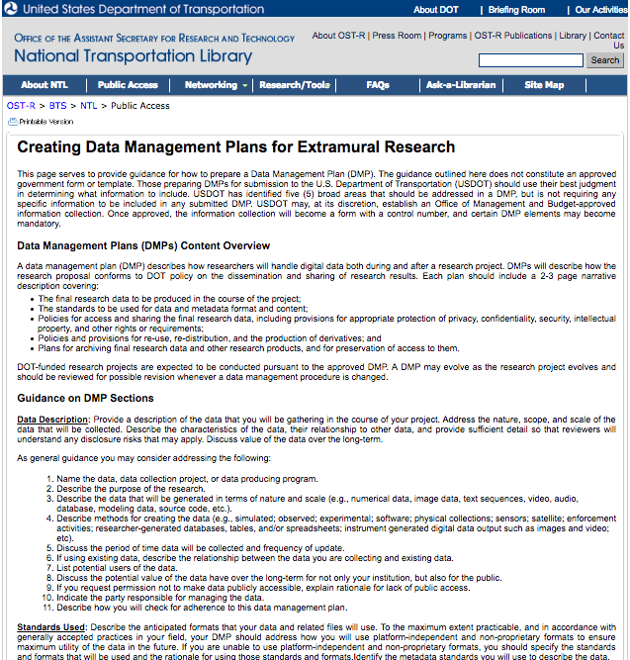
Public Access Guidance
http://ntl.bts.gov/publicaccess/creatingaDMP_extramural.html
Data Services:
Education & Cheerleading
PA Compliance Guidance
Data Management Planning training & consulting
DMP Sufficiency Checklist and Training
Data Citation Recommendations
Best Practice sharing
Future Actions
Data Curation & Preservation
FAIR Data Principles
Repository
5 Sections in DMP
Data Description
Standards Used
Access Policies
Re-Use, Redistribution, and Derivative Products Policies
Archiving and Preservation Plans
Notes:
Reassess current guidance website
Create Data Management Plan template
Create Data Management Plan Assessment Checklist
Develop DMP Evaluation Training for TMS
Assess Data Repositories for Conformance
Consult with Awardees
Produce Best Practices Visualizations & Graphics
FAIR data principles: Data should be: FORCE11 guidelines: Findable, Accessable, Interoperable, Re-usable
FAIR Data Principles
Preamble
One of the grand challenges of data-intensive science is to facilitate knowledge discovery by assisting humans and machines in their discovery of, access to, integration and analysis of, task-appropriate scientific data and their associated algorithms and workflows. Here, we describe FAIR - a set of guiding principles to make data Findable, Accessible, Interoperable, and Re-usable.
To be Findable:
F1. (meta)data are assigned a globally unique and eternally persistent identifier. F2. data are described with rich metadata. F3. (meta)data are registered or indexed in a searchable resource. F4. metadata specify the data identifier.
To be Accessible:
A1 (meta)data are retrievable by their identifier using a standardized communications protocol. A1.1 the protocol is open, free, and universally implementable. A1.2 the protocol allows for an authentication and authorization procedure, where necessary. A2 metadata are accessible, even when the data are no longer available.
To be Interoperable:
I1. (meta)data use a formal, accessible, shared, and broadly applicable language for knowledge representation. I2. (meta)data use vocabularies that follow FAIR principles. I3. (meta)data include qualified references to other (meta)data.
To be Re-usable:
R1. meta(data) have a plurality of accurate and relevant attributes. R1.1. (meta)data are released with a clear and accessible data usage license. R1.2. (meta)data are associated with their provenance. R1.3. (meta)data meet domain-relevant community standards.

Slide 7
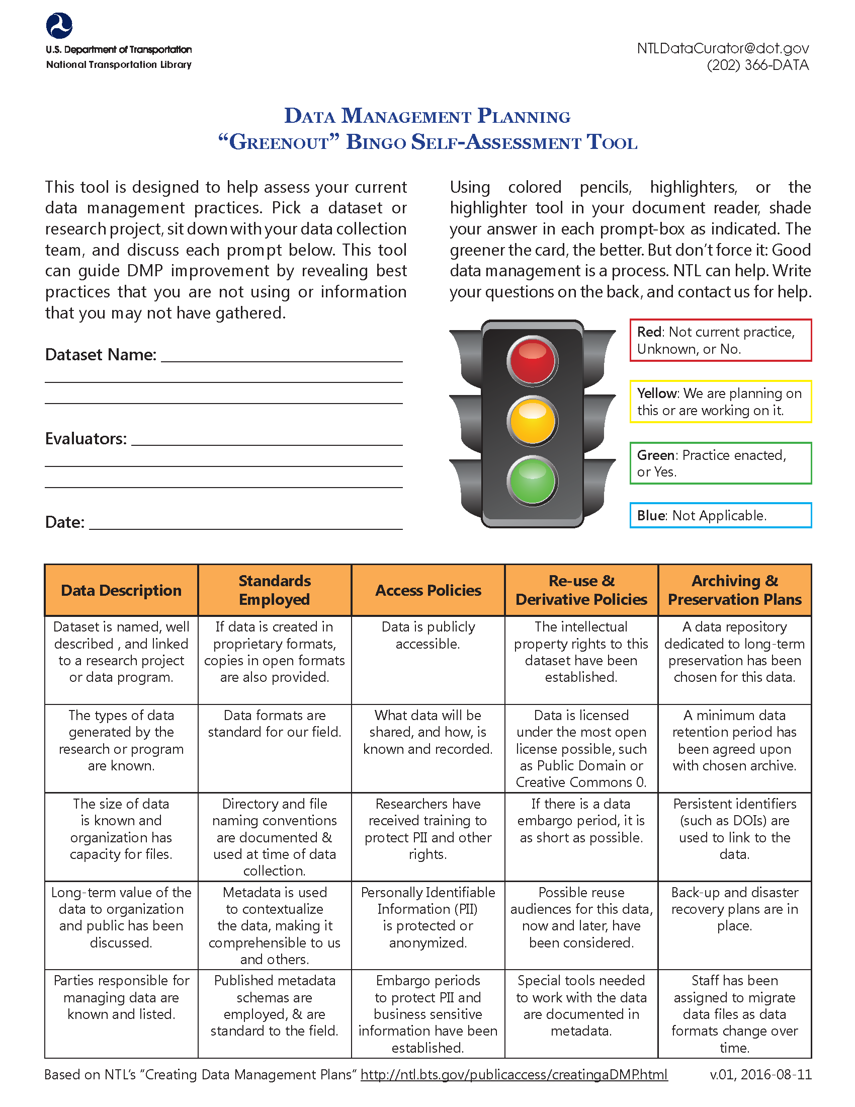
In-House Training
DMP Self-Assessment
Gives visual feedback on current state of DMP best practices
Tested with each BTS office
Used to begin DMP process for 2 BTS datasets
Transborder Freight
State Transportation Stats

Slide 8
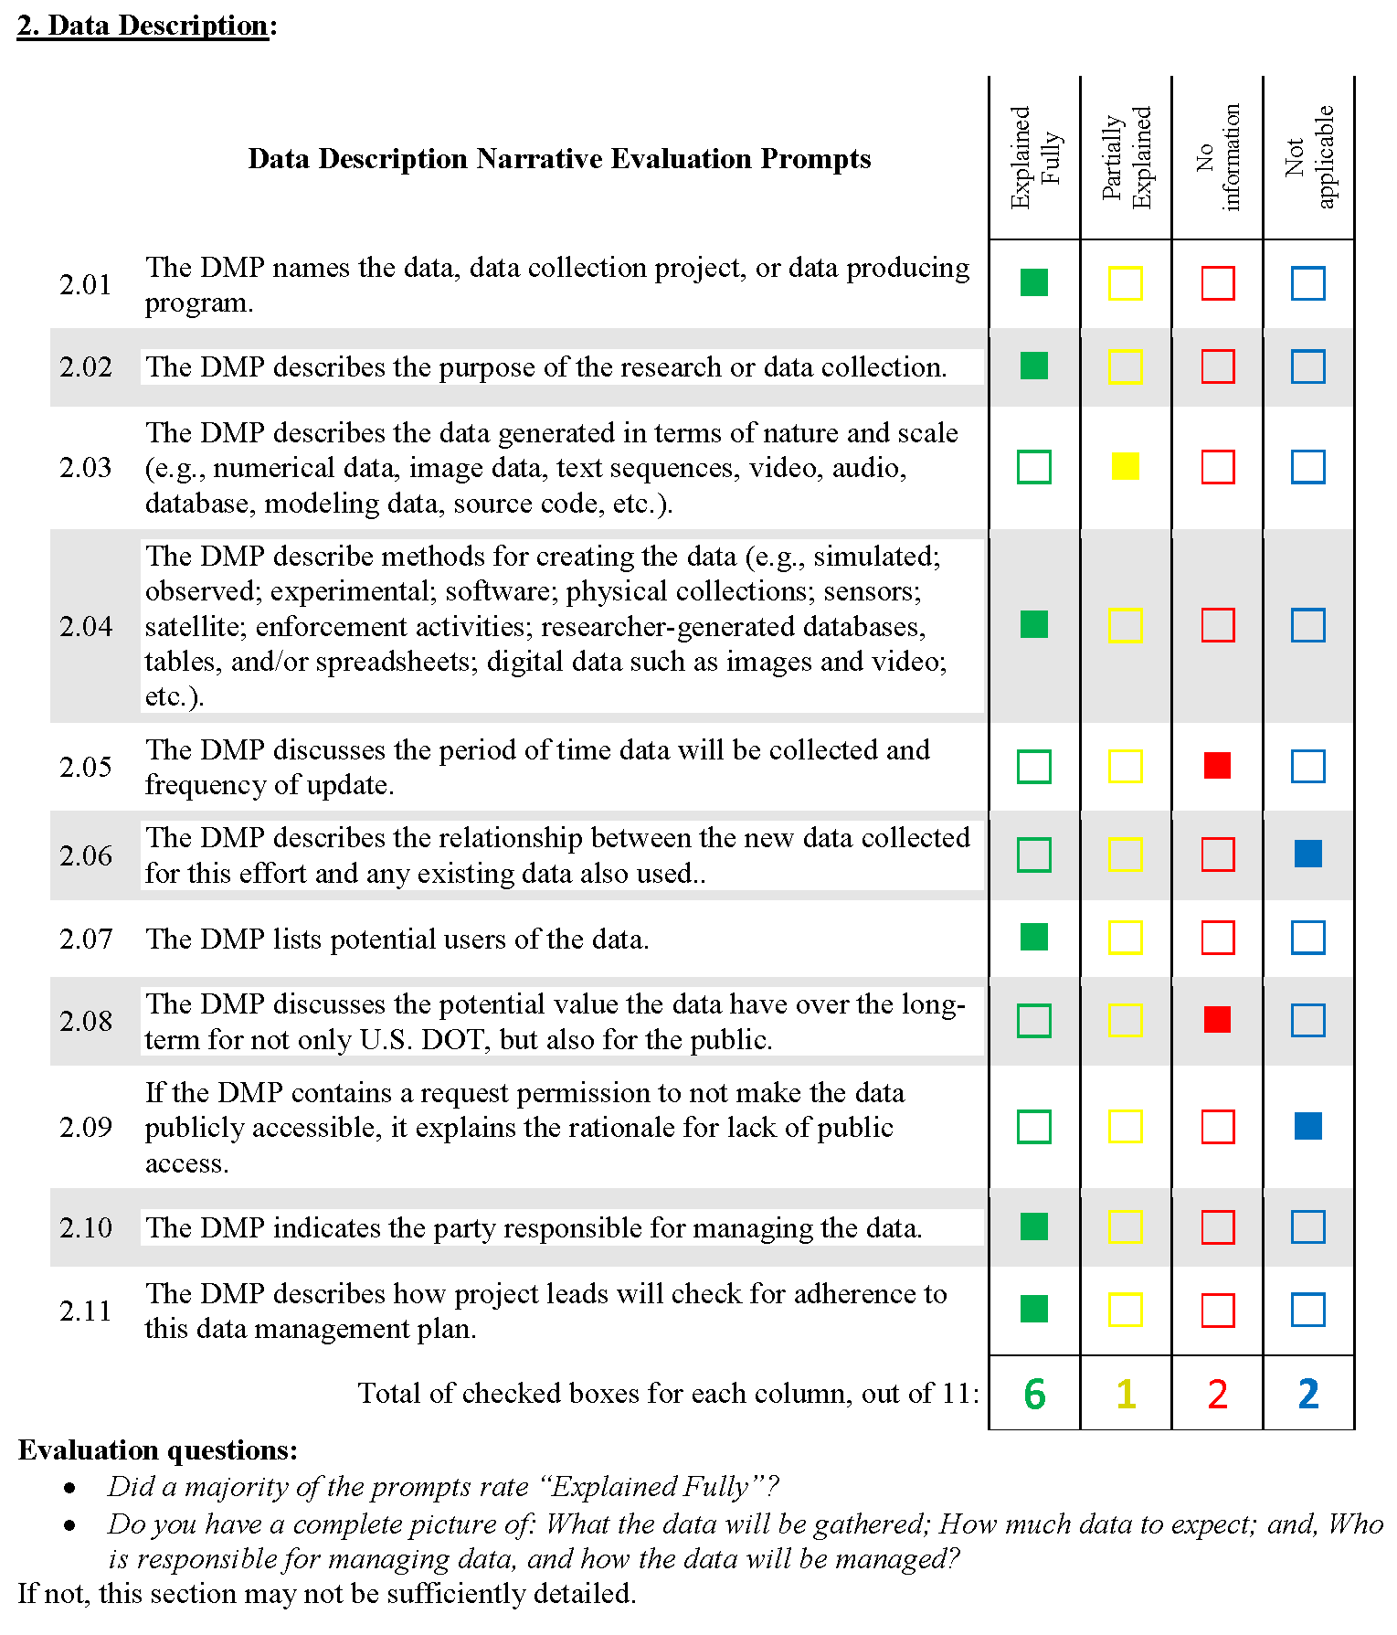
In-House Training
DMP Sufficiency Evaluation
Gives quantitative feedback to bolster subjective judgement
Precise feedback to researcher on what is missing
Better DMPs improve likelihood of long-term data preservation for public re-use

Slide 9
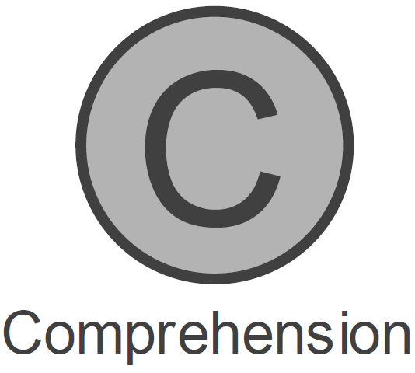
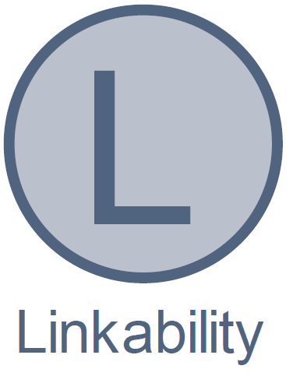
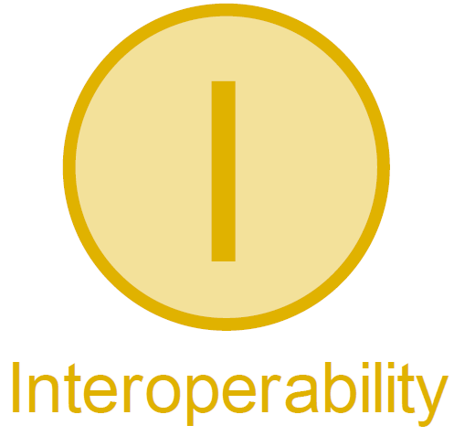
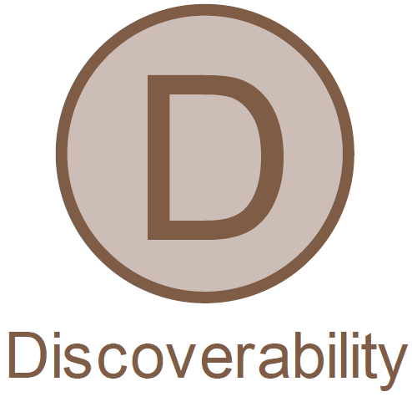
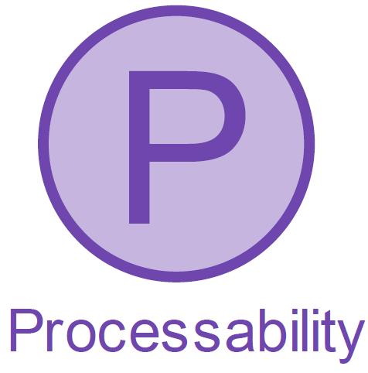
Data on the Web Best Practices⁴
Benefits
Metadata
Data Licenses
Data Provenance
Data Quality
Data Versioning
Data Identifiers
Data Description
& Standards
Data Formats
Data Vocabularies
Data Access
Data Access APIs
Access Policies
Data Reuse & Derivatives
Feedback
Data Enrichment
Republication
Archiving & Preservation
Data Preservation
https://www.w3.org/TR/dwbp/
Notes:
We can start, by embracing data on the web best practices as described by the World Wide Web Consortium (W3C) and other data curation experts.
W3C’s most recent recommendations include a large number of best practices, which can I have grouped into the categories you see on the slide.
Employing these and other best practices, USDOT can improve our own workflows, data handling practices, and data preservation, as well as make it easier for the public to locate and access DOT data.
The benefits of making data available on the web and following these best practices include:

Slide 10
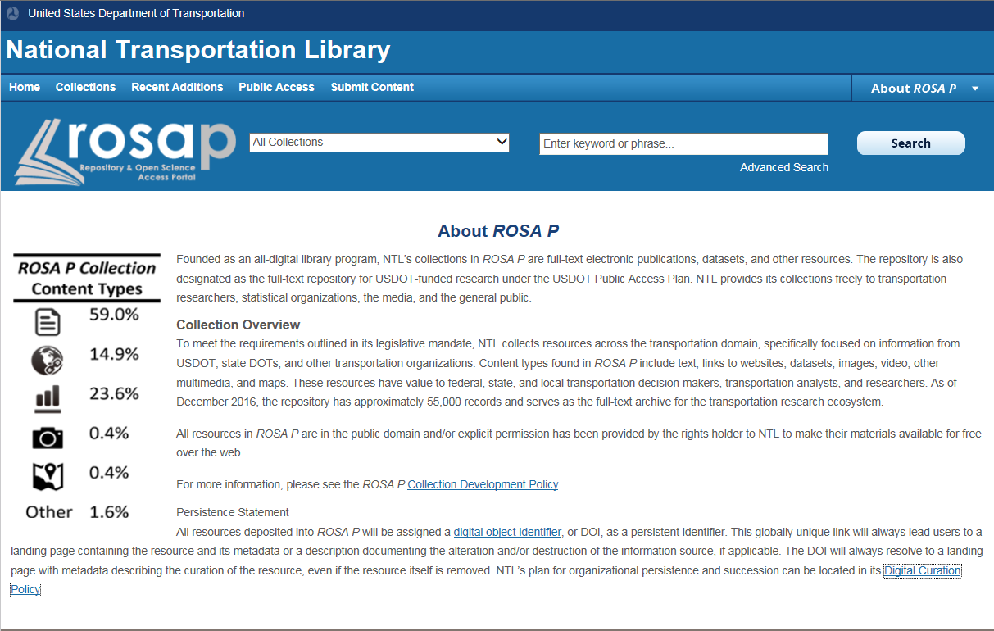
NTL’s Repository & Open Science Access Portal (ROSA P)
Immediate Steps
Launch in April 2017
Based on the CDC Public Access platform, which hosts the CDC Stacks and NOAA Institutional Repository digital libraries
AWS cloud storage
Publications & Data
DOIs
Future Steps
Trusted repository status
Notes:
Moving repository to CDC’s Public Access Platform (using Islandora repository software) hosted in the Amazon cloud. Other repositories using the platform are:
CDC Stacks: https://stacks.cdc.gov/
NOAA Institutional Repository
Similar feel across several agencies

Slide 11
Trusted Repository Status & Data Curation⁵
Data Seal of Approval – World Data Systems
Repository Audit and Certification
1. The data can be found on the Internet
2. The data are accessible (clear rights and licences)
3. The data are in a usable format
4. The data are reliable
5. The data are identified in a unique and persistent way
so that they can be referred to
Notes:
The 16 Data Seal of Approval requirements are based on the following five criteria:
1. The repository has an explicit mission to provide access to and preserve data in its domain.
2. The repository maintains all applicable licenses covering data access and use and monitorscompliance.
3. The repository has a continuity plan to ensure ongoing access to and preservation of its holdings.
4. The repository ensures, to the extent possible, that data are created, curated, accessed, and used in compliance with disciplinary and ethical norms.
5. The repository has adequate funding and sufficient numbers of qualified staff managed through a clear system of governance to effectively carry out the mission.
6. The repository adopts mechanism(s) to secure ongoing expert guidance and feedback (either in-house, or external, including scientific guidance, if relevant).
7. The repository guarantees the integrity and authenticity of the data.
8. The repository accepts data and metadata based on defined criteria to ensure relevance and understandability for data users.
9. The repository applies documented processes and procedures in managing archival storage of the data.
10. The repository assumes responsibility for long-term preservation and manages this function in a planned and documented way.
11. The repository has appropriate expertise to address technical data and metadata quality and ensures that sufficient information is available for end users to make quality-related evaluations.
12. Archiving takes place according to defined workflows from ingest to dissemination.
13. The repository enables users to discover the data and refer to them in a persistent way through proper citation.
14. The repository enables reuse of the data over time, ensuring that appropriate metadata are available to support the understanding and use of the data.
15. The repository functions on well-supported operating systems and other core infrastructural software and is using hardware and software technologies appropriate to the services it provides to its Designated Community.
16. The technical infrastructure of the repository provides for protection of the facility and its data, products, services, and users.

Slide 12
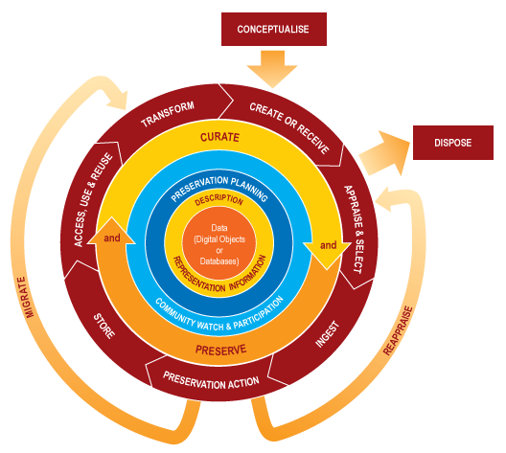
Data Curation Lifecycle Model⁶
Standards & Workflow Development & Implementation
Complete Description
Metadata Standards
Preservation Planning
DM Training
Curation & Preservation
Access & Reuse
Repository Ingest
Preservation
Migration
Disposition
Notes:
What you see is the Data Curation Lifecycle Model, as envisioned by the Data Curation Centre, in the UK.
At the center of the image, you see data creation, employing standards and workflows designed to improve data use & preservation. Moving out one ring, we have data description and representation information, using the most appropriate metadata standards. And the dark blue ring is preservation planning, which can be improved with data management training.
In my mind, these form the core of data management best practices.
As you move out of the center, you become engaged in the practices that are more curatorial in nature, including repository ingest and preservation actions; enabling and ensuring access, use, and reuse; transformations; and appraisal & disposition decisions.
These last 2, transformations, and, appraisal & disposition decisions are perhaps 2 of the most important tasks of a data curator. Transformations may mean migrating data into multiple, open formats, as, or shortly after the data is created, or may mean migrating 10 or 20 year old data into new formats as the software that was used to create the data has become obsolete and the data is in danger of being lost.
Appraisal & disposition decisions refers to the act of determining whether a dataset still has “interest and usefulness to scholarship, science, and education,” and if not, digitally shredding it to make room in storage for other useful data. These means having knowledge of current and coming research trends in the discipline in order to inform such decisions. Further, it means recording the decision to dispose of the data, and making that decision just as open as the data had been.
This sure looks like a great deal of effort. What are we going to get out of it? What are some of the benefits of data curation?
(SLIDE)
Key elements of the DCC Curation Lifecycle Model
DATA
Data, any information in binary digital form, is at the centre of the Curation Lifecycle.
This includes:
Digital Objects: simple digital objects (discrete digital items such as text files, image files or sound files, along with their related identifiers and metadata) or complex digital objects (discrete digital objects made by combining a number of other digital objects, such as websites).
Databases: structured collections of records or data stored in a computer system.
FULL LIFECYCLE ACTIONS
Description and Representation Information Assign administrative, descriptive, technical, structural and preservation metadata, using appropriate standards, to ensure adequate description and control over the long-term. Collect and assign representation information required to understand and render both the digital material and the associated metadata.
Preservation Planning Plan for preservation throughout the curation lifecycle of digital material. This would include plans for management and administration of all curation lifecycle actions.
Community Watch and Participation Maintain a watch on appropriate community activities, and participate in the development of shared standards, tools and suitable software.
Curate and Preserve Be aware of, and undertake management and administrative actions planned to promote curation and preservation throughout the curation lifecycle.
SEQUENTIAL ACTIONS
Conceptualise Conceive and plan the creation of data, including capture method and storage options.
Checklist
Create or Receive Create data including administrative, descriptive, structural and technical metadata. Preservation metadata may also be added at the time of creation.
Receive data, in accordance with documented collecting policies, from data creators, other archives, repositories or data centres, and if required assign appropriate metadata.
Checklist
Appraise and Select Evaluate data and select for long-term curation and preservation. Adhere to documented guidance, policies or legal requirements.
Checklist
Ingest Transfer data to an archive, repository, data centre or other custodian. Adhere to documented guidance, policies or legal requirements.
Checklist
Preservation Action Undertake actions to ensure long-term preservation and retention of the authoritative nature of data. Preservation actions should ensure that data remains authentic, reliable and usable while maintaining its integrity. Actions include data cleaning, validation, assigning preservation metadata, assigning representation information and ensuring acceptable data structures or file formats.
Checklist Store Store the data in a secure manner adhering to relevant standards.
Checklist
Access, Use and Reuse Ensure that data is accessible to both designated users and reusers, on a day-to-day basis. This may be in the form of publicly available published information. Robust access controls and authentication procedures may be applicable.
Checklist
Transform Create new data from the original, for example:
by migration into a different format, or
by creating a subset, by selection or query, to create newly derived results, perhaps for publication
OCCASIONAL ACTIONS
Dispose Dispose of data, which has not been selected for long-term curation and preservation in accordance with documented policies, guidance or legal requirements. Typically data may be transferred to another archive, repository, data centre or other custodian. In some instances data is destroyed. The data's nature may, for legal reasons, necessitate secure destruction.
Reappraise Return data which fails validation procedures for further appraisal and re-selection.
Migrate Migrate data to a different format. This may be done to accord with the storage environment or to ensure the data's immunity from hardware or software obsolescence.
- See more at: http://www.dcc.ac.uk/resources/curation-lifecycle-model#sthash.corgTQPA.dpuf

Slide 13
Benefits of Data Curation
Protects Unique Data from Loss
Improves Data Search & Retrieval
Enables Reuse
Facilitates Longitudinal and/or Meta Analyses
Avoids Duplication of Effort & Spending
Increases Verifiability
Opens New Lines of Scientific Discovery
Satisfies Public Access & Open Government
& Legal Requirements

Slide 14
Questions?
ntldatacurator@dot.gov

Slide 15
References
University Library, Texas A&M University. “Data Management Defined - Research Data Management - Guides at Texas A&M University.” Research Data Management, October 1, 2013. http://guides.library.tamu.edu/DataManagement
Graduate School of Library and Information Science at the University of Illinois at Urbana-Champaign. “Specialization in Data Curation,” 2013. http://www.lis.illinois.edu/academics/programs/specializations/data_curation
Definition based on Ani Adhikari and John DeNero, “The Foundations of Data Science” http://www.inferentialthinking.com/index.html “What is Data Science” http://www.inferentialthinking.com/chapter1/what-is-data-science.html
Adapted from: W3C. 2016. “Data on the Web Best Practices.” https://www.w3.org/TR/dwbp/
Repository Audit and Certification DSA–WDS Partnership WG Recommendations https://www.rd-alliance.org/group/repository-audit-and-certification-dsa%E2%80%93wds-partnership-wg/outcomes/dsa-wds-partnership
Digital Curation Centre. Data Curation Lifecycle Model. http://www.dcc.ac.uk/resources/curation-lifecycle-model

