Slide 1
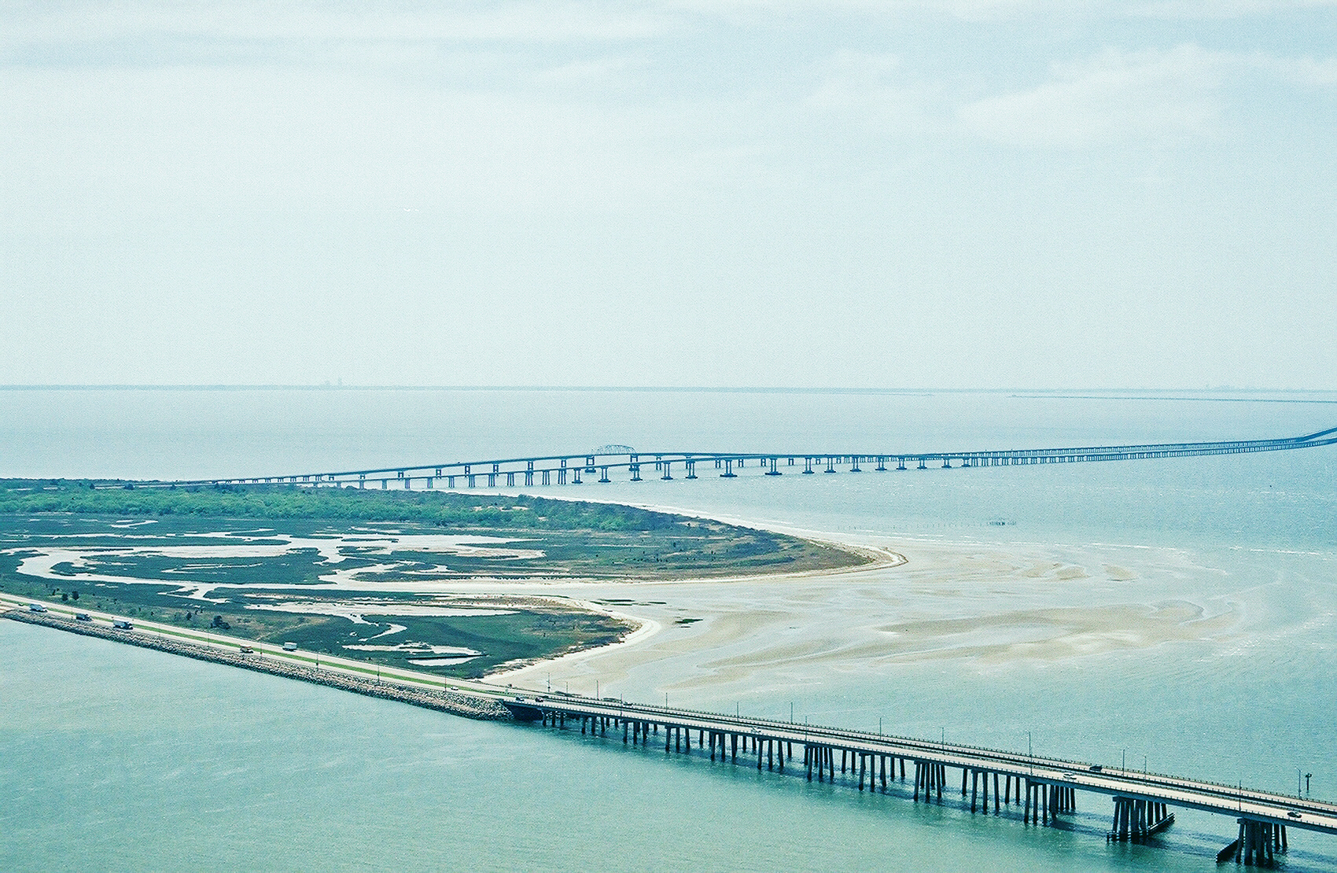
Chesapeake Bay Bridge-Tunnel Overview
Emergency Action Components

Slide 2
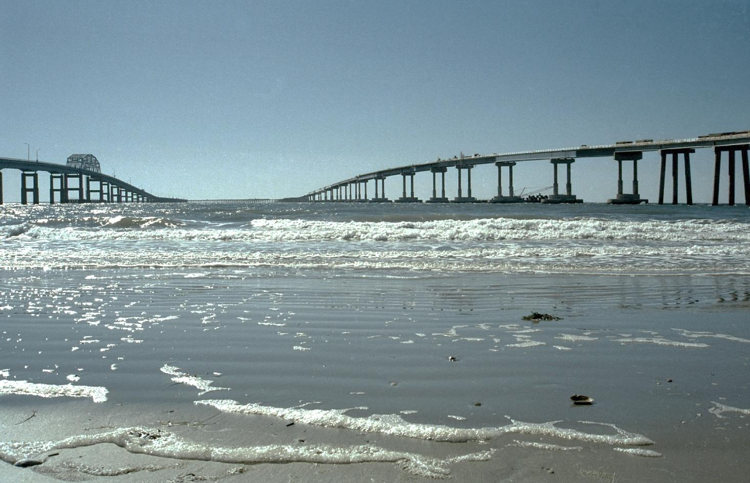
In 1956, the CBBT Commission was enabled to build the fixed crossing. The Revenue Bonds were issued in August 1960. Construction commenced in September, 1960.
The Original Crossing construction was completed and the facility was opened to traffic on April 15, 1964.
The CBBT Commission was enabled to build the Parallel Crossing in 1990. The Parallel Crossing, Phase I construction began in July, 1995.
All Parallel Bridges and Parallel Trestles were opened in stages and fully complete in July, 1999.
The Parallel Crossing, Phase II – Parallel Tunnels Design and Permitting is modeled to commence in FY 2020. Parallel Tunnel construction is modeled to commence in FY 2026.

Slide 3
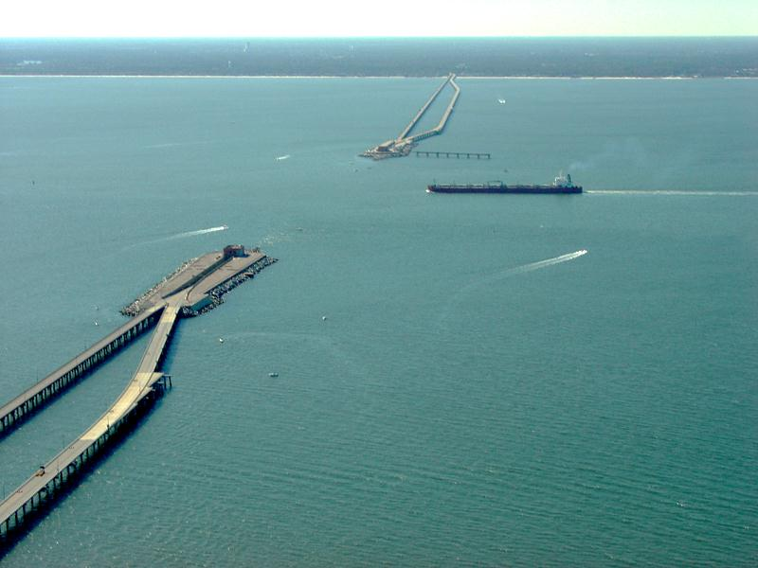
The Chesapeake Bay Bridge-Tunnel is a 17.6 mile bridge and tunnel complex that spans the mouth of the Chesapeake Bay and connects Virginia’s Eastern Shore with the mainland.
Opened to traffic April 15, 1964
Political Subdivision of Commonwealth of Virginia
No federal, state or local tax dollars used
One of the Seven Engineering Wonders of the World

Slide 4
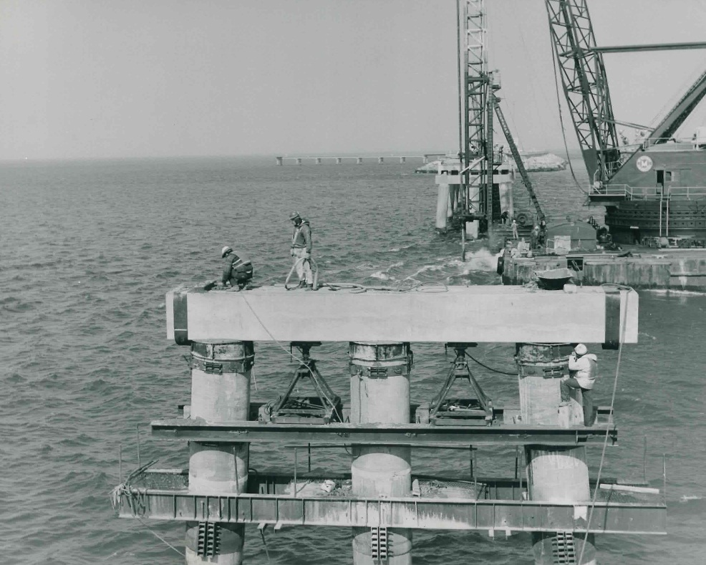
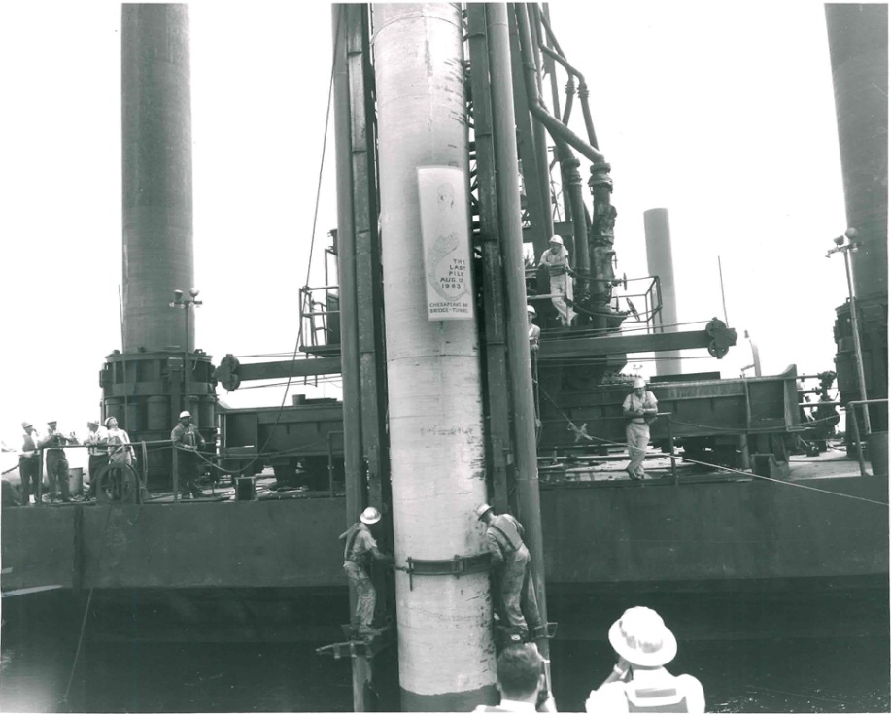
Physical Characteristics
Northbound: 2,523 piles
Southbound: 2,591 piles
5,114 total piles supporting the trestles

Slide 5
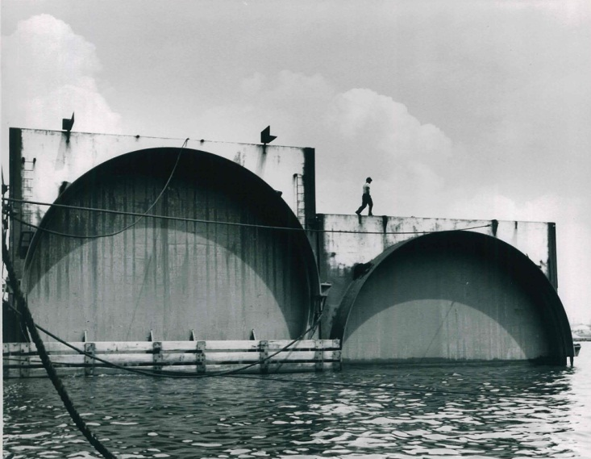
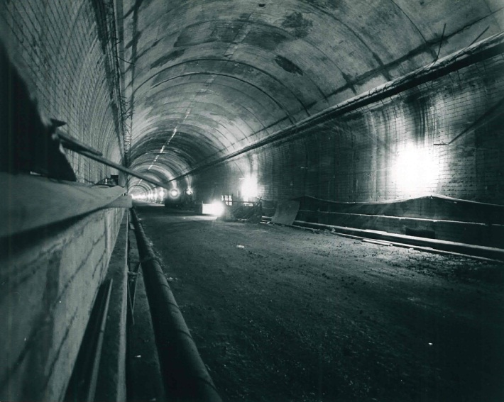
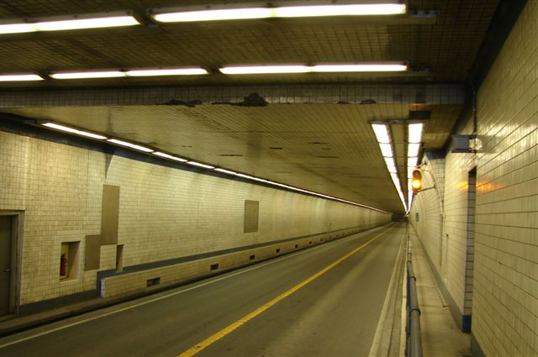
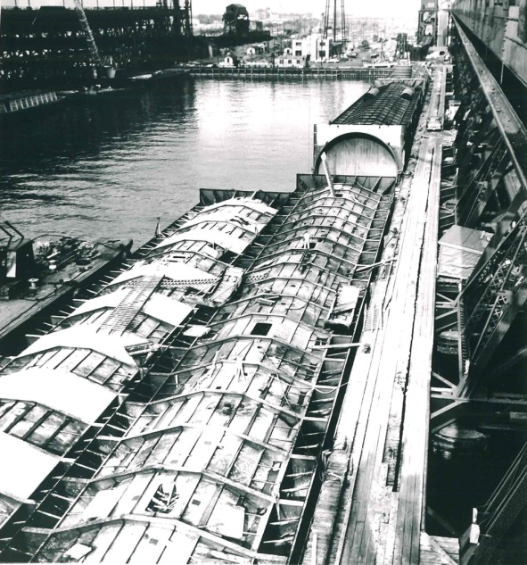
Tunnels
Trench-type tunnels
Thimble Shoal Channel Tunnel – 5,734 feet in length
Chesapeake Channel Tunnel – 5,423 in length
Tunnel Clearance – 13’6”; 24’ horizontal

Slide 6
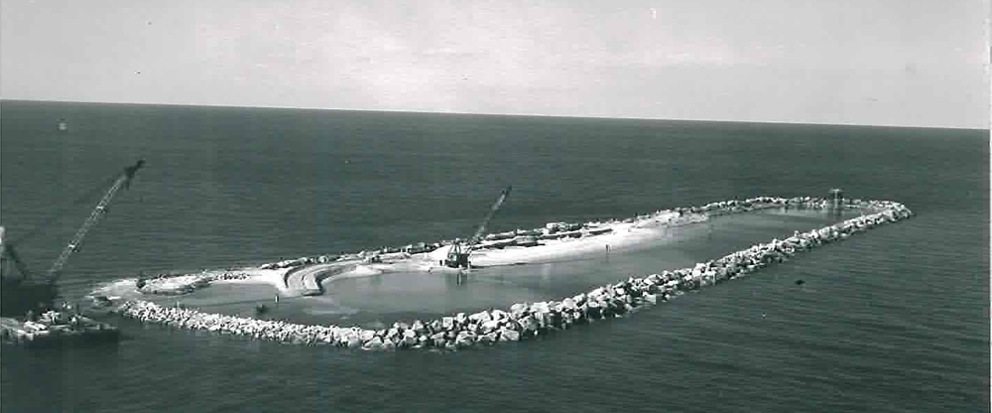
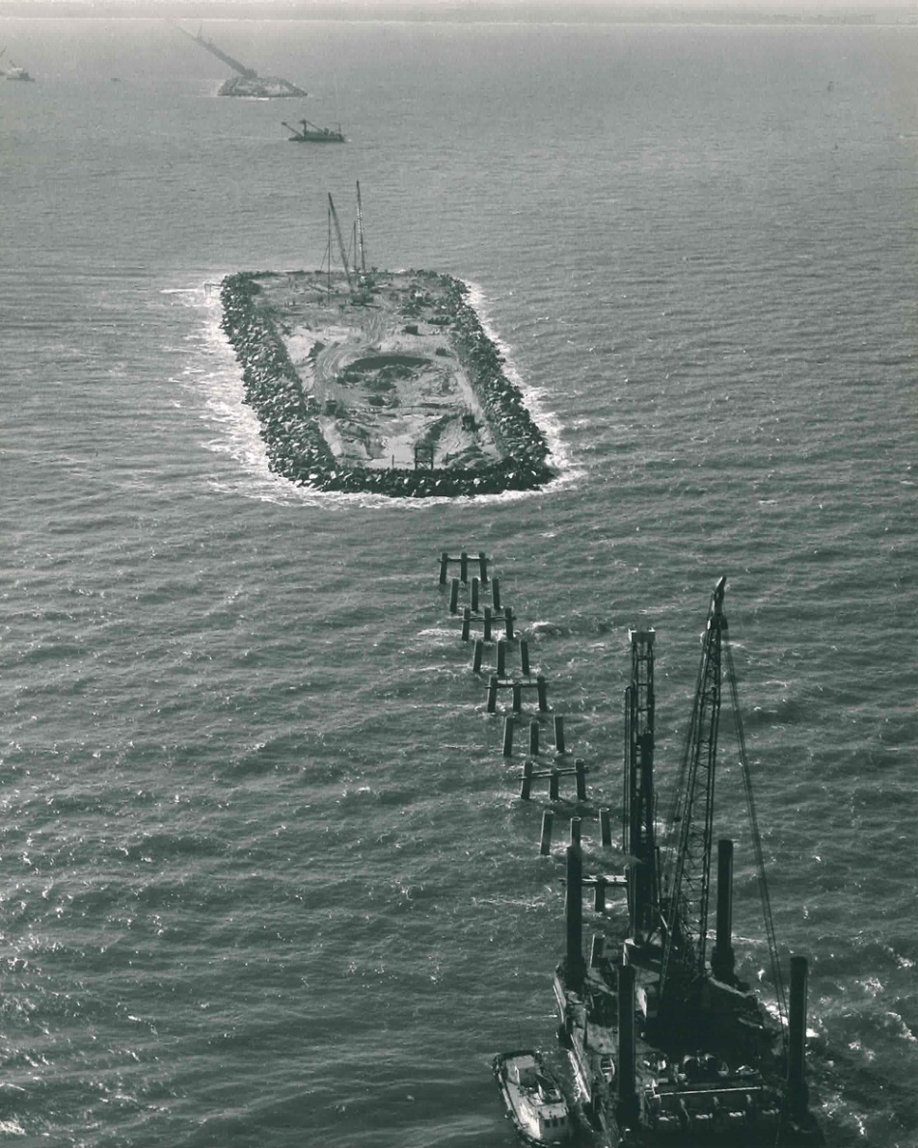
Man-made Islands
Four manmade islands
Each island approximately 10 acres of surface
30 feet above sea level
Rock Armor around islands (1.2 million tons)

Slide 7
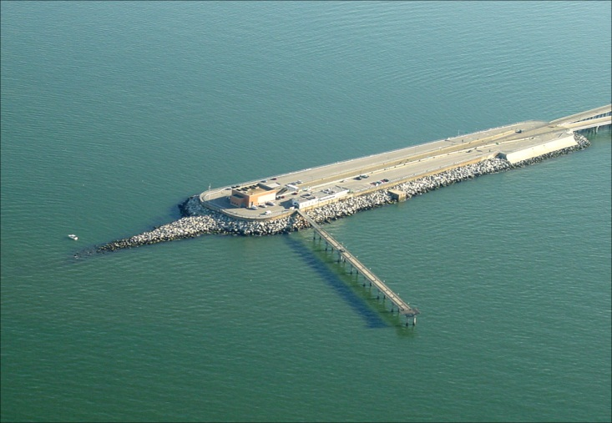

Slide 8
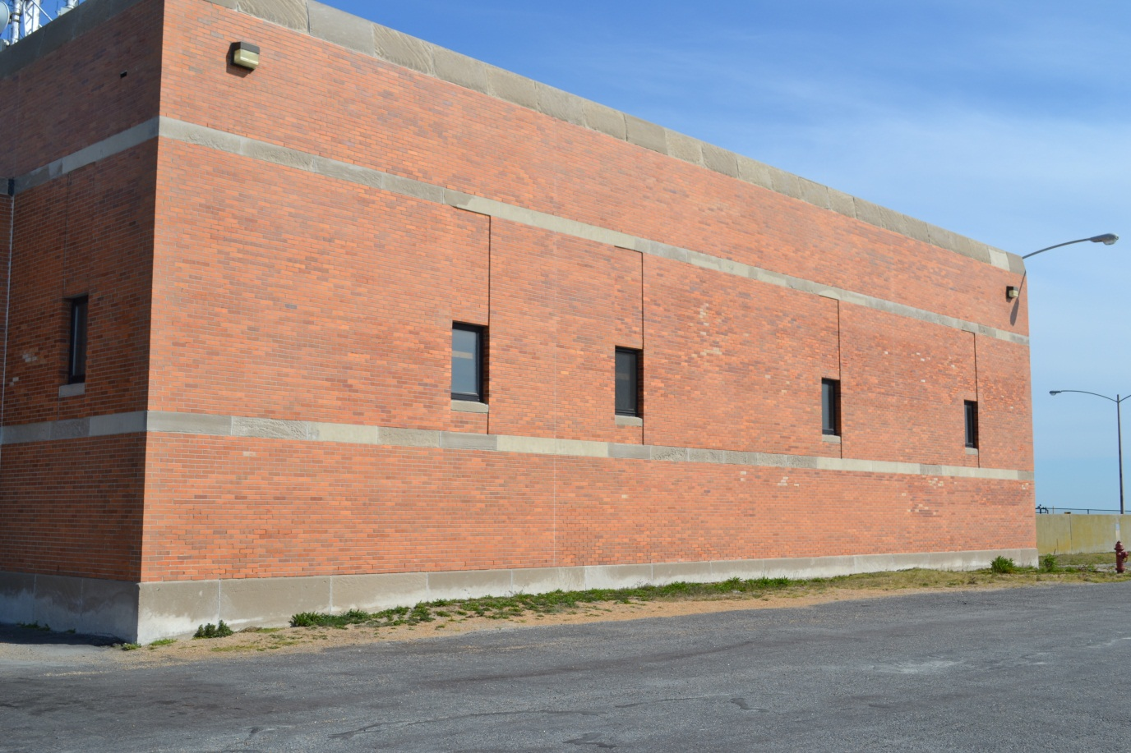
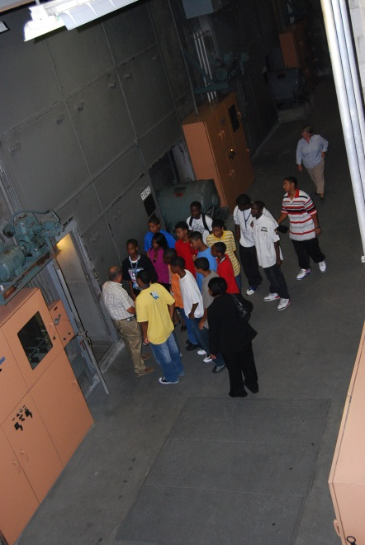
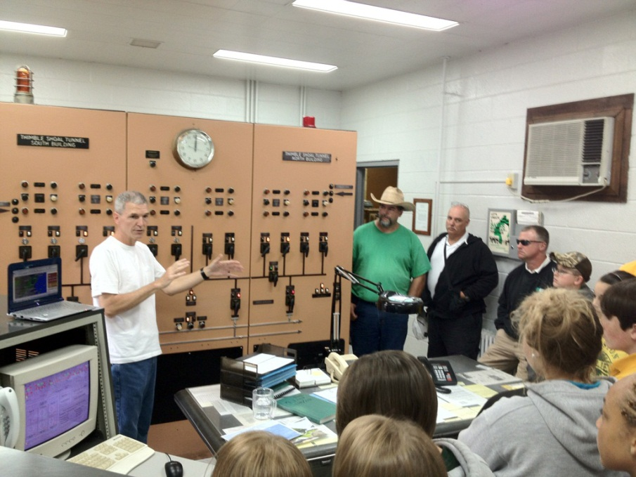
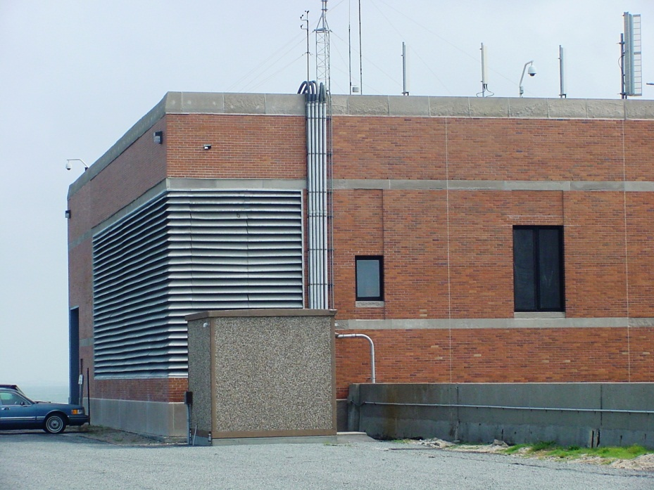
Ventilation Buildings

Slide 9
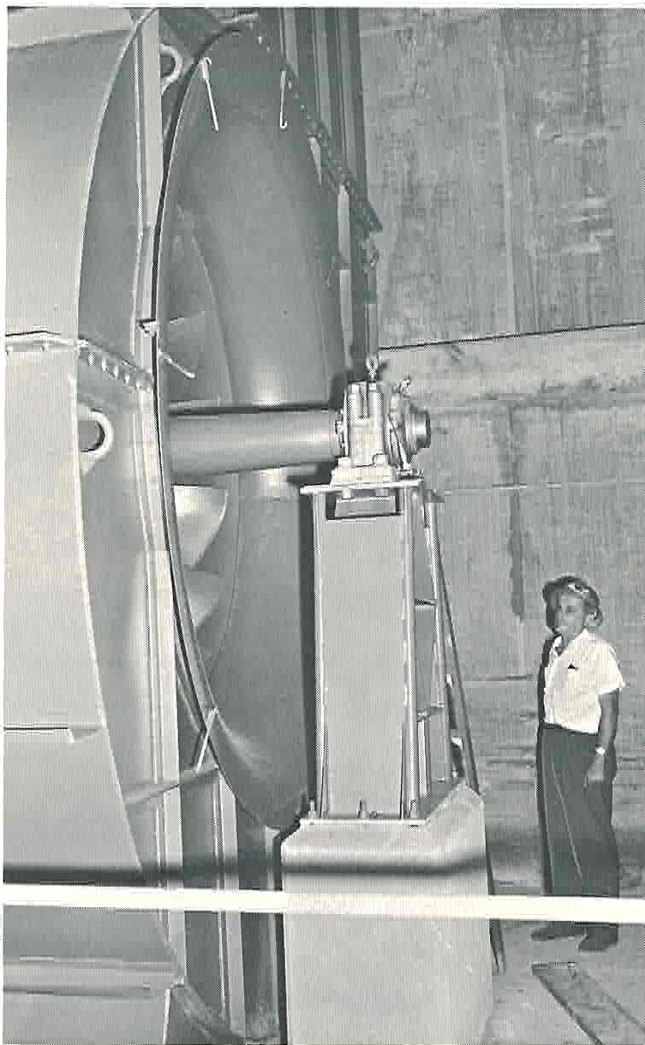
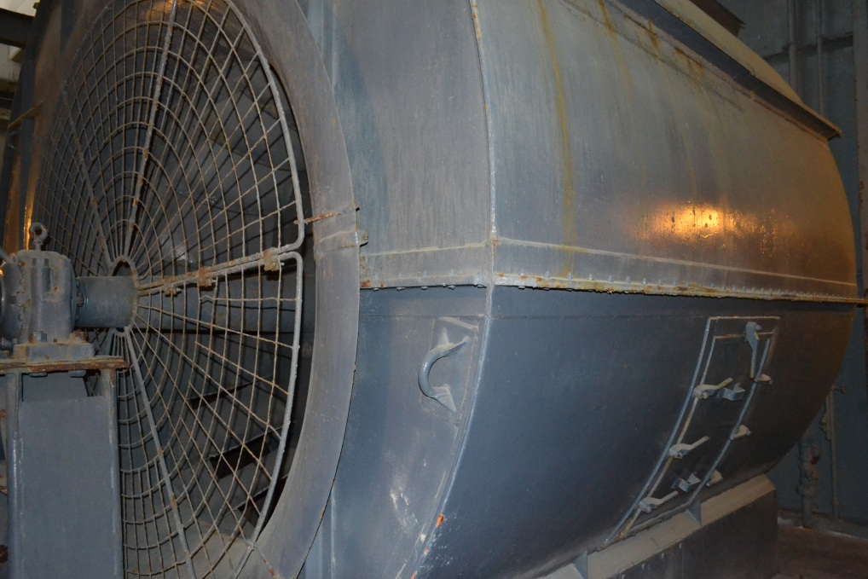
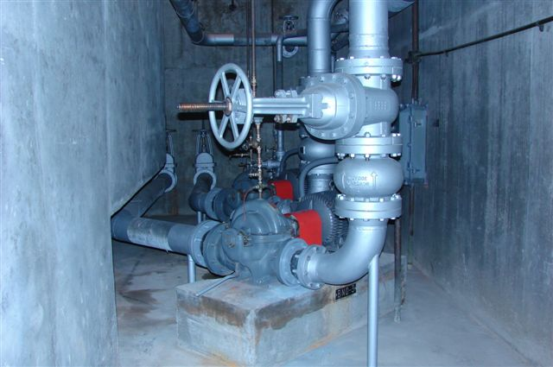
Ventilation Buildings

Slide 10
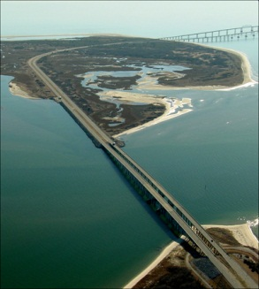
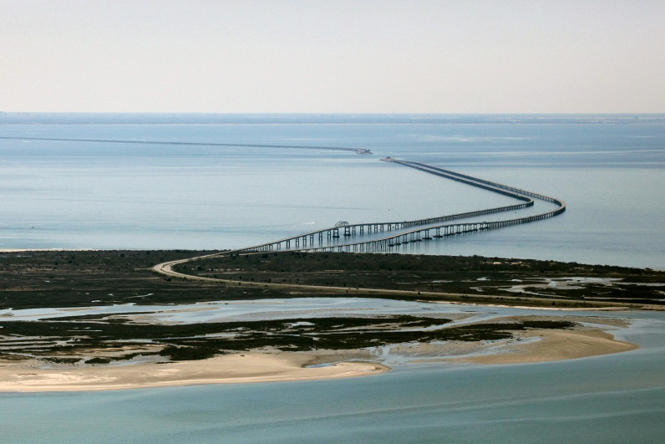
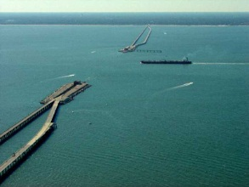
Parallel Crossing Phase I
The parallel spans were completed and opened to
traffic in July of 1999
Phase II: Additional tunnels will be added in the future; anticipated start date is 2020

Slide 11
Emergency Response Personnel

Slide 12
Police Department:
39 sworn police officers
4 revolving shifts, each consisting of:
1 Lieutenant
1 Sergeant
1 Corporal
2 Master Police Officers
3 Police Officers
1 Personnel & Training Sergeant
1 Chief of Police
5 Officers assigned to “Permanent Shift”

Slide 13
Vehicle Equipment
Equipment in Police Units:
Police radio
Speed measurement radar
Laptop computer
In-car video camera
First Aid kit
Fire extinguisher
Life ring

Slide 14
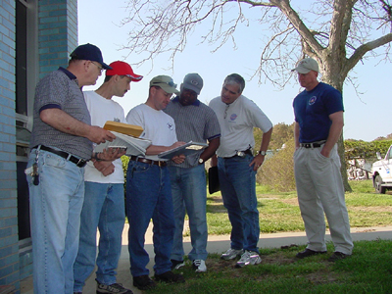
Training for Officers:
DCJS approved Basic Police School
In-Service Training:
FIREARMS & OFFICER SAFETY
DUI/DUID
ACCIDENT INVESTIGATION
CULTURAL DIVERSITY
LEGAL UPDATES
EXPLOSIVES
Specialized Training Schools:
BOMB DETECTION
HOMELAND SECURITY
CRIMINAL INTERDICTION
IED COUNTERTERRORISM
HAZARDOUS MATERIALS
RADAR
GANGS

Slide 15
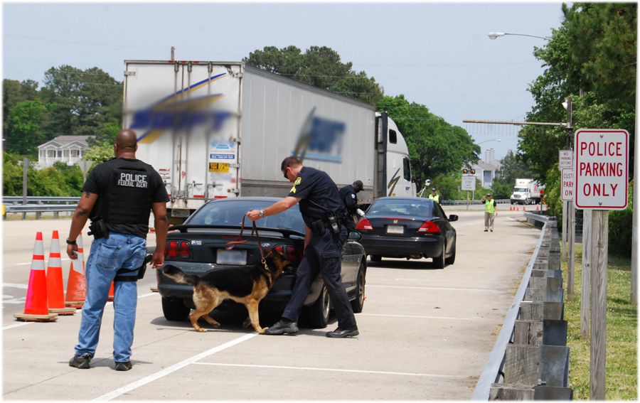
Security Operations
Work with Dept. of Homeland Security to
randomly check vehicles for explosive devices
and any illegal contraband

Slide 16
Gated Islands
3 of the 4 manmade islands are not accessible to the general public.
Security gates prohibit unauthorized access.

Slide 17
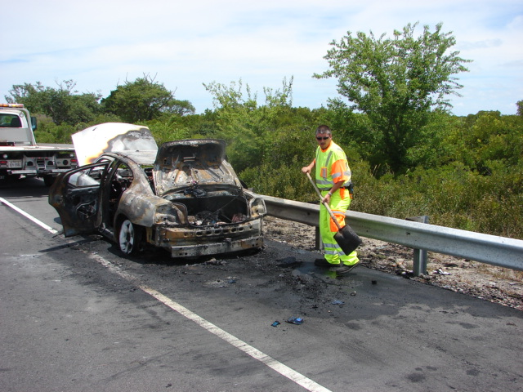
Emergency Crew Workers
4 Emergency Crew Workers assigned
to each revolving shift

Slide 18
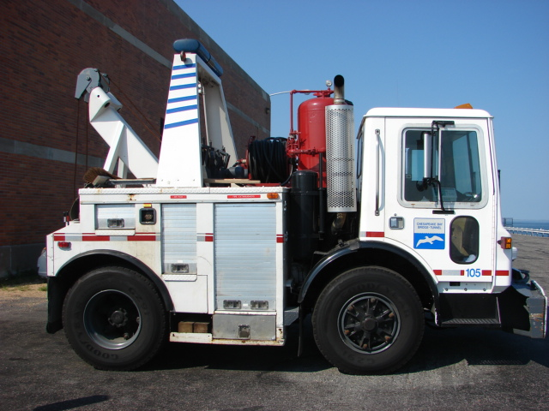
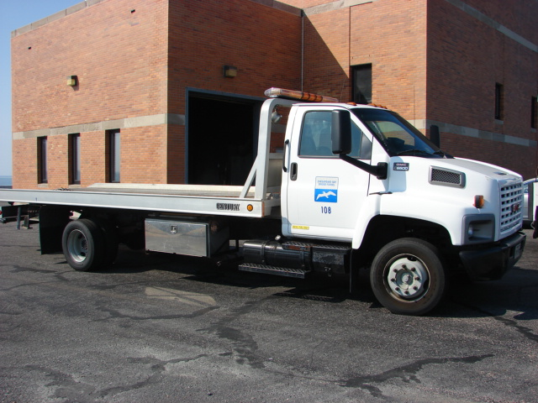
Wreckers & Fire Trucks
2 of the 4 manmade islands are equipped with a combination Fire Truck/ Wrecker and a Rollback Wrecker. These wreckers are manned 24/7 by Emergency Crew Workers.

Slide 19
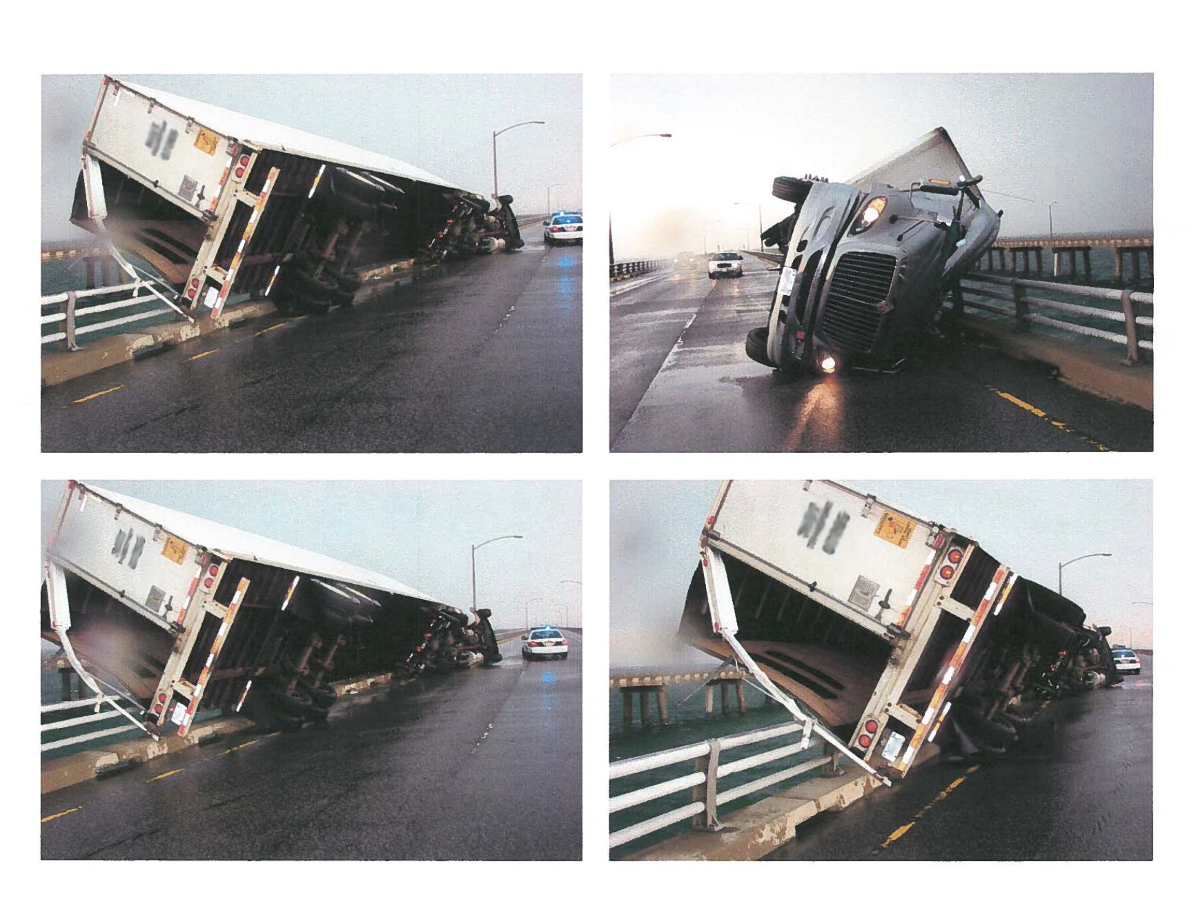
Weather Restrictions

Slide 20
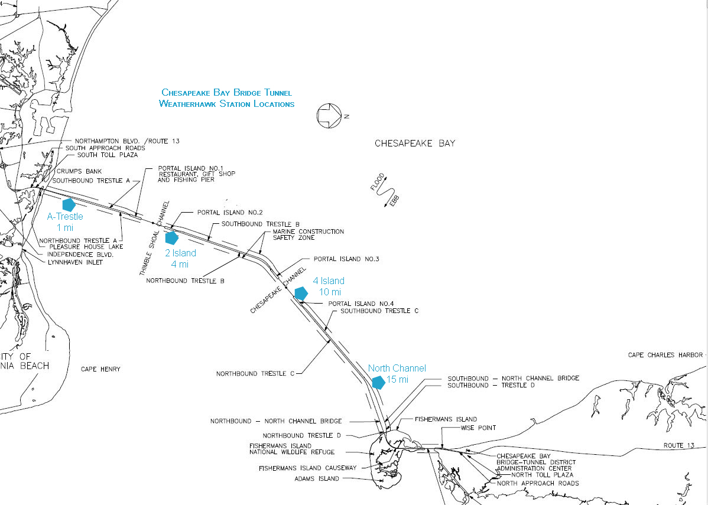
Weather Station Locations

Slide 21
Hurricanes
Upon receipt of a hurricane warning:
Alert personnel to any changes in work schedule necessary to cope with the emergency.
Brief Supervisory personnel on final emergency plans.
Upon approach of hurricane, when winds reach 25 knots:
Restrict recreational vehicles and other lightweight vehicles from entering facility.
Advise concessionaire to evacuate all concession personnel and prepare for extended closure.
Monitor weather advisories.
Initiate "Increased Readiness.“
Send pickups and Police Units to the Maintenance building for loading of sand bags.
Upon approach of hurricane, when wind reaches 45 knots:
Restrict all vehicles except heavily laden trucks.
Evacuate any non‑District personnel remaining on #1 Island.
Completely secure all buildings.
When winds reach 60 knots:
Evacuate all non‑essential personnel from Facility.
Allow no vehicular traffic except essential District emergency vehicles.
Insofar as possible, all personnel should remain within safe shelter areas until the emergency passes.
Reopening:
After the emergency passes, the Facility shall not be reopened to vehicular traffic until the Damage Survey Team has declared it safe.

Slide 22
Tornados
Tornados (including waterspouts) may strike with little or no warning, and may cause severe loss of life and property damage.
At the appearance of a tornado, the following actions should be taken:
Warning should be given to Control immediately.
Close the Facility to traffic.
Direct all traffic on Facility to the nearest tunnel, in their direction of travel.
Traffic Patrolmen/Emergency Crew Workers shall stop vehicular traffic in tunnels and allow traffic to remain until danger passes or otherwise directed.
Observe reopening procedures as in Hurricanes.

Slide 23
Traffic Regulations for High Winds except in cases of Hurricanes, Tornados, etc.
Level 1 Restrictions (40 miles per hour) | Level 2 Restrictions (47 miles per hour)
The following types of vehicles will not be permitted to cross: | The following types of vehicles will not be permitted to cross:
Large pick-up campers Camper Trailers House Trailers Anything being towed Vehicles with any kind of exterior cargo (i.e. bike racks, rooftop cargo carriers, etc.) | Motorcycles Large Pick-up campers Camper trailers House Trailers Anything being towed Vehicles with any kind of exterior cargo Empty tractor-trailers, not to include empty tanker trucks Small six-wheel trucks such as moving vans, rental trucks, school buses, etc. Tractor Trailers must gross 30,000 pounds payload in addition to the weight of the rig and six-wheel trucks must gross 15,000 pounds payload in addition to the weight of the rig in order to cross the facility.

Slide 24
Traffic Regulations for High Winds except in cases of Hurricanes, Tornados, etc. (continued)
Level 3 Restrictions (55 miles per hour) | Level 4 Restrictions (60 miles per hour)
The ONLY types of vehicles permitted to cross: | The ONLY types of vehicles permitted to cross:
Cars without exterior cargo Pick-up trucks without cargo Mini-vans Vans not to include high-profile/conversion vans SUVs Tractors without trailers Empty flatbed trailers Commercial buses Heavily-laden tractor-trailers with a 40,000 pound payload in addition to the rig. | Cars without exterior cargo Pick-up trucks without cargo Mini-vans SUVs
When winds reach 65 miles per hour or greater, alert the Office of the Chief of Police, regardless of the time of day, and await instructions regarding movement of traffic.

Slide 25
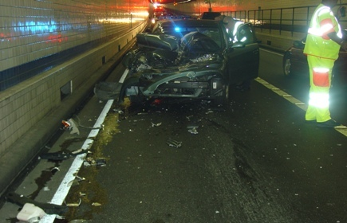
Incident Response in tunnels
Each tunnel consists of one travel lane in each direction. Depending on the situation, if only one travel lane is blocked due to an incident, traffic can be defiled around the area until the area is cleared. If both lanes are blocked, the facility must go to full closure until the area can be cleared.

Slide 26
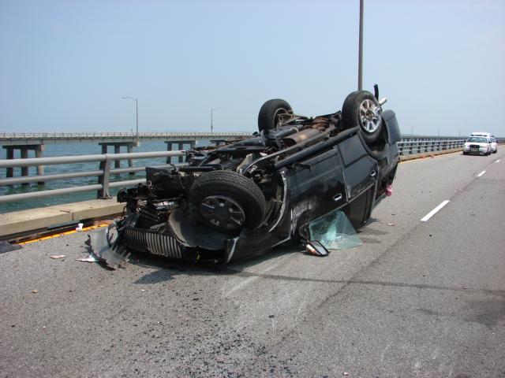
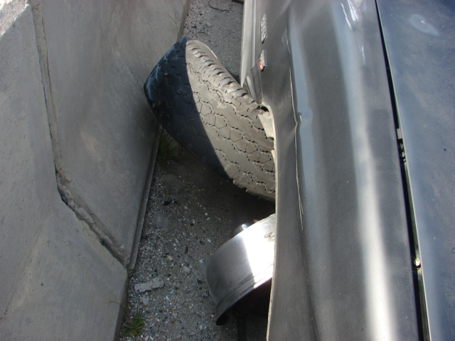
Incident Response on trestles
Each trestle consists of two traffic lanes in each direction. If one lane is blocked due to an incident, traffic can be defiled around the area until the area is cleared. If both lanes are blocked, traffic can be diverted onto the opposite span, with one lane of traffic in each direction. Once the incident is cleared, traffic can be returned to normal.

Slide 27
Maintenance Division Responsibilities during Emergencies
Damage control: when it appears that damage to District property has, or may have occurred, conduct a damage survey.
Provide and maintain necessary utilities, including emergency electrical power.
Provide and maintain a suitable boat for waterborne inspections, transportation, etc.
Repair, maintain, and operate established communication systems, including telephones and District Radio Communications facilities.

Slide 28
Roadway Repair

Slide 29
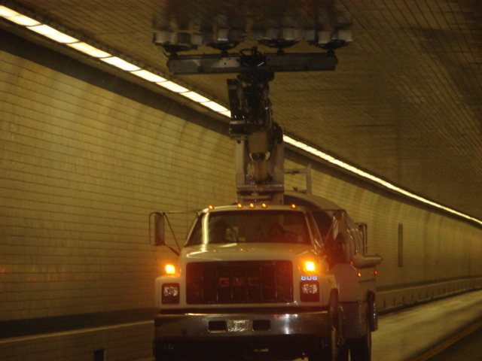
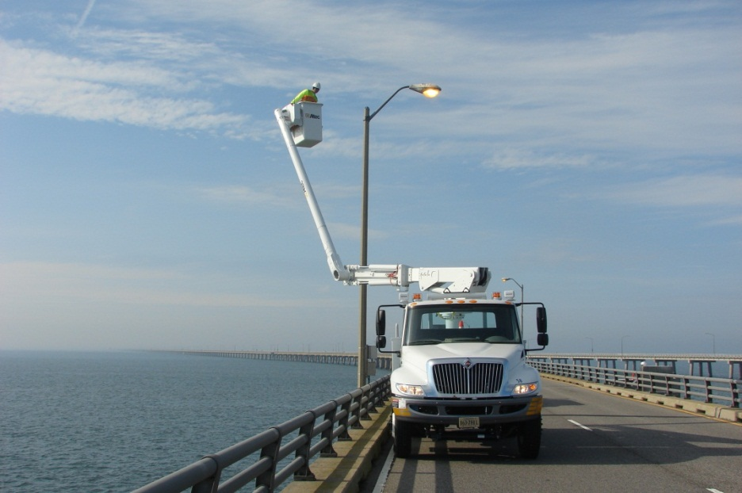
Maintenance Equipment
Specialized equipment for inspecting, repairing and maintaining facility.

Slide 30
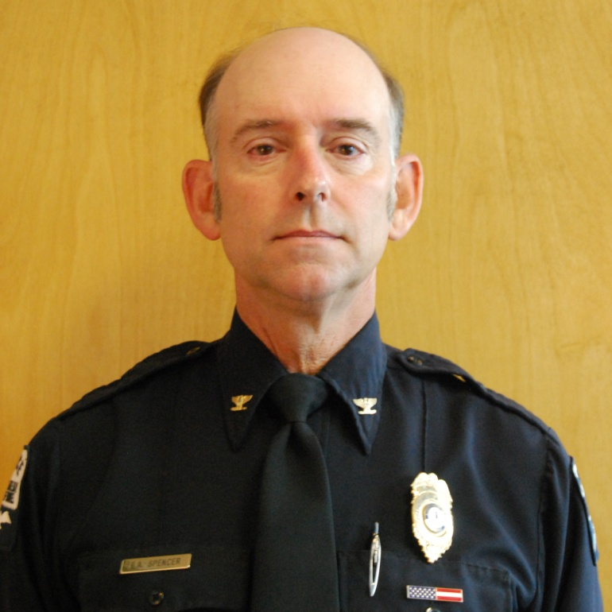
For additional information, questions, etc., please contact:
EDWARD A. SPENCER
Chief of Police/Director of Operations
Chesapeake Bay Bridge and Tunnel District
32386 Lankford Highway
Cape Charles, Virginia USA 23310
easpencer@cbbt.com
(757) 331-2960, EXT. 40

