Slide 1
Introduction to Emergency Management in the United States
Janet Benini
US Department of Transportation

Slide 2
Philosophy of Government
The United States has a decentralized government
Responsibility for managing emergencies begins with
the individual and families
Then companies
Then local governments
Then state (provincial) governments
Then the Federal (national) government
This includes both planning for emergencies and responding to them

Slide 3
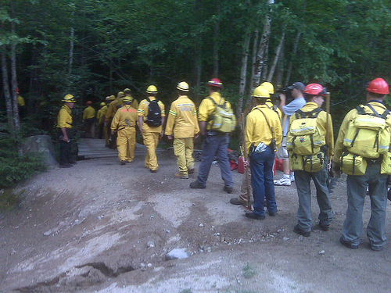
Emergency to Disaster
Emergencies happen every day, and they are usually addressed by individuals, families, businesses and local governments
When the local government needs help, they ask for “mutual aid” from nearby governments

Slide 4
Disasters
When Mutual Aid is not enough, the Governor of the State (Province) can declare a Disaster and bring more resources
If the State still needs help, the President can mobilize Federal (national) support
This happens less than 100 times per year
Control of the response always stays with the local officials, even when support comes from the State or Federal government

Slide 5
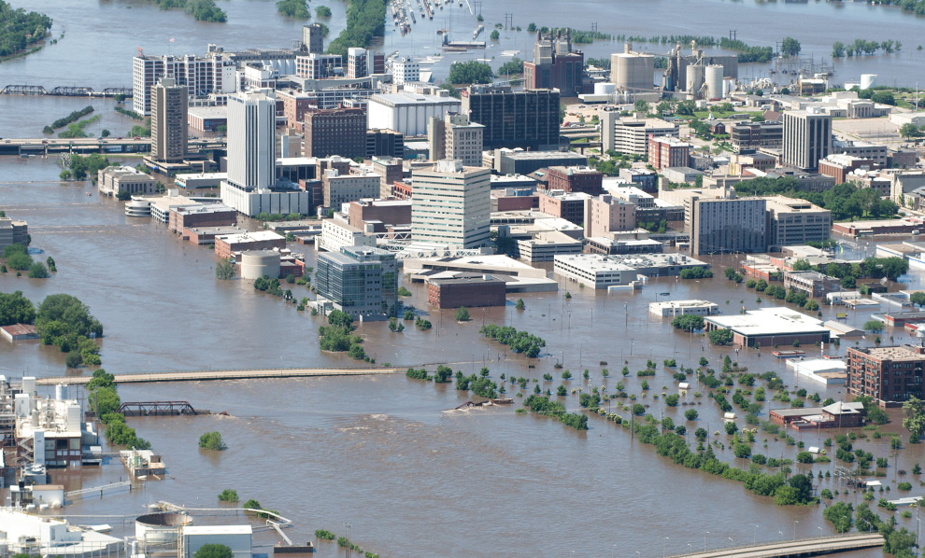
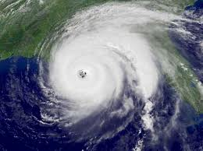
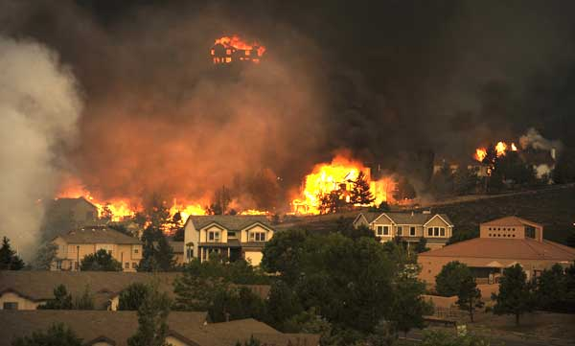
Common Disasters Include Floods, Hurricanes and Fires

Slide 6
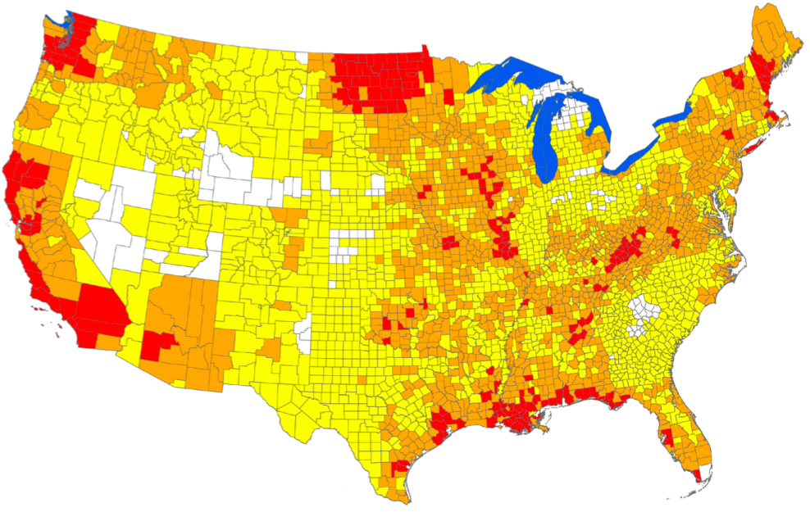
No Part of the United States is Safe from Disasters
The red areas have the most frequent disasters, the white ones have less frequent disasters

Slide 7
National Disaster Systems
The National Incident Management System is how we coordinate activities at the incident site
The National Response Framework is how we coordinate activities at the national level
Divided by Emergency Support Functions
Transportation is an Emergency Support Function, so all transportation elements work together

Slide 8
Transportation is an Important Part of Disaster Response and Recovery
Bringing in emergency supplies
Helping businesses stay open
Helping people evacuate if necessary

Slide 9
Ownership of Transportation is Complicated
Individuals and families own cars
Businesses own
Railroads
Busses that move between cities
Docks at ports
Cities own
Streets
Subways, busses, some trains
Special governments own
Airports
Ports
States own Highways
The Federal government owns the airspace

Slide 10
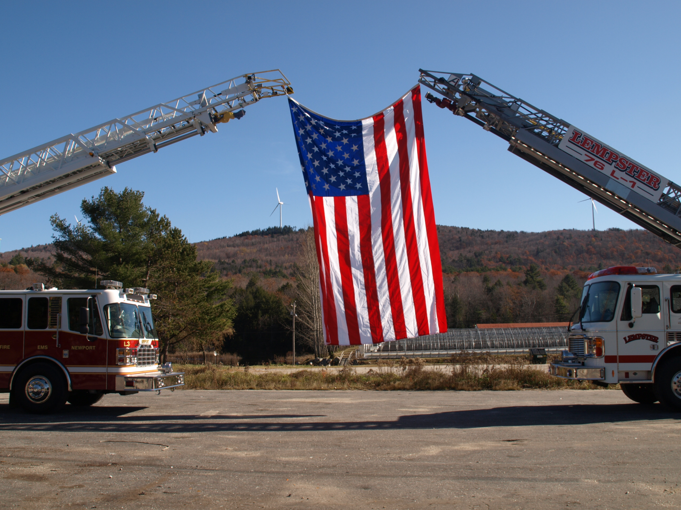
When we all work together, we can do our best

