Slide 1


U.S. CONSUMER PRODUCT SAFETY COMMISSION
Transit Subsidy Benefit Program
Supervisor Approver Training
Last updated 9.1.2026
Notes:
NOTE: USE WHITE FONT for Agency Name. When posted, the picture is much darker.

Slide 2


Program Overview
Why it matters?
What is it?
Who’s eligible?
A pre-tax federal transit subsidy that reimburses eligible commuting costs(SmarTrip, MARC, and other qualified transit) to encourage commuting by public transit.
Federal employees who regularly commute to a CPSC worksite using public transit and do not receive a parking subsidy for the same commute.
Protects Nation’s Infrastructure
Reduces air pollution & traffic congestion
Increases use of mass transit

Slide 3
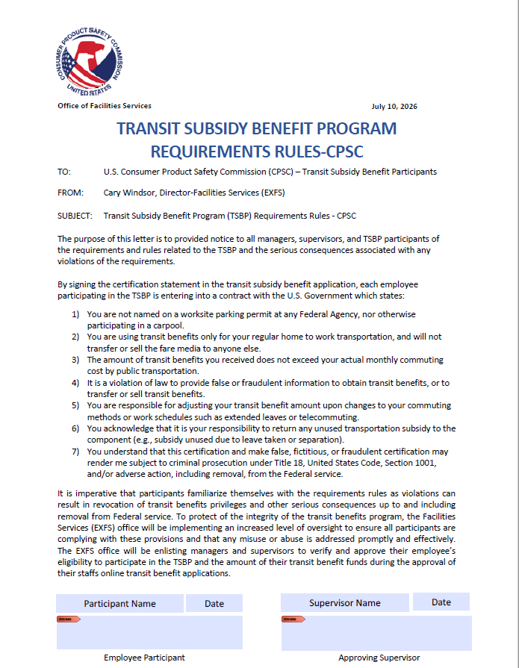
Supervisor / Approver Responsibilities
The Approver will need to review and verify the commuting distance address for all participating employees before the application can be processed.
Approvers / Supervisors will review the TSBP Policy Statement form for each employee participating in the program. (Will be sent in welcome email to each participant).
Participant employees sign and then forward to you for signature. Participant employee will then send form with both signatures to transitbenefitprogram@cpsc.gov
Make sure that all your TSBP participating employees update any major commuting changes in TRANServe.
Supervisors are the first line approvers in TRANServe for their participant employees.

Slide 4

Certification Is Required
Certify:
“To formally and legally attest a specific statement to be true”
Before employees can enroll in the Transit Subsidy Program you must first certify that certain conditions are true about you.

Slide 5

Transit Subsidy Benefit Program
Requirement Rules Form
You Must agree:
Your employee is employed by the U.S. Federal Government
Your employee is not named on a federally subsidized parking permit benefit, anywhere.
Your employee is eligible for a public transportation fare subsidy.
Your employee will use the subsidy for their daily mass transit commute from home to work and work to home.
Your employee will not give, sell or transfer it to anyone else.
Your employee will not use the Government provided subsidy in excess of the IRS limit changed yearly.
Your employee will not claim an amount in excess of their actual monthly commuting expense.
Your employee will not include parking fees as part of their commuting cost worksheet.

Slide 6
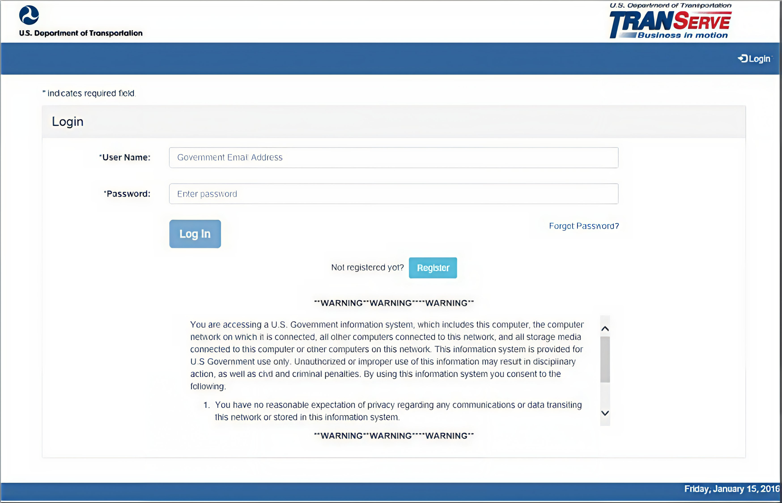
Accessing the Transit Application
Register on the home page to create an account.
Approvers must register to be added to the web application. However, they do not have to enroll in the transit benefit program.
Once the user has registered the User Role will be elevated from Applicant to the
applicable approval level.
Login - Transit Benefits System v 3.0

Slide 7
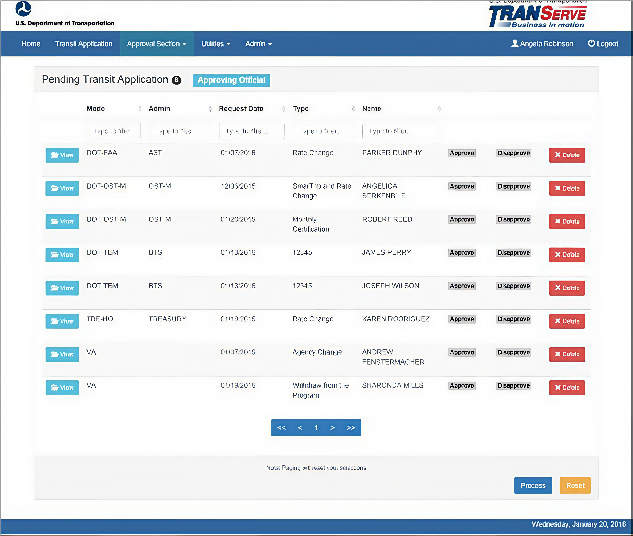
Approval Process
Log on as an approver.
2. From the Home page, click the Approval Section button; the approval page is displayed.
3. Select Approve to approve the application. After the selection is made the label will change into a checkmark.
4. Approve Pending Application.
Select Disapprove to disapprove the application. After the selection is made the label will change into a checkmark. A reason is required when an application is disapproved. Enter a reason in the reason textbox.
6. Click the Process button to
approve or disapprove the selected applications.

Slide 8
AGENCY CONTACT: TransitBenefitProgram@cpsc.gov
Tyana Trotz / EXFS
Email: ttrotz@cpsc.gov
Phone: (301) 504-6890
Alternate: Carlos Babilonia Aponte / EXFS
(240) 374-9626
cbabiloniaaponte@cpsc.gov
Facility Services Cary Windsor
Director, EXFS/CPSC
cwindsor@cpsc.gov

Slide 9
Thank you for choosing to commute using mass transit.
Information is available on our DOT Participant Website:
www.transportation.gov/transerve/participants/consumer-product-safety-commission-cpsc
Additional information is available on our intranet EXFS / CPSC:
TRANSIT SUBSIDY BENEFIT PROGRAM
For Agency specific questions, please contact:
TransitBenefitProgram@CPSC.gov

Slide 10

You’ve successfully completed the
Approver TRANServe
Transit Benefit Training

