Slide 1
FY2026 Nationally Significant Multimodal Freight and Highway Projects (INFRA) program.

Slide 2
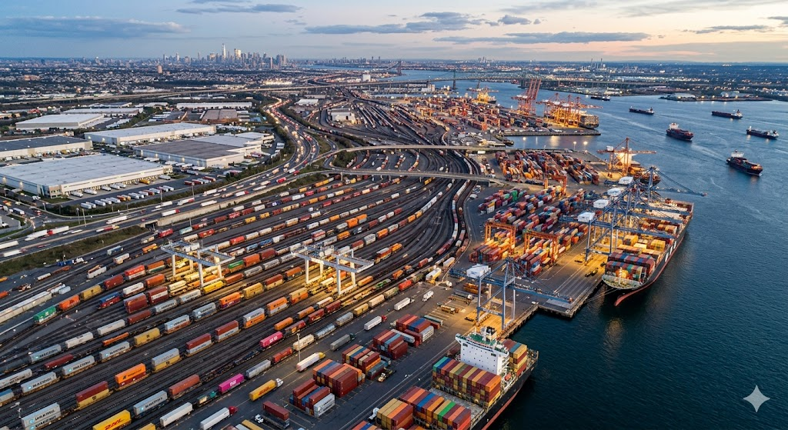
Agenda
Introduction: FY 2026 INFRA Program
Eligibility
Statutory Requirements
Selection Criteria
  Project Outcomes
  Economic Analysis
  Project Readiness Analysis
    Applicant Capacity
    Financial Completeness Assessment
    Project Risk Assessment
    Other Considerations
Application Format
Image generated by Google Gemini

Slide 3
Program Overview
Nationally Significant Multimodal Freight and Highway Projects (INFRA) program.
  The primary goal of the Nationally Significant Multimodal Freight and Highway Projects (INFRA) program is to fund surface transportation infrastructure projects of national or regional significance that improve the safety, efficiency, and reliability of the movement of people and goods in addition to expanding safe, accessible public parking for commercial motor vehicles.

Slide 4
FY 26 INFRA NOFO PROGRAM
  Track 1 ($426.7 million): Consists of $319.8 million in FY 2023 and $106.9 million in FY 2024 INFRA resources.
  Track 2 ($200 million): A dedicated carve-out of FY 2026 INFRA resources provided specifically for commercial motor vehicle (CMV) parking projects that improve highway safety and provide essential facilities.
Deadlines:
  Track 1: July 1, 2026 5:00 PM Eastern.
  Track 2: July 15, 2026 5:00 PM Eastern.
One application per project sponsor.
Each applicant may submit only one application total under this funding opportunity. You must choose either track on the project information form with that single submission.

Slide 5
Changes from the FY 2025-2026 MPDG NOFO
This INFRA funding opportunity is significantly different from the previous NOFOs (FY 2021 to 2026) in the following ways:
  Removes references to rescinded Executive Orders
  Aligns the NOFO with new Executive Orders and updates to the Outcome criteria rating rubric.
  Changes “Technical Capacity Review” to “Applicant Capacity” and “Environmental Risk Review” to “Project Risk Review” under the Project Readiness review.
  Application Review Information has been updated to clarify how INFRA applications will be assessed.
  Includes $200 million in dedicated funding for Commercial Motor Vehicle Parking.

Slide 6
Track 1 Selection Prioritization
Large-Scale Project Focus
  Total eligible project cost of $150 million or greater
Enhanced Non-Federal Leverage
  Projects that provide a non-Federal cost share of at least 50 percent of the total future eligible project costs
    This leverage priority does not apply to FY 2026 Track 2 Commercial Motor Vehicle Parking applications.
Project Readiness and Expedited Obligation
  Projects that demonstrate a high likelihood of achieving obligation no later than September 30, 2027
    Applicants must provide a comprehensive project schedule identifying the completed or anticipated completion dates for all environmental and regulatory milestones, including NEPA completion, right-of-way acquisition, and final design.

Slide 7
Track 2 Commercial motor vehicle (CMV) parking
Dedicated Funding: $200 million in FY 2026 INFRA resources carved out exclusively to address the national shortage of commercial motor vehicle (CMV) public parking.
Infrastructure must be constructed within reasonable access to or within the right-of-way of an Interstate highway, the National Highway System (NHS), or the National Highway Freight Network (NHFN).
Strict Statutory Set-Asides: Not less than 50% ($100 million) is reserved for small projects, and at least 25% must be allocated to rural projects overall.
Public-Private Partnerships: Public entities are legally authorized to partner with private companies for development, expansion, or operations.

Slide 8
FY26 INFRA Eligibility

Slide 9
Eligible Applicants
a State or group of States; a metropolitan planning organization that serves an Urbanized Area (as defined by the Bureau of the Census) with a population of more than 200,000 individuals; a unit of local government or group of local governments; a political subdivision of a State or local government; a special purpose district or public authority with a transportation function, including a port authority; a Federal land management agency that applies jointly with a State or group of States; a tribal government or a consortium of tribal governments; a multi-State corridor organization; or a multi-State or multijurisdictional group of entities described in this paragraph; For Commercial Motor Vehicle (CMV) Parking Projects: Any eligible applicant listed above may partner with a private entity to fund the development, capacity expansion, or the operation and maintenance of a facility
•

Slide 10
Eligible Projects: Track 1
Track 1: Standard INFRA Eligibility: A highway freight project on the National Highway Freight Network (NHFN); A highway or bridge project on the National Highway System (NHS); A freight intermodal, freight rail, or freight project within the boundaries of a public or private freight rail, water (including ports), or intermodal facility and that is a surface transportation infrastructure project necessary to facilitate direct intermodal interchange, transfer, or access into or out of the facility; A highway-railway grade crossing or grade separation project; A wildlife crossing project; A surface transportation project within the boundaries or functionally connected to an international border crossing that improves a facility owned by Fed/State/local government and increases throughput efficiency; A project for a marine highway corridor that is functionally connected to the NHFN and is likely to reduce road mobile source emissions; A highway, bridge, or freight project on the National Multimodal Freight Network; Track 2: FY 2026 Commercial Motor Vehicle (CMV) Parking Eligible Projects: Projects to provide public parking for commercial motor vehicles that are within reasonable access to or in the right of way of an Interstate highway, the National Highway System, or the National Highway Freight Network

Slide 11
Project Size and Cost Share
Program | Track 1: INFRA (FY 2023 & 2024) |  | Track 2: INFRA FY 2026 (Commercial Vehicle Parking)
Project Size | >$100M* in Costs | <$100M* in costs | >$100M* in Costs | <$100M* in costs
Award Size | $25 million award minimum | $5 million award minimum | $25 million award minimum | $5 million award minimum
Cost Share | Max 60% Grant Cost Share, Max 80% Federal** |  | Max 60% Grant Cost Share, Max 60% Federal*** | Max 60% Grant Cost Share, Max 80% Federal***
*7 states have a different, lower threshold for large vs. small between $66 million and $91 million (INFRA)
**14 states have a higher, sliding scale max federal share between 80% and 95% (for INFRA only)
***The FY 2026 appropriation language explicitly caps the “Federal share of the cost of a project” at 60 percent for large truck parking projects and 80 percent for small truck parking projects. This supersedes the standard INFRA rules that allow other Federal funds to stack up to 80 percent for large projects.

Slide 12
Set-asides
Track 1
  $135 million must be awarded to an INFRA Leverage Pilot project
    Federal share of the project may not exceed 50 percent*
Track 2
  50 percent ($100 million) of available CMV parking funds are reserved for small projects
    30 percent ($30 million) of that reserve is specifically dedicated to rural areas.
  Rural projects must receive no less than 25 percent ($50 million) of the total funding overall.
  *The Department is prioritizing awarding projects that come in at 50% or higher non-federal match

Slide 13
Location Designations
The INFRA program statutes are clear in defining urban and rural definitions, which differs across DOT programs. For the INFRA program:
Urban: A project is designated as urban if it is located within (or on the boundary of) a Census-designated urban area that had a population greater than 200,000 in the 2020 Census.
Rural: A project is designated as rural if it is located outside a Census-designated urban area that had a population greater than 200,000 in the 2020 Census.
The Department provides an interactive map (via the USDOT BUILD program) to show Census-designated urban areas with populations greater than 200,000 in the 2020 Census.

Slide 14
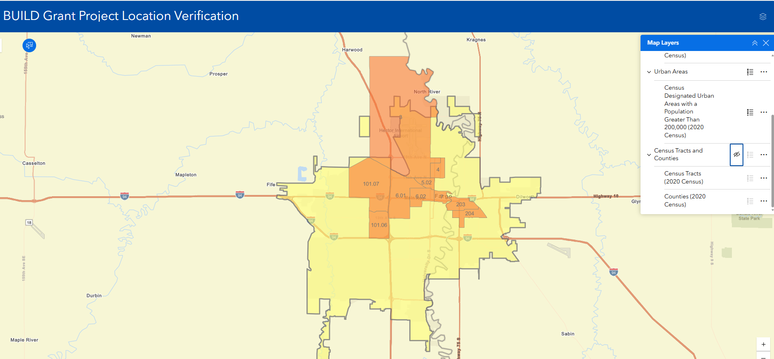
Example of the BUILD Location Verification Tool

Slide 15
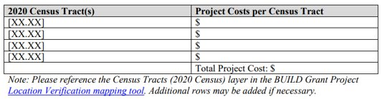
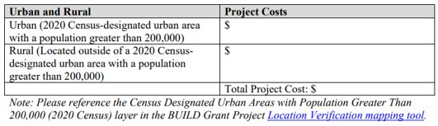
What if your project crosses multiple designations?
Projects that cross multiple areas with differing designations (urban and rural) will have their designation based on where the majority of costs are incurred.
The Project Budget file should include these tables:

Slide 16
Cost Sharing: Track 2
Special parameters for Large Truck Parking and Small Truck Parking
For projects funded under the FY 2026 commercial motor vehicle parking appropriation (Track 2), specific statutory Federal share limits apply that supersede the standard INFRA rules:
  Large Truck Parking Projects: The total Federal share of the cost of the project may not exceed 60 percent.
  Small Truck Parking Projects: The total Federal share of the cost of a project that does not meet the minimum size threshold under 23 U.S.C. 117(d)(1)(B) shall be 80 percent.

Slide 17
Restrictions on Funding
The Department must comply with the following funding restrictions:
Funding Track | Restriction
INFRA FY 2023 Funding (Track 1) | Not less than $135 million must be awarded to INFRA Leverage Pilot projects (50 percent non-Federal share)
INFRA FY 2026 Truck Parking (Track 2) | Location Requirements: Projects must be within reasonable access to or in the right of way of an Interstate highway, the National Highway System, or the National Highway Freight Network. Statutory Set-Asides: Small Projects: Not less than 50 percent ($100 million) is reserved for small projects (projects not meeting the minimum size threshold under 117(d)(1)(B)). Awards from this reserve must be at least $5 million each. Rural Small Projects: Not less than 30 percent of the Small Projects reserve ($30 million) must be used for small projects located in rural areas. Total Rural Projects: Not less than 25 percent of the total amount ($50 million) is reserved for projects located in rural areas overall.

Slide 18
INFRA Statutory Requirements
  For a large project to be selected, for either track, the Department must determine that the project meets the seven requirements described in 23 U.S.C. § 117(g).
  Small Project considerations ​cost-effectiveness​; effect on mobility in the project’s State or region.
INFRA- Large only​
(1) The project will generate national, or regional economic, mobility, or safety benefits​
(2) The project will be cost effective​
(3) The project will contribute to 1 or more of the national goals described under Section 150​
(4) The project is based on the results of preliminary engineering​
(5) With respect to related non-federal financial commitments, 1 or more stable and dependable sources of funding and financing are available to construct, maintain, and operate the project, and contingency amounts are available to cover unanticipated cost increases​
(6) The project cannot be easily and efficiently completed without other Federal funding or financing available to the project sponsor​
(7) The project is reasonably expected to begin not later than 18 months after the date of obligation of funds for the project​

Slide 19
Selection Criteria

Slide 20
Selection Criteria
USDOT Selection criteria strongly aligning with key strategic goals
To maximize the impact of Federal investment and ensure the timely delivery of nationally significant infrastructure, the Department seeks to fund project types that strongly align with key strategic goals. While all eligible applications will undergo a comprehensive and equal review process, the Department will prioritize the selection of INFRA Projects that meet the following criteria:
  Large-Scale Project Focus: The Department intends to prioritize the selection of large-scale projects that have a total eligible project cost of $150 million or greater.
  Enhanced Non-Federal Leverage: To maximize the impact of the FY 2023 and FY 2024 funds, the Department will prioritize regular INFRA projects that provide a non-Federal cost share of at least 50 percent of the total future eligible project costs (aligning with the INFRA Leverage Pilot).
  Project Readiness and Expedited Obligation: The Department will prioritize projects that demonstrate a high likelihood of achieving obligation no later than September 30, 2027.

Slide 21
Selection Criteria
Project Outcomes | Safety Economic Competitiveness and Opportunity State of Good Repair Innovation
Economic Analysis | Benefit-Cost Analysis
Project Readiness Analysis | Applicant Capacity Financial Completeness Project Risk

Slide 22
Outcome Criterion
The following outcome criteria will be used for project evaluation:
  Criterion #1: Safety
  Criterion #2: Economic Competitiveness and Opportunity
  Criterion #3: State of Good Repair
  Criterion #4: Innovation
Applications are not required to score highly in each criterion, but applicants are encouraged to propose projects that score highly in as many areas as possible.
For each criterion, the Department will evaluate whether the application uses data-driven and evidence-based methods to demonstrate that the project will provide the anticipated benefits, The Department will assign a high, medium, or non-responsive rating.

Slide 23
Outcome Rubric Ratings
For each project outcome area, the Project Outcome Analysis team will assign a 0, 1, 2, or 3 according to the scoring rubric shown below:
Highest outcome (3)
  To receive the highest outcomes rating in any given outcome area, it must be a primary project purpose, result and clear and direct data-driven benefits, and meet the description of an item listed in column “3” of the rubric
Medium outcome (2)
  A rating of “2” indicates the project results in benefits to the outcome area matching one or more of the descriptions below, but it is not a primary project purpose or the project does not otherwise meet the description of a “3” rating.
Low outcome (1)
  A rating of a “1” indicates the application does not contain enough information to assess whether the project results in benefits in the outcome area.
Non-responsive (0)
  A rating of a “0” indicates the project would negatively impact the outcome area.

Slide 24
Project Outcome Area Ratings
Safety
Economic Competitiveness and Opportunity
State of Good Repair
Innovation
The Project Outcome Analysis team will assign an overall rating according to the scoring rubric shown below.
Outcome Ratings: 4-Criteria Outcome Rating Rubric
High | Three or more 3s (Primary Purposes) and No 1s and No 0s.
Medium | Any combination of 2s and 3s that does not meet the requirement for a High rating.
Low | Any 1s (Insufficient Information) OR Any 0s (Negative Impact).

Slide 25
Project Outcome: Safety
Criteria/Rating | 2 - The project results in benefits to the outcome area matching one or more of the descriptions below, BUT it is not a primary project purpose OR the project does not otherwise meet the description of a “3” rating. | 3- The outcome area is a primary purpose of the project AND the project results in clear and direct data-driven benefits matching one or more of the descriptions in the “3” column of the rubric below.
Safety | Reduces any number of fatalities and/or serious injuries. Targets the shortage of safe parking for commercial motor vehicles. | Eliminates at-grade crossings to reduce crash risks and safely separate freight and passenger traffic Reduces fatalities and/or serious injuries in the project area to bring them below the State-wide average. Substantially expands commercial motor vehicle parking capacity in an area with a demonstrated safety concern. Incorporates specific safety improvements that are part of a documented safety risk mitigation strategy and that have corridor wide impact.

Slide 26
Project Outcome: Economic Competitiveness and Opportunity (1/2)
Criteria/Rating | 2 - The project results in benefits to the outcome area matching one or more of the descriptions below, BUT it is not a primary project purpose OR the project does not otherwise meet the description of a “3” rating. | 3- The outcome area is a primary purpose of the project AND the project results in clear and direct data-driven benefits matching one or more of the descriptions in the “3” column of the rubric below.
Economic Competitiveness and Opportunity | Improves the safety, security, or efficiency of the movement of goods. Reduces transportation costs and supply chain friction for domestic businesses, manufacturers, or agricultural producers. Facilitates tourism opportunities. Minimizes parking search times to increase freight efficiency. | Improves roadways vital to national energy security, including highways that support movement of energy equipment, and advances the Nation’s domestic energy sector in accordance with Executive Order 14154 – Unleashing American Energy. Revitalizes and restores domestic maritime industries in accordance with Executive Order 14269 – Restoring America’s Maritime Dominance. Includes union participation or project labor agreements which promote cost-effectiveness and open competition. Improves eligible land-side surface transportation access to a major air cargo hub or licensed commercial spaceport. Improves access to national security and defense facilities or facilitates movement of military cargo or personnel.

Slide 27
Project Outcome: Economic Competitiveness and Opportunity (2/2)
Criteria/Rating | 3- The outcome area is a primary purpose of the project AND the project results in clear and direct data-driven benefits matching one or more of the descriptions in the “3” column of the rubric below.
Economic Competitiveness and Opportunity | Increases efficient use of available driver Hours of Service (HOS) time by expanding commercial motor vehicle (CMV) parking in strategic locations where there is a high-demand for truck parking due to freight operational patterns, such as on high volume national freight corridors or near major freight generators. Promotes or reshores industries of national interest, including critical minerals, steel, the defense industrial base, and pharmaceutical manufacturing. Addresses a freight bottleneck, as identified in the National Freight Strategic Plan, a State Freight Plan, or as measured by relevant freight industry associations (ATRI, e.g.); Supports the growth and expansion of American exports. Measurably increases the volume, value, or economic throughput of goods moving through a major national freight corridor or port facility.

Slide 28
Project Outcome: State of Good Repair
Criteria/ Rating | 2- The project results in benefits to the outcome area matching one or more of the descriptions below, BUT it is not a primary project purpose OR the project does not otherwise meet the description of a “3” rating. | 3-The outcome area is a primary purpose of the project AND the project results in clear and direct data-driven benefits matching one or more of the descriptions in the “3” column of the rubric below.
State of Good Repair | Restores existing core infrastructure or a commercial motor vehicle (CMV) parking facility at the end of its useful life to a state of good repair. Creates new infrastructure in remote communities that will be maintained in a state of good repair. | Restores and modernizes existing core infrastructure or a commercial motor vehicle (CMV) parking facility that will result in lower long-term maintenance costs. Addresses current and projected vulnerabilities that if left unaddressed will threaten future transportation network efficiency, mobility of goods or people, or economic growth. Prioritizes improvement of the condition and safety of existing transportation infrastructure, particularly infrastructure with high cost of failure, such as bridges with lengthy detours, including single points of failure identified in the National Freight Strategic Plan. Enhances freight resilience to natural hazards or disasters (e.g., high winds, heavy snowfall, flooding, rockslides, mudslides, wildfire, or steep grades).

Slide 29
Project Outcome: Innovation
Criteria/ Rating | 2- The project results in benefits to the outcome area matching one or more of the descriptions below, BUT it is not a primary project purpose OR the project does not otherwise meet the description of a “3” rating. | 3-The outcome area is a primary purpose of the project AND the project results in clear and direct data-driven benefits matching one or more of the descriptions in the “3” column of the rubric below.
Innovation | Deploys technologies, project delivery, or financing methods that are new or innovative to the applicant or community. | Innovative Technology Deploys innovative technology to improve the safety or efficiency of freight movement. Enhances the environment for connected or automated vehicles to improve the detection and mitigation of safety risks. Uses sensors or small unmanned aerial vehicles to enhance infrastructure inspection and asset management processes. Uses sensors to monitor real-time conditions of pavement quality, signage, or other public infrastructure. Uses active grade crossing detection systems to enable responsive traffic management or uses detection systems on railroads to target and deter trespassing. Deploys technology to digitize curb management for freight usage, support more efficient freight operating practices, or help combat cargo theft through enhanced prevention and recovery.

Slide 30
Project Outcome: Innovation
Criteria/ Rating | 2- The project results in benefits to the outcome area matching one or more of the descriptions below, BUT it is not a primary project purpose OR the project does not otherwise meet the description of a “3” rating. | 3-The outcome area is a primary purpose of the project AND the project results in clear and direct data-driven benefits matching one or more of the descriptions in the “3” column of the rubric below.
Innovation |  | Innovative Project Delivery Uses practices that facilitate accelerated project delivery such as single contractor design-build arrangements, Advanced Digital Construction Management, Accelerated Bridge Construction, or Digital as-builts. Utilizes an up-to-date programmatic agreement between an environmental resource agency and a State DOT, or other NEPA lead agency, that establishes a streamlined process for environmental consultations and permits for commonly encountered project types. Innovative Financing Uses TIFIA, RRIF, or private activity bond financing; or Uses congestion pricing or other demand management strategies.

Slide 31
Benefit-Cost Analysis
The purpose of the Benefit-Cost Analysis (BCA) is to enable the Department to evaluate the cost-effectiveness of the proposed project by comparing its expected benefits to its expected costs relative to the current transportation problem, or “no-build” scenario.
There should be two BCA files included in the application: (1) a narrative description of the BCA; and (2) an unlocked spreadsheet revealing the underlying calculations.
  BCA Narrative
    The BCA narrative should carefully document the assumptions and methodology used to produce the analysis, including a description of the baseline, the sources of data used to project the outcomes of the project, and the values of key input parameters. The BCA narrative should include, at a minimum, a description of the benefits and costs to be monetized.
  BCA Spreadsheet:
    The BCA spreadsheet file should present the calculations in sufficient detail and transparency to allow the analysis to be reproduced by Department evaluators. The Department has developed a new BCA spreadsheet that is available to assist applicants in structuring their analysis (Benefit-Cost Analysis Spreadsheet Template for Discretionary Grant Programs | US Department of Transportation). Please ensure any BCA spreadsheet submitted is unlocked, to allow review.

Slide 32
Economic Analysis Rating
The Department will rely on the applicants quantitative, evidence-based, and data-supported analysis, including an assessment of the project’s estimated benefit-cost ratio (BCR) based on the supplied BCA, and will assign an economic analysis rating using the following table:
Rating | Description
High | The project’s benefits will exceed its costs, with a benefit-cost ratio of at least 2.0
Medium-High | The project’s benefits will exceed its costs
Medium | The project’s benefits are likely to exceed its costs
Medium-Low | The project’s costs are likely to exceed its benefits
Low | The project’s costs will exceed its benefits

Slide 33
Project Readiness: Applicant Capacity
Assesses the applicant’s capacity to deliver this project in a manner that satisfies Federal requirements.
Considerations include but are not limited to:
  Applicant’s history of delivering projects of similar scope and scale;
  Project’s feasibility or constructability;
  Applicable Federal requirements, including compliance with Title VI/Civil Rights requirements, ADA, Buy American, among others;
  Acquisition plan for right-of-way acquisition, if applicable.

Slide 34
Project Readiness: Financial Completeness
The applicant should include a detailed project budget that identifies all sources of funding, including INFRA funds, other Federal funds, and non-Federal funds.
Applicant should include what percent design the funding estimates are based upon (e.g. 30% design), and whether contingency is included.
All applicants should describe a plan to address potential cost overruns.
Applicant should demonstrate through letters of commitment, STIP/TIP documents, or other means, that the funding arrangement is certain and the project will be able to meet the obligation target of September 30, 2027.

Slide 35
Project Readiness: Project Risk
The applicant should include a detailed project schedule that identifies all major project milestones.
Applicant should provide information on required approvals and permits such as NEPA (National Environmental Policy Act) and other State or local environmental and planning approvals.
  Demonstrate meaningful community input through public involvement that may be affected by the project where applicable.
Applicants should describe schedule/permitting risk mitigation strategies.
  If applicable, right-of-way acquisition plans

Slide 36
Application Review Process
Analysis Review
  Projects receive a series of ratings based on highs, mediums, and lows scored through merit and technical review processes
Senior Review
  The Senior Review team reviews criteria ratings and assigns final Overall ratings of either Not Recommended, Recommended, or Highly Recommended
Selection & Award
  The Secretary makes all final award decisions from the list that the SRT sends for his consideration.

Slide 37
Application Checklist
Application Checklist
SF-424 (automatically submitted once fields are completed in grants.gov, not attachment) | Outcome Criteria Narrative
SF-424C (automatically submitted once fields are completed in grants.gov, not attachment) | Project Readiness
Project Information Form (in Excel) | Project Requirements
Project Description | Benefit-Cost Analysis Narrative
Project Location File (zipped Shapefile or KML/KMZ) | Benefit-Cost Analysis Calculations (Excel recommended)
Project Budget, Sources and Uses of Funding | Letters of Support (Optional)
Funding Commitment Documentation | Supporting documents (Optional)

Slide 38
Application Process
Applicants are strongly encouraged to make submissions in advance of the deadline.
To register on Grants.gov, applicants must:
  1. Obtain a Unique Entity Identifier (UEI) number;
  2. Register with the System for Award Management (SAM) at www.SAM.gov;
  3. Create a Grants.gov username and password; and
  4. The E-Business Point of Contact (POC) at your organization must respond to the registration email from Grants.gov and login at Grants.gov to authorize you as an Authorized Organization Representative (AOR). Please note that there can be more than one AOR for an organization.
For complete information and instructions on each of these processes, please see instructions on grants.gov registration.

Slide 39
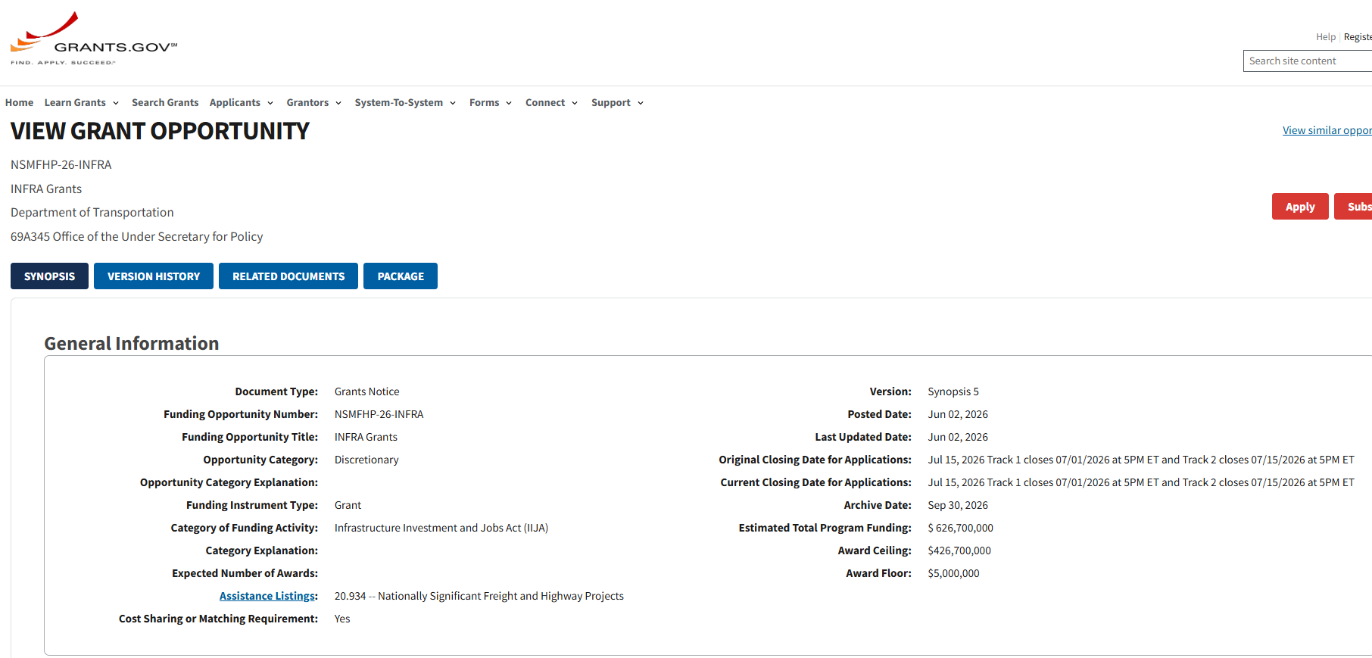
How to Apply: Grants.Gov

Slide 40
Additional Resources
MPDG Website: MPDG Program | US Department of Transportation
BCA Guidance: https://www.transportation.gov/mission/office-secretary/office-policy/transportation-policy/benefit-cost-analysis-guidance
BCA Template: https://www.transportation.gov/mission/office-secretary/office-policy/transportation-policy/benefit-cost-analysis-spreadsheet-template
USDOT Map Verification Tool: https://maps.dot.gov/BTS/GrantProjectLocationVerification/
For MPDG questions, please email: MPDGrants@dot.gov.
Thank you!

