Slide 1



Transit Benefit Program Integrity Awareness Training
Last update: 4/10/2024

Slide 2



Background
Program Overview
The transit benefit subsidy provides an incentive to Federal employees to utilize mass transit (subway/metro, bus, vanpools) for their commute. This program promotes critical clean energy goals and reduces the number of single occupancy vehicles on the road, reducing congestion and air pollution.
Eligibility
All federal employees working in full or part-time paid status
All federal interns, including unpaid student volunteers

Slide 3

Certification Is Required
Certify:
“To formally and legally attest a specific statement to be true”
Before you can enroll in the Transit Benefit Program you must first certify that certain conditions are true about you.

Slide 4
To What Must I Agree?
You Must agree:
I am employed by the U.S. Federal Government.
I am not named on a federally subsidized parking permit, anywhere.
I am eligible for a public transportation fare benefit
I will use the benefit for my daily mass transit commute to and from work
I will not give, sell or transfer it to anyone else
I will not use the Government provided benefit in excess of the IRS limit
I will not claim an amount in excess of my actual monthly commuting expense
I will not include parking fees as part of my commuting cost worksheet

Slide 5
Your Roles and Responsibilities:
Understand the Transit Benefit Program’s scope and limitations
Understand it is a violation of federal law to transfer or sell the transit benefit or to provide false or fraudulent information to obtain the benefit
Understand the potential penalties for misuse or false claims
To not be named on a worksite parking permit at any Federal agency, nor participate in a carpool

Slide 6
Your Roles and Responsibilities:
To use the transit benefit for home-to-work and work-to-home transportation only.
To ensure the amount of transit benefit received does not exceed actual monthly commuting cost of public transportation
To recertify your application to update commuting expenses whenever your commuting method, work schedule, or address changes

Slide 7
Legal Implications
Employees who misuse the transit benefit are subject to appropriate administrative action including discipline and/or disqualification from future participation in the Transit Benefit Program.
Disciplinary penalties can range from a letter of admonishment to removal from Federal Service, depending on the severity of the abuse.

Slide 8
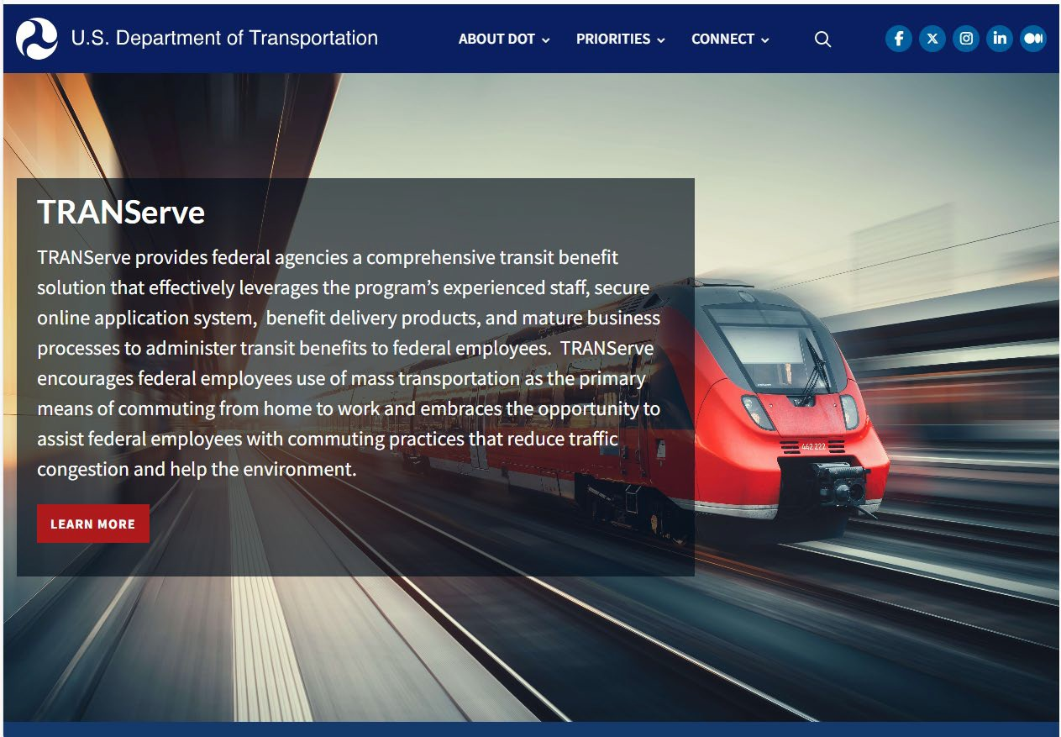
Keep Current: transportation.gov/TRANServe
Apply
Recertify
TRANServe Card
News
FAQs
Research mass transit commute
Subscribe

Slide 9
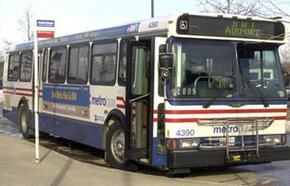
Mass Transportation modes eligible for transit benefits:
Rail
Subway
Commuter
Light
Bus
Transit Authority
Commuter
Ferry
Pedestrian or bicycle
Trolley
Qualified vanpools
Commercial/private vehicle
At least six seats, excluding the driver

Slide 10


Vanpool
The vanpool must seat a minimum of 6 passengers (not including the driver).
At least 50% of the adult seating capacity of the vehicle (not including the driver) must be used for the transportation of employees to and from work, and such transportation must represent 80% of the overall usage of the van.

Slide 11


Knowledge Check 1
.
The Transit Benefit Program’s objective is to:
A. Increase compensation of federal employees per month.
B. Incentivize federal employees to use public transportation to reduce their contributions to traffic congestion and air pollution.
C. Reward the employees for their hard work.

Slide 12
Knowledge Check 1
.
The Transit Benefit Program’s objective is to:
A. Increase compensation of federal employees per month.
B. Incentivize federal employees to use public transportation to reduce their contributions to traffic congestion and air pollution.
C. Reward the employees for their hard work.
The Federal Workforce Transportation Fringe Benefit Program under Executive Order 13150 is designed to reduce traffic congestion and air pollution.

Slide 13

Knowledge Check 2
True or False?
.
If I misuse my transit benefit by selling it or overestimating my need for the benefit, I can be removed from federal service.

Slide 14

Knowledge Check 2
True or False?
If I misuse my transit benefit by selling it or overestimating my need for the benefit, I can be removed from federal service.
. •
TRUE: Disciplinary action can range from a letter of admonishment to removal from Federal Service, depending on the severity of the abuse.

Slide 15
Knowledge Check 3
TRANServe’s Role is:
A. To distribute the transit benefit to federal employees.
B. To administer the Transit Benefit Program.
C. To establish Best Practices.
D. All of the above.

Slide 16
Knowledge Check 3
TRANServe’s Role is:
A. To distribute the transit benefit to federal employees.
B. To administer the Transit Benefit Program.
C. To establish Best Practices.
D. All of the above.
TRANServe delivers Transit Benefit Programs and establishes Best Practices.

Slide 17
Knowledge Check 4
Jermaine plans to start teleworking. The next step is to:
A. Inform his supervisor.
B. Continue claiming his transit benefit without change.
C. Submit an updated application.

Slide 18
Knowledge Check 4
Jermaine plans to start teleworking. The next step is to:
A. Inform his supervisor.
B. Continue claiming his transit benefit without change.
C. Submit an updated application.
You are responsible to update your transit benefit application and commuting cost worksheet whenever you change your commuting method, work schedule, or address.

Slide 19


Knowledge Check 5
Keeva joined a carpool after commuting on the train for 5 years. She sold her benefit since she believed the benefit belonged to her. Was this the correct course of action?
Yes
No
The answer is….

Slide 20

Knowledge Check 5
Keeva joined a carpool after commuting on the train for 5 years. She sold her benefit since she believed the benefit belonged to her. Was this the correct course of action?
Yes
No
It is against the law to give away or sell the Transit Benefit

Slide 21

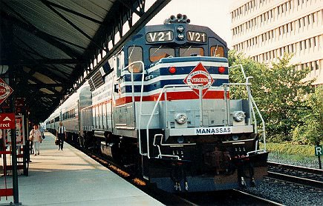

Knowledge Check 6
Hayly commutes from Virginia to get to work. Her commuting costs are $345 per month. She is eligible to receive additional transit benefit since her commute is so costly.
True
False

Slide 22
Knowledge Check 6
Hayly commutes from Virginia to get to work. Her commuting costs are $345 per month. She is eligible to receive additional transit benefit since her commute is so costly.
True
False
The federal government may provide up to the IRS maximum for mass transportation commuting
costs. Hayley must cover the additional amount, “out of pocket”.

Slide 23
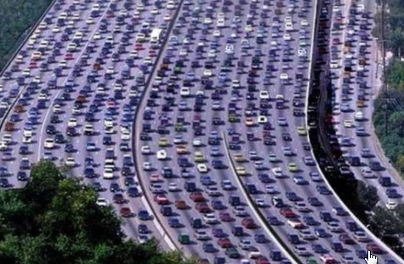
Knowledge Check 7
Becky chooses to ride in a carpool. She is eligible to receive the transit benefit.
True
False

Slide 24
Knowledge Check 7
Becky chooses to ride in a carpool. She is eligible to receive the transit benefit.
True
False
False. The Federal Transit Benefit is for federal employees who choose to commute on mass transit in a commuter highway vehicle. This includes bus, rail, light rail, and an authorized vanpool.
Carpools are not eligible for the federal transit benefit program.

Slide 25
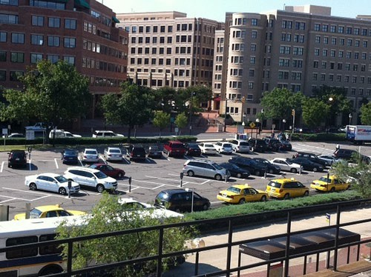
Knowledge Check 8
Ivan rides mass transit and parks in the lot near the station. He includes his parking fees in the computation of his monthly commuting cost. He is right to do this.
True
False

Slide 26
Knowledge Check 8
Ivan rides mass transit and parks in the lot near the station. He includes his parking fees in the computation of his monthly commuting cost. He is right to do this.
True
False
The Federal Transit Benefit is exclusively for your home-to-work-to-home commute on mass transportation. Any other use is actionable as fraud, waste, or abuse of federal funds.

Slide 27

Knowledge Check 9
Ciera and her supervisor agree she may telework two days each week, indefinitely. Her transit benefit is $25 per week. Now that she does not commute every day, her correct course of action is to:
A. Thank her supervisor for his/her understanding.
B. Continue claiming her transit benefit without change.
C. Change her transit benefit to $15 per week or $60 per month.

Slide 28
Knowledge Check 9
Ciera and her supervisor agree she may telework two days each week, indefinitely. Her transit benefit is $25 per week. Now that she does not commute every day, her correct course of action is to:
A. Thank her supervisors for his/her understanding.
B. Continue claiming her transit benefit without change.
C. Change her transit benefit to $15 per week or $60 per month.
You must update your application and change your benefit amount whenever your commuting expenses change.

Slide 29
Knowledge Check 10
Chris is going to an off-site meeting. He is using mass transportation to travel to and from the meeting. Since he has extra funds on his TRANServe Card he decides to use his transit benefit. This is the correct course of action.
True
False

Slide 30
Knowledge Check 10
Chris is going to an off-site meeting. He is using mass transportation to travel to and from the meeting. Since he has extra funds on his TRANServe Card he decides to use his transit benefit. This is the correct course of action.
True
False
Travel to an off-site meeting or training class is an office expense. The Transit Benefit is provided solely for your home-to-work-to-home commute via mass transportation. “Extra” funds are swept back to your Agency at the end of the monthly cycle. A permanent change requires that you update your
application, so you do not tie up much-needed funds.

Slide 31

Knowledge Check 11
Mike recently started his own vanpool company called Mike’s Ride LLC. Mike applies for Federal Transit benefits with vanpool as his mode of transportation. He will use his own vanpool company to ride to and from work. How should Mike answer the question below while applying for Transit Benefits?
Do you or a member of your household own or financially benefit from the operations of this Vanpool?
Yes
No

Slide 32
Knowledge Check 11
Mike recently started his own vanpool company called Mike’s Ride LLC. Mike applies for Federal Transit benefits with vanpool as his mode of transportation. He will use his own vanpool company to ride to and from work. How should Mike answer the question below while applying for Transit Benefits?
Do you or a member of your household own or financially benefit from the operations of this Vanpool?
Yes
No
Due to your answer, this application requires a waiver.
Please contact your transit benefit coordinator to initiate the waiver process.

Slide 33
Thank you for choosing to commute using mass transit.
Additional information is available on our Website: TRANServe | US Department of Transportation
For Agency specific questions, please contact: Insert agency-specific email or phone

Slide 34

This certifies to your agency that you have successfully completed the annual requirement to review the roles and expectations of the Transit Benefit Program.

