Slide 1
How to Apply for Safe Streets and Roads for All (SS4A): Implementation Grants
U.S. Department of Transportation
NHTSA
© romaset - stock.adobe.com
© ambrozinio - stock.adobe.com
NHTSA
Notes:
Isabella
The Infrastructure Investment and Jobs Act (IIJA) established the Safe Streets and Roads for All (SS4A) competitive grant program that provides $5 billion in grant funding over five years. Funding supports regional, local, and tribal initiatives through grants to prevent roadway deaths and serious injuries.

Slide 2
Welcome to the Safe Streets and Roads for All (SS4A): Implementation Grant Webinar
Audio
To listen via computer: Select “Computer Audio”
To listen via phone:
Call: 669-254-5252
Webinar ID: 161 906 3327
Passcode: 927608
All participants automatically join on mute, with cameras off
Technical Support
Email Webconference@dot.gov
Questions for Presenters
Please type your questions in the Q&A box
More Information
www.transportation.gov/SS4A
Today’s presentation slides and recording should be available on the SS4A Webinars page
Notes:
Isabella
Welcome to the “How to Apply for Safe Streets and Roads for All (SS4A): Implementation Grant” webinar
We want to review a few logistics first.
You can join the audio for today’s session using your computer audio or by calling in by phone using one of the numbers provided in your Zoom registration confirmation.
All participants are automatically joined on mute, with cameras off.
If you have any technical issues during the webinar, please contact our Web Conferencing team at Webconference@dot.gov for technical assistance.
If you have any questions for our presenters, please type them into the Q&A box, and we’ll get to as many of them as we can at the end of the slide presentation. Please wait to submit questions until after the program overview section, as many questions will be answered during those first few slides.
This session is being recorded. The presentation slides and the recording will be posted on the Safe Streets and Roads for All website for later reference: https://www.transportation.gov/grants/SS4A/webinars

Slide 3
SS4A Webinars
How to Apply for SS4A: Implementation Grants
This webinar will offer a general overview of the SS4A program and the grant application process, with a particular focus on applying for Implementation Grants.
Tuesday, April 15, 2025, 2:00 – 3:30 PM (Eastern Time)
How to Apply for SS4A: Action Plans
This webinar will offer a general overview of the SS4A program and the grant application process, with a particular focus on applying for grants to develop an Action Plan.
Thursday, April 17, 2025, 12:30 – 2:00 PM (Eastern Time)
How to Apply for SS4A: Supplemental Planning and Demonstration Activities
This webinar will offer a general overview of the SS4A program and the grant application process, with a particular focus on applying for grants for supplemental planning and demonstration activities.
Wednesday, April 23, 2025, 1:30 – 3:00 PM (Eastern Time)
Notes:
Isabella
Today’s webinar is the first in a series of three webinars on How to Apply for the SS4A grant opportunity. All webinars will be recorded and posted to the SS4A website.

Slide 4
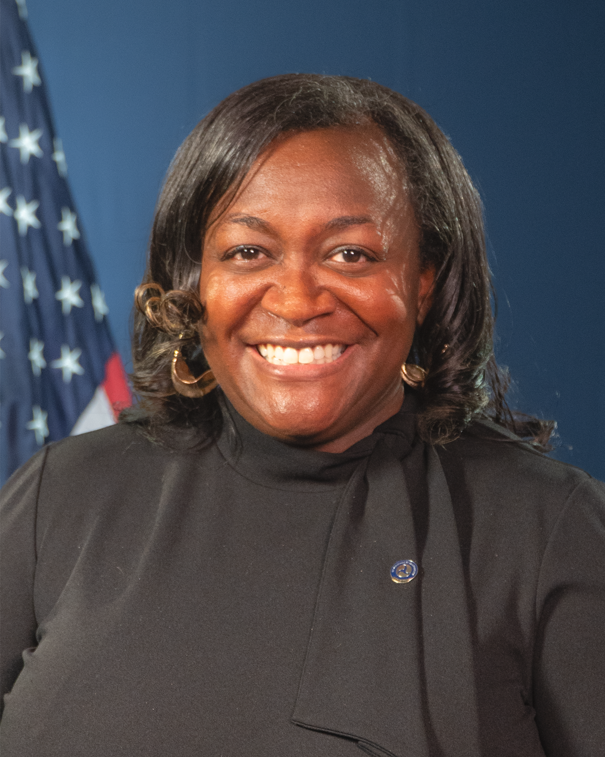
Presenters
Jessica Rich
Federal Highway Administration Office of Safety
U.S. Department of Transportation
Carolyn Mulvihill
Office of the Secretary
U.S. Department of Transportation
Andrew Emanuele
Office of the Secretary
U.S. Department of Transportation
Notes:
Isabella
I’m joined by three co-presenters today – Jessica Rich from FHWA, and Andrew Emanuele and Carolyn Mulvihill from OST. Internal Note: Speaker bios can be found at the end of the run-of-show document.
Jessica Rich works in the FHWA Office of Safety as a program manager for the Safe Streets and Roads for All program. She previously worked in the FHWA Tennessee Division as a Safety Engineer, and has over 20 years’ experience with FHWA.
Andrew Emanuele is the Program Manager for the Safe Streets and Roads for All competitive grant program in the Assistant Secretary for Transportation Policy’s Office of Infrastructure Deployment.
Carolyn Mulvihill is also a member of the SS4A team in the Office of Infrastructure Deployment. She has over 20 years of experience with DOT and the Environmental Protection Agency.

Slide 5
Are you in the right place?
The SS4A program funds regional, local, and Tribal initiatives through grants to prevent roadway deaths and serious injuries.
You’re in the right place if you:
Have an existing, eligible Action Plan.
Are ready to implement projects and strategies outlined in that Action Plan, with the potential for additional planning, analysis, and pilot activities.
Notes:
Isabella
All information related to the grant program can be found at www.transportation.gov/SS4A or by reviewing the NOFO at https://www.transportation.gov/grants/ss4a
This webinar is intended to support applicants in understanding the eligibility requirements for Implementation Grants, including eligible activities.
It is important to note - If your community does not have an existing Action Plan, you should apply for a Planning and Demonstration Grant and NOT an Implementation Grant. The next two webinars in the How to Apply series cover those grants and the activities that can be included. You can register for those webinars on the SS4A website; alternatively the recordings of those webinars along with slide decks will be posted on the SS4A website in the coming weeks.
We will discuss eligible applicant types later on in today’s presentation; however, if you are joining us from a private agency or State DOT, it is worth noting that these entities are not eligible to apply for an SS4A grant as a lead applicant.

Slide 6
SS4A FY25 NOFO Is Now Open
Notice of Funding Opportunity (NOFO) is now OPEN
Submit technical questions by May 29, 2025, to ss4a@dot.gov
FY25 SS4A Application Deadline is June 26, 2025, 5:00 PM EDT
Additional resources about SS4A and the NOFO can be found at https://www.transportation.gov/grants/SS4A
Notes:
Isabella
There is a single deadline for all SS4A application types in FY25 - June 26, 2025, by 5:00 PM ET. That includes Planning and Demonstration Grant and Implementation Grant applications.
Late applications will not be accepted. If you have technical issues submitting your application, we can only consider your application if you contact support@valideval.com documenting your technical issue no later than 4 hours prior to the application deadline.
If you have technical questions, please submit those to the ss4a inbox, ss4a@dot.gov, by May 29, 2025.

Slide 7
SS4A Grant Program Overview
Notes:
Isabella hands over to Andrew

Slide 8
Safe Streets and Roads for All
$5 billion competitive grant program, with ~$1 billion per year over 5 years
Purpose: prevent deaths and serious injuries on our roadways
Focus on comprehensive safety action planning, and implementing projects and strategies identified in safety Action Plans
Inclusive of all types of roadway safety interventions across the Safe System Approach
Notes:
PRESENTER
SS4A was authorized by Congress with $5 billion in advanced appropriations, $1 billion is made available each year over 5 years. FY25 is year 4 of the program, so we have more than $2 billion more in funding left.
The SS4A program is built on the development of a Comprehensive Safety Action Plan, which uses data, a taskforce of safety stakeholders, and public engagement to identify the biggest safety problems in a community and through that effort creates a list of priority safety projects and strategies to address those safety problems. The program also supports the design and implementation of projects and strategies via Implementation Grants.
This program enables interventions that interconnect just like in a Safe System Approach that uses multiple interventions to build safety redundancies to protect people, including infrastructure, behavioral, and operational activities. If you are not familiar with the Safe System Approach, check out https://www.transportation.gov/safe-system-approach

Slide 9
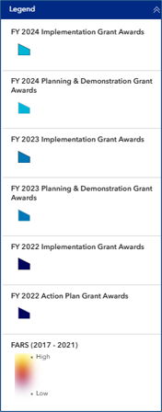
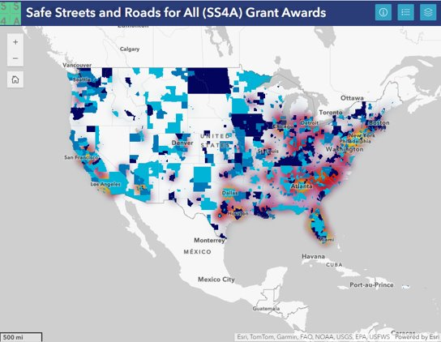
Safe Streets and Roads for All Funding to Date
FY22 to FY24
Over 1,800 awards made totaling $3 billion
SS4A awards will improve roadway safety planning for over 75% of the nation’s population
900+ awards made to rural communities totaling over $750 million
Notes:
The SS4A program has made over 1800 awards across the three previous funding cycles. This map shows the awarded communities in the country in blue, with high fatality areas highlighted in red. As you can see, we have a fair amount of the high fatality areas covered, but not all. We also have some gaps in rural areas that we are aiming to fill.
-In FY 25 there is approximately. $1 billion available for funding, 30% of which is available for planning and demonstration activities and 70% of which is available for implementation.

Slide 10
New in FY25
New in FY25
One application deadline: June 26th, 2025, 5:00 PM EDT
Underserved Communities will use the same definition as Areas of Persistent Poverty
No more than 3 plans can be used to meet Action Plan requirements
Streamlined Implementation Grant selection criteria: Safety Need, Safety Impact, and Engagement and Collaboration
Map requirement
New SS4A applicant resources
Notes:
PRESENTER
We want to outline a few changes to the FY25 NOFO.
First this year we have a single application deadline, meaning all application materials must be submitted by June 26th, 2025, at 5:00pm Eastern.
The way we are calculating underserved communities has changed to use the same definition as Areas of Persistent Poverty. We have a new tool to help applicants identifying underserved communities in their area which we will go through later today.
A limit of three plans has been set when meeting the Action Plan requirements necessary when applying for Implementation Grants
The selection criteria for Implementation Grant have been modified slightly, with safety need and safety impact now being evaluated separately
There are new requirements regarding the format for map submittals – applicants now must submit a map in PDF and spatial formats.
And lastly, we have developed several new applicant resources, including guidance to help applicants navigate submitting the necessary Standard Forms
We will go into each of these changes more throughout the presentation. To learn more about each change please see the FY25 NOFO.

Slide 11
Expected Award Size and Requirements
NOFO pg.
3
Grant Type | Expected Grant Range*
Planning and Demonstration Grant | $100K - $5M
Implementation Grant | $2.5M - $25M
Requirements
80% Federal | 20% local match
In-kind contributions can be used as match
Set aside for planning and demonstration activities is ~$302 million in FY25
Developing new Action Plans, as well as supplemental planning and demonstration activities
Supplemental planning and demonstration activities included in an Implementation Grant count toward set aside
No more than 15% of funds can be awarded to projects in a single State in a given fiscal year
Tribal applications are not counted toward the State cap
DOT expects to award between 40 to 70 Implementation Grants and between 400 to 700 Planning and Demonstration Grants.
*Note: These are expected sizes, and applicants may request more or less funding.
Notes:
PRESENTER
Note that these are EXPECTED grant sizes, and applications can be smaller or larger than the amounts listed here. This was to provide a sense to applicants of what we are generally expecting. We will still consider and treat equally a proposal that asks for less funding, or more funding.
The 20% local match applies to all applicants. This means that up to 80% of the funding can come from Federal sources, and 20% must come from non-Federal sources. Non-Federal sources may include local funds Tribal Transportation Program funds, funds from other non-Federal sources, and in-kind contributions. We will provide additional discussion on match requirements later in this presentation.
The 15% State cap is inclusive of all SS4A grant types – Planning and Demonstration, and Implementation
DOT expects to 40 to 70 Implementation Grants and between 400 to 700 Planning and Demonstration Grants
Lastly, the 40% planning set aside was changed to 30% for this year. We will talk about what this means in real terms on the next slide

Slide 12
Planning and Demonstration Set Aside Update
The legislative set-aside for planning activities has been reduced from 40% to 30% in FY25
There will be $302 million available for Planning and Demonstration Grant awards, plus any supplemental planning and demonstration activities bundled into Implementation Grant applications
Historically Planning and Demonstration activities have been undersubscribed; FY24 was the first year SS4A was oversubscribed for planning
What does this mean for SS4A?
More funding available for Implementation Grants ($680 million)
Applicants are still encouraged to bundle supplemental planning and demonstration activities into either grant type
If we are oversubscribed again for planning and demonstration, the program will look at applicants with High-rated planning and demonstration activities that also meet the Award Considerations and SS4A Grant Priorities outlined in the NOFO
Notes:
As mentioned, the set aside for SS4A planning activities was reduced from 40% to 30%. Some of you who have been following the SS4A program may remember that a similar change was made in FY24 too.
This means there will be $300 million available for Planning and Demonstration Grant awards in FY25, plus any Implementation proposals that have bundled supplemental planning and demonstration activities
Historically the SS4A program has been undersubscribed for planning and demonstration activities, leading to carry over funds year to year. However for the first time in FY24 SS4A was oversubscribed for planning, and as a result we had to turn down some highly rated proposals.
What does this mean for the program, and particularly for Implementation Grant applicants?
Well first, it means more funding for Implementation Grants
Applicants are still encouraged to bundle supplemental planning and demonstration activities alongside their construction and design projects. It’s very likely that – even if we are oversubscribed again for planning – planning dollars will be in less demand than funding for implementation projects
If we are oversubscribed again, when deciding whether to fund the bundled supplemental planning and demonstration activities in your proposals, we will be looking for highly rated activities and applicants that meet the additional award considerations and program priorities outlined in the NOFO

Slide 13
Is SS4A for My Community?
Will SS4A meet the safety needs of my community?
How burdensome is the application process?
What’s the likelihood I’ll get funded?
I’m concerned about non-Federal matching fund requirements. What’s the story?
Notes:
PRESENTER
Will SS4A meet the safety needs of my community?
SS4A provides a lot of flexibility in the development of your safety plan, and it is scalable for small places with hundreds of people to millions of people in metropolitan regions.
The type of roadway safety activities eligible for funding are broader than the average program and allows rural and Tribal communities with different needs than their suburban or urban counterparts to identify issues unique to that community, and propose tailored solutions.
What is the application process like?
We have streamlined the application process to the extent we can. Particularly for those applying for planning and demonstration grants, the application narrative is only 2-3 pages, a few data points from publicly available data that we provide instructions on how to get, and some of the required Government standard forms. For Implementation Grant applications we don’t require applicants to complete benefit cost analysis.
We have a lot of resources on our website geared towards those with lower levels of experience with Federal grant applications, and we have a responsive team that is available to answer your eligibility questions via the SS4A inbox
What is the likelihood I’ll be funded?
For Planning and Demonstration Grants – the likelihood is high! And the likelihood of receiving funding is much higher than the average Federal competitive grant program. We funded every eligible and complete Planning and Demonstration Grant application during the FY22 and FY23 cycles with FY24 being the first year being oversubscribed.
Implementation Grant applications are more competitive, but we have written the NOFO so that rural, Tribal, and low-capacity communities are competitive in the award selection process.
We are offering Action Plan pre-application reviews. This means that if you are intending to apply for an Implementation Grant and aren’t certain that your plan meets the SS4A Action Plan requirements, you can send your plan to the SS4A team who will review your plan and tell if you if it’s eligible or not BEFORE the application deadline!
What’s the story on match requirements?
Yes, there is a 20% match requirement, and unless authorized in statute, Federal Funds may not be used toward it. We realize this is a barrier for many, and it’s what is in the legislation so we have no flexibility for waivers and exemptions.
However, match does not have to come from your local community treasury, it just has to be non-Federal funds. We have resources on how to think about in-kind contributions such as staff time, which can count towards match. Award recipients received match assistance from State DOTs, and foundation support previous SS4A rounds.
For Tribal areas with Tribal Transportation Funds, those funds are eligible to count for non-Federal match, which we hope will help Tribal communities participate in the program.

Slide 14
Eligibility
Notes:
Andrew

Slide 15
Eligible Applicants
NOFO pg. 7
Political subdivision of a State
A unit of government under the authority of State law, including cities, towns, counties, special districts, and similar units of local government.
A transit district, authority, or public benefit corporation if it was created under State law.
A college or university if it was created under State law
Federally recognized Tribal government
Metropolitan planning organization (MPO)
Multijurisdictional group comprised of the entities above
Multijurisdictional Implementation Grant applications may be beneficial if:
The proposed projects and strategies are within the roles and responsibilities of multiple jurisdictions (e.g., a city applying to implement a project that is located on a county-owned road).
The applicant wishes to partner with an entity with more experience administering Federal grants.
Learn more about applicant eligibility.
Notes:
PRESENTER
Eligible recipients generally include:
Political subdivisions of a State, which is defined as a unit of government created by and under the authority of a higher level of government.
This includes cities, towns, counties, special districts, and similar units of local government.
A transit agency may be eligible as a political subdivision of a State if it was created under State law.
A college or university if it was created under State law
Tribal governments
Metropolitan Planning Organizations
A combination of those
I want to take a moment to talk about “multijurisdictional groups”.
ONLY the primary applicant will be party to the grant, but we encourage collaborative efforts.
Remember, just one application per applicant, but that is to be the lead applicant. You can partner with as many folks as it makes sense in your community.
We at the Department believe that developing a new Action Plan using a regional or multijurisdictional approach has significant benefits; however, those benefits are less clear for Implementation Grants. Implementation Grants with a multijurisdictional approach may see primary benefits when the proposed area covers multiple jurisdictions or clearly identifies specific roles and responsibilities of multiple places. For example, a city who plans on doing work in an area that includes a county road.
Working together with other eligible recipients is a great strategy to help smaller communities that may not have experience with the Federal grants process, or the staff capacity to manage grants.

Slide 16
Implementation Grant Eligibility Requirements
NOFO pg. 7
Implementation Grant applicants must also have:
An Eligible Action Plan that
Meets the Self-Certification Eligibility Worksheet requirements; Focuses on the roadway network within the applicant’s jurisdiction; Identifies projects and strategies to address identified safety concerns; and Is not a required State-level Action Plan (e.g., Strategic Highway Safety Plan). See additional information at Action Plan Requirements.
Jurisdiction
Ownership and/or maintenance responsibilities over a roadway network; Safety responsibilities that affect roadways; and/or An agreement from the agency that has ownership and/or maintenance responsibilities for the roadway within the applicant’s jurisdiction. Letter of Intent due by application deadline. Memorandum of Agreement/Understanding due before grant agreement, if project is awarded.
Notes:
PRESENTER
The Action Plan informs the Implementation Grant application. A lot of our focus is on making sure that there are solid, comprehensive safety action plans, and implementing the projects and strategies identified in those plans.
Examples of ineligible State-level action plans: Strategic Highway Safety Plan required in 23 U.S.C. § 148, State Highway Safety Plans required in 23 U.S.C. § 402, Commercial Vehicle Safety Plans required in 49 U.S.C. § 31102
Existing plan or plans should be uploaded as an attachment to your application, or even better provide the link to the publicly available plan.
I know a lot of you have questions about whether your current plan or series of local plans will meet the criteria to be able to move on to apply for an Implementation Grant. We have a page on our website that gets into that more. It’s on the slide here and we will post it in the chat. Please read through the information there because it will likely answer a lot of your questions.
Potential Implementation Grant applicants have the option of submitting their Action Plan early as part of a pre-application review. This consists of submitting your plan and a completed Self-Certification Eligibility Worksheet on or before May 9, 2025 to ss4a@dot.gov with the subject “Implementation Grant Eligibility Review: Applicant Name.” You should expect to hear back within 3 weeks. The SS4A team will then let you know whether your Action Plan is eligible, if it’s not, what sections are missing, so that you can determine whether it is appropriate to apply for an Implementation Grant or a Planning and Demonstration Grant to address the areas that are lacking from your plan.

Slide 17
Eligible Activities and Grant Types​
NOFO pg. 20
Planning and Demonstration
Develop or complete a comprehensive safety Action Plan (A)
Implementation
Conduct supplemental safety planning (in support of a safety Action Plan) (A1)
MUST
Carry out demonstration activities (in support of a safety Action Plan) (A2)
Implement projects and strategies (C)
Conduct planning and design (B)
Conduct supplemental safety planning (in support of an existing safety Action Plan) (A1)
Carry out demonstration activities (in support of an existing safety Action Plan) (A2)
and MAY
Eligible Activities:
Develop Comprehensive Safety Action Plan
(A1) Supplemental safety planning
(A2) Demonstration activities
(B) Conduct planning, design, and development activities for projects and strategies identified in an Action Plan
(C) Carry out projects and strategies identified in an Action Plan
Learn more about eligible activities.
Notes:
PRESENTER
Basic overview of activity types
There are three buckets of eligible activities as written in the legislation
Develop a comprehensive safety action plan, conduct supplemental safety planning or carry out demonstration activities to inform an Action Plan, or Activity (A)
Conduct planning, design, and development activities for projects and strategies identified in an Action Plan, or Activity (B)
Carry out projects and strategies identified in an Action Plan, or Activity (C)
Implementation Grant applications must request funds for activity (C) and *may also* request funds in their application for activities (A) and (B).
Given the 30% set aside for planning (eligible Activity A), we will highlight today some examples of supplemental planning and demonstration activities which can be bundled into Implementation Grant applications.

Slide 18
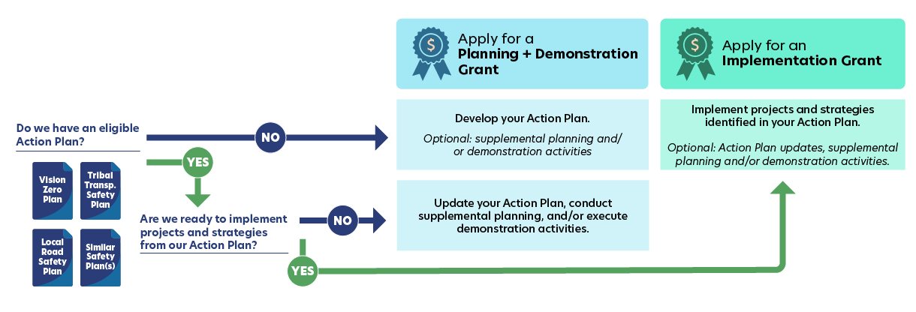
Planning and Demonstration or Implementation Grant?
See the Self-Certification Eligibility Worksheet to determine if your plan is eligible!
Notes:
PRESENTER
If you have done some safety planning, but aren’t sure which grant type to apply for, this diagram can help you confirm which grant path is right for you.
If your community does not already have a plan and is not covered by an eligible Action Plan at the county or regional level, or perhaps you have a plan, but it is missing some of the required SS4A elements detailed in the Self-Certification Eligibility Worksheet, you should apply for a Planning and Demonstration Grant. You may also include supplemental planning and/or demonstration activities if they will inform or enhance your Action Plan.
If you have an existing plan, and you’re thinking about applying for an Implementation Grant, but you’re really not sure if it meets the SS4A requirements, we are offering pre-application reviews of the action plan for Implementation Grant applicants. We’ll discuss the pre-application review in more detail later on in today’s presentation
If you already have an eligible Action Plan, you have some options:
One: Apply for an Implementation grant to deliver a project or strategy identified in your Action Plan.
Another option is to apply for planning and demonstration grant funding. Supplemental planning and demonstration activities should inform or enhance your Action Plan and/or gauge effectiveness of projects or strategies before implementing them permanently. If you are still working on your Action Plan, you can apply for Planning and Demonstration grant funds to do supplemental planning and demonstration activities, provided you received funding in a previous round to develop or update that Action Plan.
The supplemental planning and demonstration activities webinar will be held next week on April 23rd. That webinar will cover how they can be incorporated into SS4A grants. We want to highlight that we are encouraging these activities for either grant type, no matter where you are in the process. That is because they are relatively inexpensive, easy to complete activities that can increase safety and help your community better prepare for implementation projects.

Slide 19
Eligible Action Plans
NOFO pgs.
15-16, Table 1
Leadership Commitment and Goal Setting
Planning Structure
Safety Analysis
Engagement and Collaboration
Policy and Process Changes
Strategy and Project Selections
Progress and Transparency
Read more about Action Plans.
Notes:
PRESENTER
Action Plans are the foundation of the SS4A Program and are critical to reaching zero roadway deaths and serious injuries. There are 7 key components of an Action Plan which are listed here.
We won’t cover these components in detail today. You can check out our Action Plan webinar next week for more information on each of these components.
For the purposes of today, we’ll discuss how Implementation Grant applicants can self-certify whether their existing plans are eligible and meet the requirements listed here.
The SS4A website has many resources about Action Plans, what qualifies as an eligible plan for the purposes of the SS4A program, and how to develop a great Action Plan.

Slide 20
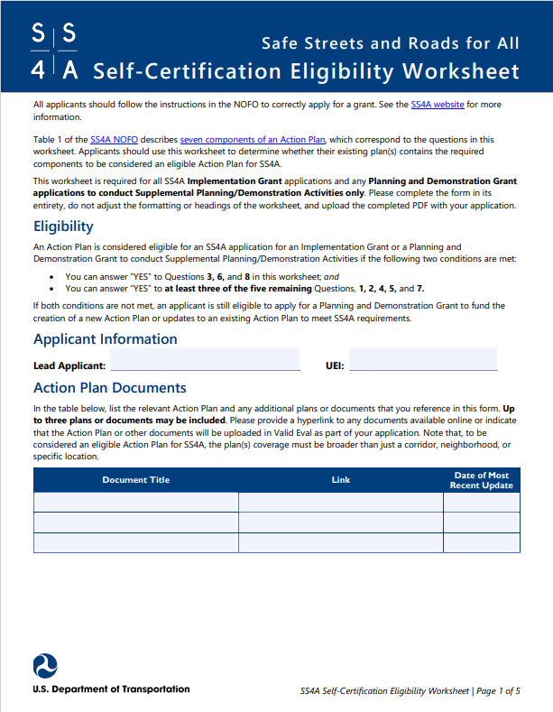
Self-Certification Eligibility
Potential Implementation Grant applicants may submit their Action Plans for a pre-application eligibility review by May 9th
Required:
Roadway safety analysis with mapping
A list of projects and strategies identified in the plan
Publication or updates between 2020 and June 26, 2025
Plus at least 3 of the following:
Commitment to eliminate roadway fatalities, and a safety goal
Task force responsible for the Action Plan
Meaningfully engaged public, stakeholders, partner agencies
Approach to updating existing plans, policies, guides
Metrics to assess progress over time
Notes:
PRESENTER
As part of your application, you are required to fill out a self-certification checklist, which walks you through the elements that should be in your Action Plan.
This checklist is available on the SS4A website and in Valid Eval and is the best way to identify whether your Action Plan is eligible.
If your existing plan does not meet these criteria, we encourage you to apply for a Planning and Demonstration Grant to update it to meet all the elements, and you could also include some supplemental planning and/or demonstration activities.
Note your eligible plan does not have to be called a “Comprehensive Safety Action Plan” or “Vision Zero Action Plan”, and you may meet the conditions through up to three plans – you just need to document that in this checklist.
Applicants can pre-submit their Action Plan for an eligibility review. Email SS4A@dot.gov with the subject “Implementation Grant Eligibility Review: [Applicant Name, State]” on or before May 9, 2025 with your self-certification eligibility worksheet and link to your publicly available Action Plan.

Slide 21
Action Plan Updates
NOFO, pgs. 14-15
Award Condition: Comprehensive Plans
You must update your Action Plan as a condition to receiving a grant award IF:
You have any "No" responses on the Self-Certification Eligibility Worksheet, OR
The Action Plan(s) does not include all road users.
You can request supplemental planning funding for this!
Award considerations:
Applicants which received SS4A funding in a previous round to develop or update an Action Plan.
Applicants with finalized Comprehensive Safety Action Plans that include all components in Table 1 of the NOFO.
New in FY24
New in FY25
Notes:
PRESENTER
As a condition to receiving an Implementation Grant award, you must update your Action Plan if it is missing any key components.
This includes the following:
If you said “no” to any of the responses in the Self-Certification Eligibility Worksheet.
Your plan does not include all road users; for example a pedestrian safety plan would need to incorporate bicyclist and motor vehicle safety.
You can apply for supplemental planning funds to complete any missing element. If you must do it anyways, you might as well have us pay for it! (or 4/5s of it).
In terms of award considerations:
NEW THIS YEAR: we have added an award consideration for IG applicants with Action Plans that were developed with funding from the SS4A program. We know there are communities that received funding early on in the program and now have completed plans and are ready to implement projects and strategies.
There is another incentive to update your plans to bring up as well – in FY24 and again this year we may give preference to applicants with Action Plans that meet all requirements of a Comprehensive Safety Action Plan.

Slide 22
Implementation Grant Activities
Notes:
Andrew hands over to Jessica

Slide 23
What does an Implementation Grant fund?
NOFO, pg. 20
Implementation Grants must fund the execution of projects and strategies identified in an Action Plan that address roadway safety problems, Activity (C).
Projects and strategies can be infrastructure, behavioral, and/or operationally focused.
Implementation Grants may also fund:
Planning, design, and development activities for projects and strategies identified in an Action Plan, Activity (B).
Supplemental planning and demonstration activities to inform the development of an Action Plan, Activity (A).
Notes:
PRESENTER
We covered this a bit earlier, but just to emphasize what Implementation Grants specifically fund – here is a list.
DOT encourages Implementation Grant applicants to include supplemental Action Plan activities in their applications to further improve and update existing plans.
Quick question: Should you submit an application that solely requests funding for design plans for a construction project that you are planning on funding via another grant? No! Implementation Grants must fund the actual execution of the projects and strategies. So you cannot just fund design for a project.

Slide 24
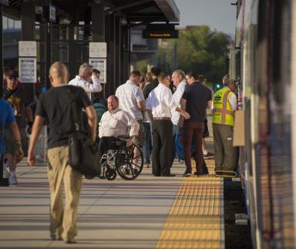
Implementation Grant Activities - Examples
Examples of Implementation Projects and Strategies (C)
Source: USDOT
Source: USDOT
Source: USDOT
Safe Routes to Schools
Speed Management
Highway Safety
Source: FTA
Source: USDOT
Source: USDOT
Transit Safety
Emergency Medical Service Interventions
Pedestrian Safety
Notes:
PRESENTER
Implementation Grants support projects and strategies that are identified in an action plan to address a roadway safety problem. There is a lot of flexibility in what that could encompass, including infrastructure safety, behavioral safety, and operational safety activities.
Examples include:
-Creating safe routes to school through education, outreach, crossing guards, and improved infrastructure that help young people safely walk, bike, or roll.
-Speed Management through complete streets re-designs and traffic calming programs
-Improving safety in rural and tribal areas through measures such as rumble strips and shoulder focused improved roadway markings.
-Improving safe transportation access through transit programs for users with disabilities by creating accessible infrastructure that enhances safety for all users getting to and from transit locations. Improvements must be roadway focused but are encouraged to include multimodal elements such as where people walk to a transit rail station.
-Improving first responder services with enhanced emergency vehicle warning systems and other measures to improve EMS response times.
-Working with community members in an identified problem area to carry out speed management and other street design changes.

Slide 25
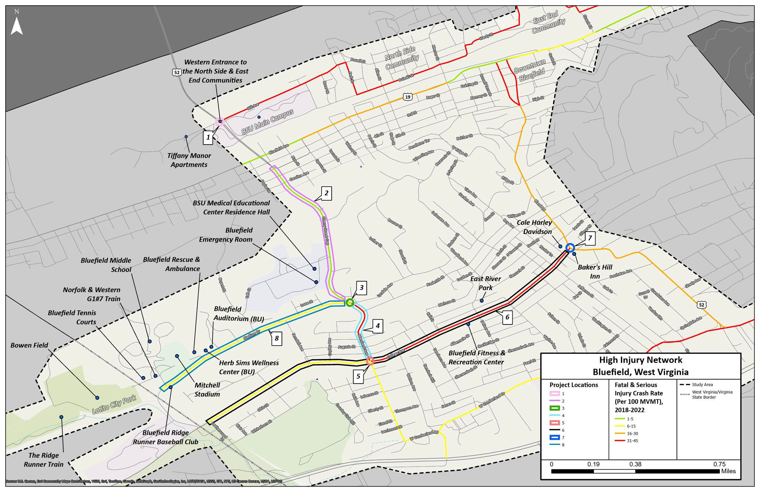
Implementation Grant Activities: Bluefield, West Virginia (FY24)
Bluefield, West Virginia: $25,547,532 Implementation
This project will convert four key intersections to roundabouts; install new multimodal accommodations and make safety improvements at 9 locations on the City’s high injury network.
Project includes:
New roundabouts
New sidewalks
New crosswalks
New & upgraded street lighting
Traffic calming strategies
Rectangular rapid-flashing beacons
Activity C
Image credit: City of Bluefield SS4A application
Notes:
PRESENTER
Here is an example of an SS4A FY24 Implementation Grant that was awarded to Bluefield West Virginia that had a systemic approach to their projects. Project locations and safety needs were clearly outlined in their action plan and the impact of the chosen safety improvements had data driven details for potentially significant safety benefits.

Slide 26
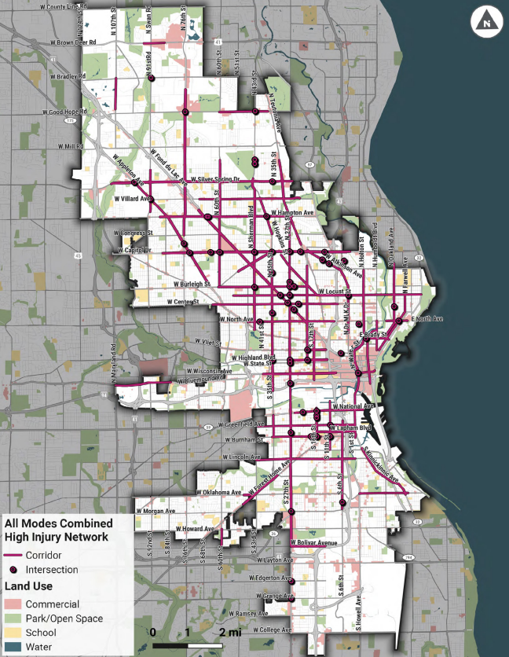
Implementation Grant Activities: City of Milwaukee, WI (FY24)
City of Milwaukee, Wisconsin: $25,000,000 Implementation
This project will implement an array of safety treatments to address reckless driving and elevated pedestrian/bicyclist crashes along a heavily used, two-mile corridor.
Activity B
Activity C
Project includes planning, design, and construction of the Center Street Transformation Project:
Bus bulb-outs and curb extensions
Reduced curb radii
Narrower travel lanes
Leading pedestrian intervals
Raised intersections
Speed limit reductions
Image credit: City of Milwaukee SS4A application
Notes:
PRESENTER
Here is another example of an SS4A FY24 Implementation Grant that was awarded to Milwaukee, WI that addressed safety needs along an important high-crash corridor. This is an example of an award that funded both project design (Activity B) and construction costs (Activity C).

Slide 27
Implementation Grant Activities: Southwest Minnesota EMS Corp (FY24)
Southwest Minnesota EMS Corp: $9,997,062 Implementation
This project will implement a regional tele-EMS system to expedite access to definitive trauma care after an injury causing crash.
Supports volunteer EMS agencies across 18 counties; 54 agencies receive access to Avel eCare services to an area with no Level I or Level II Trauma Centers
Activity C
Image credit: Southwest Minnesota EMS Corp SS4A application
Notes:
PRESENTER
Here is an example of an SS4A FY24 Implementation Grant that was awarded to Southwest Minnesota EMS Corp that involves implementation of an emergency medical service intervention enhancement project.

Slide 28
Demonstration Activities
NOFO pg. 17
Demonstration Activities to inform an Action Plan
Feasibility studies using quick-build strategies, low-cost, and temporary materials
Manual on Uniform Traffic Control Device (MUTCD) engineering studies
Pilot programs for behavioral or operational activities that include at least one element of the Safe System Approach
Pilot programs that demonstrate safety benefits of new technologies
Image credit: Solomon Foundation
See Demonstration examples on the SS4A Webpage.
Notes:
PRESENTER
As I mentioned earlier, despite the lowered set aside for planning and demonstration, we still encourage applicants to bundle supplemental planning and demonstration activities into their Implementation Grant proposals.
Demonstration activities:
We have lots of information on our website, including examples of previous funded activities.
Demonstration activities are temporary in nature and meant to test changes that will advance safety before you spend millions on projects and strategies.
Demonstration activities tie back to information in the Action Plan, especially the list of projects and strategies.
One question you might have is, “what is the difference between implementing projects and strategies and doing demonstration activities?”. Well, demonstration activities are supposed to be temporary and smaller scale and must get assessed for their benefits. That assessment informs the Action Plan and your list of projects and strategies in that plan. Implementing projects and strategies can be permanent construction and long-term solutions, and they’re already on your Action Plan’s to-do list.
More examples of eligible demonstration activities, including examples of funded demonstration activities from previous rounds is available on the SS4A website: https://www.transportation.gov/grants/ss4a/example-funded-supplemental-planning-and-demonstration-activities
We will host a webinar about supplemental planning and demonstration projects next week, on Wednesday, April 23 from 1:30-3pm. You can register for that webinar on our website.

Slide 29
Demonstration Activities vs. Projects and Strategies
NOFO pg. 15
Demonstration activities in support of an Action Plan (A2)
Informs the list of projects and strategies in an Action Plan
Projects and strategies identified in an Action Plan (C)
Listed in an Action Plan as a project and/or strategy
Temporary in nature
Small scale
Pilots and testing, finite period
Assesses the benefits of an approach
Permanent
Major construction
System-wide
Implementing the Action Plan
Notes:
PRESENTER
I just went through the groups of eligible demonstration activities, and now I would like to reiterate the difference between “demonstration activities” and “implementation.” They can be easily blurred, depending on the materials you use, the scope of work you perform, and so what distinguishes each activity is important. Signage and plastic bollards and technology all could be part of a bigger implementation project, so it gets tricky.
Since there are a lot of scenarios for demonstration activities, I can’t outline every example of what’s in and what’s out, but here are some general guidelines.
Demonstration activities are temporary in nature, for a finite period, smaller scale, pilots and tests to inform an action plan, and incorporate a way to assess the benefits of the approach.
If it is not informing an Action Plan, or if you are not assessing the benefits, it’s not a demonstration activity.
Implementation, on the other hand, is listed as project and strategy in an Action Plan to address an identified safety problem. It can be permanent, major construction related, be system wide, and is really implementing the Action Plan.
One rule of thumb to bring up: if you are ripping up or pouring concrete it’s very likely an implementation project, not a demonstration activity.
While demonstration projects are eligible for funding through Implementation Grants, it is important to understand the distinction between activities A and C for two key reasons.
The first reason is that your IG application MUST include activity C. If your application only includes more temporary, pilot-style projects, you should apply for a Planning and Demonstration Grant.
The second reason is that as part of the application itself, you will need to itemize and show the funding request for activities A, B, and C. So it is important for you to understand which is which.

Slide 30
Supplemental Planning Activities
NOFO pg. 17
Supplemental planning enhances an Action Plan and could include:
Topical, complementary safety plans
Road safety audits
Consolidating Action Plans components into a single Comprehensive Safety Action Plan
Additional safety analysis and data collection
Progress reporting
Stakeholder engagement and collaboration
Updating existing Action Plans
See Supplemental Planning examples on the SS4A webpage.
Image Credit: FHWA, 2022
Notes:
We are also emphasizing the benefits and opportunity to include supplemental planning activities in your application.
Supplemental planning encompasses any updates or enhancements you make to the components of your Action Plan. It can be updating an existing plan, or adding bells and whistles, or taking deeper dives based on the identified needs of your community.
Topical safety sub-plans could be speed management, accessibility for individuals with disabilities, Americans with Disabilities Act of 1990 (ADA) transition plans, safety-focused Intelligent Transportation System implementation, lighting, or other relevant safety topics.
Maybe there’s a high injury network series of roads that you want to do road safety audits on, or additional data analysis to identify contributing factors.
You can also conduct follow-up stakeholder engagement and collaboration, for example to gather input on a potential project idea or strategy.
You can also apply for supplemental planning to update or fill out elements in your existing plan. So if your plan is on the older end of a 5-year period, or if you met the self-certification checklist criteria but were missing some elements, or piecing together the eligibility from multiple existing plans, we strongly encourage you to update your plan. You can include a funding request for supplemental planning to do so.

Slide 31
Supplemental Action Plan Activities vs. Project-Level Planning
NOFO pgs. 20-21
Supplemental Planning in support of an Action Plan (A1)
Planning, design, and development activities for projects and strategies identified in an Action Plan (B)
Pre-construction engineering or design for an infrastructure project;
Follow-up stakeholder engagement and collaboration;
Action Plan progress report development;
Complementary planning efforts such as speed management plans, accessibility and transition plans, and lighting management plans.
Documentation to comply with the National Environmental Policy Act requirements for a specific project;
Right-of-way acquisition;
Permitting for an infrastructure safety project;
Expanded analysis and/or data collection;
Developing advertising documents
Note: Any funds requested for (B) activities must be directly tied to (C) activities. E.g., if you are applying for (B) to design a new roundabout, you must be applying for (C) to build that same roundabout.
Notes:
We understand that the term “planning” encompasses a broad set of activities and so we want to be clear about what is supplemental planning. Again, both A and B are eligible activities for an Implementation Grant, but because you will need to enter them separately in your application, we want to help you understand the differences.
Supplemental planning activities under eligible activity (A) support or enhance an Action Plan. The final deliverable for supplemental planning is a written product that connects to, and enhances, an Action Plan and is publicly available.
On the other hand, Planning, design, and development activities for projects and strategies identified in an Action Plan (activity B) support project-level design or implementation. A project-level environmental review or the construction design of a project are two such examples.
Note - Any funding requested for (B) activities must be directly tied to (C) activities. E.g., if you are applying for (B) to design a new roundabout, you must be applying for (C) to build that same roundabout.

Slide 32
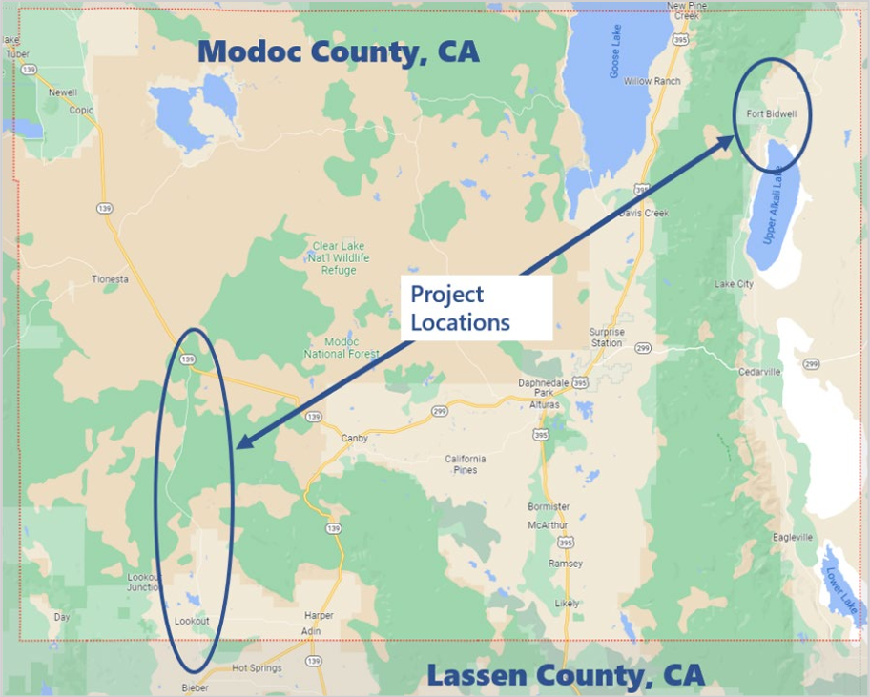
Implementation Grant AND Supplemental Planning Activities: Modoc County, CA (FY22)
Modoc County, California: $12,954,400 Implementation
This project will improve safety along two corridors in rural disadvantaged communities and Tribal areas that have Modoc County’s most dangerous crash history: County Road 91 and County Road 1.
Project Highlights:
Implement speed control, and infrastructure features for persons with disabilities, and pedestrian crosswalks.
Update crash data to include the most recent 10-year period to help validate data sets and show the effectiveness of the safety improvements.
Activity C
Activity A
Notes:
Here is an example of an SS4A FY22 Implementation Grant that was awarded to Modoc County, California.
This is a great example of how a community can include both implementation and supplemental planning within a single Implementation Grant application.
Implementation activities include – speed control and implementation of accessible infrastructure features for persons with disabilities.
Supplemental Planning activities include – updating crash data.

Slide 33
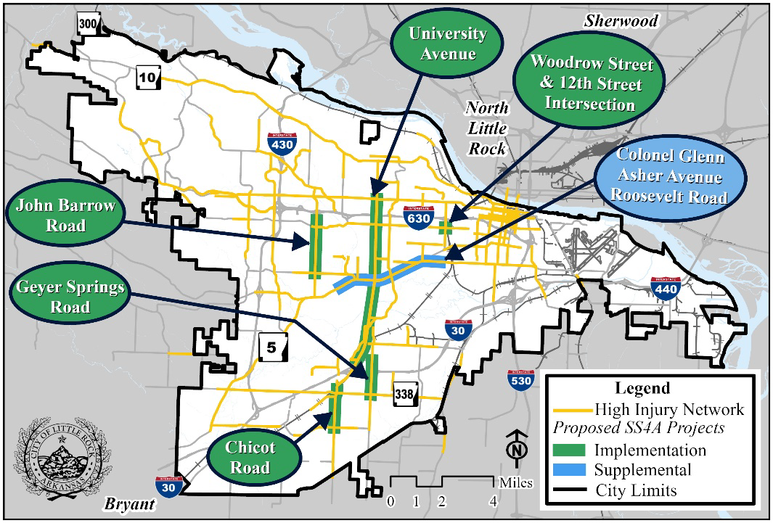
Implementation Grant AND Supplemental Planning Activities: Little Rock, AR (FY24)
Little Rock, Arkansas: $25,000,000 Implementation
This project will make improvements to five major corridors for implementation and one major corridor for supplemental planning along its high-injury network.
Project Highlights:
Implement speed control, corridor access management, roundabouts, roadway reconfiguration, and pedestrian crosswalks.
Conducting a planning study along one high-injury network segment and four high-injury intersections that scored in the top 10 segments and top 20 intersections in the region.
Activity C
Activity A
Notes:
Here is an example of an SS4A FY24 Implementation Grant that was awarded to Little Rock Arkansas
This is another great example of how a community can include both implementation and supplemental planning within a single Implementation Grant application.
Implementation activities include – systemic deployment of over 20 FHWA proven safety countermeasures across projects identified in the action plan that are on the HIN
Supplemental Planning activities include – planning study & road safety audit.

Slide 34
Implementation Grant Activities - Reminders
Reminders
Projects and strategies must be identified in an existing, eligible plan.
Projects and strategies outside of an eligible plan should not be included.
Projects and strategies that cross multiple political subdivisions, safety issue areas, and corridors/roadway networks are permitted and can be bundled together so long as they are in an existing, eligible plan(s).
Implementation Grants may fund supplemental planning and demonstration activities to inform an Action Plan. Implementation Grants do not fund the development of new Action Plans.
Applicants may only submit a single application.
Notes:
In general we are looking for systemic projects over a large geographic areas that address safety problems along for example multiple high crash corridors as opposed to an individual spot treatment as the sole project. You can bundle multiple projects into one Implementation Grant application.
We encourage folks to include projects and strategies that address multiple safety issue areas to the extent it makes sense. Maybe in part you focus on activities to address driver speeding in one area, a dangerous curve in a different area, and the safety of people walking in yet another area that is covered by the action plan. This can include different geographic areas, just make it clear in the application the location(s) and how it connects back to your jurisdiction’s safety problems.
As I mentioned before, one application per eligible applicant which includes joint applications. You may partner with many entities.

Slide 35
Ineligible Projects and Strategies
✖
Projects and strategies whose primary purpose is not roadway safety.
Projects and strategies exclusively focused on non-roadway modes of transportation.
Capital projects to construct new roadways used for motor vehicles. New roadways exclusively for non-motorists is an eligible activity if the primary purpose is safety-related.
✖
Infrastructure projects primarily intended to expand capacity to improve Levels of Service for motorists on an existing roadway, such as the creation of additional lanes.
Maintenance activities for an existing roadway primarily to maintain a state of good repair. However, roadway modifications on an existing roadway in support of specific safety-related projects identified in an Action Plan are eligible activities.
Development or implementation of a public transportation agency safety plan (PTASP) required by 49 U.S.C. § 5329.
✖
✖
✖
✖
Notes:
Now here are some examples of ineligible Implementation Grant projects and strategies as defined in our NOFO

Slide 36
How to Apply
Notes:
Carolyn

Slide 37
Application Overview
NOFO pg. 25
Obtain a Unique Entity Identifier Number (UEI) via SAM.gov.
Before submitting your SS4A application, you must obtain a UEI. This may take up to 30 days.
Register with Valid Eval
Registration should take around 10 minutes.
Do not apply through Grants.gov
Submit on time!
Applicants that do not already have a UEI are encouraged to start this process now.
You will need to register for the Valid Eval account that corresponds with the grant type you wish to apply for (Planning and Demonstration, or Implementation).
Final applications must be submitted by: June 26th, 2025
Applicants that already have UEIs are encouraged to verify their UEI is active on SAM.gov
Applicants are strongly encouraged to submit in advance of the deadline.
The primary contact will receive a confirmation email after submission.
Notes:
PRESENTER
Let me walk you through a few of the key steps on how to apply for an SS4A grant.
you must have a Unique Entity Identifier (UEI) number in order to apply. To request a UEI, please visit SAM.gov. Note that this may take up to 30 days, so the sooner you apply the better. If you have an existing UEI, you may need to renew it. Keep in mind other departments in your community may have a UEI already, so coordinating with them may help. Please verify your UEI is active before initiating your SS4A application.
Register with Valid Eval:
Valid Eval is a software company SS4A uses to receive and evaluate applications. Applicants MUST submit their applications via Valid Eval. Do not submit an application to Grants.gov, it will not be accepted.
Go to Valid Eval’s signup page and register for one of two account types, depending on the grant type you are applying to. You can register now, I suggest doing so sooner rather than later.
There’s a different registration link for Planning and Demonstration Grants, and Implementation Grants. If you plan to apply for an Implementation Grant, please be sure you are using the correct sign up link.
The person who registers for Valid Eval and submits the application will be the primary contact for the application and must be employed by the applicant (the city, town, county, etc.)
This person should be someone we can contact between when your application is submitted until December 2025 who will respond within 2 business days, and put up an away message with another POC while on leave.
A contractor can help with the application process, but the POC must be someone from the organization applying.
Late applications
There is a single application deadline for SS4A Grants this year– June 26th, 2025 at 5:00 PM EST. Late applications will not be accepted. If you have technical issues submitting, we can only consider your application if you contact support@valideval.com documenting your technical issue no later than 4 hours prior to the application deadline.

Slide 38
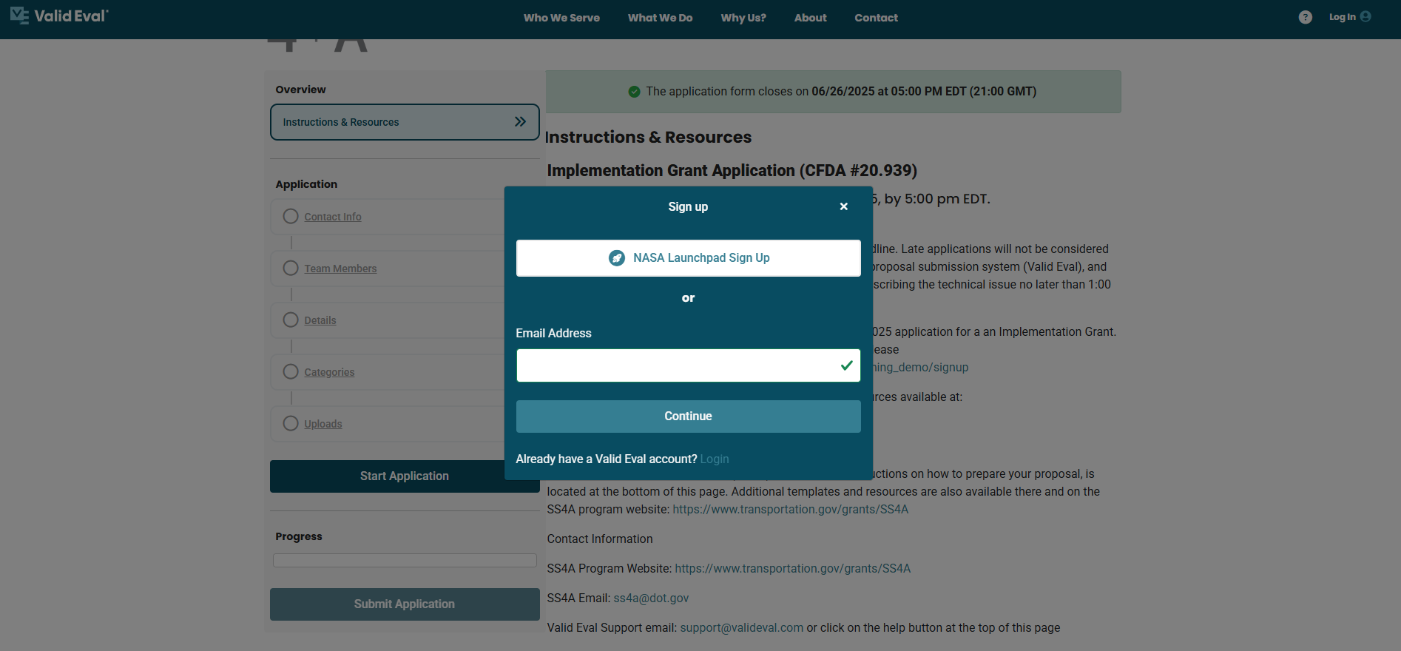
Sign Up for Valid Eval
Notes:
PRESENTER
This is what the Valid Eval registration page looks like.
You will need to register with your email address or if you already have a Valid Eval account, login with your credentials
Once you sign up, basic contact information will auto-fill.
You will be able to save your application and come back to Valid Eval later if you cannot complete the application in one sitting.
We recommend reviewing the questions early on to ensure that you have all required information.
At the bottom of the Valid Eval sign up page, you can see a list of the required documents which are available for download in the application. Many of these documents are also available on the SS4A website.
Valid Eval will not let you submit if you are missing required information.

Slide 39
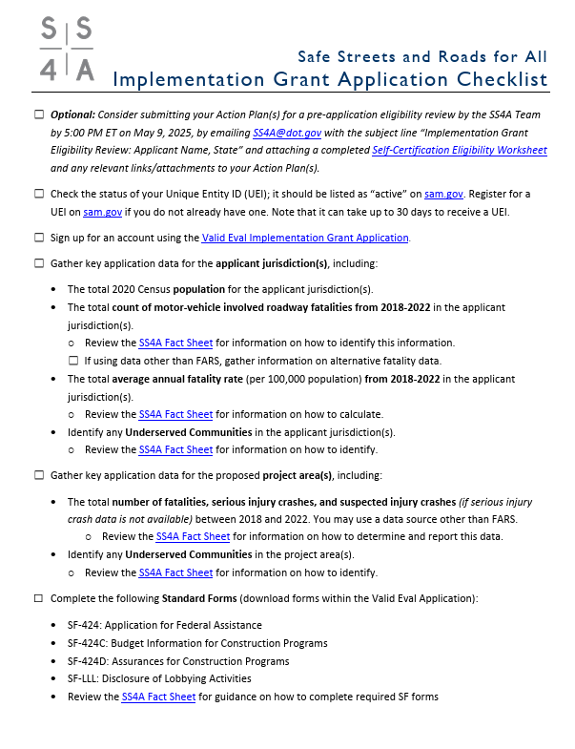
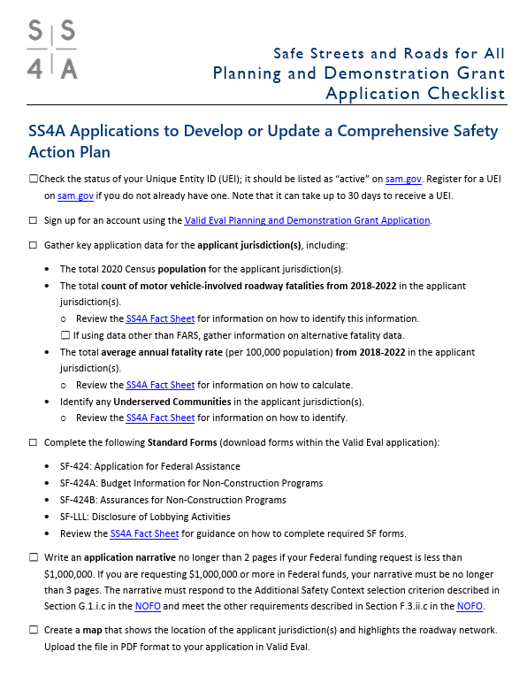
Application Aids
A series of checklists and planning worksheets is available on the SS4A website and Valid Eval to help guide applicants through the eligibility and application process.
SS4A Resources Webpage
Notes:
Speaking of our website, I’d be remiss not to mention that we have a lot of resources on our website to help you fill out your application.
We realize that for some of our applicants this is their first Federal funding request, and some folks might not be familiar with the process.
To support our first time Federal applicants, we have created a lot of resources to help you develop a successful application. There are tons of resources to help you, including checklists, FAQs, step-by-step instructions on how to get the required data points, and explainers on key topics of interest based on last year’s funding round.
We also periodically update the website with timely info on FAQs and more
We highly recommend that you review these materials to ensure that you are submitting a complete application.
If you have questions there’s a decent chance the answer is in our materials; however, if you can’t find answers, we have an email inbox to reach out: SS4A@dot.gov

Slide 40
Standard Forms
NOFO pg. 34
Application for Federal Assistance (SF-424)
Budget Information for Construction Programs (SF-424C)
Assurances for Construction Programs (SF-424D)
Disclosure of Lobbying Activities (SF-LLL)
NOTES:
Downloading the blank SF forms from Valid Eval will help ensure that you have the correct version and that you can sign digitally (particularly for the SF-424)
Make sure that the request amounts on the SF-424, SF-424C, and other application materials are the same!
Notes:
PRESENTER
To apply for an Implementation Grant there are some basic forms to fill out.
There are multiple versions of the SF forms, and so to avoid confusion, we recommend downloading the blank SF forms from Valid Eval to ensure you have the correct version.
Please note that several of the SF forms you will be asked to complete have expired. These are the latest form versions and so please go ahead and complete them. It is possible that if updated SF forms are released during the SS4A grant cycle, we may ask applicants selected for award to complete the updated forms.
Friendly reminders to:
Make sure you sign SF forms digitally (unless your jurisdiction requires wet signatures)
Make sure your total Federal funding request, local match, and total project cost are the same across the SF-424C, the SF-424, your supplemental budget, and what’s entered in Valid Eval
There is an SF form fact sheet that has more information on how to complete the required SF forms that we will go over in more detail on the next slide.

Slide 41
How to Complete Standard Forms
Standard Forms (SF) “How To” Guide for SS4A
Intended to assist applicants with step-by-step guidance on how to complete the required Standard Forms
Standard Forms “How To” Guide for SS4A
Notes:
PRESENTER
There is one application aid that is new this year that I wanted to highlight and that is a Standard Form “How to” Guide.
We know that navigating the laundry list of forms can be daunting. To help applicants navigate the submission requirements we have provided a Standard Forms How To Guide which is intended to assist applicants with completing the required SFs for SS4A. We recommend using the forms included in the Valid Eval application or linked in this application aid to ensure you are completing the correct versions of the forms.

Slide 42
Key Information Questions
NOFO pgs. 34-36
Lead applicant name and UEI
Total applicant jurisdiction population
Total count roadway fatalities 2018-2022
Total average annual fatality rate per 100,000 population
Inclusion of underserved communities in jurisdiction(s) and project area(s)
Project area fatalities 2018-2022
Project area serious injuries 2018-2022
Project title and goal
Total SS4A funding request, non-Federal share, total SS4A project cost, and total other Federal funds (if applicable)
See Section F – Submission Requirements and Deadline – of the NOFO for a complete list
Notes:
As part of the SS4A application we ask applicants to provide data points related to your safety profile overall, whether your jurisdiction(s) and project area(s) include any underserved communities, and specific fatality and serious injury data for the project areas in the proposal.
We have resources and guides to help to provide accurate information for all of this.
The next few slides highlight these resources.
Include historical crash information for the project area, specifically the # of relevant fatalities and serious injuries for the projects. This is one way we are asking folks to show the magnitude of the safety problem, and I’ll talk later on about how we plan to combine it with your Federal funding request.
Want more direction on how provide that project area fatalities and serious injuries? We have a fact sheet online.

Slide 43
Calculating Key Application Data
Fatality Count
5-Year Average Fatality Rate (Per 100,000 Persons)
See the “Calculating Average Annual Fatality Rate” SS4A Fact Sheet for more information
See the “IG Project Area Crash Data” Fact Sheet for more information on obtaining project-level data
Total count motor vehicle-involved roadway fatalities from 2018 to 2022
Example: 217 fatalities
Total count motor vehicle-involved roadway fatalities from 2018 to 2022
÷
5
÷
Total jurisdiction population
× 100,000 Persons
Example: 217 fatalities ÷ 5 years = 43.4 avg fatalities
43.4 avg fatalities ÷ 1,255,296 population = 0.0000346
0.0000346 per capita × 100,000 =
3.46 fatalities per 100,000 persons
Notes:
PRESENTER
As discussed, Implementation Grant applicants are required to provide crash data for their jurisdiction(s) and project area(s)
For each of the requested data points, we have resources on how to obtain them. Good news: they are from publicly available sources, and we have tried to make life as easy for you all as possible.
Why do we ask for these data? Well, I’ll show it later it on but it’s another way we look at safety need and the extent of the roadway safety problem. These data points we are asking for reflect safety need in different ways:
# of fatalities (entire jurisdiction)
Fatality rate per population
Let me walk through these with you.
I’ll note that we will be spot checking these numbers for accuracy once applications are submitted. Try your best to provide the information based on the instructions, and we’ll be looking on the backend at these.
Fatality Count
For the fatality information we recommend using the Fatality Analysis Reporting System or FARS. We are asking for years 2018-2022 so it will be comparable across all applicants. Our colleagues at the National Highway Traffic Safety Administration has a nifty tool called the FIRST tool where you can query your fatality count.
Note we’re looking for the number of people killed in a crash, not the number of crashes with fatalities in them.
For those who have their own data to submit, you can also submit a fatality count from another source but you need to cite where it came from and you should reference 2018-2022 data.
Fatality Rate
Once you have your fatality count, you are part way there already.
We’re normalizing fatalities on a per population basis to reflect the fact we have communities of all different sizes applying for the program.
When we say “average annual rate,” we mean per 100,000 persons and should use an annual average as opposed to a 5-year count.
Next is to get your jurisdiction’s population, which is based off of the 2020 Census population data for the jurisdiction or jurisdictions included in your application. You can grab that information from the U.S. Census website.
For population data, if your application includes multiple jurisdictions or areas, you should use the population for the Census tracts that best align with the jurisdictions included in the application.
Once you get the population figure you want to do the calculation we have on this slide. Let’s walk through the example…
Finally for Implementation Grant applicants, you will also be required to provide the number of fatalities in your project area(s) as well as any serious injury crashes or suspected injury crashes (if known). More information on how to provide the necessary project area crash data for your application is provided in an application aid on the SS4A website.

Slide 44
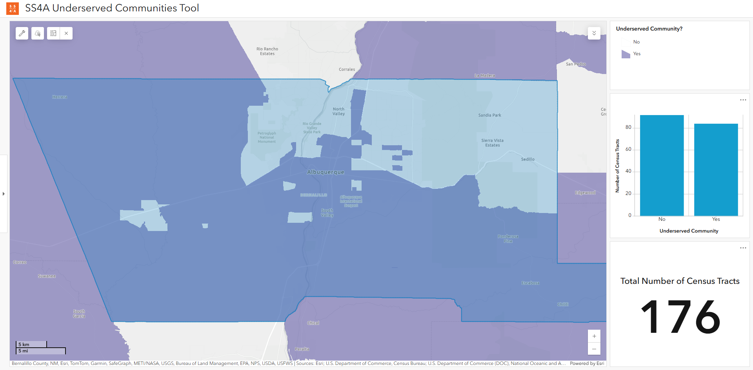
Population in Underserved Communities
Use the DOT Underserved Communities Tool to identify whether your jurisdiction(s) are entirely, partially, or not included within an underserved community.
When you visit the Tool, there are a couple of ways to find your jurisdiction:
Zoom and pan on the map.
Enter a location or address.
Underserved communities are indicated in purple on the map. A visual assessment is generally appropriate to determine whether your jurisdiction(s) contain any underserved areas.
SS4A Underserved Communities Tool
Notes:
PRESENTER
The next requirement is related to underserved communities. There have been several changes to this application requirement this year, so please be sure to check out the NOFO and our identifying underserved communities application aid available on the SS4A website for more information.
Per the NOFO, underserved communities are defined using the same definition as Areas of Persistent Poverty. There are a couple of ways that Areas of Persistent Poverty are defined (which are spelled out in the NOFO), but essentially these are Census tracts or counties with a history of having a population living in poverty that is greater than or equal to 20% of the population.
In the past, we have asked applicants to determine the percentage of the population living in an underserved community, but we are simplifying things this year, and you will just need to identify whether the jurisdiction(s) and project areas included in the application are entirely, partially, or not included within an underserved community.
We have developed a mapping tool to help you determine which category your jurisdiction is in.
In the example on the slide (Albuquerque, NM), a visual assessment of the map of Albuquerque, New Mexico shows that the jurisdiction is partially located within an underserved community.
Note that Implementation Grant applicants must also identify whether their proposed project areas are entirely, partially, or not included within an underserved community
There are additional instructions on the SS4A website to use the tool for a more detailed determination.
Note that the Percentage of the population in an Underserved Community Census tract is considered as part of the decision criteria – USDOT will be making this calculation for all applicants to ensure that the approach to the calculation is consistent across all applications.

Slide 45
Narrative for Implementation Grants
NOFO pg. 37-40
Narrative – Up to 12 pages to respond to the selection criteria and describe the project readiness.
Up to 14 pages if including supplemental planning and demonstration activities. The extra 2 pages must be focused on responding to the “Supplemental Planning and Demonstration Activities” selection criterion.
The Self-Certification Eligibility Worksheet, Budget, and appendices do not count towards the page limit.
See Section F.3.iii.c for additional narrative style guidelines.
Narratives should respond to the Implementation Grant selection criterion outlined in NOFO Section G.1.ii
Applicants are not required to follow a specific narrative format, but the structure should clearly identify the narrative associated with each selection criterion.
The Department recommends the narrative follow the outline below:
Overview
Location
Response to Selection Criteria
Project Readiness
Notes:
Now let’s talk about the application narrative, and the expectations here.
The narrative, which describes your scope of work and responds to the selection criteria, can be no more than 12 pages. We will allow up to 14 pages if your application includes supplemental planning or demonstration activities, but those extra pages must be focused on responding to the Supplemental Planning and Demonstration Activities selection criterion.
You can do appendices, but we recommend minimizing those to just essential supporting documents that corroborate what you are saying in the narrative.
On the next several slides we will talk about some of the additional application elements. For a full list of application requirements, see Section F of the NOFO and the Implementation Grant checklist shown earlier

Slide 46
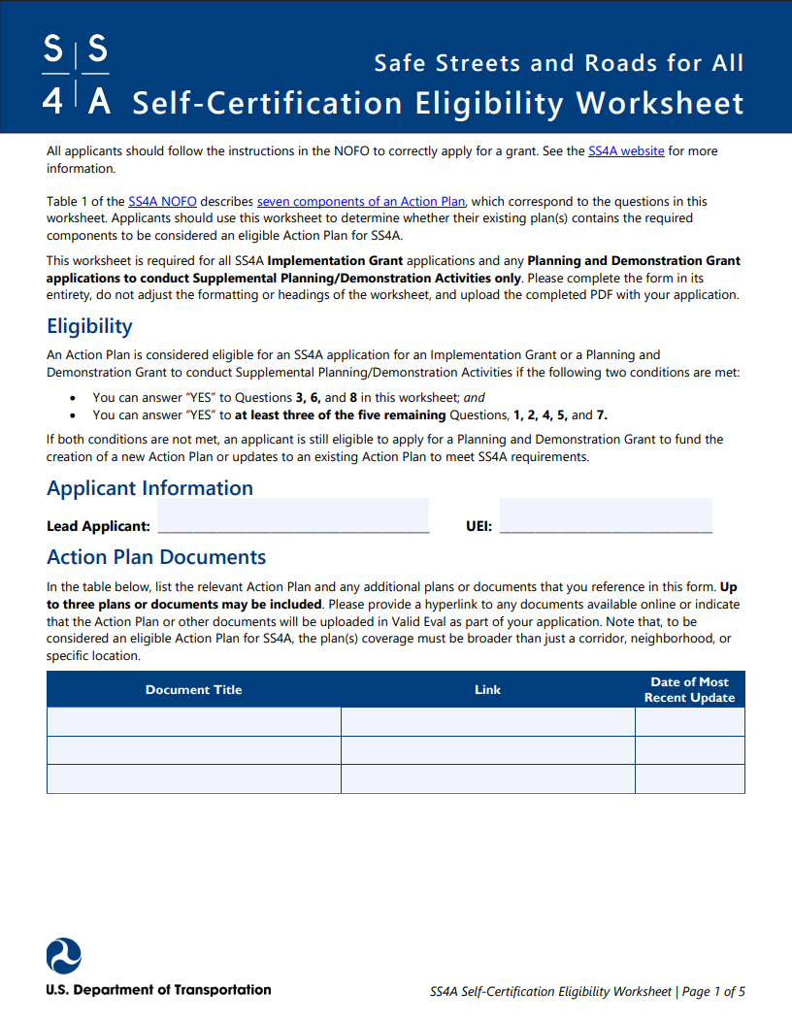
Self-Certification Eligibility Worksheet
Implementation Grant applicants must have a finalized eligible Action Plan by June 26, 2025.
Eligible Action Plans MUST be able to respond “yes” to questions #3, 6, and 8 in the Self-Certification Eligibility Worksheet:
Safety Analysis (#3)
Strategy and Project Selections (#6)
Plan was finalized and/or last updated between 2020 and June 26, 2025 (#8)
AND at least 3 of the 5 remaining questions:
Leadership commitment and goal setting (#1)
Planning Structure (#2)
Engagement and collaboration (#4)
Policy and process changes (#5)
Progress and transparency (#7)
SS4A Self-Certification Eligibility Worksheet
Notes:
We touched on this at the beginning of today’s webinar but let’s dive into this self-certification eligibility worksheet in more detail.
You must have an eligible action plan to apply for an Implementation Grant
You may submit a pre-application eligibility review for help in determining the eligibility of your existing Action Plan.
Email SS4A@dot.gov with the subject, “Implementation Grant Eligibility Review: [Applicant Name, State]”.
You can expect us to get back to you within a couple of weeks.
The deadline for those requests is May 9, 2025
We require links/PDFs of your plans, and specific citations to make the verification process seamless.
Moral of the story, follow the directions and you’ll be fine.
There are 8 questions, of which 3 must be a Yes to be an eligible plan related to analysis, the list of projects and strategies, and the timeliness of the plan.
Let’s go through them.
Analysis (#3)
Analysis of existing conditions and trends to establish a baseline in your jurisdiction;
Locations of past crashes along with contributing factors and crash types;
Systemic and specific safety needs that go beyond just crash location (road features, specific safety needs)
Strategy and Project Selections (#6)
it must include a list of projects and strategies are the activities to address your roadway safety problems. Should include time horizons and prioritization, acknowledging that some of these projects and strategies are contingent on funding, which is why you applied for the Safe Streets and Roads for all program in the first place.
Date (#8) - the plan needs to have been finalized or last updated within the past 5 years – so anytime in 2020 until June 26, 2025.
If you can’t meet that timeline, I would suggest looking into the Planning and Demonstration Grant.
Link here - https://www.transportation.gov/grants/ss4a/self-certification-worksheet
In addition to those 3 required Yes questions, you have to be able to say yes to 3 out of the 5 remaining questions. I won’t go through these in the same detail, but the other questions focus on the key components found in Table 1. Let’s go through them.
Public leadership commitment that states a goal of zero roadway fatalities and serious injuries, and a target date for a reduction
Some folks have stated a goal of zero by X date. USDOT committed to zero and committed to a 2/3 reduction by 2040
Was a coordinating body responsible for developing, implementing and monitoring the Action Plan? A summer intern in a vacuum doesn’t count.
Did you engage the public, the private sector, and community groups that informed the plan development? Or was it a few folks in your Public Works Department?
Did you also have coordination with inter and intra governmental efforts, as appropriate based on your specific situation and context?
Did you assess policies, plans, and guidelines to prioritize safety?
Is the plan public, and how are you measuring progress over time?
Remember that if your plan doesn’t have all 5 of the remaining elements, you will need to update these as a condition of your award.

Slide 47
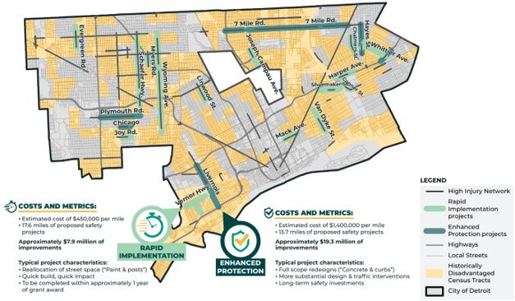
Location and Map(s)
NOFO pg. 39
Need to show your:
Jurisdiction’s boundaries
High-Injury Network or equivalent
Location(s) for projects and strategies
Ensure that the map is of adequate quality for reviewers to understand your community and project.
Submit the map in:
PDF file; and
Spatial format (e.g., Shapefile, .KML)
Example: Detroit, MI FY22 Implementation Grant Map
New in FY25
See the “Preparing your Spatial Data File” application aid for assistance.
Notes:
We require you to provide mapping information to show your jurisdiction, high-injury network or equivalent, and the location(s) for the projects and strategies.
Some like Detroit, - the example shown here - did all 3 at once and threw in underserved Census tracts.
For those who are choosing to select locations later on, which you can do, you need to ID which locations are under consideration.
Note that – as mentioned earlier – you’ll need to submit the map in PDF and shapefile formats

Slide 48
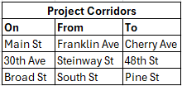
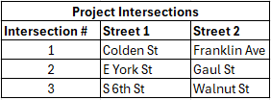
Location and Map(s) Contd.
NOFO pg. 39
Why this data is important
Program Evaluation
Communicating reach & impact of program
How the data gets used
Check & validate application information
Tracking safety trends over time
Where the funding is going
What populations are benefiting
Pro tip:
For applications with multiple project corridors, we recommend including a table of the segments in your application. Intersection # should match those listed on the map.
See the “Preparing your Spatial Data File” application aid for assistance.
Notes:
Location data is important to include as it gets used for program evaluation and creating dashboards to show the reach and impact of the program
Location data gets used to check & validate application info, tracking safety trends over time, and where the funding is going ex what populations are benefiting
IG Protip: For applications with multiple project locations, include a table of the segments in your application to better define where the project activities are taking place.

Slide 49
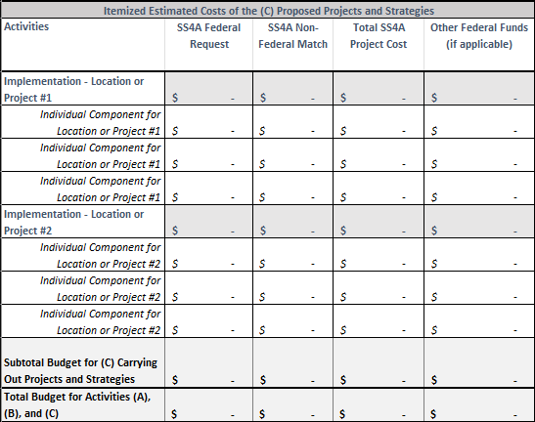
Required Budget Documents
NOFO pg. 42
SF-424
Distinguish between Federal and Non-Federal share in section 18
SF-424C Budget Information for Construction Activities
Distinguish between Federal and Non-Federal share
Supplemental Estimated Budget to distinguish costs by eligible activity areas – A, B, and C – and itemize major expenses
Budget Template Excel file provided in Valid Eval
Valid Eval
Provide cost breakdown by Federal, non-Federal match, Total project cost, and Other Federal funds (if applicable)
Implementation Grant Supplemental Budget Template
Notes:
Implementation
The budget only includes eligible costs associated with executing Implementation grant.
On the SF-424C form funding sources should be clearly grouped into two categories: Federal share, and non-Federal share.
We also require a supplemental estimated budget that does two main things:
Provide an itemized inventory of major expenses; and
Delineate the funding amounts for work that is under Activity (A), Activity (B), or Activity (C). We use this information to know how much funding for supplemental planning and demonstration activities you requested, which goes to that planning set aside instead of the available implementation funds.
We have developed a budget template, which is available in Valid Eval and shown here. This file illustrates how you can organize your budget and I encourage you to use it. Why re-invent the wheel?
NEW THIS YEAR: We have also developed an example budget to help applicants see the level of detail we are looking for. An example for Implementation Grants is linked here and I encourage you to look at it: https://www.transportation.gov/grants/ss4a/implementation-grant-budget-template

Slide 50
Budget – Administration and Requirements
Please account for the administration of a grant agreement, policy provisions, and reporting requirements:
2 CFR Part 200
Civil Rights and Title VI
National Environmental Policy Act of 1969 (NEPA)
Domestic Preference Requirements
Labor and Workforce
Critical Infrastructure Security and Resilience
Other Administrative and Policy Requirements
Progress reporting on grant activities
Data submissions on program outputs and outcomes
Notes:
Speaking of budgets, I wanted to briefly reference Federal requirements when thinking about your budget, which are an administrative burden applicants should consider.
Should you get an award, there are strings attached and reporting requirements.
If you are uncertain about how much is the level of effort for such administrative burdens, you will probably be disappointed to hear it’s more than you’d expect. Talk with someone who has done a similar grant before to hear about what will be expected. Your State DOT, your local transit agency, maybe your MPO would be good to ask.
We are committed to helping those be able to successfully execute their grant agreement and abide by all Federal requirements.
Look at section H of the NOFO for more details, but I highlight various components worth flagging here.

Slide 51
Agreement Funding: 20% Cost Share and Match Reminders
Recipients must contribute a non-Federal matching share of no less than 20 percent of TOTAL eligible activity costs.
Grant agreements are expected to be administered on a reimbursement basis, and recipients will be reimbursed for up to 80% of their eligible expenses.
Tribal Transportation Program and Tribal Transportation Program Safety Funds may be used as non-Federal match.
SS4A will waive up to $200,000 in local match requirements for eligible applicants located in the U.S. Virgin Islands, Guam, American Samoa, and the Commonwealth of the Northern Mariana Islands; there are no other match waivers for the program.
Local match may only be used once and may not be used as match for multiple Federal awards.
Notes:
PRESENTER
As mentioned previously, SS4A has an 80 / 20 cost share requirement, so up to 80% of the costs can be paid for by Federal funds.
The SS4A program is governed by 2 CFR 200, the Code of Federal Regulations, which outlines cost principles for Federal awards.
I’m not a lawyer or Federal grant regulations master, and this could probably be an entire training unto itself, but we can give some high level information here, and I’ll also note we supplement with an FAQ and resources on our website.
So the 80 / 20 match is for the total amount of the award costs. So not every line item needs to have a 20% match, just so long as it all adds up that Federal funds pay no more than 80% of the costs.
State funding derived from Federal sources – aka the Federal Highway Administration Federal aid program, or American Rescue Plan funds, etc. are still Federal sources and cannot be used as local match.
Go through other examples listed on the slide…

Slide 52
Agreement Funding: 20% Cost Share and Match Reminders (Contd.)
Unless authorized in statute, Federal funds cannot be used toward a recipient’s local match requirement.
Funds from other entities such as partners may count towards the match as long as they are non-Federal funds.
In-kind contributions such as staff time, purchased goods/services, and other direct expenses can be used toward the local match requirement.
Indirect rate is allowable
Expenses incurred prior to the grant agreement being executed are not eligible expenses (unless explicitly authorized by the Department).
Applicants that intend to combine SS4A funds with Title 23, U.S.C. funds should expect a significant delay in executing a grant agreement.
Learn more about DOT’s Matching Funds for SS4A Grants and Understanding Non-Federal Match Requirements pages.
Notes:
PRESENTER
Go through examples on the slide…
Match does not have to come from your local treasury. Iowa State DOT provided the match for all the counties and MPOs that applied in FY22, Kansas DOT and Massachusetts DOT provided match for some applicants too. Charitable foundations and universities have also provided in-kind support to help meet match requirements for Tribal communities and other applicants.

Slide 53
Implementation Grant Review and Award Selection Process
Notes:
Carolyn
- Alright, you just learned a ton about whether you are eligible to apply, some parameters about what you can apply for, and what an application entails.
Now let’s talk through the Implementation Grant review and award selection process.

Slide 54
Implementation Grant Selection Criteria and Considerations
NOFO pg. 48
Three selection criteria:
Safety Need
Safety Impact
Engagement and Collaboration
One optional selection criterion:
Supplemental Planning and Demonstration Activities (only if included in the application)
Additional Consideration: Project readiness rating
Award considerations:
Received SS4A funds to develop/update an Action Plan
% of funds spent in underserved communities
Rural areas
Enhance the geographic diversity of Implementation Grant recipients
Principles from DOT Order, Ensuring Reliance Upon Sound Economic Analysis in DOT Policies, Programs and Activities
Infrastructure reducing lane capacity for vehicles viewed less favorably
Federal funding requests < $10 million
Action Plans with all 8 components
High ratio of Killed and Serious Injuries per $1 million in Federal funding requested
Safety Need
Safety Impact
Engagement and Collaboration
Optional: Supplemental Planning and Demonstration Activities
Project Readiness Rating
Award Considerations
Notes:
There are three required selection criteria that all Implementation Grant applications should respond to in your narrative. Supplemental Planning & Demonstration activities is the fourth and optional selection criterion
The slide here shows the three selection criteria – Safety Need, Safety Impact, and Engagement and Collaboration - as well as the additional award considerations we will be looking at as part of your overall application review and selection.
Each application is rated on a scale of Highly Recommended, Recommended, Acceptable, to Not Recommended. Your ratings for each of the required selection criteria roll up into an overall rating for your application. We’ll discuss this more in a few slides.
As noted, there is a 4th selection called “Supplemental Planning and Demonstration Activities.” You only need to respond to this selection criterion if you include supplemental planning and demonstration activities in your application. This criterion is rated separately and does not factor into your overall application rating.
The selection criterion for supplemental planning and demonstration activities is evaluated and considered separately from the other four selection criteria.
There are also some award selection considerations after the merit review portion. These have been expanded on in FY25
Now let’s walk through each of the selection criteria in detail

Slide 55
Selection Criterion #1: Safety Need
NOFO pg. 48
DOT will assess whether the applicant has demonstrated the safety need in the community based on the extent to which:
The safety problem to be addressed is described, including historical trends, fatal and serious injury crash locations, contributing factors, and crash types by category of road user.
Crashes and/or crash risk are displayed in a high-injury network or similar geospatial risk visualization.
Safety risk is summarized from risk models, hazard analysis, the identification of high-risk roadway features, road safety audits/assessments, near miss data, and/or other proactive safety analyses.
Notes:
The first selection criterion is Safety Need
Here we are looking at how well you describe the safety needs on your community. This can be based on:
The safety problem you describe, supported by historical trends and data, fatal and serious injury crash locations, contributing crash factors, and crash types by road users
Projects should be concentrated in your high injury network and we’d like to see the crashes or crash risk shown in some type of geospatial visuation
Safety risks are also important, and so any data you have on risks from risk models, high-risk roadway features, road safety audits, near miss data, etc. is also good to include here when describing the safety needs of your community

Slide 56
Safety Need Rating Methodology
NOFO pg. 56
Safety Need
Demonstrates the project is addressing a substantial safety problem
The narrative is well-articulated and strongly supported by data and analysis
The narrative links the specific safety problem to relevant historical data at the proposed project locations
Identifies whether locations are on the High-Injury Network or equivalent
Notes:
Description of the safety need
Safety Need will be rated on a scale of High, Medium, Low, or Non-Responsive
For a specific breakdown of the Safety Need rating guidelines, see Section G of the NOFO, but here is an example of what a HIGH rated Safety Need section looks like
The narrative and supporting information demonstrate the proposal is addressing a substantial safety problem. We hope this is straightforward, your Action Plan can be a major source for this content. The narrative is well-articulated and is strongly supported by data and analysis.
As mentioned, besides counting historical fatality data, identifying safety risks and other proactive safety analyses you’ve done can also tell a compelling story
Latent risk in the system does not always lead to a fatal crash in a specific spot, and if we’re thinking about solving roadway safety issues systemically you can’t just address each place a death or serious injury occurs.
Project and strategy locations need to be described in relation to your high injury network.

Slide 57
Selection Criterion #2: Safety Impact
NOFO pgs. 48-50
DOT will assess whether the proposal is likely to:
Significantly reduce or eliminate roadway fatalities and serious injuries;
Employ low-cost, high-impact strategies over a wide geographic area; and
Include evidence-based projects and strategies.
DOT will assess the applicant’s description of the safety impact assessment, and implementation costs as part of the Safety Impact criterion.
See Section G: Application Review Information of the NOFO for additional details on how the Safety Impact section will be rated.
Notes:
The second selection criterion we’ll be looking at is Safety Impact.
Here we’re looking for:
Whether your proposed projects and strategies will significantly reduce or eliminate roadway fatalities and serious injuries. We are focusing specifically on preventing crashes that cause serious and fatal injuries, not all crashes.
low-cost, high-impact strategies over a wider geographic area. So a fancy spot treatment that is expensive and doesn’t do much for safety isn’t going to do as well as systemic countermeasures employed over a larger set of locations that are low-cost.
You’ll see the word evidence-based and data-driven in a lot of these. Generally, the more you can point to projects and strategies as being evidence-based the better. FHWA and NHTSA have lots of resources to help identify interventions that meet a safety need and will do so effectively, or at least more effectively than a number of alternatives.
I’m going to underscore this a few times: make sure your application clearly articulates what is the safety problem and how your proposed projects will address it.
Finally the Safety Impact selection criterion also considers the extent to which projects and strategies make effective use of Federal funds to address fatalities per $1 million in funds requested. DOT will weight and combine injury and fatality data to assess your fatality data in relation to your requested implementation costs.

Slide 58
Safety Impact Rating Methodology
Safety Impact
Projects and strategies comprehensively address identified safety issues.
Implementation Costs
Are itemized and summarized in a logical manner, including capital costs for infrastructure, behavioral, and operational safety improvements.
Costs for implementation of projects and strategies are clearly articulated, well-summarized and reasonable.
The projects and strategies proposed are:
Highly effective;
Based on evidence;
Use a systemic approach;
Mostly based on a high injury network; and
Have benefits that persist over time
The projects and strategies are expected to prevent a significant number of fatalities and serious injuries per funds requested.
Projects and strategies address locations that have many historical fatalities and serious injuries, and the supporting data are clearly relevant to the crash location and type.
Notes:
The Safety Impact section of your narrative will also be rated on a scale of High, Medium, Low to Non-Responsive.
For a specific breakdown of the Safety Impact rating guidelines, see Section G of the NOFO, but here is an example of what a HIGH rated Safety Impact section looks like
Here we are assessing the extent to which your project includes:
Impactful, evidence-based interventions that are primarily on the high injury network or address high risk roadway features
Again, make it really clear in the narrative how the safety problem is connected to the projects and strategies.
To give an example, if you have a rural motor vehicle roadway departure problem, why are you doing separated bike lanes and not rumble strips?
Evidence-based, low-cost, high-impact strategies and projects over a wider geographic area. I’ll note that one corridor proposal is not considered to be a wide geographic area, those are systemic projects or ones with lots of corridors.
Addresses safety issues involving multiple road users.
For even greater impact, come at a given safety issue through multiple projects and strategies. Projects and strategies which comprehensively address the identified safety issue through the full suite of infrastructure, behavioral, and operational safety activities to the extent its in your plan and makes sense.
To the extent the safety benefit persist over time is another factor.
We will be evaluating whether the projects and strategies have strong potential to address the safety problem.
Implementation costs
Lay everything out in your supplemental estimated budget. We will assess the extent to which projects and strategies are itemized and summarized, reasonable and necessary
We will also be looking at the value of your proposal based on the amount of funding requested in relation to the number of fatalities/serious injuries addressed through your proposal.

Slide 59
Selection Criterion #3: Engagement & Collaboration
NOFO pg. 51
DOT will assess the extent to which projects and strategies:
Ensure investment in preventing roadway fatalities and serious injuries in underserved communities including rural communities.
Include demographic analysis, both quantitative and qualitative, and stakeholder engagement as part of the development and implementation process.
Included or will include meaningful engagement with the public during all phases of the project such as planning, design, construction, and implementation.
Leverage partnerships to achieve safety benefits and avoid negative consequences.
Notes:
The third and final required selection criterion is Engagement and Collaboration.
The response to this criterion should focus on engagement and collaboration in relation to the implementation of the projects and strategies.
Key piece here is the engagement in connection to the projects and strategies. Try to avoid including generic boilerplate language about how your jurisdiction engages with community and be specific about your engagement strategies for the project specifically.
You want to be responsive to the criterion based on the bullet points in the NOFO, with clear, direct, and logical narrative. Description, anecdotes, and data points that are detailed and relevant are always helpful.
Here we are looking for:
Whether your proposed projects and strategies will benefit underserved communities
Whether your narrative includes demographic analysis, both qualitative and quantitative, and descriptions of stakeholder engagement as part of the project development and implementation process
Whether you have done meaningful engagement to date, or plan to do engagement, and during all phases of the project
Demonstrated partnerships to ensure project success and achieve safety benefits
Again, focus the story on the projects and strategies!

Slide 60
Implementation Grant Application Ratings
NOFO pg. 57
Applicants will receive a rating of High, Medium, Low, or Non-Responsive for each of the three required Implementation Grant selection criteria.
Together, these selection criteria ratings add up to an overall application rating of:
Highly Recommended;
Recommended;
Acceptable; or
Not Recommended
What does not affect the overall application rating:
Project readiness rating
Supplemental Planning and Demonstration Activities selection criterion
Award considerations
Notes:
As discussed, your overall Implementation Grant rating will either be Highly Recommended, Recommended, Acceptable, or Not Recommended.
What gets you a highly recommended? Substantively responds to the selection criteria.
Clear, direct, and logical narrative.
Provides compelling, specific details.
Provides quantified or illustrative examples.
Other parts of the selection process do not affect the overall application rating, specifically the project readiness rating, the Supplemental Planning and Demonstration Activities selection criterion, and the award selection considerations.

Slide 61
Selection Criterion #4: Supplemental Planning and Demonstration Activities
NOFO pg. 62
This selection criterion is only for applications that include supplemental planning and/or demonstration activities.
This selection criterion will be considered separately from the other selection criteria.
Narrative for the Supplemental Planning and Demonstration Activities selection criterion should describe:
Scope of the work to be performed;
Roadway safety issues that necessitate safety activities; and
How the funded activities will inform an Action Plan.
Rated on “High,” “Medium,” “Low,” or “Non-Responsive”
If proposing demonstration activities to inform an Action Plan:
Describe how you will measure the potential benefits; and
Provide a brief schedule showing when the activities will be in place (e.g., hardware installed, when the pilot would begin, etc.), and the start/end dates of the work.
Notes:
This selection criterion only for applications that have requested funding for supplemental planning and/or demonstration activities only.
If you only include implementation project and strategy funding requests, no need to include this section!
One other thing to re-emphasize: this selection criterion will be considered separately from the other three selection criteria and does not impact the overall rating of the projects and strategies.
We have a webinar coming up on Wednesday, April 23 on the possibilities associated with supplemental planning and demonstration activities. I won’t dwell on this here, but I do encourage you to register on our website to join the supplemental planning and demonstration webinar being held next week.

Slide 62
Project Readiness Evaluation
NOFO pg. 52
Assesses whether an applicant could reasonably execute and complete the full scope of work within 5 years. Two possible ratings:
Likely
Unlikely
DOT will evaluate the extent to which application narratives:
Document all applicable local, State, and Federal requirements
Includes an activity schedule that identifies major project and strategy milestones, required permits and approvals, NEPA status, STIP/TIP status (if applicable), public involvement, right-of-way acquisition plans, utility relocation, etc. See Section G.1.ii.e of the NOFO for a complete list.
Applications with an “unlikely” project readiness may be removed from consideration or scoped down to remove projects and strategies unlikely to be completed within 5 years.
Notes:
The project readiness evaluation assesses whether an applicant could reasonably execute and complete the projects and strategies within 5 years.
The rating is binary: likely, or unlikely.
We request a detailed activity schedule that includes milestones and activities such as design and construction standards; environmental processes (National Environmental Policy Act); permits, and approvals.
At a minimum, you must include information on National Environmental Policy Act (NEPA) status, and whether utility relocation and/or right-of-way acquisition is required.
More complex projects for example those that involve railroad crossings have large implications; please be sure to account for this in your project readiness section.
Document all applicable local, State, and Federal requirements.
Indicate if you will be seeking permission to use roadway design standards that are different from those generally applied by the State.
Applications with an “unlikely” project readiness may be removed from consideration or scoped down to remove projects and strategies unlikely to be completed within 5 years. We don’t want to fund projects that have high risk of being left unfinished. We only had a few of those last year, but I think we’re going to be a little tougher this year.

Slide 63
Lessons Learned, Tips and Tricks
Notes:
Carolyn
- Whew we’ve gone through a lot of slides, and we are on the home stretch.
Before we get to the Q&A, I want to give you all the inside scoop that people who decided not to review these webinar materials won’t have.
Also, I want you to put your best foot forward and give you the greatest chance to put in a solid application.

Slide 64
Lessons Learned: What Worked Well
Clearly written, easy to understand narrative.
Well-articulated, detailed, and logical connection between the safety problem, and the proposed projects and strategies.
Scope and focus are well-defined and manageable to communicate.
Systemic projects had clear projects and strategies to address a specific safety problem.
Strong, project-level details, data points, and anecdotes that align well with the selection criteria, especially for the non-Safety Impact selection criteria.
Including supplemental planning and demonstration activities in your application; DOT updated the selection criteria to make it easier to give you a partial award.
Notes:
We have some lessons learned from last time, and a cohort of those who received an award.
Based on the hundreds of applications we have received, there are a few things that worked well :
Clearly written, easy to understand narratives. Assume the people reviewing your application are three overworked safety subject matter experts who are going to each spend about an hour reviewing your application, and an hour writing up their thoughts. If you don’t make it easy on us, it’s to your detriment.
Successful applications clearly connected the safety problem to the proposed projects and strategies, with details and suitable interventions.
Some applicants created really nice linear tables that walked through the problem, the extent, and the how the interventions tied back to it all.
I think this goes into the next bullet, which is a scope and a focus that is well-defined and manageable to communicate.
We purposefully only allowed 12 pages to force you to be clear and focused.
I have heard feedback that people were concerned that systemic projects were difficult to do in this framework. I would say that we encourage systemic projects, and they should be targeted and focused in their scope and approach to be successful just like corridor projects. Many past awardees employed that method.
For the other selection criteria beyond Safety Impact, the inclusion of details, data points, and anecdotes that align well with the selection criteria bolster an application.
For example:
For Engagement and Collaboration, you need to go beyond what you did for your Action Plan and describe what you did and are doing for the specific project you are proposing – how did you engage with key stakeholders? What community outreach did you do? Design charrettes? Getting feedback on various project alternatives? What kind of outreach will you do, if awarded, to keep the community engaged? Preconstruction notices? Information on new infrastructure (how to use a pedestrian hybrid beacon, etc.)? Detour routes for road closures as part of construction?
Lastly, you’ve heard this, but we encourage you to include supplemental planning and demonstration activities bundled into your application. Despite the lowered set aside for planning, we still expect to be oversubscribed for Implementation Grants. We have created a system to provide partial awards to those that propose good planning and demonstration activities but were successful at receiving a full award.

Slide 65
Lessons Learned: What Did Not Work Well
Difficult to read narratives.
Key narrative information in appendices; many attachments with unclear connection or utility.
Underdeveloped connection between the safety problem and the proposed projects and strategies.
Everything and the kitchen sink from your Action Plan.
Common sense interventions that would complement the project are not included.
Funds for projects and strategies with marginal safety benefits or are not on a High-Injury Network.
Vague, high-level language without specific details to try to meet the selection criteria.
Notes:
So… here’s the other side of the coin, common themes of unsuccessful applications and what to potentially mitigate or avoid.
Narratives that are difficult to read. Get someone with fresh eyes to do a clarity check at the very end. Don’t get too creative with the structure or writing, the closer you stay to the different selection criteria and sign postage in the NOFO the better. Again, if you don’t make it easy on us, it’s to your detriment.
Some applicants put key information in the appendix, like the safety impact. Put the key details and highlights in your 12 page narrative and use the appendix to support assertions. Don’t give us a thousand pages of appendices, the likelihood of someone looking through all of them is not high. Just the good stuff, less is more.
Some applications requested to fund a whole list of projects from their Action Plan, without a focused approach and clear narrative. This makes it really difficult to evaluate, and makes it difficult to score high on the Safety Impact criterion.
Some regional and county approaches asked cities what projects they wanted to include, and included all of those. They did not fare well either because they were not focused and well-defined.
Too many unknowns related to the project strategy scope and location. To provide flexibility in the implementation of projects and strategies that involve systemic safety strategies or bundling of similar countermeasures, you can wait to finalize the actual site. If you do so, it must be crystal clear the specific intervention types, share common safety risk characteristics, and be located primarily on the High-Injury Network.
There were some applications that said locations are TBD, and interventions are TBD. It is really hard to do well on the Safety Impact when everything is TBD.
Some folks included projects and strategies that appeared to have marginal benefits. Maybe there is a small funding amount for something that is not evidence-based or widely known to be effective. That’s okay, but it should be very small. The vast majority should be evidence-based and effective.
Lastly, some folks applied for projects not on their high-injury network, and did not explain why. Most of the work should be on your high-injury network or the equivalent such as addressing high-risk roadway features.

Slide 66
Friendly Advice and Reminders
The SS4A program will consider one application per applicant, and applicants may only apply to one type of grant.
Applicants must have a finalized eligible Action Plan to apply for an Implementation grant.
Applicants may pre-submit Action Plans and Self-Certification Eligibility Worksheet for review by May 9, 2025, at 5:00 PM ET.
DOT encourages bundling supplemental planning and demonstration activities in Implementation Grants.
The application deadline is June 26, 2025, at 5:00 PM ET. Late applications will not be accepted.
New in FY24
Notes:
We are so close. A few more reminders:
One application per applicant.
You must have an eligible plan in place to apply for an Implementation Grant.
You can pre-submit your Action Plan for eligibility review by May 9th
Bundle in those supplemental planning and demonstration activities, and check out our other webinar to get ideas. Remember they don’t have to be in the same location as your projects and strategies, and can cover different safety topics.
Lastly, submit early. Do not wait until the deadline and put yourself at risk with technical issues.

Slide 67
Q&A
Notes:
Carolyn: “Now I am going to hand it over to Isabella for the Q&A”
TRANSITION FROM Carolyn TO Isabella
Isabella:
Introduces the Q&A.
Notes that participants can submit questions or comments using the Q&A function.
Reads aloud submitted questions and asks the panelists to respond.
(Questions have been posted into the shared Webinar Q&A Responses document that all panelists have access to.)

