Slide 1
How to Apply for Safe Streets and Roads for All (SS4A): Action Plans
U.S. Department of Transportation
NHTSA
© romaset - stock.adobe.com
© ambrozinio - stock.adobe.com
NHTSA
Notes:
Isabella
The Infrastructure Investment and Jobs Act (IIJA) established the Safe Streets and Roads for All (SS4A) competitive grant program that provides $5 billion in grant funding over five years. Funding supports regional, local, and tribal initiatives through grants to prevent roadway deaths and serious injuries.

Slide 2
Welcome to: How to Apply for Safe Streets and Roads for All (SS4A): Action Plans
Audio
To listen via computer: Select “Computer Audio”
To listen via phone:
Call: 669-254-5252
Webinar ID: 160 854 3689
Passcode: 166144
All participants automatically join on mute, with cameras off
Technical Support
Email Webconference@dot.gov
Questions for Presenters
Please type your questions in the Q&A box
More Information
www.transportation.gov/SS4A
Today’s presentation slides and recording will be available on the SS4A Webinars page
Notes:
Isabella
Welcome to the “How to Apply for Safe Streets and Roads for All (SS4A): Action Plans” webinar
We want to review a few logistics first.
You can join the audio for today’s session using your computer audio or by calling in by phone using one of the numbers provided in your Zoom registration confirmation.
All participants are automatically joined on mute, with cameras off.
If you have any technical issues during the webinar, please contact our Web Conferencing team at Webconference@dot.gov for technical assistance.
If you have any questions for our presenters, please type them into the Q&A box, and we’ll get to as many of them as we can at the end of the slide presentation.
This session is being recorded. The presentation slides and the recording will be posted on the Safe Streets and Roads for All website for later reference: https://www.transportation.gov/grants/SS4A/webinars

Slide 3
SS4A Webinars
How to Apply for SS4A: Implementation Grants
This webinar will offer a general overview of the SS4A program and the grant application process, with a particular focus on applying for Implementation Grants.
Tuesday, April 15, 2025, 2:00 – 3:30 PM (Eastern Time)
How to Apply for SS4A: Action Plans
This webinar will offer a general overview of the SS4A program and the grant application process, with a particular focus on applying for grants to develop an Action Plan.
Thursday, April 17, 2025, 12:30 – 2:00 PM (Eastern Time)
How to Apply for SS4A: Supplemental Planning and Demonstration Activities
This webinar will offer a general overview of the SS4A program and the grant application process, with a particular focus on applying for grants for supplemental planning and demonstration activities.
Wednesday, April 23, 2025, 1:30 – 3:00 PM (Eastern Time)
Notes:
Isabella
Today’s webinar is the second in a series of three webinars on How to Apply for the SS4A grant opportunity. All webinars will be recorded and posted to the SS4A website. If you are interested in listening to the other two webinars you can find the recording on Implementation Grants from Tuesday, April 15th and information on how to register for the session on Supplemental Planning and Demonstration Activities on the SS4A website.

Slide 4
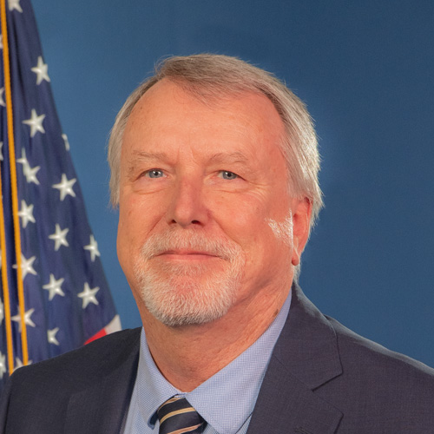
Presenters
Stephen Parker
Federal Highway Administration
U.S. Department of Transportation
Carolyn Mulvihill
Office of the Secretary
U.S. Department of Transportation
Andrew Emanuele
Office of the Secretary
U.S. Department of Transportation
Notes:
Isabella
I’m joined by three co-presenters today – Stephen Parker from FHWA, and Andrew Emanuele and Carolyn Mulvihill from OST. Internal Note: Speaker bios can be found at the end of the run-of-show document.
Stephen Parker is the FHWA Program Manager for the Safe Streets and Roads for All program administering SS4A grants across 11 states, (planning and demonstration and implementation grants in Alaska, Colorado, Connecticut, Hawaii, Massachusetts, Oregon, and Washington and implementation grants in Arizona, Nevada and Utah).
Andrew Emanuele is the Program Manager for the Safe Streets and Roads for All competitive grant program in the Assistant Secretary for Transportation Policy’s Office of Infrastructure Deployment.
Carolyn Mulvihill is also a member of the SS4A team in the Office of Infrastructure Deployment. She has over 20 years of experience with DOT and the Environmental Protection Agency.

Slide 5
Are you in the right place?
The SS4A program funds regional, local, and Tribal initiatives through grants to prevent roadway deaths and serious injuries.
You're in the right place if you:
Want to address roadway safety in your community
Do not have an eligible action plan in place and/or are not ready to implement projects and strategies
Think you will be applying for a Planning and Demonstration Grant to develop a Comprehensive Safety Action Plan
Notes:
Isabella
All information related to the grant program can be found at www.transportation.gov/SS4A or by reviewing the NOFO at https://www.transportation.gov/grants/ss4a/fy25-nofo
Note that there is a webinar next week that will focus on the supplemental planning and demonstration activities. If you are new to roadway safety planning and will be applying for a Planning and Demonstration Grant to develop an Action Plan, you can *also* request funding to conduct supplemental planning or demonstration activities. These activities can be completed in tandem to help inform your Action Plan. Today’s webinar will also be relevant for communities with existing Action Plans that would like to improve their plans in some fashion – to meet the SS4A Action Plan requirements, or to in some way enhance their current plan. For these applicants you can also bundle supplemental planning and demonstration activities into your Action Plan application.
We will discuss eligible applicant types later on in today’s presentation, however if you are joining us from a private agency or State DOT – it is worth noting that these entities are not eligible to apply for an SS4A grant as a lead applicant.

Slide 6
SS4A FY25 NOFO Is Now Open
Notice of Funding Opportunity (NOFO) is now OPEN
FY25 SS4A Application Deadline is June 26, 2025, 5:00 PM EDT​
Submit technical questions by May 29, 2025, to ss4a@dot.gov
Additional resources about SS4A and the NOFO can be found at https://www.transportation.gov/grants/SS4A
Notes:
Isabella
There is a single deadline for all grant application in FY25 - June 26, 2025, by 5:00 PM ET. That includes Action Plan, Planning and Demonstration, and Implementation Grant applications.
If you have technical issues submitting, we can only consider your application if you contact support@valideval.com documenting your technical issue no later than 4 hours prior to the application deadline.
If you have technical questions, please submit those to the ss4a inbox, ss4a@dot.gov, by May 29, 2025.

Slide 7
SS4A Grant Program Overview
Notes:
Isabella hands over to presenter 1

Slide 8
Safe Streets and Roads for All
$5 billion competitive grant program, with ~$1 billion per year over 5 years
Purpose: to prevent deaths and serious injuries on our roadways
Focus on comprehensive safety action planning, and implementing projects and strategies identified in safety Action Plans
Inclusive of all types of roadway safety interventions across the Safe System Approach
Notes:
PRESENTER
SS4A was authorized by Congress with $5 billion in advanced appropriations, $1 billion is made available each year over 5 years. FY25 is year 4 of the program, so we have more than $2 billion more in funding left.
The SS4A program is built on the development of a Comprehensive Safety Action Plan, which uses data, a taskforce of safety stakeholders, and public engagement to identify the biggest safety problems in a community and through that effort creates a list of priority safety projects and strategies to address those safety problems. The program also supports the design and implementation of projects and strategies through the Implementation Grant category.
This program enables interventions that interconnect just like in a Safe System Approach that uses multiple interventions to build safety redundancies to protect people, including infrastructure, behavioral, and operational activities. If you are not familiar with the Safe System Approach, check out https://www.transportation.gov/safe-system-approach

Slide 9
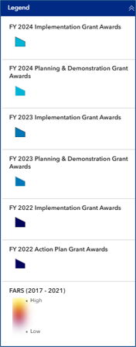
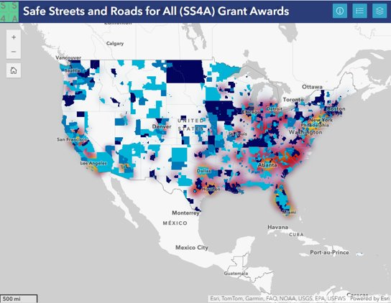
Safe Streets and Roads for All Funding to Date
FY22 to FY24
Over 1,800 awards made totaling $3 billion
SS4A awards will improve roadway safety planning for over 75% of the nation’s population
900+ awards made to rural communities totaling over $750 million
Notes:
PRESENTER
The SS4A program has made over 1800 awards across the three previous funding cycles. The map shows areas with high fatalities in red. As you can see we have a fair amount of the high fatality areas covered, but not all. We also have some gaps in rural areas that we are aiming to fill.
-In FY 25 there is approximately. $1 billion available for funding, 30% of which is available for planning and demonstration activities and 70% of which is available for implementation.

Slide 10
New in FY25
New in FY25
One application deadline: June 26th, 2025, 5:00 PM EDT
Underserved Communities will use the same definition as Areas of Persistent Poverty
Applicants applying for supplemental planning and demonstration only must either have an existing Action Plan or one in progress that is being funded through the SS4A program
No more than 3 plans can be used to meet Action Plan requirements
Map requirement
New SS4A applicant resources
Notes:
PRESENTER
We want to outline a few changes to the FY25 NOFO.
First this year we have a single application deadline, meaning all application material must be submitted by June 26th, 2025 5:00pm.
The way we are calculating underserved communities has changed to use the same definition as Areas of Persistent Poverty. We will go over how to calculate that number later in the session.
Applicants that are looking to apply for supplemental planning and demonstration activities ONLY without developing or updating an Action Plan must either have an existing Action Plan that meets the Action Plan requirements that we will go over later or NEW THIS YEAR have received funding in a previous round to develop or update an Action Plan. This means that if you are currently developing an Action Plan that is not funded through the SS4A program you would NOT Be eligible to apply for supplemental planning and Demonstration activities ONLY. We still encourage you to apply for Planning and Demonstration activities in conjunction with developing or updating an Action Plan.
A limit of three plans has been set when meeting the Action Plan requirements necessary when applying for Implementation Grants and Planning and Demonstration only.
There are new requirements regarding the format for map submittals
And lastly, we have developed several new applicant resources, including guidance to help applicants navigate submitting the necessary Standard Forms
We will go into each of these changes more throughout the presentation. To learn more about each change please see the FY25 NOFO .

Slide 11
Expected Award Size and Requirements
NOFO pg. 3
Grant Type | Expected Grant Range*
Planning and Demonstration Grant | $100K - $5M
Implementation Grant | $2.5M - $25M
Requirements
80% Federal | 20% local match
In-kind contributions can be used as match
Set aside for planning and demonstration activities ($302 million this year)**
Developing new Action Plans, as well as supplemental planning and demonstration activities
Supplemental planning and demonstration activities included in an Implementation Grant count toward set aside
No more than 15% of funds can be awarded to projects in a single State in a given fiscal year
Tribal applications are not counted toward the State cap
DOT expects to award between 40 to 70 Implementation Grants and between 400 to 700 Planning and Demonstration Grants.
*Note: These are expected sizes, and applicants may request more or less funding.
Notes:
PRESENTER
Note that these are EXPECTED grant sizes, and applications can be smaller or larger than the amounts listed here. This was to provide a sense to applicants of what we are generally expecting. We will still consider and treat equally a proposal that asks for less funding, or more funding.
The 20% local match applies to all applicants. This means that up to 80% of the funding can come from Federal sources, and 20% must come from non-Federal sources. Non-Federal sources may include local funds Tribal Transportation Program funds, funds from other non-Federal sources, and in-kind contributions. We will provide additional discussion on match requirements later in this presentation.
The 15% State cap is inclusive of all SS4A grant types – Planning and Demonstration, and Implementation
DOT expects to 40 to 70 Implementation Grants and between 400 to 700 Planning and Demonstration Grants

Slide 12
Planning and Demonstration Set Aside Update
The legislative set-aside for planning activities has been reduced from 40% to 30% in FY25
There will be $302 million available for Planning and Demonstration Grant awards, plus any supplemental planning and demonstration activities bundled into Implementation Grant applications
Historically Planning and Demonstration activities have been undersubscribed; FY24 was the first year SS4A was oversubscribed for planning
What does this mean for SS4A?
More funding available for Implementation Grants ($680 million)
Applicants are still encouraged to bundle supplemental planning and demonstration activities into either grant type
If we are oversubscribed again for planning and demonstration, the program will look at applicants that meet the Award Considerations and SS4A Grant Priorities in the NOFO
Notes:
As mentioned, the set aside for SS4A planning activities was reduced from 40% to 30%
There will be $300 million available for Planning and Demonstration Grant awards, plus any Implementation proposals that have bundled supplemental planning and demonstration activities
Historically the SS4A program has been undersubscribed for planning and demonstration activities, leading to carry over funds year to year. However for the first time in FY24 SS4A was oversubscribed for planning, and as a result we had to turn down some highly rated proposals.
What does this mean for the program?
More funding for IG
Applicants are still encouraged to bundle supp planning and demonstration activities alongside their Action Plan development. It’s very likely that – even if we are oversubscribed again for planning – planning dollars will be in less demand than funding for implementation projects
For PDG, the expected maximum award size was reduced from $10m to $5m; and so while applicants are still encouraged to request funding for higher dollar supplemental planning and demonstration activities, the maximum award size was lowered to ensure we can reach more communities and spread these dollars farther in the event we are oversubscribed again

Slide 13
Is SS4A for My Community?
Will SS4A meet the safety needs of my community?
How burdensome is the application process?
What’s the likelihood I’ll get funded?
I’m concerned about non-Federal matching fund requirements. What’s the story?
Notes:
PRESENTER
The value proposition, and straight talk about match.
Will SS4A meet the safety needs of my community?
SS4A provides a lot of flexibility in the development of your safety plan, and it is scalable for small places with hundreds of people to millions of people in metropolitan regions.
The type of roadway safety activities eligible for funding are broader than the average program and allows rural and Tribal communities with different needs than their suburban or urban counterparts to identify issues unique to that community, and propose tailored solutions.
What is the application process like?
We have streamlined the application process to the extent we can. Particularly for those applying for planning and demonstration grants, the application narrative is only 2-3 pages, a few data points from publicly available data that we provide instructions on how to get, and some of the required Government standard forms. For Implementation Grant applications we don’t require applicants to complete benefit cost analysis.
We have a lot of resources on our website geared towards those with lower levels of experience with Federal grant applications, and we have a responsive team that is available to answer your eligibility questions via the SS4A inbox
What is the likelihood I’ll be funded?
For Planning and Demonstration Grants – the likelihood is high! And the likelihood of receiving funding is much higher than the average Federal competitive grant program. We funded every eligible and complete Planning and Demonstration Grant application during the FY22 and FY23 cycles with FY24 being the first year being oversubscribed.
Implementation Grant applications are more competitive, but we have written the NOFO so that rural, Tribal, and low-capacity communities are competitive in the award selection process.
What’s the story on match requirements?
Yes, there is a 20% match requirement, and unless authorized in statute, Federal Funds may not be used toward it. We realize this is a barrier for many, and it’s what is in the legislation so we have no flexibility for waivers and exemptions.
However, match does not have to come from your local community treasury, it just has to be non-Federal funds. We have resources on how to think about in-kind contributions such as staff time, which can count towards match. Award recipients received match assistance from State DOTs, and foundation support previous SS4A rounds.
For Tribal areas with Tribal Transportation Funds, those funds are eligible to count for non-Federal match, which we hope will help Tribal communities participate in the program.

Slide 14
Eligibility
Notes:
PRESENTER

Slide 15
SS4A Overview: Eligible Applicants
NOFO pg.
7
Political subdivision of a State
A unit of government under the authority of State law, including cities, towns, counties, special districts, and similar units of local government.
A transit district, authority, or public benefit corporation if it was created under State law, including transit authorities operated by political subdivisions of a State.
A state college or university if it was created under State law.
Federally recognized Tribal government
Metropolitan planning organization (MPO)
Multijurisdictional group comprised of the entities above
Learn more about applicant eligibility.
Notes:
PRESENTER
Eligible recipients generally include:
Political subdivisions of a State, which is defined as a unit of government created by and under the authority of a higher level of government.
This includes cities, towns, counties, special districts, and similar units of local government.
A transit agency may be eligible as a political subdivision of a State if it was created under State law.
A state college or university may be eligible as a political subdivision of a State if it was created under State law.
Tribal governments
Metropolitan Planning Organizations
A combination of those
I want to take a moment to talk about “multijurisdictional groups”.
Working together with other eligible recipients is a great strategy to help smaller communities that may not have experience with the Federal grants process, or the staff capacity to manage grants. MPOs might be a natural focus for partnering in their regions.
Note that ONLY the primary applicant will be party to the grant, but we encourage collaborative efforts.
Also Note that State DOTs are not eligible recipients, but they can be great partners to provide technical expertise in the planning and implementation process.
A key tip, non-profits are NOT eligible applicants unless created under State law with roadway safety and/or planning responsibilities that are equivalent to a political subdivision of a State.

Slide 16
Eligible Activities and Grant Types
NOFO pgs. 14-19
Planning and Demonstration Grant
Develop a comprehensive safety action plan (A)
Implementation Grant
Conduct supplemental safety planning (in support of a safety action plan) (A1)
Carry out demonstration activities (in support of a safety action plan) (A2)
Carry out demonstration activities (A2)
Conduct supplemental safety planning (A1)
Conduct planning and design (B)
Implement projects and strategies (C)
Eligible Activities:
Develop Comprehensive Safety Action Plan
(A1) Supplemental safety planning
(A2) Demonstration activities
(B) Conduct planning, design, and development activities for projects and strategies identified in an Action Plan
(C) Implement projects and strategies identified in an Action Plan
Learn more about eligible activities.
Notes:
PRESENTER
There are 3 main buckets of eligible activities in the SS4A program, which are funded through 2 main types of grants: 1) Planning and Demonstration Grants, and 2) Implementation Grants. Today’s webinar focuses just on how to apply for a Planning and Demonstration Grant to develop a Comprehensive Safety Action Plan. Internal note: Direct people to other webinars and don't spend a lot of time talking about B and C activities.
Basic overview of activity types
Planning and Demonstration Grants fund three different sets of activities – 1) Develop a comprehensive safety Action Plan, 2) Conduct supplemental planning in support of an Action Plan, and 3) Carry out demonstration activities in support of an action plan.
Please note that SS4A has a very particular definition of planning – the development of a comprehensive safety action plan.
Planning activities such as preliminary engineering, design, ROW acquisition, etc. and other pre-construction planning costs can only be funded under the Implementation Grant category.
As mentioned earlier, a program requirement is 30% of funds have to go to activities A, A1, and A2 – develop a comprehensive safety action plan, conduct supplemental planning, or conduct demonstration activities.
We won’t cover these in detail today but for your awareness, Implementation Grants fund:
Implement projects and strategies (C)
Conduct planning and design (B)
Conduct supplemental safety planning (A1)
Carry out demonstration activities (A2)

Slide 17
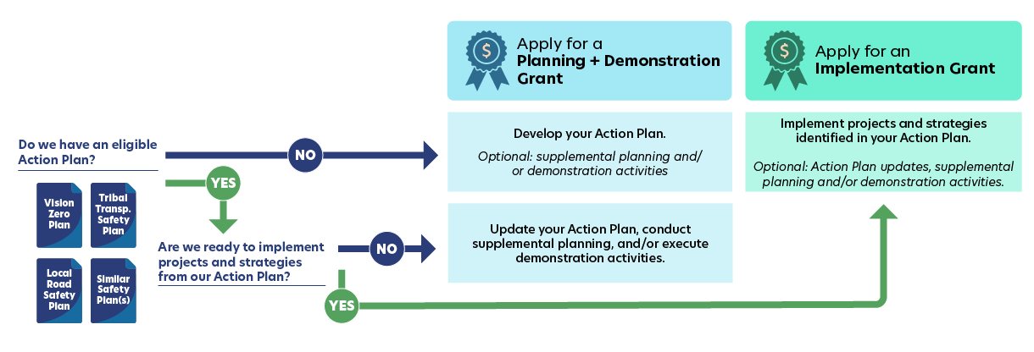
Planning and Demonstration or Implementation Grant?
See the Self-Certification Eligibility Worksheet to determine if your plan is eligible!
Notes:
PRESENTER
If you have done some safety planning, but aren’t sure which grant type to apply for, this diagram can help you confirm which grant path is right for you.
If your community does not already have a plan and is not covered by an Action Plan being prepared with SS4A funds from previous years, or perhaps you have a plan, but it is missing some of the required SS4A elements detailed in the Self-Certification Eligibility Worksheet, you should apply for a Planning and Demonstration Grant. You may also include supplemental planning and/or demonstration activities if they will inform or enhance your Action Plan.
If you have an existing plan, and you’re thinking about applying for an Implementation Grant, but you’re really not sure if it meets the SS4A requirements, we are offering pre-application reviews of the action plan for Implementation Grant applicants. For more information, visit the SS4A website: https://www.transportation.gov/grants/ss4a/action-plan-review
If you already have an eligible Action Plan, you have some options:
One: Apply for an Implementation grant to deliver a project or strategy identified in your Action Plan. Our April 15th webinar covered implementation projects and requirements to apply for Implementation grants.
Another option is to apply for planning and demonstration grant funding. Supplemental planning and demonstration activities should inform or enhance your Action Plan and/or gauge effectiveness of projects or strategies before implementing them permanently. If you are still working on your Action Plan, you can apply for Planning and Demonstration grant funds to do supplemental planning and demonstration activities, provided you received funding in a previous round to develop or update that Action Plan.
The supplemental planning and demonstration activities webinar will be held next week on April 23rd. That webinar will cover how they can be incorporated into SS4A grants. We want to highlight that we are encouraging these activities for either grant type, no matter where you are in the process. That is because they are relatively inexpensive, easy to complete activities that can increase safety and help your community better prepare for implementation projects.

Slide 18
Comprehensive Safety Action Plan Components
Notes:
PRESENTER

Slide 19
Planning and Demonstration Grants
NOFO pgs.
15-18
Action Plan
Develop or complete a Comprehensive Safety Action Plan
7 components to an Action Plan
Supplemental Planning Activities to enhance an Action Plan
Topical safety plans
Road safety audits
Additional safety analysis and data collection
Follow-up stakeholder engagement
Demonstration Activities to inform an Action Plan
Feasibility studies using quick-build strategies
Manual on Uniform Traffic Control Device (MUTCD) engineering studies
Pilot programs for behavioral or operational activities
Pilot programs for new technology
Notes:
PRESENTER
As I mentioned earlier, Planning and Demonstration Grants can be used for three main types of activities, including: 1) developing an Action Plan, 2) conducting supplemental planning to enhance an Action Plan, or 3) completing demonstration activities to inform an Action Plan.
First let’s talk about Action Plans. There are seven main components to it, which I’ll go through in more detail in a moment. In general, the Comprehensive Safety Action Plan (or simply “Action Plans”) uses data and analysis to identify a community’s safety problems, engages the public and other stakeholders in the planning process, and based on all that information, develops a list of projects and strategies to address the identified safety problems.
Note that pre-construction planning such as environmental reviews, and preliminary engineering and design for specific projects in an Action Plan cannot be funded using a Planning and Demonstration Grant. These activities can only be funded under the Implementation Grant category. For more information on these activities, check out the Implementation webinar recording from Tuesday, April 15th on the SS4A website.
Let’s talk through supplemental planning and demonstration activities next.
If you are applying to develop a Comprehensive Safety Action Plan, you can also request funding for supplemental planning and demonstration activities to help inform your Comprehensive Safety Action Plan.
I want to emphasize this – if you are interested in requesting funds for supplemental planning and demonstration activities, you are not required to have a completed Comprehensive Safety Action Plan:
You can request funds to conduct supplemental planning or demonstration activities at the same time that you are developing your Action Plan; or
You can request funds for supplemental planning or demonstration activities ONLY, if you are already working on an SS4A-funded Comprehensive Safety Action Plan. However, NEW THIS YEAR, applicants looking to apply for supplemental planning or demonstration activities ONLY while developing their Comprehensive Safety Action Plan, must have that Action Plan be funded by previous cycles of SS4A.
We will provide more information on how to apply for supplemental planning and demonstration activity funding during next week’s webinar, as well as provide some examples of supplemental planning and demonstration activities funded by SS4A in FY22, FY23 and FY24, however, we will briefly cover some of these topics now:
If you look at the middle column of this slide, supplemental planning updates or elaborates on the components of an Action Plan. It can be updating an existing plan, or adding bells and whistles, or taking deeper dives based on the identified needs of a community. Examples include:
Topical safety plans such as speed management, vulnerable road users, accessibility for individuals with disabilities, Americans with Disabilities Act of 1990 (ADA) transition plans, safety-focused Intelligent Transportation System implementation, lighting, or other relevant safety plans.
Maybe there’s a high injury network series of roads that you want to do road safety audits on, or additional data analysis to identify contributing factors – this would also be considered supplemental planning.
You can also further engage your community, or assess how different population groups such as children, seniors, or other communities should be considered in the implementation of projects and strategies.
Demonstration activities:
Demonstration activities are temporary in nature and meant to test changes that will advance safety before you spend millions on projects and strategies.
Demonstration activities tie back to informing your Action Plan, especially the list of projects and strategies.
We won’t go into detail about examples of demonstration activities today. Next week’s webinar will address those activities in detail. We encourage you to check the webinar out, either live next week or in the recording released after.
One question you might have is what is the difference between implementing projects and strategies and doing demonstration activities? Well, demonstration activities are supposed to be temporary and smaller scale and must get assessed for their benefits. That assessment informs the Action Plan and your list of projects and strategies in that plan. Implementing projects and strategies can be permanent construction and long-term solutions, and they’re already on your Action Plan’s to-do list.

Slide 20
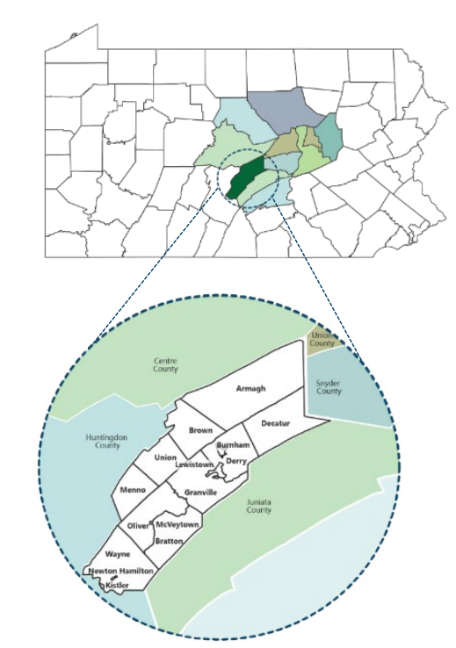
Mifflin County, Pennsylvania: $356,458 Action Plan
The award will be used by Mifflin County to develop a Comprehensive Safety Action Plan in their community.
Mifflin County overview:
46,143 total jurisdiction population
32 traffic fatalities from 2018-2022
Fatality rate of 13.90 per 100,000 population
85% underserved population
Notes:
PRESENTER
The focus today is on developing an Action Plan for a community that does not already have one. This example of Mifflin County is one of many rural communities that received a grant to develop an Action Plan in FY24.

Slide 21
SS4A Required Action Plan Components
NOFO pgs.,
15-17 Table 1
Leadership Commitment and Goal Setting
Planning Structure
Safety Analysis
Engagement and Collaboration
Policy and Process Changes
Strategy and Project Selections
Progress and Transparency
Read more about Action Plans.
Notes:
PRESENTER
You are likely here because your community currently doesn’t have a plan that meets these requirements. Over the next several slides, we will discuss each required element and how to incorporate it into your plan if you are awarded planning and demonstration grant funds to develop your Action Plan.
Action Plans are the foundation of the SS4A Program and are critical to reaching zero roadway deaths and serious injuries.
If you have one or more plans that include some, but not enough, of the required elements listed here, apply for Planning and Demonstration funds to complete the existing plan and/or compile your multiple plans into a single comprehensive plan.

Slide 22
Leadership Commitment + Goal Setting
NOFO pg. 15
Public commitment from a high-ranking official and/or governing body in the jurisdiction to an eventual goal of zero roadway fatalities and serious injuries.
Commitment includes either:
Target date to reach zero
A percentage reduction in roadway fatalities and serious injuries by a specific date
Notes:
PRESENTER
An official public commitment (e.g., resolution, policy, ordinance, etc.) by a high-ranking official and/or governing body (e.g., Mayor, City Council, Tribal Council, MPO Policy Board, etc.) to an eventual goal of zero roadway fatalities and serious injuries. The commitment must include either a target date to reach zero deaths, OR a percentage reduction of roadway fatalities and serious injuries by a specific date.
The commitment must include a goal and timeline for eliminating roadway fatalities and serious injuries achieved through one, or both, of the following:
(1) the target date for achieving zero roadway fatalities and serious injuries, OR
(2) a percentage reduction of roadway fatalities and serious injuries by a specific date with an eventual goal of eliminating roadway fatalities and serious injuries.
An example may be a Resolution with a goal of zero roadway fatalities and serious injuries by 2030. We have cities that have achieved a zero goal, so we know it's possible.

Slide 23
Planning Structure
NOFO pg. 16
A committee, task force, implementation group, or similar body charged with oversight of the Action Plan development, implementation, and monitoring.
Notes:
PRESENTER
Building an enthusiastic team with a diverse skill set is the first step to success in developing a comprehensive safety action plan. This has two main benefits. First, you get lots of perspectives from different stakeholders. Second, a varied team creates buy-in, which is crucial for implementing your plan. The group should have a clear set of roles and responsibilities to ensure the plan is not only implemented, but also to ensure progress towards your safety goals is monitored and regularly updated.

Slide 24
Safety Analysis
NOFO pg. 16
Analysis of existing conditions and historical trends to baseline the level of crashes involving fatalities and serious injuries.
Analysis of the location where there are crashes, the severity, as well as contributing factors and crash types.
Analysis of systemic and specific safety needs, as needed (e.g., high risk road features, specific safety needs of relevant road users).
A geospatial identification (geographic or locational data using maps) of higher risk locations.
Notes:
PRESENTER
Next, using data to understand the safety needs and issues in a community is an essential and required component of a Comprehensive Safety Action Plan. Ensuring you have a clear understanding of your safety problems will help later on when you begin to select appropriate countermeasures to address the safety problems.
The Safety Analysis component of your Action Plan should include:
an analysis of the existing conditions and historical trends to develop a baseline understanding of the number and severity of crashes involving fatalities and serious injuries in your jurisdiction
Analysis of the location(s) where there are crashes, as well as contributing factors and crash types by relevant road users (for example motorists, people walking, transit users, etc.).
Analysis of systemic and specific safety needs is also performed, as needed (e.g., high-risk road features, specific safety needs of relevant road users, analysis of the built environment, demographic, and structural issues, etc.). To the extent practical, the analysis should include all roadways within the jurisdiction, without regard for ownership.
And finally, based on the safety analysis performed, a geospatial identification of higher-risk locations is developed (a High-Injury Network or equivalent).
There are many different sources for data and ways to conduct analyses to understand the safety issues in your community. We have information on the website on using FARS, the Fatality Analysis Reporting System, to standardize crash rates and data, and that is what we recommend that people use when filling out SS4A applications.

Slide 25
Engagement + Collaboration
NOFO pg. 16
Engagement with the public and relevant stakeholders, including the private sector and community groups.
Incorporation of information received from the engagement and collaboration into the plan.
Coordination that includes inter- and intra-governmental cooperation and collaboration, as appropriate.
Notes:
PRESENTER
Information received from public engagement and collaboration is analyzed and incorporated into the Action Plan. Overlapping jurisdictions are included in the process. Plans and processes are coordinated and aligned with other governmental plans and planning processes to the extent practical. Engagement may include town halls, online meetings, pop-up outreach, story maps, quick videos, crowdsourcing, survey tools, real-time polling tools, and social media. It is important to demonstrate in your Action Plan how public feedback was used to help inform the Action Plan (for instance, to corroborate safety needs, to prioritize projects and strategies, etc.).

Slide 26
Policy + Process Changes
NOFO pg. 16
Assessment of current policies, plans, guidelines, and/or standards to identify opportunities to improve how processes prioritize safety
Strategy for implementation through the adoption of revised or new policies, guidelines, and/or standards.
Notes:
PRESENTER
For this section of your Action Plan, you will need to consider your current policies, plans, guidelines, and/or standards to identify where there are gaps and opportunities to prioritize safety. Your Action Plan will also identify a strategy for implementation, for example through the adoption of updated or new policies, guidelines. In addition, if your community has a couple of smaller plans that address some of the SS4A Action Plan requirements, you may want to consider folding those plans into your Action Plan, incorporating updates as needed. This will help ensure consistency and provide a comprehensive guide to increase safety in your community.

Slide 27
Strategy + Project Selection
NOFO pg. 16
Comprehensive set of projects and strategies to address safety problems.
Provide time ranges for deployment and project prioritization criteria.
Interventions should be focused on infrastructure, behavioral, and/or operational safety.
Notes:
PRESENTER
Using your safety data analysis and other evidence and noteworthy practices and stakeholder input ,you will then identify a comprehensive set of projects and strategies to address the safety problems you have identified. These strategies and countermeasures should focus on a Safe System Approach – building in redundancies, ensuring safety is proactive, recognizing that humans make mistakes, and responsibility is shared, etc. – and leading to effective interventions, and considering multidisciplinary activities. To the extent practical, any limitations you have identified in your safety data and public engagement should be identified and mitigated.
Once identified, the list of projects and strategies is prioritized in a list that provides time ranges for when the strategies and countermeasures will be deployed (e.g., short-, mid-, and long-term timeframes). You should also provide an explanation for the project prioritization criteria used. Many plans get very specific on the exact strategy and cost for each project, and we encourage this to the extent you wish to understand the cost implications for each priority strategy. If you do plan to apply for an Implementation grant in the future, this will assist you in completing that application.

Slide 28
Progress + Transparency
NOFO pg. 17
A description of how progress will be measured over time that includes, at a minimum, outcome data.
Posted publicly online.
Notes:
PRESENTER
This element of your Action Plan is to describe your method to measure progress over time after your Action Plan is developed, including how output and outcomes will be measured. This element of your plan will also include a means to ensure ongoing transparency is established with residents and other relevant stakeholders. The approach must include, at a minimum, annual public and accessible reporting on progress toward reducing roadway fatalities and serious injuries and public posting of the Action Plan online.
Assessing progress should be considered relative to the baseline to help you understand what is working and what isn’t. The plan is posted publicly online for transparency and accountability.

Slide 29
What is Not A Comprehensive Safety Action Plan
NOT:​
Corridor plan​ or study
Site plan (e.g., intersection)​
ADA Transition Plan
Safe Routes to School Plan
These are examples of supplemental planning, not a Comprehensive Safety Action Plan
We encourage you to apply for supplemental planning if you wish to develop any of the safety plans listed above and others that do not meet the requirements of a Comprehensive Safety Action Plan
Notes:
PRESENTER
I have just described in detail the 7 required components of a Comprehensive Safety Action Plan. As you develop your budget and application to request funding to develop a Comprehensive Safety Action Plan, I hope the previous explanation gives you lots of good detail to work from.
I know there has been some confusion in the past about what exactly is a Comprehensive Safety Action Plan, and one way to help clarify this is to describe what a Comprehensive Safety Action Plan is NOT –
It is NOT a corridor plan or study; site plan; ADA Transition Plan; or Safe Routes to School Plan. These are all great and beneficial safety planning processes that you can request funding for as a supplemental planning activity under SS4A, however these are not Comprehensive Safety Action Plans, which should address safety for all road users across your jurisdiction. Please note that if you wish to conduct any of these supplemental safety planning activities, you will need to demonstrate that you are actively working on a Comprehensive Safety Action Plan too in order to meet the SS4A requirements.
And to reiterate, as we mentioned earlier - planning activities such as design or concept plans, preliminary engineering, design, ROW acquisition, etc. and other pre-construction planning costs can only be funded under the Implementation Grant category, not the Planning and Demonstration Grant.

Slide 30
How to Apply
Notes:
PRESENTER CHANGE
Thank you to the first presenter. My colleague covered some of the grant program basics, and then walked through what you would be doing for a Planning and Demonstration Grant, namely developing a comprehensive safety action plan. Talking through those components and what they mean hopefully gave you all a good idea of what we’re expecting.
This next section I’ll be getting into provides more detail about how to apply, the application process, as well as the application review and selection process.

Slide 31
Application Overview
Obtain a Unique Entity Identifier Number (UEI) via SAM.gov.
Before submitting your SS4A application, you must obtain a UEI. This may take up to 30 days.
Register with Valid Eval
Registration should take around 10 minutes.
Do not apply through Grants.gov
Submit on time!
Applicants that do not already have a UEI are encouraged to start this process now.
You will need to register for the Valid Eval account that corresponds with the grant type you wish to apply for (Planning and Demonstration, or Implementation).
Final applications must be submitted by: June 26th, 2025
Applicants that already have UEIs are encouraged to verify their UEI is active on SAM.gov
Applicants are strongly encouraged to submit in advance of the deadline.
The primary contact will receive a confirmation email after submission.
Notes:
PRESENTER
Let me walk you through a few of the key steps on how to apply for an SS4A grant.
you must have a Unique Entity Identifier (UEI) number in order to apply. To request a UEI, please visit SAM.gov. Note that this may take up to 30 days, so the sooner you apply the better. If you have an existing UEI, you may need to renew it. Keep in mind other departments in your community may have a UEI already, so coordinating with them may help. Please verify your UEI is active before initiating your SS4A application.
Register with Valid Eval:
Valid Eval is a software company SS4A uses to receive and evaluate applications. Applicants MUST submit their applications via Valid Eval. Do not submit an application to Grants.gov, it will not be accepted.
Go to Valid Eval’s signup page and register for one of two account types, depending on the grant type you are applying to. You can register now, I suggest doing so sooner rather than later.
There’s a different registration link for Planning and Demonstration Grants, and Implementation Grants. You want to use the sign up link for Planning and Demonstration Grants.
The person who registers for Valid Eval and submits the application will be the primary contact for the application and must be employed by the applicant (the city, town, county, etc.)
This person should be someone we can contact between when your application is submitted until December 2025 who will respond within 2 business days, and put up an away message with another POC while on leave.
A contractor can help with the application process, but the POC must be someone from the organization applying.
Late applications
There is a single application deadline for SS4A Grants this year– June 26th, 2025 at 5:00 PM EST. Late applications will not be accepted. If you have technical issues submitting, we can only consider your application if you contact support@valideval.com documenting your technical issue no later than 4 hours prior to the application deadline.

Slide 32
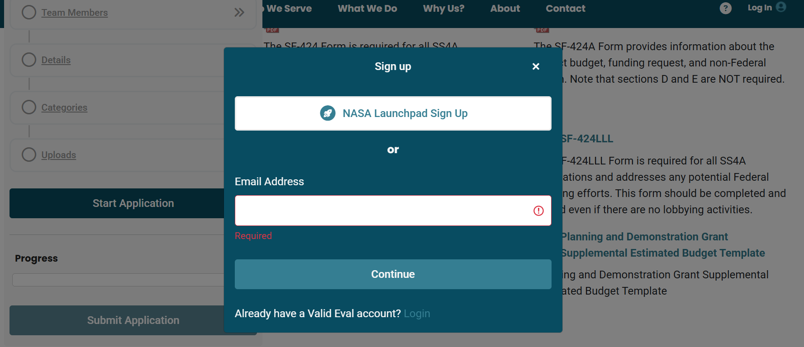
Sign Up for Valid Eval
Notes:
PRESENTER
This is what the Valid Eval sign up looks like.
You will need to register with your email address or if you already have a Valid Eval account, login with your credentials
Once you sign up, basic contact information will auto-fill.
You will be able to save your application and come back to Valid Eval later if you cannot complete the application in one sitting.
We recommend reviewing the questions early on to ensure that you have all required information.
At the bottom of the Valid Eval sign up page, you can see a list of the required documents which are available for download in the application. Many of these documents are also available on the SS4A website.
Valid Eval will not let you submit if you are missing required information.

Slide 33
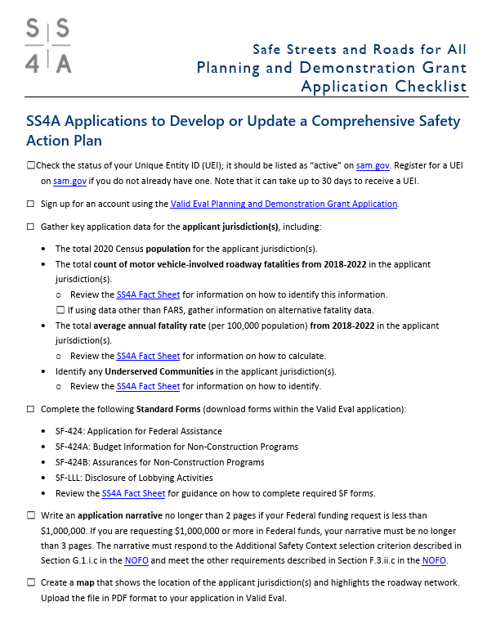
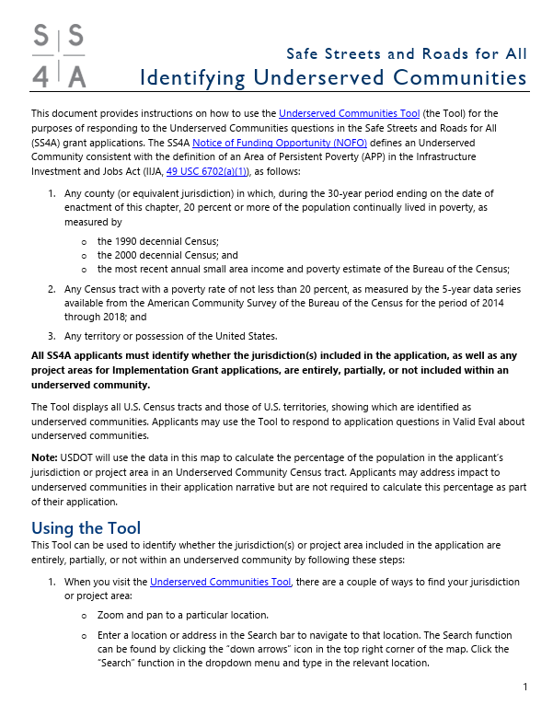
Application Aids
A series of checklists and planning worksheets is available on the SS4A website and Valid Eval to help guide applicants through the eligibility and application process.
SS4A Resources Webpage
Notes:
PRESENTER
We realize that for some of our applicants this is their first Federal funding request, and some folks might not be familiar with the process.
To support our first time Federal applicants, we have created a lot of resources to help you develop a successful application. There are tons of resources to help you, including checklists, FAQs, step-by-step instructions on how to get the required data points, and explainers on key topics of interest based on last year’s funding round.
We also periodically update the website with timely info on FAQs and more
We highly recommend that you review these materials to ensure that you are submitting a complete application.
If you have questions there’s a decent chance the answer is in our materials; however, if you can’t find answers, we have an email inbox to reach out: SS4A@dot.gov

Slide 34
Standard Forms
NOFO pg. 27
Application for Federal Assistance (SF-424)
Budget Information for Non-Construction Programs (SF-424A)
Assurances for Non-Construction Programs (SF-424B)
Disclosure of Lobbying Activities (SF-LLL)
NOTES:
Downloading the blank SF forms from Valid Eval will help ensure that you have the correct version and that you can sign digitally (particularly for the SF-424)
Make sure that the request amounts on the SF-424, SF-424A, and other application materials are the same!
Sections D and E of the SF-424A are NOT required!
Notes:
PRESENTER
To apply for a Planning and Demonstration Grant there are some basic forms to fill out.
There are multiple versions of the SF forms, and so to avoid confusion, we recommend downloading the blank SF forms from Valid Eval to ensure you have the correct version.
Please note that several of the SF forms you will be asked to complete have expired. These are the latest form versions and so please go ahead and complete them. It is possible that if updated SF forms are released during the grant cycle, we may ask applicants selected for award to complete the updated forms.
Friendly reminders to:
Make sure you sign SF forms digitally (unless your jurisdiction requires wet signatures)
Make sure your total Federal funding request, local match, and total project cost are the same across the SF-424A, the SF-424, your supplemental budget, and what’s entered in Valid Eval
Sections D and E of the SF-424A are not required. You may leave them blank. There is an SF form fact sheet that has more information on how to complete the required SF forms that we will go over in more detail on the next slide.

Slide 35
How to Complete Standard Forms
Standard Forms (SF) “How to” Guide for SS4A
Intended to assist applicants with step-by-step guidance on how to complete the required Standard Forms
Standard Forms “How To” Guide for SS4A
Notes:
PRESENTER
We know that navigating the laundry list of forms can be daunting. To help applicants navigate the submission requirements we have provided a Standard Forms How To Guide which is intended to assist applicants with completing the required SFs for SS4A. We recommend using the forms included in the Valid Eval application or linked in this application aid to ensure you are completing the correct versions of the forms. As you can see from the screenshot here, the Standard Forms How to Guide walks applicants through each of the required fields of the Standard Forms with guidance on what to input. A link to this guide is provided on the slide.

Slide 36
Key Information Questions
NOFO pgs. 28-30
Planning and Demonstration Grant applicants are required to respond to questions in the Valid Eval application form including:
Lead applicant name and UEI
Total applicant jurisdiction population
Total count roadway fatalities (2018-2022)
Total average annual fatality rate per 100,000 population
Inclusion of underserved communities
Project title and goal
Application type
Total SS4A funding request, non-Federal share, total SS4A project cost, and total other Federal funds (if applicable)
See Section F – Submission Requirements and Deadline – of the NOFO for a complete list
Notes:
The NOFO includes a list of key information questions which applicants will address through the Valid Eval application form. A list is provided in Section F of the NOFO, and I’ve highlighted here some of the key information you will be required to include in your Valid Eval application form. This includes things like your applicant name and UEI, total population for your jurisdiction, total count of roadway fatalities and more. We will walk through how to provide the required data points related to roadway fatalities and underserved communities on the next couple of slides.

Slide 37
Calculating Key Application Data
Fatality Count
5-Year Average Fatality Rate (Per 100,000 Persons)
See the “Calculating Average Annual Fatality Rate” SS4A Fact Sheet for more information
Total count motor vehicle-involved roadway fatalities from 2018 to 2022
Example: 217 fatalities
Total count motor vehicle-involved roadway fatalities from 2018 to 2022
÷
5
÷
Total jurisdiction population
× 100,000 Persons
Example: 217 fatalities ÷ 5 years = 43.4 avg fatalities
43.4 avg fatalities ÷ 1,255,296 population = 0.0000346
0.0000346 per capita × 100,000 =
3.46 fatalities per 100,000 persons
Notes:
PRESENTER
Applicants are required to provide two key safety data points as part of their application.
We have resources on how to obtain these data. Good news: the safety data are from publicly available sources, and we have tried to make life as easy for you all as possible.
Why do we ask for these data? Well, I’ll show it later it on but it’s another way we look at safety need and the extent of the roadway safety problem. These 2 data points we are asking for reflect safety need in different ways:
# of fatalities (entire jurisdiction)
Fatality rate per population
Let me walk through these with you.
I’ll note that we will be spot checking these numbers for accuracy once applications are submitted. Try your best to provide the information based on the instructions, and we’ll be looking on the backend at these.
Fatality Count
For the fatality information we recommend using the Fatality Analysis Reporting System or FARS. We are asking for years 2018-2022 because that is the most recent FARS data currently available, so it will be comparable across all applicants. Our colleagues at the National Highway Traffic Safety Administration have a nifty tool called the FIRST tool where you can query your fatality count.
Note we’re looking for the number of people killed in a crash, not the number of crashes with fatalities in them.
For those who have their own data to submit, you can also submit a fatality count from another source but you need to cite where it came from and you should reference 2018-2022 data only.
Fatality Rate
Once you have fatality count, you are part way there already.
We’re normalizing fatalities on a per population basis to reflect the fact we have communities of all different sizes applying for the program.
When we say “average annual rate,” we mean per 100,000 persons and should use an annual average as opposed to a 5-year count.
Next is to get your jurisdiction’s population, which is based off of the 2020 Census population data for the jurisdiction or jurisdictions included in your application. You can grab that information from the U.S. Census website.
For population data, if your application includes multiple jurisdictions or areas, you should use the population for the Census tracts that best align with the jurisdictions included in the application.
Once you get the population figure you want to do the calculation we have on this slide. Let’s walk through the example…

Slide 38
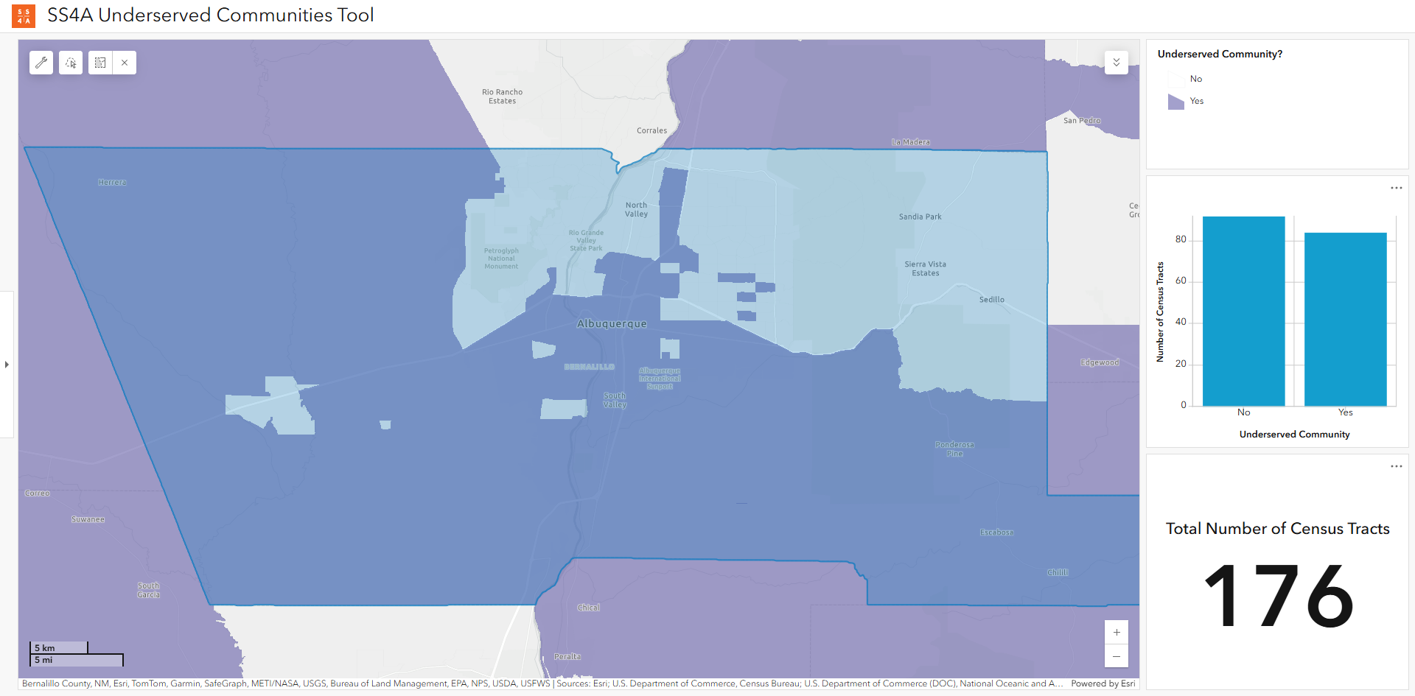
Population in Underserved Communities
Use the DOT Underserved Communities Tool to identify whether your jurisdiction(s) are entirely, partially, or not included within an underserved community.
When you visit the Tool, there are a couple of ways to find your jurisdiction:
Zoom and pan on the map.
Enter a location or address.
Underserved communities are indicated in purple on the map. A visual assessment is generally appropriate to determine whether your jurisdiction(s) contain any underserved areas.
SS4A Underserved Communities Tool
Notes:
PRESENTER
The next requirement is related to underserved communities. There have been several changes to this application requirement this year, so please be sure to check out the NOFO and our identifying underserved communities application aid available on the SS4A website for more information.
Per the NOFO, underserved communities are defined using the same definition as Areas of Persistent Poverty. There are a couple of ways that Areas of Persistent Poverty are defined (which are spelled out in the NOFO), but essentially these are Census tracts or counties with a history of having a population living in poverty that is greater than or equal to 20% of the population.
In the past, we have asked applicants to determine the percentage of the population living in an underserved community, but we are simplifying things this year, and you will just need to identify whether the jurisdiction(s) included in the application are entirely, partially, or not included within an underserved community.
We have developed a mapping tool to help you determine which category your jurisdiction is in.
In the example on the slide (Albuquerque, NM), a visual assessment of the map of Albuquerque, New Mexico shows that the jurisdiction is partially located within an underserved community.
There are additional instructions on the SS4A website to use the tool for a more detailed determination.
Note that the Percentage of the population in an Underserved Community Census tract is considered as part of the decision criteria – USDOT will be making this calculation for all applicants to ensure that the approach to the calculation is consistent across all applications.

Slide 39
Narrative for Planning and Demonstration Grants
NOFO pgs. 29-30
Maximum 2 pages for Federal funding requests under $1,000,000.
If requesting $1,000,000 or more in Federal funds, the narrative must be no longer than 3 pages.
Narrative should respond to the Additional Safety Context selection criterion outlined in NOFO Section G.1.i.c
The Department will assess whether the applicant has described:
The scope of work to be performed;
The roadway safety issues that necessitate Action Plan development; and
How the funded activities will inform an Action Plan and support the identification of projects and strategies that will:
Lead to a significant reduction or elimination of roadway fatalities and serious injuries involving various road users;
Employ low-cost, high-impact strategies that can improve safety over a wider geographical area;
Involve engaging with a variety of public and private stakeholders;
Adopt innovative technologies to promote safety; and
Be evidence-based or build evidence around what works.
Notes:
PRESENTER
Now let’s talk about the application narrative, and the expectations here.
Compared to other Federal discretionary grants, the amount of narrative we are looking for is relatively short – just two to three pages. This is meant to reduce the application burden and set expectations about the level of detail we need.
We are asking you to describe the scope of work, the roadway safety issues that need to be addressed (to the extent you know them), and how your work will inform an Action Plan. I will provide more information in a couple of slides on how we will assess application narratives.
Finally, we ask that your application narratives address how your proposed activities will inform your Action Plan and support the identification of projects and strategies that will:
Lead to a significant reduction or elimination of roadway fatalities and serious injuries involving various road users;
Employ low-cost, high-impact strategies that can improve safety over a wider geographical area;
Involve engaging with a variety of public and private stakeholders;
Adopt innovative technologies to promote safety; and
Be evidence-based or build evidence around what works.
Here we are looking for narratives to demonstrate a clear understanding of how you intend to develop your Action Plans, and ensure that any projects/strategies identified through your planning process align with these priority items here. We appreciate that you may be early in the safety planning process and don’t yet know what projects and strategies will be identified, but we want to make sure you have a clear strategy and approach to developing your Action Plan.
There is also some information on demonstration activity narrative requirements that I won’t go into detail here, BUT we will be going into more detail for those in our webinar focused on supplemental planning and demonstration activities. If you haven’t already signed up for that webinar yet, I would suggest doing so. Anyone applying to develop a new Action Plan can also apply for supplemental planning and demonstration activities.

Slide 40
Self-Certification Eligibility Worksheet
This worksheet is only required for SS4A Planning and Demonstration Grant applicants requesting funding just for Supplemental Planning and/or Demonstration Activities.
You do not need to complete this form if:
You are in the process of developing an Action Plan with SS4A funding from a previous cycle
You are also applying to develop/update an Action Plan, even if supplemental planning and/or demonstration activities are included
SS4A Self-Certification Eligibility Worksheet
Notes:
Some of you may already have an established Action Plan and are looking to apply for only supplemental planning and demonstration activities. That’s great! But you will be required to complete a Self-Certification Eligibility Worksheet to show that your established plan is eligible and meets all the minimum requirements.
Note that you do not need to complete the Self-Certification Eligibility Worksheet if:
You are in the process of developing an Action Plan with SS4A funding from a previous cycle
You are also applying to develop/update an Action Plan, even if supplemental planning and/or demonstration activities are included

Slide 41
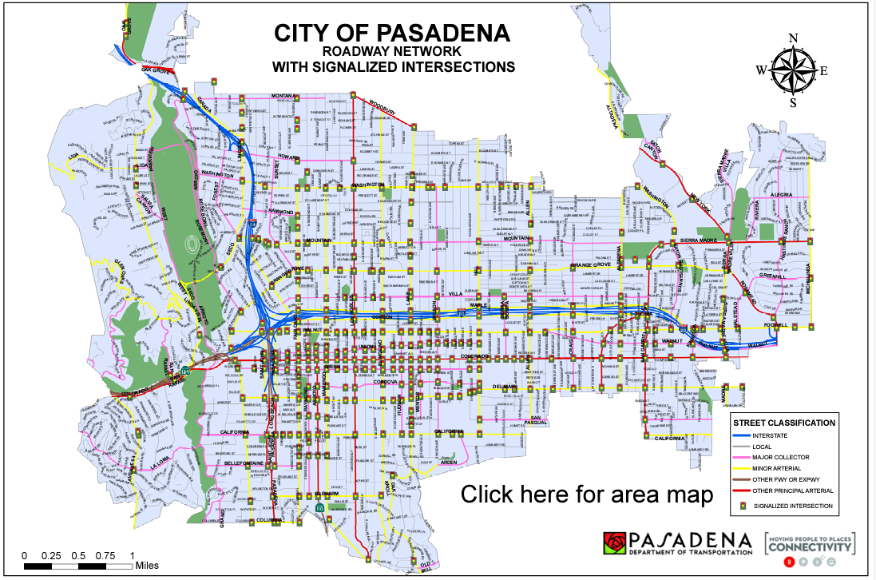
Map
NOFO pg. 31
Submit a map that shows the location of the jurisdiction and highlights the roadway network.
Applicants requesting funding for demonstration activities should include the locations of any proposed demonstration pilots if known.
Maps must be submitted in both PDF and spatial format (e.g., Shapefile or KML).
Ensure that the map is of adequate quality for reviewers to understand your community.
City of Pasadena Road Map
New in FY25
Image Credit: City of Pasadena SS4A FY23 Application
See the “Preparing your Spatial Data File” application aid for assistance.
Notes:
PRESENTER
Planning and Demonstration Grant applicants are required to submit a map as part of their application
The map should show your jurisdiction and highlight the roadway network under your control
NEW THIS YEAR:
Applicants requesting funding for demonstration activities should include the locations of any proposed pilots in their map (if known)
Maps must be submitted in both PDF AND spatial formats (e.g., Shapefile or KML)
If the proposed scope of your Action Plan is only part of the map (e.g., you are a County applicant applying for County roadways only), mark it with some sort of line or boundary and have a legend that indicates what is within scope.
This is especially helpful for those applicants who are submitting for a group of jurisdictions.

Slide 42
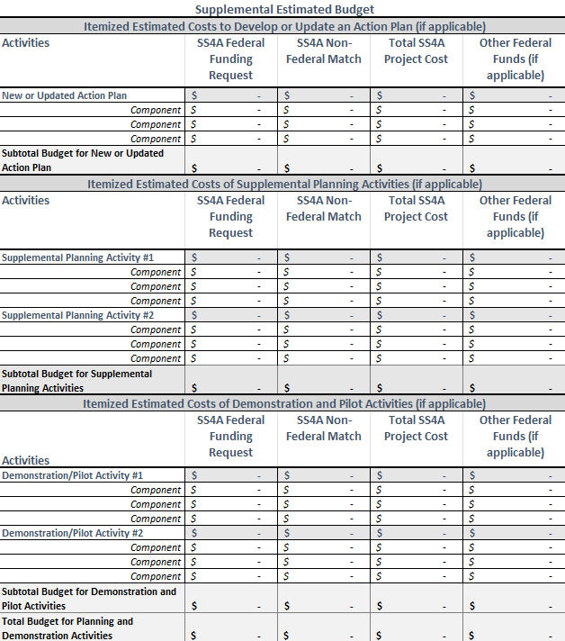
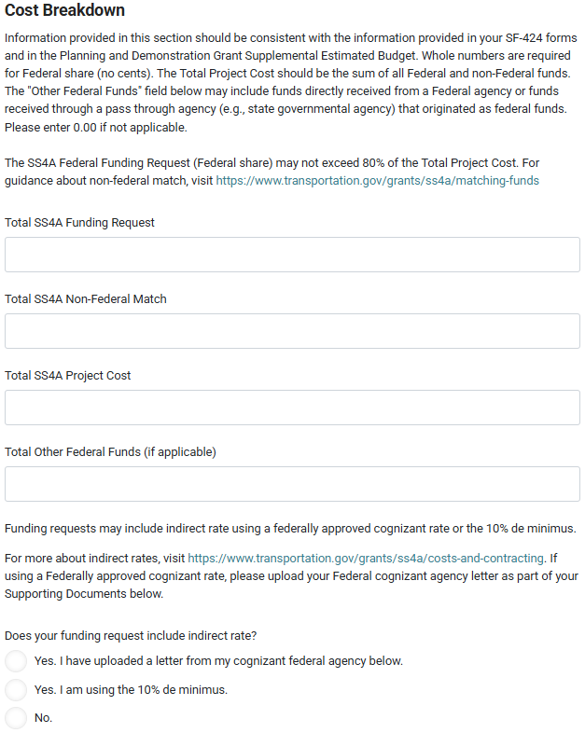
Required Budget Documents
NOFO pgs. 31-32
SF-424
Distinguish between Federal and Non-Federal share in section 18
SF-424A
Distinguish between Federal and Non-Federal share
Planning and Demonstration Supplemental Estimated Budget
Template Excel file provided in Valid Eval
Valid Eval
Provide cost breakdown by Federal, non-Federal match, Total project cost, and Other Federal funds (if applicable)
Planning and Demonstration Grant Supplemental Budget Template
Notes:
PRESENTER
Planning and Demo
As mentioned earlier, please be careful to ensure that the SS4A request, non-federal match, and total project cost are consistent across these four documents. If there is a discrepancy in the numbers, the SS4A team will use the amounts in the SF-424 as the federal share, non-federal match, and total project cost for the purposes of review and award.
All Planning and Demonstration Grant applicants are required to submit a supplemental estimated budget template. An Excel template is provided for download via Valid Eval and SS4A and we recommend that you use it! (see the image on the far right of the screen)
If you are applying to develop an Action Plan only, the supplemental estimated budget can be very simple!
For those who are applying and bundling activities into one proposal that includes developing a new plan, supplemental planning, and/or demonstration activities, you will need to delineate the cost breakdown of each activity in your budget, and the activities outlined in your budget should match what is described in your application narrative.
NEW THIS YEAR We have developed an example budget to help applicants understand the level of detail we are looking for, which I’ll cover on the next slide.
The budget must only include eligible costs associated with executing the planning and demonstration grant.
Note: Indirect rate is an allowable cost for SS4A. Applicants with a rate approved by their Federal Cognizant Agency as identified in 2 CFR 200.1 must use that rate. Otherwise, a 10 percent de minimus rate may be applied following the requirements outlined 2 CFR 200.412 through 200.415. If an applicant includes indirect rate as part of their application and has a Federal Cognizant Agency letter with their approved rate indicated, they should include the letter as part of their application materials.

Slide 43
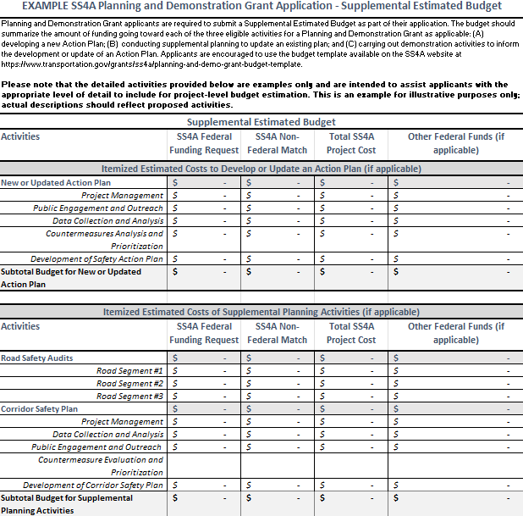
Supplemental Estimated Budget
NOFO pgs. 32-33
All Planning and Demonstration Grant applicants will be required to submit a Supplemental Estimated Budget summarizing the amount of funding going toward each of the three eligible activities:
1) developing a new Action Plan
2) conducting supplemental planning to update an existing plan
3) carrying out demonstration activities to inform the development or an update of an Action Plan
The Department will assess the extent to which budget costs are reasonable, necessary, and allocable, and the extent to which budget costs are delineated between each of the three eligible activities.
The Department will also review whether costs are reasonable and adequate if the amount requested is under $100,000.
Example Planning and Demonstration Grant supplemental budget
Notes:
PRESENTER
As discussed on the previous slide, all Planning and Demonstration Grant applicants are required to complete a supplemental estimated budget.
This budget should summarize the amount of funding going to each of the three eligible activities: 1) developing a new action plan, 2) conducting supplemental planning to enhance or update an action plan; and 3) carrying out demonstration activities to inform an action plan.
The picture to the right shows a budget template with example work activities to highlight the appropriate level of detail to include for project-level budget estimation. This example is available on the SS4A website:
As part of the application review and selection process, the DOT will assess the extent to which budget costs are reasonable, necessary, and allocable. DOT reserves the right to not award applicants requesting less than $100,000 if the budget is determined to be inadequate for the scope of the activities.

Slide 44
Agreement Funding: 20% Cost Share and Match Reminders
Recipients must contribute a non-Federal matching share of no less than 20 percent of TOTAL eligible activity costs.
Grant agreements are expected to be administered on a reimbursement basis, and recipients will be reimbursed for up to 80% of their eligible expenses.
Tribal Transportation Program and Tribal Transportation Program Safety Funds may be used as non-Federal match.
Local match may only be used once and may not be used as match for multiple Federal awards.
Notes:
PRESENTER
As mentioned previously, the grant has an 80 / 20 cost share requirement, so up to 80% of the costs can be paid for by Federal funds.
2 Code of Federal Regulations Part 200 outlines cost share, matches, and in-kind contributions. There are principles of whether costs are allocable and reasonable.
I’m not a lawyer or Federal grant regulations master, and this could probably be an entire training unto itself, but we can give some high level information here, and I’ll also note we supplement with an FAQ and resources on our website.
So the 80 / 20 match is for the total amount of the award costs. So not every line item needs to have a 20% match, just so long as it all adds up that Federal funds pay no more than 80% of the costs.
State funding derived from Federal sources – aka the Federal Highway Administration Federal aid program, or American Rescue Plan funds, etc. are still Federal sources.

Slide 45
Agreement Funding: 20% Cost Share and Match Reminders (Contd.)
Unless authorized in statute, Federal funds cannot be used toward a recipient’s local match requirement.
Funds from other entities such as partners may count towards the match as long as they are non-Federal funds.
In-kind contributions such as staff time, purchased goods/services, and other direct expenses can be used toward the local match requirement.
Indirect rate is allowable
Expenses incurred prior to the grant agreement being executed are not eligible expenses (unless explicitly authorized by the Department).
Applicants that intend to combine SS4A funds with Title 23, U.S.C. funds should expect a significant delay in executing a grant agreement.
Learn more about DOT’s Matching Funds for SS4A Grants and Understanding Non-Federal Match Requirements pages.
Notes:
PRESENTER
Match does not have to come from your local treasury. Iowa State DOT fronted the match for all the counties and MPOs that applied in FY22, Kansas DOT and Massachusetts DOT provided match for some applicants too. A foundation provided match for a Tribal community. Staff time, goods/services, and other direct expenses can be used toward the local match requirement.

Slide 46
Planning and Demonstration Grant Review and Selection Process
Notes:
PRESENTER
Let me dive into how your application will be evaluated, and the selection consideration process to determine whether you will receive an award or not.

Slide 47
Planning and Demonstration Grant Selection Criteria
NOFO pgs. 46-48
Developed to be accessible to all communities, lower barrier to entry
Three selection criteria:
Safety Impact (quantitative, two ratings)
Count of roadway fatalities from the most recent set of 5-year data (FARS 2018-2022 or equivalent).
Fatality rate, normalized per 100,000 persons.
Underserved Communities (quantitative, one rating)
Percentage of the population in an Underserved Community Census tract (using 2020 Census population data). Underserved Community uses the same definition as Areas of Persistent Poverty.
Additional Safety Context (2- to 3-page narrative)
Budget costs are an additional consideration
Award Considerations
High Fatality Rates: The Department may prioritize SS4A Planning and Demonstration Grant applications with a fatality rate ≥ 17.5 per 100,000 persons
No Prior SS4A Funding: The Department may prioritize SS4A Planning and Demonstration Grant applications that have not previously received SS4A funding.
Safety Impact
New in FY25
Underserved Communities
Additional Safety Context
Budget Costs
New in FY25
Notes:
There are 3 main selection criteria used to evaluate Planning and Demonstration Grant applications:
Safety Impact
Underserved Communities
Additional Safety Context
Budget costs are an additional consideration: Applicants are required to show how different funding sources will share in each activity and present the data in whole dollars in a table similar to Table 3 of the NOFO. The Planning and Demonstration Grant Supplemental Estimated Budget should summarize the amount of funding going toward each of the three eligible activities for a Planning and Demonstration Grant (developing a new Action Plan, conducting supplemental planning to update an existing plan, and carrying out demonstration activities to inform the development or update of an Action Plan). Applicants requesting less than $100,000 in funding must also explain how the scope of activities will be completed with the funding amount proposed.
We have two award considerations for Planning and Demonstration applicants. One for applicants with high fatality rates. The other being NEW THIS YEAR for applicants that have no prior SS4A awards.

Slide 48
Evaluation: Additional Safety Context Criterion
NOFO pg. 57
The Department will assess the narrative’s alignment with the Additional Safety Context selection criterion and will assign a rating of “High,” “Medium,” “Low,” or “Non-Responsive.”
 | High | Medium | Low | Non-Responsive
Rating Scale | The application is very responsive to the criteria and is expected to advance safety planning. The narrative has clear descriptions of the work scope and the roadway safety problem to be addressed. The proposed approach will strongly inform an Action Plan. For demonstration activities only: The narrative clearly describes how the activities will be measured and evaluated. | The application is responsive to the criteria and is performing safety planning activities. The narrative has descriptions of the work scope and the roadway safety problem to be addressed. The proposed approach will inform an Action Plan. For demonstration activities only: The narrative describes how the activities will be measured and evaluated. | The application is minimally responsive to the criteria. The proposed approach is weakly tied to an Action Plan. For demonstration activities only: The narrative provides minimal detail on how the activities will be measured and evaluated. | The narrative indicates the proposal is counter to the criteria, does not contain sufficient information, or is not connected to an Action Plan. For demonstration activities only: Detail on how the activities will be measured and evaluated are not included.
Notes:
PRESENTER
I mentioned awhile back that I would get to how we will evaluate the narrative, and here it is.
The narratives will be rated based on their responsiveness to the Additional Safety Selection Criterion outlined in the NOFO, and will receive a rating of either “high,” “medium,” “low,” or “non-responsive.”
If you are rated high, the narrative has clear descriptions of the scope of work and the roadway safety problem to be addressed. The proposed approach will strongly inform an Action Plan.
Especially if you are applying just to develop a new action plan, we aren’t expecting you to know everything about roadway safety. We realize some are starting from the beginning, and that’s okay.
That being said, you still have to be responsive to the selection criterion.
And what that does mean to strongly inform the Action Plan for those who are developing a new Action Plan? Again as mentioned before we are looking for whether you describe how you intend to identify projects and strategies through your Action Plan development that will:
Save lives for various types of people using the roads
Employ low-cost, high-impact strategies that can improve safety over a wider geographical area
Involve engaging with a variety of public and private stakeholders
Adopt innovative technologies to promote safety
Be evidence-based or build evidence around what works
So… what does all that mean? Basically, we want to make sure you’ve given a little bit of thought about what a comprehensive safety action plan would potentially entail. Not a lot, two to three pages, but some.

Slide 49
SS4A Application Quick Tip
For New Action Plan applicants only:
Check the SS4A cumulative awards map to see if your community is already covered by an SS4A Action Plan *before you apply*
An application may be considered duplicative when another jurisdiction is already preparing an Action Plan in the same area using FY22, FY23, or FY24 SS4A funding
If your MPO/County/City is already developing an Action Plan, you can still request funding for supplemental planning, demonstration activities, and other complementary Comprehensive Safety Action Plan activities
Check the SS4A Cumulative Awards Map
Notes:
PRESENTER
We are nearing the end of today’s presentation, however we wanted to note one final important consideration for Planning and Demonstration Grant applicants, particularly those thinking about applying to develop a new Comprehensive Safety Action Plan for their community.
As part of the review process, we want to make sure that any applicants requesting funding to develop a new Action Plan are not already covered by an SS4A Action Plan. If you are thinking about applying to develop a new Action Plan for your community, we encourage you to visit the SS4A awards map – before you apply – to see if your community is already covered by an SS4A Action Plan, which may be an opportunity to partner.
If, for example, the county or region that your city is in has received an award to develop an Action Plan, your own application to develop an Action Plan may be considered duplicative. Consider whether you need to create your own Action Plan (you’ll need to explain why in your application if you do, for example how your proposed plan is different and will complement rather than duplicate the existing plan) or if it might be more effective to collaborate with that other agency on their work.
If your MPO, county, or city has already received SS4A funds to develop an Action Plan – that’s OK! You can still request funding for supplemental planning, demonstration activities, and other complementary Comprehensive Safety Action Plan activities that help to inform your region’s safety action plan.
We will touch on examples of eligible supplemental planning and demonstration activities in the webinar on supplemental planning and demonstration activities next week, so if you are interested in learning more about these activities, please register for our webinar next week which will focus on how to incorporate supplemental planning and demonstration activities in your SS4A proposal.
I will cover what we mean when we say “duplicative and overlapping jurisdictions” over the next couple of slides.

Slide 50
Duplication and Overlapping Jurisdictions
NOFO pg. 9
An application may be deemed duplicative if requesting funds to either develop a new Action Plan when another jurisdiction is already preparing an Action Plan in the same area using previous years funding or is developing a new Action Plan in the same area as another FY25 application.
Duplicative funding requests to develop a new Action Plan will be identified and assessed for merit within the context of other jurisdictions and their planning activities.
The Department encourages complementary but distinctive activities, including but not limited to demonstration activities that will help inform the development of an Action Plan.
Notes:
PRESENTER
Let’s talk about duplication and overlapping jurisdictions
As mentioned at the start of today’s presentation, about 75% of the US is already covered by SS4A awards to improve roadway safety planning and we are expecting hundreds of applications again this year
From my standpoint, interconnected, coordinated, complementary planning is great across communities, especially those that share various responsibilities and have different roles.
That being said, that we don’t want to safety plan in siloes, and we have a fiscal responsibility not to pay for the same thing twice.
So part of this is making sure we are using Federal funds wisely, and not duplicating efforts.
In our processes we’ll be looking at your geographic areas to identify potentially overlapping jurisdictions.
We are going to take a look at those applying to do work in the same area, and see the extent to which it’s the same thing or not.
If it looks pretty similar, we will likely reach out and ask that you consolidate applications or work out an arrangement that isn’t duplicative.
If we can’t reach an arrangement, we reserve the right not to fund an application irrespective of its merits.

Slide 51
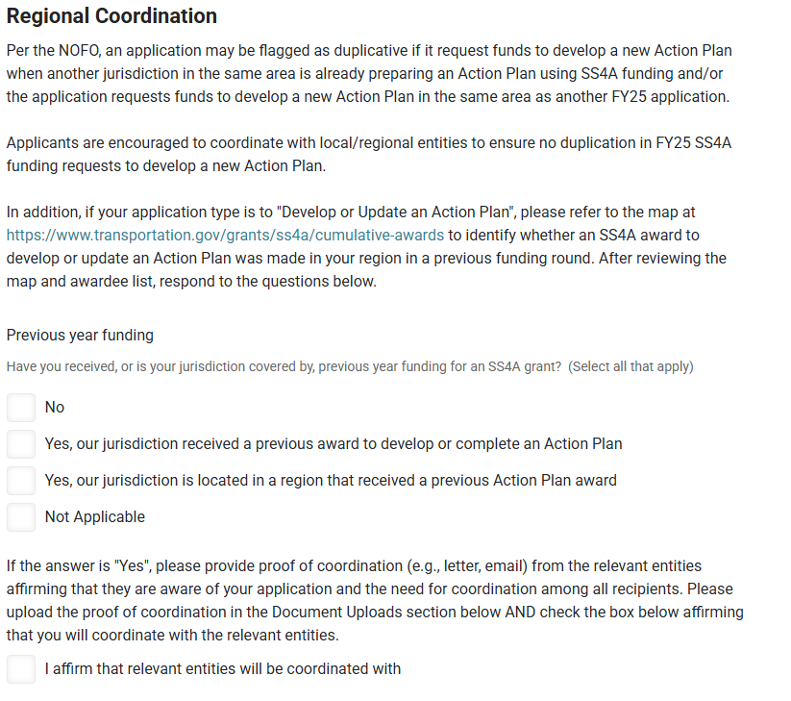
How to Address Overlap and Duplication Before Applying
Check the SS4A awards map!
Coordinate with relevant jurisdictions that are also potentially applying and/or received an award to develop a new Action Plan in FY22, FY23, and/or FY24
Are there relevant regional, county-level, municipal, Tribal governments to coordinate with before you submit your application?
Decide whether the proposed Action Plan development is complementary or duplicative.
Provide proof of coordination (e.g., letter or email) if your jurisdiction received, or is covered by, previous year SS4A funding.
Notes:
PRESENTER
The application in Valid Eval will ask you to note whether any other entities in your area are also applying, and if you choose to continue with an individual effort, you’ll need to discuss how the activities differ from other efforts and affirm that you will coordinate as appropriate.
If there are multiple Planning and Demonstration Grant application submissions that cover the same area from different applicants, clearly explain how they are different from each other. The Valid Eval application form includes a question about coordination to prompt conversations upfront. If you look at the SS4A awards map and see that your area is already covered by a previous SS4A planning award, you will need to provide a letter or email from the entities to demonstrate proof of coordination and explain how your proposed plan differs and complements their activities.

Slide 52
Tips and Tricks
Notes:
PRESENTER

Slide 53
Friendly Advice and Reminders
Most FY22 and FY23 Planning and Demonstration Grant applicants received an award; FY24 was the first year we were oversubscribed.
Application narratives do not need to be overly long, but please provide specifics relevant for your community. Three sentences of information is not enough!
Remember to include in the narrative
The scope of work to be performed;
The roadway safety issues that necessitate Action Plan development; and
How the funded activities will inform an Action Plan and support the identification of projects and strategies.
Letters of support provide minimal value to Planning and Demonstration Grant applications.
Budgets and Federal funding requests should reflect the level of effort needed to administer a Federal grant. Applicants requesting less than $100,000 in funding must explain how the scope of activities will be completed with the funding amount proposed.
The primary contact on the application should be able to respond to emails from the SS4A Team between June and December.
One application per applicant. Applications are submitted through Valid Eval, NOT Grants.gov.
Notes:
PRESENTER
We will be reviewing applications for completeness as a first step so that we can reach out to communities missing any materials early in the process. We ask that applicants keep an eye out for those messages and respond promptly to requests for additional information. This will help ensure that your application gets evaluated and scored for the grant selection. Reminder that we have tried to provide more material on the website to help ensure that everyone knows what materials they need to submit.

Slide 54
Q&A
Notes:
NOAH
Noah introduces the Q&A. Notes that participants can submit questions or comments using the Q&A function. Reads aloud submitted questions and asks the panelists to respond. Questions have been posted into the shared Webinar Q&A Responses document that all panelists have access to.
Hand to Paul when done

Slide 55
Appendix

Slide 56
Village of Warwick, NY: $406,167 Demonstration Activities (FY23)
The award to the Village of Warwick will be used to pilot the Slow Down Warwick Campaign, addressing driver-behavior-related issues that contribute to crashes such as speeding, improper passing, driver inattention, and others.
Project highlights:
Installation of signage and roadway paintings to alert drivers to the need for increased attention
Targeted roadways and intersections prioritized using crash/injury data
10 site deployments over a 20-month period
Image Credit: Village of Warwick Comprehensive Plan (2021-22)

Slide 57
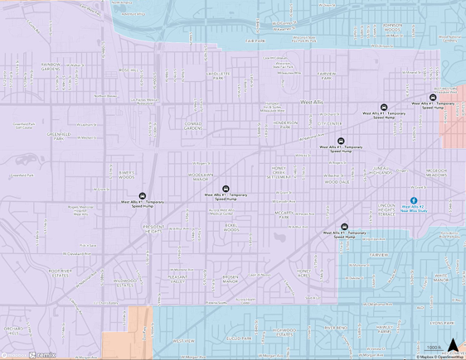
Milwaukee County DOT, WI: $219,918 Demonstration Activities (FY23)
The award to the Milwaukee County DOT will be used to pilot demonstration activities in 5 municipalities including Greendale, South Milwaukee, Shorewood, Wauwatosa, and West Allis.
Project Highlights:
Village of Greendale – Temporary speed bumps with a speed trailer to collect traffic counts/speed data at 2 intersections.
Village of Shorewood – Temporary traffic circles near an elementary school and fire department and temporary curb extensions near east/west arterial connecting the Oak Leaf Trail regional bike network.
City of South Milwaukee – Traffic Stacker cones, traffic barrels, high-visibility signage, and speed trailers on a high-risk pedestrian crossing.
City of Wauwatosa – Five temporary traffic circles at locations that meet crash, speed, and/or volume thresholds, using pilot video analytics to capture near-miss data.
City of West Allis – Portable speed humps to reduce speed on neighborhood streets, and a near-miss analysis study using pilot video analytics at one of the City’s high-crash intersections.
Image Credit: Milwaukee County DOT SS4A Application

Slide 58
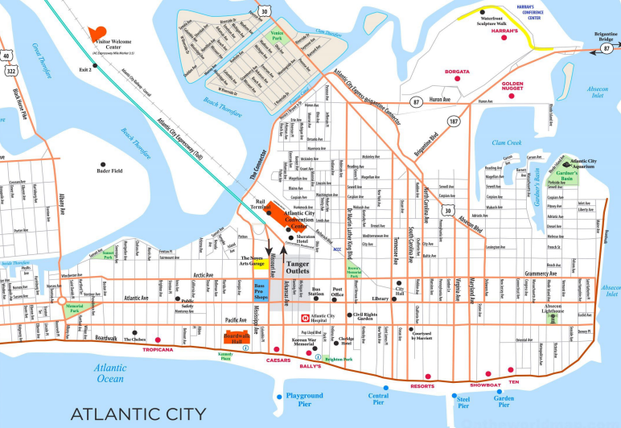
Atlantic City, NJ: $200,000 Supplemental Planning (FY22)
The award to Atlantic City will be used to update and consolidate multiple plans including a Bicycle and Pedestrian Plan, a Road Safety Assessment, and a City Boardwalk Assessment.
Project Highlights:
Conduct expanded data collection and evaluation, feasibility studies, and progress reports to meet current needs and land use recommendations
Provide targeted assessments, such as the review of traffic enforcement strategies
Conduct follow-up stakeholder engagement through regularly scheduled public meetings
Image Credit: City of Atlantic City SS4A Application
Notes:
Here are two examples from last round that include both supplemental planning and demonstration activity examples.
Atlantic City in NJ received $200k for supplemental planning to update and consolidate multiple plans including a Bicycle and Pedestrian Plan, a Road Safety Assessment, and a City Boardwalk Assessment.

Slide 59
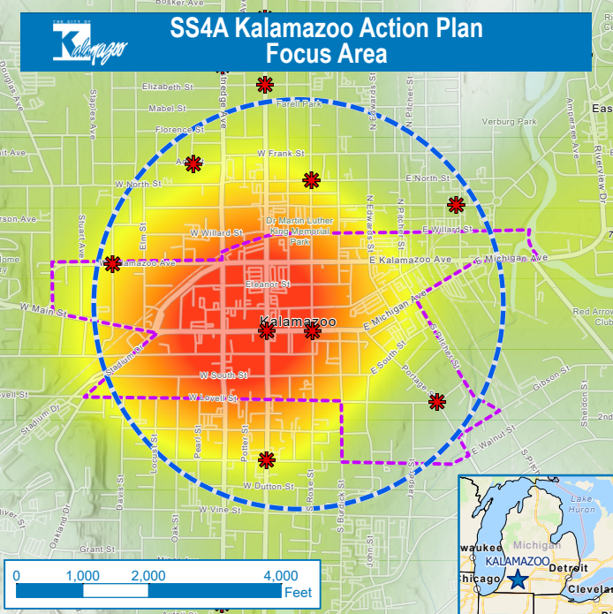
City of Kalamazoo, MI : $750,000 Supplemental Planning and Demonstration Activities (FY22)
The award will be used by the City of Kalamazoo to build upon the existing safety action plan through data analysis to improve safety and pilot testing of countermeasures to determine local effectiveness.
Project Highlights:
Intersection analysis of pedestrian safety and crashes
Development of sidewalk safety and bus stop safety plans
Key corridor lighting study and development of improvement plan
Mini-roundabout, two-way cycle track, and protected bike facilities pilots
Image Credit: City of Kalamazoo SS4A Application
Notes:
This Kalamazoo example has both planning and demonstration activities in it.
Planning
Includes implementation of studies and analysis of data to address gaps in current knowledge to reduce crashes, improve safety, and reduce fatalities. These studies will actively inform the selection future safety countermeasures.
Pilots
Includes some demonstration activities via pilots such as a mini-roundabout, and bike lane pilot.

