Slide 1
University Transportation Centers
^{Presented by:}
USDOT’s University Transportation
Centers (UTC) Program and the Council of
University Transportation Centers (CUTC)

Slide 2
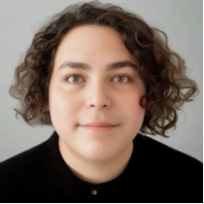
Leonardo Vazquez-Raygoza
AIR
University of Texas at El Paso
Center for Advancing Research in Transportation Emissions, Energy, and Health (CARTEEH) l led by Texas A&M University, College Station
Research Area(s):
Air Quality
Thesis Title:
Comprehensive Assessment of Nitrogen Dioxide, Tropospheric Ozone, and Fine Particulate Matter Exposure in Vulnerable Communities: Levering a Community Network for Advanced Air Quality Monitoring

Slide 3
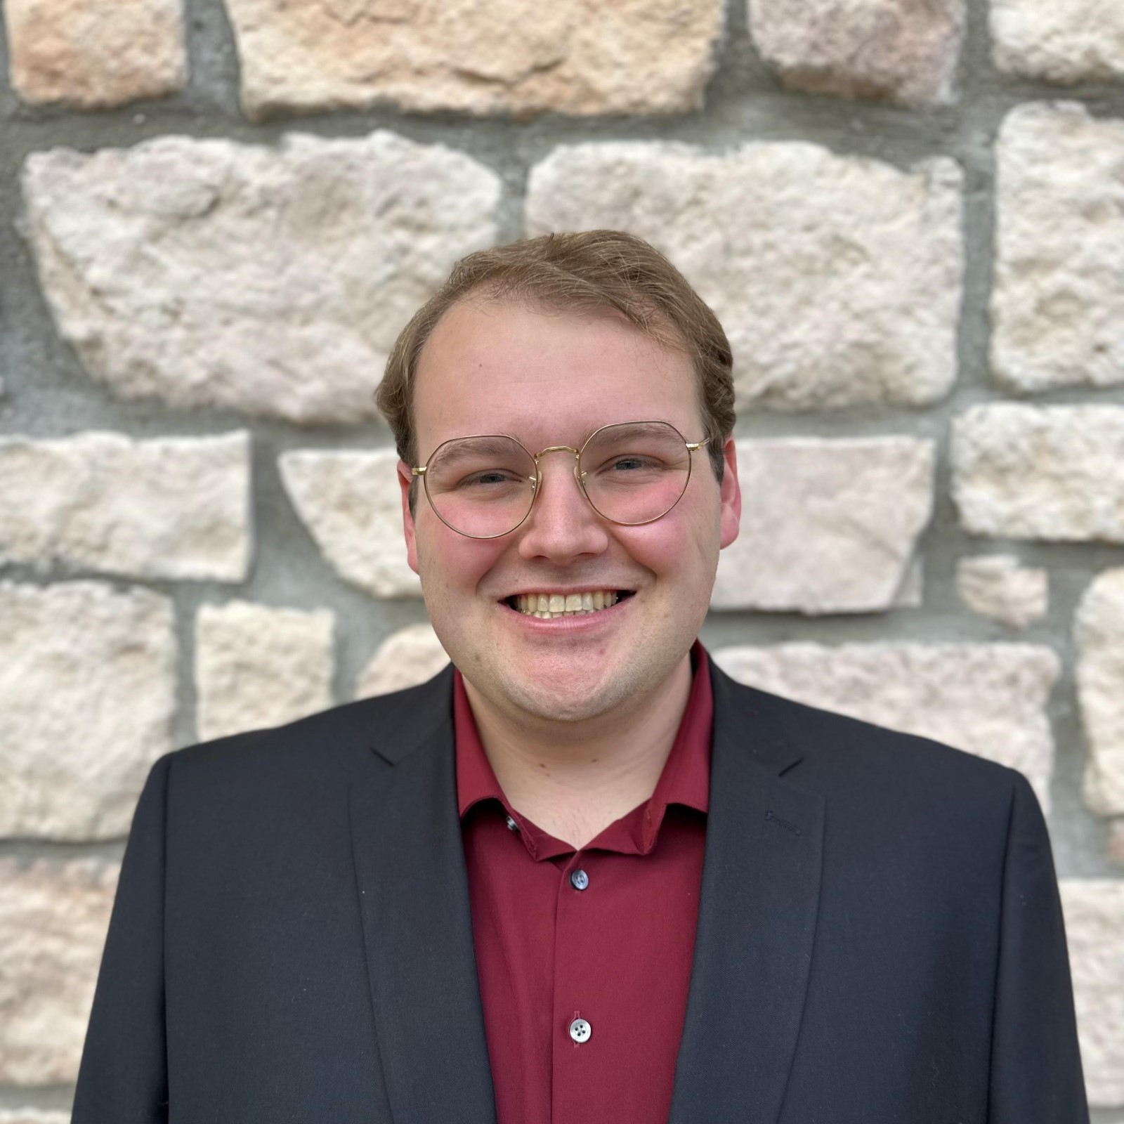
Andrew Gombac
MARITIME
Texas State University
Coastal Research and Education Actions for Transportation Equity (CREATE)
Research Area(s):
Geophysics and geotechnical engineering
Thesis Title:
Marine Electrical Resistivity to Identify Sediment Resuspension from Deep Draft Vessels

Slide 4
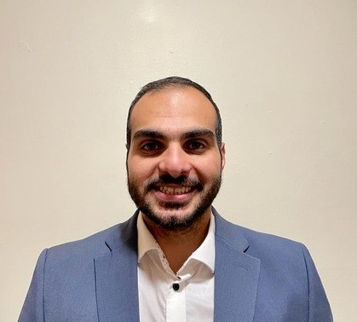
Mohammad Bilal Al-Khasawneh
MULTIMODAL
University of Maryland
Center for Multi-Modal Mobility in Urban, Rural and Tribal Areas (CMMM)
Research Area(s):
Big data for demand modeling, large-scale data analysis, data linkage
Thesis Title:
Enhancing Transportation Data Accuracy and Integration: Techniques for Small Area Estimation and Mobile Device Data Linkage

Slide 5
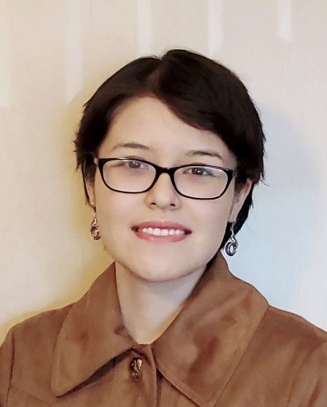
Anais Barja
MULTIMODAL
Washington State University
Environmentally Responsible Transportation Center for Communities of Concern (ERTC3)
led by the University of Missouri, Kansas City
Research Area(s):
Environmental Analysis with Causal AI
Thesis Title:
Understanding Environmental Impact of Transportation Systems Using Causal AI

Slide 6
Timothy Bernard
MULTIMODAL
Florida International University
Innovative Bridge Technologies/Accelerated Bridge Construction University Transportation Center (IBT/ABC-UTC) led by Florida International University
Research Area(s):
Freight and Structural Engineering
Thesis Title:
Evaluating Digital Twin Technology and Internet-of-Things Sensors for Informed Asset Management

Slide 7
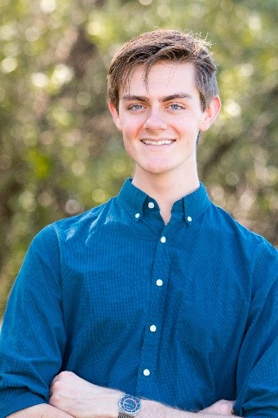
Dawson Beatty
MULTIMODAL
Virginia Tech
Center for Assured and Resilient Navigation in Advanced Transportation Systems (CARNATIONS) led by Illinois Institute of Technology
Research Area(s):
Transportation insecurity, social inclusion, travel behavior, and travel survey methods
Thesis Title:
Global Navigation Satellite System (GNSS) Spoofing Detection, Mitigation, and Recovery for Multi-Vehicle Systems Using Blind Array Processing

Slide 8
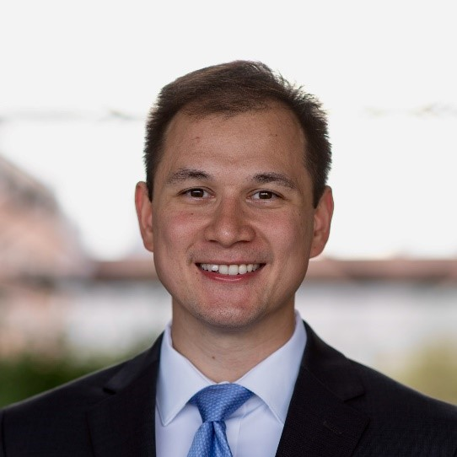
Zachary Clements
MULTIMODAL
University of Texas at Austin
Center for Automated Vehicle Research with Multimodal Assured Navigation (CARMEN+) led by the Ohio State University
Research Area(s):
Resilient and Secure Navigation
Thesis Title:
GNSS Interference Geolocation from Low Earth Orbit

Slide 9
Amy Fong
MULTIMODAL
University of Michigan
Center for Understanding Future Travel Behavior and Demand (TBD)
Research Area(s):
Transportation insecurity, social inclusion, travel behavior, and travel survey methods
Thesis Title:
Integrating Transportation Insecurity with Travel Behavior Analysis

Slide 10
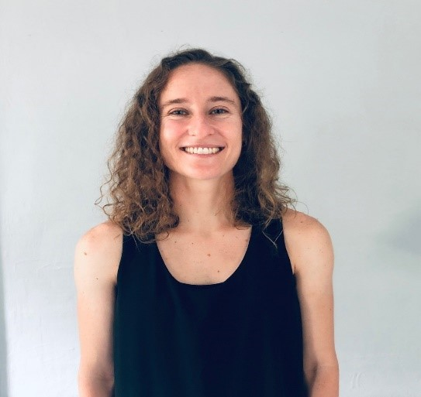
Lindsay Graff
MULTIMODAL
Carnegie Mellon University
National Center for Safety (Safety21)
Research Area(s):
Network modeling and infrastructure planning in multimodal transportation networks
Thesis Title:
Optimizing Mobility Infrastructure, Services, and Subsidies in Multimodal Transportation Networks

Slide 11
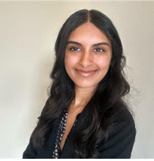
Sharika Hegde
MULTIMODAL
Northwestern University
Center for Connected and Automated Transportation (CCAT) led by the University of Michigan
Research Area(s):
Traffic Flow Theory / Multi-modal Urban Planning
Thesis Title:
A Design Framework for Integrating Multimodal Mobility in Human-Centered Urban Streetscapes

Slide 12
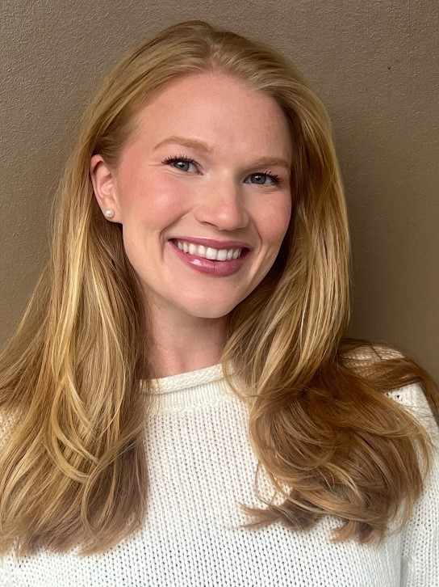
Alexandra Holliday
MULTIMODAL
University of New Orleans
Maritime Transportation Research and Education Center (MarTREC) led by the University of Arkansas
Research Area(s):
Freight-Based Economic Development Strategy
Thesis Title:
Economic Impact Analysis of Artificial Draft Restriction on the Lower Mississippi River Port Complex

Slide 13
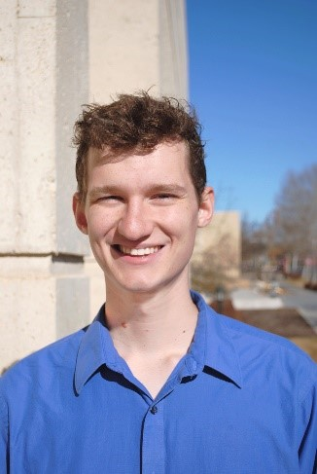
Eamon Lauster
MULTIMODAL
University of Illinois Chicago
Center for Freight Transportation for Efficient and Resilient Supply Chain (FERSC) led by University of Tennessee, Knoxville
Research Area(s):
Freight planning, vehicle automation
Thesis Title:
Understanding and Modeling Middle-Mile Logistics Automation

Slide 14
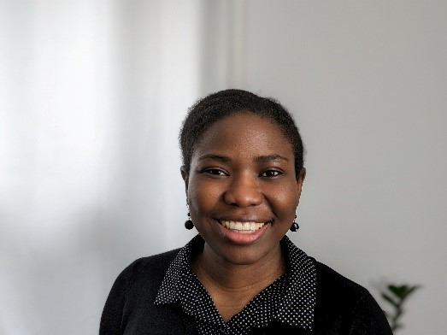
Tolu Oke
MULTIMODAL
University of Massachusetts – Amherst
New England University Transportation Center (NEUTC)
Research Area(s):
Pedestrian safety, transit safety, safety infrastructure, transportation planning, travel demand modeling, behavioral research, data analytics, decision-making, financial and economic evaluation
Thesis Title:
Pedestrian Safety Near Transit Bus Stops

Slide 15
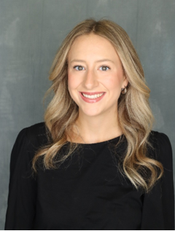
Allison Rewalt
MULTIMODAL
University of Tennessee, Knoxville
Center for Pedestrian and Bicyclist Safety (CPBS) led by University of New Mexico
Research Area(s):
Pedestrian and bicycle safety when using public transit
Thesis Title:
Identifying Research Priorities to Improve Safety for Pedestrians and Bicyclists Accessing Bus Stops

Slide 16
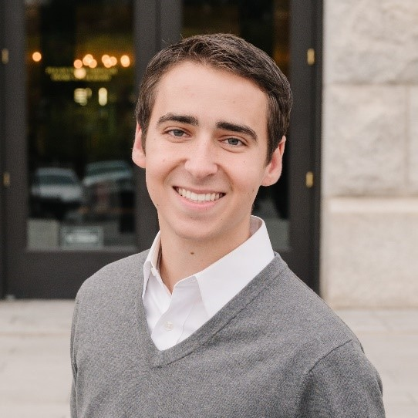
Matthew Davis
PUBLIC TRANSIT
University of Tennessee Knoxville
University Transportation Center for Regional and Rural Connected Communities (CR2C2) led by North Carolina A&T State University
Research Area(s):
Public transportation, fare equity, travel behavior trends
Thesis Title:
A Cluster Analysis of Demand Response Transit Travel: Findings from Rural Tennessee

Slide 17
Heryang Lee
PUBLIC TRANSIT
San José State University
Mineta Consortium for Equitable, Efficient, and Sustainable Transportation (MCEEST)
Research Area(s):
Capital construction, project delivery
Thesis Title:
Analyzing the "BART Effect": Identifying Capital Construction Bid Trends at SF Bay Area Rapid Transit District

Slide 18
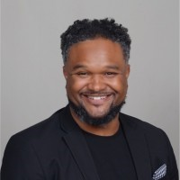
Evan Michael Taylor
PUBLIC TRANSIT
Morgan State University
Sustainable Mobility and Accessibility Regional Transportation Equity Research Center (SMARTER)
Research Area(s):
Transit fare policies
Thesis Title:
Understanding Fare Purchasing Behavior

Slide 19
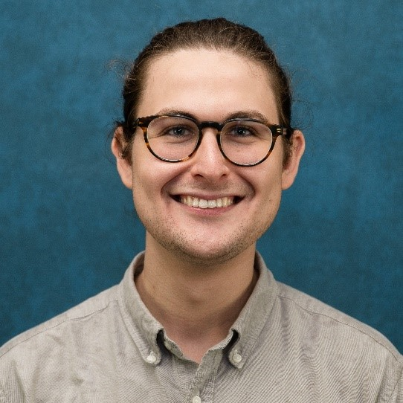
Andrew Tritch
PUBLIC TRANSIT
University of New Orleans
Center for Equitable Transit-Oriented Communities (CETOC)
Research Area(s):
Travel behavior, transit-oriented development, active transportation
Thesis Title:
Enhancing Public Transit with Shared Micromobility: How to Effectively Integrate These Two Modes of Transportation

Slide 20
Jeffery Pams
RAIL
University of Texas Rio Grande Valley
University Transportation Center for Railway Safety (UTCRS)
Research Area(s):
Infrastructure condition monitoring, vibration analysis
Thesis Title:
Vibration-Based Models for Onboard Diagnostics and Prognostics of Railroad Bearings and Wheels

Slide 21
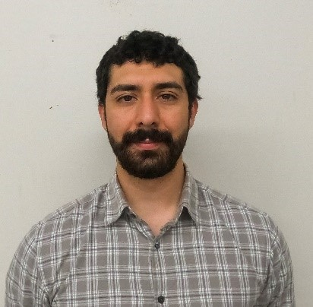
Juan Carlos Cruz Rivera
ROAD
University of Texas at San Antonio
Transportation Infrastructure Precast Innovation Center (TRANS-IPIC) led by University of Illinois Urbana-Champaign
Research Area(s):
Intelligent systems and automation
Thesis Title:
Gaze-directed UAV-UGV Coordination Framework for Onsite Quality Inspection of Precast Bridge Construction

Slide 22
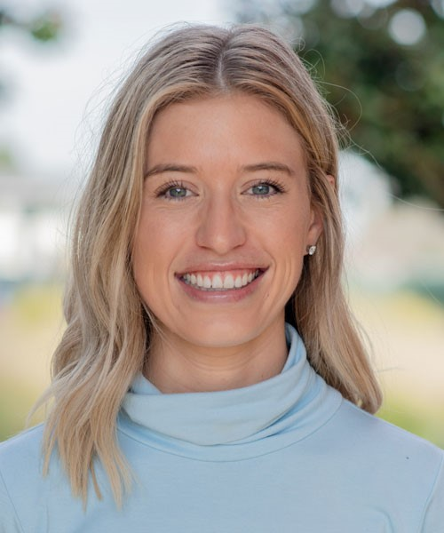
Sarah Dennis
ROAD
University of California, Davis
National Center for Sustainable Transportation (NCST)
Research Area(s):
Sustainable transportation, freight, environmental justice, air quality, environmental epidemiology
Thesis Title:
Integrating human exposure into freight transportation modeling for a sustainable and equitable future

Slide 23
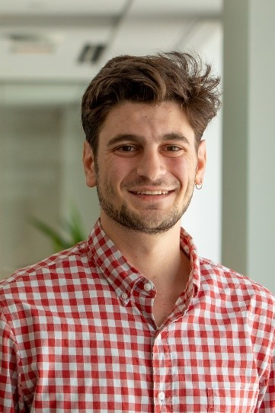
Travis Fried
ROAD
University of Washington
Pacific Northwest Transportation Consortium (PacTrans)
Research Area(s):
Freight and environmental justice
Thesis Title:
Delivering Justice: Toward Equity in Urban Freight Planning

Slide 24
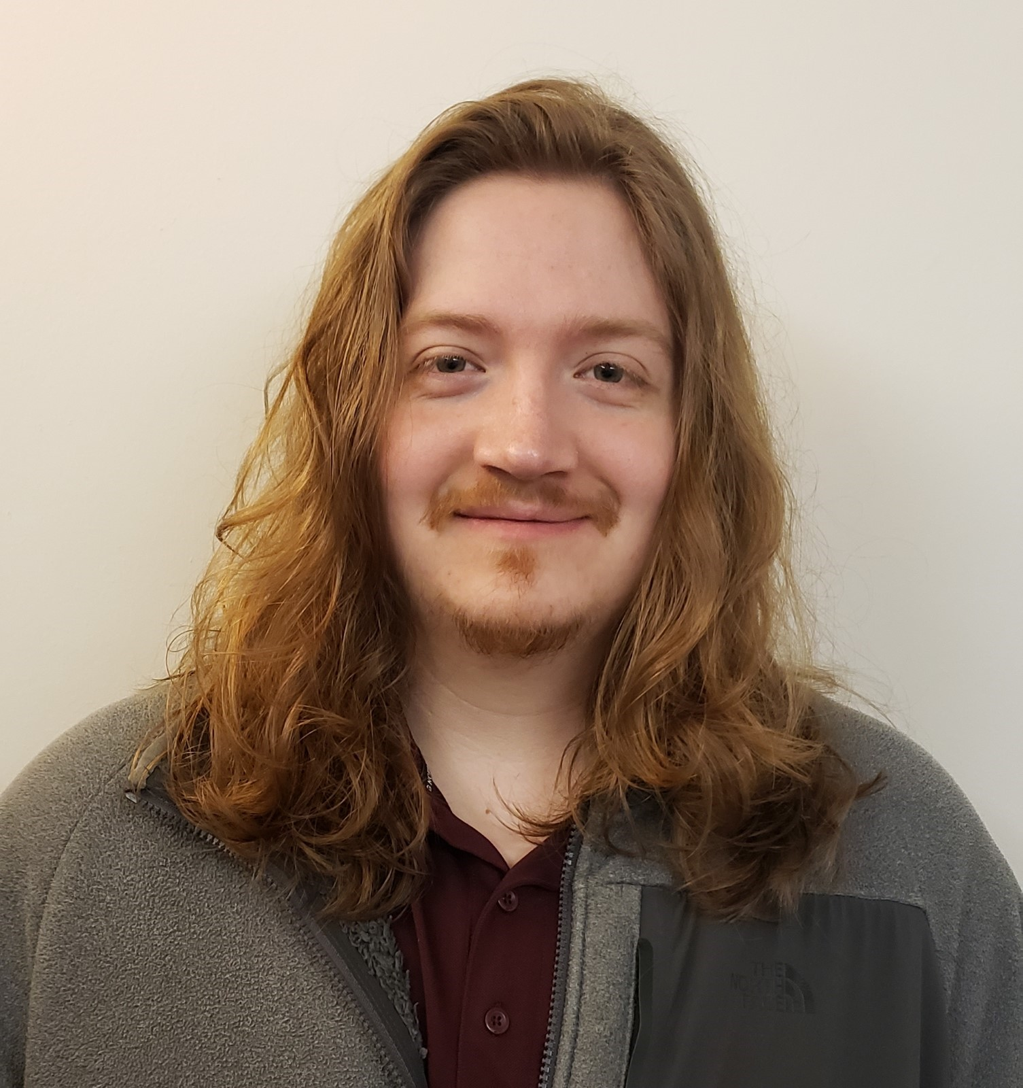
Reid Holland
ROAD
Rutgers, The State University of New Jersey
Connected Communities for Smart Mobility Toward Accessible and Resilient Transportation for Equitably Reducing Congestion (C2SMARTER) led by New York University
Research Area(s):
Advanced concrete materials, Structural Health Monitoring, Structural Reliability, Finite Element Analysis
Thesis Title:
Development of Prediction Models for Ultra High-Performance Concrete in Shear

Slide 25
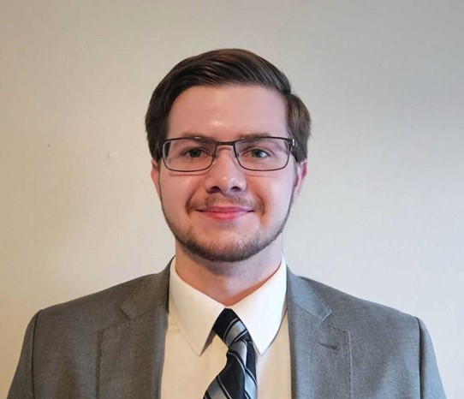
John Holt
ROAD
University of Kansas
Mid-America Transportation Center for Transportation Safety and Equity (MATC) led by University of Nebraska-Lincoln
Research Area(s):
Fracture mechanics behavior and material characterization for highway infrastructure
Thesis Title:
Development of In-situ Fracture Toughness Evaluation for Bridge Safety

Slide 26
Xiatian Iogansen
ROAD
University of California, Davis
Pacific Southwest Region University Transportation Center (PSR UTC) led by the University of Southern California
Research Area(s):
Travel behavior modeling, Electrification, Travel demand management
Thesis Title:
Investigating Heterogeneity in Private Vehicle Ownership, Preferences towards Alternative-Fuel Vehicles, and Adoption of Shared Mobility Options

Slide 27
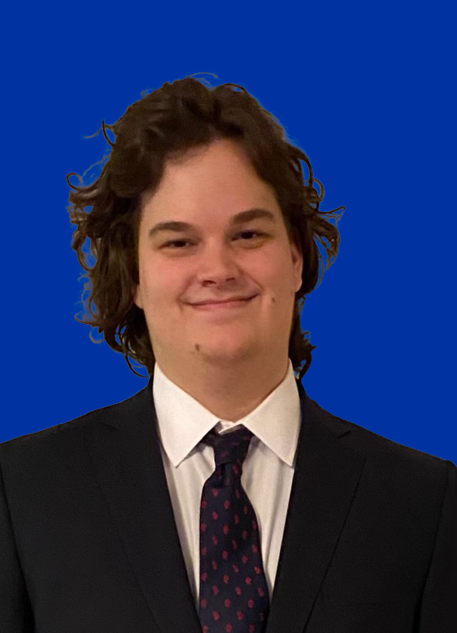
Marc Jacquet
ROAD
Embry-Riddle Aeronautical University
Transportation Cybersecurity Center for Advanced Research and Education (CYBER-CARE) led by the University of Houston
Research Area(s):
Transportation Cybersecurity
Thesis Title:
A Distributed Framework for Transportation Cybersecurity Simulation

Slide 28
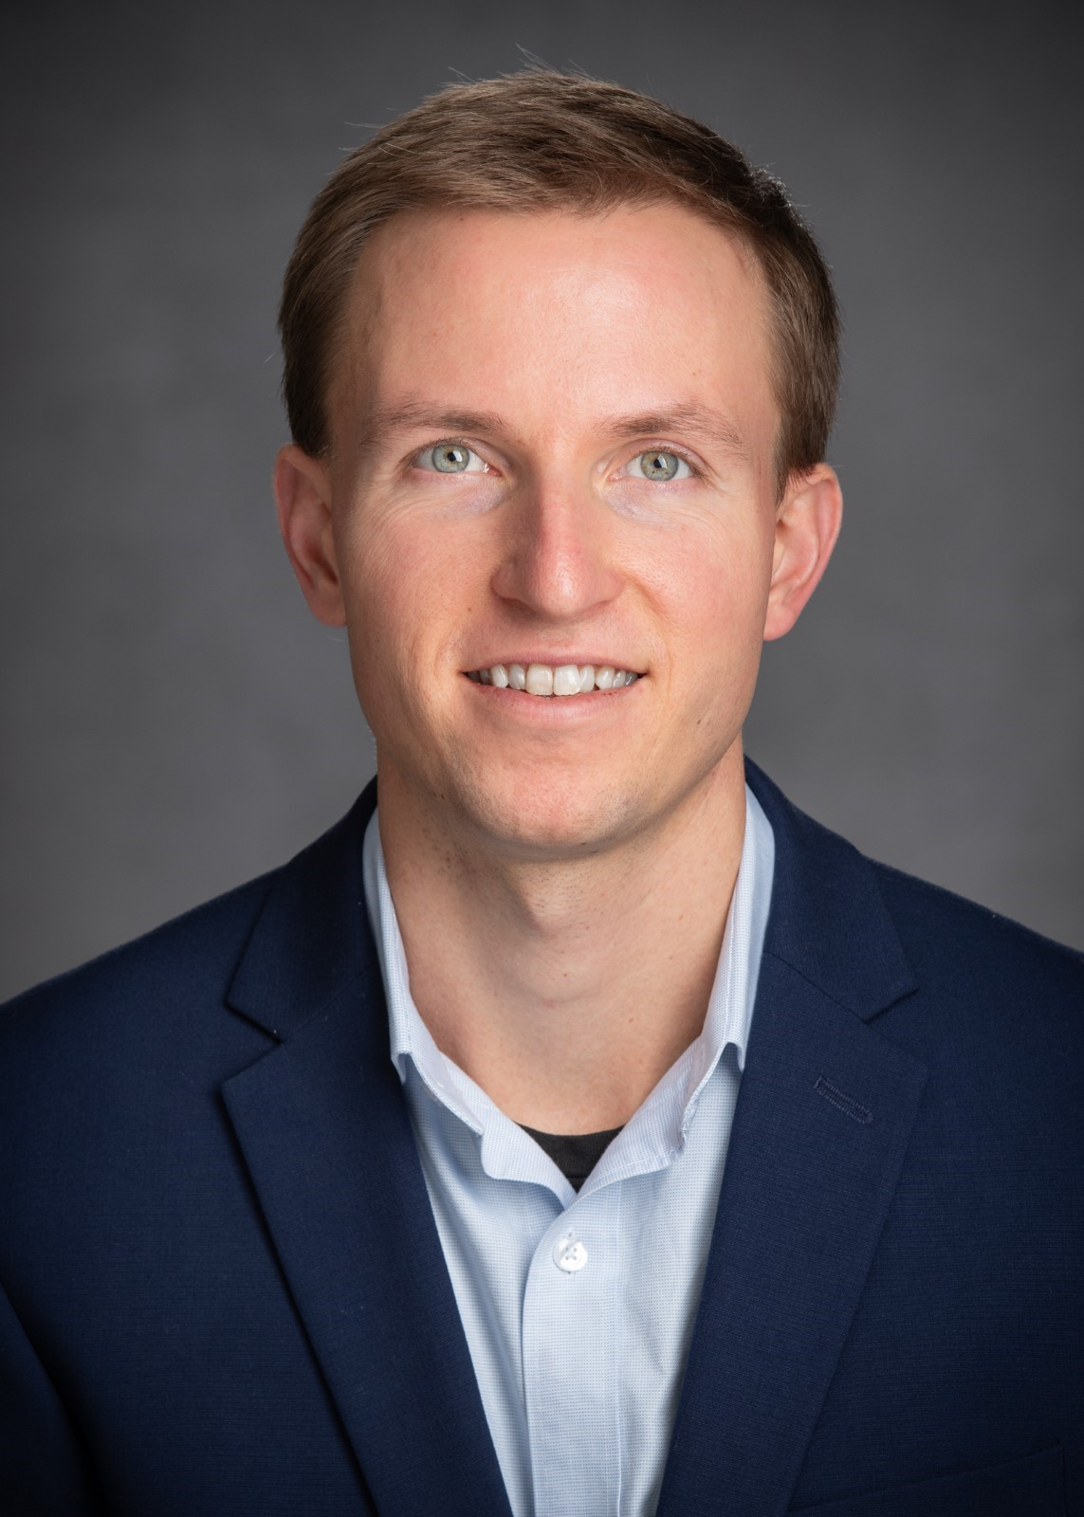
Ryan Jones
ROAD
North Dakota State University
Center for Transformative Infrastructure Preservation and Sustainability (CTIPS)
Research Area(s):
Autonomous Trucking in U.S. Freight
Thesis Title:
Developing Business Cases for Autonomous Trucks in North Dakota and Identifying the Most Likely Application - A Delphi-based Scenario Study

Slide 29
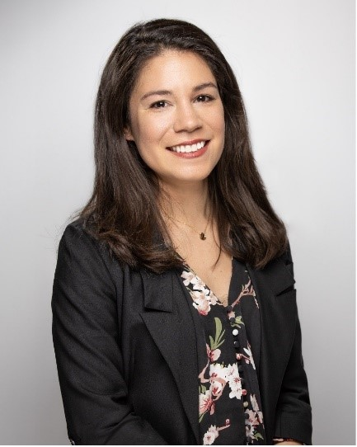
Catherine Lucero
ROAD
Oregon State University
Center for Durable and Resilient Transportation Infrastructure (DuRe-Transp) led by University of Texas at Arlington
Research Area(s):
Materials and Pavement Friction
Thesis Title:
Evaluation of the Long-Term Durability of Concrete with Natural Pozzolans

Slide 30
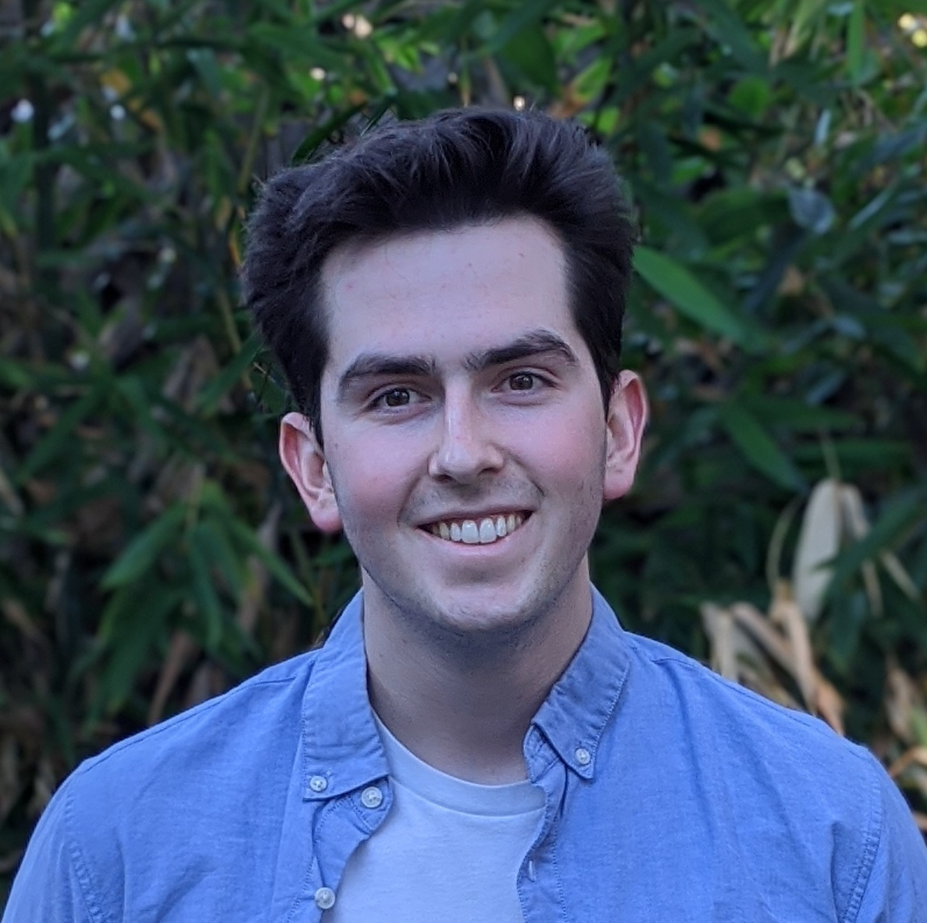
Eric Vin
ROAD
University of California at Santa Cruz
National Center for Transportation Cybersecurity and Resiliency (TRACR) led by Clemson University
Research Area(s):
Verification and analysis of cyber-physical systems
Thesis Title:
Verification and Synthesis of Cyber-Physical Systems using Scenic

Slide 31
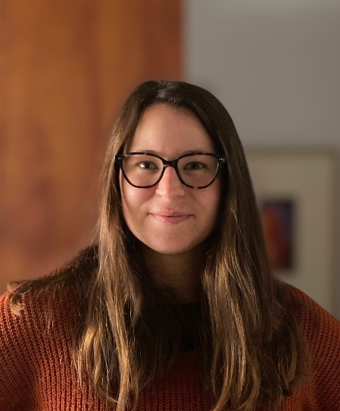
Abigail (Abby) Winrich
ROAD
Oklahoma State University
Southern Plains Transportation Center (SPTC) led by University of Oklahoma
Research Area(s):
Soil and water assessment tool, hydrologic and water quality system, turbidity, model calibration, agricultural best management practices (BMPs), non-point source pollution
Thesis Title:
Modeling Recurrent Turbidity Impairments in Oklahoma and the Impact of Targeted Best Management Practices on Sediment Concentrations

