Slide 1
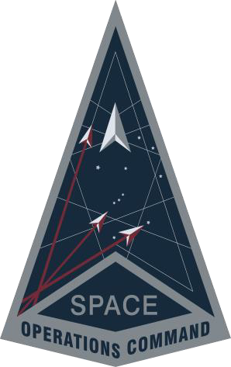
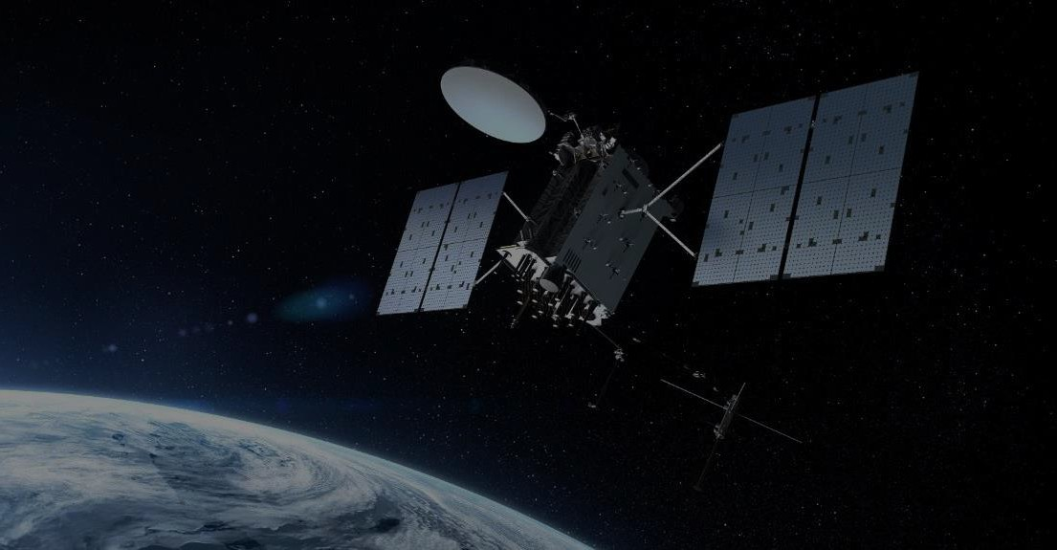
Global Positioning System Operations
Classification: UNCLASSIFIED
Lieutenant Colonel Robert Wray
Commander, 2d Space Operations Squadron
Schriever Space Force Base, Colorado
Classification: UNCLASSIFIED

Slide 2
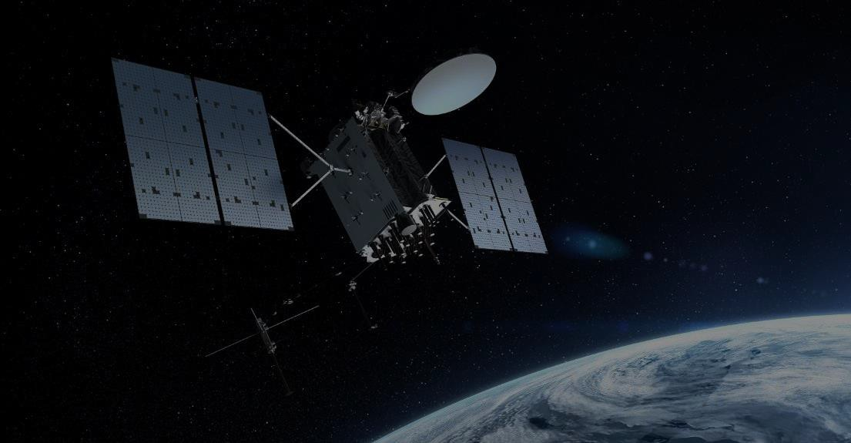
GPS: 50 Years Without Fail
Classification: UNCLASSIFIED
Agility – Innovation – Boldness
1973: GPS funded by Congress
1978: First GPS Satellites on Orbit
1983: GPS Guaranteed Free to Civil Users
1993: GPS Initial Operational Capability
2000: Selective Availability Turned Off
2003: Wide Area Augmentation System Fielded
GPS is the highest integrity sat navigation system
The Gold Standard: GPS has never failed
Classification: UNCLASSIFIED

Slide 3
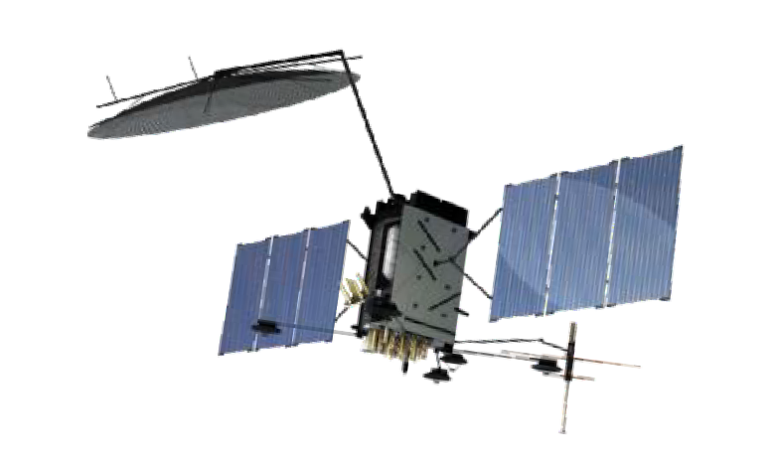
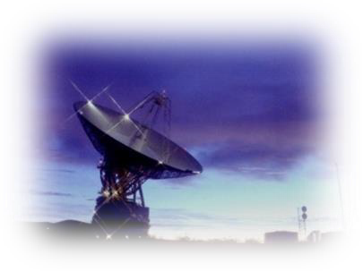
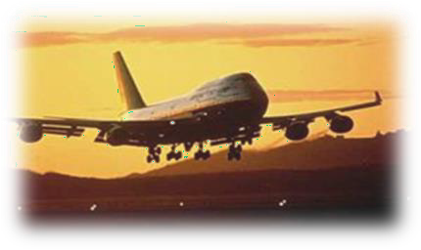
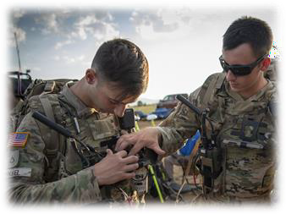
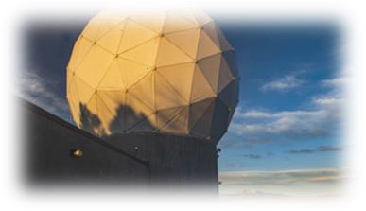
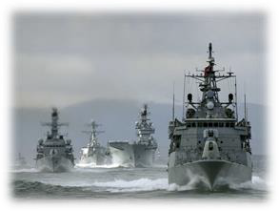
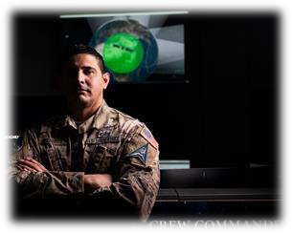
Classification: UNCLASSIFIED
GPS Architecture
Agility – Innovation – Boldness
Space Segment
Broadcasting free signal since 1978
Control Segment
User Segment
10 Crew Operators / Combined 21 monitor
& antenna stations worldwide
Reaching over 6 billion users every second
Free Global Service to Civilian, Commercial, Military & International Users
Classification: UNCLASSIFIED
4
4

Slide 4
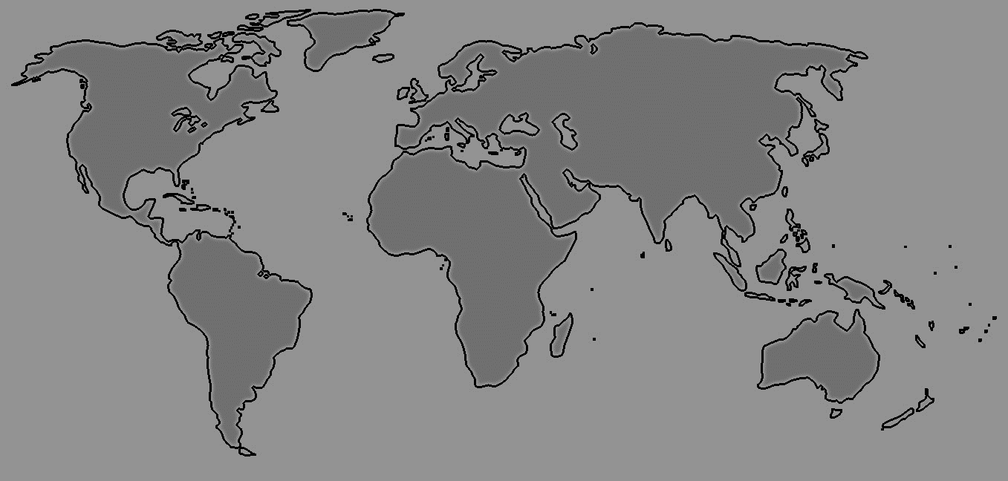
Classification: UNCLASSIFIED
Where is GPS?
Thule Tracking Station, Greenland
Alaska-Eilson AFB
UK MOD - TCS Oakhanger
Colorado Springs- USSF
New Hampshire Tracking Station, NH
South Korea - Osan AB
Vandenberg Tracking Station, CA
Washington D.C. - USNO
Cape Canaveral - USSF
Bahrain - USN
Kaena Point, HI - USSF
Guam Tracking Station, Guam
Kwajalein - USA
Ecuador - US Embassy
Ascension - RAF
Diego Garcia - USN
Uruguay - US Embassy
South Africa - US Embassy
Australia – Defense Science & Technology
Australia – Stirling Navy Base
New Zealand – Government Site
Master Control Station (MCS)
Alternate Master Control Station (AMCS)
Ground Antenna
Satellite Control Network (SCN) Remote Tracking Station
National Geospatial Agency (NGA) Monitor Stations
Space Force Monitor Station
Classification: UNCLASSIFIED

Slide 5
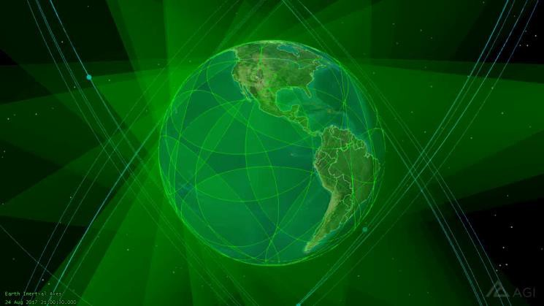
GPS Constellation Status
Classification: UNCLASSIFIED
Agility – Innovation – Boldness
Satellite Block | Quantity | Average Age (yrs) | Oldest (yrs)
GPS IIR | 7 | 21.8 | 26.4
GPS IIR-M | 7 | 16.2 | 18.3
GPS IIF | 11 | 9.7 | 13.6
GPS III | 6 | 3.0 | 5.0
37 Satellite – 31 Set Healthy
24 Needed for Baseline Capability
Average URE* | Best Day URE | Worst Day URE
48.4 cm | 34.1 cm (23 Jun 23) | 163.7 cm (25 Jan 23)
GPS Signal in Space (SIS) Performance
2023 Data
*All User Range Errors (UREs) are Root Mean Square values
Classification: UNCLASSIFIED
₆6

Slide 6
Classification: UNCLASSIFIED
Global Impact of GPS
Critical Sectors:
Transportation
Agriculture
Energy
Water / Waster water
Maritime
Public Safety
Defense
Finance
Telecommunications
GPS enables >$1B of U.S. Gross Domestic Product daily
GPS consistently meets all technical performance commitments: Accuracy, Integrity, Availability and Continuity
Classification: UNCLASSIFIED
6
Space Starts Here
Notes:
SVO: Projected on TV behind SVO

Slide 7
GPS Future: New Civil Signals
Classification: UNCLASSIFIED
New: L1C Signal
Enable interoperability
Common civil signal for GPS and Galileo
Japan's Quasi-Zenith Satellite System (QZSS) and China's BeiDou system are adopting L1C-like signals
Improve GPS reception in cities and other challenging environments
New: L2C Signal
When combined with L1 C/A in a dual-frequency receiver, L2C enables ionospheric correction, which can increase accuracy
Dual-frequency GPS receivers may achieve the same accuracy as the military user
Improved: L5 – Safety of Life Signal
Safety-of-life transportation and other high-performance applications
Improved signal structure for enhanced performance
Higher transmitted power than L1/L2 signal (~3 dB, or 2× as powerful)
Wider bandwidth provides a 10× processing gain for the receiver
Signal in protected International Telecommunications Union and Aeronautical Radionavigation Services (RNSS) band
7
Classification: UNCLASSIFIED

Slide 8
Homeland Defense: Crucible
Classification: UNCLASSIFIED
Agility – Innovation – Boldness
Purpose:
Detect, characterize, and resolve GPS disruptions in the U.S. caused by intentional or unintentional Electromagnetic Interference (EMI)
Triggered by large-scale disruptions affecting:
Positioning services for ground, air, and/or maritime users
U.S. Critical Infrastructure
Principal Agencies:
2 SOPS - Coast Guard Navigation Center – Federal Aviation Administration
Nat Coordination Center for Communications – Federal Communications Commission
Department of Defense and Department of Transportation: Committed, Critical Partners to the Success of GPS
Classification: UNCLASSIFIED

