Slide 1
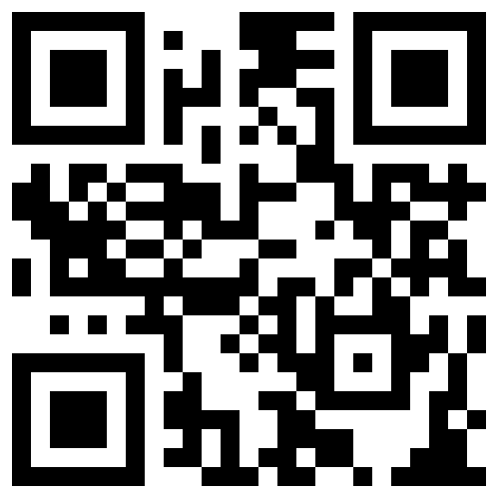
Advocating policies & systems to protect GPS satellites, signals, & users.
www.RNTFnd.org

