Slide 1
Integrity Awareness Training Annual Requirement
Transit Benefit Program
Last updated
2023

Slide 2
Topics
Program Overview
Background
TRANServe Role
Participant Role
Legal Implications
Website Resources: https://www.transportation.gov/transerve/
Understanding the Certification Statement
Knowledge Checks (Questions and Answers)
Helpful Information

Slide 3
Program Overview
Transit Subsidy Program:
Protects Nation’s Infrastructure
Reduces air pollution & traffic congestion
Increases use of mass transit
Studies show traffic congestion:
Wastes 1.9 billion gallons of gas
Costs over $100 billion in wasted fuel & lost time
Tax-free subsidy for actual costs of mass transit commutes
Up to the maximum set by the IRS statutory limit

Slide 4
Background
Program History
1991 - Federal Transit Administration Program Pilot
1993 - Clean Air Act
2000 – E.O. 13150 Federal Workforce Transportation
Fringe Benefit
2005 - SAFETEA-LU
Eligibility
All federal employees working in full or part time paid status
All federal interns and volunteers working in a non-paid status- Refer to agency for guidance

Slide 5
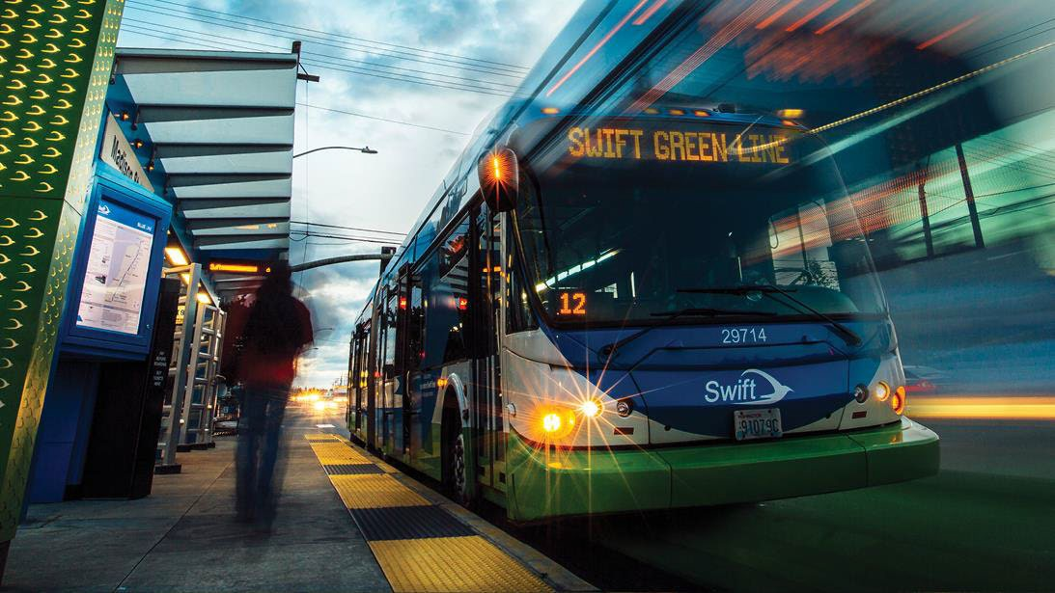
Approved Mass Transportation
Rail
Subway
Commuter
Bus
Transit authority
Commuter
Ferry
Pedestrian or bicycle
Trolley
Qualified Vanpools
Commercial or private vehicle with at least six adult passengers, excluding the driver

Slide 6
Not Approved for Transit Subsidy
POV- Single Occupancy
Taxi
Carpool
RideShare
Bike
Bike Share
Scooters
Personal Bikes
Refer to your Agency
Parking
Garage
Commuter Parking
Street Parking

Slide 7
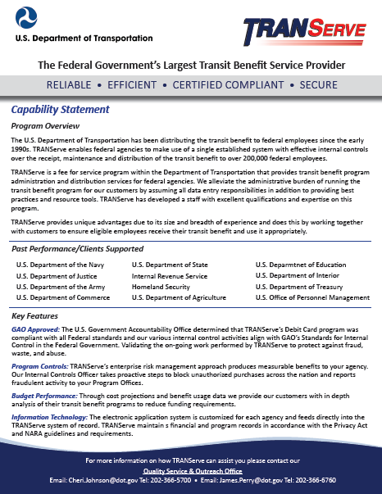
TRANServe’s Role
Service Provider to Federal Agencies
Administers the Transit Subsidy Program
Distributes the transit subsidy to agency qualified employees
Establishes best practices
Provides education, answers and support to Program Offices and participants

Slide 8
Participant Roles and Responsibilities
Understand the Transit Subsidy Program’s scope and limitations
Understand it is a violation of federal law to transfer or sell the transit subsidy or to provide false or fraudulent information in order to obtain the subsidy
Understand the potential penalties for misuse or false claims

Slide 9
Participant Roles and Responsibilities
To not be named on a worksite parking permit at any Federal agency, nor participate in a carpool
To use the transit subsidy for home to work and work to home transportation only
To ensure the amount of transit subsidy received does not exceed actual monthly commuting cost of public transportation
To recertify your application to update commuting expenses during annual recertification and whenever your commuting method, work schedule or address changes

Slide 10
Legal Implications
Employees who misuse the transit subsidy are subject to appropriate administrative action including discipline and/or disqualification from future participation in the Transit Subsidy Program
Disciplinary action can range from written warning to removal from Federal Service, depending on the severity of the abuse

Slide 11
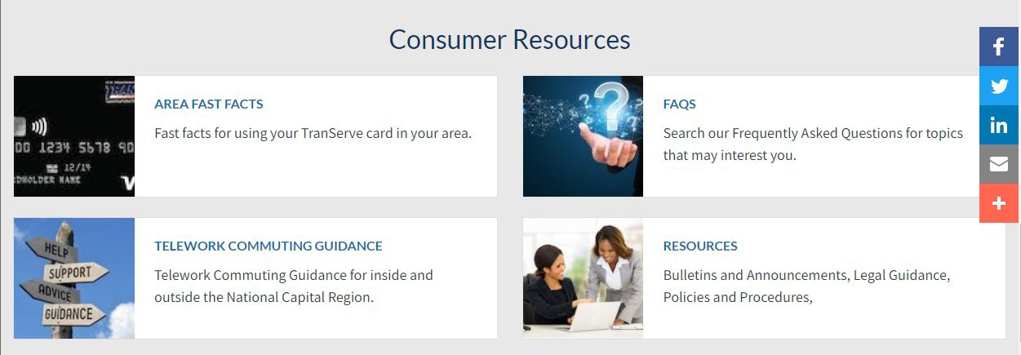
Website Resources:
www.transportation.gov/transerve/
Apply
Recertify
TRANServe card
News
FAQs
Research Transit-Area Fast Facts

Slide 12
Knowledge Check: Question #1
The Transit Benefit Program objective is to:
A. Increase compensation of federal employees per month
B. Encourage federal employees to use mass transportation to reduce their contributions to traffic congestion and air pollution
C. Reward the employees for their hard work

Slide 13
Knowledge Check: Answer #1
The Transit Benefit Program objective is to:
A. Increase compensation of federal employees per month
B. Encourage federal employees to use mass transportation to reduce their contributions to traffic congestion and air pollution
C. Reward the employees for their hard work
The Federal Workforce Transportation Fringe Benefit Program under Executive Order 13150 is designed to reduce traffic congestion and air pollution.

Slide 14
Knowledge Check: Question # 2
If I misuse my transit benefit by selling it or over-estimating my commuting cost, I can be removed from federal service
True
False

Slide 15
Knowledge Check: Answer #2
If I misuse my transit benefit by selling it or over-estimating my commuting cost, I can be removed from federal service
True
False
True: Disciplinary action can range from written warning to removal from Federal Service, depending on the severity of the abuse.
. •

Slide 16
Knowledge Check: Question #3
What information can be found on TRANServe’s website?
A. Link to your online application
B. How to get a replacement TRANServe Card
C. Best practices using your Transit Benefit
D. All of the above

Slide 17
Knowledge Check: Answer #3
What information can be found on TRANServe’s website?
A. Link to your online application
B. How to get a replacement TRANServe Card
C. Best practices using your Transit Benefit
D. All of the above
Visit the TRANServe website for all questions and resources: https://www.transportation.gov/transerve

Slide 18
Knowledge Check: Question #4
Martha plans to start teleworking. The next step is to:
A. Inform her supervisor
B. Continue claiming her transit subsidy without change
C. Submit an updated application that reflects her new
actual commuting cost

Slide 19
Knowledge Check: Answer #4
Martha plans to start teleworking. The next step is to:
A. Inform her supervisor
B. Continue claiming her transit subsidy without change
C. Submit an updated application that reflects her new actual commuting cost
You are responsible to update your transit subsidy application and commuting cost worksheet whenever you change your commuting method, work schedule, or address.

Slide 20
The Trans.it Benefit Certification Statement

Slide 21
Certification Is Required
Certify:
“To formally and legally attest a specific statement to be true”
Before you can enroll in the Transit Subsidy Program you must first certify that certain conditions are true about you

Slide 22
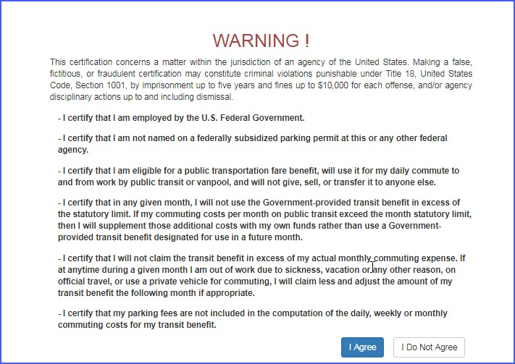
Read the Certification Statement Carefully

Slide 23
To What Must I Agree?
You Must agree:
I am employed by the U.S. Federal Government
I am not named on a federally subsidized parking permit, anywhere
I am eligible for a public transportation fare subsidy
I will use the subsidy for my daily mass transit commute to and from work
I will not give, sell or transfer it to anyone else
I will not use the Government provided subsidy in excess of the IRS limit
I will not claim an amount in excess of my actual monthly commuting expense
I will not include parking fees as part of my commuting cost worksheet

Slide 24
Knowledge Check: Question #5
Keeva moved closer to work and now walks to work after commuting on the train. She would like to call a taxi on bad weather days. Can she use her subsidy for this mode of transportation?
Yes
No
The answer is….

Slide 25
Knowledge Check: Answer #5
Keeva moved closer to work and now walks to work after commuting on the train. She would like to call a taxi on bad weather days. Can she use her subsidy for this mode of transportation?
Yes
No
Single occupancy modes of transportation are not eligible for Transit Subsidy.

Slide 26
Knowledge Check: Question #6
Haley commutes from Virginia to get to work. Her commuting costs are $321 per month. She is eligible to receive additional transit subsidy since her commute is so costly.
True
False

Slide 27
Knowledge Check: Answer #6
Haley commutes from Virginia to get to work. Her commuting costs are $321 per month. She is eligible to receive additional transit subsidy since her commute is so costly.
True
False
The federal government
may provide up to the IRS maximum for mass transportation commuting costs.
Haley must cover the additional amount, “out of pocket”.

Slide 28
Knowledge Check: Question #7
Becky chooses to ride in a carpool. She is eligible to receive the transit subsidy.
True
False

Slide 29
Knowledge Check: Answer #7
Becky chooses to ride in a carpool. She is eligible to receive the transit subsidy.
True
False
The Federal Transit Subsidy is for federal employees who choose to commute on mass transit in a commuter highway vehicle. This includes bus, rail, light rail and an authorized vanpools-(6 adult passengers or more).

Slide 30
Knowledge Check: Question #8
Ivan rides mass transit and parks in the lot near the station. He includes his parking fees as part of his monthly commuting cost. He is right to do this.
True
False

Slide 31
Knowledge Check: Answer #8
Ivan rides mass transit and parks in the lot near the station. He includes his parking fees as of his monthly commuting cost. He is right to do this.
True
False
The Federal Transit Benefit is exclusively for your home-to-work-to-home commute on mass transportation. Any other use is actionable as fraud, waste, or abuse of federal funds

Slide 32
Knowledge Check: Question #9
Ciera and her supervisor agree that she may telework two days each week, indefinitely. Her current transit subsidy is $25 per week. Now that she does not commute every day, her correct course of action is to:
A. Thank her supervisor for his/her understanding.
B. Continue claiming her transit subsidy without change.
C. Submit application to reflect her new actual commuting cost.

Slide 33
Knowledge Check: Answer #9
Ciera and her supervisor agree that she may telework two days each week, indefinitely. Her current transit subsidy is $25 per week. Now that she does not commute every day, her correct course of action is to:
A. Thank her supervisor for his/her understanding.
B. Continue claiming her transit subsidy without change.
C. Submit application to reflect her new actual commuting cost.
Anytime your information changes an application is required: work location, commuting cost, home address.

Slide 34
Knowledge Check: Question #10
Chris is going to an off-site meeting. He is using mass transportation to travel to and from the meeting. Since he has available funds he decides to use his transit subsidy. This is the correct course of action.
True
False

Slide 35
Knowledge Check: Answer #10
Chris is going to an off-site meeting. He is using mass transportation to travel to and from the meeting. Since he has available funds he decides to use his transit benefit. This is the correct course of action.
True
False
Travel to an off-site meeting or training class is an office expense. The Transit Subsidy is provided solely for your home-to-work-to- home commute via mass transportation.

Slide 36
Helpful Information

Slide 37
The TRANServe Card
Answers and Activation: www.transportation.gov/TRANServe/my-transerve-card
Monitor Your Benefit: https://www.access.usbank.com
Customer Service: 1-800-994-6722
Organization Code: TRANSV

Slide 38
TRANServe Card Funding Cycles
Benefit Month | Funds Available
October | September 10-October 9
November | October 10-November 9
December | November 10-December 9
January | December 10-January 9
February | January 10-February 9
March | February 10-March 9
April | March 10-April 9
May | April 10-May 9
June | May 10-June 9
July | June 10-July 9
August | July 10-August 9
September | August 10-September 9
TIP: Purchase by the 4th to avoid wasting your benefit.
This is to allow your vendor enough time to post the charges before the subsidy month resets.

Slide 39
National Capital Region’s SmartTrip Card
…
Register Your Card: https://smartrip.wmata.com/Account/Create
Answers: https://www.wmata.com/fares/smartrip/faq.cfm
Monitor Your Benefit: https://smartrip.wmata.com/Account/Login
Customer Service: 888-SMARTRIP (M-F, 7AM-8PM)

Slide 40
SmarTrip Card Funding Cycles
Benefit Month | Funds Available
October | October 1-31
November | November 1-30
December | December 1-30
January | January 1-30
February | February 1-28
March | March 1-31
April | April 1-30
May | May 1-30
June | June 1-30
July | July 1-31
August | August 1-31
September | September 1-30
TIP: Monitor your funds through your online account at the website below: https://smartrip.wmata.com/Account/Login

Slide 41
Thank you for choosing to commute using mass transit and welcome to the program.
Additional information is available on our Website: https://www.transportation.gov/transerve/faq
For specific questions, find your DOT Modal Point of Contact here: https://www.transportation.gov/transerve/participants/dot-transit-subsidy- modal-points-contact

Slide 42
for successfully completing the Transit Subsidy Integrity Awareness Training
Confirm by checking box through online application

