Slide 1

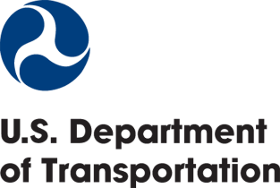
DOT Advisory Committee
On Human Trafficking
PUBLIC MEETING
October 3, 2023
9:30am – 5:00pm EDT

Slide 2


Facilitating the Transportation Sector’s Collective Impact
in Combating Human Trafficking

Slide 3

The U.S. Department of Transportation
combats human trafficking by working with public and private sector stakeholders to empower transportation employees and the traveling public to recognize and report possible instances of human trafficking.

Slide 4

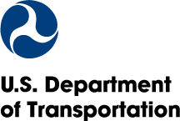
Overview
  Statistics
  Federal Cooperation
  Legislative Authorities
  TLAHT Initiative
  Global Cooperation
  Grants & Award

Slide 5

GLOBAL ESTIMATED PREVALENCE
PREVALENCE
TOTAL | 27.6 million
Adults | 88%
Males | 57%
Females | 43%
Children/ Minors | 12%
Length | ~15.4 months
FORCED LABOR (private + state imposed)
TOTAL | 77%
Adults | 92%
Males | 68%
Females | 32%
Children/ Minors | 8%
COMMERCIAL SEXUAL EXPLOITATION
TOTAL | 23%
Adults | 73%
Females | 78%
Children/ Minors | 27%
Males | 22%
SOURCE: International Labour Organization, 2021

Slide 6






GLOBAL TRANSPORT-
RELATED DATA
BORDER POINT
MODE | OFFICIAL 80% | UNOFFICIAL
 | 34% | 26%
 | 33% | 15%
 | 20% | 5%
 | 11% | 28%
 | 1% | 12%
 | <1% | 5%
80,000+ Trafficked
Persons
171 Countries
SOURCE: Counter-Trafficking Data Collaborative,
Initiative of the International Organization for
Migration, 2020

Slide 7
4P Framework
Federal Cooperation
UN Palermo Protocol &
US Trafficking Victims Protection Act (TVPA)
President’s Interagency Task Force to Monitor and Combat Trafficking in Persons (PITF)
Cabinet-level entity coordinates USG efforts
Senior Policy Operating Group (SPOG)
  Coordinates interagency policy, grants, research
National Action Plan to Combat Human Trafficking
Transportation Focus
  Raising awareness, domestic/international stakeholder engagement, and CDL enforcement
Prosecution
Protection
Prevention
Partnership

Slide 8

Legislative Authorities
2016 FAA Extension, Safety & Security Act
2019 Frederick Douglass Trafficking Victims Prevention and Protection Reauthorization Act
Flight attendant training
Track air carrier training, tips, and notification
2018 Combating Human Trafficking in Commercial Vehicles Act
2021 Infrastructure Investment and Jobs Act
Expand FMCSA outreach, education, and funding,
Establish Advisory Committee
Triennial Advisory Committee report.
2022 Human Trafficking Prevention Act
2018 No Human Trafficking on Our Roads Act
Coordinate with owners/operators on posting Hotline in restrooms.
Lifetime CDL disqualification
2023 Trafficking Victims Prevention
and Protection Reauthorization Act
2018 FAA Reauthorization Act
Customer-facing air carrier employee training
Biennial training and employee code of conduct

Slide 9





Transportation
Leaders Against Human Trafficking
Call to Action
Join the Effort &
Sign the Pledge
Leadership Engagement
Industry Education & Sharing
Policy Development
Public Awareness and Outreach
Information-Sharing and Analysis
Issue a
Leader Statement
Train Employees
Raise Public
Awareness

Slide 10

TLAHT Signatories
Training
~600 Signatories Agreed to Train
1.3 Million+ Employees
199 Airports and Airlines
146 Urban & Rural Transit Agencies
59 Trucking and Bus Companies
50 State DOTs
13 Ports
9 Railways
3 Pipeline Companies
8 States
12 Cities
USDOT
  55,000 DOT Employees
  Bus/Truck Inspectors
Trainings for Stakeholders
  New Multimodal
  Blue Lightning Initiative

Slide 11

"The only thing more effective than millions of transportation workers empowered to identify and report human trafficking is hundreds of millions of traveling Americans helping with that same goal. Together we can save people from human trafficking across our transportation systems.”
USDOT SECRETARY
PETE BUTTIGIEG

Slide 12

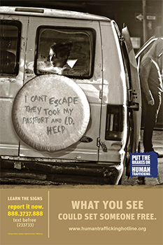
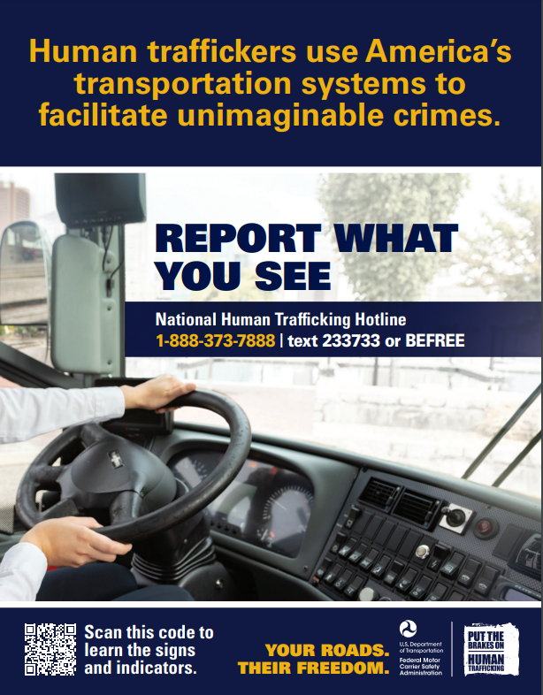

TLAHT AWARENESS POSTERS

Slide 13



Global Cooperation
International Civil Aviation Organization (ICAO)
Asia Pacific Economic
Cooperation (APEC)
Ministerial Statements
Awareness Pilot Project
Comprehensive Strategy & Workshop
Circular 352: Cabin Crew Training Guidelines
Recommended Practices 8.49 & 8.50
  Clear reporting systems
  Relevant/Competent Authorities POCs
  Awareness Training
Working Group: Comprehensive Strategy
Resolutions Adopted
  A40-15: Policies, reporting protocols, training
  A41-16: Comprehensive Strategy
OECD International Transport
Forum (ITF)
Multilateral Engagement
Ministerial Statements

Slide 14
USDOT GRANTS AND AWARD
Expanding Funding to Include Counter-Trafficking Efforts
Commercial Driver’s License
Program Implementation
$3+ million to support counter-trafficking efforts through driver’s license standards and programs
Transit Public Safety
$5.4 million to prevent human trafficking and other crimes on buses, trains, and other forms of public transportation
Annual Combating Human Trafficking
in Transportation
Impact Award
$50,000 for innovative and shareable solutions to combat human trafficking in the transportation industry

Slide 15
Transportation.gov/TLAHT
transportation.gov/stophumantrafficking
trafficking@dot.gov

Slide 16

The National Human Trafficking Hotline and Intersections with Transportation
October 3, 2023
The National Human Trafficking Hotline is supported by the Administration for Children and Families (ACF) of the United States (U.S.) Department of Health and Human Services (HHS) as part of a financial assistance award totaling $4.5 million annually with 78% percentage funded by ACF/HHS and $1.3 million and 22% percentage funded by non-government source(s). The contents are those of the author(s) and do not necessarily represent the official views of, nor an endorsement, by ACF/HHS, or the U.S. Government. For more information, please visit the ACF website, Administrative and National Policy Requirements: https://www.acf.hhs.gov/administrative-and-national-policy-requirements#chapter-8.

Slide 17
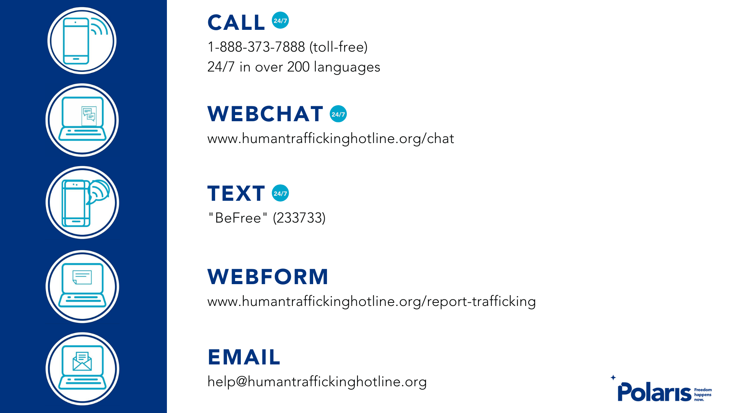
Notes:
Megan
I’d like to tell you a bit about the Trafficking Hotline program.
The National Human Trafficking Hotline connects victims and survivors of sex and labor trafficking with services and supports to get help and stay safe. The Trafficking Hotline also receives tips about potential situations of sex and labor trafficking and facilitates reporting that information to the appropriate authorities in certain cases.
The Hotline itself is available 24/7, 365 and can assist people in a variety of languages through bilingual advocates and tele-interpretation. The Trafficking Hotline is confidential - meaning we don’t share any information about who has called us without the permission of the caller themselves.
Additionally, we operate from a person-centered approach, which means that particularly with trafficking situations involving adults we always endeavor to learn from the victim/survivor about their wishes - what is safest for them in terms of next steps? We report situations involving immediate danger, threats of harm to oneself or others and abuse, neglect and trafficking to minors as required by law.
Over the years of operating the Trafficking Hotline we have found those who have proximity and context to trafficking situations (survivors, victims, those close to them such as family and friends) are the individuals/groups with the most information to share and benefit most from the support provided by the NHTH.
The five ways that individuals can connect with us are: phone, text, webchat, online tip reporting/webform and email. Incoming phone signals are the highest volume but text messages are the fastest growing method for reaching out to the Trafficking Hotline.

Slide 18
2021 NHTH Data Highlights
From 1/1/2021 - 12/31/2021, there were 10,359 likely trafficking situations shared to the National Human Trafficking Hotline. In those situations, a total of 16,554 likely victims of trafficking were identified.
Our data shows that trafficking victims are generally recruited by someone they know - such as a family member or caregiver (33%), an intimate partner (28%), or an employer (22%).
As a whole, the internet remained the top reported recruitment location.
Emotional abuse (28%), economic abuse (26%), and threats (23%) remained the most frequently reported methods of force, fraud, and coercion experienced by likely victims
Interaction with friends and family was the top reported access point; in 2021, friends and family were the access point for help for 43% of victims with an identified access point (3,317).

Slide 19
Why It Works
A Single Memorable Number
Centralized Data Collection & Analysis
24/7 National Coordination Center
Government Support, NGO Independence
Notes:
24/7 Coordination Center
The Hotline has the infrastructure and resources to assist victims and survivors and the anti-trafficking field 24 hours a day, 7 days a week, anywhere in the U.S. and U.S. territories, in more than 200 hundred languages.
Has the staff capacity to respond to multiple calls simultaneously
National scope, but with local scope– allows us to :
Manage complex, long-term, and multi-jurisdictional cases
Provide continuity for callers
Partnerships we have developed across the country and make-up the nearly 4,000 service providers, NGOs, government agencies, and law enforcement entities listed in the Referral Directory.
Single Memorable Number
Human trafficking victims are frequently moved and they may not be able to call a local hotline or know what the local hotline # is
With one memorable number, victims/survivors don’t have to spend time researching who to call at their new location, instead they can call our hotline and we can connect them with individualized services
Centralized Data Collection & Analysis
Centralized data collection allows us to detect new trends and identify promising practices and gaps in trafficking networks, in law enforcement response, and in victim services.
Also ensures that all calls/cases are viewed from the same lens.

Slide 20
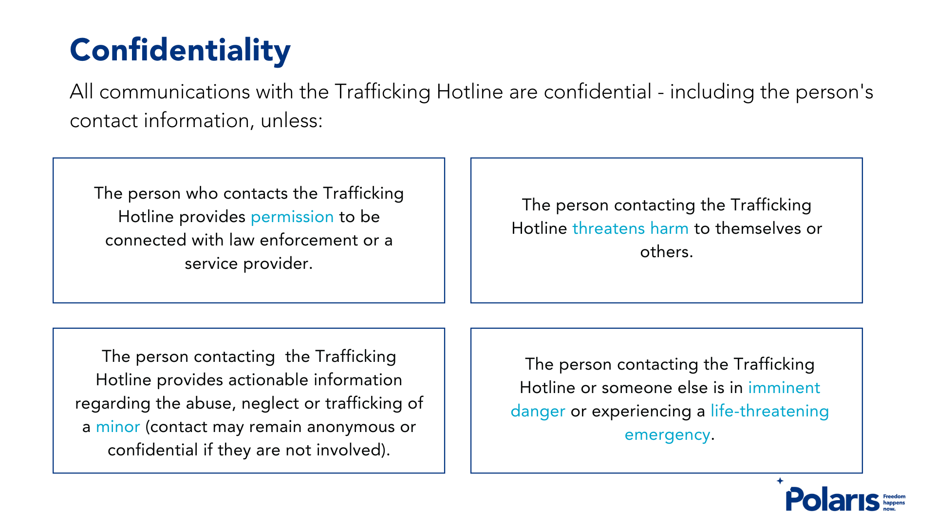

Slide 21
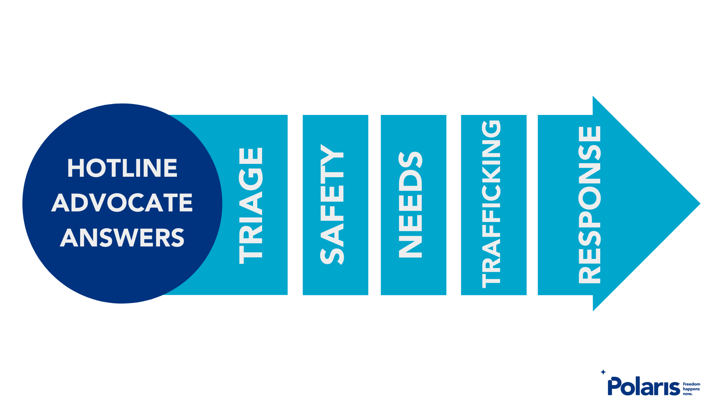

Slide 22
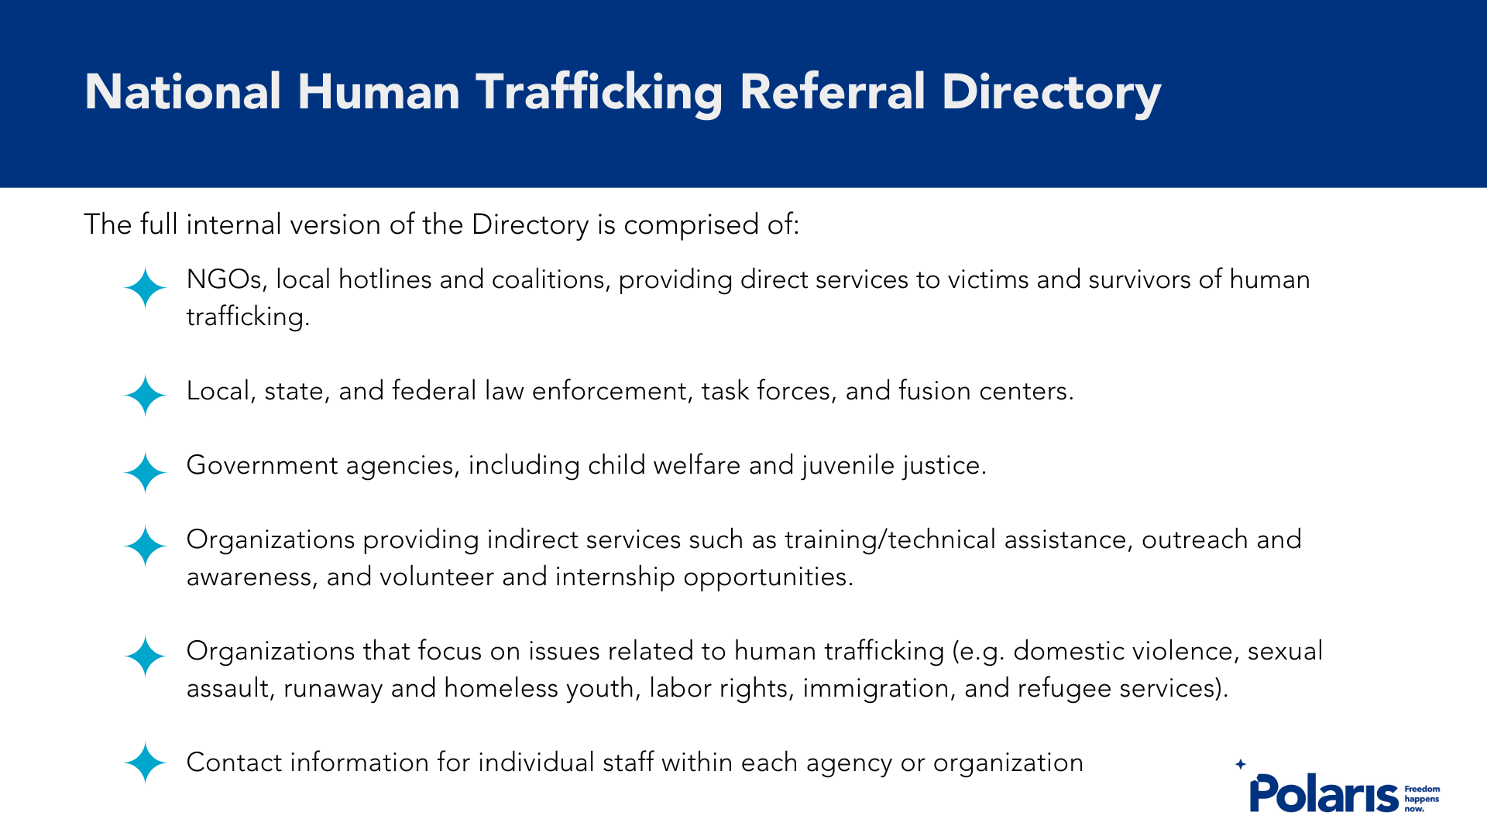

Slide 23
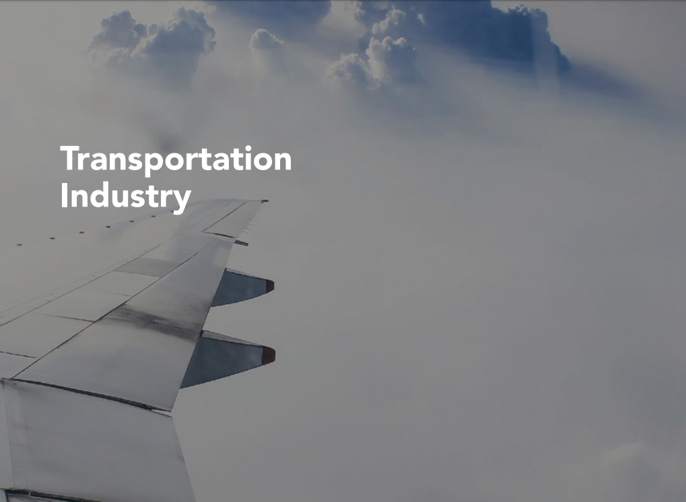

Slide 24
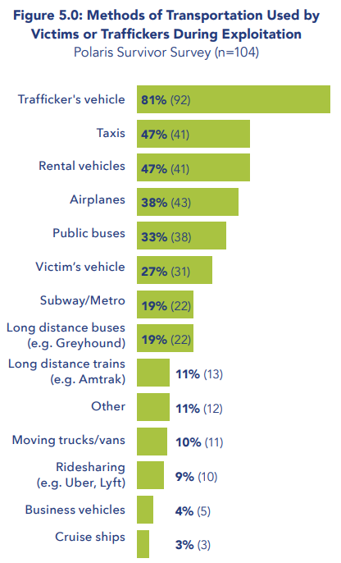
Transportation Industry
Trafficking use long-distance buses and airplanes to transport victims to them
Traffickers and victims rely on public and private transportation to conduct business
Victims are coming into contact with public transit during exit attempts
  54% stated a lack of transportation access was a barrier in them leaving

Slide 25
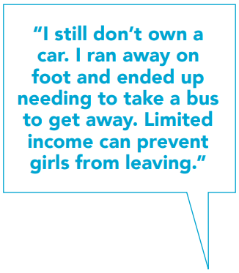
Transportation Industry
Recommendations
“I would like to say that now, working with women that are active in or have just gotten out of the life, yes, they all use Uber and Lyft.”
“I took buses every time I ran away.”
Travel vouchers or point donation
Post prevention-based materials with National Hotline number at transit stations and airports
Notes:
Provide travel vouchers or point’s donations
This can be used by victims to escape trafficking situations as well as aid them in rebuilding their lives.
In 2022, thanks to partners such as Delta and Southwest Airlines, we assisted 194 survivors with in-kind resources, including 177 flights and 186 nights in hotels.
Prevention based materials at transit hubs
Directed a people who have experienced trafficking and those close to them
Language access

Slide 26
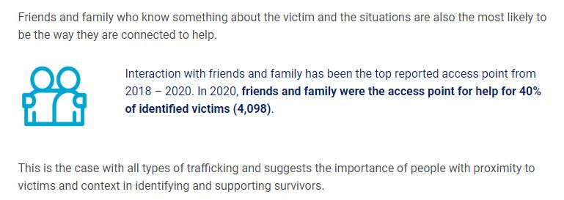
Who is contacting the Hotline?
Notes:
Other common ways victims and survivors access help are via access to health services (19%), via general social services (13%) and via access to social media (11%)

Slide 27

The best way to help is by paying attention to the people you actually know or interact with.
It’s about
PROXIMITY
and
CONTEXT

Slide 28

Understanding how to recognize trafficking within the context of your lifestyle or job can be useful.
Notes:
Truckers Against Trafficking examples.

Slide 29
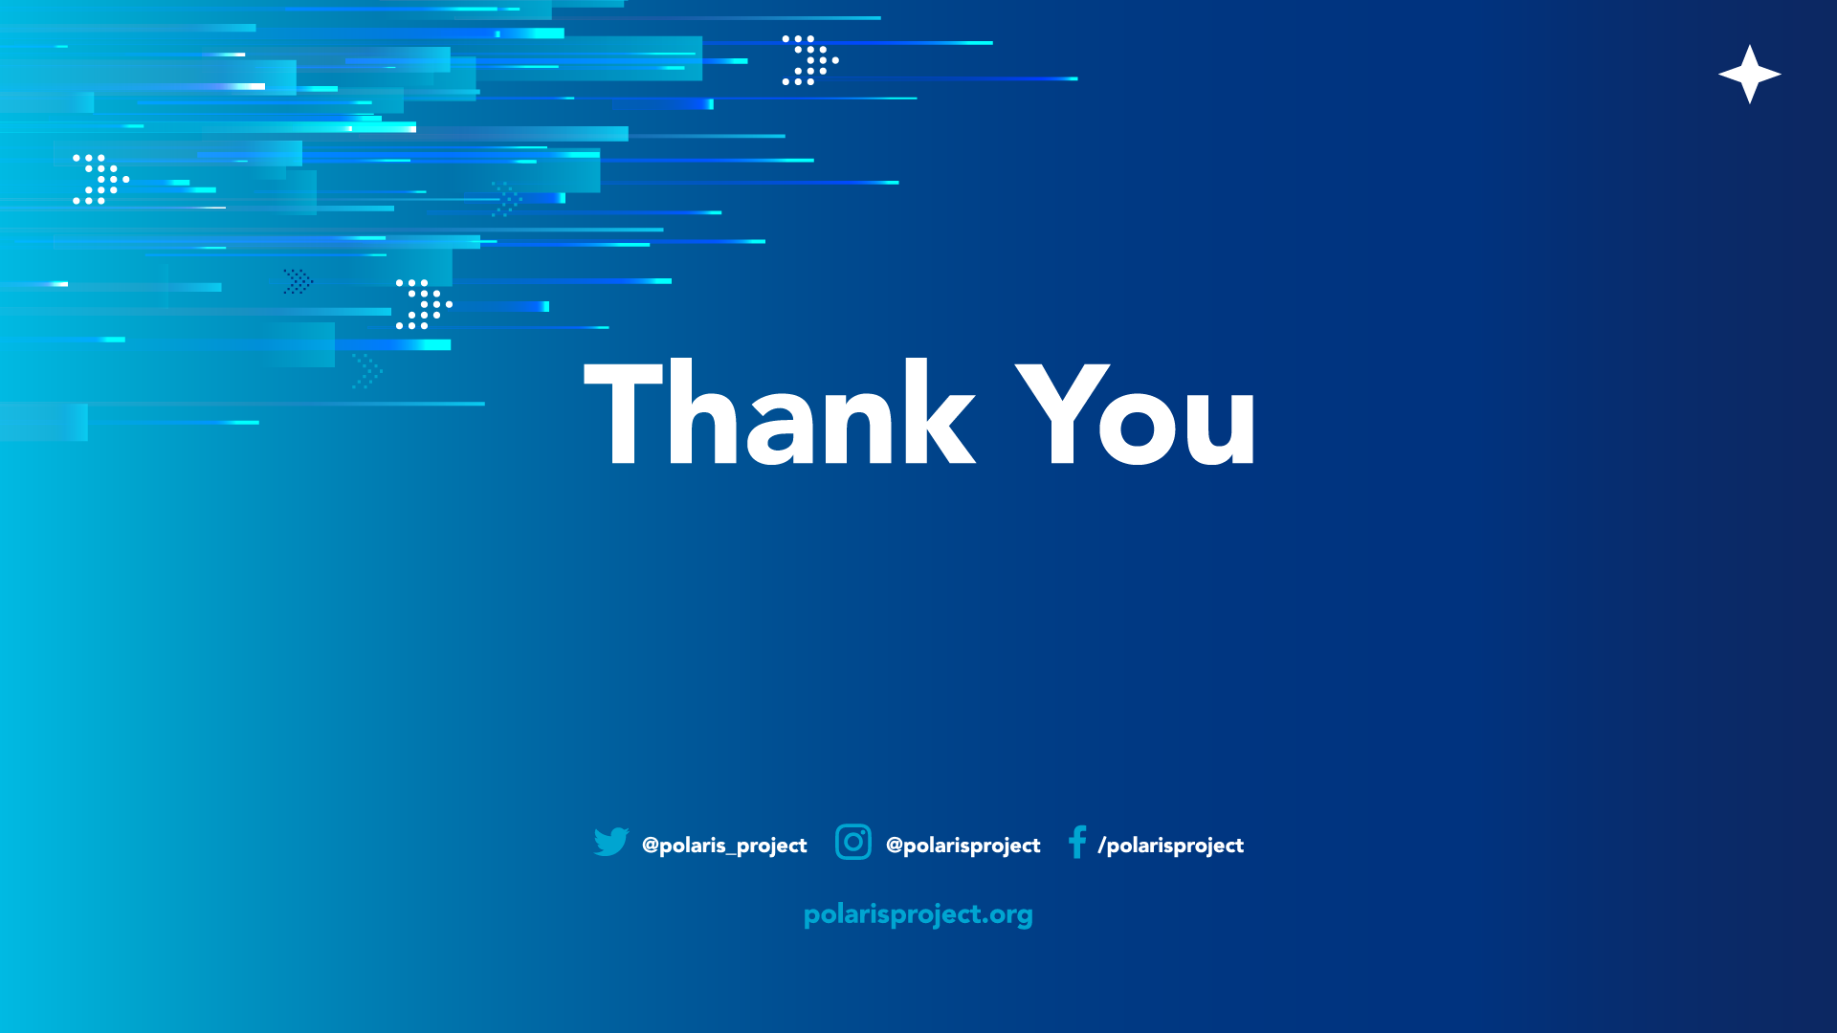
Megan Cutter
Managing Director
National Human Trafficking Hotline
mcutter@polarisproject.org

Slide 30


Truckers Against Trafficking
Prevention and Intervention:
Combatting Human Trafficking Through the Trucking and Bus Industries

Slide 31




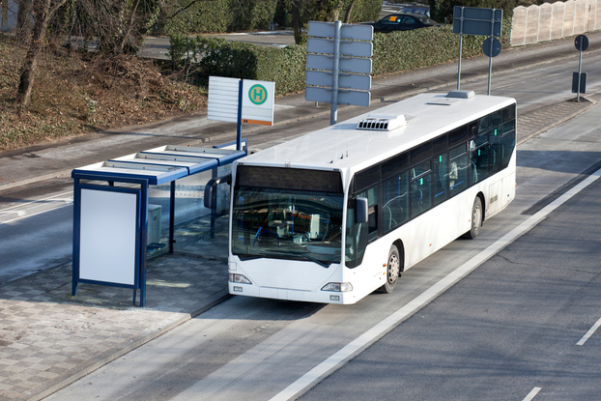



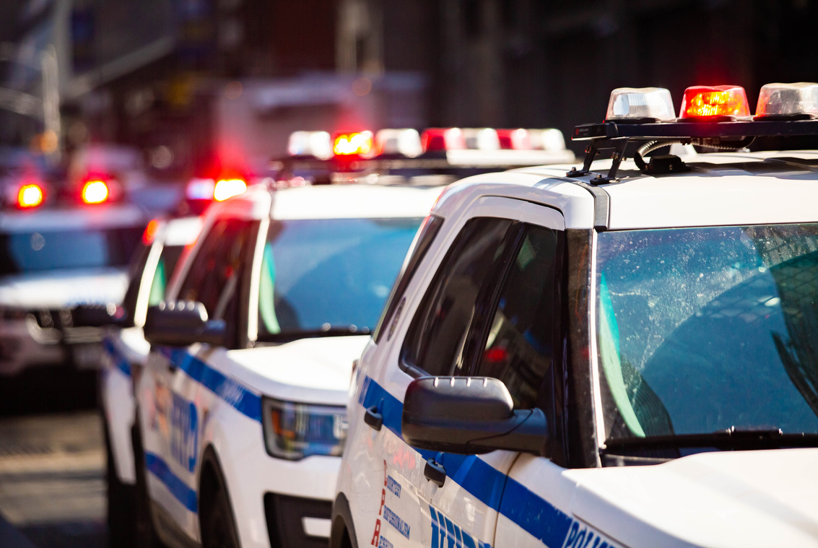



It started with training for truckers, but it has expanded to be so much more...
Truckers Against Trafficking (TAT) seeks to educate, equip, empower and mobilize members of the trucking, bus and energy industries to combat human trafficking as part of their regular jobs.
WE ARE A SYSTEMS CHANGE ORGANIZATION
Shipping Partner
Shipping Partner

Slide 32




Building a mobile army
Professional Drivers:
  Are the eyes and ears out on the road
  Are trained to be vigilant/observant
  Intersect with victims
    truck stops/parking lots
    rest areas
    city streets
    gas stations
    places of business
    hotels/motels
    bus terminals
    on board

Slide 33

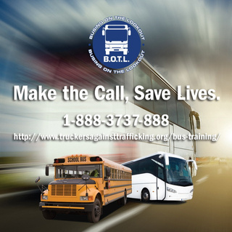
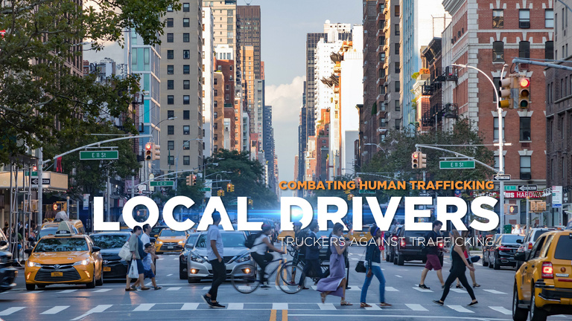

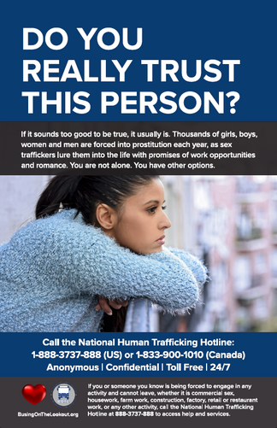
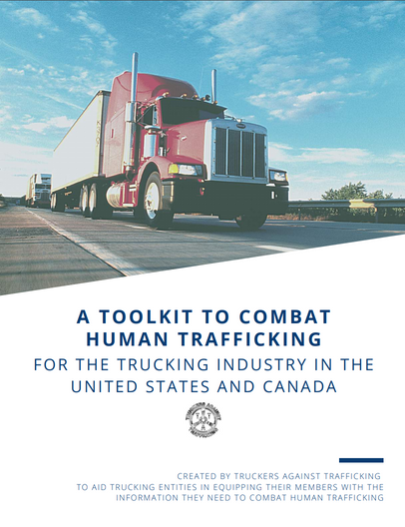
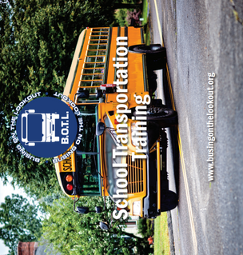


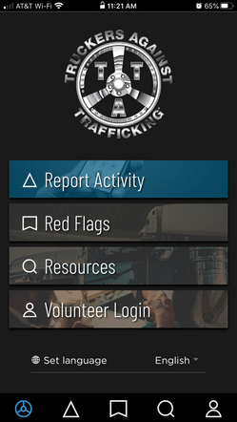
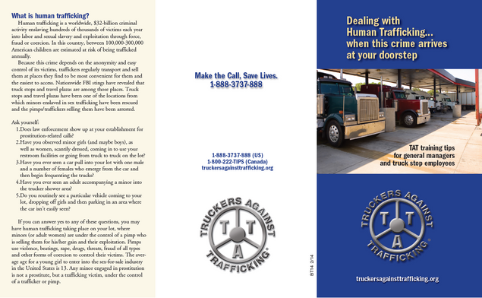

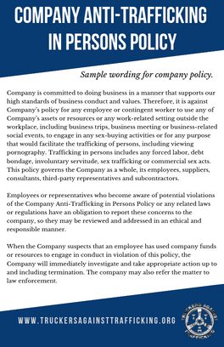

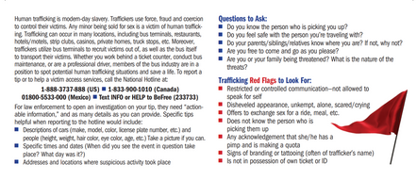

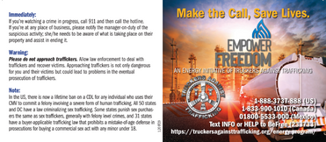
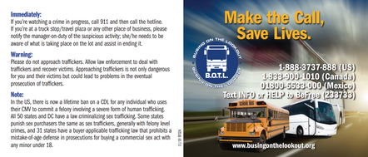
TAT provides free, industry-specific training.

Slide 34

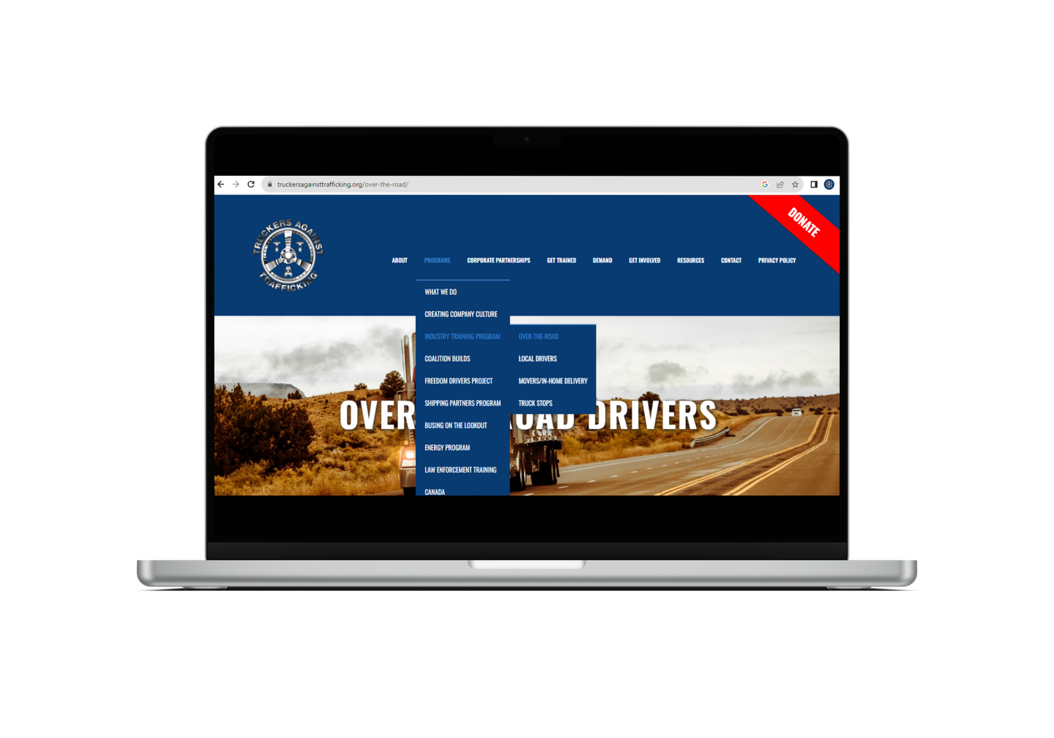
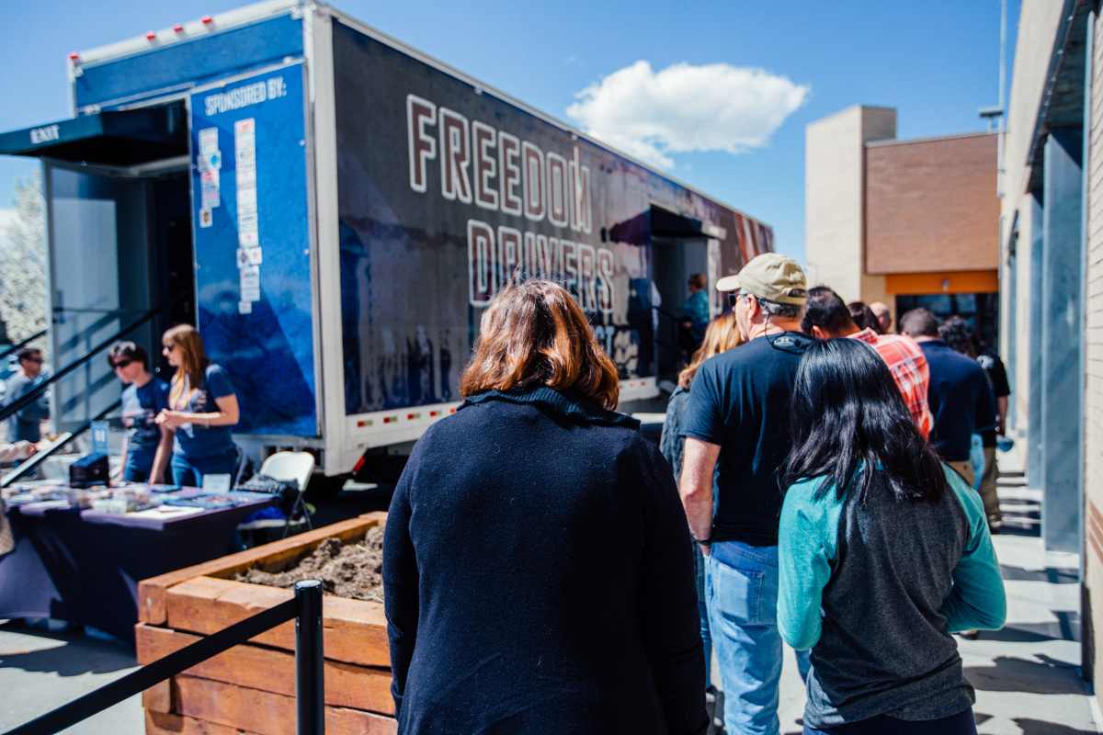
Working alongside industry
  Provide free, industry-specific training
  Create guidance and tools for implementing anti-trafficking policies and protocols
  Help partners leverage their networks to spread awareness
  Activate corporate employees to address root causes
  Equip industry members with resources to take back to their communities and homes

Slide 35
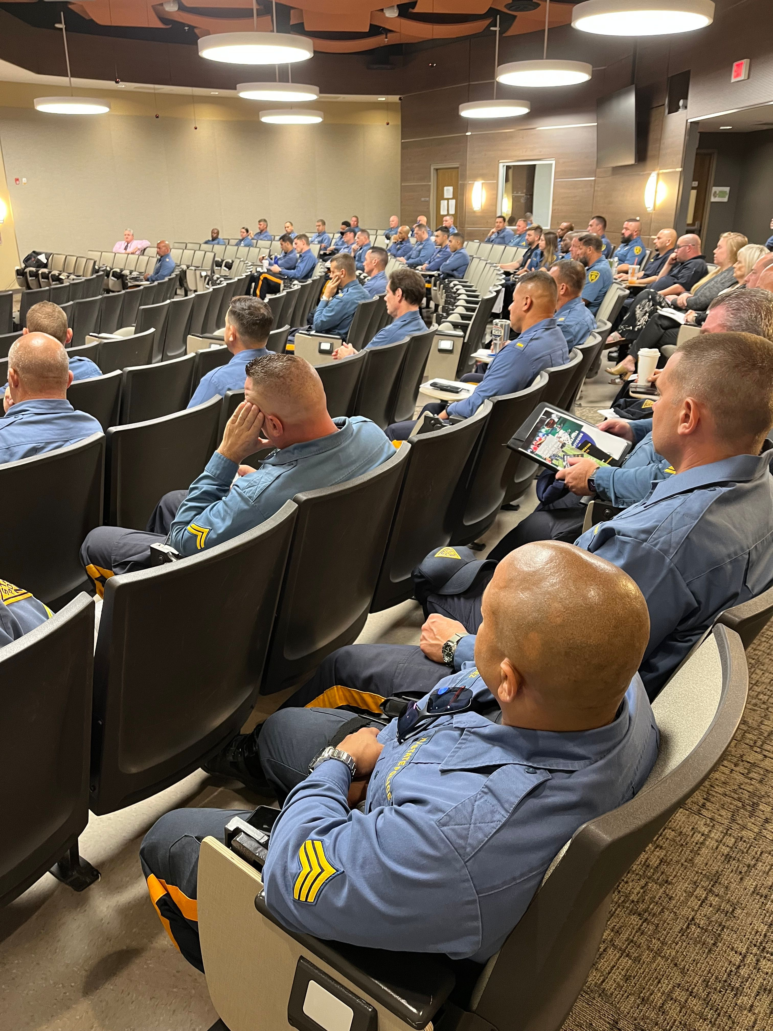
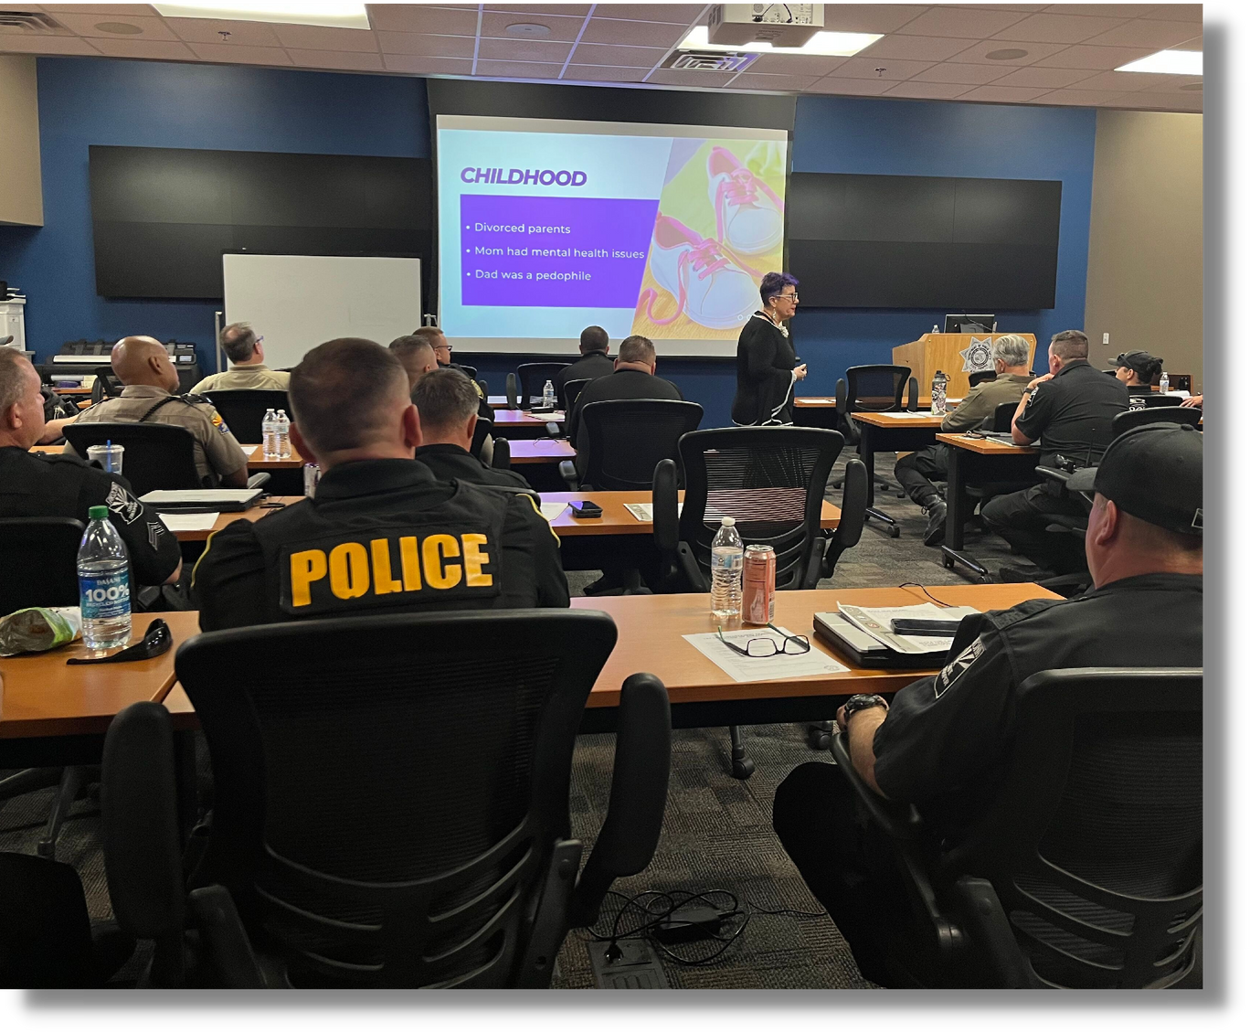
Working alongside the public sector
  Provide training for law enforcement
  Offer training resources for state agencies (DOTs, DORs, DOLs, DMVs)
  Work alongside state agencies to adopt models that combat human trafficking

Slide 36
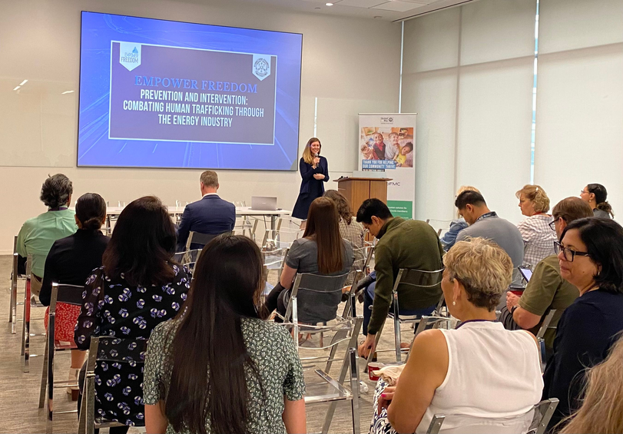
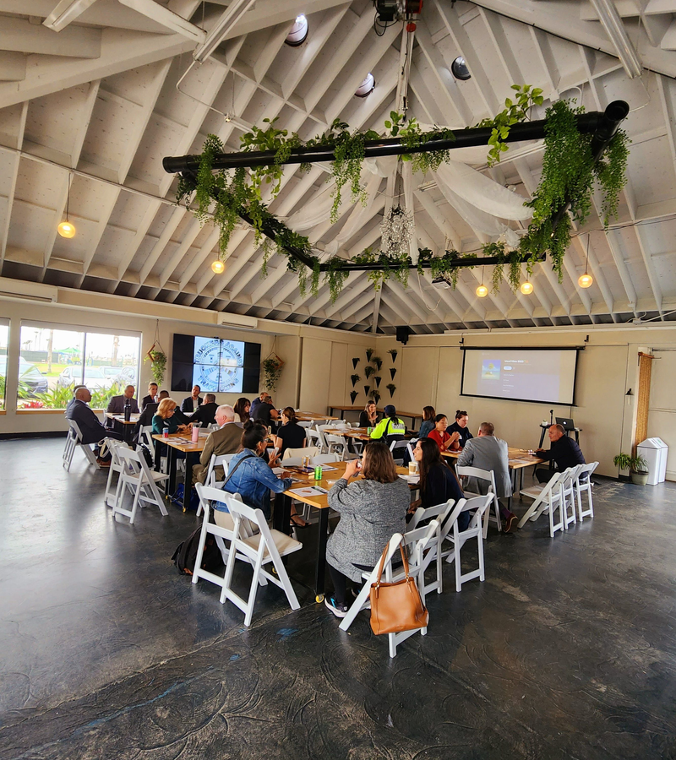
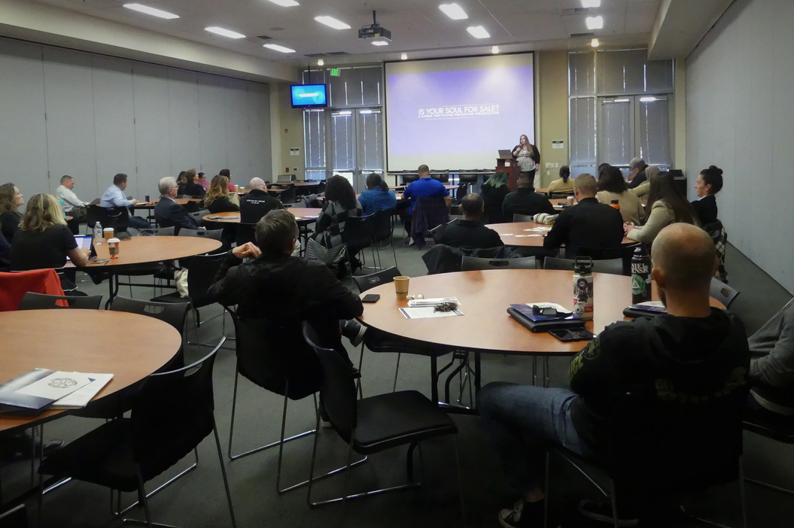

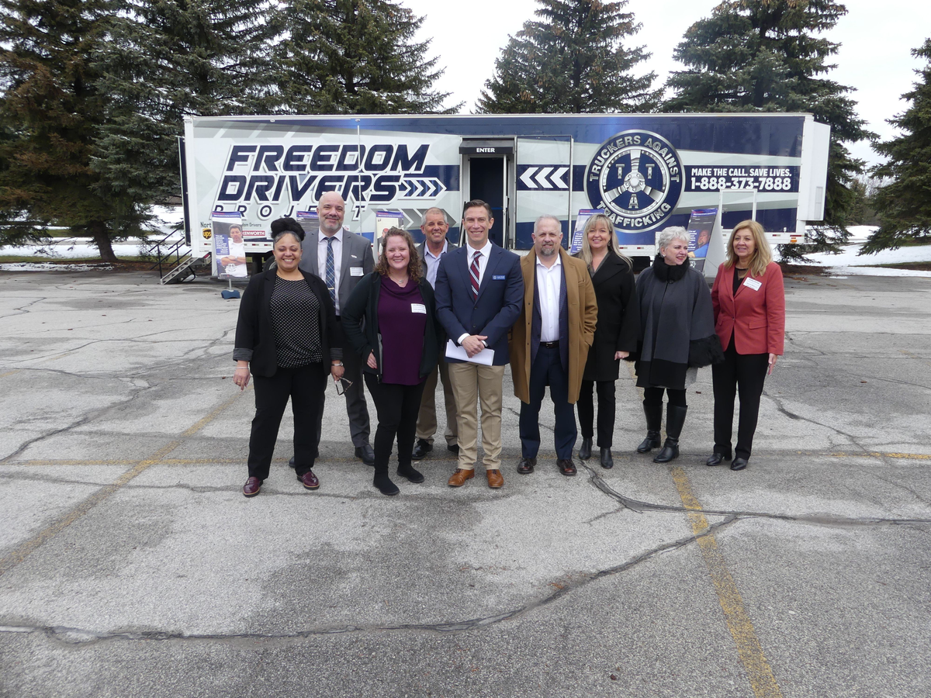


Building Public-Private Partnerships
  Host Coalition Build events that convene local public and private partners.
  Collaborate with state and local task forces across the country.
  Work alongside industry partners to pass legislation mandating human trafficking training in CDL schools.
  Currently, 13 states include TAT training in CDL curriculum.
TAT has hosted
Coalition Builds in
states and
Canadian Provinces.

Slide 37

1,631,820
registered as TAT Trained
Partner with over 140 private bus companies, 2,100 school districts and 260 public transit agencies through Busing on the Lookout (BOTL)
Partner with over 619 trucking companies/organizations
Partner with all 50 state trucking associations
9,344 law enforcement trained
49 states have adopted models for counter-trafficking initiatives

Slide 38
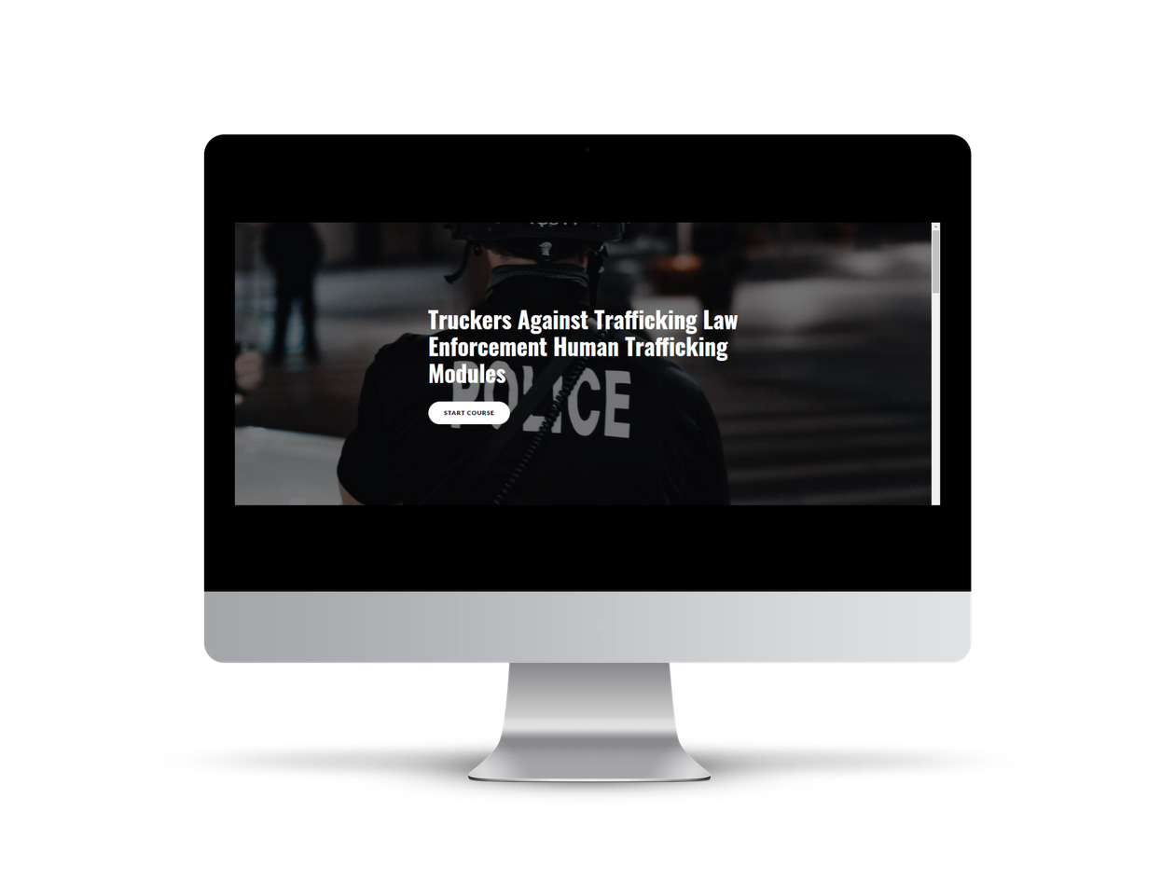
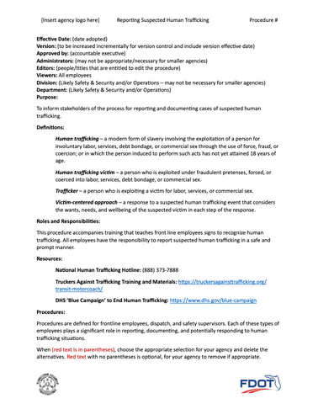
Innovating and co-creating
  With Florida DOT and Florida Transit Safety and Operations Network, developed a Human Trafficking Response Procedure Template for transit agencies
  Creating on-demand law enforcement training modules to equip LEOs on human trafficking
  BOTL's Youth on Transportation Initiative convenes and mobilizes community transportation partners and other stakeholders to create local systems that protect youth from exploitation as they move throughout their days.

Slide 39
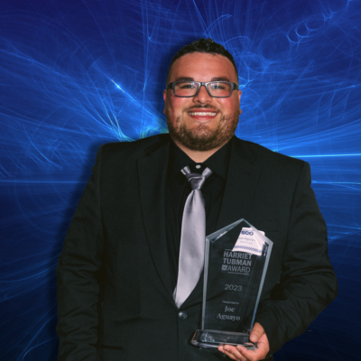
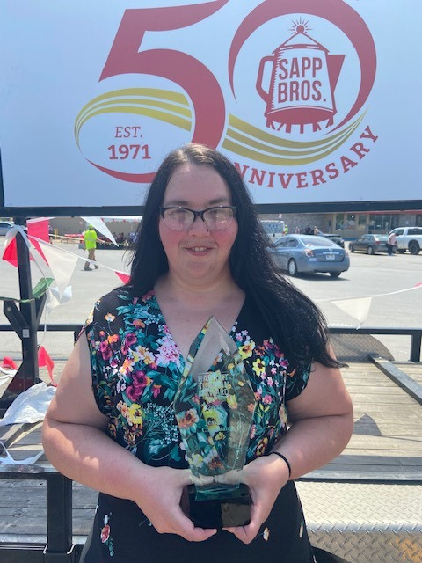

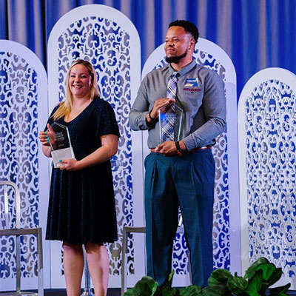
Making an Impact
“Thank God - what saved me was that truck driver.”

Slide 40
ESTHER GOETSCH
Executive Director
Truckers Against Trafficking
egoetsch@truckersagainsttrafficking.org

Slide 41
Port of Seattle Comprehensive
Anti-Human Trafficking Strategy
Commission President Sam Cho

Slide 42
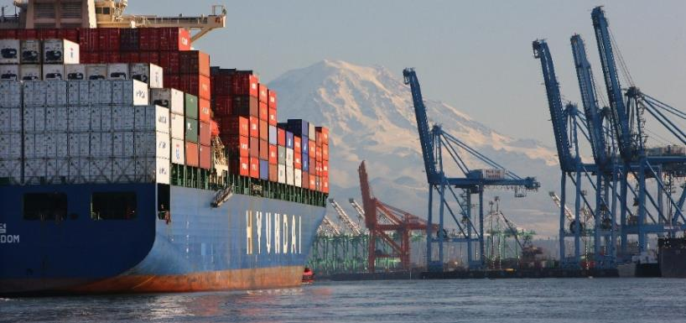

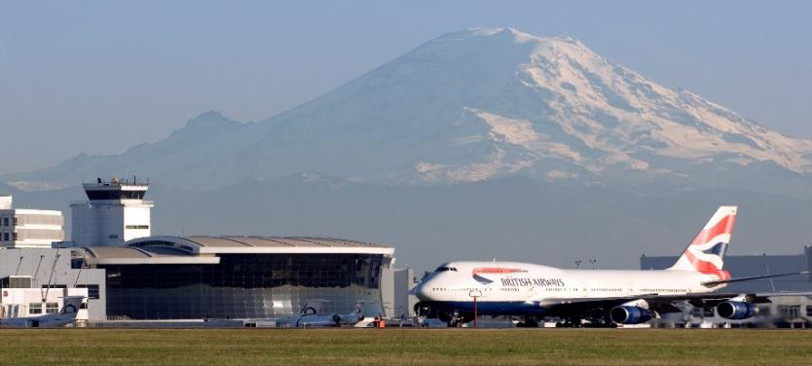
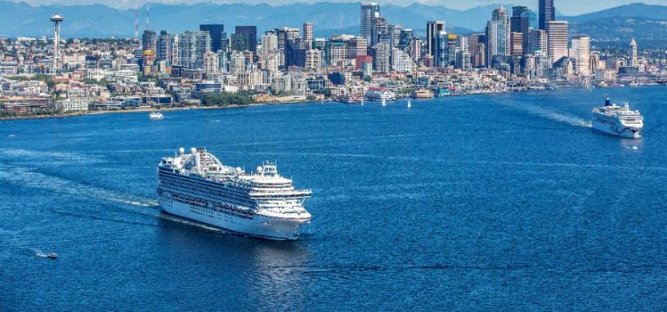
Port of Seattle: A County-wide Special Purpose Government
Northwest Seaport Alliance
Maritime Industrial and Marinas
Seattle-Tacoma International Airport
Largest Cruise Port on the U.S. West Coast
Notes:
The Port of Seattle is a county-wide special purpose public agency.
Washington state law gives the Port of Seattle the authority to run a diverse set of lines of business.
To my knowledge, the Port of Seattle is unique among ports nationwide in that we operate a major seaport, airport, cruise terminal, and fishing fleet.
Washington state law also designates elected officials to provide oversight and policy direction for the Port's investments and initiatives.
Our county elects five at large Commissioners every four years, I am one of these Commissioners.

Slide 43
Why a Port Anti-Trafficking Effort?
Washington had the 8th highest call volume to the National Human Trafficking Hotline in 2019.
Our Role:
  As both the owner/operator of an airport and a wide array of maritime facilities
  As a major employer
  As a public sector leader
Notes:
The Port really does feel a strong need to act to combat human trafficking, both as a responsible public agency, and, lets be real, a tempting target for human traffickers looking to move people from Asia into the United States.
Personally, this issue has impacted my community, and partially inspired my run for office.

Slide 44
Commission Motion
Curriculum and plan making training broadly available to all Port employees
Making AHT training broadly available to all external stake holders operating in Port facilities
Join key alliances and committees to ensure the Port’s engagement on this topic regionally
Conduct initial awareness raising through media and communications efforts to users of the Port’s facilities and local residents
Advocate at the state and federal level for policy changes that further the Port’s and region’s human trafficking reduction efforts
Notes:
Training in place & being developed includes – Refresher video on knowing the signs of potential trafficking and reporting in all airport badge holder trainings, pledge kits to PAAHT member companies with training materials, cobranded posters with DHS under the umbrella of the Blue Lightning Campaign, BEST training materials for Port employees (Ports to Freedom/Flights to Freedom), recurring speaker series, 2024 National Human Trafficking Awareness Day breakfast & moderated speaker event,
We are working to create & implement a 3rd party code of conduct as well.

Slide 45
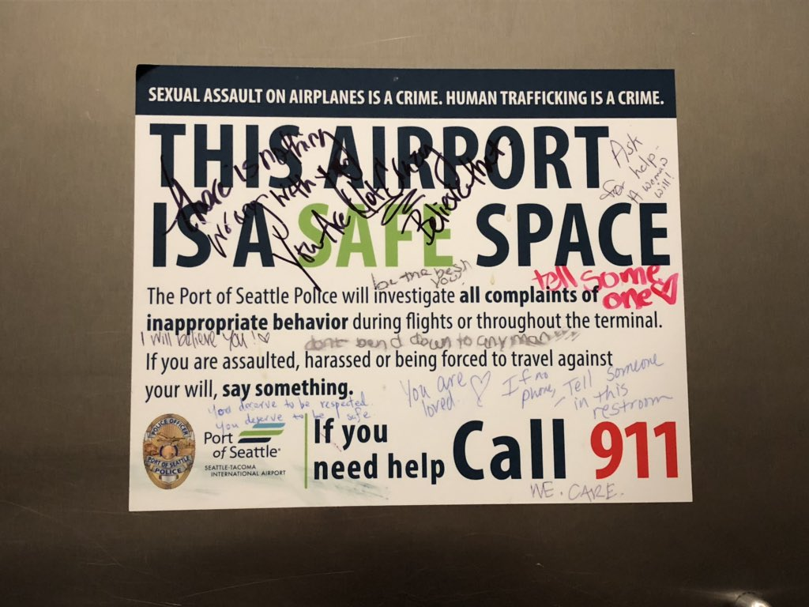
Commission Motion Con’t
Ensure that Port policies and our Code of Conduct fully restricts employee engagement in any aspect of trafficking
Install signage in Port facilities that helps increase awareness of this issue and reduces trafficking in our region
Explore implementation of a final tier of tactics.
Staff shall have begun implementation of those final tier tactics that not only are most achievable but also have the broadest return on investment in terms of multiplying the Port's impact on reducing human trafficking.

Slide 46
Port Human Trafficking Strategy
Port Commission passed a motion committing staff to finalizing and implementing a Port-wide strategy to combat human trafficking with four areas of focus:
Anti-Human Trafficking Strategy
Internal Policies and Procedures
Eliminate or Reduce Human Trafficking Conducive Conditions within Port Facilities;
Long Term Enduring Program
Public Awareness and Education
Employee Awareness & Training
Community Partnership
Notes:
The Port’s anti-trafficking efforts are authorized under a 2018 Commission motion, the broad elements of which you can see here.

Slide 47
Current Practices
Policy & Protocol Change
EX-21, October 2018
Training
Flights to Freedom, Ports to Freedom in LMS
Port of Seattle completion rate: 98-99%
Public Awareness
#NotAlone Campaign Launch 2021
Signage posted across Port facilities in Maritime & SEA
Partnerships
US DOT, Washington AG’s Office, King County, City of Seattle, Sound Transit, Alaska Airlines, Delta Airlines, Lyft, Uber, Multiple Local Non-Profit Survivor Advocacy Groups, Aviation and Maritime Industry Professional Organizations
Mandated employee code of conduct & competencies
Regional Awareness Campaign Launch, January 2019
Law Enforcement Specific Training for Port Police
Connection of refresher training & the badging process
Notes:
Training: Port/Flights to Freedom in partnership with BEST
Public Awareness: Not Alone in partnership with BEST
Partnerships: Those listed plus BEST, DHS, TwentyFour-Seven, Inc. (survivor owned company with QR code that drives people to a Port specific educations website. Also provides resources to victims & the company works with survivors to develop material that is used on our site)

Slide 48
Maritime
Commercial Fishing
Pledge
Spread the Word
Recreational Boating
Community Outreach
Container Terminals
Cruise
Real Estate
Pledge
Buildings, Parks, Restrooms
Pledge
Seattle Boat Show
Seafair
Pacific Marine Expo
Pledge
Community Outreach
Seek opportunities for bystander messaging
Community Outreach
Parks
Others
Special Events
Signage (Durable)
Pledge (NSWA/Terminal Operators)
Truck Drivers
Department of Transportation
Signage in Employee Accessible Areas
Notes:
While most of our anti-trafficking efforts to date have focused on the Aviation side, the Port is rolling out anti-trafficking efforts across our operations and lines of business.
Here you can see the work that we have done on our Maritime side.

Slide 49
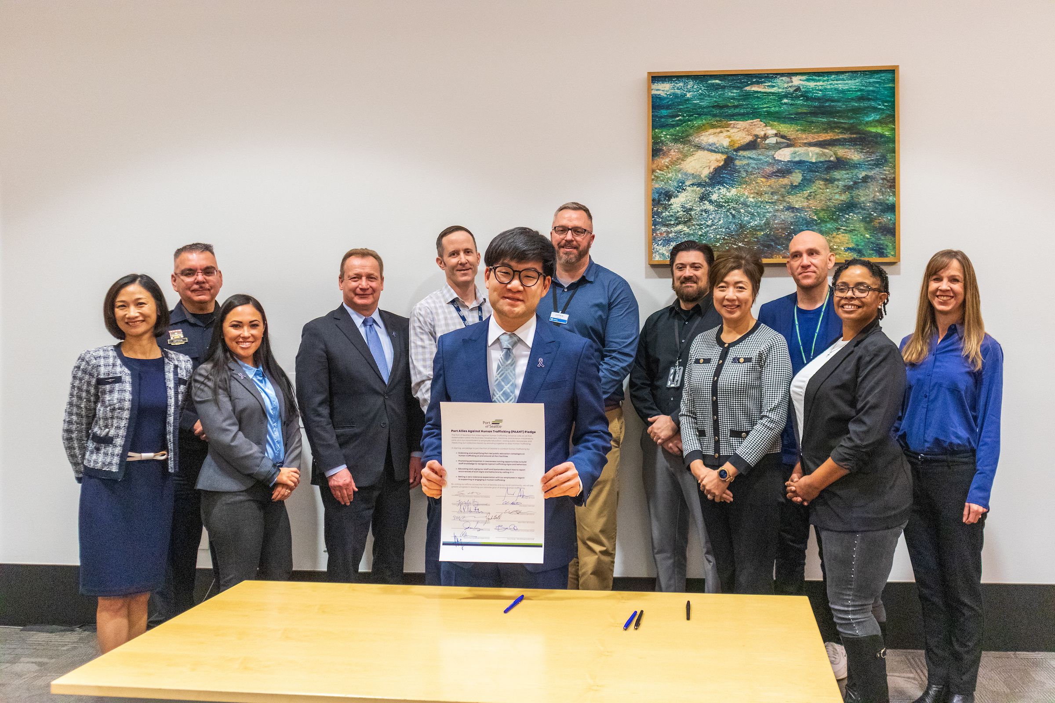
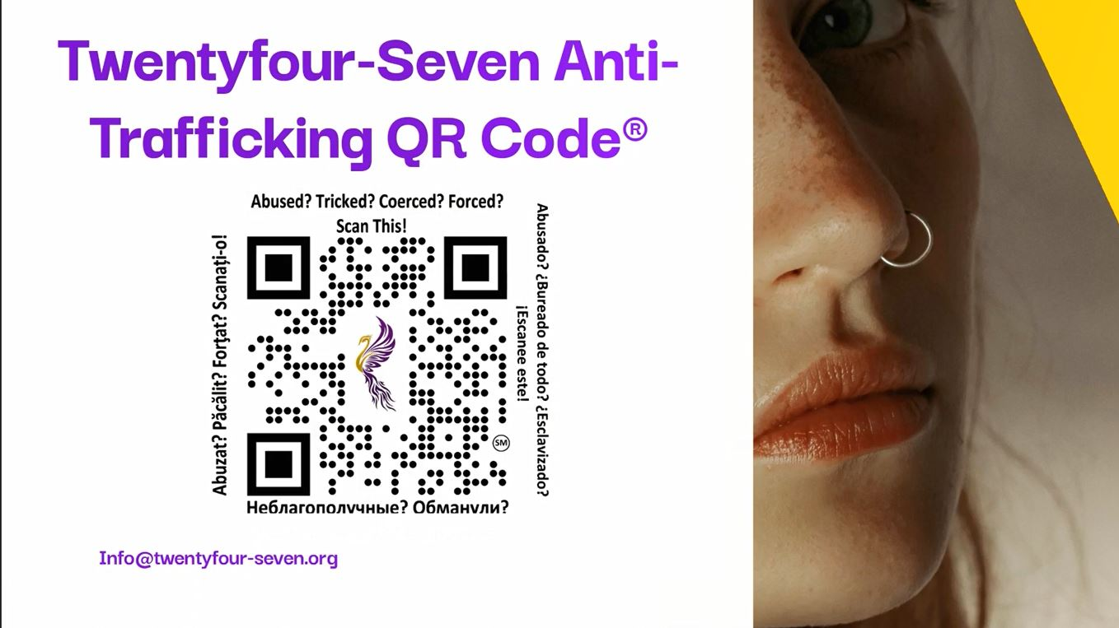
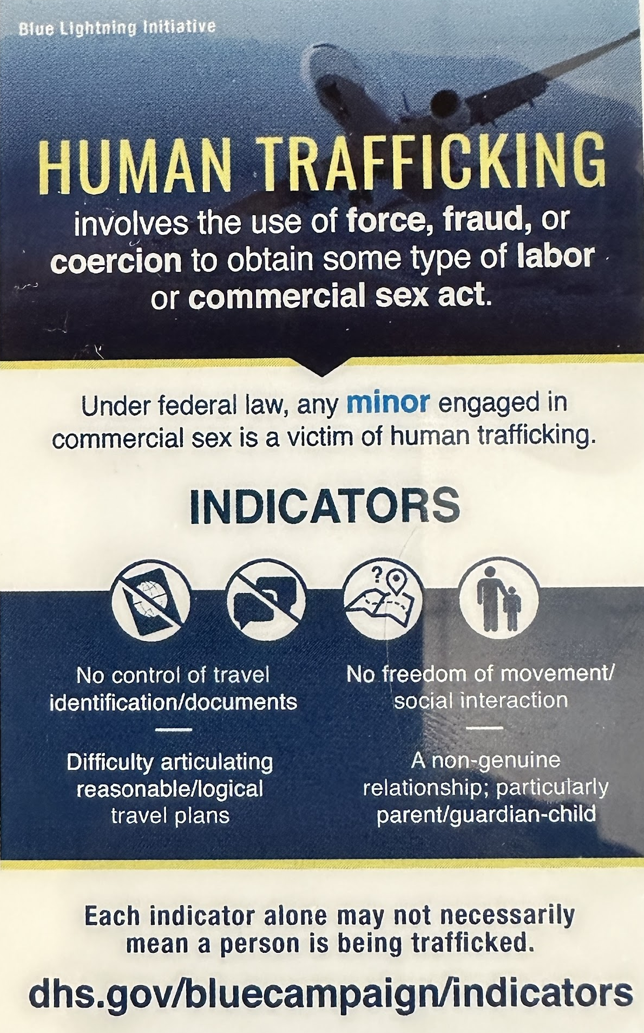
2022-2025 Snapshot of Strategies
Messaging
  "Do You Know the Signs" to spark bystander action
  Messaging translated to several languages
Public Awareness
  Port Allies Against Human Trafficking Pledge developed and offered to Port tenants across Aviation & Maritime
  twentyfour-seven.org Anti-Trafficking QR Code will be placed throughout Port of Seattle owned properties across all business lines
Training & Education
  Connecting badging renewal to training opportunities
  Internal & external events to educate on human trafficking
DHS Blue Campaign Partnership
  Signed an MOU with DHS, formerly joining the Blue Lightning Initiative
Notes:
PAAHT
-The Port of Seattle’s Port Allies Against Human Trafficking initiative calls on all Port Stakeholders within the Business Development, Maritime, and Aviation Industries to joins us in our commitment to employee education, raising public awareness and measuring our collective impact by standing together to stop Human Trafficking.
-In signing, allies pledge to join the Port of Seattle to combat Human Trafficking by:
» Endorsing and amplifying Port-led public education campaigns on human trafficking at and around all Port facilities
» Promoting participation in awareness training opportunities to build staff knowledge to recognize typical trafficking signs and behaviors
» Educating and urging our staff and bystanders about how to report occurrences of such signs and behaviors by calling 9-1-1
» Setting a zero-tolerance expectation with our employees in regard to supporting or engaging in human trafficking
By uniting our efforts across the Port of Seattle and our local community, we will see greater progress in reaching our ultimate goal of ending human trafficking.
24/7 Anti-Trafficking QR Codes
-We have a signed contract and will be deploying the QR codes across all business lines and facilities, from Port owned properties and Parks to Cruise Terminals and Fishermen's Terminal to Seattle-Tacoma International Airport.
-The Twentyfour- Seven Anti-trafficking QR Codes® can be placed anywhere where potential victims may be. Strategic placement is a deciding factor in providing a victim with the opportunity to seek help or an observer to report signs of trafficking.
-Twentyfour -Seven has developed patented method of delivering crucial information to victims in transit anywhere in the world by giving survivors and by standards the ability to select their language to request help, request information or report suspicious activity. The implementation of the QR code will allow a more timely response for potential human trafficking situations and allow us to better measure reports and requests for information.
Blue Lightning Campaign
-The MOU allows the Port access to the Blue Lightning Initiative awareness training, allows the Port to Produce Co-Branded collateral such as Indicator cards, Posters and Signage
-This partnership also allows Port and especially SEA align with airports across the country that are partnered with the Blue Lightning Campaign and currently use the BLI Training, signage and indicator cards.

Slide 50

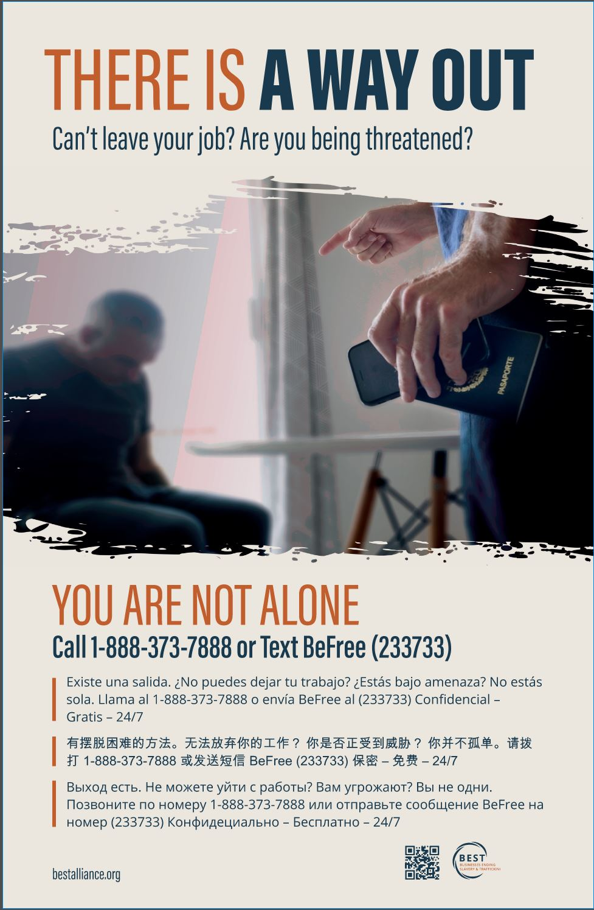
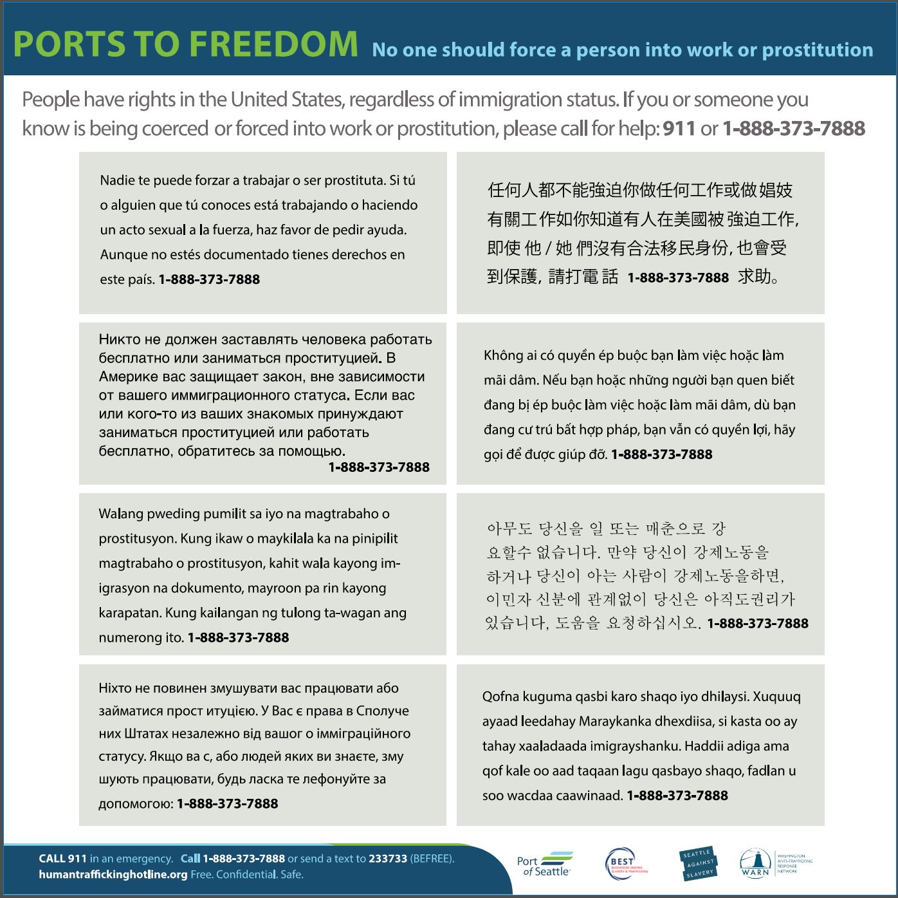
Public Awareness Highlights
Notes:
-Multi-lingual signs on all restroom stall door
-Survivor focused Statewide Awareness Campaign lead by Business Ending Slavery and Trafficking, these posters are throughout our Port Facilites and properties across all business lines (AV, Maritime, Parks and Economic Development Properties)

Slide 51
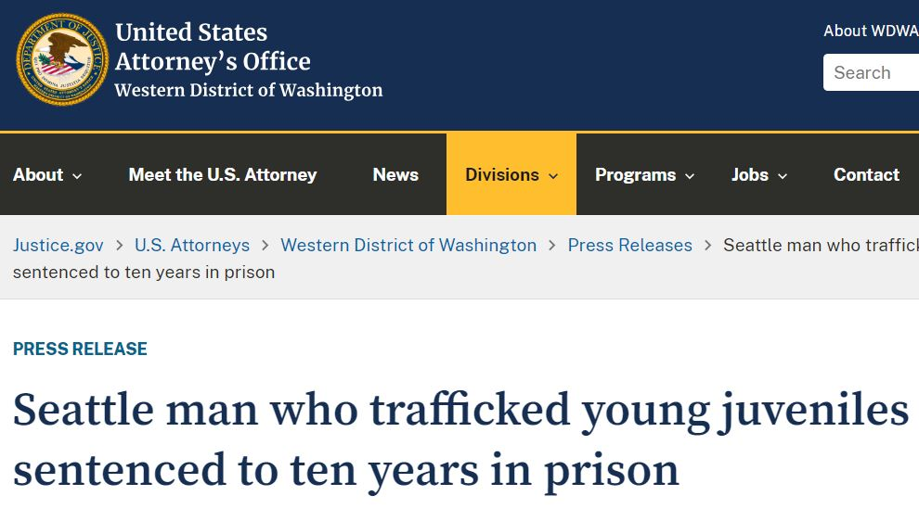
Human Trafficker Apprehension and Conviction
A call to National Human Trafficking Hotline in November 2021 identified that the perpetrator was picking up victims from Seattle-Tacoma International Airport
The Caller reported minors were being trafficked in the area known as "the Track or Blade" on Aurora Ave North in Seattle
This was a joint investigation with Port of Seattle Police, Seattle Police Dept and the FBI
Port of Seattle Police supported the investigation by analyzing and provided hundreds of hours of video of activities related to the case and by identifying the perpetrator
Perpetrator was arrested in February 2022 by Port of Seattle Police as he drove to SEA Arrivals to pick up what he believed to be a 17 yr old girl
The perpetrator was sentenced to 12 yrs in prison, 10 yrs of supervised release, required to register as a sex offender and pay $50,000 to each of his three victims
Notes:
On a final note, I will call out the following case that resulted in the arrest last year of a trafficker after a tip on the National Human Trafficking hotline and a joint investigation by Port of Seattle Police, the Seattle Police Department, and the FBI.
Release linked here https://www.justice.gov/usao-wdwa/pr/seattle-man-who-trafficked-young-juveniles-sentenced-ten-years-prison
Seattle – A 23-year-old Seattle man, was sentenced today in U.S. District Court in Seattle to ten years in prison for attempted sex trafficking of a minor, announced U.S. Attorney Nick Brown. Issac Shorack was arrested at Sea-Tac Airport in February 2022 as he drove to the arrivals area to pick up a person he believed to be a 17-year-old minor. In fact, Shorack had been communicating with an undercover agent about traveling to Seattle to work as a prostitute. Shorack first came to the attention of law enforcement in November 2021, with a tip to a National Human Trafficking hotline alleging he was trafficking juveniles. At today’s sentencing hearing, U.S. District Judge Tana Lin said Shorack preyed on “Young, confused, and impressionable girls…. You were looking for young vulnerable girls, and when they were afraid, you threatened them with violence.”
“Mr. Shorack used threats and violence to control vulnerable juveniles who he sold for sex on Aurora Avenue,” said U.S. Attorney Nick Brown. “He made hundreds of thousands of dollars by exploiting and endangering young women and used the money to fund his lavish lifestyle.”
According to records in the case, the investigation began with a call to the National Human Trafficking Hotline in November 2021. The caller reported information about minors who were being trafficked in the Seattle area – in the location known as “the track” or “the blade” on Aurora Avenue North. The FBI began an investigation and was able to trace some of the activities of Shorack and the minors he controlled for sex trafficking. Forensic examination of electronic devices revealed text messages showing Shorack in control of the minors’ activities including pricing, what sex acts they should engage in with sex buyers, the use of condoms and information about whether they were earning enough money for him. Investigators analyzed Shorack’s texts to the minors about how much money they were making and saw that they correlated with cash deposits made into his bank accounts. In his text messages, Shorack also bragged about physically assaulting another victim and threatened physical violence if the victims did not follow his orders. Shorack also admitted that he knew at least three of his victims were minors.
The FBI used an experienced undercover agent based out of state to reach out to Shorack posing as a 17-year-old minor. Shorack communicated with the “minor” via phone and text messages and attempted to entice her to travel to Seattle and work for him as a prostitute. Shorack had some of the minors under his control reach out to the undercover officer as well to try to recruit her to work for him. Shorack used various questions to try to determine whether the undercover was law enforcement. Ultimately, Shorack purchased a ticket for the “minor” to fly to Seattle and told her he would pick her up outside baggage claim. Instead, Shorack was arrested by Port of Seattle Police.
“Mr. Shorack used threats and violence to control vulnerable juveniles who he sold for sex on Aurora Avenue,” said U.S. Attorney Nick Brown. “He made hundreds of thousands of dollars by exploiting and endangering young women and used the money to fund his lavish lifestyle.”
“It is deplorable that Mr. Shorack not only recruited minors from across the country, but he also demonstrated zero concern for his victims’ well-being,” said Richard A. Collodi, Special Agent in Charge of the FBI’s Seattle field Office. “The work the FBI and our law enforcement partners are doing to combat modern-day slavery is critical in ending this dehumanizing crime.”
An analysis of Shorack’s bank accounts revealed he deposited more than $360,000 in prostitution proceeds. Today Judge Lin ordered Shorack to pay $50,000 in restitution to each of his three minor victims for a total of $150,000.
In asking for a 12-year-sentece with ten years of community supervision to follow, Assistant United States Attorney Kate Crisham wrote to the court, Shorack “is a predatory person who was willing to recruit and live off the prostitution profits of vulnerable juveniles and young women. By virtue of engaging in this conduct, he poses a very real danger to the community and has the potential to continue to sexually exploit women upon his release.”
Shorack will be on ten years of supervised release following prison, and will be required to register as a sex offender.
The National Human Trafficking Hotline is 1-888-373-7888. The case was investigated by the FBI with assistance from the Seattle Police Department and the Port of Seattle Police.
The case was prosecuted by Assistant United States Attorney Kate Crisham. Ms. Crisham is the Anti-Human Trafficking Coordinator for the Western District of Washington.

Slide 52
Questions?

Slide 53
Combating Human Trafficking
Amtrak Police Department
Anti-Trafficking Mitigation Efforts

Slide 54
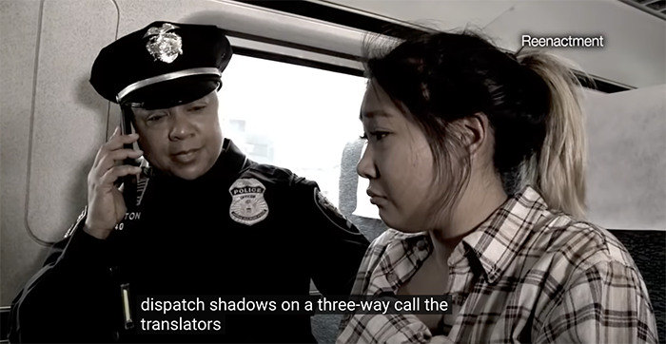
Human Trafficking Awareness Training History
Amtrak and the Amtrak Police Department (APD) have led a multi-year and multi-disciplined effort raise awareness of human trafficking.
In April of 2012, DHS & DOT met with Amtrak and requested partnership in delivering human trafficking awareness training to front-line employees and APD Police Officers.
After a press conference held later that year to announce the partnership, all Amtrak employees received access to DHS human trafficking awareness training.
Distribution of training material continued yearly and was refreshed in 2018 with a video developed by the APD.

Slide 55

Public Awareness Program
  Amtrak displays U.S. Department of Homeland Security “Blue Campaign” human trafficking awareness public service announcements and videos provided through a partnership with the U.S. Department of Transportation and the A21 Campaign (a global 501 non-profit, non-governmental organization that works to fight human trafficking), on video screens located in major stations throughout the Amtrak system.

Slide 56
APD Human Trafficking Working Group
The APD Human Trafficking Working Group was launched in October 2020, to develop methods for mitigating the potential for human trafficking in the passenger railroad system.
Group staffing has expanded over the years and now includes APD Communications Manager, Patrol Officers, Detectives, Investigators, Sr. Manager Safety & Security Analytics, and Criminal Data Analysts.
The working group has delivered key programs that have been deployed throughout the U.S.

Slide 57

APD Human Trafficking Key Programs
Employee Training:
The APD developed a new employee human trafficking awareness training video in partnership with Amtrak Human Resources.
In January 2022, 18,000+ letters containing human trafficking awareness information and a QR code linking to the video were sent to Amtrak employees’ addresses.
The human trafficking awareness training video is now being incorporated into the mandatory New Employee Orientation (NEO) training for both management and agreement employees.

Slide 58

APD Human Trafficking Key Programs
Employee Training:
On July 21, 2023, APD Human Trafficking Working Group members joined counterparts from the Department of Homeland Security and Department of Transportation to deliver human trafficking awareness training to frontline employees in Washington, D.C.

Slide 59

APD Human Trafficking Key Programs
Improving Employee Reporting:
Along with calling or texting the APD National Communications Center, the Anonymous Amtrak Employee Human Trafficking Tip form allows another method to send detailed information about possible encounters with human trafficking victims.

Slide 60


APD Human Trafficking Key Programs
Victim Assistance:
QR code contact point stickers from Twentyfour Seven have been placed in restroom stalls of all 30 Amtrak owned stations and also non-owned stations where Amtrak has service.
Twentyfour-Seven is a Florida-based not for profit anti-trafficking human rights organization created by a human trafficking survivor.
This QR code directs a trafficking victim to the Polaris website and other information to allow them to access available resources and can generate a tip that there is a victim in one of our facilities.
HSI and Twentyfour-Seven have verified that Amtrak codes have been scanned by victims.
Sample

Slide 61

APD Human Trafficking Key Programs
H.R.7181 - Human Trafficking Prevention Act of 2022 Requirements
Posting contact information for the national human trafficking hotline. In all federal buildings, In restrooms of U.S. aircraft, airports, over-the-road buses, bus stations, passenger trains, and passenger railroad stations, and at each port of entry.
Collaborative effort to address design and distribution of signage at Amtrak.
APD, Mechanical, Station Facilities Management, Station Standards, CML Product Development & Customer Service, Brand Communications, and human trafficking survivors.

Slide 62
APD Human Trafficking Key Programs
Improved reporting and training for Amtrak Police Officers:
Initiated improvement to the records management system and reporting protocols to ensure better data collection on potential incidents with a nexus to human trafficking.
Created and distributed human trafficking-related roll call and training bulletins, videos, posters and pocket cards.
Facilitated the APD Participation in a global research collaboration spearheaded by United Against Slavery to fight human trafficking via the 2021 National Outreach Survey for Transportation (NOST) project.
Initiated partnership with the National Child Protection Task Force. The members of the Task Force volunteer their time to any agency on important, time-sensitive cases focusing on human trafficking, child exploitation and missing persons cases.
Partnered with HSI to provide human trafficking training during FIO, and APD Detectives and Investigators Training Conferences.

Slide 63

APD Human Trafficking Key Programs
Developed new training resource for Amtrak Police Officers:
Partnered with A21 to create the Counter-Trafficking Toolkit for APD Officers.
A comprehensive, web-based training resource for law enforcement.

Slide 64


World Day Against Trafficking in Persons
Raising Awareness and Executive Level Support
Distributed an Employee Update titled “What We Are Doing to Help Control Human Trafficking” to all employees.
CEO Stephen Gardner signed the DOT Transportation Leaders Against Human Trafficking (TLAHT) agreement at the request of the APD Human Trafficking Working Group.
In addition, all members of the Amtrak Executive Leadership Team signed an extended initiative document in support of the TLAHT Pledge.

Slide 65
Questions?

Slide 66

Michigan State Police
Truckers Against Trafficking Initiative
Lt. Col. Mike Krumm
Deputy Director, Professional Development Bureau
KrummM@michigan.gov

Slide 67

Mission
Provide the highest quality commercial vehicle enforcement and public safety services throughout Michigan.

Slide 68
Vision
A national leader in commercial vehicle enforcement and a partner in law enforcement and public safety, with a highly trained and specialized force that is mobile, flexible, and responsive to emerging public safety needs across Michigan.

Slide 69


David Lorenzen
Iowa DOT MVE
Kendis Paris
Truckers Against Trafficking

Slide 70

Making An Impact
2013

Slide 71

Michigan Initiative
October 2014, solicited volunteers. 2 selected
Official kick January 15, 2015
  Train Our Members
  Provide Resources / Support
  Identify Subject Matter Experts
  Track Activity
  Engage Media
  Identify Key Partnerships
  Share With Others

Slide 72


Train Members / Provide Resources
Trained 170 members in December of 2014.
Equipped with talking points, TAT wallet cards, TAT stickers, and posters

Slide 73
Train Subject Matter Experts
Advanced training for 16 personnel to serve as District Coordinators and Subject Matter Experts (SME).
Duties included identifying all truck stops, rest areas, and large trucking companies in the area.
Contact locations and give brief presentations ( 5 to 30 minutes)
In total: 162 presentations, reached 1,744 individuals in 2015.

Slide 74

Track Activity / Engage Media
MSP Commercial Vehicle Enforcement Division
Joins Fight Against Human Trafficking
FOR IMMEDIATE RELEASE February 5, 2015

Slide 75




Identify / Engage Key Partnerships

Slide 76




Collaborate With Others
Quad-State Initiatives / National Initiatives

Slide 77
Material Cost

Slide 78


Additional Steps
CDL Training Program
Traffic Stop Arrests
Intelligence Gathering /
Undercover Operations

Slide 79
Make An Impact
2015 Truckers Against Trafficking Annual Report

Slide 80
Human Trafficking Hot Spots in Michigan

Slide 81
2014 National Human
Trafficking Statistics

Slide 82
2018 National Human
Trafficking Statistics

Slide 83

Hotline Calls in Michigan
More than 512 calls in 2014.
  Of these calls 131 were human trafficking
  6 came from Truck Stops
  40% of these calls involved Minors
More than 816 calls in 2015 – 40% Increase
  Of these 152 were human trafficking – 16%

Slide 84

Michigan Calls

Slide 85

Agency Support
MSP "Look Again" - YouTube

Slide 86

Questions

Slide 88


Human Trafficking Awareness
DOT Advisory Committee on Human Trafficking
October 26, 2023
Date
88
Notes:
Good morning everyone! I’m Leslie Richards – SEPTA’s General Manager and CEO

Slide 89


Human Trafficking Awareness
Statistics
National Human Trafficking Hotline Data
Nationwide
Pennsylvania
Pennsylvania ranks ninth in the nation in most reported cases of human trafficking.
Human Trafficking Awareness – October 3, 2023
89
Notes:
According to the National Human Trafficking Hotline, in 2021 there were 51,073 signals received nationwide.
10.360 of them occurred in Pennsylvania, ranking it 9th in the nation

Slide 90
Human Trafficking Awareness
SEPTA at a Glance
One of the leading transportation agencies working to prevent human trafficking.
Human Trafficking Awareness – October 3, 2023
90
Notes:
SEPTA is the fifth largest mass transit system in the country with 9,300 employees, 2,800 vehicles, 285 subway and rail stations, 13,000 bus and trolley stops and 150 routes,
The agency plays a critical role in halting human trafficking in southeastern Pennsylvania.
We are proud to be one of the leading transportation agencies working to prevent human trafficking

Slide 91






Human Trafficking Awareness
Initiatives
Human Trafficking Awareness Month/Video
Signage
Employee Training
Transit Watch App
Partnerships
Spreading Awareness – SXSW Conference
Human Trafficking Awareness – October 3, 2023
91
Notes:
At SEPTA, we have several initiatives that prioritize this issue include strategic partnerships, signage, training, our transit watch app and highlighting human trafficking awareness month.

Slide 92

Human Trafficking Awareness
Human Trafficking Awareness Month/Video
Human Trafficking Awareness – October 3, 2023
92
Notes:
For Human Trafficking Awareness Month SEPTA promoted a video on its social media channels outlining tips to help customers recognizing a potential trafficking situation and report it.

Slide 93


Human Trafficking Awareness
Signage
Human Trafficking Awareness – October 3, 2023
93
Notes:
SEPTA is displaying the National Human Trafficking Hotline across all digital screens on the system
And since 2014, we have installed permanent signage at select Transit and Regional Rail stations
These signs promoting the hotline are now part of SEPTA’s standard sign package.

Slide 94


Human Trafficking Awareness
Employee Training
Frontline Employees
Transit Police
Human Trafficking Awareness – October 3, 2023
94
Notes:
In addition to signage, every frontline employee is trained to recognize the characteristics of trafficking
and SEPTA Transit Police officers attend the Villanova Law Institute to learn how to investigate these crimes

Slide 95

Human Trafficking Awareness
Transit Watch App
Human Trafficking Awareness – October 3, 2023
95
Notes:
While January is National Human Trafficking Prevention Month, human trafficking happens every day, and SEPTA encourages everyone to be part of the solution by learning how to spot the signs
Human trafficking is a report category on the SEPTA Transit Watch app, which gives riders the ability to discreetly report safety and security issues to SEPTA Transit Police

Slide 96





Human Trafficking Awareness
Partnerships
Human Trafficking Awareness – October 3, 2023
96
Notes:
We’ve partnering with Dr. Ellyn Jo Waller, the founder of the She’s My Sister Anti-Human Trafficking Ministry at Enon Tabernacle Baptist Church
The ministry supports the Salvation Army’s New Day Center in Kensington, which provides a consistent, safe, and welcoming environment for women exploited by the commercial sex industry.

Slide 97



Human Trafficking Awareness
Spreading Awareness - SXSW
Human Trafficking Awareness – October 3, 2023
97
Notes:
In March of this year, I joined Nuria Fernandez, Esther Goetsch and Shea Rhodes at SXSW to raise awareness around transportations role in stopping human trafficking.

Slide 98






Human Trafficking Awareness
Impact
Transit Police Investigations
Bus Operator Action
Put the Brakes on Human Trafficking
Transportation Leaders Against Human Trafficking Pledge
Human Trafficking Awareness – October 3, 2023
98
Notes:
These efforts are paying off – SEPTA Transit Police have investigated several cases of suspected human trafficking over the years
A SEPTA Transit Police investigation found a woman was being trafficked in the Kensington section of the City and the investigation was referred to the Department of Homeland Security.
SEPTA Transit police came in contact with a woman who was riding on the Market-Frankford Line. She was of diminished capacity and told officers that she lived in a motel with a man who she only knew as “Black Bird.” She was transported to Philadelphia’s Special Victims Unit and a human trafficking case was initiated.
Shirley Russell, a SEPTA bus operator, put her training into action to stop the attempted abduction of a 14-year-old girl.
Shirley joined me and other transportation leaders from across the county at the U.S. Department of Transportation’s Put the Brakes on Human Trafficking event in Washington DC. While there, I signed the Transportation Leaders Against Human Trafficking Pledge.

Slide 99

Human Trafficking Awareness
Human Trafficking Awareness – October 3, 2023
99

Slide 100






ACHT Purpose
A systematic assessment of …
Data
Strategies
Policies
Protocols
Training and Awareness Needs
… regarding the intersection of the transportation sector and human trafficking.

Slide 101


Best
Practices
Establish comprehensive strategies and policies
Train employees
Engage in public awareness initiatives

Slide 102
Recommendations
Ensure Leadership Commitment
Supply Dedicated Funding
Increase Public and Private Partnerships
Train Employees and Raise Public Awareness
Expand Data and Information-Sharing Across Transportation Entities
Adopt Zero-Tolerance Policies and Protocols
Provide Victim and Survivor Support

Slide 103



2024 Suggestions
Commit to the Work
Create Structure for the Subs
Develop structure immediately
Rely on USDOT Team
Big task ahead and short timeframe
Bring your knowledge to bear
Pull your weight
Remember the why
Determine roles
Set clear intermediate deadlines
Stay on task
Provide clarity
Ask for what you need
All on the same team
Foundational supports

Slide 105
ACHT Recommendations:
Accomplishments and Challenges

Slide 106
49 Recommendations for U.S. DOT, Congress,
States, & Industry, NGOs, and Local
Funding
Leadership
Partnership
Policies & Protocols
Training & Awareness
Data & Information Sharing
Victim & Survivor Support

Slide 107
Challenges
Awareness
Understanding
Organizational Commitment
Legislative Authority
Funding
  Organizational
  Appropriations
Hotline Limitations

