Slide 1
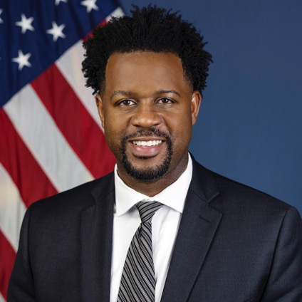
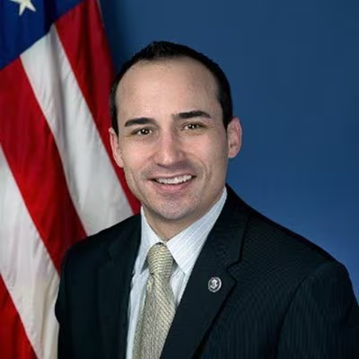
Dr. Robert Hampshire
Deputy Assistant Secretary for Research and Technology and Chief Science Officer
U.S. Department of Transportation
Vinn White
Senior Advisor for Innovation, Office of the Secretary, U.S. Department of Transportation

Slide 2
Vinn White
Senior Advisor for Innovation,
Office of the Secretary,
U.S. Department of Transportation

Slide 3
Dr. Robert Hampshire
Deputy Assistant Secretary for Research and Technology and Chief Science Officer
U.S. Department of Transportation

Slide 4
USDOT Automation Research
July 2023
Dr. Robert Hampshire
Deputy Assistant Secretary for Research and Technology and Chief Science Officer
U.S. Department of Transportation

Slide 5

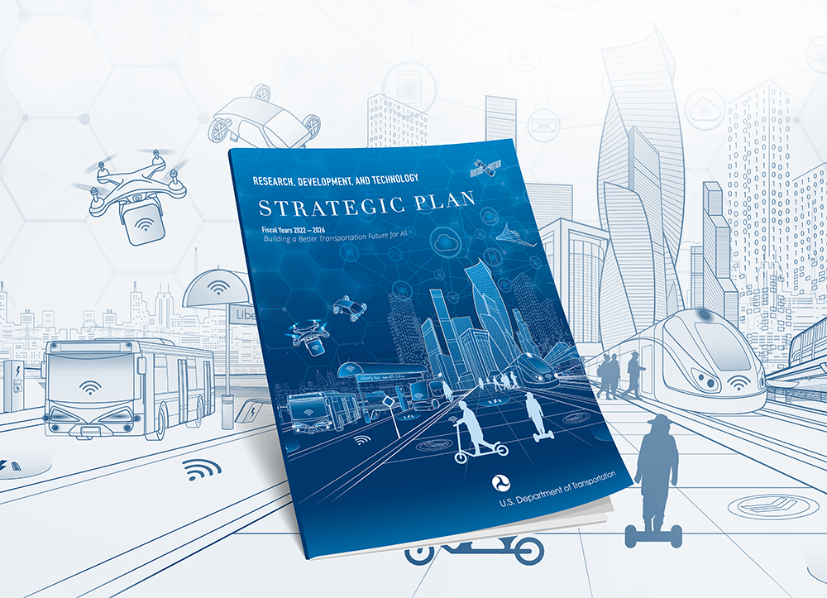



Building a Better Transportation Future for All
Notes:
Hello everyone, thank you all for having me here.
I’m Dr. Robert Hampshire, I’m the Deputy Assistant Secretary for Research and Technology and Chief Scientist at USDOT.
Welcome to this plenary session.
I am pleased to be back again with you this year to talk about Current and Planned Activity in AV Research from the DOT perspective, more specifically from my office—I’ll give you an update about the work that we’re doing across the modes and highlight some specific activities that relate to automation and automation research.
It has been a tremendous year in terms of DOT programming, and we have lots to talk about on the automation front.
Last year, I talked about the Bipartisan Infrastructure Law (BIL) and strategic planning - and I gave you all the roadmap, so to speak, for where DOT was heading and a big overview of what was coming. Now we’re hitting the road.
We started with our strategic plan and how it structured our efforts - and how those efforts serve key policy priorities in the BIL.
Now we’re at a point where we’re actively heading into the future with scalable technology and a full suite of programs and opportunities open to address our transportation needs today.

Slide 6
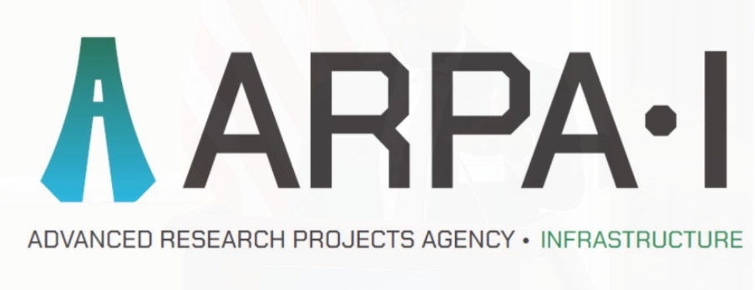
Advanced Research Projects Agency - Infrastructure (ARPA-I)
ARPA-I’s mission is to catalyze the development of innovative technologies, systems, and capabilities that transform the nation’s physical and digital infrastructure to ensure American leadership. We aim to build the future of transportation that is safe, secure, efficient and resilient, while achieving net-zero emissions and increasing equity and access for all.
https://www.transportation.gov/arpa-i
Notes:
Let’s start with Advanced Research Projects Agency - Infrastructure (ARPA-I).
ARPA-I is a new agency at DOT focusing on transportation and infrastructure, modeled after the very successful ARPA-E and DARPA models.
It’s a crosswalk to tackle opportunities by supporting breakthroughs that extend beyond our existing R&D portfolios, as well as build community-oriented R&D agendas.
We are incredibly enthusiastic about ARPA-I – we believe that it will catalyze the development of innovative technologies, systems, and capabilities to transform the nation’s physical and digital infrastructure.
It will enable us to more quickly and effectively build a transportation system that reflects our values – one that is safe, equitable, climate-friendly, resilient, and strengthens our economy.

Slide 7
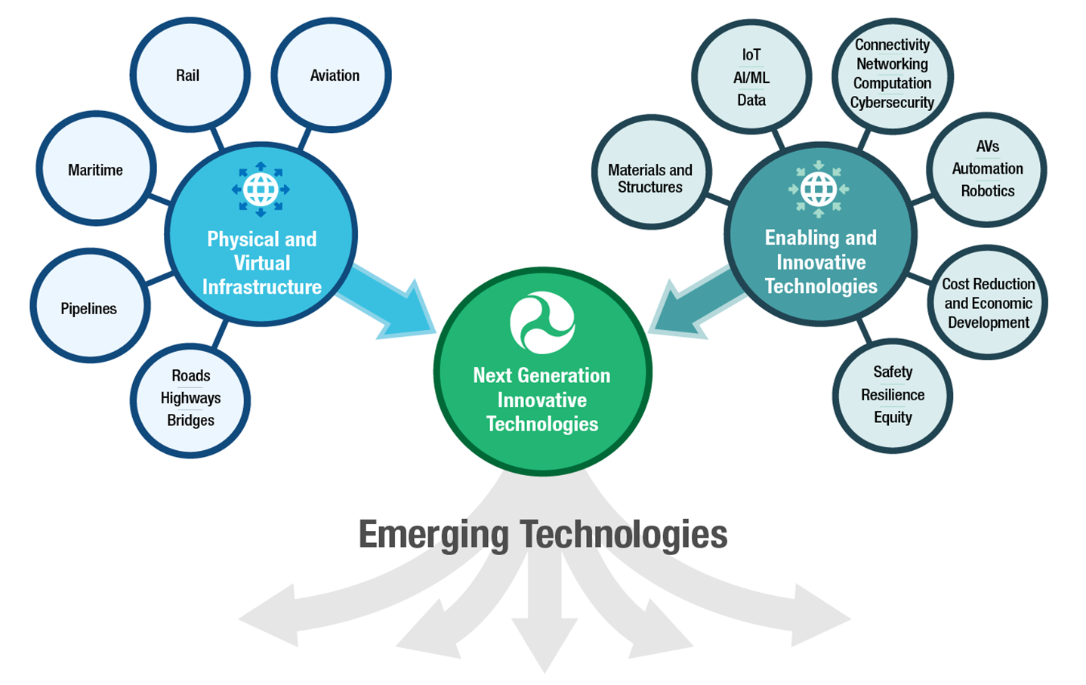
The Goal of ARPA-I
Develop Innovative Infrastructure Technologies and Solutions for Transportation
ARPA-I will be to Transportation as DARPA is to Defense, and ARPA-E is to Energy
Develop innovative solutions to persistent problems in infrastructure and transportation
Unleash US innovation and creating new infrastructure R&D ecosystems
Ensure the US has a 21st Century Infrastructure System and will reach the goal of net-zero GHG emissions by 2050
Develop infrastructure that will create the safest, most efficient, climate friendly and resilient transportation system in the world
Notes:
The ARPA-I website is up and on June 13, together with the White House, ARPA-I launched an RFI with questions related to safety, advanced construction materials and methods, digital infrastructure, freight logistics and optimization, climate and resilience, and other areas in transportation infrastructure.
I highly encourage you to look and respond to the RFI. We want to hear from you about what you see as challenges and where there are opportunities. You have until July 28, to weigh in.

Slide 8
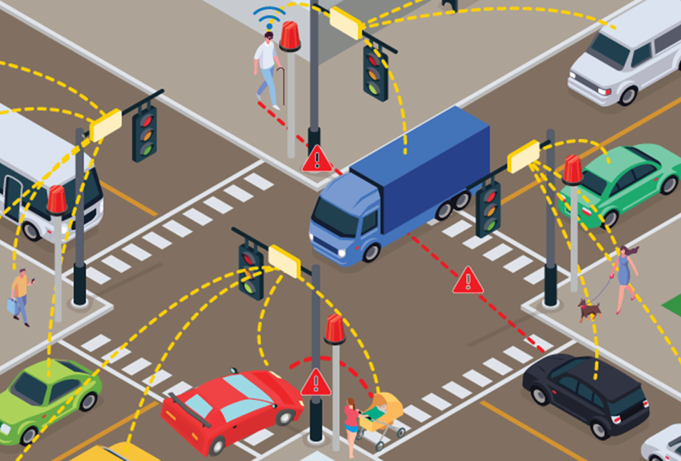


Intersection Safety Challenge
Concept Illustration: Intersection Safety System
VISION: Transform intersection safety with innovative intersection safety systems that mitigate unsafe conditions involving vehicles and vulnerable road users in real-time.
PRIZE COMPETITION: Encourage teams of innovators and end-users to develop and test their intersection safety systems to compete for up to $6M total in prizes.
  Deadline to submit a Concept Paper for Stage 1A is 9/25/23, 05:00 PM EDT.
ALIGNMENT WITH DOT PRIORITIES: Aligns with the National Roadway Safety Strategy (NRSS) and supplements U.S. DOT safety and equity efforts.
Image Source: U.S. DOT
Prize Competition (Stage 1A and Stage 1B)
Contract Awards (Stage 2)
LEARN MORE AT: https://its.dot.gov/isc/
Stage 1A:
Concept Assessment
Stage 1B:
System Assessment & Virtual Testing
Potential Stage 2: Prototype & Field Testing
Notes:
In conjunction with this, our Intersection Safety Challenge is also open through September 25.
It’s a $6 million prize competition aimed at improving intersection safety by leveraging machine vision, sensor fusion, and real-time decision making to create safer conditions for pedestrians, cyclists, and drivers at intersections.
This challenge not only ensures that we continue to promote innovative research and development (R&D) and safety efforts, but also to create foundational technologies: tools and methods that will enhance transportation planning decisions, infrastructure design, and traffic signaling. All that relies in part on having solid digital infrastructure: again, widescale deployment of sensor technology, curb tech, smart signals, and more.

Slide 9





University Transportation Center (UTC) Program
($450 Million BIL Program - $800 Million Value)
The UTC program is a Congressionally-mandated financial-assistance (competitive grants) program to US university consortia.
Purpose:
(A) Advance transportation expertise & technology through education, research, & technology transfer activities;
(B) Provide for a critical multimodal transportation knowledge base outside of the Department of Transportation; and
(C) Address critical workforce needs & educate the next generation of transportation leaders.
FY22 Awards:
Total of 34 awards to institutions; two institutions (Carnegie Mellon Univ., Univ. of Michigan & Ohio State Univ.) with a focus on automated vehicles.
Notes:
This is an excellent segue into our University Transportation Centers (UTC) Program.
The UTC program and the research that has come from it, have played a necessary and vital role in advancing state of the art transportation research and technology. The UTC program, as some or most of you know, works through a consortium of schools to advance technology and expertise across transportation disciplines through education, solutions-oriented research and technology transfer, and the exploration and sharing of cutting-edge ideas and approaches.
We just recently announced the winner of our latest UTC grant competition, and they are off and running. We now have 34 UTCs (with a 35th being recompeted) across the country. Secretary Buttigieg and I have been making visits to some of the schools, and they have amazing things on the horizon in terms of cutting-edge research in the field of automation.

Slide 10
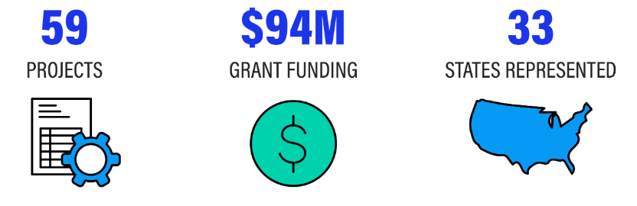
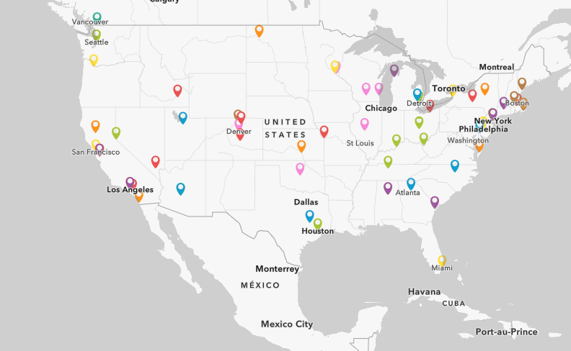

Funding Opportunities: SMART and ATTAIN Grant Programs
Strengthening Mobility and Revolutionizing Transportation (SMART) Grants Program
In March 2023, USDOT announced the first round of funding for the SMART Grants Program.
SMART Grant awards included 59 projects across 33 states and totaled $94 million.
The FY23 SMART Grant Notice of Funding Opportunity is expected to open in August 2023 for the second round of Stage 1 grants.
Advanced Transportation Technology and Innovation (ATTAIN) Program
In May 2023, USDOT announced ATTAIN FY2022 project selections.
ATTAIN grants included 8 projects across 8 states and totaled more than $52 million.
The Minnesota's Autonomous Rural Transit Initiative (MARTI) project received $9.3M in funding to expand a current ADS pilot.
The FY23 ATTAIN Notice of Funding Opportunity is expected to open later in 2023
Notes:
We’ve also awarded $94 million through the Department’s Strengthening Mobility and Revolutionizing Transportation (SMART) Grants Program.
Secretary Buttigieg made the announcement back in March and so far, we have awards for 59 projects across 33 states through the first round of funding.
Projects selected under this first stage of funding cut across technology areas and represent a variety of project types.
While there were no automation projects selected for Stage 1 grants, “coordinated automation” was included as a technology area, and there are additional SMART Grant funding rounds coming with the FY23 Notice of Funding Opportunity expected to open next month for the second round of Stage 1 SMART grants.
The Federal Highway Administration announced the Advanced Transportation Technology and Innovation (ATTAIN) Program and more than $52 million in grants were awarded for eight states.
As part of President Biden’s Investing in America agenda, these ATTAIN grants will fund technology-based solutions that improve the travel experience for millions of Americans who use our highway and transit systems, with expanded eligibility for projects in communities that have previously lacked investments, including rural areas and areas of persistent poverty.
One example - the Minnesota's Autonomous Rural Transit Initiative (MARTI) project received $9,302,812 in funding to expand a current ADS pilot. The pilot is a free on-demand automated micro-transit service in Grand Rapids, MN that is intended to make transit services more reliant, convenient and accessible in rural communities, including for wheelchair users. The project area includes disadvantaged communities.
The FY23 ATTAIN Notice of Funding Opportunity is expected to open later this year.

Slide 11
ITS4US – Buffalo’s Self-Driving Shuttle
Autonomous Driving Functions:
      Sensing & Perception
      Path & Motion planning
      Vehicle Control
Pickup & Drop-off Monitoring
Passenger Monitoring
V2X Communications
Passenger Information System
Accessibility Support
Wheel-chair securement
Operational Design Domain
Source: Gopalakrishna, D. et al. (2021).
Notes:
We also have the ITS4US Program.
This is a multi-modal effort aimed at enabling communities to demonstrate integrated technology deployments supporting independent and seamless travel for all users across all modes, regardless of location, income, or disability.
As part of Buffalo’s ITS4US, the site will be deploying up to two, level 4 ADS-equipped buses to help solve first mile / last mile transportation barriers that affect underserved populations.
These buses will be integrated with the trip planning platform created as part of this deployment and will provide circulation in the Buffalo Niagara Medical Campus (BNMC) and surrounding residential neighborhoods as an on-demand service. This service provides travel in the BNMC and residential neighborhoods and support for first- and last-mile transit connections.

Slide 12
Federal Transit Administration (FTA) Activity
Advanced Driver Assistance Systems (ADAS) and Automated Transit Bus Maintenance and Yard Operations Demonstrations: $11.6 million to six projects
Colorado DOT
$1.3M FTA Grant
Connecticut DOT
$2.0M FTA Grant
Capital Metropolitan Transportation Authority $950K ITS JPO Grant
Virginia Tech
$4.5M FTA Grant
University of Alabama $2.0M FTA Grant
LEGEND
Pinellas Suncoast Transit Authority
$893K FTA Grant
Funded Projects:
Transit Bus ADAS
Yard Operations
Note: Federal grant funding amounts are rounded.
Notes:
Very briefly I’ll give a rundown of some of our modal activities
In September 2022, FTA announced a Notice of Funding Opportunity (NOFO) to solicit proposals for transit bus automation demonstrations of Advanced Driver Assistance Systems (ADAS) and automation of bus movements in transit bus yards and in June announced $11.6 million to six projects. Examples of projects include strategies for avoiding collisions with pedestrians, improved emergency braking, and precision movement for bus fueling, charging, and maintenance.

Slide 13
FHWA Activity – Report to Congress
Background: Section 11504 of the Bipartisan Infrastructure Law (BIL) calls for a study on the existing and future impacts of self-driving vehicles on transportation infrastructure, mobility, the environment, and safety.
Current Status: Final draft under review for official submission to Congress
Scope: Focused on potential impacts of ADS (SAE Levels 3-5) on the roadway infrastructure, environment and mobility.
Outline: Report includes discussion of:
  Overview of ADS technology, definitions, use cases, and applications
  USDOT roles and activities on ADS impacts
  Potential impacts of ADS on the following: roadway infrastructure, personal mobility, travel demand, roadway capacity/congestion, roadway operations safety, freight and goods delivery, land use and the environment
  Potential recommendations for research and infrastructure
Notes:
Federal Highways is working in collaboration with other USDOT modal agencies and the Volpe Center to develop a study on the existing and future impacts of self-driving vehicles on transportation infrastructure, mobility, the environment, and safety.

Slide 14
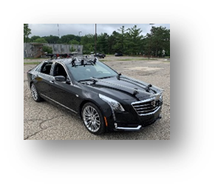
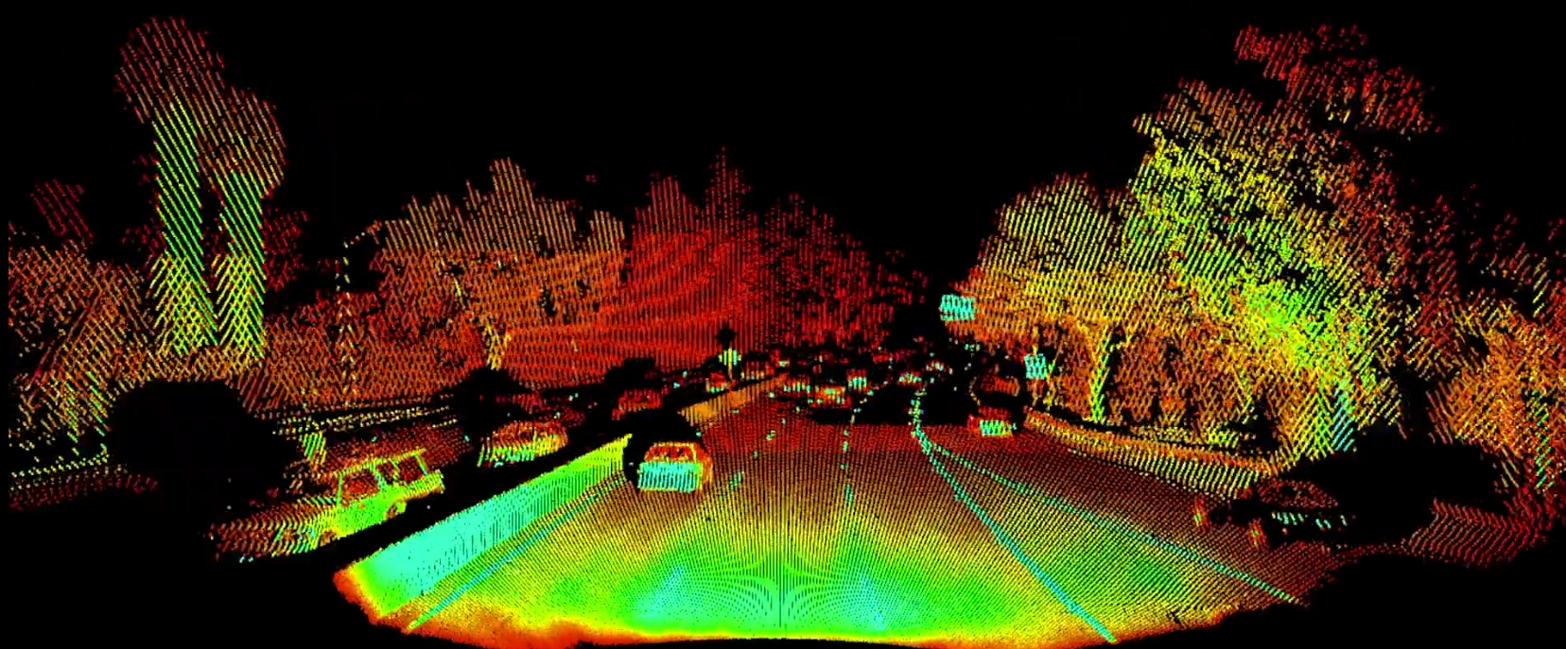
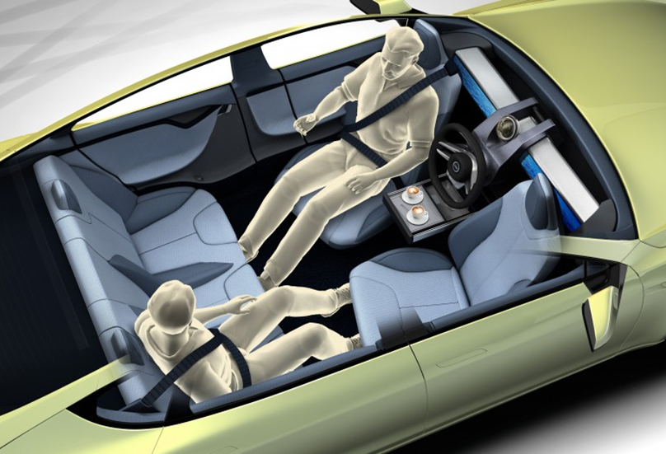
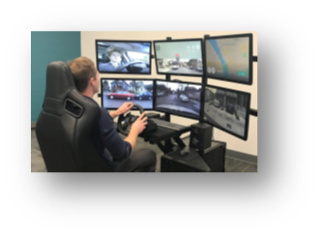
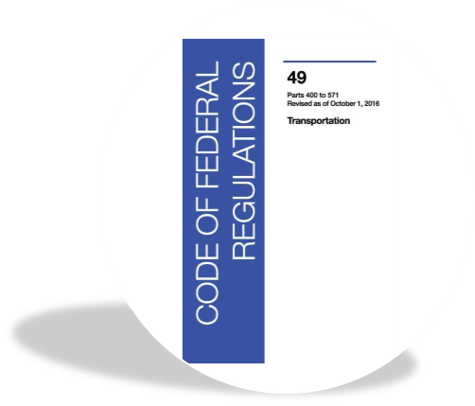

NHTSA Activity
NHTSA Areas of Research Emphasis in ADS
System Safety Performance
Component and Subsystem Testing and Functional Safety
Crashworthiness and Alternative Cabin Design
Human Factors/Accessibility Considerations
Federal Motor Vehicle Safety Standard (FMVSS) Conformance Research
Vehicle Cybersecurity
Notes:
NHTSA ADS safety performance research program has been exploring methods, metrics, and tools for assessing the safety of ADS-equipped vehicles as a complete system. Their research focuses on advancing multiple assessment methods, including simulation, test track, and on-road evaluations in 6 key areas.

Slide 15

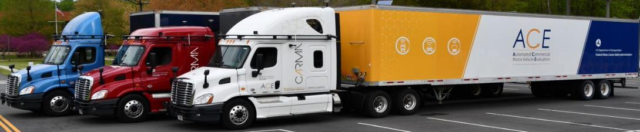
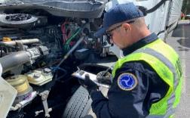
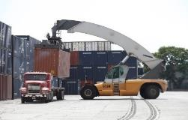
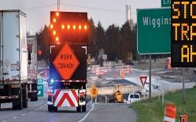

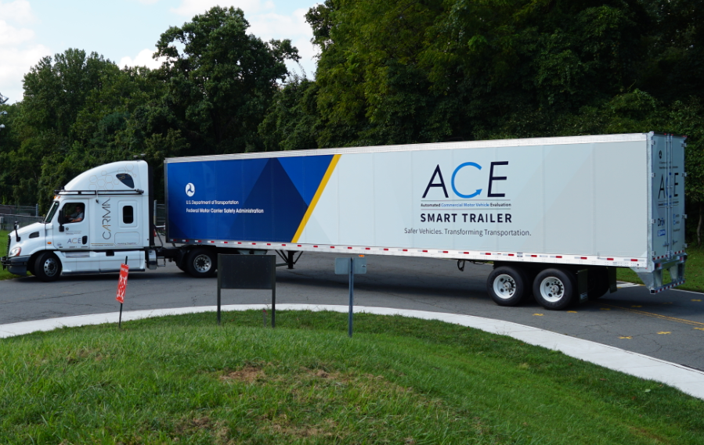
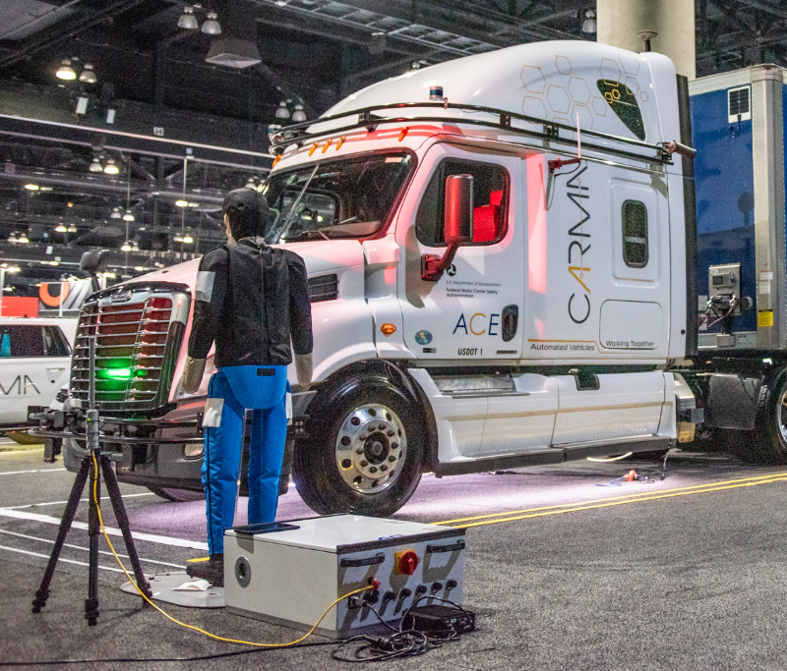
FMCSA Activity – Automated CMV Evaluation (ACE) Program
Research Goals
Conduct research to inform safety equivalency decisions for waivers, exemptions, and pilot programs
Focus efforts on the intersection of automated CMVs and public safety officials
Identify and promote best practices for industry’s use of automated CMVs
Roadside Inspection /
Enforcement
Port Drayage
Work Zones
Emergency Response
Smart Trailers
Vulnerable Road Users
2020
2024
Notes:
Federal Motor Carriers Through their Automated CMV Evaluation (ACE) program, the FMCSA conducts joint research with multiple modal offices and other stakeholders on the integration of ADS-equipped CMVs into the transportation network. FMCSA’s research focuses on the safe and efficient operation of ADS-equipped CMV’s by motor carriers for roadside inspection, work zone, port drayage, emergency response and normal driving scenarios.

Slide 16
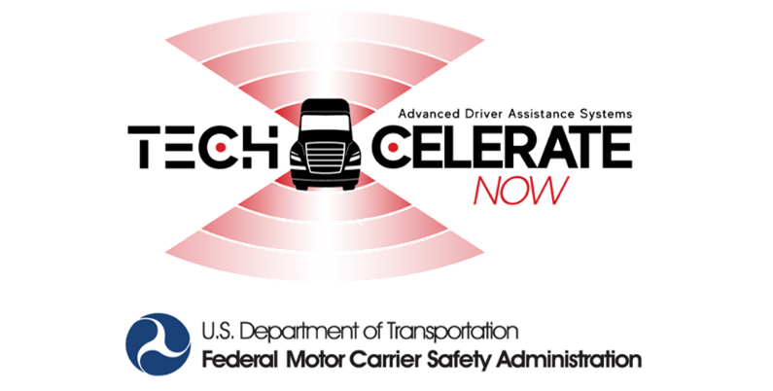
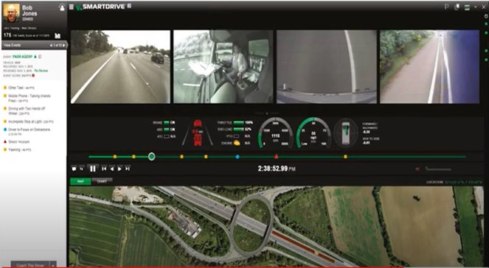
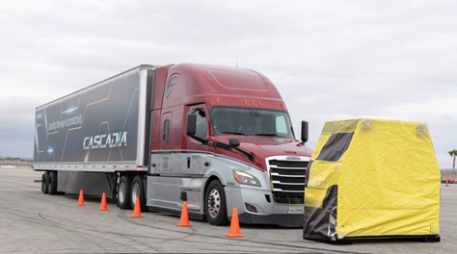
FMCSA Activity – Advanced Driver Assistance Systems Research
National Outreach Campaign
Naturalistic Vehicle Testing
ADAS Technologies
Forward Collision Warning (FCW)
Lane Departure Warning (LDW)​
Automatic Emergency Braking (AEB)
Pedestrian Collision Warning (PCW)
On-Board Monitoring Systems (OBMS)
Others​
Controlled Vehicle Testing
AEB NPRM Announcement
NHTSA and FMCSA Propose New Safety Standard Requiring Automatic Emergency Braking Systems in Heavy Vehicles
Proposed rule could prevent over 19,000 crashes, save 155 lives, and prevent thousands of injuries every year (NHTSA.gov, June 22, 2023)
Notes:
Later this year FMCSA is planning to award a Phase II Tech-Celerate Now program, they also have other ongoing ADAS activities include a naturalistic field study to quantify the efficacy of ADAS systems from real world driving data and jointly NHTSA and FMCSA have announced a Notice of Proposed Rulemaking (NPRM) on June 22, 2023, that would require AEB systems on heavy vehicles. This proposed rule could prevent over 19,000 rear-end crashes, save lives, and prevent thousands of injuries every year.

Slide 17
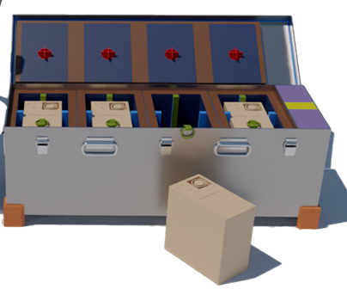
PHMSA Activity
Hazardous Material Detection for Autonomous Vehicles
Battery Logistics Integrated Safety System (BLISS)
BLISS is a Phase II Small Business Innovation Research project with the Office of Hazardous Materials in PHMSA.
BLISS is an intelligent battery packaging system that will be able to detect and communicate to emergency responders if there is a thermal runaway event.
This novel packaging technology is adaptable to a variety of battery form factors and chemistries.
The packaging system will detect thermal runaway before it occurs, isolate fires that occur, and notify first responders, all while being operator agnostic.
Digital rendering of BLISS protype
Notes:
Also, PHMSA funded the Battery Logistics Integrated Safety System (BLISS) to address numerous recent incidents of battery fires and explosions that occurred in transportation. BLISS is a Phase II Small Business Innovation Research project to develop an intelligent battery packaging system that will be able to detect and communicate to emergency responders if there is a thermal runaway.

Slide 18
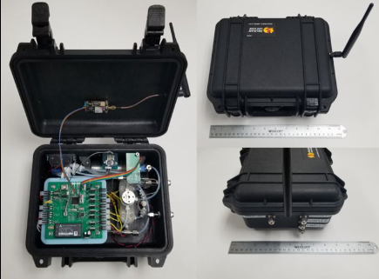
PHMSA Activity
Hazardous Material Detection for Autonomous Vehicles
Compact Leak Detector for Autonomous Vehicles with Adelphi Technologies
Adelphi has a Phase II Small Business Innovation Research project with the Office of Hazardous Materials in PHMSA.
The system merges traditional GC detection with novel sensor technology to provide highly accurate and sensitive leak detection for a variety of hazardous materials.
These detectors can then be placed on anything from Drones to rail cars, and from cargo tanks to the hulls of vessels to help provide around-the-clock management of potential hazardous situations.
Small business’s prototype of compact leak detector
Notes:
The BLISS and Compact Leak Detector work done by PHMSA are examples of particularly specific government roles in ADS-related research. I also want to highlight that PHMSA will be part of the USDOT Listening Session that will be held later this afternoon.

Slide 19
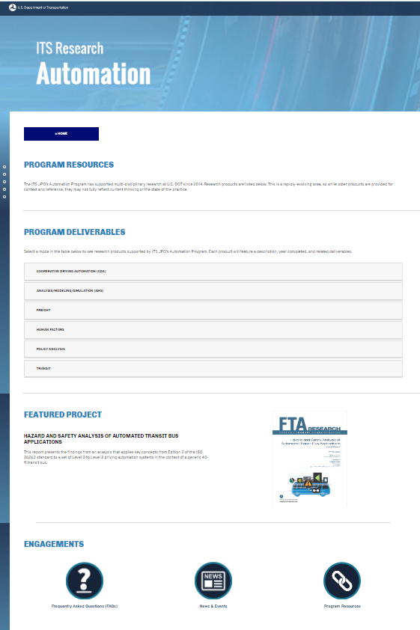
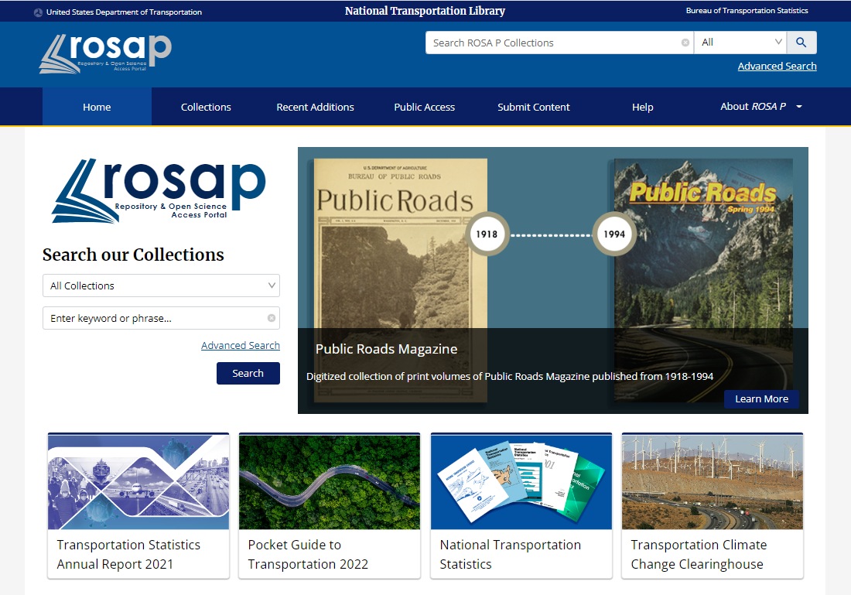
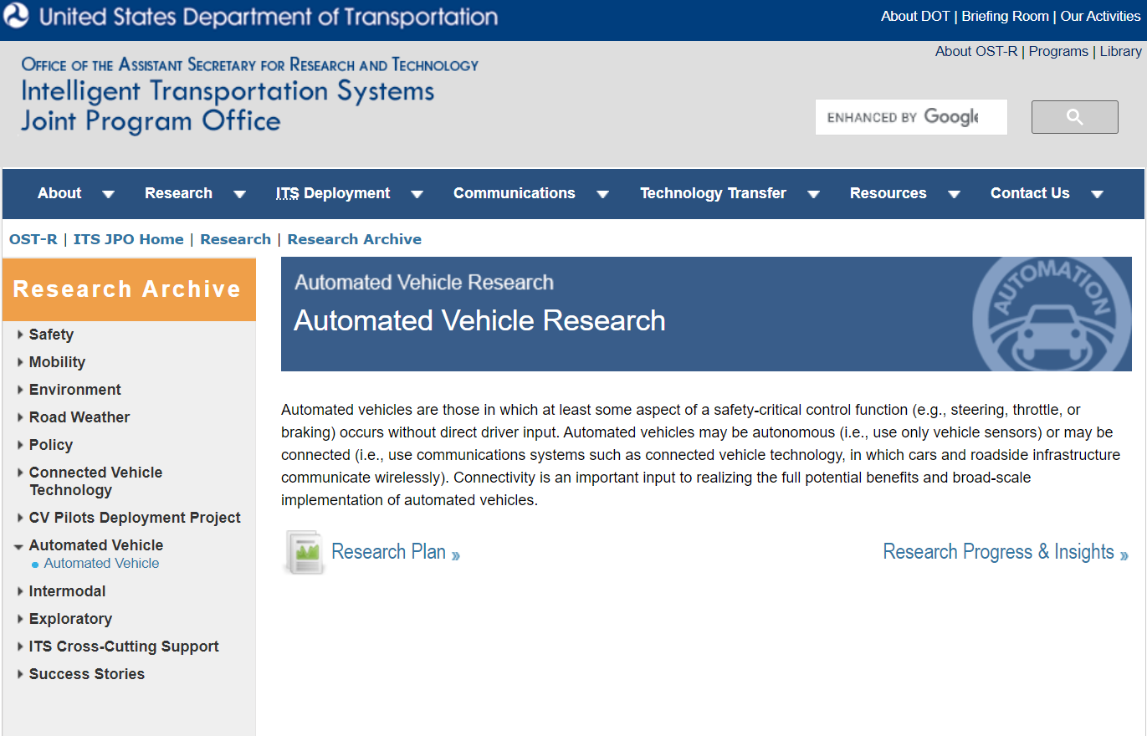
Research Resources
USDOT automation research and resources are available in many public locations, including:
National Transportation Library
Repository & Open Science Access Portal (ROSA-P)
ITS JPO Automation Program Website
ITS Professional Capacity Building (PCB) Website
Notes:
I want to note that our automation research and resources are available via:
National Transportation Library (NTL – just celebrated its 25th anniversary)
Repository & Open Science Access Portal (ROSA-P)
ITS JPO Automation Program Website
ITS Professional Capacity Building (PCB) Website

Slide 20
Contact
Dr. Robert Hampshire
Deputy Assistant Secretary for Research and Technology and Chief Science Officer
U.S. Department of Transportation
(202) 366-6321
robert.hampshire@dot.gov
Notes:
Again, these are just a few examples of ongoing work. We have launched whole ecosystem of programs for you to look forward to and engage with. We’re really moving along and making tremendous strides forward. I highly encourage you to keep an eye out in over the coming months for more.

