Slide 1
University Transportation Centers
^{Presented by:}
USDOT’s University Transportation
Centers (UTC) Program and the Council of
University Transportation Centers (CUTC)

Slide 2
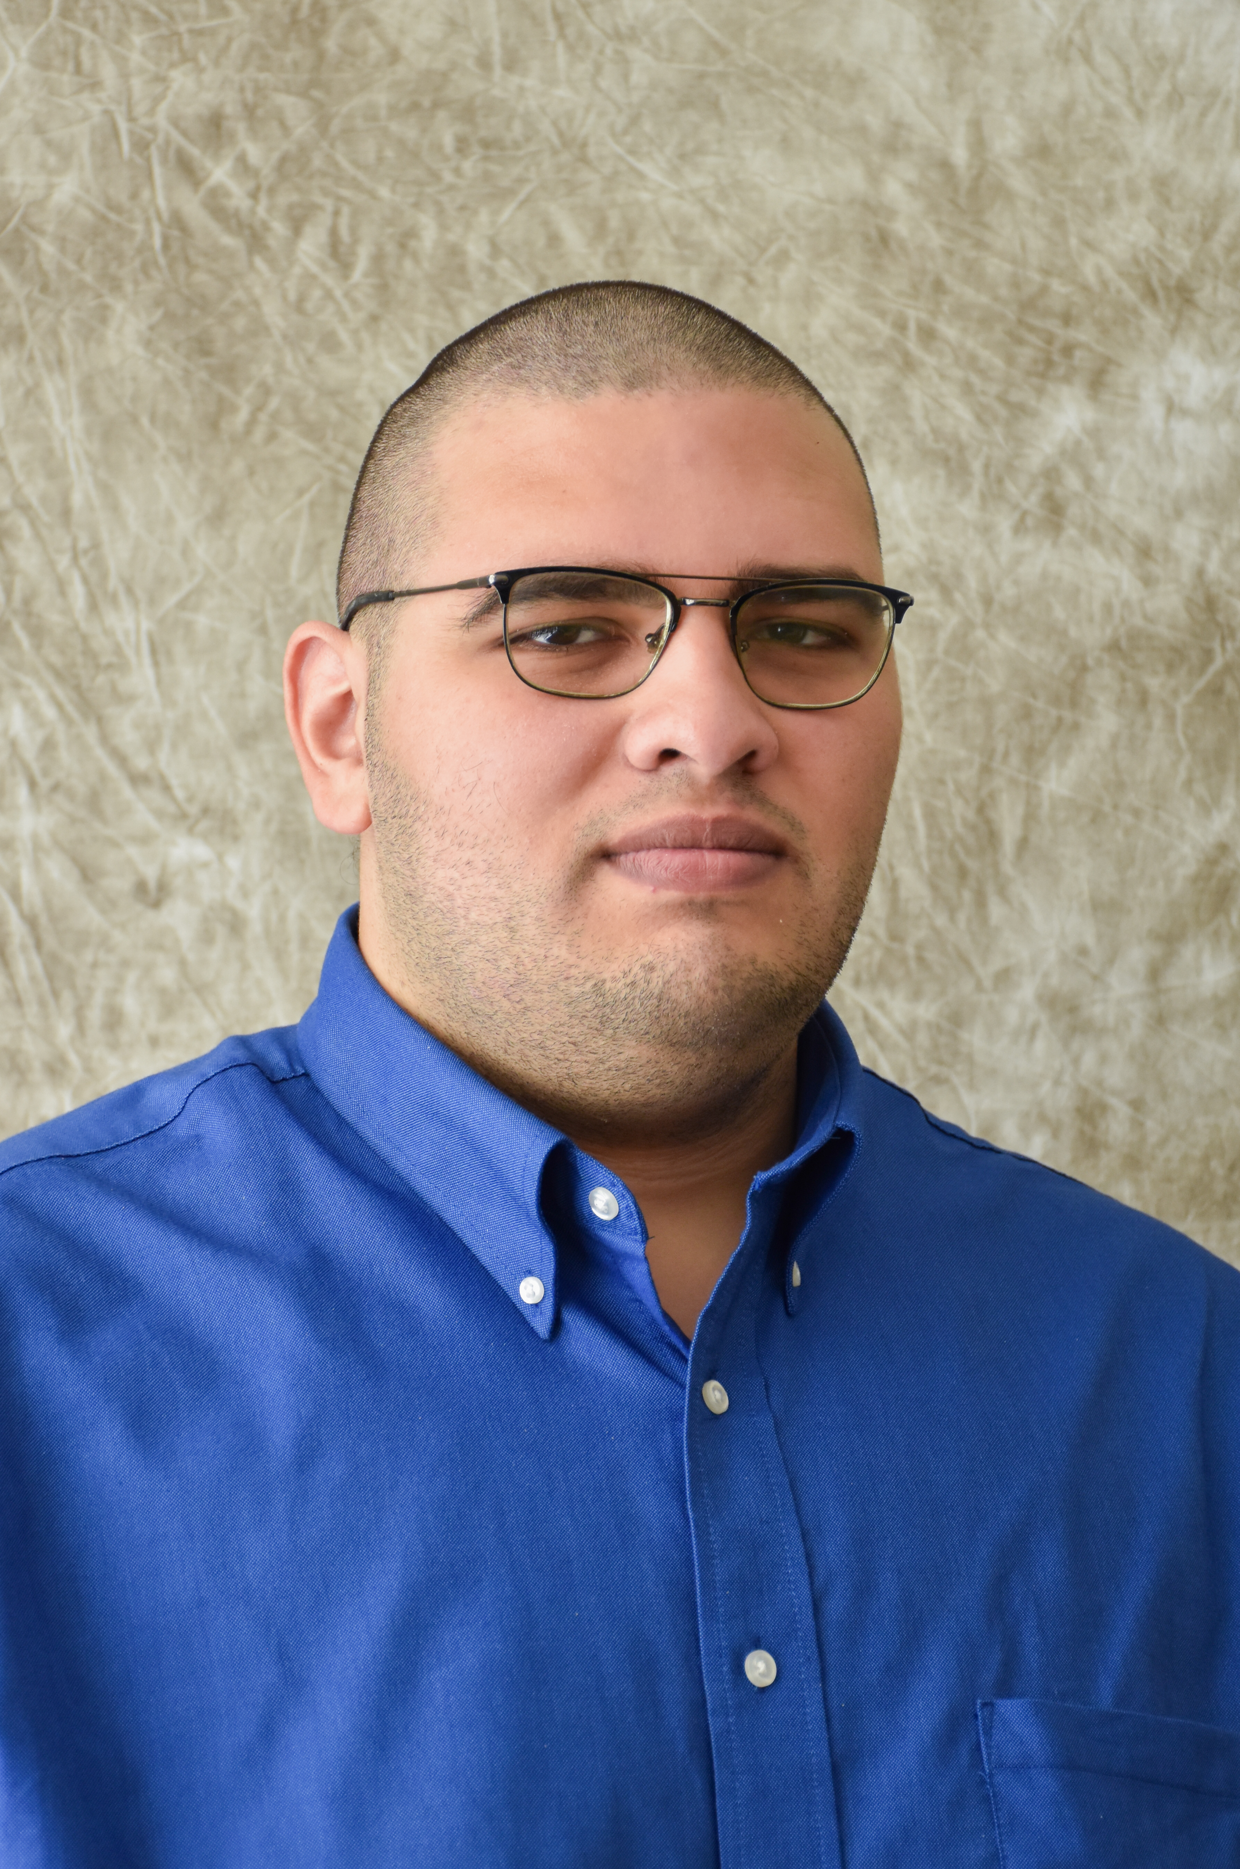
Khalid Al-Kady
MULTIMODAL
University of Nebraska-Lincoln
Mid-America Transportation Center
Research Area(s):
Remote Structural Health Monitoring (SHM), Large-scale structural testing, computer vision/deep learning-based SHM solutions
Dissertation Title:
Novel Pipelines for Dynamic Structural Health Monitoring Using Commercially Available Platforms

Slide 3
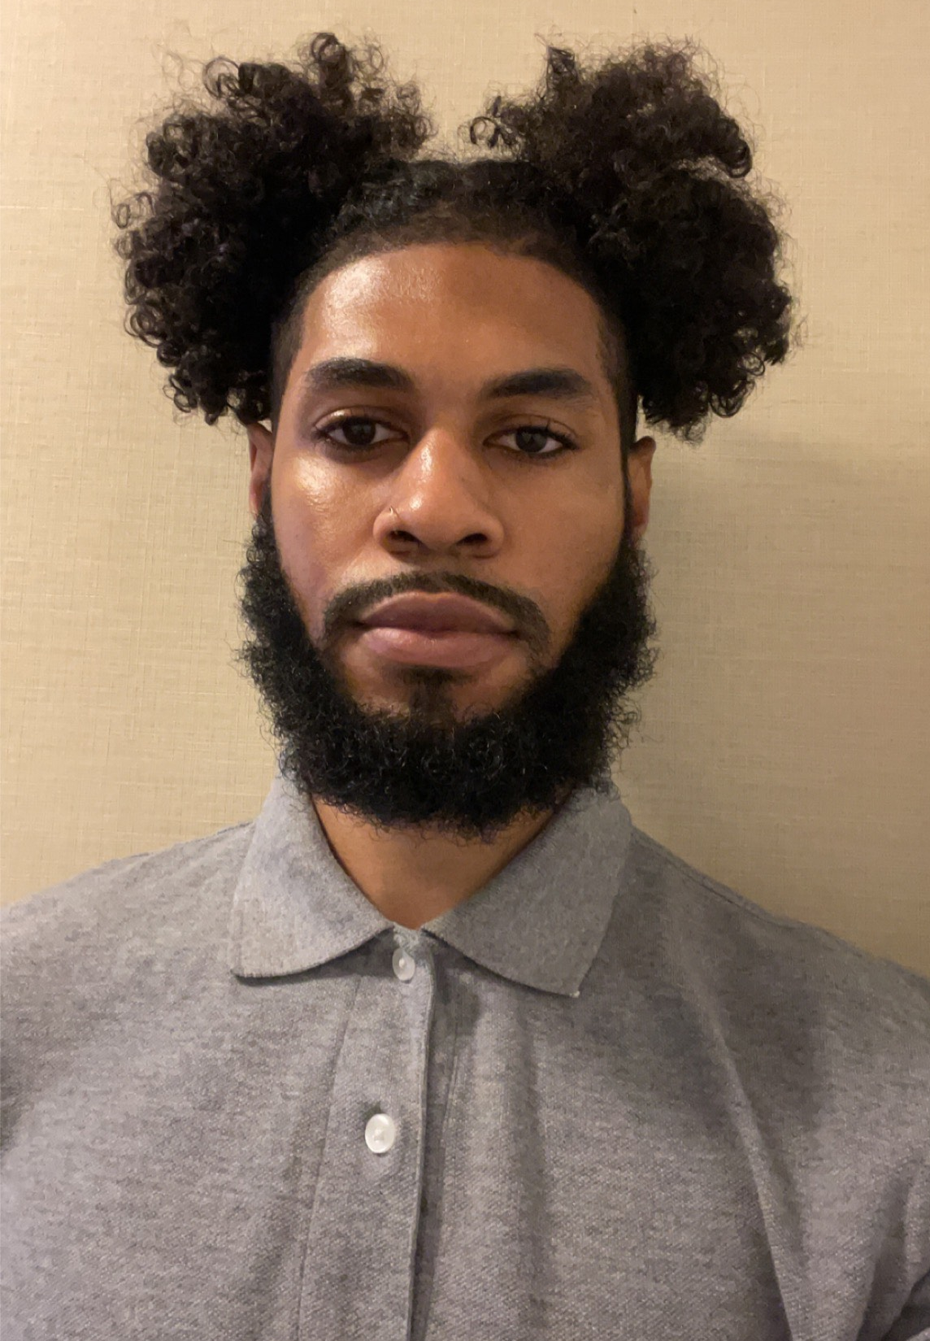
Javon Barrett
MULTIMODAL
Morgan State University
Urban Mobility and Equity Center
Research Area(s):
Connected and autonomous vehicles
Research Title:
Leveraging a Driver Eye-Movement Tracking Sensor for the Enhancement of an In-Vehicle Audio-Visual Alert System for Averting High-Risk Conflicts with Pedestrians and Cyclists in the Urban Driving Environment

Slide 4
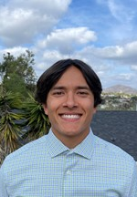
Django Bergcollins
MULTIMODAL
San Diego State University
Safety Through Disruption (Safe-D)
Research Area(s):
Intelligent Transportation Management Systems
Research Title:
Developing an Intelligent Transportation Management Center (ITMC) with a Safety Evaluation Focus for Smart Cities

Slide 5
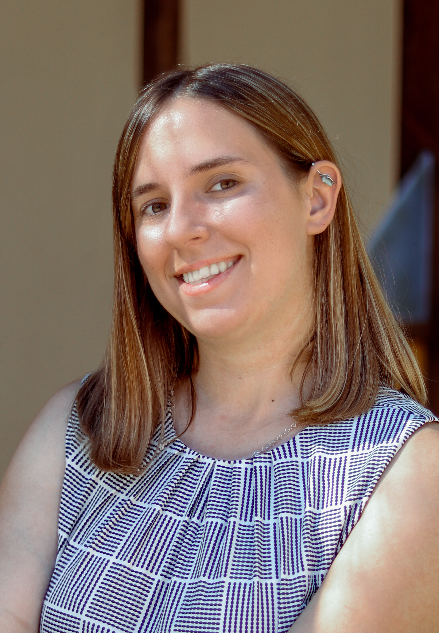
Lauren Brown
MULTIMODAL
University of Texas at El Paso
Connected Cities for Smart Mobility towards Accessible and Resilient Transportation
Research Area(s):
Smart cities, digital twins, accessibility, safety, equity
Thesis Title:
Applying Smart Cities Indices to a Multi-Modal Corridor

Slide 6

Luisa Castrejon
MULTIMODAL
University of Texas at El Paso
Center for Transportation, Environment, and Community Health
Research Area(s):
Sustainable Infrastructure
Thesis Title:
Applying Smart Cities Indices to a Multimodal Corridor

Slide 7

Fred Chambers
MULTIMODAL
Benedict College
Center for Connected Multimodal Mobility (C2M2)
Research Area(s):
Intelligent Transportation Systems
Research Title:
The Effect of Dust and Sand on the Propagating EM Millimeter Plane Wave

Slide 8

Taylor Dinehart
MULTIMODAL
University of South Florida
National Institute for Congestion Reduction
Research Area(s):
Public health, resilience, sustainability, equity, safety
Research Title:
Feasibility of a Regional Transportation Systems Management and Operations (TSMO) Program

Slide 9
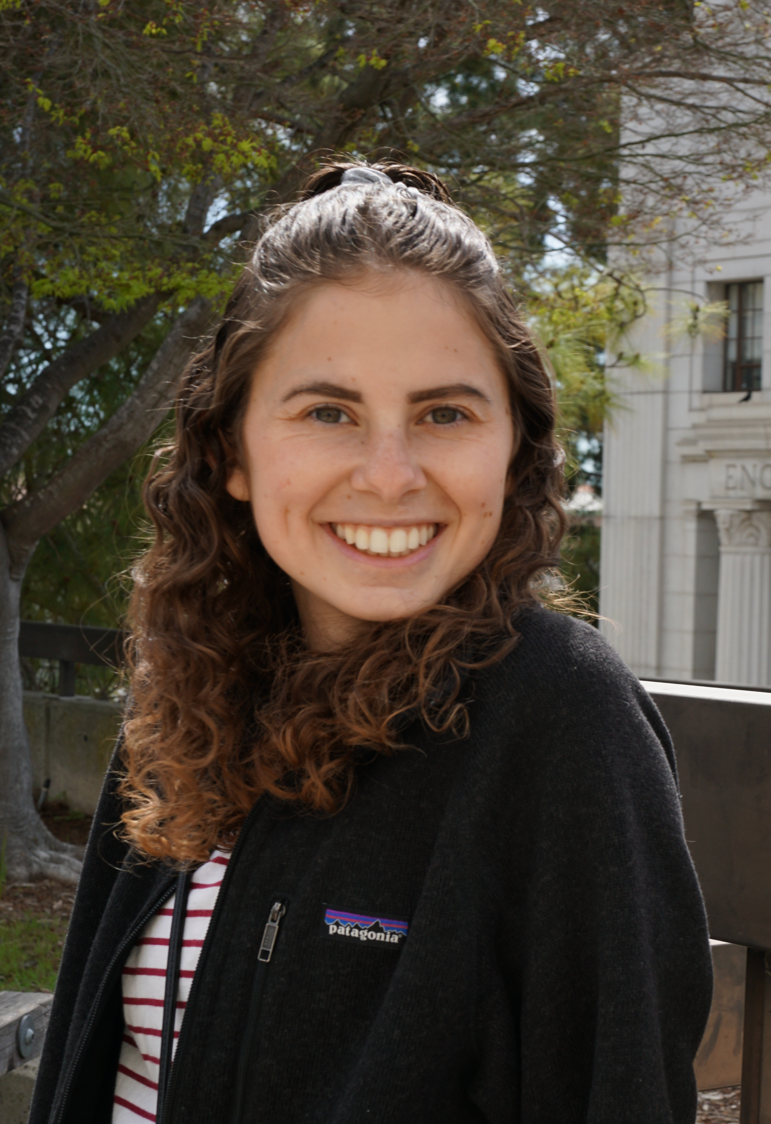
Abbie Dirks
MULTIMODAL
Arizona State University
Teaching Old Models New Tricks (TOMNET)
Research Area(s):
Travel behavior and attitudes, shared mobility, perceptions towards emerging transportation technologies, and transportation equity
Thesis Title:
Access to Food in a Severe Prolonged Disruption: The Case of Grocery and Meal Shopping During the COVID-19 Pandemic

Slide 10
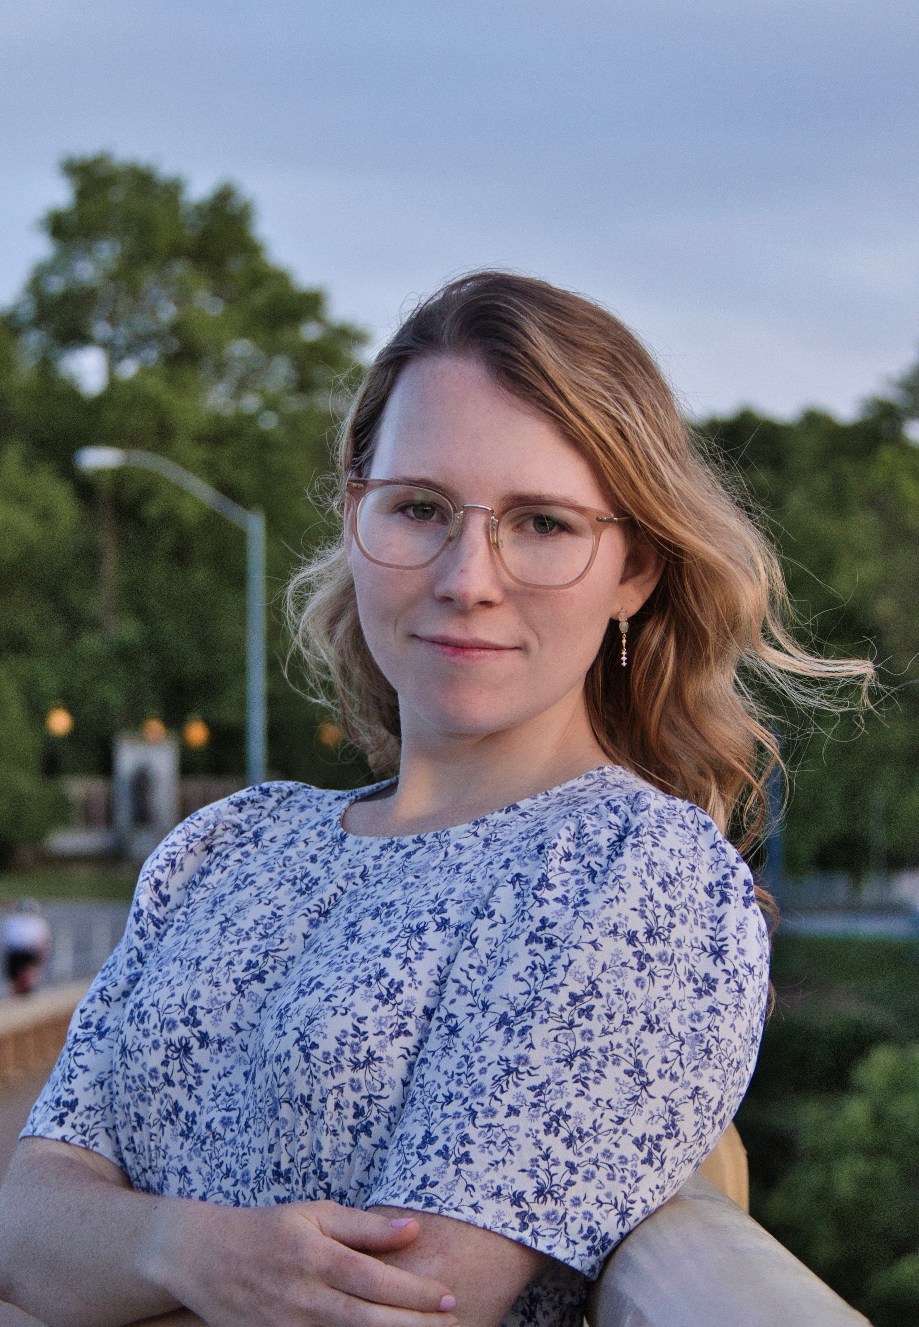
Lily Hanig
MULTIMODAL
Carnegie Mellon University
Mobility21
Research Area(s):
Systems planning and optimization of transportation systems for equity, and low emissions
Thesis Title:
Planning for Equitable Outcomes During Periods of Disruption in the Transportation Sector

Slide 11
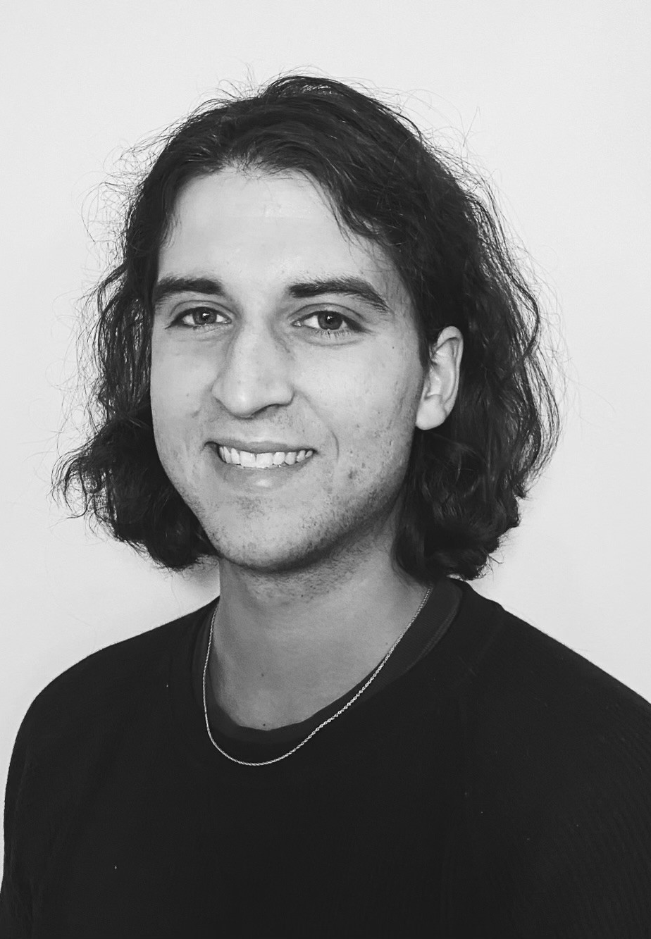
Quinn Packer
MULTIMODAL
University of Connecticut
Center Advanced Multimodal Mobility and Solutions and Education
Research Area(s):
Transportation safety and an equitable and sustainable society for all
Thesis Title:
Pedestrian Signal Compliance Under Concurrent and Exclusive Phasing at Traffic Signals Considering Geo-Spatial Factors

Slide 12
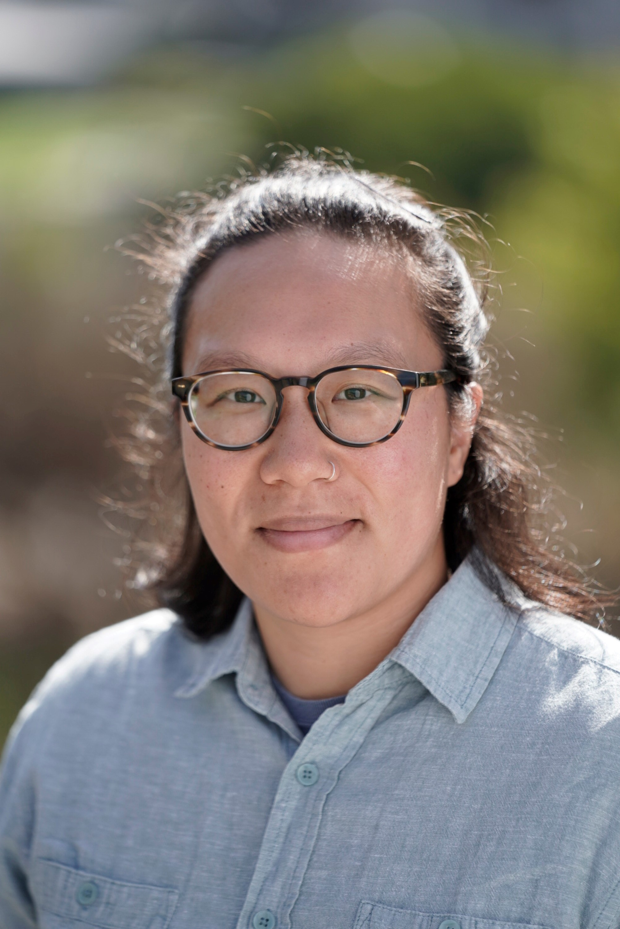
Alexandra Pan
MULTIMODAL
University of California, Berkeley
Tier 1 University Transportation Center on Telemobility
Research Area(s):
Housing and transportation decisions of low- and moderate-income suburban residents
Thesis Title:
Crabgrass Confinement: Housing and Transportation Accessibility Challenges of Suburban Poverty

Slide 13
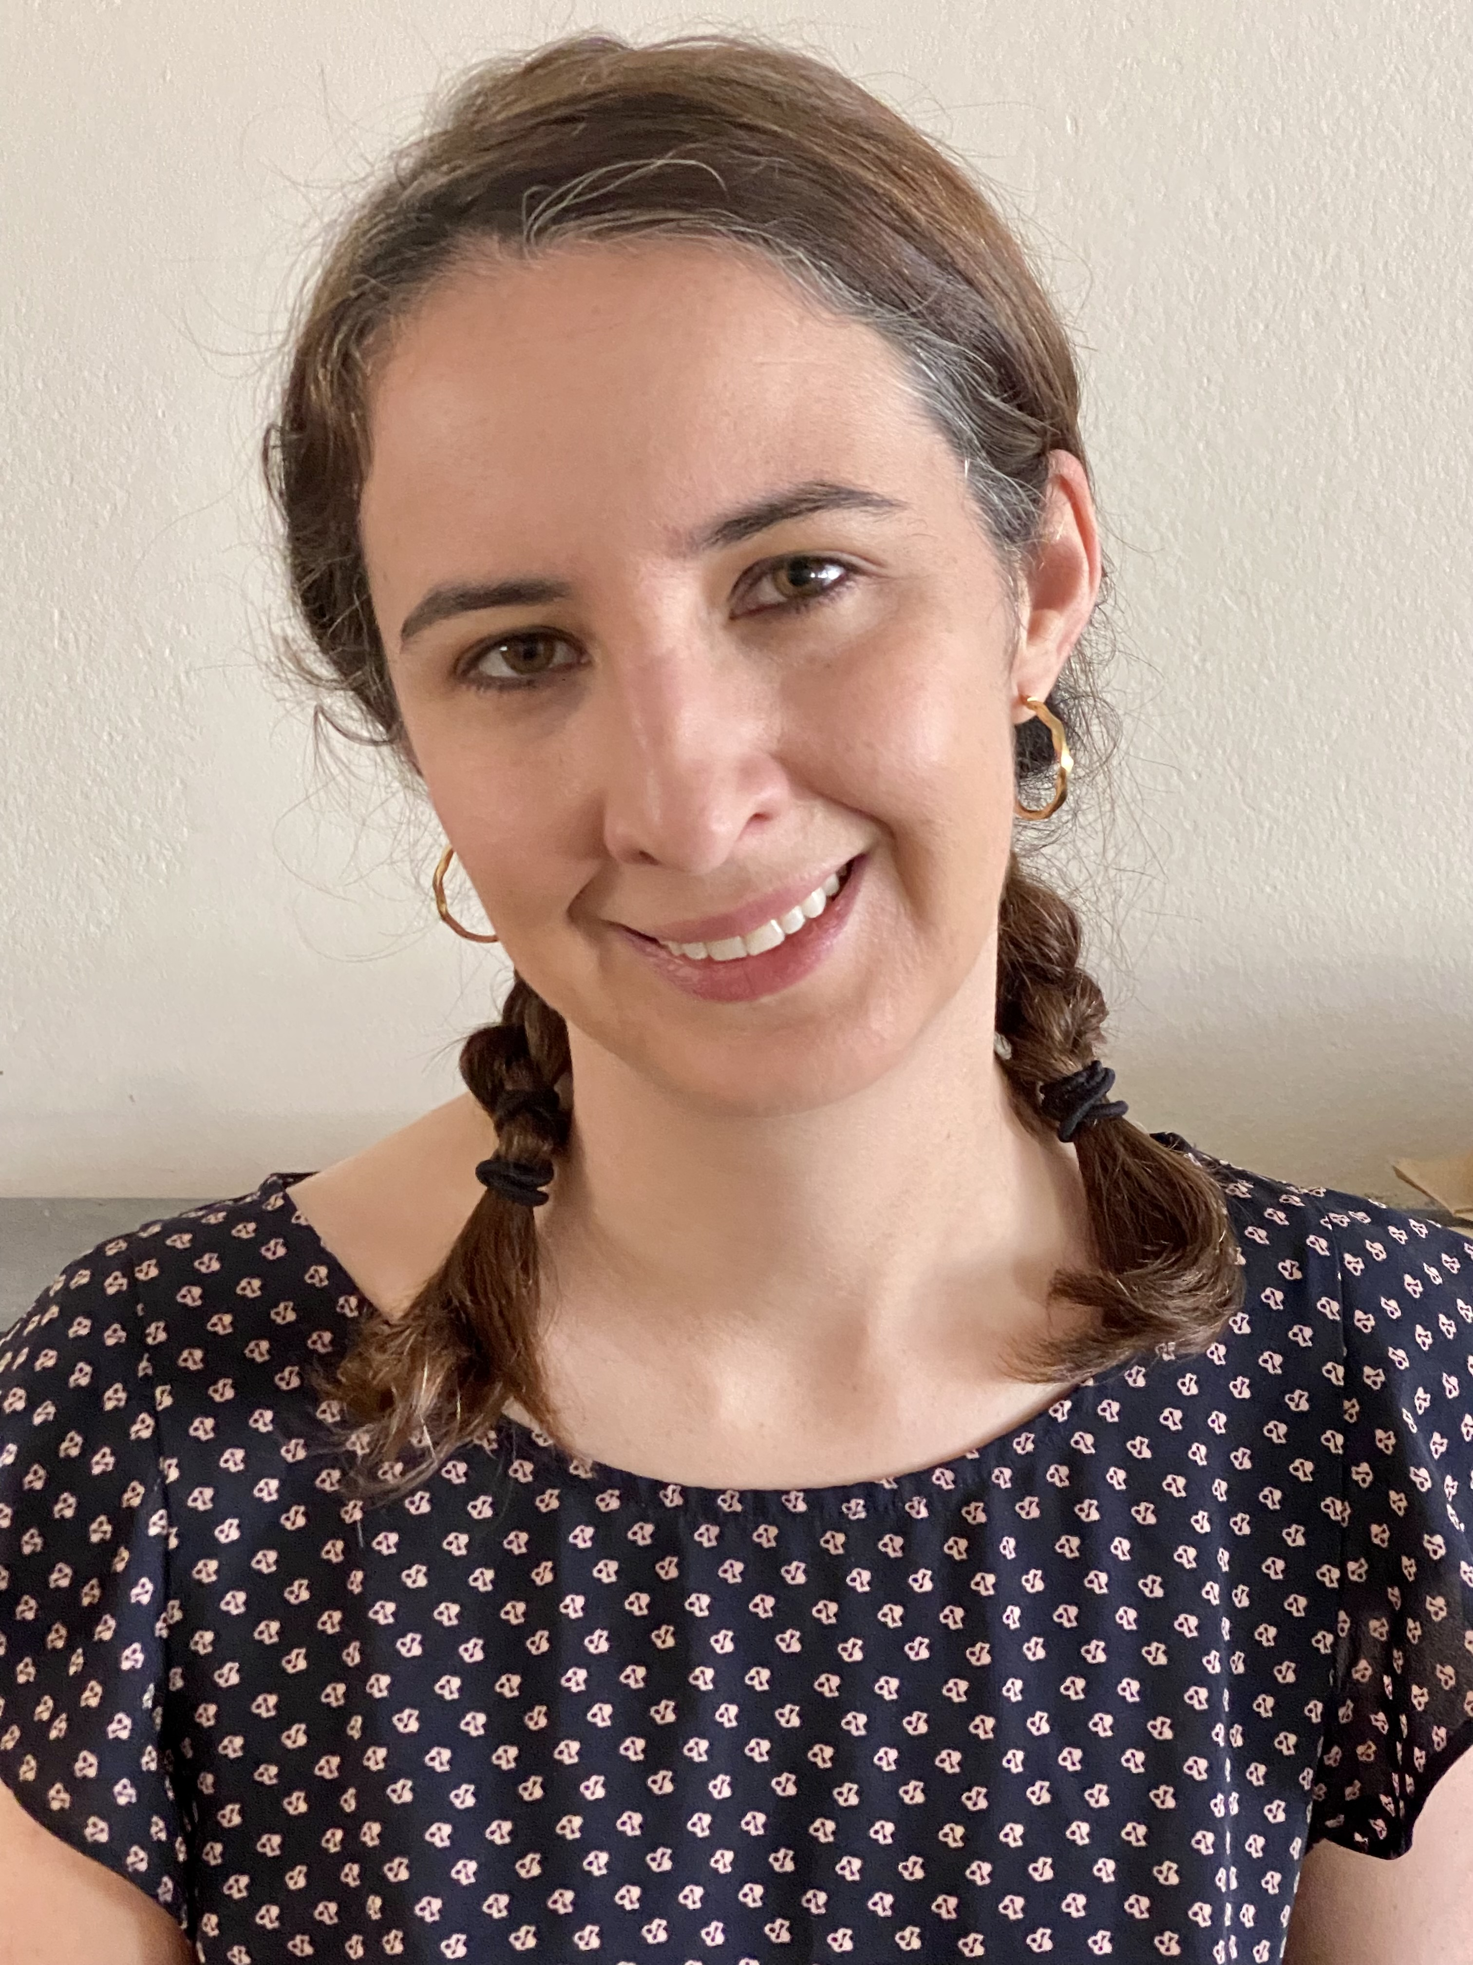
Julene Paul
MULTIMODAL
University of California, Los Angeles
Pacific Southwest Region University Transportation Center
Research Area(s):
Transportation equity
Dissertation Title:
Sharing in and Sharing Out: Rates and Predictors of Informal Automobile Sharing in the U.S.

Slide 14
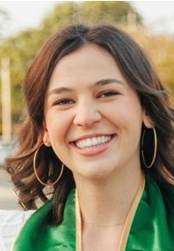
Peyton Ratto
MULTIMODAL
California Polytechnic State University, San Luis Obispo
Center for Transportation Equity, Decisions and Dollars
Research Area(s):
Potential for reducing vehicle miles traveled
Thesis Title:
Impact of Innovative Financing Tools on the Production of In-fill Housing and Reduction in VMT

Slide 15
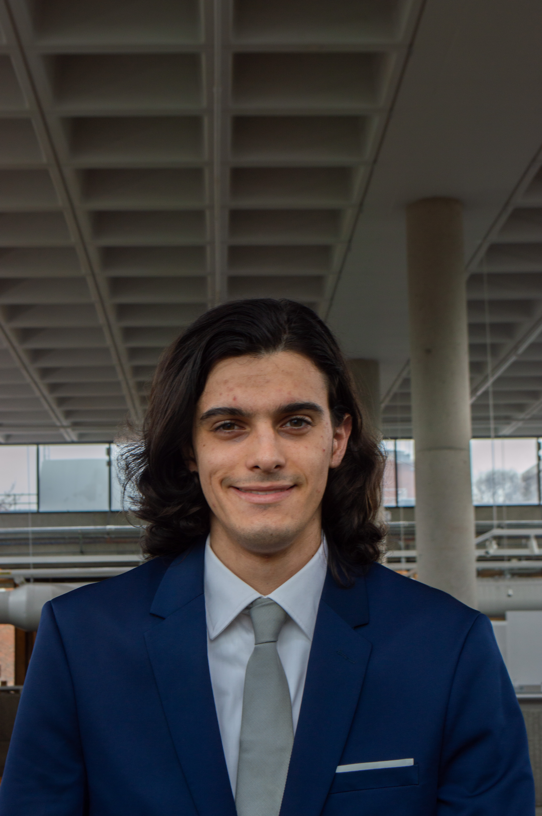
Matteo Saracco
MULTIMODAL
Georgia Institute of Technology
Southeastern Transportation Research, Innovation, Development and Education Center
Research Area(s):
Curb management strategies, microscopic simulation and model calibration
Research Topics:
Curb management strategies and simulation
Microscopic simulation model calibration

Slide 16
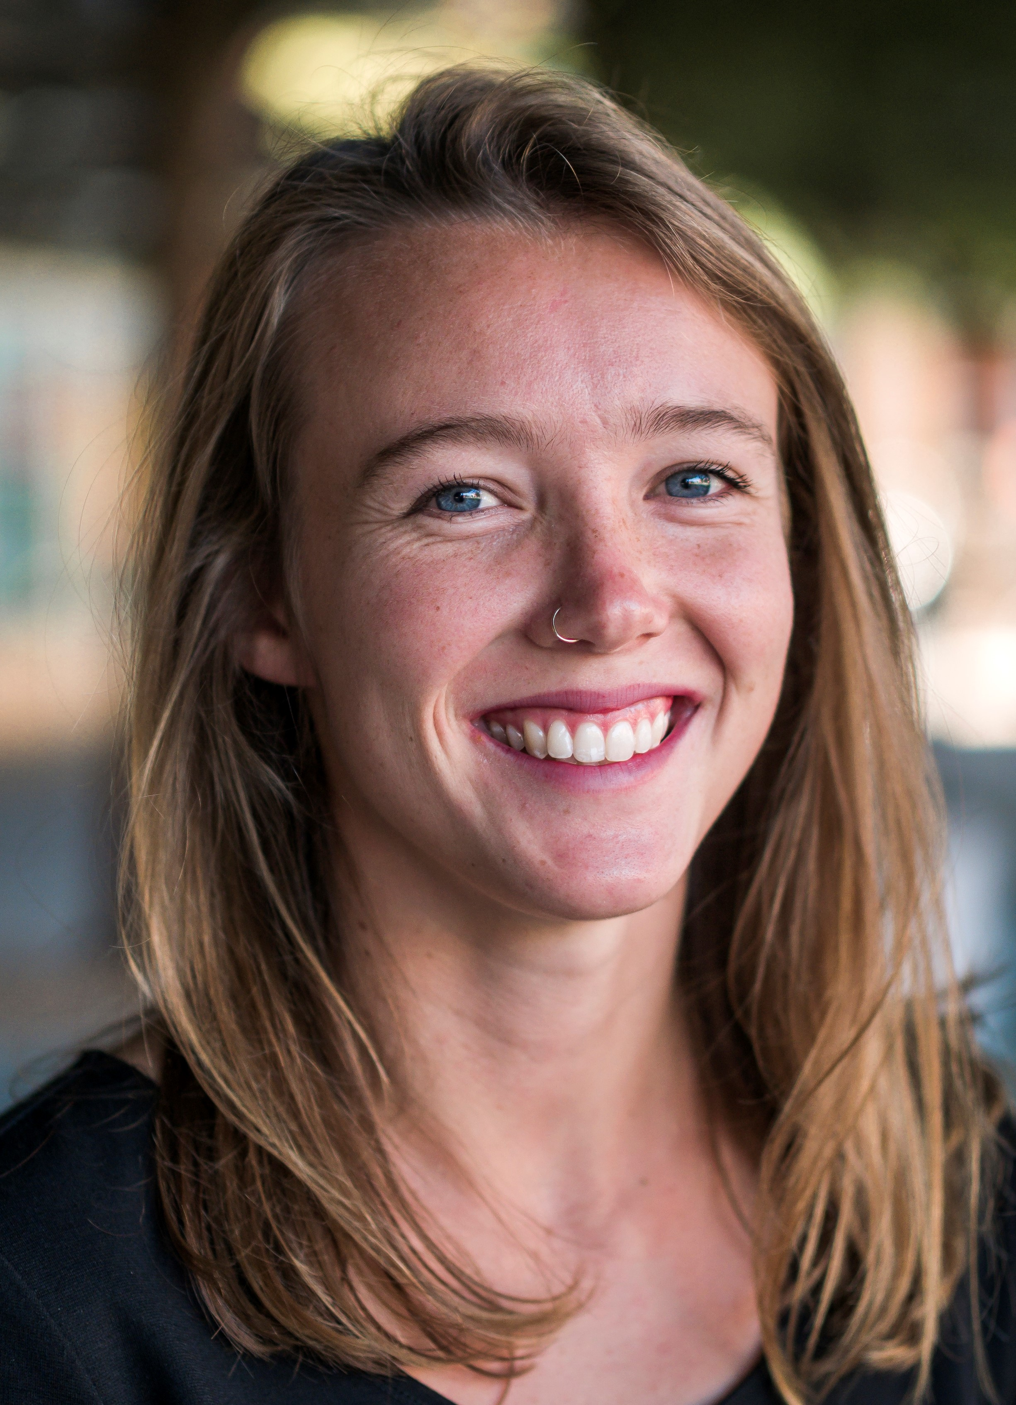
Margaret Slattery
MULTIMODAL
University of California, Davis
National Center for Sustainable Transportation
Research Area(s):
Critical mineral supply chains for clean transportation
Dissertation Title:
Incorporating Stakeholder Perspectives in Industrial Ecology: A Justice-Oriented Analysis of the Lithium-Ion Battery Value Chain

Slide 17
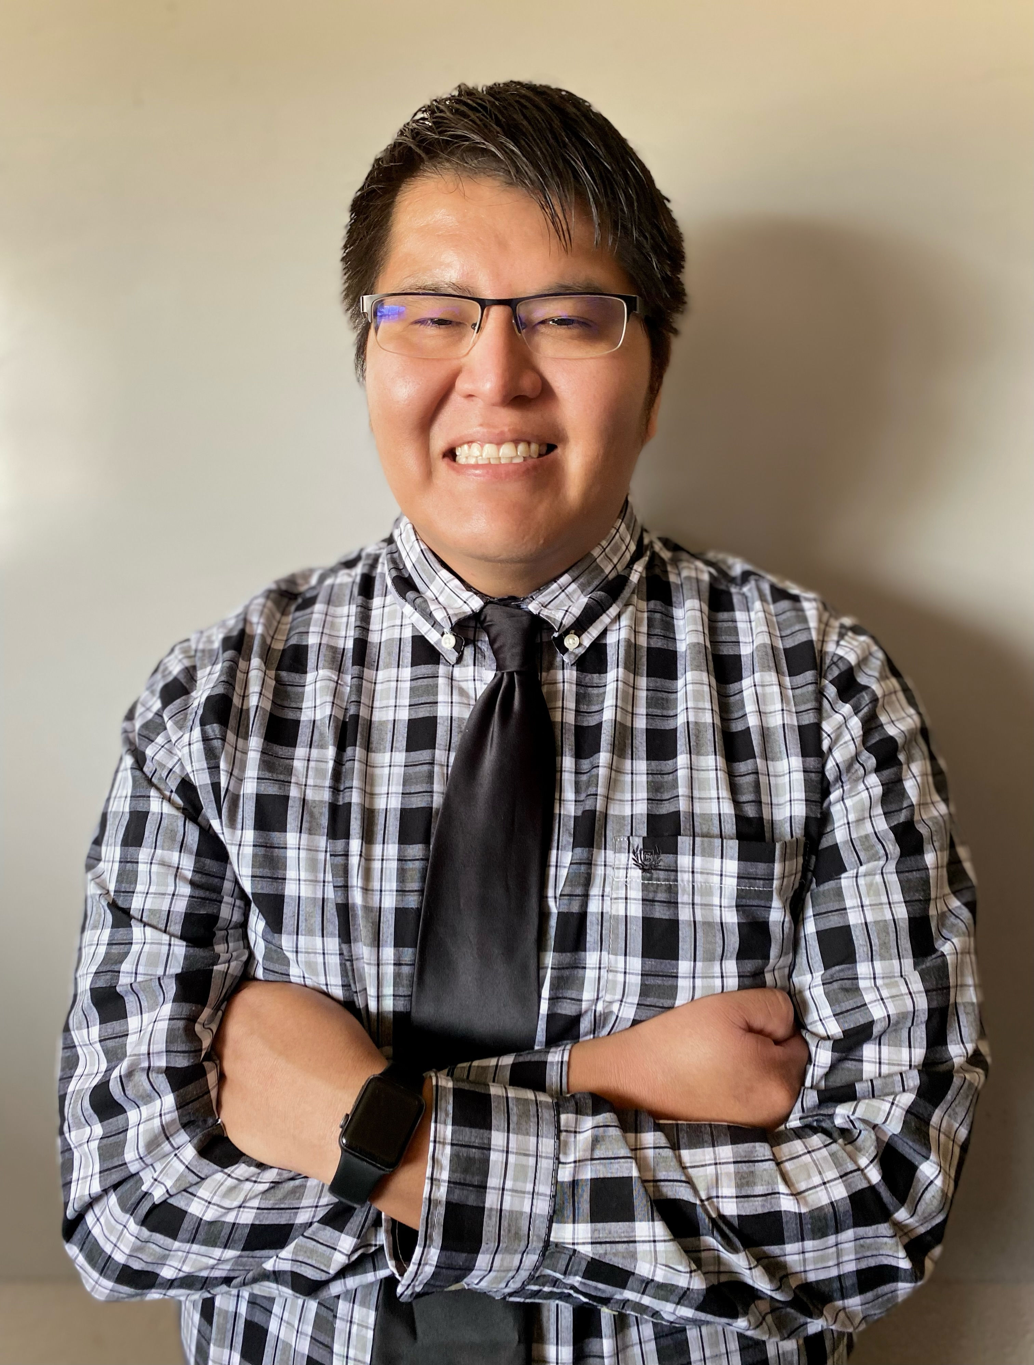
William Toledo
MULTIMODAL
New Mexico State University
Transportation Consortium of Southcentral States
Research Area(s):
Ultra-high performance concrete, overlay systems, bond assessment, and bond characterization
Dissertation Title:
Ultra-High Performance Concrete Overlay Bond Characterization through Experimental, Field, and Analytical Testing

Slide 18
Carrie Tremblatt
MULTIMODAL
University of Colorado Denver
Mountains-Plains Consortium
Research Area(s):
Road safety, built environment, mode choice, public health
Thesis Title:
A Systems-Level Analysis of Left-Turning Vehicle-Pedestrian Crashes

Slide 19
Geoffrey Vega
MULTIMODAL
Polytechnic University of Puerto Rico
Center for Advanced Infrastructure and Transportation
Research Area(s):
Finite Element Analysis and Computational Fluid Dynamics
Dissertation Title:
Analysis of Failure in Cantilevered Overhead Sign Support–Truss with Post Due to Hurricane Maria

Slide 20

Michelle Duren
PUBLIC TRANSIT
Johns Hopkins University
Center for Advancing Research in Transportation Emissions, Energy and Health
Research Area(s):
Health policy, vehicle emissions
Dissertation Title:
Understanding Modal Shift during the Pandemic and Quantifying its Public Health Impact

Slide 21
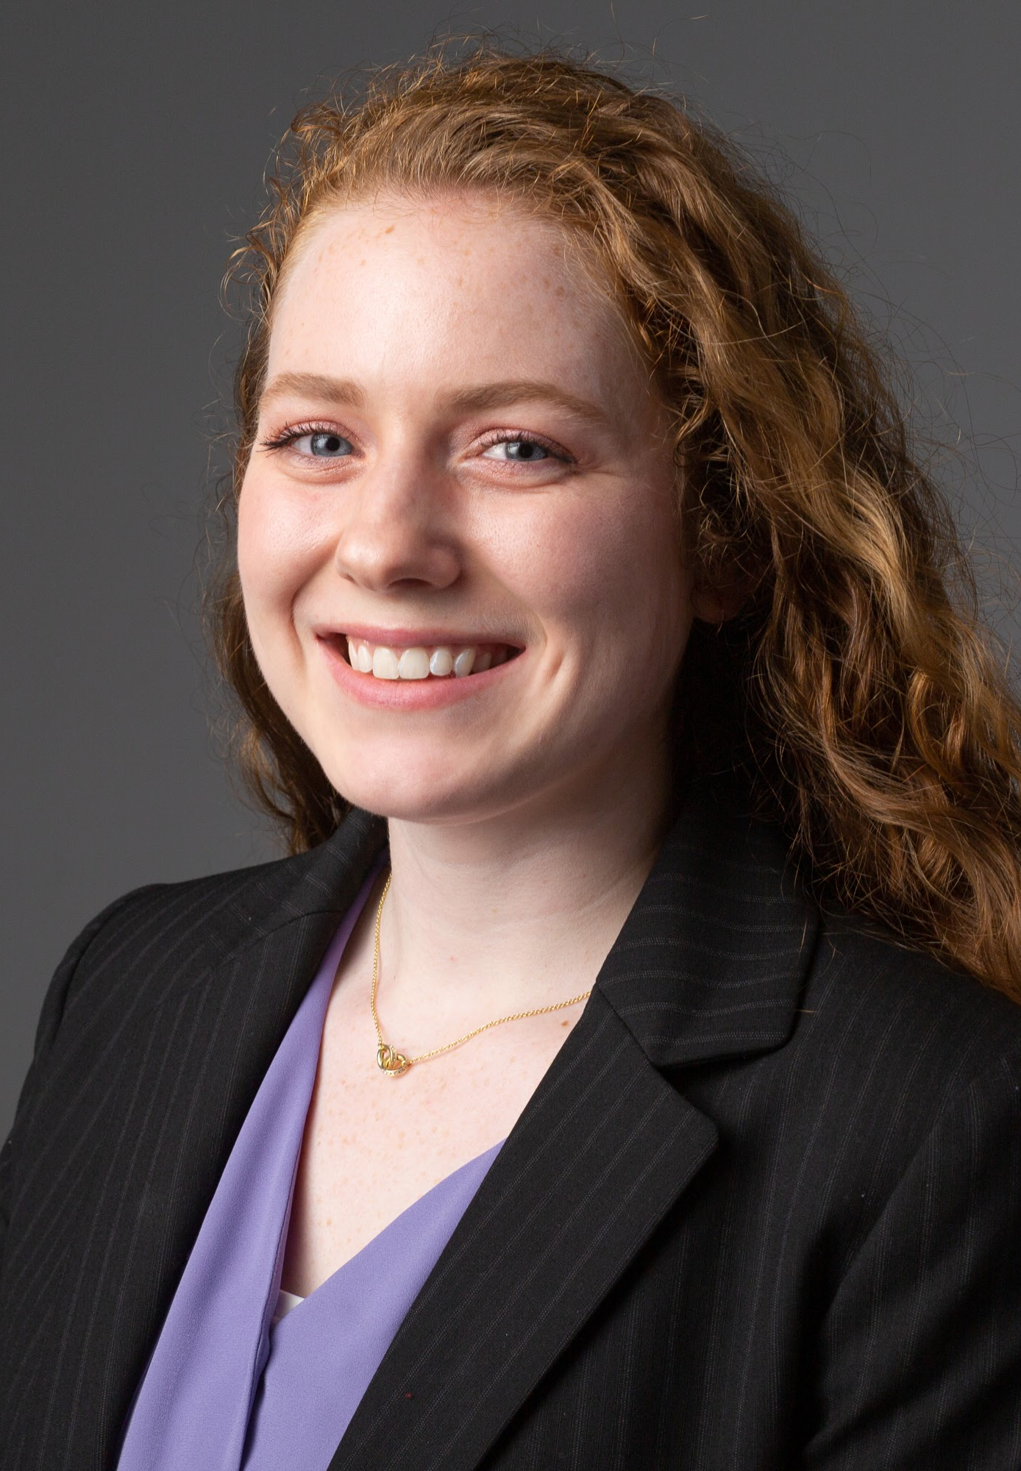
Ashley Hightower
PUBLIC TRANSIT
University of Tennessee at Knoxville
Transit – Serving Communities Optimally, Responsively, and Efficiently (T-SCORE) Center
Research Area(s):
Equitable transportation
Thesis Title:
Current Practices and Potential Rider Benefits of Fare Capping Policies in the USA

Slide 22

Kurtis Johnson
PUBLIC TRANSIT
Eastern Washington University
Small Urban, Rural and Tribal Center on Mobility
Research Area(s):
Equity, environmental justice, and the connection between health and transportation
Thesis Title:
Formal Informalities – case study of tribal transit

Slide 23
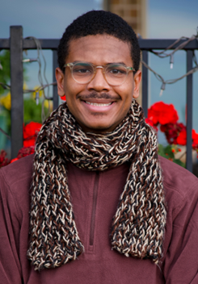
Aqshems Nichols
PUBLIC TRANSIT
University of California, Berkeley
Collaborative Sciences Center for Road Safety
Research Area(s):
Transportation Access and Equity
Dissertation Title:
Investigating Transportation Access to Community Colleges

Slide 24
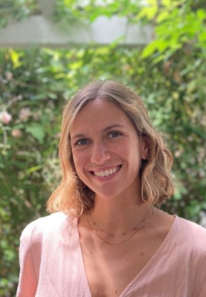
Sadie Mae Palmatier
PUBLIC TRANSIT
University of Oregon
National Institute for Transportation and Communities
Research Area(s):
Effects of minimum parking requirements on land use and transportation
Thesis Title:
When Parking Goes Away, Does Housing Come to Stay?

Slide 25

Valencia Stewart
PUBLIC TRANSIT
Texas Southern University
Cooperative Mobility for Competitive Megaregions
Research Area(s):
Travel demand modeling, congestion pricing
Thesis Title:
Regional Toll roads Vs Median Income: An Examination of The Relationship Between Toll Roads and Community Realities

Slide 26
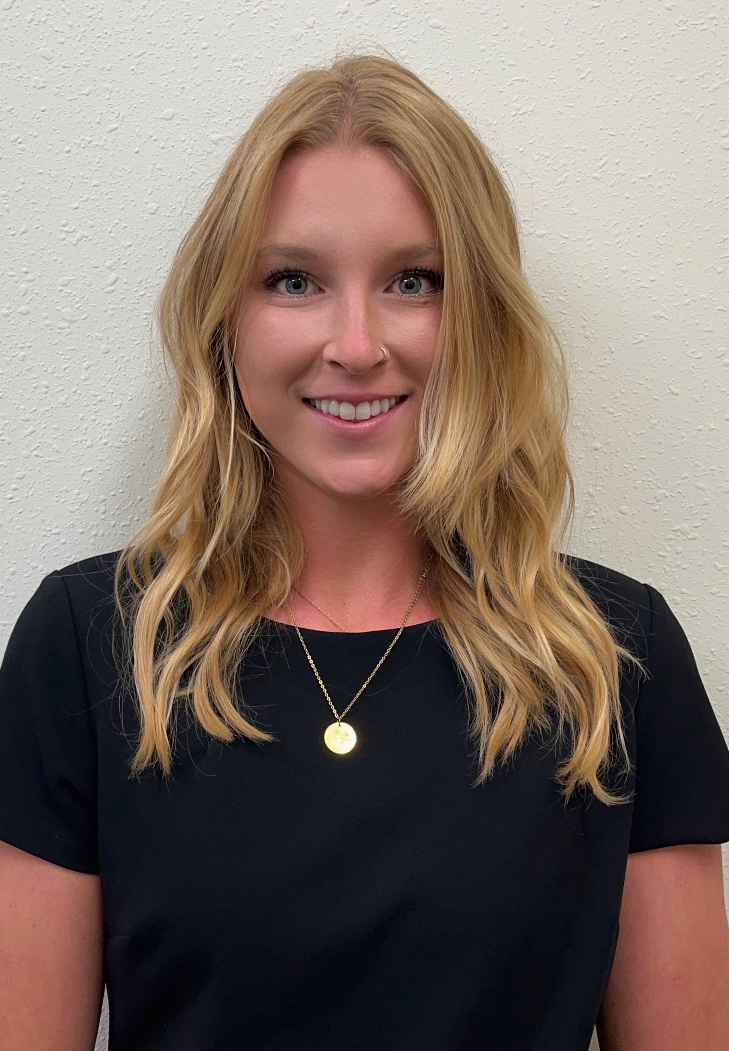
Helena Breuer
ROAD
Oregon State University
Pacific Northwest Transportation Consortium (PacTrans)
Research Area(s):
Human Factors in Transportation, Automated Vehicles
Thesis Title:
Innovative Design Solutions for Vehicle-Bicycle Collisions at Signalized Intersections

Slide 27

Milana Cimesa
ROAD
University of Nevada, Reno
Accelerated Bridge Construction (ABC-UTC)
Research Area(s):
Structural and Bridge Engineering: Compressive behavior of emerging types of ultra-high performance concrete with applications for bridge and building columns
Thesis Title:
Advancing Design and Detailing of Ultra-High Performance Concrete (UHPC) Axial Columns

Slide 28
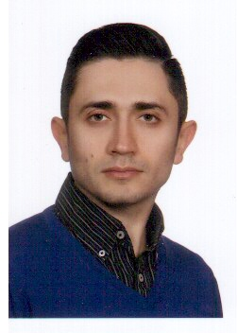
Mehrdad Ghyabi
ROAD
George Mason University
Center for Integrated Asset Management for Multi-Modal
Research Area(s):
Vision-based structural health monitoring
Dissertation Title:
Smart Cities and A Modern Approach to Structural Health Monitoring: Autonomous Visual Sensing and Decision Making

Slide 29
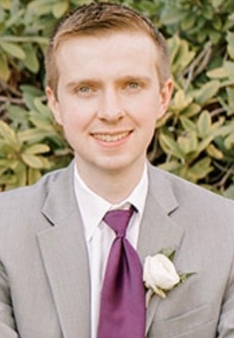
William Hughes, EIT
ROAD
University of Connecticut
Transportation Infrastructure Durability Center
Research Area(s):
Resilience of structures and system to natural hazards
Dissertation Title:
Physics-based and Data-driven Infrastructure Digital Twins for Community Resilience Assessment under Strong Storms

Slide 30
Zachary Jerome
ROAD
University of Michigan
Center for Connected Automated Transportation (CCAT)
Research Area(s):
Improving traffic control systems through the use of connected vehicle and infrastructure
technology
Dissertation Title:
The research topic will focus on using connected vehicle (CV) and infrastructure technology to improve traffic control systems in terms of efficiency and safety.

Slide 31
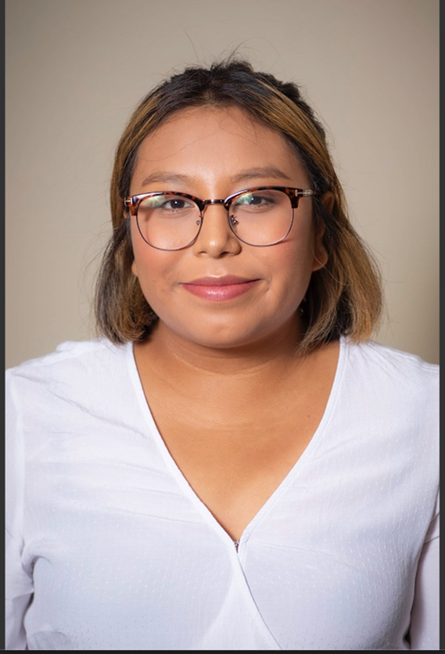
Lizbeth Juarez-Bartolo
ROAD
University of Arkansas
Maritime Transportation Research and Education Center
Research Area(s):
Improving traffic control systems through the use of connected vehicle and infrastructure technology
Thesis Title:
Food Deserts Effect on Arkansas’s Rural Residents’ Exposure to Vehicle Crashes

Slide 32
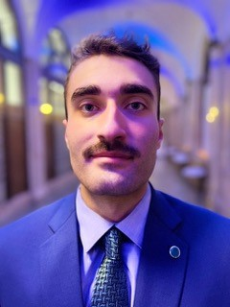
Hadi Khoury
ROAD
North Carolina Agricultural and Technical State University
Center for Advanced Transportation Mobility
Research Area(s):
Designing equitable discounts for express lanes
Research Title:
Model-Driven Equitable Discount Design For Express Lanes

Slide 33
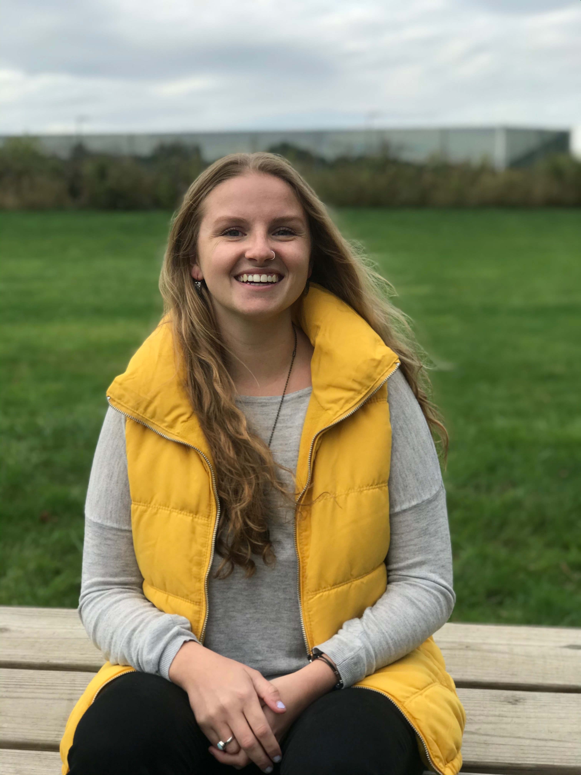
Emily Shull
ROAD
University of Iowa
Safety Research Using Simulation
Research Area(s):
Conditional automation, human-machine interaction, attention, and human-machine interfaces
Dissertation Title:
Maintaining Attention with Enhanced HMI in Level 3 Driving

Slide 34
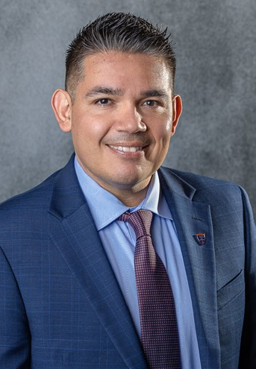
Josue Vaglienty
ROAD
San Jose State University
Mineta Consortium for Transportation Mobility
Research Area(s):
Multimodal transportation
Thesis Title:
Resilience and Climate Change Adaptation of Intercity Rail Corridors

Slide 35
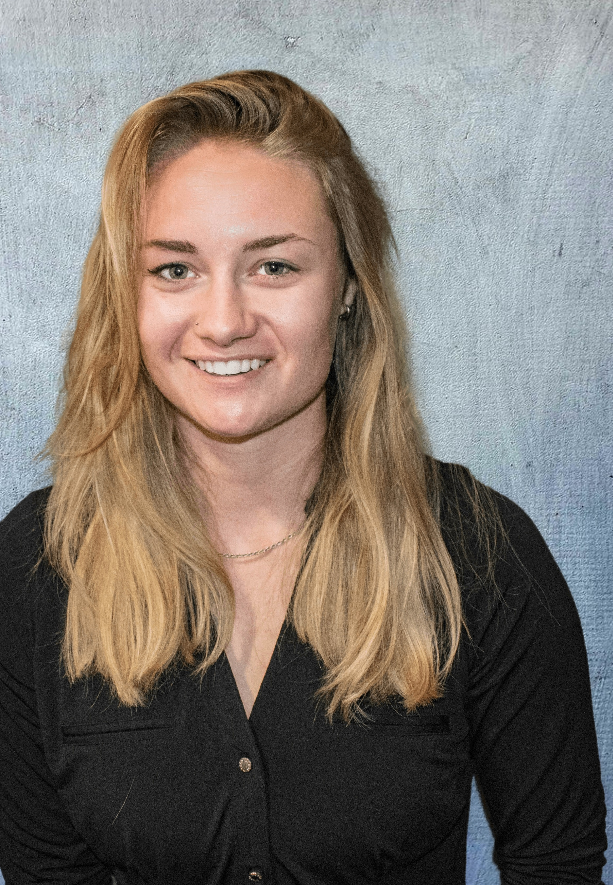
Jade Williams
ROAD
University of Idaho
Center for Safety Equity in Transportation
Research Area(s):
Future technologies in transportation engineering with current focus on opinions of autonomous vehicles in rural areas
Thesis Title:
The Perception of Autonomous Driving in Rural Communities

