Slide 1
University Transportation Centers
^{Presented by:}
USDOT’s University Transportation
Centers (UTC) Program and the Council of
University Transportation Centers (CUTC)

Slide 2
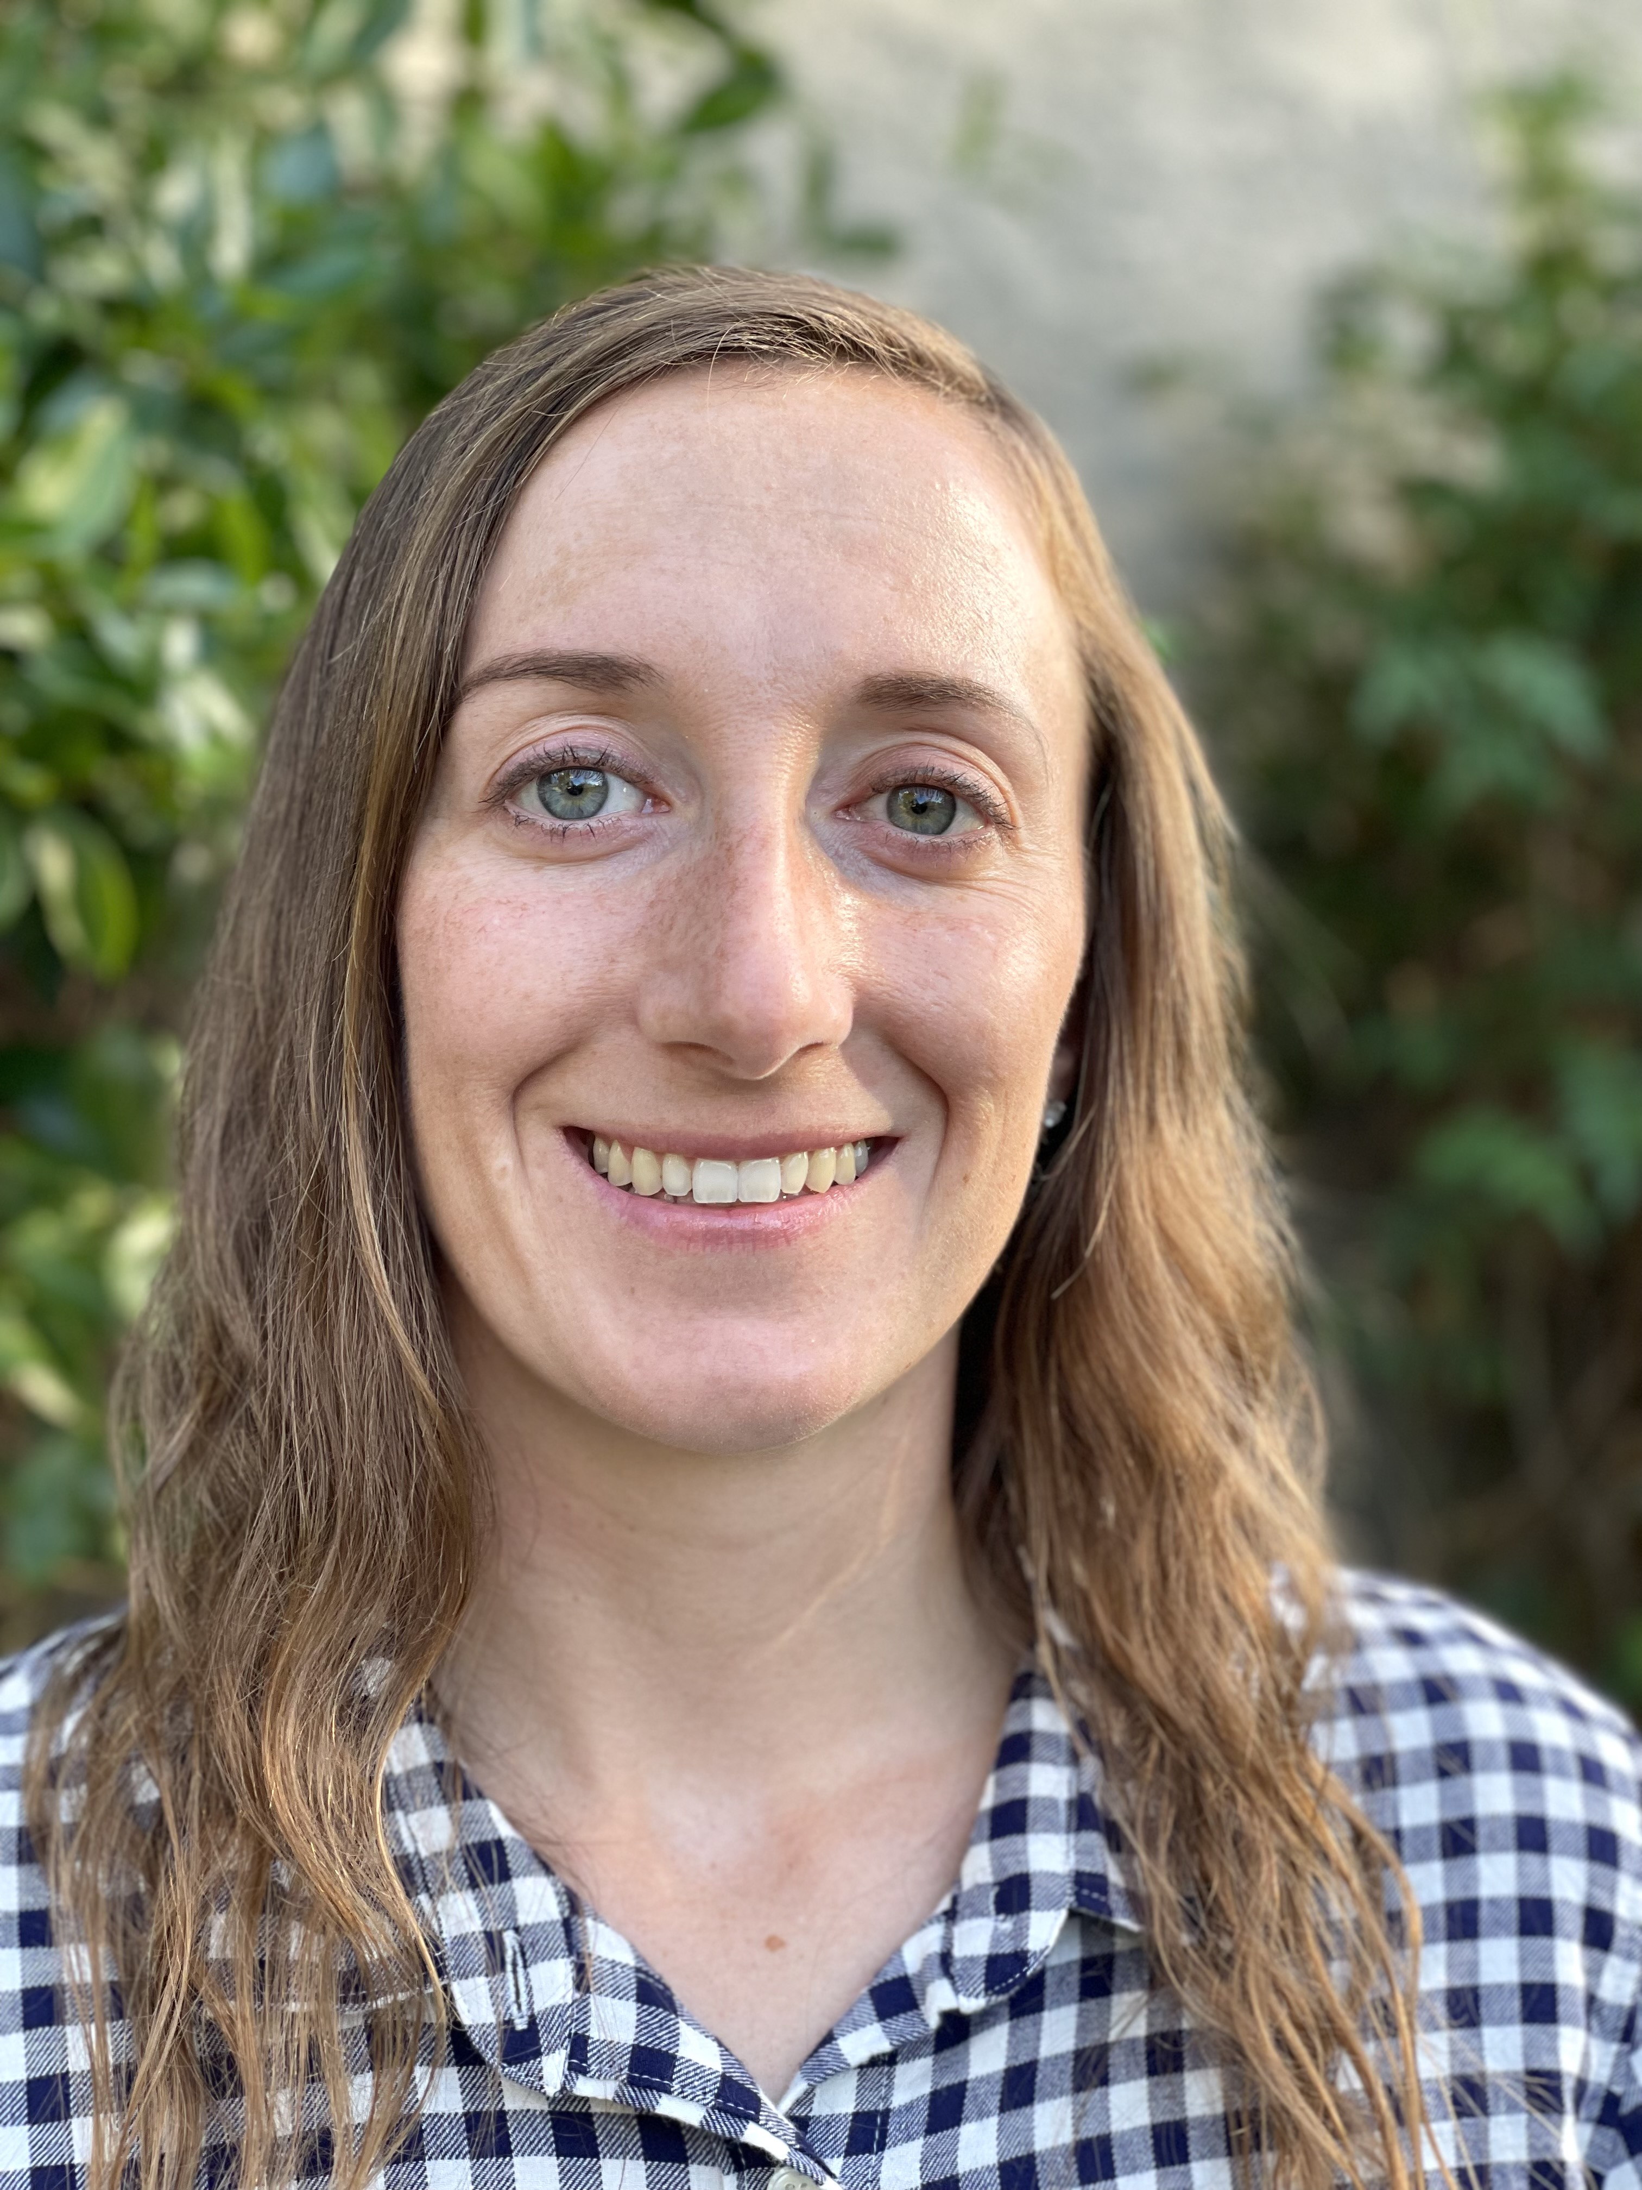
Marissa Brown
MULTIMODAL
San Jose State University
Mineta Consortium for Transportation Mobility (MCTM)
Research Area(s):
Achieving reductions in vehicle miles traveled through enhanced traveler access to public transportation, and improved safety and connectivity for active transportation
Thesis Title:
N/A

Slide 3
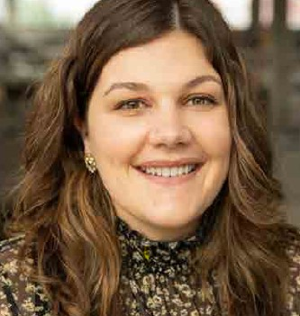
Regan Buchanan
MULTIMODAL
Georgia Institute of Technology
Center for Teaching Old Models New Tricks (TOMNET)
Research Area(s):
Travel behavior and attitudes
Thesis Title:
Thesis not required. Instead, Regan is writing a research paper on car ownership patterns during and
after COVID-19.

Slide 4
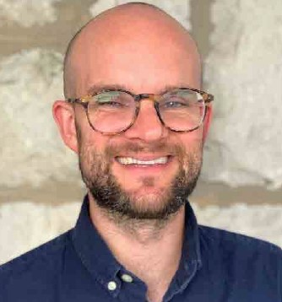
Joshua H. Davidson
MULTIMODAL
University of Pennsylvania
Cooperative Mobility for Competitive Megaregions (CM²)
Research Area(s):
Transportation geography and methods
Thesis Title:
Commute Change: The Effect of Exogenous Shocks in the Transit, Residential, and Public Health
Systems on Individual-Level Commutes

Slide 5
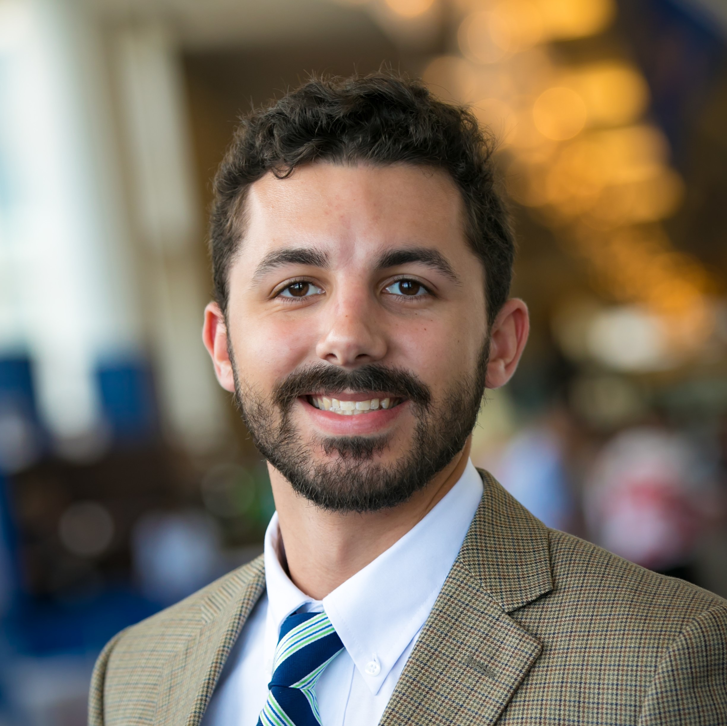
Mitchell P. Fisher II
MULTIMODAL
Auburn University
Southeastern Transportation Research, Innovation, Development and Education Center (STRIDE)
Research Area(s):
Long-distance travel behavior and Mobility as a Service (MaaS) in rural communities
Thesis Title:
Evaluating Long-Distance Travel Survey Demographic, Tripmaking, and Geographic Representativeness to Improve Design and Collection

Slide 6
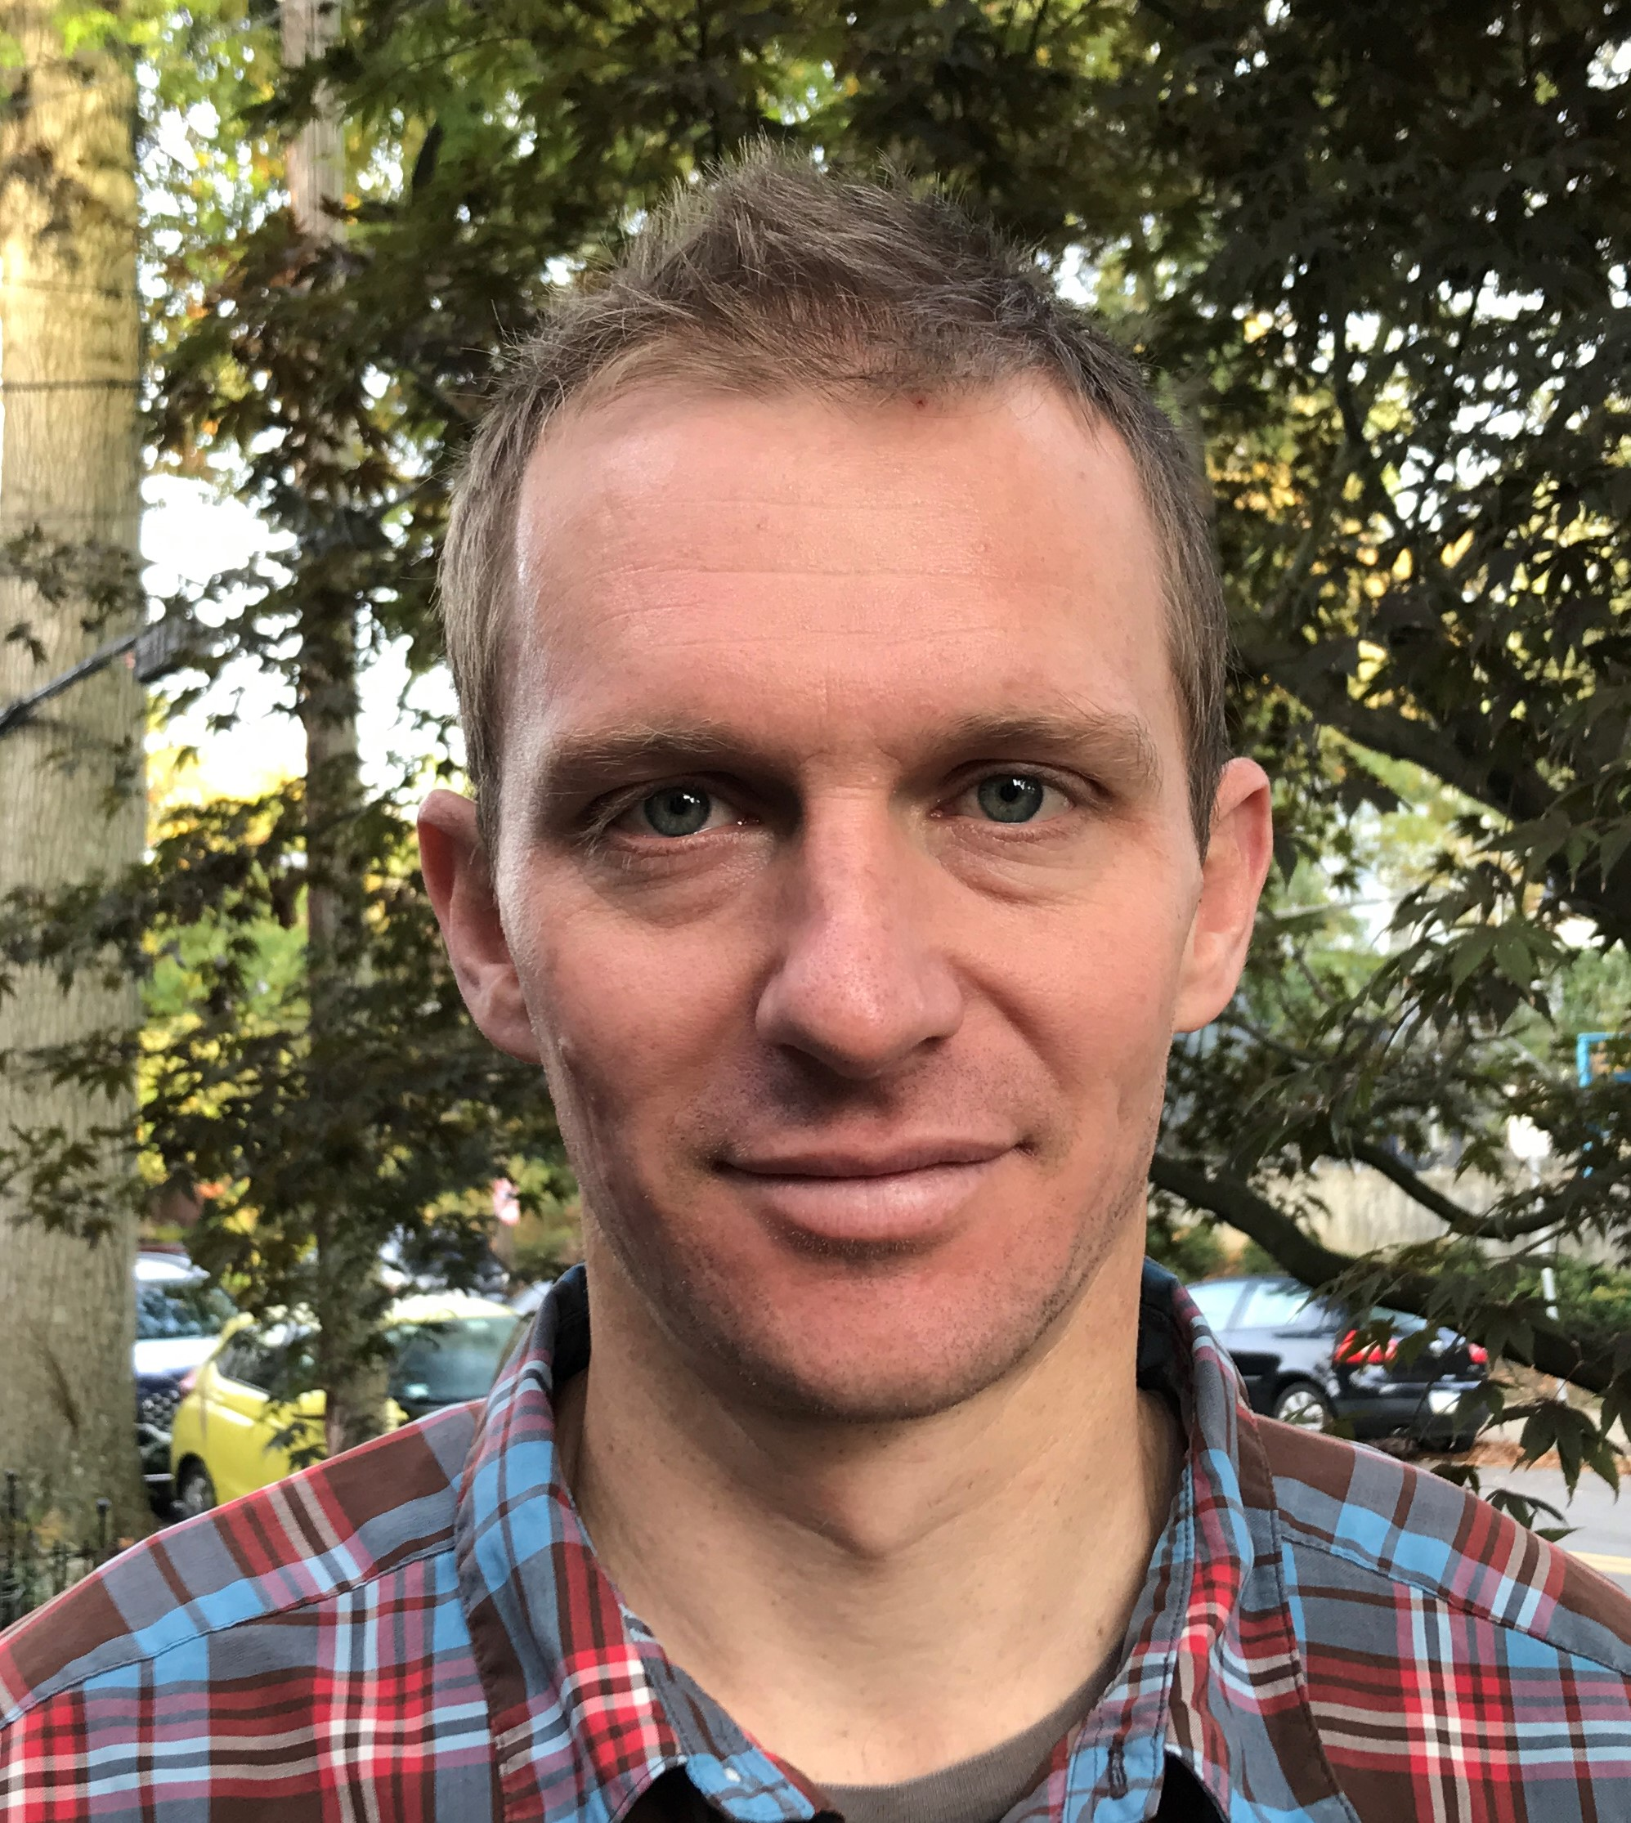
Rick Grahn
MULTIMODAL
Carnegie Mellon University
National University Transportation Center for Improving Mobility (Mobility21)
Research Area(s):
Emerging technologies and public transit
Thesis Title:
Evaluating and Optimizing Shared Mobility Services to Improve Public Transit Efficiency, Accessibility, and Reliability

Slide 7
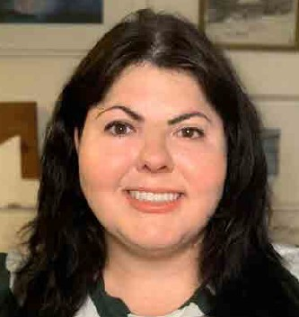
Sarah Grajdura
MULTIMODAL
University of California, Davis
National Center for Sustainable Transportation (NCST)
Research Area(s):
Evacuation modeling and disaster resilience
Thesis Title:
Wildfire Evacuation and Transportation Equity: Mixed Methods Approaches

Slide 8
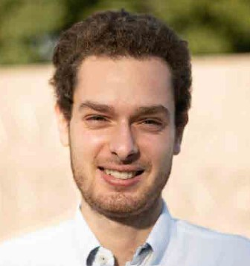
Nadim Khairallah
MULTIMODAL
University of California, Irvine
CARMEN: Center for Automated Vehicles Research with Multimodal AssurEd Navigation
Research Area(s):
Positioning, navigation, and timing; connected and automated vehicles; sensor fusion
Thesis Title:
Simultaneous Tracking and Navigation with Megaconstellation LEO Satellites: Models, Implementation, and Performance

Slide 9
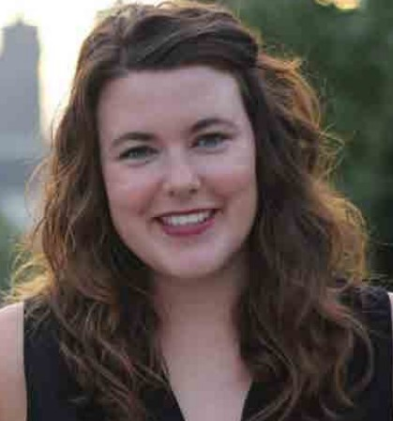
Rachael Thompson Panik
MULTIMODAL
Georgia Institute of Technology
Center for Transportation Equity, Decisions and Dollars (CTEDD)
Research Area(s):
Bicycle/pedestrian safety, human factors, and crash/collision risk mitigation
Thesis Title:
Creating a Situation-Aware Sensing Environment for Cyclists: An Innovative and Cost-Effective Smartphone-Based Approach

Slide 10
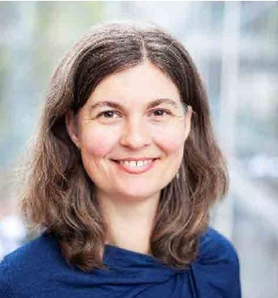
Kelly Rodgers
MULTIMODAL
Portland State University
National Institute for Transportation and Communities (NITC)
Research Area(s):
Evidence-based policy; travel and the built environment
Thesis Title:
The Use and Influence of Health Indicators in Municipal Transportation Plans

Slide 11
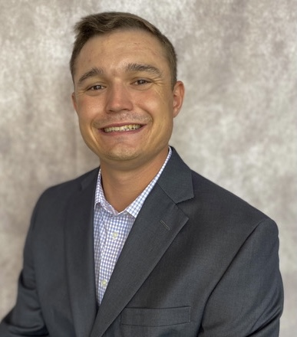
Matthew Stanley
MULTIMODAL
Clemson University
Center for Connected Multimodal Mobility (C²M²)
Research Area(s):
Fatal crash analysis
Thesis Title:
Chasing Target Zero: Contributing Factors of Fatal Crashes in South Carolina

Slide 12
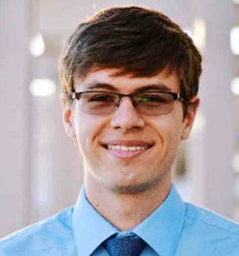
Alexander Sundt
MULTIMODAL
University of Michigan
Center for Connected Automated Transportation (CCAT)
Research Area(s):
Emerging mobility systems for mixed-use applications
Thesis Title:
Improving the Efficiency of Ride-Hailing Systems Using Ride-Pooling

Slide 13
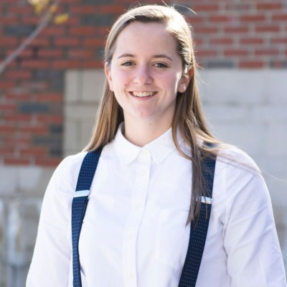
Carly Venditti
MULTIMODAL
Texas A&M University
National Institute for Congestion Reduction (NICR)
Research Area(s):
Housing, equity/access
Thesis Title:
N/A

Slide 14
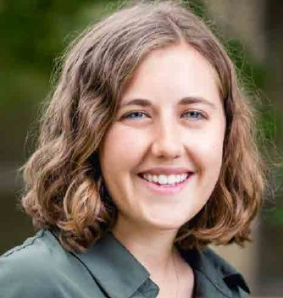
Emma Vinella-Brusher
MULTIMODAL
University of North Carolina at Chapel Hill
Collaborative Sciences Center for Road Safety (CSCRS)
Research Area(s):
Transportation barriers to food and healthcare access
Thesis Title:
Reckoning with Food Apartheid: A Case Study of Four U.S. Cities

Slide 15
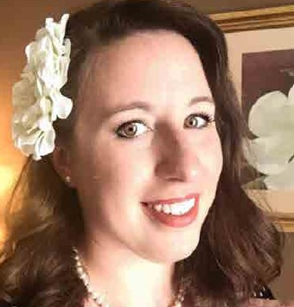
Brittany Nicole Waggener
MULTIMODAL
University of New Orleans
Maritime Transportation Research and Education Center (MarTREC)
Research Area(s):
Vital infrastructure reconstruction
Thesis Title:
Reconstructing Wren’s City of London Churches and the Shaping of National Identity 1941–1969

Slide 16
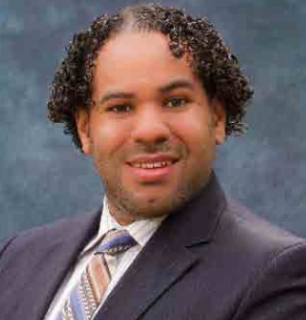
Zakhary Mallett
PUBLIC TRANSIT
University of Southern California (USC)
Pacific Southwest Region University Transportation Center (PSR)
Research Area(s):
Transportation finance; the transportation-land use connect; urban economics; disruptive transportation technologies
Thesis Title:
Equity and Demand Implications of Rail Transit Fare Policies

Slide 17
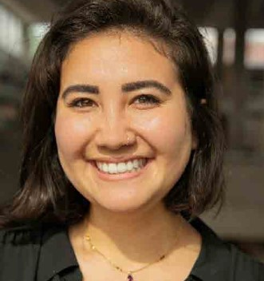
Bianca Mers
PUBLIC TRANSIT
Georgia Institute of Technology
Transit-Serving Communities Optimally, Responsively, and Efficiently (T-SCORE) Center
Research Area(s):
Transit ridership and equity
Thesis Title:
Not yet initiated

Slide 18
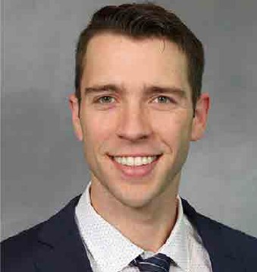
Christian David Sprague
PUBLIC TRANSIT
Cornell University
Center for Transportation, Environment, and Community Health (CTECH)
Research Area(s):
Education policy and economics; human behavior; accessibility
Thesis Title:
Convenience is King: School Choice, Student Outcomes, and the Role of Education Policy

Slide 19
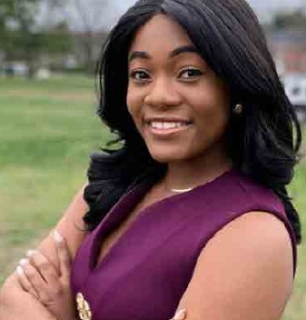
Dunsin Fadojutimi
ROAD
Morgan State University
Urban Mobility & Equity Center (UMEC)
Research Area(s):
Connected and automated vehicles
Thesis Title:
Not required for bachelor’s degree

Slide 20
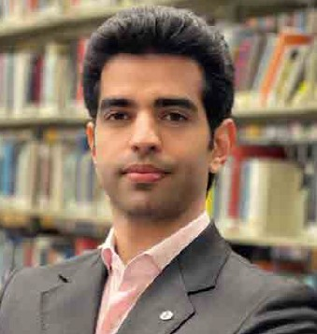
Saman Farhangdoust
ROAD
Florida International University
Accelerated Bridge Construction University Transportation Center (ABC-UTC)
Research Area(s):
Smart and resilient infrastructure systems
Thesis Title:
Epoxy GFRP-Dowel Splice for Prestressed Precast Concrete Pile

Slide 21
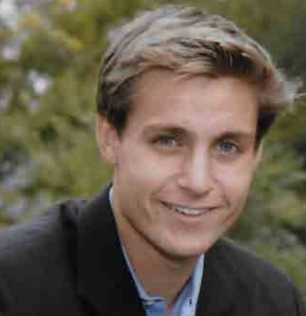
Diarmuid Gregory
ROAD
University of Vermont
Transportation Infrastructure Durability Center (TIDC)
Research Area(s):
Durability; energy harvesting
Thesis Title:
Chitosan-Based Shrinking Fibers for Post-Cure Stressing to Increase Durability of Concrete

Slide 22
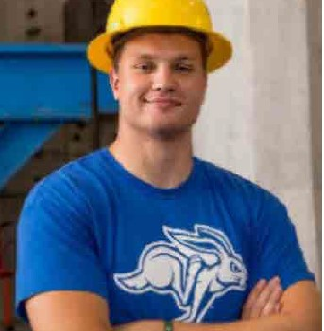
Kal Hart
ROAD
South Dakota State University
National Center for Transportation Infrastructure Durability & Life-Extension (TriDurLE)
Research Area(s):
Repairable precast bridge bents for extreme events
Thesis Title:
Repairable Precast Bridge Bents for Seismic Events

Slide 23
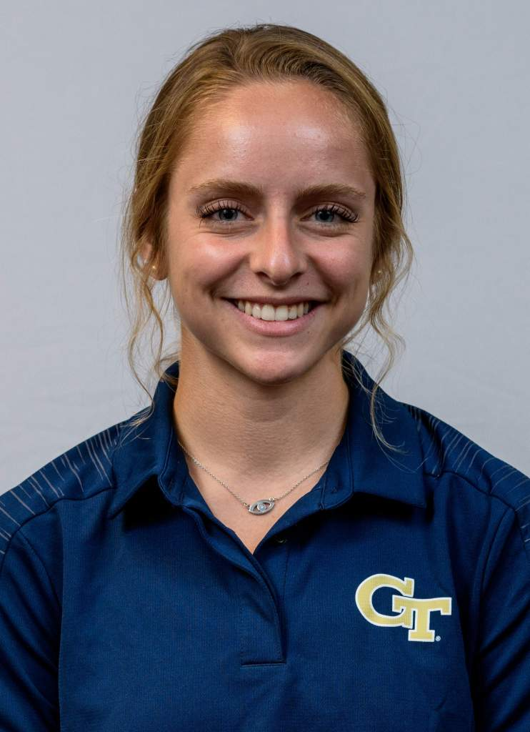
Hana Herndon
ROAD
Georgia Institute of Technology
Inspecting and Preserving Infrastructure through Robotic Exploration (INSPIRE)
Research Area(s):
Machine learning and computer vision approaches for assessing bridge degradation and structural reliability
Thesis Title:
Not required for M.S.

Slide 24
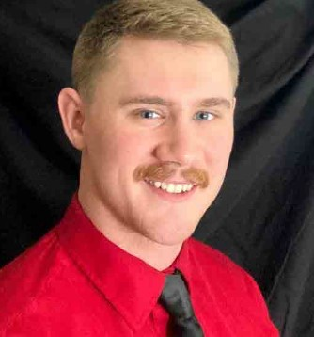
John Higgins
ROAD
University of Wyoming
Mountains-Plains Consortium
Research Area(s):
Infrastructure systems; materials; roadway construction
Thesis Title:
N/A

Slide 25
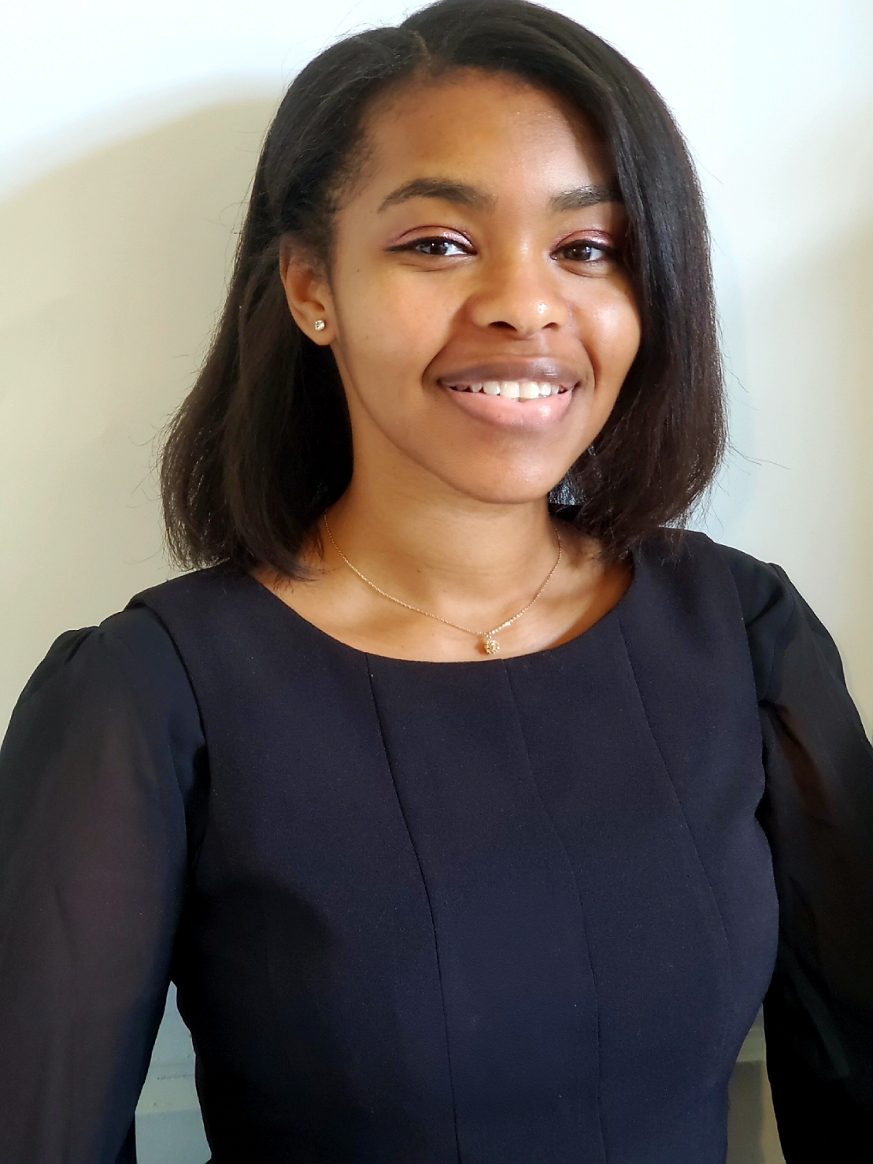
Lauren Hill-Beaton
ROAD
Rutgers, The State University of New Jersey
Center for Advanced Infrastructure and Transportation (CAIT)
Research Area(s):
Climate change impacts on road infrastructure
Thesis Title:
Identifying and Interpreting Double Intertropical Convergence Zone Occurrence in the Western Pacific

Slide 26
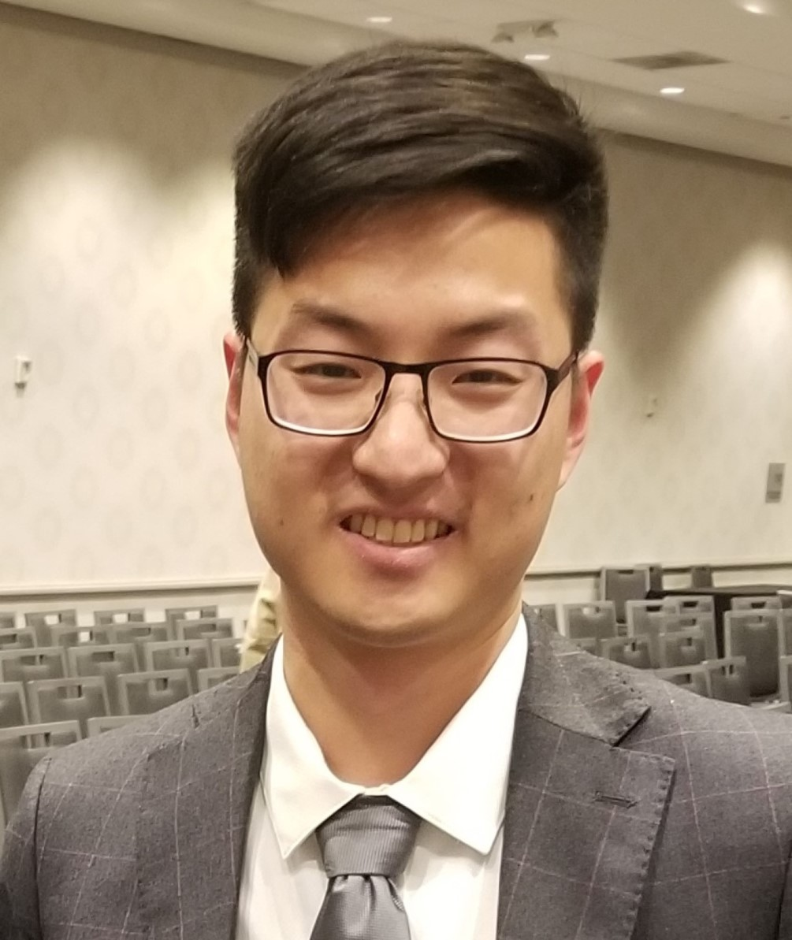
Oscar Huang
ROAD
Texas A&M University
Transportation Consortium of South-Central States (Tran-SET)
Research Area(s):
Geopolymer, mortars and concretes, rebar corrosion, soil stabilization
Thesis Title:
Geopolymer for Eco-Friendly Transportation Infrastructure Applications

Slide 27
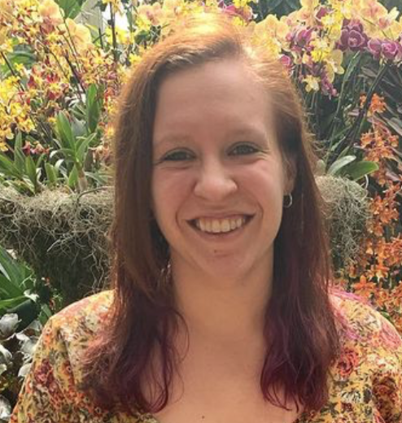
Hailee Kulich
ROAD
University of Pittsburgh
Automated Vehicle Services for People with Disabilities–Involved Responsive Engineering (ASPIRE) Center
Research Area(s):
Accessibility of vehicles and transportation systems
Thesis Title:
Development of the Caregiver Assisted Transfer Technique Instrument

Slide 28
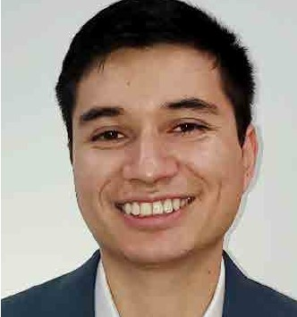
Daniel F. Ortiz
ROAD
Rutgers, The State University of New Jersey
Connected Cities for Smart Mobility toward Accessible and Resilient Transportation (C2SMART)
Research Area(s):
UHPC; prestressed concrete; carbon fiber reinforced polymer (CFRP) tendons; resiliency
Thesis Title:
Flexural Behavior of Prestressed UHPC Beams with Hybrid (Steel-CFRP) Tendons

Slide 29
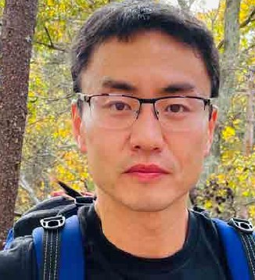
Bo Qiu
ROAD
University of North Carolina at Charlotte
Center for Advanced Multimodal Mobility and Solutions and Education (CAMMSE)
Research Area(s):
Travel time forecasting and safety data analysis
Thesis Title:
Travel Time Forecasting on a Freeway Corridor: A Dynamic Information Fusion Model Based on the Machine Learning Approach

Slide 30
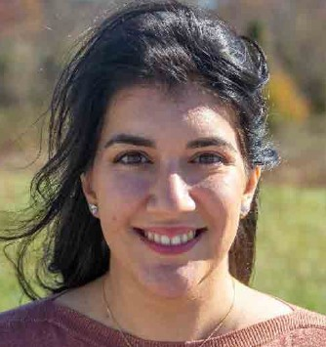
Alexandria Rossi-Alvarez
ROAD
Virginia Polytechnic Institute and State University (Virginia Tech)
Safety Through Disruption (Safe-D): Goal Zero
Research Area(s):
Connected and automated vehicles
Thesis Title:
Impact of Highly Automated Vehicle External Communication on Other Road User Behavior

Slide 31
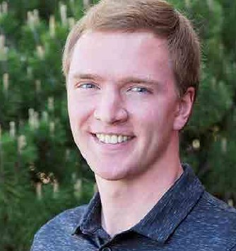
Riley Ruskamp
ROAD
University of Nebraska–Lincoln
Mid-America Transportation Center (MATC)
Research Area(s):
Finite element analysis in roadside safety
Thesis Title:
Evaluation of Next-Generation Non-Proprietary Portable Concrete Barrier Design Concepts

Slide 32
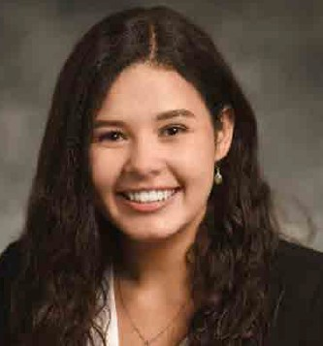
Kristen Sanchez
ROAD
Texas A&M University
Center for Advancing Research in Transportation Emissions, Energy, and Health (CARTEEH)
Research Area(s):
Transportation, air quality, and health
Thesis Title:
Not required for M.P.H.

Slide 33
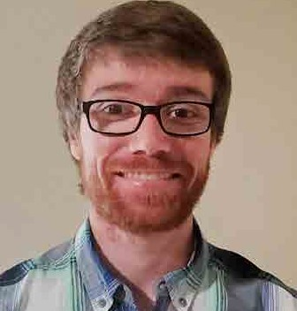
Brandt Souvenir
ROAD
University of Idaho
Center for Safety Equity in Transportation (CSET)
Research Area(s):
Risks associated with school transportation
Thesis Title:
Examining Present-Day School Travel Risks

Slide 34
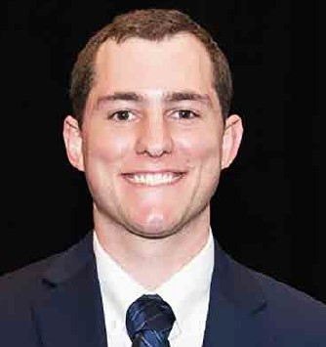
Brian Staes
ROAD
Oregon State University
Pacific Northwest Transportation Consortium (PacTrans)
Research Area(s):
Understanding the traffic flow theory behind extensive and heavy gridlock on freeways for
urban congestion relief, and integrating traffic flow theory principles into multidisciplinary
evacuation modeling
Thesis Title:
Diagnosis of Freeway Bottlenecks During the Mass Evacuation for Hurricane Irma on Florida’s
Turnpike Mainline

Slide 35
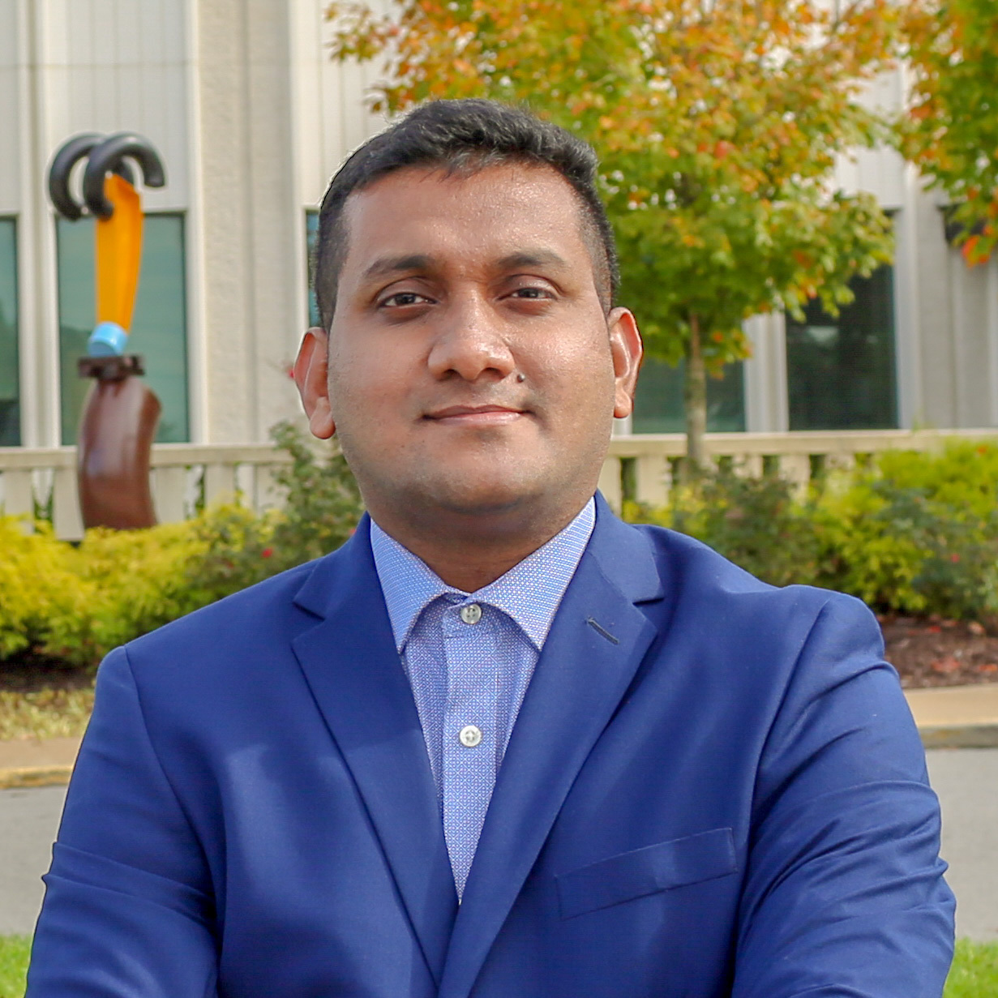
Mohhammad Afsar Sujon
ROAD
West Virginia University
Center for Integrated Asset Management for MultiModal Transportation Infrastructure Systems (CIAMTIS)
Research Area(s):
Applications of big data by utilizing machine learning and computer vision techniques for cost effective transportation infrastructure asset management
Thesis Title:
Virtual Weigh-In-Motion Data-Driven Pavement Performance Prediction Models for Optimizing Pavement Inspection Schedule

Slide 36
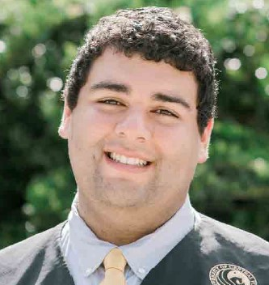
Jorge Ugan
ROAD
University of Central Florida
Safety Research Using Simulation (SAFER-SIM)
Research Area(s):
Transportation human factors and safety
Thesis Title:
Effect of Various Speed Management Strategies on Bicycle Crashes for Urban Roads in Central Florida

Slide 37
University Transportation Centers
^{Presented by:}
USDOT’s University Transportation
Centers (UTC) Program and the Council of
University Transportation Centers (CUTC)

